Slide 1
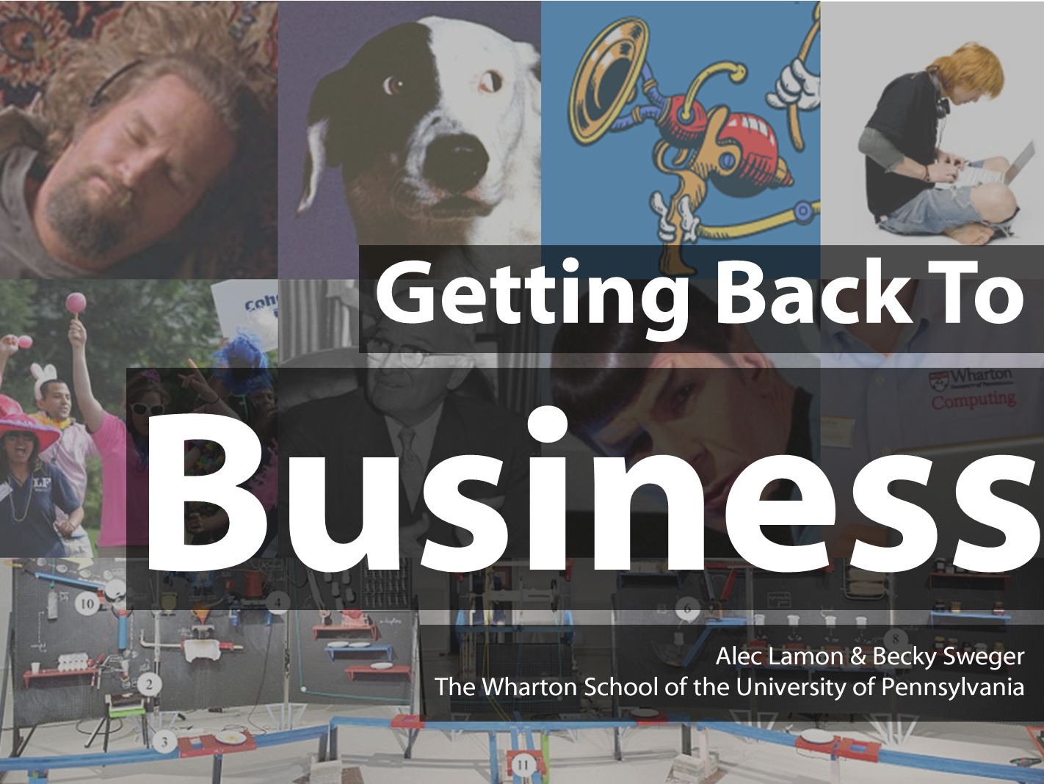

Slide 2
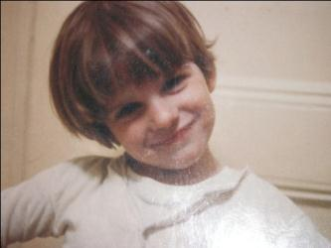
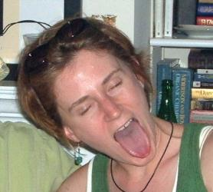
Alec Lamon
Senior Director, CAOS
Wharton Computing
Becky Sweger
IT Director, Student Experience
Wharton Computing
Major: English Literature
Minor: Art History
Career: Technology
Sign: Pisces
LinkedIn
Major: English
Concentration: Tech Writing
Career: Technology
Sign: Cancer
LinkedIn

Slide 3
Getting back to business:
A strategic plan for supporting
the success of your students

Slide 4
Back to business
Photo by Kendall Whitehouse

Slide 5
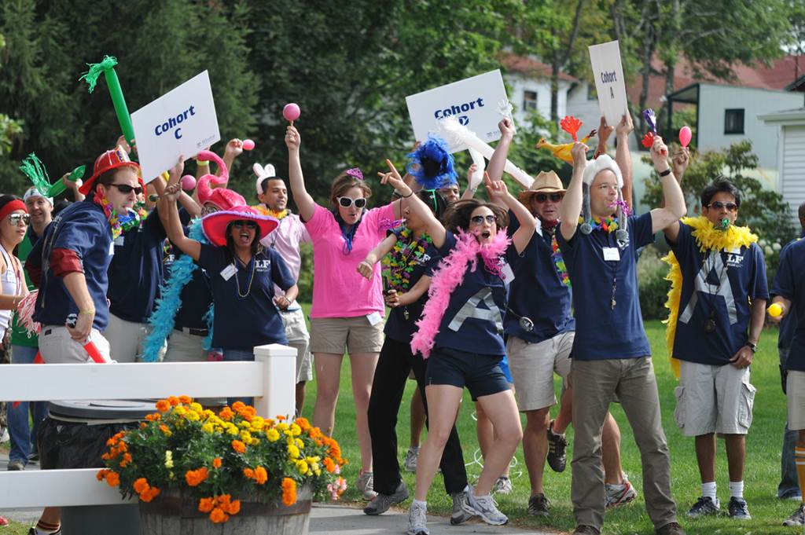
August
Photo by Anjani Jain

Slide 6
March

Slide 7
Well positioned?
Warner Brothers

Slide 8
IT Satisfaction Trend
Photo by coba

Slide 9
Now What?
Now What?

Slide 10
New Survey!

Slide 11
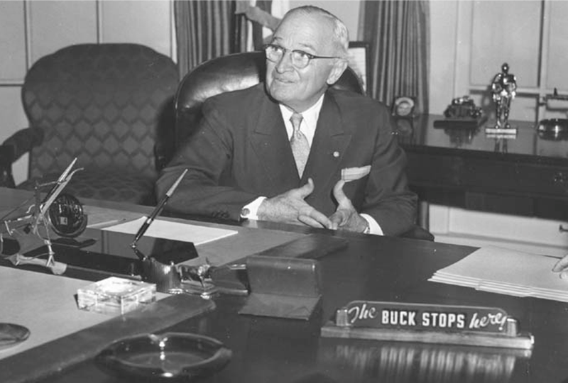
No Point Person

Slide 12
New Position
IT Director of Student Experience

Slide 13
IT Satisfaction Trend
Photo by coba

Slide 14
Results
Signal to Noise
Silos
Distance

Slide 15
Strategy
Outreach
Image
Integration

Slide 16
How to get the attention of extremely busy people?

Slide 17
Timing is everything.
Targeted messages.
Short messages.
Many channels.

Slide 18
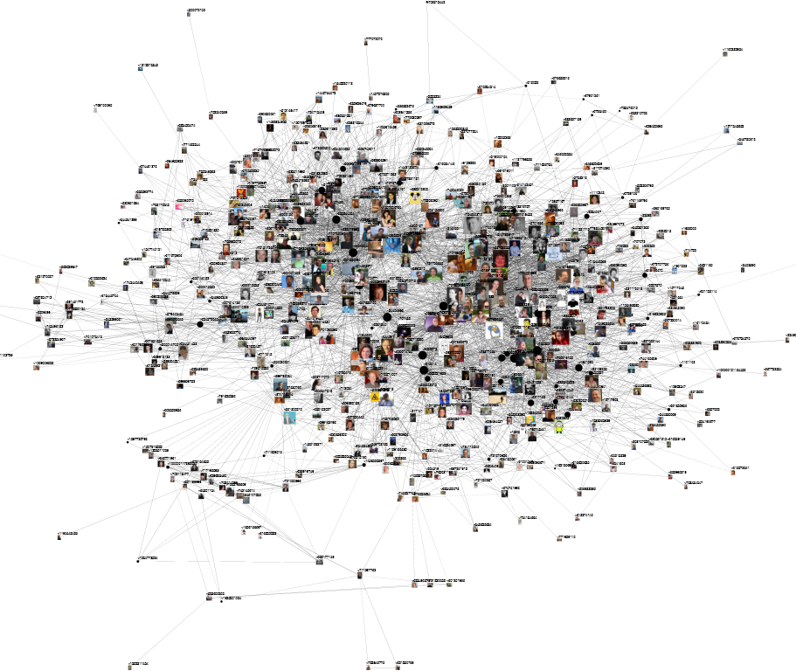
New channel:
student-elected IT reps
Photo by marc_smith

Slide 19
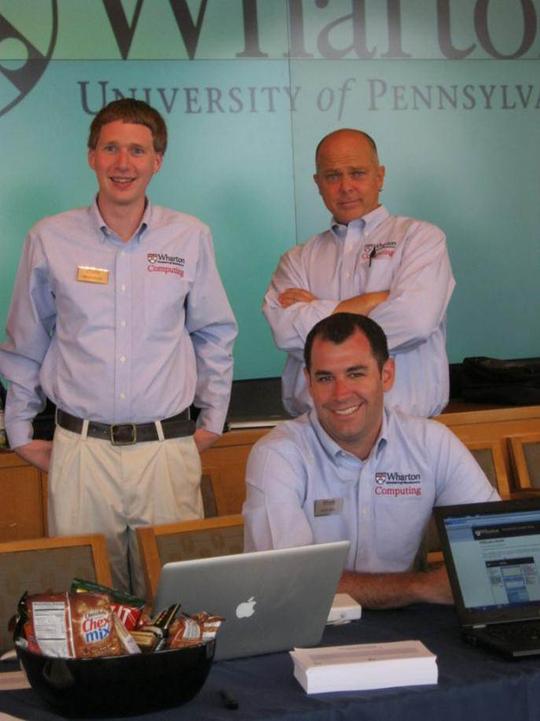
New old channel:
Face-to-face

Slide 20
Face-to-face: leave the office
Photo by Kendall Whitehouse

Slide 21
Strategy
Outreach
Image
Integration

Slide 22
Waiting for course packs

Slide 23
Survey Says….

Slide 24
New course pack process
:=)
:=|
:=(
>:=(
Log into courseware
Click course materials link
Log in again
Search for course materials
Purchase materials
Download individual files
Print
Collate

Slide 25
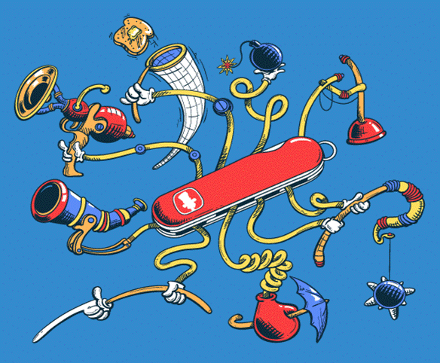
Not an ecosystem

Slide 26
Ecosystem

Slide 27
Strategy
Outreach
Image
Integration

Slide 28
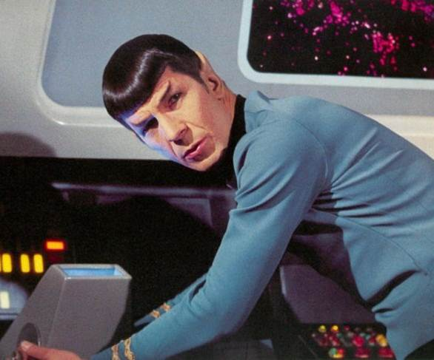
The disconcerting realm of emotion

Slide 29
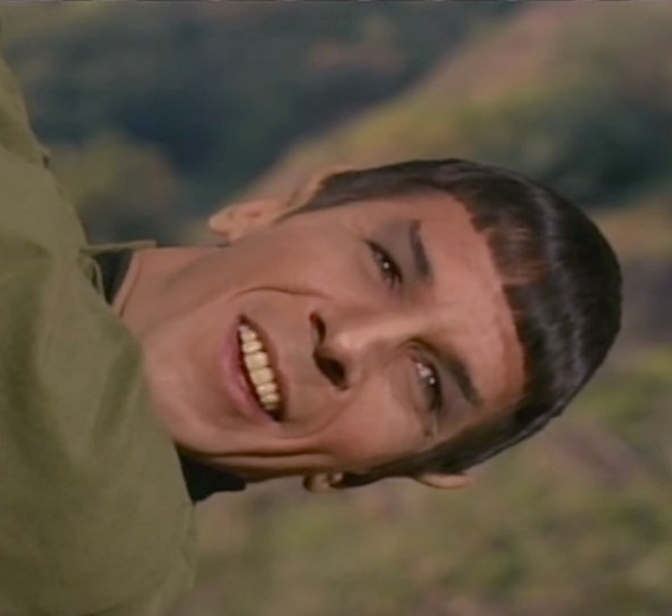
Embrace the emotions!

Slide 30
Give IT a voice

Slide 31
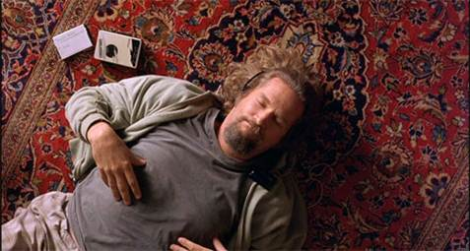
It really ties the room together.

Slide 32
Strategy
Outreach
Image
Integration

Slide 33
Questions?

Slide 34
TBD

