Slide 1
A Conversation with Campus Counsel on Current Developments in IT Outsourcing: Legal Challenges and Practical Suggestions
Steven J. McDonald and Joshua Dermott | October 20, 2011

Slide 2
Cloud Cover
The law, lawyers, and you
Contracts 101
A look inside cloud contracts
Chasing the clouds away

Slide 3
DEDICATION
"Could you just take a quick look at this [15-page, 8-point font, form] contract [that's been on my desk for the last three months] and let me know whether it's OK [before the vendor comes in 30 minutes from now to pick it up]?"
– Numerous clients who will for their and my protection remain anonymous

Slide 4
Can: What is Possible
May: What is Permissible
Should: What is Advisable
Must: What is Required

Slide 5
Decisions, Decisions
Law
Risks
Benefits
Costs
Values
Relationships
Public Relations
Practicalities
. . .

Slide 6
Advice and Consent
Lawyers give advice, not orders
Can (may) I do X?
Administrators make decisions and choices
How can (may) I do X?
Lawyers don't make your decisions.
Lawyers help make your decisions better.

Slide 7
What is a Contract?
An agreement between two or more people that is enforceable by law

Slide 8
What Does it Take to Make a Contract?
Offer: I'll do/pay X if you do/don't do Y
Acceptance: OK (in any form)
Consideration: X and Y
In other words, there must be a bargain (in the sense of an agreed, mutual exchange), but it need not be a "bargain" (in the sense of an equal exchange or good deal)

Slide 9
WHAT DOESN'T IT TAKE TO MAKE A CONTRACT?
A negotiation
Courts will strike out terms of non-negotiable contracts only if they are "unconscionable"
A written document (usually)
A written document that is consistent with your negotiations
A written document that you have read
A written document that you understand
A signature (usually)
Terms that are "fair" and "reasonable"
A lawyer
All that matters is that you have "manifested your mutual assent" to the contract

Slide 10
Contracts: An Owner's Manual
Who: the parties
What: the rights and duties of the parties
Where: the place of performance
When: the term(s) of the contract; deadlines
Why: any relevant background
How: the method of performance
How much: the amount and terms of payment
What if: termination rights and remedies

Slide 11
A Contract is, First and Foremost, a Business Document
"You've got to be very careful if you don't know where you're going, because you might not get there." – Yogi Berra
If you don't know and specify what it is you want to receive, you're going to get only what the vendor wants to provide
"You don't get what you deserve, you get what you negotiate." – Chester L. Karrass

Slide 12
Let's Make a Deal
All of the things that you have to worry about when you do it, they should be worrying about when they do it
But it may not be in their business model
Or they may not even be aware of it
Trust, but verify
Ignore:
"No one's ever complained about that before"
"We can't do that – it's 'free'"
"It's organic – we can't specify details now"

Slide 13
CLOUD CONTRACT ISSUES TO WATCH OUT FOR
FERPA/Privacy/ Confidentiality
Data security and data breach responsibilities
E-discovery
Patent infringement
Incorporated URL terms that are modifiable at will
Responsibility for end users
Export controls
Service level agreements
Suspension/Termination and their aftermath
Warranties (and lack thereof)
Indemnification (both ways)
Choice of law and jurisdiction

Slide 14
Data Privacy/Security/Breach
FERPA – student records
HIPAA – medical records
Gramm-Leach-Bliley – "financial" records
PCI-DSS – credit card records
"Personal information" under a state data protection statute
Especially "personal information" about Massachusetts residents, wherever located . . .

Slide 15
Data Privacy/Security/Breach
All have "safeguarding" requirements of varying degrees of intensity
In general, must specifically require vendors to comply with them on your behalf by contract (not to mention monitor them as well)
Who is responsible/liable in the event of a breach?

Slide 16
PATENT INFRINGEMENT
Blackboard v. Desire2Learn
Acacia Media Technologies v. The World
Is your vendor willing to warrant that it actually owns what it's selling, and that it won’t be your problem if it turns out that it doesn’t?

Slide 17
Warranties
"VENDOR MAKES NO WARRANTY OF ANY KIND, WHETHER EXPRESS, IMPLIED, STATUTORY, OR OTHERWISE, INCLUDING WITHOUT LIMITATION WARRANTIES OF MERCHANTABILITY, FITNESS FOR A PARTICULAR USE, AND NONINFRINGEMENT."
Translation: "Abandon all hope, ye who enter here. We don't know whether this thing works, and we're not even sure we own it."

Slide 18
Honesty is Hardly Ever Heard
We don't claim Interactive EasyFlow is good for anything – if you think it is, great, but it's up to you to decide. If Interactive EasyFlow doesn't work: tough. If you lose a million because Interactive EasyFlow messes up, it's you that's out the million, not us. If you don't like this disclaimer: tough. We reserve the right to do the absolute minimum provided by law, up to and including nothing. This is basically the same disclaimer that comes with all software packages, but ours is in plain English and theirs is in legalese. We didn't really want to include any disclaimer at all, but our lawyers insisted. We tried to ignore them but they threatened us with the attack shark, at which point we relented.

Slide 19
Responsibility for End Users
Institution shall be responsible for ensuring that its users comply with the terms of this agreement (which is confidential, and which it therefore may not tell them about)
Institution shall use its best efforts to ensure that its users comply with the terms of this agreement
Institution shall use reasonable efforts to ensure that its users comply with the terms of this agreement
Institution shall inform its users of their obligations under this agreement
Institution shall not authorize its users to engage in actions that violate this agreement

Slide 20
SUSPENSION/TERMINATION AND THEIR AFTERMATH
How fast, and for what reasons, can the vendor suspend or terminate service?
Will you have time to make the necessary transition to another vendor?
Will you have access to your data?
In what format, and for how long?

Slide 21
Choice of Law and Jurisdiction
Yours v. theirs
Limitations on state institutions
Delete it and defer the argument till later
Suit must be filed in defendant's jurisdiction

Slide 22
And Watch Out for This
22
This Agreement contains the entire agreement of the parties with respect to its subject matter and supersedes all prior negotiations, agreements, and understandings with respect thereto. This Agreement may be amended only by a written document duly executed by both parties.
Translation: "If it's not in there, it's not enforceable."
Also: "Everything the salesman told you is a lie."

Slide 23
ARE YOU CIRRUS?
23
http://www.google.com/apps/intl/en/terms/education_terms.html

Slide 24
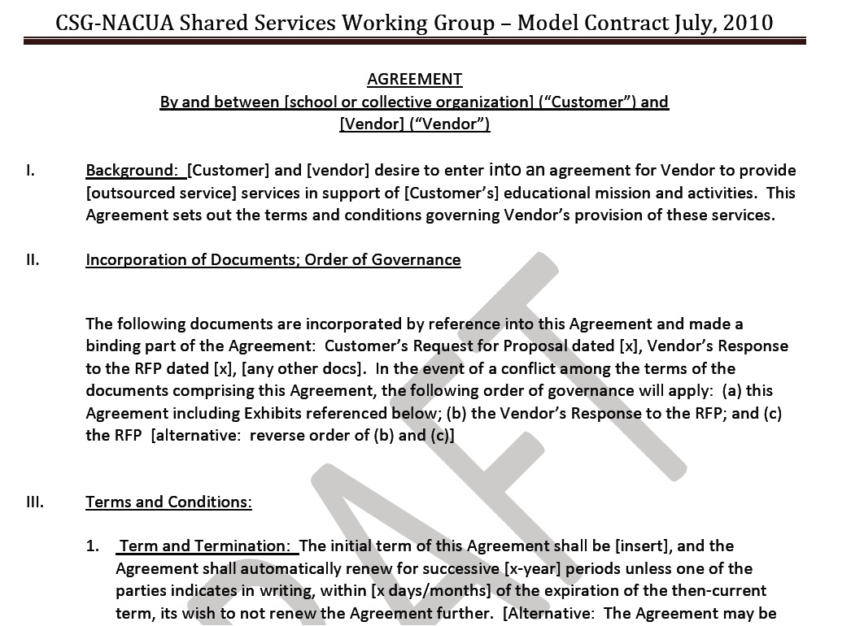
A BREAK IN THE CLOUDS?

Slide 25
ON A CLEAR DAY . . . .
12 public and private schools issued a joint RFP for student, faculty, and staff e-mail and related apps, based on the model RFP
7 proposals were submitted; narrowed to 2 finalists
Lawyers from the schools split into two teams and began to negotiate with the 2 finalists concurrently, attempting to start from the model contract
Negotiations have so far resulted in mixed results, with FERPA, HIPAA/BAA agreements, location of data storage, and vendor liability for data breach among the most difficult points with at least one of the finalists each, and the model itself a point of contention with one of the finalists
Hope is that the negotiations will produce agreements that will "scale" easily and that vendors can offer generally
Regardless, negotiations have resulted in useful updates of the model documents, which will be released soon

Slide 26
AT HOME IN THE STORM
Schools have also periodically discussed using Internet2, another group, or ourselves to develop dedicated higher ed cloud for storage or other purposes
Could avoid difficulties encountered with for-profit vendors
But campus users may want services we can't match
Another possible alternative: Internet2 as "broker" that could increase bargaining power on difficult issues and/or obtain group discounts
October 4, 2011: Internet2 announced "Net+ Services" pilot project
HP to provide high speed computing cycles
Box.net to provide storage (like Dropbox)
Participating schools will contract with I2 and pay administrative fee; I2 will contract with vendors
Pilot schools include Cal-Berkeley, Cornell, Indiana, Michigan, Notre Dame, Penn State, Utah

Slide 27
UNDERNEATH MY UMBRELLA

Slide 28
The Silver Lining
Your lawyer really isn't trying to botch the deal for you by raising these issues
You're paying him or her to be a professional pessimist, for your protection
Ultimately, much of this is a question of risk management, and you make the call

Slide 29
QUESTIONS AND CONVERSATION

Slide 30
THANK YOU

