Slide 1
A Collaborative Approach
to Cloud Computing…
How Five Institutions (now seven) and the
Tennessee Board of Regents went from
Storming to Performing
Notes:
Spoiler Alert … this isn’t just another “going to the cloud” Story!
Tom Danford, Chief Information Officer for the Tennessee Board of Regents (and colleagues) – want to welcome you to our digital poster session. What sets our project apart from just another “going to the cloud” story is our strategy. We’ve collectively/collaboratively used virtualization and clustering technology to realize such economies of scale that our costs are lower or at least “breakeven” and we still have all the advantages that hosting brings.
It’s been a long journey getting to this juncture with the concept hatched in 2009 and finally realized in 2011 through 2012. Going forward the poster is divided into 5 sections, but I’d encourage you to pay special attention to slide #4 where we define what exactly is a collaborative cloud project before moving into the other sections.
My colleagues and I will identify ourselves at the beginning of each section to provide a little narrative as to what you can expect to get out of the upcoming section. We encourage you to take advantage of the social media hashtags to ask questions and provide feedback or please feel free to send e-mail as well.
Thank you for your interest and we look forward to hearing from you.

Slide 2
A Collaborative Approach to Cloud Computing
#E12_PS002
http://bit.ly/RgEROJ
Timothy Carroll
Assistant VP, Information Technology
Roane State Community College
Thomas S. Danford
Chief Information Officer
Tennessee Board of Regents
Joe Sargent
Executive Director / CIO
Walters State Community College
Emily Siciensky
Associate VP for Information Technology
Columbia State Community College
November 7th, 2012 (1:30 – 2:30 PM)
Notes:
Welcome Digital Poster Gallery Attendee,
We are honored to have been selected to present a poster session and to have the opportunity to participate in the inaugural Digital Poster Gallery. To accommodate the digital version we are using a hybrid approach where we have created a PowerPoint slide deck with narrative provided in the notes section for each slide. Additionally, at the beginning of each section we have provided a voice narrative as to what the viewer can expect to get out of the upcoming section. We hope that you find it useful and please contact any of us with any questions you may have.
Thank you for viewing our presentation/poster,
Tim, Tom, Joe, and Emily

Slide 3
Poster Session Topics
What is a Collaborative Cloud Project?
Overview – Timeline, Including RFI Process
Pros & Cons
Costing
Tangibles/Intangibles
Lessons Learned
Notes:
Topics:
This presentation/poster session is of course about a Cloud Computing initiative, but it’s different than most cloud computing initiatives in that it was done not by just a single institution but by multiple institutions in collaboration with one another. It has been divided into the 5 sections below that illustrate the advantages and challenges of such a collaborative project:
Overview – Timeline, Including RFI Process
Pros & Cons
Costing
Tangibles/Intangibles
Lessons Learned
However, before getting into the details of the strategy it’s important that the viewer fully understand the concept of this project which is described in the following slide.

Slide 4
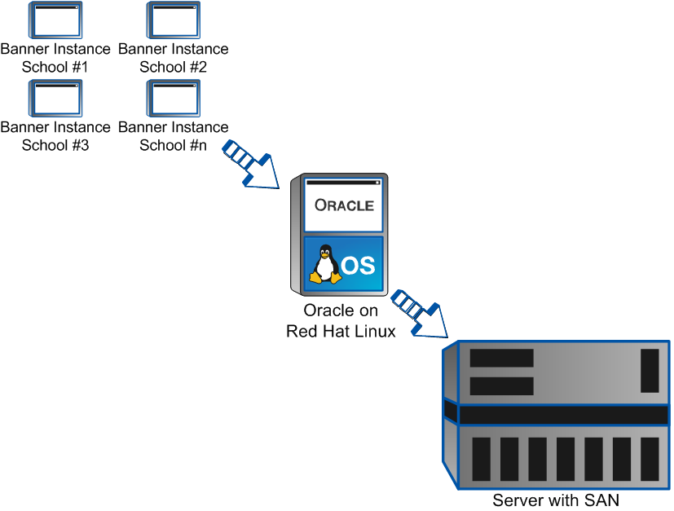
What is a Collaborative Cloud Project?
When two or more schools pool their resources to share common hardware and software in a hosted environment … utilizing virtualization and clustering technologies.
Notes:
What is a Collaborative Cloud Project?
We all know that if any single institution goes into a hosted environment it typically costs more than what the institution could do it for themselves on their campus. Hosting providers understand this so they sell the institution on the extra costs by stressing that the added security, redundancy, staff, QC, etc. that the institution will get from hosting with their company is “value add” and worth doing business with them.
What sets our story/poster apart from just another “going to the cloud” story is our premise that: If we collectively (5 now 7 institutions) go to the cloud and use virtualization and clustering technology on the same platform(s), we realize such economies of scale that our costs will be “breakeven” or even at a “cost savings,” and we’ll still be able to take advantage of the tangible and intangible benefits of hosting.
The graphic on this slide is a high level (perhaps oversimplified) conceptual diagram as to how the strategy works. Multiple institutions have their administrative RDBMS (Banner) installed on a single instance of Oracle (using Oracle’s Real-time Application Clustering (RAC) software) on the Red Hat Linux OS that operates on physical server(s) (In our case we have two physical servers for high availability and load balancing across the two servers and not to put too fine a point on it we duplicate the environments for development/test and production). With respect to the administrative application and middleware servers, they are housed in a high availability VMware cluster.
Results: Prior to the cloud initiative: minimum 16 RDBMS servers with no fewer than 40 app and middleware servers (assuming an average of 5 per campus).
After the cloud initiative: 4 RDBMS servers and all app and middleware servers as virtual machines in a high availability VMware cluster.

Slide 5
Overview – Timeline,
Including RFI Process
Notes:
Emily Siciensky, Associate Vice President for Information Technology, Columbia State Community College

Slide 6
Institutions in the Collaborative Cloud
The Initial Six Organizations
Cleveland State Community College
Columbia State Community College
Jackson State Community College
Motlow State Community College
Roane State Community College
TBR Central Office
New Additions
Dyersburg State Community College
Walters State Community College
Future Additions
1 – 2 Universities
Additional Community Colleges
Notes:
About the Tennessee Board of Regents:
The Tennessee Board of Regents is the sixth largest system of public higher education in the nation, with 46 institutions, over 200,000 students, and 14,000 full-time employees. The system consists of six universities – one of which has a law school and one of which has medical and pharmacy schools, 13 community colleges, 27 technology centers, and the system office. TBR conducts classes in 90 of the 95 counties in Tennessee, and offers a large variety of degrees and services. The Tennessee Board of Regents institutions credential over 22,000 individuals each year, making them job-ready and better prepared for the 21st century workforce.
For additional information please visit: http://www.tbr.edu
Overview
Before the Banner implementation in 2006, as we migrated from Plus , many of us investigated the possibility of hosting. The connectivity costs (especially for institutions with facilities in rural areas) were too high to make this a viable option at that time.
In 2009, when much of the server hardware needed to be replaced, we wanted to take another look at this since connectivity costs had gone down, hardware maintenance costs had gone up and disaster recovery plans were getting more expensive and complicated. As a system, we were also asked to consider more collaborative projects and implementations in order to be more cost efficient in our daily administrative operations.
In addition we wanted to look at more efficient ways to better utilize our staff in support of a growing list of academic initiatives that required a technology focus such as early alert and student retention systems.

Slide 7
Cloud Computing Roadmap Items
Objective: Provide for an orderly migration to a cloud computing environment
Current State Analysis
Opportunity & Concerns Identification
Business Case & Roadmap
Activities
IT management interviews and surveys
Stakeholder interviews and surveys
IT architecture analysis
IT budget analysis
IT staffing analysis
Review existing audit and risk analysis reports and documentation
Cloud/hosting vendor capabilities research
Deliverables
Current State assessment (gap analysis and process capability)
Interview key findings and observations
Rough Order of Magnitude (ROM) Estimate
Activities
Identify key opportunities and benefits
Establish Executive Dashboard Vision and priorities
Develop initiative write-ups including:
Project principles & desired outcomes
Roles and expectations
Budgeting and resource allocations
Document overall changes to process, technology and data
Finalize framework for governance and related initiatives
Deliverables
Future State Capability Vision
Principles of Implementation
Governance Structure
Budgetary Proposal
Activities
Define key initiatives to achieve desired future state capabilities
Finalize statement of work and project plan
Identify interdependencies and required implementation sequencing
Prepare project budget
Negotiate service level expectations
Develop a talent management program
Present consolidated roadmap, metrics design and related definitions to executive leadership
Deliverables
Statement of Work (SOW) Project Plan/Work Breakdown Structured (WBS)
Detailed Budget
Service Level Agreement (SLA) & Dashboards
Job descriptions and staff development plans
Contract with terms & conditions
Notes:
Cloud Computing Roadmap Items
The migration of an ERP system from individual installations to a collaborative hosted environment is a huge undertaking, and not to be taken lightly. In many ways it is more complex than the initial migration from Plus to Banner. To initiate the feasibility study here are some steps taken in the early stages:
Discussions with IT leadership from every TBR institution
A hosting consortium is organized for interested parties
Technical Staff begins to outline requirements, hosting task force is organized consisting of technical and financial leadership
Task force is charged with development of an RFI, with a list of possible hosting partners
RFI is submitted, 12 possible partners responded – State of Tennessee’s OIR is selected
The work begins to outline requirements, document current system states, project hardware architecture, infrastructure needs, technical sessions with stake holders

Slide 8
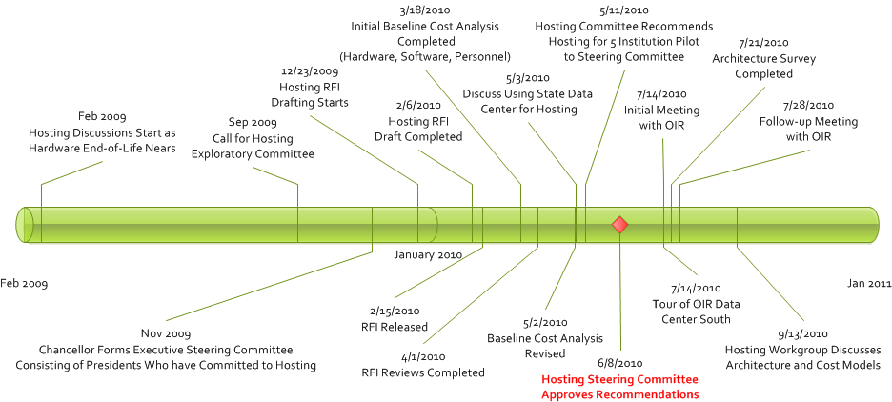
Pre-Implementation Timeline
Notes:
Pre-Implementation Timeline, RFI, Selection of Partner
Here is a graphic depiction of the pre-implementation timeline – from the initial discussions in 2009, to major milestones along the way. Once the consortium was set in place made up of a volunteer group in November 2009, and RFI was developed and released to potential partners in Feb 2010. Reviews of the responses were completed in April. The recommendation to host the servers at the State of Tennessee OIR facility was made, with architectural discussion held in September 2010.

Slide 9
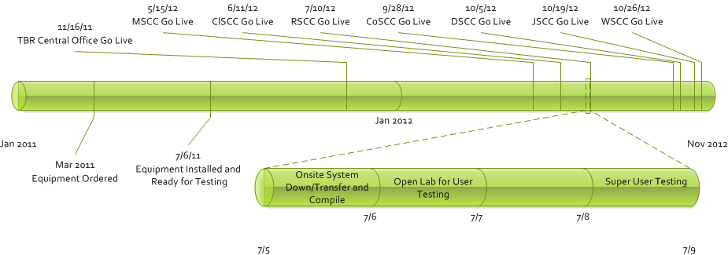
Implementation Timeline
Notes:
Implementation Timeline
In January 2011, the architecture for the environment was beginning to take shape; server and storage platforms were configured as well as ironing out the details around licensing, and database technologies. We outlined the go live projections, with a phased-in approach – that is the implementation would span over the course of 7 months, with one institution migrating each month from 5/2021-10/2012. We skipped the month of August since the Fall 2012 semester classes began leaving little time for migration work. The central office migrated several months before the start of institution migrations, setting the stage for database and application, mid-tier server structures. The institutions’ use of several third party applications, the implications on network and connectivity structures within that dynamic took several months of discussion, testing and re-testing before the first institution, Motlow State, was completed.
Issues still open – maintenance windows and upgrade schedules

Slide 10
Example Go-Live: RSCC
Thursday Noon 7/5/12 – System Down
Friday 7/6/12 from 8-12 am Lab Opened for Walk-in communications testing
Banner left open over weekend for Super User Testing
Monday 7/9/12 - Resolved OIR Firewall (PAT*) issues
4:30 PM Monday 7/9/12 – Opened Banner and RaiderNet (Luminis) for all users
Tuesday 7/10/12 AM 150 students processed in New Student
Orientation
* Port Address Translation
Week of 7/9 Resolved Single Sign-on, Banner Channels Issues and Week of 7/16 resolved Scholarship applications
Planning 2009-2012
Notes:
Example Go-Live: Roane State Community College
Testing for this kind of scenario is not the traditional type of testing – the functional users are looking for connectivity issues, not feature/function issues. The software did not change functions, but rather location. The preliminary planning and work done on the front end of the project by technical resources at the TBR the colleges and OIR really paid off during the implementation. The migration for the colleges required no more than 3 days to complete once the process began.

Slide 11
PROs & CONs
Notes:
Joe Sargent, Executive Director/CIO Walters State Community College - As with any project there are PROs and CONs. The PROs and CONs on this project were somewhat difficult to identify in the beginning. Since this was a ground breaking effort utilizing a state agency as the third party vendor, some concerns and benefits were challenging to evaluate until we had invested ourselves deeply in the project. Now that we are on the others side we can better evaluate the PROs and CONs of moving to a hosted environment.

Slide 12
PROs – Campus Perspective
IT staff can be repurposed to more “value add” job functions
Better computing infrastructure w/o large capital expenditures
Pooling resources results in lower overall costs (15-30%)
Standardization across application suite
A more robust disaster recovery (DR) strategy
Notes:
PROs – Campus Perspective
Many of the TBR institutions were approaching the need to refresh their ERP system hardware. The discussion of moving our systems into the cloud was extremely compelling compared to replacing the aging hardware. By pooling our resources we could realize cost saving of 15 to 30 percent, achieve standardized applications across institutions, provide better computing systems with robust disaster recovery and business continuity options, and allow IT staff to focus more on user needs rather than hardware management and oversight.

Slide 13
PROs (continued)
Less complex IT audits
Enhanced security within Banner
Lower licensing costs for OS, DBMS, compilers, etc.
“On-sight” support with proactive monitoring
Notes:
PROs (continued)
Additionally, having standardized systems would provide less complex IT audits, enhance our overall ERP security model, lower licensing costs across the board, and provide us with 24x7 on-sight support with proactive monitoring.

Slide 14
PROs – Shared Environment
Standardization of system equipment
Scheduled maintenance & 24x7 staff support
Standardized system processes
“Force multiplier” doing more with less for the campuses
Enables staff to “specialize”
Notes:
PROs – Shared Environment
Within the shared environment we were able to standardize all equipment to provide a virtualized environment that served all the institutions at the level they required based on need. The ability to have scheduled maintenance time with staff that supported the system 24x7 was key in providing the necessary up-time required in higher education today. The concept of cloud hosting allowed the campuses to do “more with less” and enables the staff to specialize.

Slide 15
CONs – Campus Perspective
Perceived loss of control of system/data
Perceived concerns for long-term employment
The unknown – will hosting work with 3rd party applications
Campus may have to alter processes to fit into hosted environment
Scheduled downtimes for maintenance
Notes:
CONs – Campus Perspective
With change comes uneasiness and some of our partner schools had that within their teams. Some were concerned that they would lose control of their data or that downsizing could be a negative result. Others were concerned with the compatibility of the third party products working within the hosted environment and getting the support required from those third parties. Additionally, the local campuses were concerned that processes would have to be altered and in turn require retraining of employees. Another concern was the need for scheduled downtimes for maintenance. Individual schools had always controlled their own environments and the hosted world was going to remove that comfort and control zone that they had historically managed.

Slide 16
CONs – Shared Environment
Additional security concerns
Outages will effect more than one campus
Internal changes with development practices
Complex infrastructure configurations
Notes:
CONs – Shared Environment
All of the schools had concerns in regards to security of the systems and the expanded access that hosting offered outside of their own protected network. Multi-site outages were also a concern since all schools would be down if the hosting site had failures or maintenance needs. Other concerns focused on the possibility that development methods would need to change with internal staff since the environment would no longer be local to the institution.
The individual school’s complex networks also added additional concerns. Many schools have had the opportunity to implement secure networks with minimal access. This hosting effort required them to open access to external systems that they normally had not allowed in the past. Additionally, the hosting entity had never worked with higher education in this capacity and many schools were concerned about the hosting entities flexibility and how their issues would be addressed by the hosting entity.

Slide 17
Costing
Notes:
Tim Carroll, Assistant Vice President Information Technology at Roane State Community College - In the following section you will be given insight into our attempt to establish our current costs and predict the hosting costs for the first five pilot institutions. While the costs for the initial five schools were slightly higher than we predicted, the actual results have far exceeded our expectations. Performance has been exceptional. Through the use of virtualization and clustering technology we have been able to add two schools without additional hardware. We expect a cost reduction for all schools moving forward.

Slide 18
Objectives of the Cost Analysis
Determine the current operational and administrative costs (establish a baseline)
Determine if moving from an on site model to a hosted model would be cost effective (affordable)
Decide if any tangible and intangible benefits would be worth any increase in incremental costs (value add)
Notes:
Objectives of the Cost Analysis
In order to determine whether the project was worth pursuing, the Hosting Team decided to perform a cost analysis. The main objectives were to establish the baseline costs so we would know if the project was cost effective and therefore successful. Additionally, we wanted to know if the benefits of hosting would be worth more than the additional expenses incurred.

Slide 19
Analysis Summary
Baseline costs for the five pilot institutions
Existing Hardware - $1.62M invested (upgrade replacement costs projected at $1.49M one time)
Existing Administrative Costs - $2.68M no savings anticipated in this area
Cost Benefit Analysis four years
Estimated hosting services - $2.072M
Estimated operational costs - $167K
Estimated net savings - $167K
ROI - $167K
Notes:
Analysis Summary
Our initial analysis showed that for the first five schools, the costs would be slightly higher than our current operations. However, we knew other schools would be added that would eventually drive the cost down. We also determined that the value of tangible and intangible benefits were worth more than the additional costs.

Slide 20
Predicted Results of Analysis
Cost Effective … initially break-even or just over current costs …drops as others join
Gains (Tangible and Intangible) added value that could not be duplicated on campus
Hardware configuration robust enough to add additional institutions for added cost savings
Sparked interest from other institutions who will join later
Will explore more advanced technology as it comes on line to further reduce costs in the future
Notes:
Predicted Results of Analysis
At this point, the Hosting Team determined that given the relatively small amount of additional cost versus the tangible and intangible benefits gained from hosting, we recommended to the Executive Steering Committee that we should proceed with the pilot of five schools.

Slide 21
Actual Results
Has cost slightly more than initially thought due to steep learning curve of OIR and TBR
Increased performance due to virtualized servers and RAC database
Have added two additional institutions to the original five, with two more in the queue without having to add hardware; memory only
Expect costs to go down when all schools are operational
The following slides show the details of the baseline and cost benefit model.
Notes:
Actual Results
While the costs have gone up slightly more than we initially predicted, the increase in performance and the tangible and intangible benefits more that off-set the increased costs. Since the initial five schools have gone live, two more have been added, with a third due to go-live in March 2013… all without having to add additional hardware. Only the memory had to be upgraded to accommodate the additional schools.

Slide 22
Breakeven Analysis
Breakeven
(5 institutions)
Notes:
Breakeven Analysis:
The fixed costs will remain relatively constant for the seven schools in the Hosted environment. This means that the fixed cost to each school will go down with additional institutions being added. One note, each school may have additional servers and services outside the shared set which will affect the cost to the school.

Slide 23
Baseline Costs - Hardware
Existing Administrative Hardware | Participant Totals
1. Administrative Computing Platform(s)
A. Production | $339,930
B. Development | $99,047
C. Test | $177,533
D. Other (e.g. Training) | $15,000
2. ODS/EDW (Data Warehousing) Computing Platform(s)/Workflow | $0
A. Production | $100,305
B. Development | $0
C. Test | $40,021
D. Other (e.g. Training) | $0
3. Luminis (Portal) Computing Platform(s) | $0
A. Production | $65,566
B. Development | $20,767
C. Test | $9,799
D. Other (e.g. Training) | $0
4. Administrative Computing Disk Storage (SAN) | $360,999
5. Dedicated Communications & Security Equipment (Firewalls, Switches, Routers, etc.) | $131,711
6. Other sunk costs related to administrative purposes (UPS, etc.) | $83,991
7. Workflow Server | $20,000
8. Eprint server | $2,500
9. Backup system and software | $55,000
Tape Library Replacement | $0
10. Disaster Recovery | $100,000
Total | $1,622,169
Sun Replacement Cost for all five Community Colleges is$1.49 million
Notes:
The remaining slides in this section provide the details of the cost-benefit analysis.

Slide 24
Baseline Costs – Administrative
Budgeted Recurring Administrative Costs | Participant Totals
1. Total IT Personnel Costs for Administrative Computing
A. Network and Network Security Support | $44,709
B. Solaris/Linux/Hardware Support | $79,768
C. Database Administration (DBA) | $375,068
D. Banner Application (programmers, analysts, etc.) | $448,275
E. ODS/EDW (Data Warehousing) | $49,044
F. LuminisWeb (Portal) | $104,139
G. Other Applications (TouchNet, Housing, etc.) | $257,606
H. Helpline and User Support | $130,607
F. Application(s) Training | $9,700
F. Administration and Planning | $142,178
2. Contractual and Consulting (Strata Info Group, SunGard HE, etc.) | $90,000
3. Hardware Maintenance and other Costs | $140,540
4. Software - Purchases/licenses, Maintenance (Compilers, TOAD, Linux, etc.) | $799,366
5. Professional Development and Training | $17,350
Total | $2,688,350

Slide 25
Cost Benefit Model
 |  |  |  |  | Option 2 (Hosting - Linux - Oracle RAC -0 FTE)
Organization's Operational Costs per Option |  |  |  |  | FY | FY | FY | FY
 |  |  |  |  | 2010-11 | 2011-12 | 2012-13 | 2013-14 | TOTAL
1. Staffing Costs (Operational Costs) |  |  |  |  | $0 | $0 | $0 | $0 | $0
i. Full-time IT Staff (Salaries & Benefits) |  |  |  |  | $0 | $0 | $0 | $0 | $0
ii. # of Full-time IT Staff Required |  |  |  |  | 0.00 | 0.00 | 0.00 | 0.00 | 0.00
iii. Other Full-time Staff (Salaries - for FT staff from depts other than IT) |  |  |  |  | $0 | $0 | $0 | $0 | $0
iv. # of Other Full-time Staff Required |  |  |  |  | 0.00 | 0.00 | 0.00 | 0.00 | 0.00
v. Contract Staff (Costs - PT or contract staff) |  |  |  |  | $0 | $0 | $0 | $0 | $0
vi. # of Contractors Required |  |  |  |  | 0.00 | 0.00 | 0.00 | 0.00 | 0.00
2. Third-party Costs (Operational Costs) |  |  |  |  | $517,460 | $517,460 | $427,860 | $427,860 | $1,890,639
i. Vendor/External Consultant Services |  |  |  |  | $0 | $0 | $0 | $0 | $0
ii. Maintenance & Support Services |  |  |  |  | ($160,540) | ($160,540) | ($160,540) | ($160,540) | ($642,161)
iii. Hosting Services |  |  |  |  | $518,000 | $518,000 | $518,000 | $518,000 | $2,072,000
iv. Telecommunications Services |  |  |  |  | $0 | $0 | $0 | $0 | $0
v. Other |  |  |  | Oracle RAC license | $160,000 | $160,000 | $70,400 | $70,400 | $460,800
3. Infrastructure Costs (Operational Costs) |  |  |  |  | ($1,723,011) | $0 | $0 | $0 | ($1,723,011)
i. Data Center |  |  |  |  | $0 | $0 | $0 | $0 | $0
ii. Hardware |  |  |  |  | (1,723,011) | $0 | $0 | $0 | ($1,723,011)
iii. Software |  |  |  |  | $0 | $0 | $0 | $0 | $0
iv. Other |  |  |  | Specify | $0 | $0 | $0 | $0 | $0
4. Miscellaneous Costs (Operational Costs) |  |  |  |  | $0 | $0 | $0 | $0 | $0
i. Training |  |  |  |  | $0 | $0 | $0 | $0 | $0
ii. Travel |  |  |  |  | $0 | $0 | $0 | $0 | $0
iii. Supplies |  |  |  |  | $0 | $0 | $0 | $0 | $0
iv. Other |  |  |  | Specify | $0 | $0 | $0 | $0 | $0
Subtotal of Operational Costs |  |  |  |  | ($1,205,552) | $517,460 | $427,860 | $427,860 | $167,628

Slide 26
Cost Benefit (continued)
Cost/Benefit and Return on Investment Analysis Summary Report for
Option 2 (Hosting - Linux - Oracle RAC - 0 FTE)
 |  | 1 | 2 | 3 | 4 | TOTAL
 |  | FY | FY | FY | FY
 |  | 2010-11 | 2011-12 | 2012-13 | 2013-14
Capital Cost |  | 3.00% | 3.00% | 3.00% | 3.00%
Cost Benefit Analysis
(a) | Net savings for implementing this option | $1,205,552 | ($517,460) | ($427,860) | ($427,860) | ($167,628)
(b) | Total Project Cost for this option | $0 | $0 | $0 | $0 | $0
(c) | Year to Year Staffing Change | 31.30 | 31.30 | 31.30 | 31.30
Return on Investment Analysis
(d) | Return on Investment (a) - (b) | $1,205,552 | ($517,460) | ($427,860) | ($427,860) | ($167,628)
(f) | Breakeven Fiscal Year | NO PAYBACK | This is the year in which the project's investment costs are recovered
(g) | Net Present Value (NPV) | ($125,325) | NPV accounts for the time value of money. It is more appropriate for long projects

Slide 27
Tangibles/Intangibles
Notes:
Thomas Danford - If you’re still listening at this point we must be keeping your attention?
Having once read management theorist Phil Crosby’s book “Quality is Free” this section resonated the most with me. Given the discussion to this point we recognized that our cloud/hosting approach would be able to deliver both tangible and intangible benefits that we previously did not have. Most importantly though it would be at a price that was equal to or even less than what we were then paying. In other words quality would finally be free.
The slides in this section will include a discussion about value and how this project narrowed our perceived value to the market value.
Finally, it will finish up with an overview of the many benefits we’re receiving by partnering with our hosting provider.

Slide 28
Types of Value
Value Add – Bundling or packaging features and benefits that leads to greater customer acceptance in order to create a competitive advantage
Market Value – Estimated (highest) price that a product or service will sell for in a competitive market
Perceived Value – Customer's opinion of a product's value to him or her
Latent Value – Potential but not presently evident or realized (i.e. obvious or explicit)
“Collaborative hosting narrows the margin in both the market value, and the value being perceived”
Notes:
Types of Value:
The term “value” pops up often in IT and it’s a term that is very germane to a discussion surrounding hosting or cloud computing so let’s dissect it a bit on how it’s used and how it applies.
Value Add – As mentioned earlier, is where hosting providers stress their value proposition to potential hosting clients by highlighting features and benefits that lead to greater customer acceptance in order to create a competitive advantage (e.g. security, redundancy, staff, QC, etc.).
Market Value – Is the estimated (of course highest) price that a product or service will sell for in a competitive market.
Perceived Value – Is the customer's opinion of what they would be willing to pay for a product, service, or to make a problem go away.
Latent Value – Is the potential but not presently evident or realized value that could be realized (e.g. piggy backing on new technology advances)
Hosting/Cloud Computing has tremendous Value Add and Latent Value, but for the campus as a consumer Market Value vs. Perceived Value is always the stumbling block. Market Value is always higher than Perceived Value.
However, our experience in taking a “collaborative approach” to hosting/cloud computing narrows if not eliminates the margin between market value and perceived value because there is no longer a cost differential. You’re in effect getting the hosting/cloud computing Value Add … at a price that’s neutral or better than what could be accomplished doing the same locally.

Slide 29
Tangible & Intangible Benefits
Categories of Tangible Benefits
Physical Plant
Infrastructure
Service Levels (staff multipliers)
Categories of Intangible Benefits
Consternation
Leadership & Internal Clients
External Factors (audit, press, etc.)
Opportunity Lost
“Things which matter most must never be at the mercy of things which matter least” – Goethe
Notes:
Addressing Tangible an Intangible Benefits …
Tangible benefits are basically divided into three categories related to (1) Physical plant, (2) Infrastructure, and (3) Service levels. All of these will be addressed in the next slide.
Intangible benefits though need to be mentioned as they diminish drastically in a hosted/cloud computing environment. Strict change management brought about by the hosting organization reduces “maverick” requests for change and a well controlled environment reduces issues with IT audits and certainly any negative press brought about by security breaches.
Most importantly though it relieves/enables campus staff to concentrate on “Things which matter most” which is dealing with how to better serve students.

Slide 30
Tangibles/Intangibles
Notes:
Tangibles/Intangibles
In this slide we informally (and non-scientifically) consulted with IT leaders to determine (given their situation) what they would be willing to pay to “cure” the “tangible/intangible” issues in the slide. Going back to the “value” discussion and the “perceived” vs. “market” value the perceived value was understandably less than market value. Nevertheless though the collaborative approach narrowed the margin between perceived and market values.

Slide 31
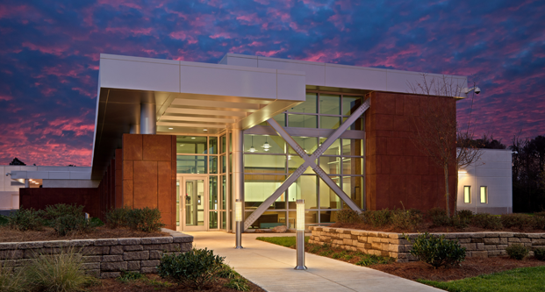
Tennessee South Service Center
In an ever changing world, IT disaster recovery has become a vital part of every IT director's duties. Planning for natural disaster or the unthinkable man-made disaster has become increasingly critical for the smooth operation of state and local government.
Photography by Brian Robbins
Notes:
About the Office for Information Resources (OIR):
OIR is a division within the Department of Finance & Administration (F&A) which reports to the State’s Commissioner of Finance. OIR's clients primarily consist of State agencies, departments and commissions. However, they are open to providing hosting services to local government and higher education to include both public and private institutions. Though public higher education does not report through nor is required to use OIR we have partnered with them for years on statewide networking, disaster recovery, and most recently this hosting project.
This new data center that is in this and subsequent slides received its Certificate of Occupancy (CO) in 2011. It is the State’s second data center with the original (which is now undergoing renovations) being in downtown Nashville. Having two geographically distributed centers provides additional disaster recovery options for many of the State's mission critical applications, as well as allowing OIR to develop a range of cost effective DR offerings for State agencies and other clients such as this hosting project.

Slide 32
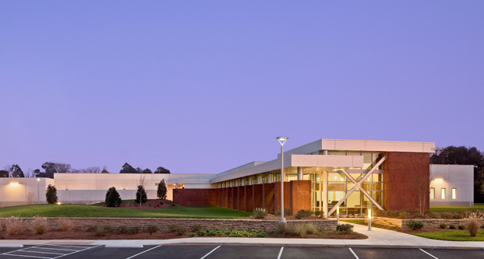
Structure
In the wake of many recent natural and manmade disasters such as 9/11, safety and security of data systems has become a top priority. The State of Tennessee's Data Center South was purpose built to include these structural features: Designed to withstand F3 tornadoes and moderate earthquakes and provide physical barriers such as a perimeter fence.
Photography by Brian Robbins
Notes:
Interesting Trivia … In the history of the TBR two of our institutions have had their data center operations impacted by tornadoes (Tennessee is right in the middle of tornado alley). Additionally, four of our institutions are in the New Madrid Fault Earthquake Zone … two of those institutions have elected to join the hosting project.
About the New Madrid Fault Earthquake Zone:
The New Madrid fault zone is six times bigger than the San Andreas fault zone in California and it covers portions of Illinois, Indiana, Missouri, Arkansas, Kentucky, Tennessee and Mississippi. Though about 200 years ago in 1811 – 12 the biggest earthquakes in the history of the United States were caused by the New Madrid fault. Four quakes happened in that timeframe that were estimated to have been magnitude-7.0 or greater. It was reported that those earthquakes opened deep fissures in the ground, caused the Mississippi River to run backwards and were felt as far away as Boston.

Slide 33
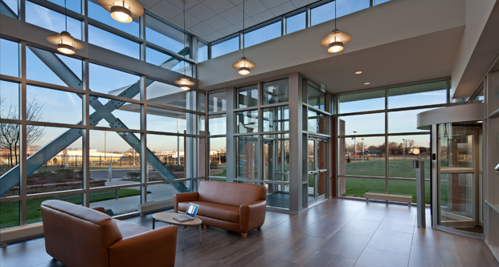
Security
In addition to structural considerations, the State of Tennessee's Data Center South was purpose built to include these security features: Card access and iris scanners, 24 x 7 x 365 monitored video surveillance and on-site security officers.
Photography by Brian Robbins
Notes:
Interesting Trivia … Perhaps the most common IT audit weakness/finding that TBR institutions are cited for relate to physical security along with fire detection and suppression.

Slide 34
Infrastructure
Data Center South provides a separate caged area with lockable 7-ft server cabinets. The cabling plant consists of a 3-tiered, overhead cable tray system, providing both fiber and copper cabling. Cabinets are preconfigured with A-side and B-side network and power to provide maximum flexibility and eliminate any single points of failure.
Photography by Brian Robbins
Notes:
Interesting Trivia … Power is run off of batteries (active as opposed to standby uninterruptable power supply).

Slide 35
Cooling and Equipment Yard
Data Center South provides high availability at Tier-III levels and is maintainable while operating, without requiring maintenance windows to repair, replace or maintain the critical mechanical and electrical systems. The power and cooling systems are designed to support high density computing with 2N and N+1 redundancy features.
Photography by Brian Robbins
Notes:
Interesting Trivia … Two standby generators have enough diesel fuel to operate the facility for 5 days.

Slide 36
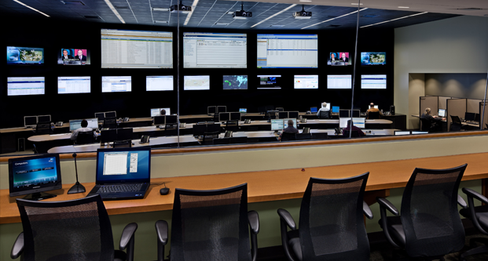
Command Center
Leveraging the State's relationship with AT&T, the center provides fast and reliable access to either the Internet or the State's NetTN network. Fiber entering the building from diverse locations ensures high availability and greater redundancy.
Photography by Brian Robbins
Notes:
Interesting Trivia … Though the Command Center monitors all systems in the facility, we have the ability to also monitor them to provide some redundancy and to aid in monitoring performance for future growth planning.

Slide 37
NetTN – Tennessee’s Private Network
Performance - Application Performance Management for critical applications and real-time applications. End-to-end performance management for network components, transport and applications.
Agility - Transport and Access flexibility from Managed Internet Service to Private Line DSL Copper, Ethernet or Fiber. Remote Access options, e.g. broadband.
Security - IP Security Services from Premise Firewall to Web Security, Network-Based Firewall and Intrusion Detection/Prevention.
Control - Customized view into managed infrastructure, including service ticket management, reporting, billing, and more.
Notes:
About NetTN:
In 2008, AT&T was awarded the NetTN contract for telecommunication services. This contract includes the data network products and services that support the statewide10 Gbps backbone infrastructure, utilizing Multi-Protocol Label Switching (MPLS) to facilitate secure, redundant, high performance wide area network connectivity. NetTN is a fully meshed network in compliance with the latest convergence technology. It can be scaled to any office’s size and needs, and it accommodates various access methods such as DSL, Private Line, Metro Ethernet and Wavelength services.
For more information on NetTN please visit: http://www.nettn.net
NetTN Partners
911
eHealth
K-12
Libraries and Local Government
Non-Profits
PBS
Private Higher Education Institutions
State of Tennessee Office for Information Resources (OIR)
TEMA
Tennessee Board of Regents
University of Tennessee

Slide 38
Mobile Worker
Internet
3G/4G/LTE WiFi
Tennessee South Service Center
Core Network Strategy
Redundant Core Routers
Redundant 10Gbps links
Redundant Firewall & IPS
Geo failover of Security & AVPN services
Redundant Internet Egress
IPAM & DNS Services
Johnson
City
Nashville
AVPN
Video Services
Knoxville
DSL
Memphis
Remote
Location
Dial via ANIRA
Future Services
Chattanooga
Mobile
Worker
Hosted Campus
Hosted Campus
Performance
Agility
Security
Control
38
Notes:
More on NetTN:
The basic design of the NetTN MPLS network allows each customer’s data traffic to travel a Virtual Private Network (VPN) path from the point of entry into the network to the final destination. Customers can control which of their offices are allowed to communicate with other customer offices and those that must maintain complete separation. MPLS allows for the co-existence of all government, education, eHealth, 911 and non-profit organizations on the network, along with providing the products and services needed to support new technologies and multiple options for connectivity, performance, and quality of service.
The NetTN network is designed and constructed to accommodate data, voice (VoIP), multimedia and video over the same access circuit. Differentiated Sevices (DiffServ) is utilized within the network for end to end IP QoS features.
NetTN is designed for 99.999% accuracy at the core and 99.95% accuracy at the end sites.
Service Components or Product Features included in Base Price:
Circuit to the customer premises
Managed router services (Cisco model dependent on circuit size)
Internet access (optional)
Managed firewall security to and from the Internet
Managed intrusion prevention and intrusion detection to and from the Internet
Connectivity to all other sites on the NetTN network
Internet2 for eligible entities
Proactive network management and monitoring
Industry leading service level agreements
Optional NetTN Managed Services:
H.323 Video - NetTN provides a fully managed H.323 video network for all NetTN Partners. This video network provides low cost, multiple point video bridges, as well as no cost point-to-point for sites on the NetTN network
Remote Access - NetTN provides a low cost dial-up service for end users to remotely connect to resources on the NetTN network. Remote access also includes options for broadband access, SSL VPN, and multi-factor authentication services
Managed Internet Service - For Internet access only Internet service from T1 to 1Gbps is available
Email, Content Filtering, and web hosting services are also available
Non-managed services include:
Point-to-Point Data Circuits
Primary Rate ISDN Service

Slide 39
Lessons Learned
Notes:
Joe Sargent, Executive Director/CIO Walters State Community College - This project provided us great opportunities to learn throughout every process. In this section we will lead you through the lessons we learned as we went through our planning and implementation phases.

Slide 40
Lessons Learned (Pre-Implementation)
What Worked Well
Project lead was not an IT person
Project lead was from a campus not the system (TBR) office
Executive committee consisted of campus presidents
Recommendations
Definition of full project scope at the start
Campus & hosting technical staff work together early on in the project
Notes:
Lesson Learned (Pre-implementation)
This project originally started off with a group of five schools researching the viability of going to a centralized hosted environment. This effort was not led by a career IT executive or someone from the central Tennessee Board of Regents office. The schools created a research committee that was led by one of the participating school’s chief finance officer (CFO). Other members on this committee consisted of the participating school’s CIOs, the central office CIO, and a few other select technical IT members. An executive committee consisting of the participating school’s presidents was designated to review, approve, and recommend the ultimate hosting solution we would pursue.

Slide 41
Lessons Learned (Post Implementation)
Cultural differences between higher education and hosting (e.g. bureaucratic)
Expectations differ between higher education and hosting (e.g. access)
Project success leads to scope creep
Multi-campus environments can be implemented easier and more consistently
Importance of change management is amplified
Notes:
Lessons Learned (Post Implementation)
In our hosting solution we partnered with the state IT group instead of a private entity. We found that there were many cultural, procedural, and terminology differences between our teams and their organization. Our expectations of how processes and requests should be handled were often times different from the hosting organization. These were areas we had to identify and work through throughout the project.

Slide 42
Thank-you for Stopping By …
Timothy Carroll
Assistant VP, Information Technology
Roane State Community College
carrolltd@roanestate.edu
Joe Sargent
Executive Director / CIO
Walters State Community College
joe.sargent@ws.edu
Thomas S. Danford
Chief Information Officer
Tennessee Board of Regents
tdanford@tbr.edu
Emily Siciensky
Associate VP for Information Technology
Columbia State Community College
esiciensky@columbiastate.edu

