Slide 1
UK national data driven services to education
Robert Haymon-Collins and Myles Danson

Slide 2
Session outline
Orientation
Focus on national business intelligence service
Focus on national learning analytics service

Slide 3
Orientation

Slide 4





23%
2.3m
$47.5bn
Postgraduate
In the UK there is…
160
Students in HE
77%
Income of HEIs
Higher education institutions
1,085
Undergraduate
Providers of further education
and skills
470
$12bn
Colleges providing further
education
4.9m
Learners in FE
Funding for FE and skills

Slide 5

Who we are?
Jisc is the UK higher, further education
and skills sectors’ not-for-profit organisation for digital services and solutions
Provide trusted advice and practical assistance for universities, colleges and learning providers
Operate shared digital infrastructure
and services
We…
Negotiate sector-wide deals with IT vendors and commercial publishers
Notes:
We are a registered charity and champion the use of digital technologies in UK education and research. We develop shared services for our members, most recently by partnering with vendors. We provide trusted advice and support, reduces sector costs across shared network, digital content, IT services and procurement negotiations

Slide 6
Strategic priorities
Data and analytics
Open agenda
Research enablement
Cyber security and access and identity manage-ment
Collaboration and international-isation
Teaching, learning
and student experience
Our
customers
Sector
and
enterprise efficiency
Institutional
and academic leadership
in the digital age
Digital standards and policies
Digital translation from other sectors/industries
Notes:
Data and analytics is right up front

Slide 7
How we innovate/ R&D/ new services

Slide 8
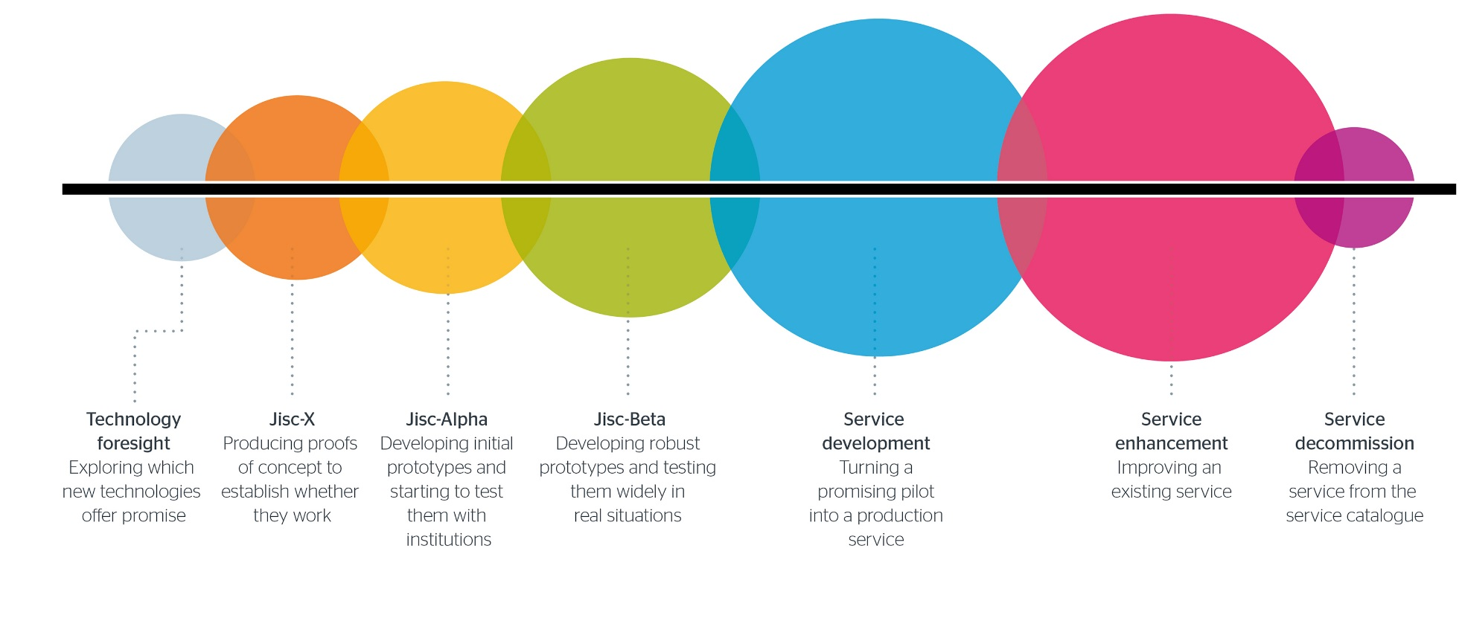
Pipeline

Slide 9
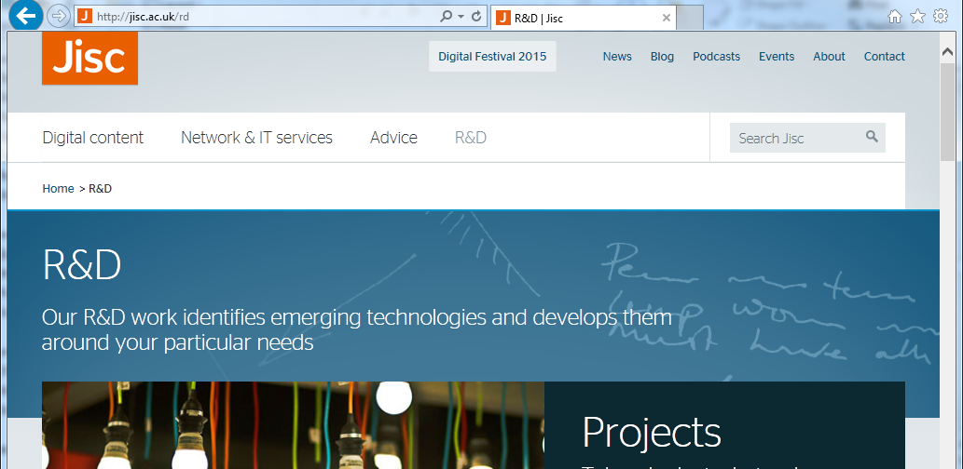
Jisc R&D web site
Jisc.ac.uk/rd
Notes:
Includes dashboards showing cost of investment, timescale, risk and pipeline progress point

Slide 10






















Co-design partners and participation
142 ideas considered
24 defined and pitched
6 challenges prioritised
100 senior stakeholders prioritised ideas
(inc. 5 PVCs)
1000 colleagues consulted
Notes:
Massive consultation across members resulted in 6 Challenges – areas for exploration and potential new service development

Slide 11



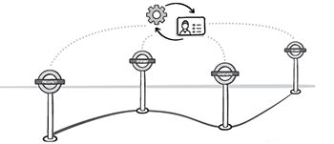
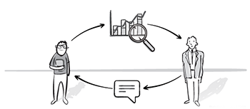

Co-design challenges
Research at risk (R@R)
Implementing FELTAG
Digital learning
and capabilities
Prospect to alumnus (P2A)
Learning analytics
Business intelligence
Hosting platform
Hosting platform
Notes:
We’ll discuss two of these data underpinned challenge areas – Business Intelligence and Learning Analytics

Slide 12
About business intelligence

Slide 13
Higher education statistics agency (HESA)
Collects a range of data every year UK-wide from universities, higher
education colleges
Provide that data to UK government and funding bodies to support their work
Publish official statistics and in many accessible formats for use by a wide range of organisations and individuals
Funded by the subscriptions of the HE providers from whom they collect data
Notes:
HESA is a not for profit mandatory subscription data collection and distribution organization
All 180 Universities and HE providers are in the club – they pay and add data, they receive clean and trusted data for benchmarking and strategic planning
It’s mandatory for publicly funded UK Universities

Slide 14
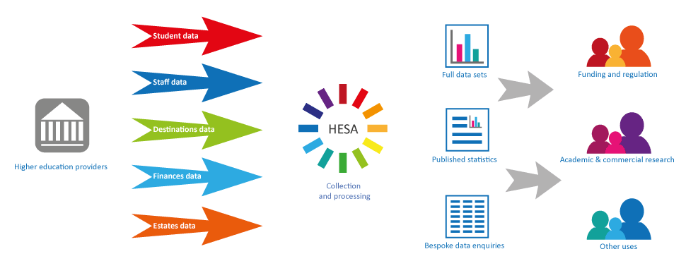
HESA overview
Notes:
Data collections follow 5 high level themes.
Students (unique identifer, course subscriptions, demographics), staff (unique identifier, roles), destinations (of leavers – so first job or other program of study) and data about the physical university estate, all collected annually and shared
Have begun work on in year collections

Slide 15
HESA and Jisc business intelligence initiative
Notes:
The benefits of good business intelligence to support evidenced-based decision making are well known, yet there has been little join up to help UK education providers exploit it. HESA and Jisc have joined forces to develop tools, services and advice that will enable a wide range of staff in making sound business decisions.
1. Service going out to 180 Higher education providers and bodies staged production November 15 – April 16
2. An agile research and development pilot to feed the production service involving 60 Planners from 70 Higher education providers running November 15 – November 16

Slide 16
Notes:
Overview of production and R&D services
Collaborators UK Higher education statistics agency (HESA) and Jisc
Heidi acronym
Heidi Plus – the service initially drawing on HESA data collections (low hanging data)
Heidi Lab – the Research and development project identifying other data for mash up analysis and new production content
Dashboards and visualisations delivered via Tableau server to 180 Higher Education Providers and bodies
All created by HESA – so rather than each university doing the analsyis for insights, HESA do it for them
Any low maturity capability institution can still access the data and analyses
Limited to the HESA data sources
Bronze (receive dashboards takes it to any staff role), silver (create own analsyes based on non attributable data) and gold users (analyse attribuatle data for planning purposes with strict end user agreement)
All access requires; Organizational information security audit, organization agreement, end user agreement

Slide 17
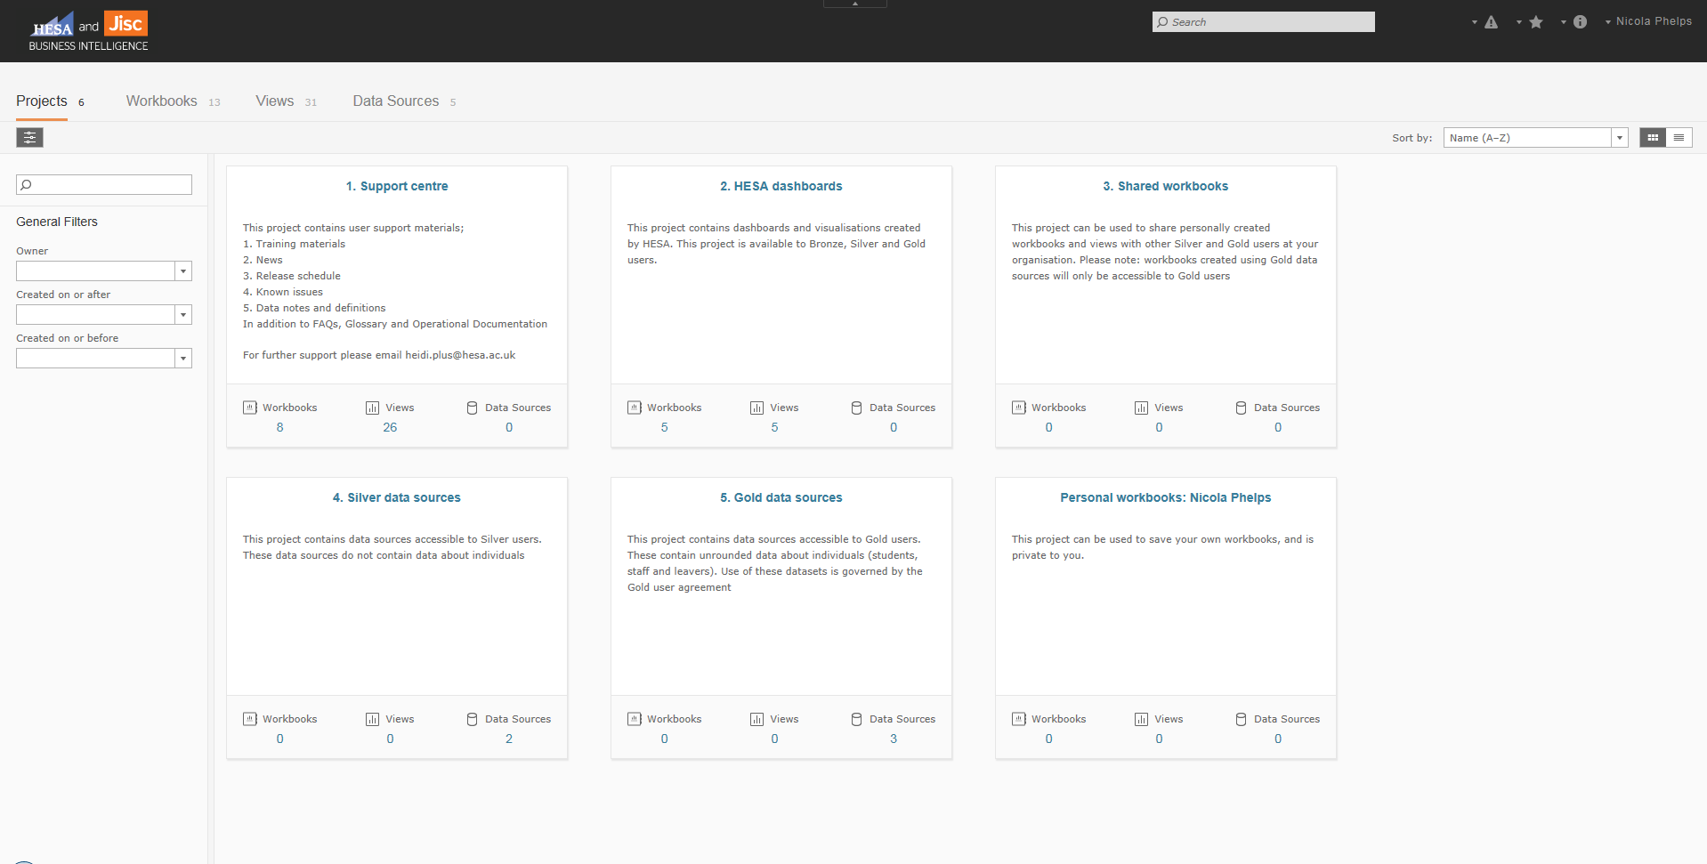
Notes:
Initial Heidi Plus dashboards

Slide 18
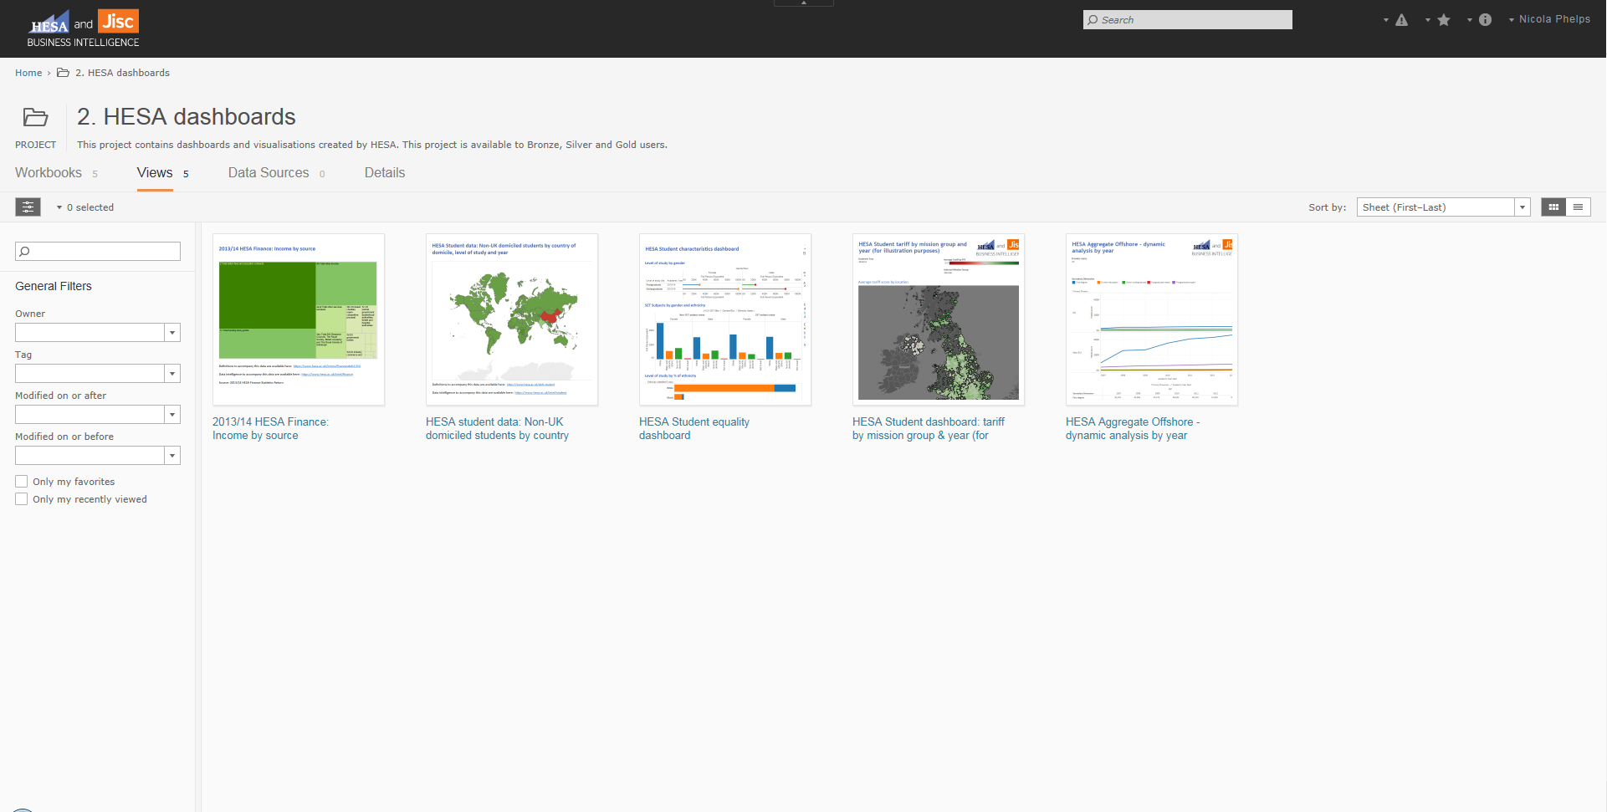
Notes:
Initial Heidi Plus dashboards

Slide 19
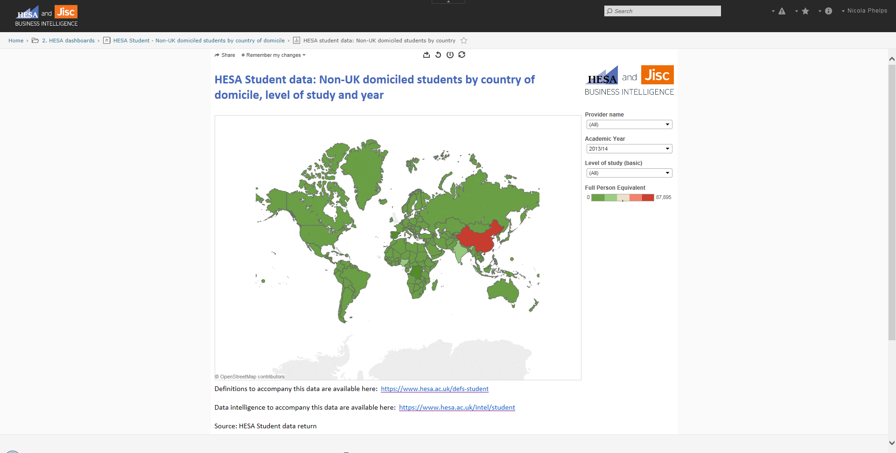
Notes:
Initial Heidi Plus dashboards

Slide 20
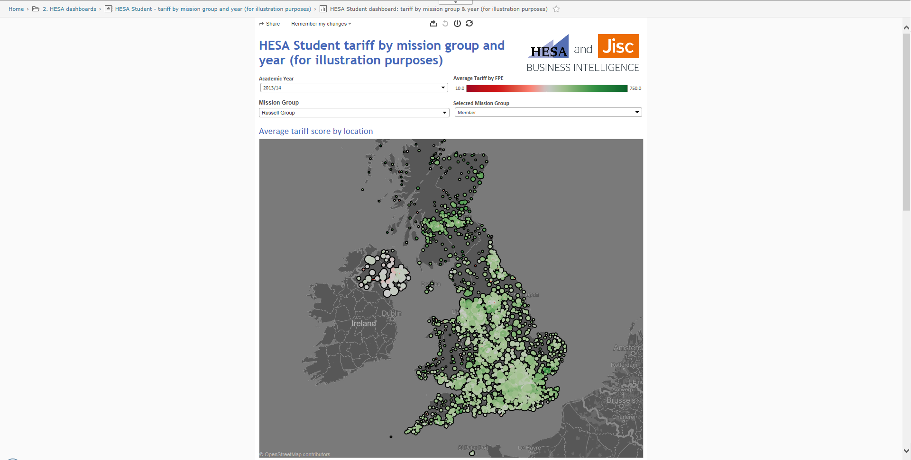
Notes:
Initial Heidi Plus dashboards

Slide 21
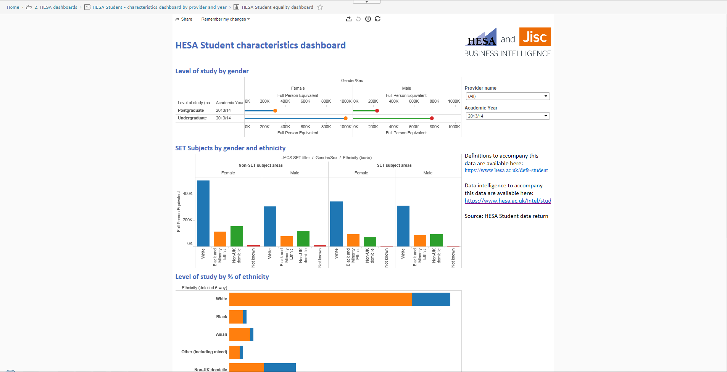
Notes:
Initial Heidi Plus dashboards

Slide 22
Heidi Lab
A new national analytics research and development project
Focuses on business questions that can’t be addressed through Heidi Plus
Support improvement in sector efficiency through the submission and analysis of professional services cost benchmarking data
Technical; MS SQL Web and Business (elastic), DocumentDB (elastic), Alteryx, Tableau server
Notes:
A first attempt at large scale cross institutional collaboration to create new BI dashboards and analyses based on wide data collections for a national service to all UK education and research. A national project engaging with 70 experts from 60 HEPs to identify new business questions, likely data and undertake analysis for new service content
Cloud based so can expand based on demand

Slide 23
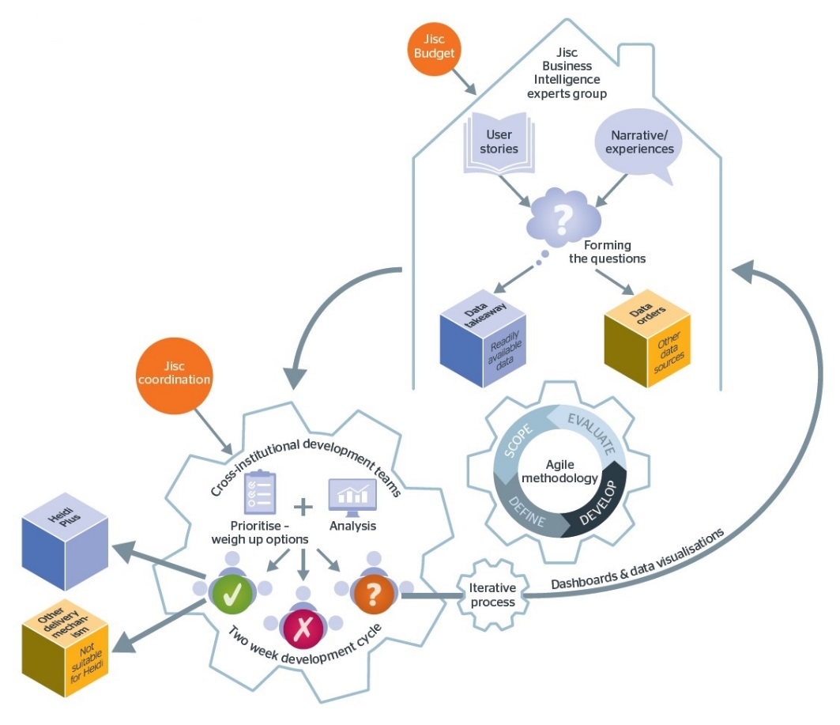
As an: | Outreach officer
When: | Planning widening participation recruitment
I want to: | Better understand potential student demographics
So I can: | Achieve my targets in the most efficient way
Notes:
Our BI Experts group (comprises 60 strategic planners from 70 Universities) provide the community design input. They work to identify the decision making needs of a wider range of staff roles than currently use BI.
Fits agile methodology – cost, time and quality are fixed but scope can vary
First attemot at national agile development data project
Activities include;
Define user stories comprising As an (staff role) When I am (context) I want to (BI derived insight) so I can (action taken). Eg. 'as an' outreach officer, 'when I am' planning my widening participation recruitment, 'I want to' better understand national student demographics, 'so that I can' achieve my targets in the most efficient way.
Map in the data sources where insights may lay
Devolve into agile R&D teams doing data prep, load and analysis (Winter cycle 43 planners from 27 univdersities forming 8 teams)
Regroup to provide new service candidates through acceptance testing
Successful outputs migrate to Heidi-Plus
Key learning – people tend to know about high end, locked up data sets requiring data sharing agreements / subscriptions

Slide 24


Data catalogue
Image: dankueck CC BY SA 2.0
Image: Anton Bielouso CC BY_SA 2.0
Notes:
We describe a 'library' of data for potential use in BI for education and research. While all data is available in the library, some is more difficult to access. We propose the distinctions of top shelf (requiring rungs of a ladder) and low shelf (easily picked)
Low shelf
This data is publicly available but has other barriers to access; vast, distributed, no common vocabulary, complex, not designed to be combined with other data. Examples include demographic, geo-spatial, international, census
The project seeks to ease access to these for BI purposes by cataloguing, preparing, linking, loading and making available for experimentation purposes
Top shelf
This is data is either available by subscription or is locked to third party organisations who may provide their own analyses at cost. Examples include funding and regulatory, local councils, Government bodies, fees and admissions, careers and trajectory, current study data, staff, research, financial, estates or even institutions themselves
The project seeks to unlock this for BI purposes by negotiating access on behalf of the wider sector, licensing, preparing, linking, loading and making available for experimentation purposes
The data catalogue is a living online resource in use by the analysis teams, developing

Slide 25
Business intelligence maturity

Slide 26
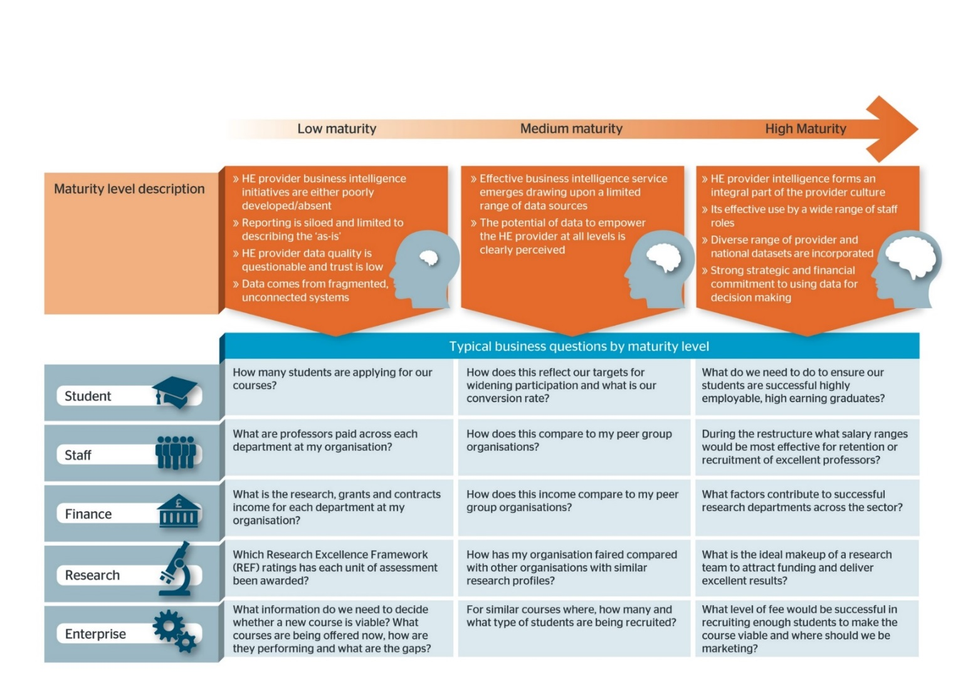
Notes:
Our national survey mirrors that run in the US via the Higher Education Data Warehouse Forum and Europe via EUNIS offering wider than UK benchmarking. 51 Universities shared their capacity with regard to a number of widely accepted facets of BI implementation. It gives an indication of national state of capability as well as identifying leaders and laggers for the service to match up and help. We will provide the full analysis in late October 2015.

Slide 27
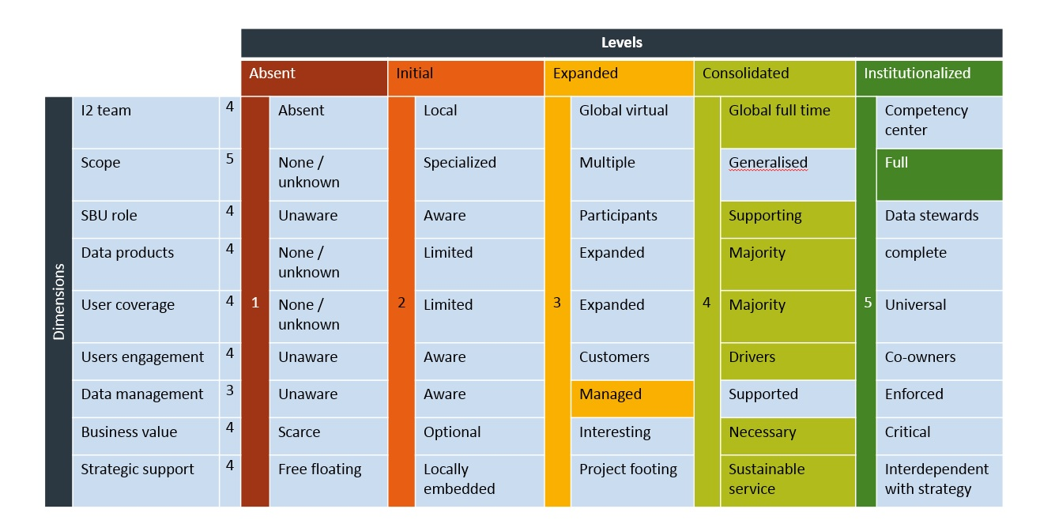
Notes:
Dimensions with 5 levels of maturity as Institutional Intelligence Team, Scope, Source Business Unit Role, range of data products in use (dashboards, scorecards, advanced analytics etc), User coverage as range of staff roles / groups (admin, teachers and researchers, students, alumni), User engagement (role of users in information supply chain - unaware, aware, drivers - active partners in the process), Data management (existence and effective application of data lifecycle management - data access, integration, retention, archive, Business Value (impact through effective use), Strategic support (formalisation of the institutional intelligence strategy)

Slide 28
Notes:
HEDW US anonymized results mashed up with Jisc UK anonymized results. We are discussing opportunities and are in touch with EUNIS RE their European survey.

Slide 29
Significant dates
Heidi Plus soft launch
  July 2015 (closed)
  September 2015
  (open with limited features)
  November 2015
  (production launch)
Heidi Lab
  Application drive summer 2015
  Agile development cycle
  1 Nov 2015 - Jan 2016
  Showcase event Feb 2016
  Application drive spring 2016
  Cycle 2 Feb - March 2016
  Cycle 3 May - July 2016
Notes:
Heidi Plus runs in parallel with old Heidi until November 2016
Heidi lab has recruited 43 people from 27 institutions. We'll run a showcase event of outputs in Feb 2016 around HESPA conference
Recruit again and run a further cycle in summer 2016
So three opportunities to migrate outputs to service using wider than HESA data
Options going forward will depend on success

Slide 30
Keep in touch
business-intelligence.ac.uk
Twitter @HESA @jisc #hesajiscbi

Slide 31
Learning analytics - a new pilot national shared service
Notes:
Pilot scheme going live in September for 10 HEIs
Another 10 on waiting list
Great interest

Slide 32
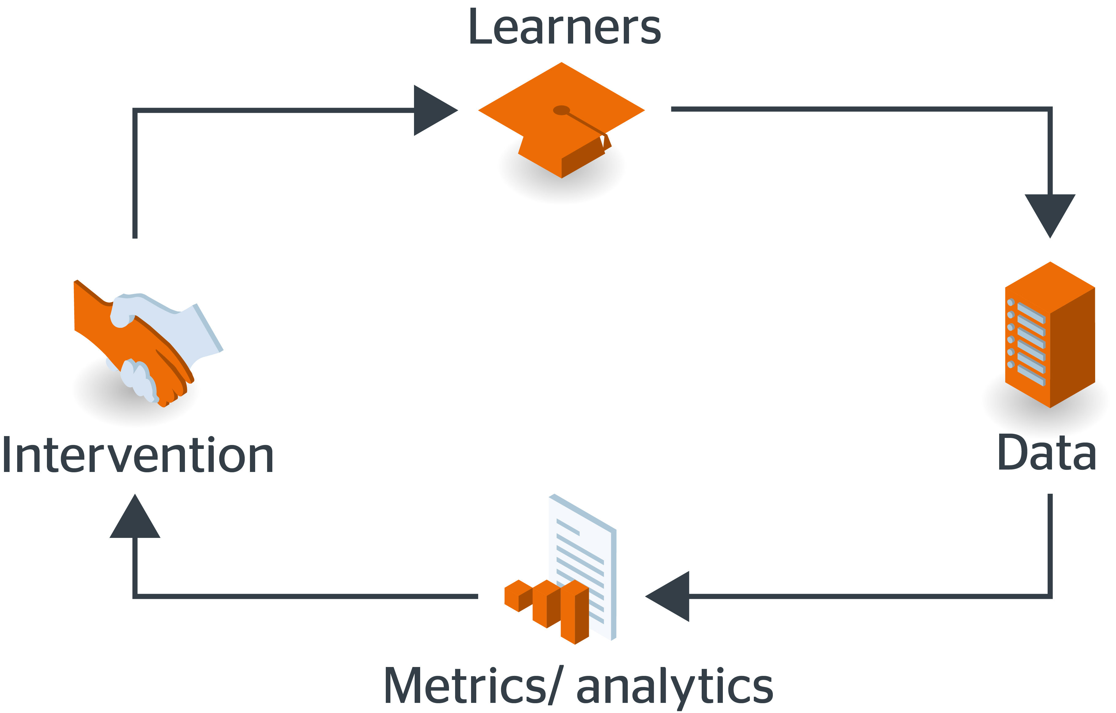
Learning Analytics
“The application of big data techniques such as machine-based learning and data mining to help learners and institutions meet their goals.”
  Improve retention
  Improve achievement
  Improve employability
  Personalised learning
Notes:
Widely accepted definition we’re using for this
These are in priority
Retention and achievement are a split between our post 92 (teaching focused) HEIs and our Russell Group (research focused)
Personalised learning is a hope rather than an expectation

Slide 33
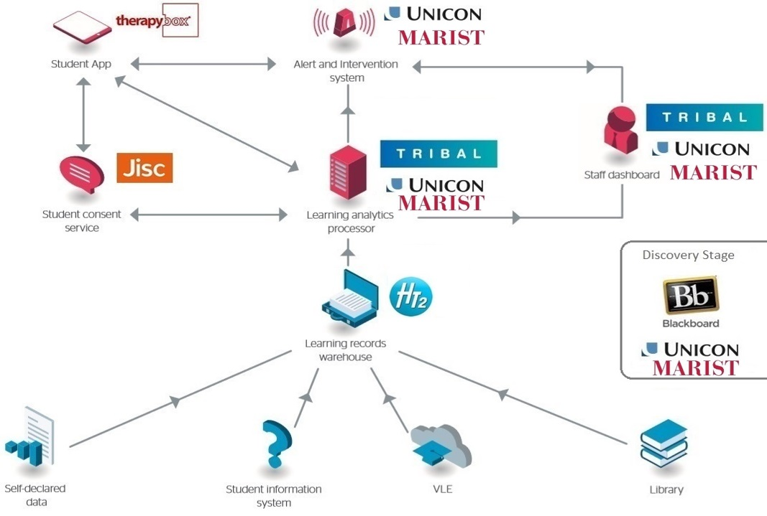


National learning analytics service architecture
Notes:
Describe how it works: ‘learning fingerprints’ from VLE, SRS, Lib, etc. aggregated into national warehouse in cloud. Combined with students’ own data. Delivered to students via app, staff via dashboard. Dashboard is what people want, but isn’t where we think the main benefits lie – they are to the left
It’s an open architecture so we expect others to plug in, maybe do things better – we’re stimulating the market not ruling it
It feeds findings / experiences back into the modelling
Everyone has these sources so widely applicable
Aiming to include systems with more than 10% of market share so on VLE Moodle is done
Will develop for more as demand from our customers
Suppliers noted here – these responded to our procurement framework. Jisc is underastking the student consent service itself.
Remember – it’s an open architecture so our aim is to embrace other supliers / vendors

Slide 34






Our project partners
Notes:
Have run commercial tender as and enlisted leading commercial suppliers, e.g. Blackboard, Tribal.

Slide 35
Jisc’s learning analytics project
  Three core strands:
Learning
analytics service
Toolkit
Community
Jisc learning analytics
Notes:
Three aspects – the service itself, a toolkit to assist in getting stared, a community of users and developers to drive it

Slide 36
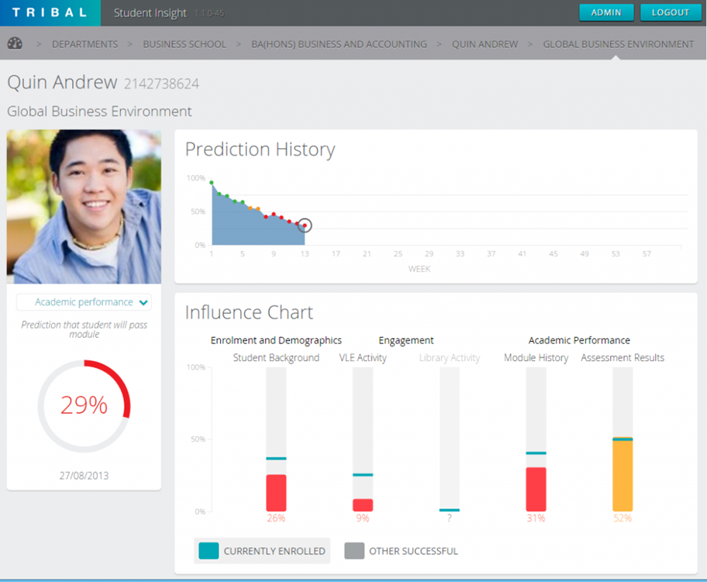
Staff dashboard
Notes:
Retention: allows tutors to track students at risk and intervene.
Teaching quality: Compare with various norms. Tailor and personalise teaching. Improve learning experience and outcomes.
Unicon (Jesus at stand #927 / Marist (Josh in the audience) and Tribal

Slide 37
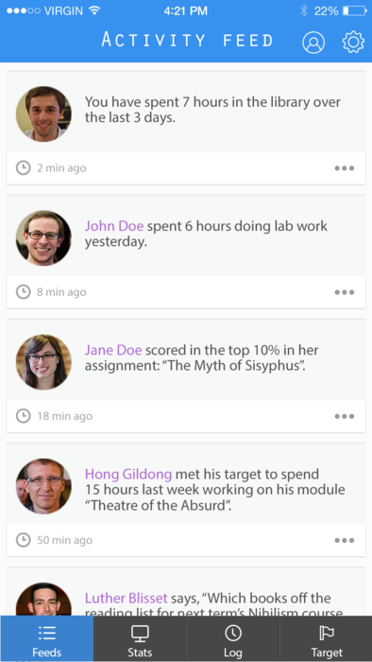
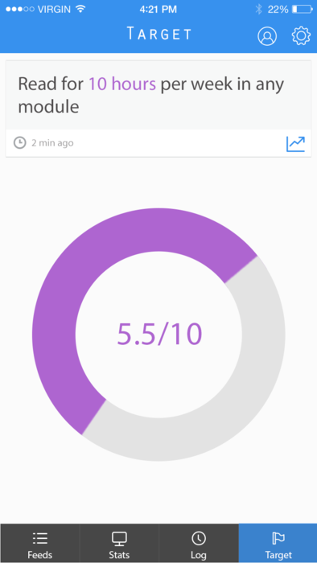
Student app
Notes:
Track progress, compare with cohort: gamification. Set and track personal targets.
Improved engagement and learning.
– think health tracker apps
Therapy Box development

Slide 38
Alert and intervention system
Tools to allow management of interactions with students once risk has been identified:
Case management
Intervention management
Data fed back into model
etc…
  Based on open source tools from Unicon/Marist (Student success plan)
Notes:
Unicon developed (Jesus at stand #927 / Marist (Josh in the audience)

Slide 39
Notes:
Bigger look at the alert and intervention system

Slide 40
Jisc learning analytics toolkit
Notes:
That was the service, ths is the toolkit

Slide 41
Discovery …
The learning analytics discovery service is a way of investigating your institution’s readiness for learning analytics. The process investigates strategic, technical, process and data readiness, providing recommendations for action before moving on to deploy a learning analytics solution.

Slide 42

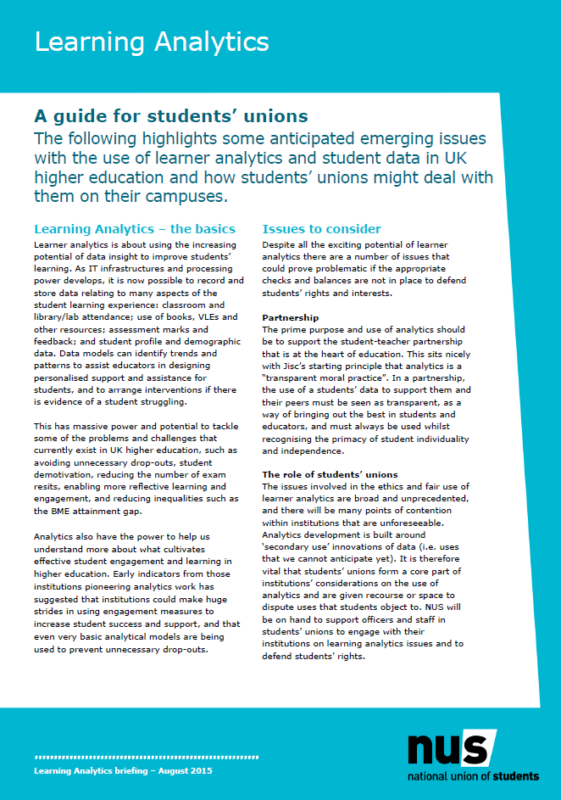
Ethical framework
Jisc.ac.uk/guides/code-of-practice-for-learning-analytics
nusconnect.org.uk/resources/learning-analytics-a-guide-for-students-unions
Notes:
Gap around ethics: huge amount of data, generated post-registration, and also demographic. Jisc filling the gap; picked up by our UK National Union of Students and with international interest
Note the links!

Slide 43
Code of practice
Privacy
Transparency and consent
Validity
Minimising adverse impacts
Access
Enabling positive interventions
Responsibility
Notes:
Issues map well to any data underpinned service

Slide 44
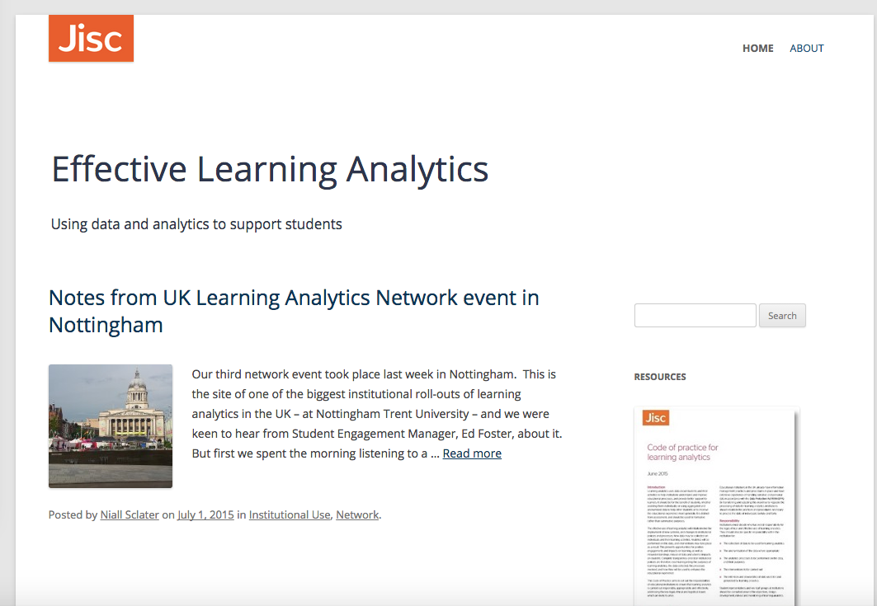
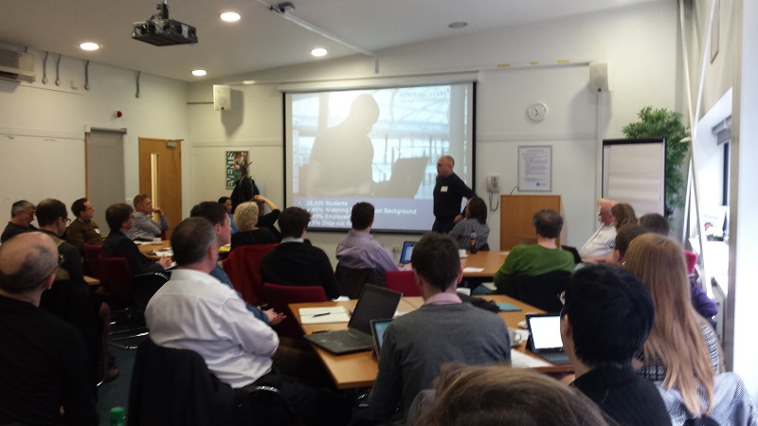

Project Blog, mailing list and network events
Blog: analytics.jiscinvolve.org
Mailing: analytics@jiscmail.com

Slide 45

deCODE – Iceland genomics research
Reference data
Family trees
Personal health records
Iceland’s genetic data bank
Outcomes
Understanding genetic nature of diseases
Predictors of future health
Personalised medicine
Analytics number crunching
Notes:
Picked up on the parallel of health vs learning
Health you see a Doctor who draws on insights from large scale data, applies to your own personal condition to provide a treatment
No such action in education.
Iceland called “world’s largest genomics experiment” – subject of high-impact Nature papers etc.
Compare detailed genome sequences with family trees and health records, gain real understanding of diseases such as Alzheimers, cancer, etc. and moves towards predictive, personalised medicine

Slide 46
LA warehouse: our DNA bank for higher E-Learning?
Reference data
Demographics
Entry qualifications
Learning and employment outcomes
UK learning data warehouse
Outcomes
Deep understanding of e-learning
Metrics for engagement, learning gain
Personalised next generation e-learning
Analytics number crunching
Notes:
A vision for a UK national service to provide personal learning based on analysis of wide scale data mapped to you

Slide 47
Big data impact on higher education
Can we create trusted big data collections?
Can we engender a trusted big data broker?
Can we ethically and legally develop and deliver big data derived shared services?
We think so, if we work collaboratively in taking small steps toward the vision
Notes:
So what for Higher Education and Big Data?
Micro level insights for outcomes based success (Learning analytics) (student, course, department, institution) is potentially easier as no issues with vocabulary and definitions and currency (and transparency / consent / ethical positive use. Can deal with behavioral insights which seem promising. Can identify differences from the norm and explore
Macro level (Business Intelligence) currency and data definitions more challenging, but useful for planning and benchmarking
Makes sense to do these on a larger scale than at individual institutional level
Personalized learning, skills and employability seem areas
Qualification success may not link to employability, but the data may help identify what the secondary drivers that are

Slide 48
Robert Haymon-Collins
Robert.Haymon-Collins@jisc.ac.uk
Myles Danson
Myles.Danson@jisc.ac.uk

Slide 49
Current engagement
Phase 1 (Sept – Jan)
University of Exeter
Edge Hill University
Glasgow Caledonian University
University of Strathclyde
University of Gloucestershire
Leeds City College
Phase 1 pipeline
City University London
Oxford Brookes University
Newman University
University of Essex
Plymouth University
Keele University
Swansea University
Falmouth University
University Campus Suffolk
Southampton Solent University
City of Wolverhampton College
Coventry University
The College of Estate Management
North West
Regional College
Southern Regional College
Tameside College

Slide 50
Current engagement
Phase 2 pipeline
Aberystwyth University
Bangor University
Belfast Metropolitan College
Brunel University London
Goldsmiths College
London Knowledge Lab
Open University
University of Bristol
University of Huddersfield
University of Wolverhampton
UWTSD
University of Kent

Slide 51
How’s the data collected?
Notes:
Go to ‘View’ menu > ‘Header and Footer…’ to edit the footers on this slide (click ‘Apply’ to change only the currently selected slide, or ‘Apply to All’ to change the footers on all slides).
To change the images on this slide:
Click once on an image to select it, and then delete it
Drag a replacement picture to the placeholder or click the icon in the centre of the placeholder to browse for & add another image
Once you have added your replacement image, you may need to put it into the background so that it doesn’t cover other items on the slide. Do this by right-clicking on the new image and choosing ‘Arrange’ > ‘Send to Back’ from the contextual menu

Slide 52





Data collection
ETL
TinCan
(xAPI)
About the student
Activity data
Notes:
Tin can supported now. Calliper not yet ready but can be, it’s an open architecture

Slide 53
About the student’ data
Personal (demographic) data
  Birthdate, gender etc.
Course data
  Mode of study, level etc.
Grade data
  Assignment, module etc.
(Aligned with HESA data)
Notes:
It’s based on who they are, what they’re doing and their grade data

Slide 54
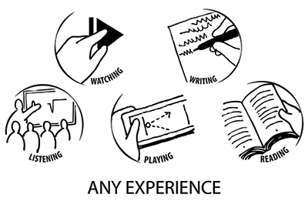
Activity data via Tin Can API
People learn from interactions with other people, content, and beyond
These actions can happen anywhere and signal an event where learning
could occur
When an activity needs to be recorded, the application sends secure statements in the form of “Actor, verb, object” or “I did this” to the Learning Record Store (LRS.)
From: tincanapi.com/

Slide 55
Activity data (trivial!) examples
Actor | Action | Object | Result
Michael | Accessed | VLE
Kim | Added | Module comment
Sally | Completed | Basic maths test | 85.0
registry.tincanapi.com

