Slide 1
Fully Integrated Activity-Based Costing
Kelly Block• Karen Greenwalt• Michael Hites

Slide 2
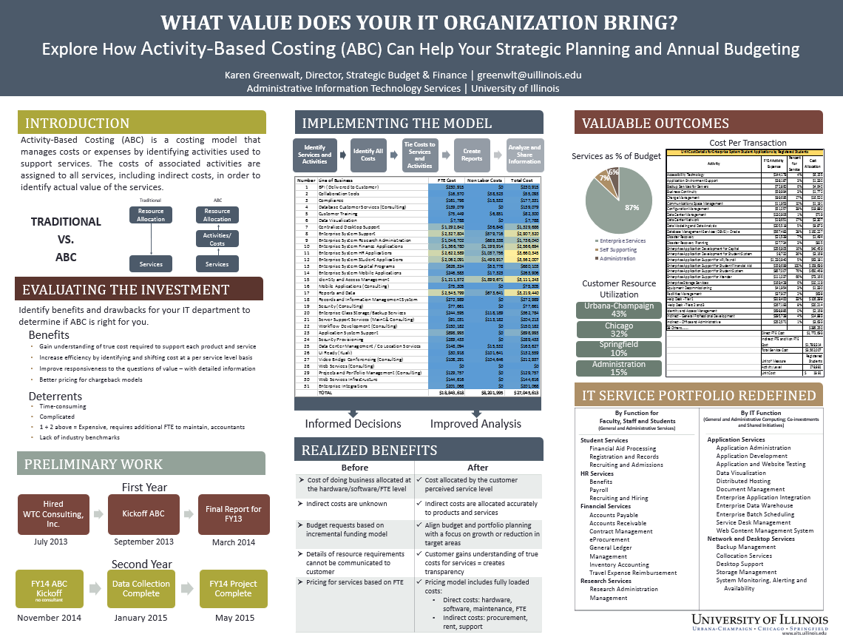

Slide 3
Questions:
Karen Greenwalt
Director Strategic Budget and Finance
University of Illinois Central Administration
greenwlt@uillinois.edu

