Slide 1
Engaging Students in Community-Based, Collaborative Research Using Geotagging and Free Cloud-Based Tools
EDUCAUSE Learning Initiative (ELI)
February 4-6, 2012
Jean Kelso Sandlin
Julius Bianchi
Joan Wines

Slide 2
Cal Lutheran at a Glance
Founded 1959
37 UG majors
Master’s degrees in education, business, computer science, psychology, information systems and technology, and economics
Enrollment Total: 4,203

Slide 3
CLU’s Academic iPad Initiative
December 2010: Provost call for proposals funded by Cabinet Strategic Objectives Budget
Spring 2011: 3 classes
Summer 2011: 3 classes
Fall 2011: 7 classes
Spring 2012: 9 classes + spring musical cast
Fall 2012: 11 classes
Spring 2013: 9 classes

Slide 4
iPad Project Requirements
Congratulations! Your iPad pilot project has been funded for the Spring 2011 semester. Agreeing to conduct the pilot includes:
Integrating the iPad into your specified course
Participating in a group meeting with the other iPad project faculty
Conducting an assessment that includes the impact using the iPads had on student learning.
Presenting your project at a faculty or departmental meeting, a retreat, a CTL Lunch, or a conference.

Slide 5
Acquisition & Distribution
ISS ordered and processed iPads through the Library.
Distributed iPads during a class session
iPads tracked with the library system.
Students required to complete a form acknowledging receipt of the iPad.
iPads came with a case and AppleCare maintenance.
ISS provides assistance with iPad functions and any needed repairs.

Slide 6
How to engage "the former audience” in research readiness through geotagging/mapping
Multi-disciplinary opportunities
fostering collaboration, independence, engagement and creativity.
Notes:
Ask who is here? Educators? Supporters of Educator? Technology companies?
Are there any examples when placing visuals or text in a geographic context for analysis can be beneficial?
Some Examples:
Rock formations in geology; the stories of immigrants in your city, sociology; water analysis results in biology? Literacy rates in education?
Justice Mapping Center: mapped those who are incarcerted in a city and found “million dollar blocks”
Most disciplines have
I teach advertising – and with 500-3000 images per day, no wonder students think they know it all. If you are going to become a communication scholar, it will serve you well to be able to provide analysis and criticism; including the ethical considerations surrounding advertising

Slide 7
How to engage "the former audience” in research readiness through geotagging/mapping
“They are showing all of us … new ways of talking, of learning.”
- Dan Gillmor, who coined the term “the former audience” and authored of We the Media: Grassroots Journalism by the People, for the People
“These tools don’t get socially interesting until they get technologically boring.”
- Clay Shirky, author of Here Comes Everybody and Cognitive Surplus
“Students are adopting technologies and then adapting them to support their own self-directed learning.”
– Project Tomorrow, Speak Up 2012 Report
Notes:
I teach advertising – and with 500-3000 images per day, no wonder students think they know it all. If you are going to become a communication scholar, it will serve you well to be able to provide analysis and criticism; including the ethical considerations surrounding advertising. Julie Evans of Project tomorrow told us last year in Portland in Educause that students of tomorrow don’t want to be bound by classroom; the community is their classroom community – tap into world
digitally-rich learning – relevancy and context

Slide 8
Idea
Exploring apps for travel courses.
Journaling, tagging & mapping photos.
Notes:
The power of the visuals and reflection,
But wouldn’t it be more powerful to share other’s perspectives? And what if you could overlay demographics? The you could add a more critical dimension to the visual. The

Slide 9
An opportunity to …
Introduce research readiness through an experiential lens.
Foster collaboration, independence and creativity
Increase critical exploration of advertising (move students from desensitization to re-sensitization).
Encourage interaction with unfamiliar technology (especially geo-tagging) for skill-building & professional experience.
Provide equal opportunities for students who don’t have access to unlimited data plans, photo capabilities or GPS tagging on smart phones.
Notes:
I also had some other agenda items:
Hands-on experience with more complex technology
desensitized to advertising, some will work in the industry and should be made aware of a way to critical analyze issues. Many of my students won’t slect jobs in the advertising industry, but as consumers, I want them to be able to have those skills to critical consider advertising - last year my ad campaigns students worked with a start up in Seattle and they dubbed their pilot campaign the “insane campaign” – and the client selected it. I was the only one to bring up the concern of how it portrayed mental illness. We have a creative critique for which we ; I want to introduce an ethical lens without preaching. Advertising is a discipline constantly fighting regulations and imposing many self-regulations – I wanted them to see beyond regulations.
Most undergraduate research is reserved for senior-level classes; with special opportunities for honors or in summer by application. I was a first-gen who was told to get a job, I wanted to expose students who may not have opportunity. May never consider it. (one student now interested and wants to work on a project with me looking at representations of miniorites in media post Obama election).

Slide 10
Designing the Project
Project Design Considerations:
Limited research experience
Scaffolding=previously published research on outdoor advertising (billboards)
Foster student collaboration/creativity
Provide choice
Limited resources (no GIS – geo info sys)
Free census data
Within local community
Challenges: Local regulations
Notes:
A Cross-Sectional Prevalence Study of Ethnically Targeted and GeneralAudience Outdoor Obesity-Related Advertising
Collaborative Research and Action to Control the Geographic Placement of Outdor Advertsing of Alchool and Tabacco Products in Chicago
Association Between Residential Exposure to Outdoor Alcohol Advertising and Problem Drinking Among African American Women in NewYork City
Does outdoor alcohol advertising around elementary schools vary by the ethnicity of students in the school?

Slide 11
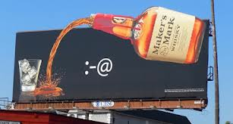
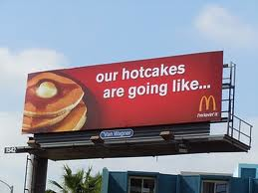

Slide 12
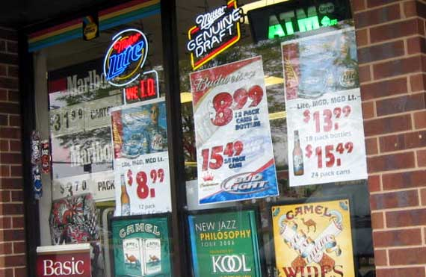
Designing the Project
Using geotagging and free cloud-based tools to map and analyze convenience storefront signage in relation to demographics.
Notes:
A Cross-Sectional Prevalence Study of Ethnically Targeted and General
Audience Outdoor Obesity-Related Advertising
Collaborative Research and Action to Control the Geographic Placement of Outdor Advertsing of Alchool and Tabacco Products in Chicago
Association Between
Residential Exposure to
Outdoor Alcohol
Advertising and Problem Drinking Among African American Women in NewYork City
Does outdoor alcohol advertising around elementary schools
vary by the ethnicity of students in the school?

Slide 13
Goals shared with students…
This project will give you an opportunity to:
Explore advertising research and the ways it impacts our every day lives
Critically consider an advertising issue with social implications
Plan a project from data collection to the results
Practice and hone collaborative communication skills
Utilize and experiment with new technology
Develop a portfolio-worthy experience

Slide 14
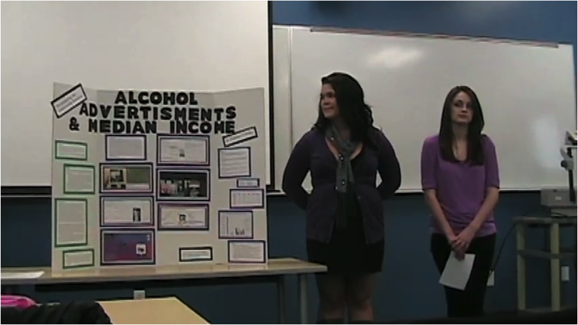
Project Steps
Preparations
Field Test & Data Collection
Fusion Table & KLM Creation
Census Data Overlay
Analyze Data & Create Poster
Present

Slide 15
Project Steps: Preparations
Sign up for a free gmail account
Sign up for a free Panoramio Account (Google)
Sign up for a free Latitudes Account (Google)
On a computer, go to your Panoramio Account to “settings” and enable “Mapping Latitude Location History”
From your Panoramio account, search for the group “com380f11” and send an application to be accepted into the group.
Make sure you are signed into Latitudes on your ipad2 prior to taking a photo through Panoramio (This allows Panoramio to ID it via location). You may also take photos using a smart phone and upload the photos to your Panoramio account IF you have geo-location tagging enabled.
Upload Your photos and descriptions to our Panoramio group account

Slide 17
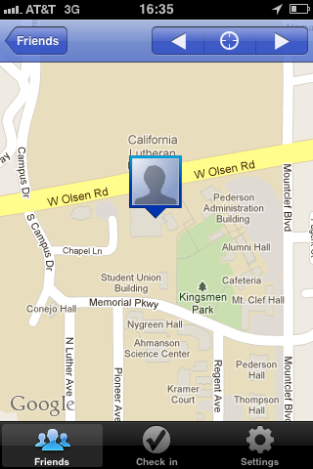
Latitudes

Slide 20
Part One: Field Test & Data Collection
Prepare to Test Run Software/Equipment Check
Bring your iPad 2 into the field
Open Latitudes
Sign into Your Panoramio Account
Take a photo using your Panoramio Account Name and Upload it
Check to see if Panoramio gave it a location
Open Your Panoramio Account on a computer
Using Panoramio, establish a tag “COM380F11” and tag your photo
Notes:
Field test was important to identity possible pitfalls, like make sure you are logged into latitudes before you begin and make sure same account is used for latidtes and uploadeing phots into Panoramio.

Slide 21
Location Code

Slide 22
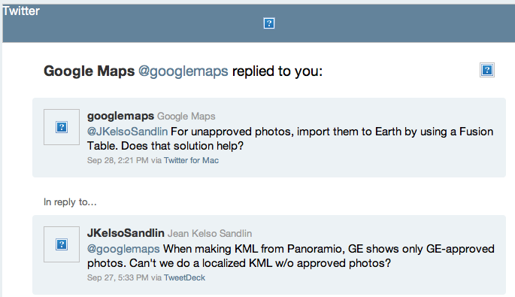
Part One Pitfalls
Panoramio app is limited in scope. Can only upload photo; cannot label or tag.
Panoramio won’t display photos on Google Earth if they don’t meet criteria requiring to find an end-round (Fusion Tables).
Modified instructions included:
Open Your Panoramio Account on a computer
Using Panoramio, establish a tag “COM380F11” and tag your photo
See Part Two for Fusion Table adjustment
Notes:
Field test was important to identity possible pitfalls, like make sure you are logged into latitudes before you begin and make sure same account is used for latidtes and uploadeing phots into Panoramio.

Slide 24
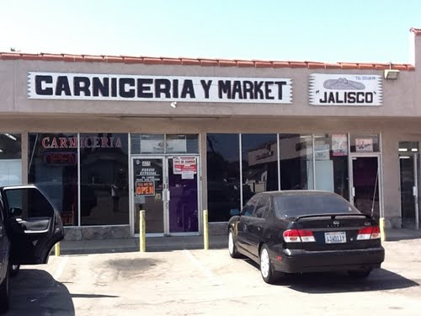
A Field Test Bonus!
Notes:
Also – field testing was helpful because we had a definition of what a convenience store was…and it specified no meat…however, during the field test, students discovered that the convenience stores in predominately Mexican American neighborhoods all had a small meat counter, but reflected a conveience store in every other way.
We began discussing this if we kept to our original definition we had come up with in the classroom, we would have “ignored” entrie neighborhoods, most of which were populated by high Hispanic populations, so we had a discussion about cultural bias, and they made a change in the definition…This is why experiential learning tops classroom instruction!!

Slide 25
Part Two: Fusion table & KML file creation
From the email you received, work as a group to modify the fusion table to reflect your group’s data collection.
From your group’s fusion table, create a KML map and submit on the discussion board under “Ethics Project.” Please submit only one KML table per group.
Directions for a KML Map: To make a KML file, begin in Fusion Tables. Once your table is complete, select "Visualize" and then select "Map." Once the map appears, select "export to KML." It will automatically place the KML file on your "Google Earth" application. However, to post your map for other groups to see, find the KML file (look under your downloads) and then post it to the discussion board as an attachment. Remember, only one post per group.
Notes:
Field test

Slide 32
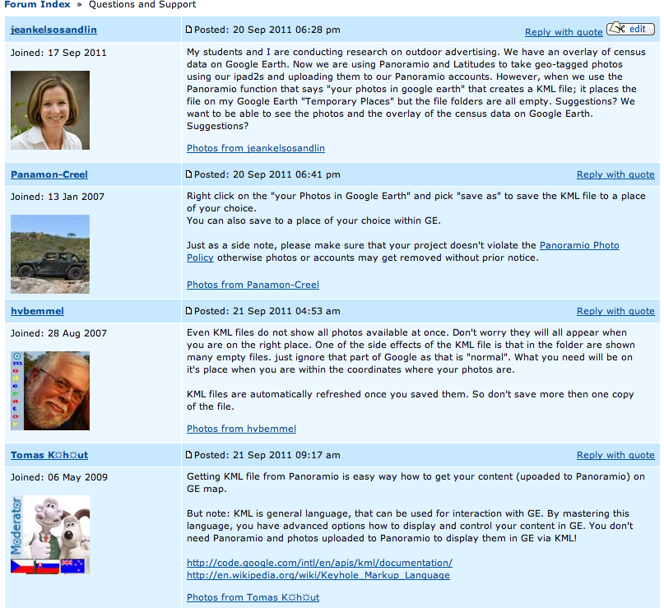
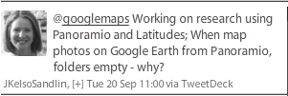
Part Two Pitfalls
KML tables were exporting blank folders.
Browser sensitivity. (Chrome)

Slide 33
Part Three: Census Data Overlay
You can use the maps I’ve already created to view the census data on Ventura County’s Medium Income and Ethnicity. These maps (KML files) are located under our “Ethics Project” Blackboard under “Census Maps”
If you want to look at information besides income and ethnicity, you may by following the directions below:
Update at US Census Site:
According to the site, they are “evaluating how to best implement a tool that allows you to access KMLs. We expect to have an update as to how we plan to implement the production and release of KMLs in early 2013.”
Download the map into your Google Earth Account
Notes:
Field test

Slide 37
Part Three Pitfalls
Free census data is outdated.
Overlay of KMLs does not work on ipad2s.
Update at US Census Site:
According to the site, they are “evaluating how to best implement a tool that allows you to access KMLs. We expect to have an update as to how we plan to implement the production and release of KMLs in early 2013.”
Notes:
Field test

Slide 38
Part Four & Five: Analyze Data; Create Poster
Analyze Your Data
Analyze your data in accordance with your question. Use tables, spreadsheets or other helpful ways to tell the story of your results. Make sure you and your group members decide on how you will consistently code, measure or otherwise analyze your data.
Poster
Create a well-designed research poster that tells the story of your research. It must include an introduction or abstract, methods, results, literature, conclusion. It should also include a title and the names of those students in the research group. One poster per research group.
There is a template on our Ethics Project Blackboard site and an example of a completed project.
Here are other resources:
Flicker site of poster sessions: http://www.flickr.com/groups/postersessions/pool/page2/
Creating Effective Poster Presentations
http://www.ncsu.edu/project/posters/NewSite/index.html
Notes:
Field test

Slide 39
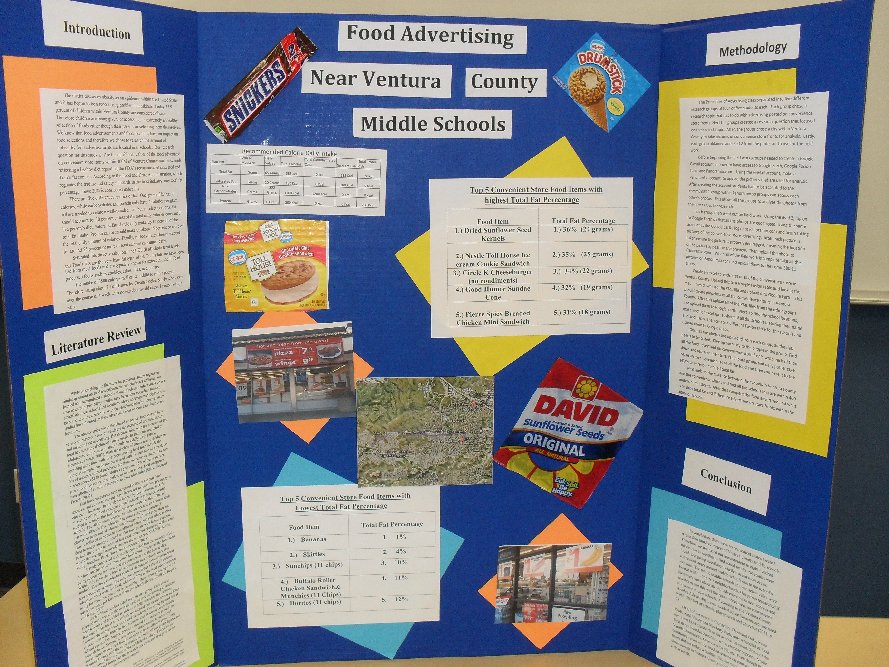

Slide 40
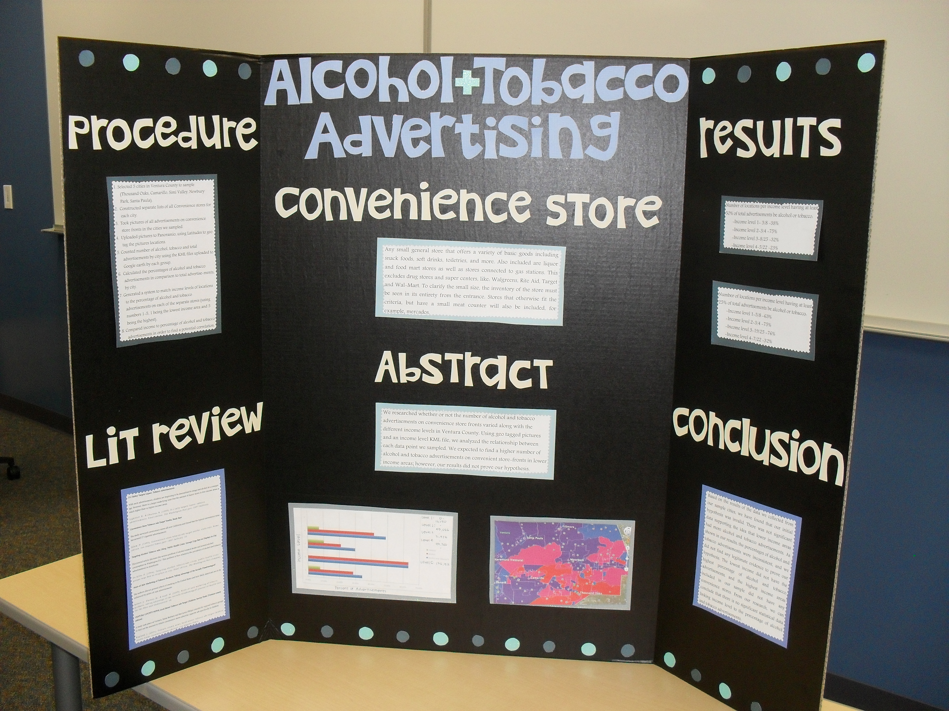

Slide 41
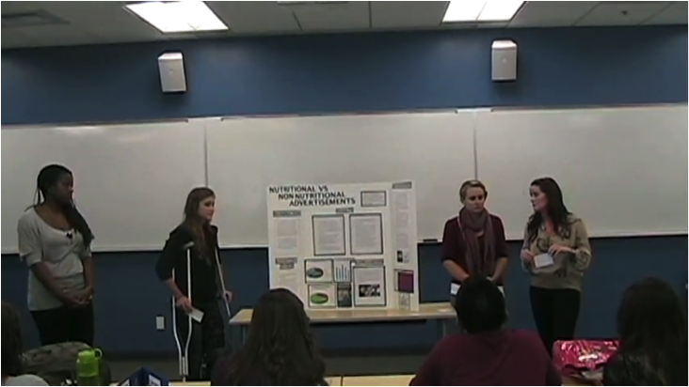
Part Six & Seven: Present
Part Six: One-on-one interviews
Each member of the research team should be able to explain every part of the research, including the technology behind mapping and geotagging.
Part 7: Group Presentation
A ten-minute explanation of your results using your poster as your guide. No Powerpoint or other visuals.
Notes:
Field test

Slide 42
Overcoming Lack of Technical Support
Institutional
Discussion boards
Twitter support
Don’t assume apps are same for computer and ipad.

Slide 43
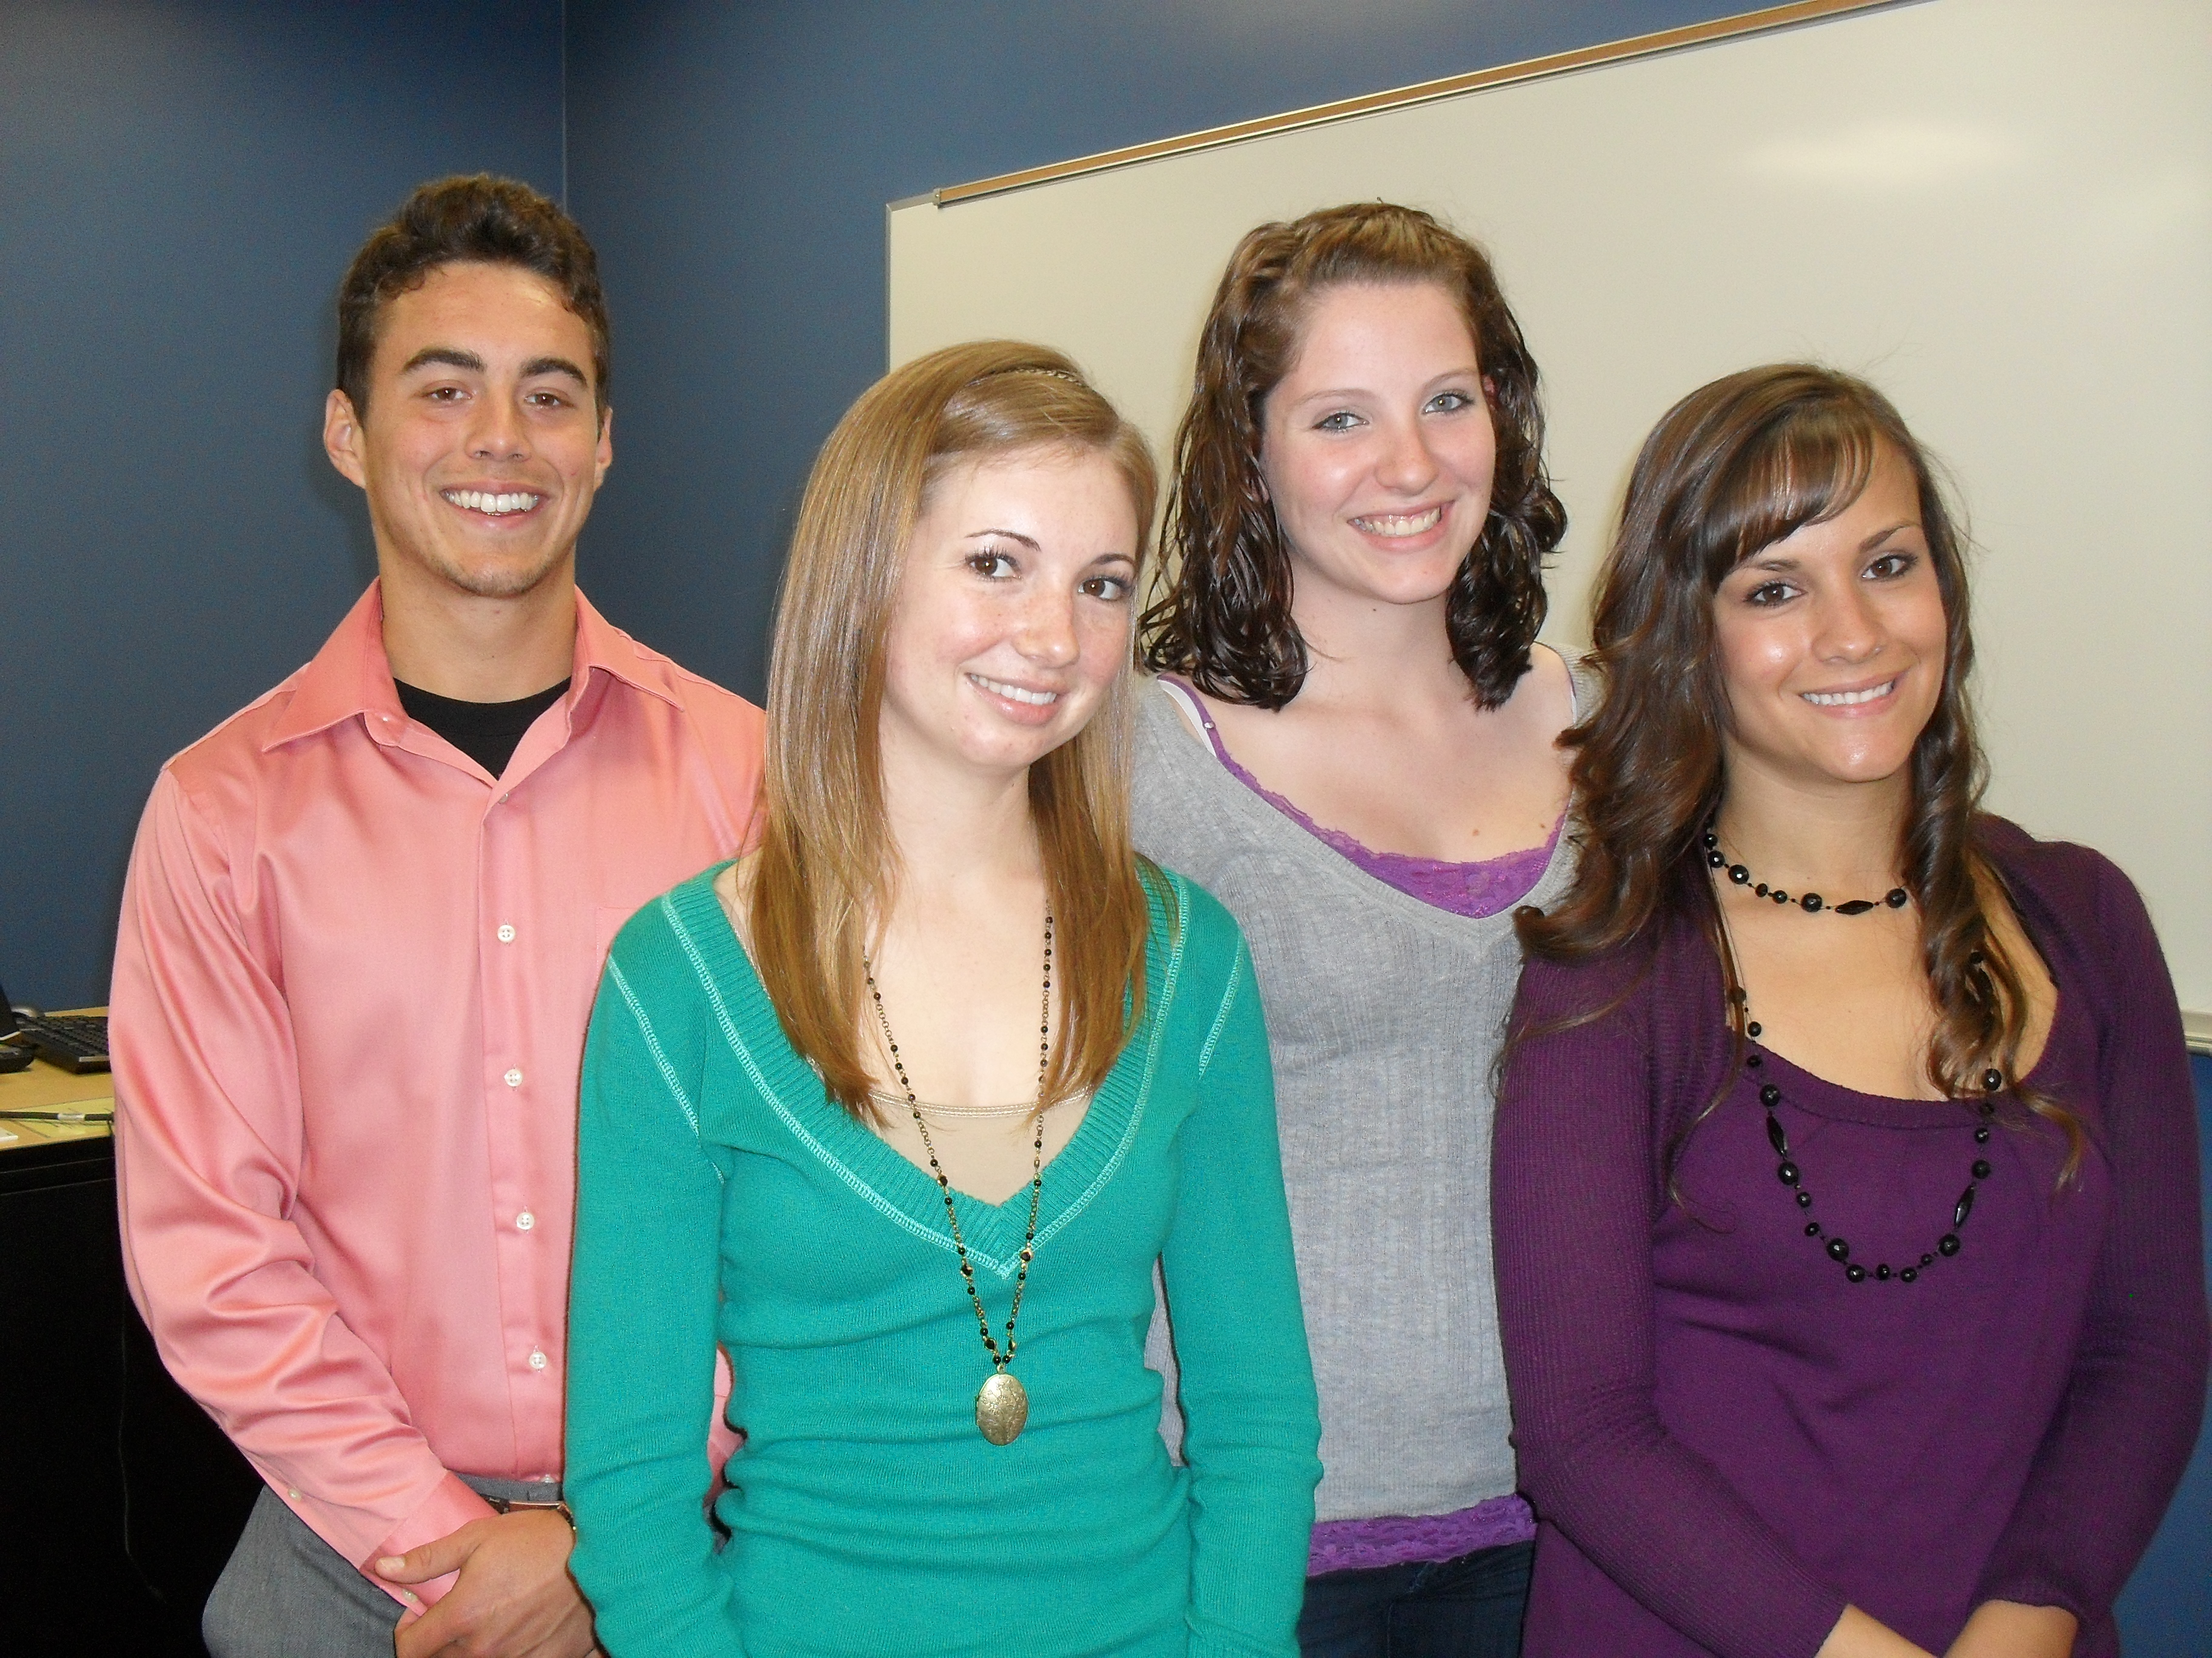
Positive Outcomes
High degree of student engagement/critical thinking
Evidence of applied knowledge: Demonstrated use of geotagging in advertising campaign project.
Students experienced importance of definitions, researcher bias, analyzing results.

Slide 44
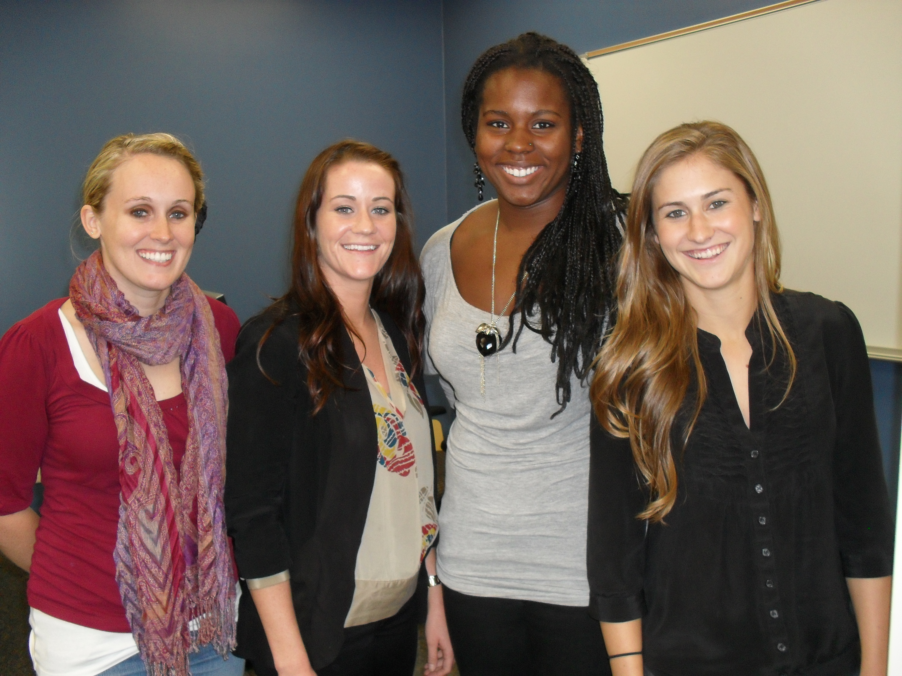
Student Feedback
I experienced a high degree of intellectual and/or creative challenge: 4.7 (of 5/mean 4.3 in dept)
I loved the adventure in this class. The information was interesting, but the two core projects of this class allowed us to explore and be creative.
It was a lot to digest and learn about in the short amount of time.
The work load was unreasonable.
Needed clearer explanation and guidelines from the beginning.
I appreciated that we learned about up-and-coming technology. It was definitely worth the technological issues and I’m grateful to have this under my belt before applying to jobs.

Slide 45
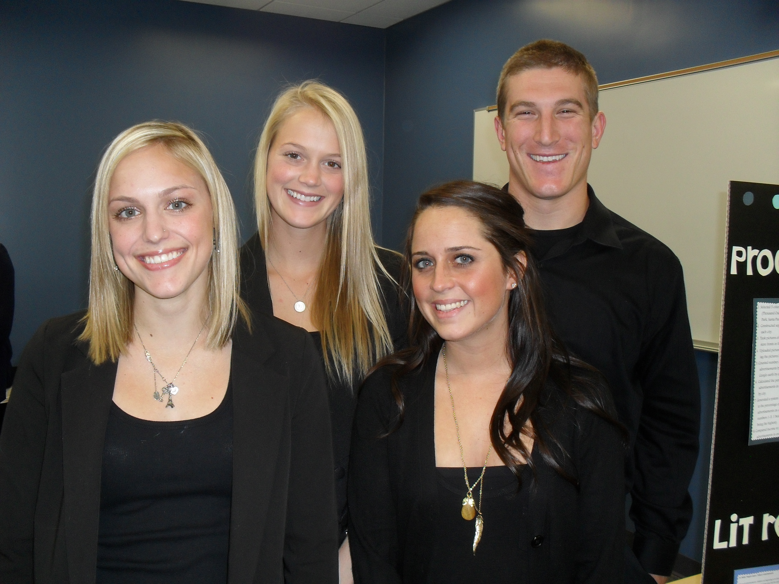
Other considerations
Allow more time to fully explore results and trouble-shoot technical glitches.
Using Beta technology is risky, especially with free products that don’t offer support.
Mapping is being used in many disciplines and integrates community well. An example is NPR’s story “Million Dollar Blocks” aJustice Mapping Center project.

Slide 46
Contact Information
Jean Kelso Sandlin: jsandlin@callutheran.edu
Julius Bianchi: bianchi@callutheran.edu
Joan Wines: wines@callutheran.edu

