Slide 1
Greg Smith, Cathy Allison, Angie Hammons
Teaching and technology Decisions to Support a Campus in an Ever Changing Environment

Slide 2
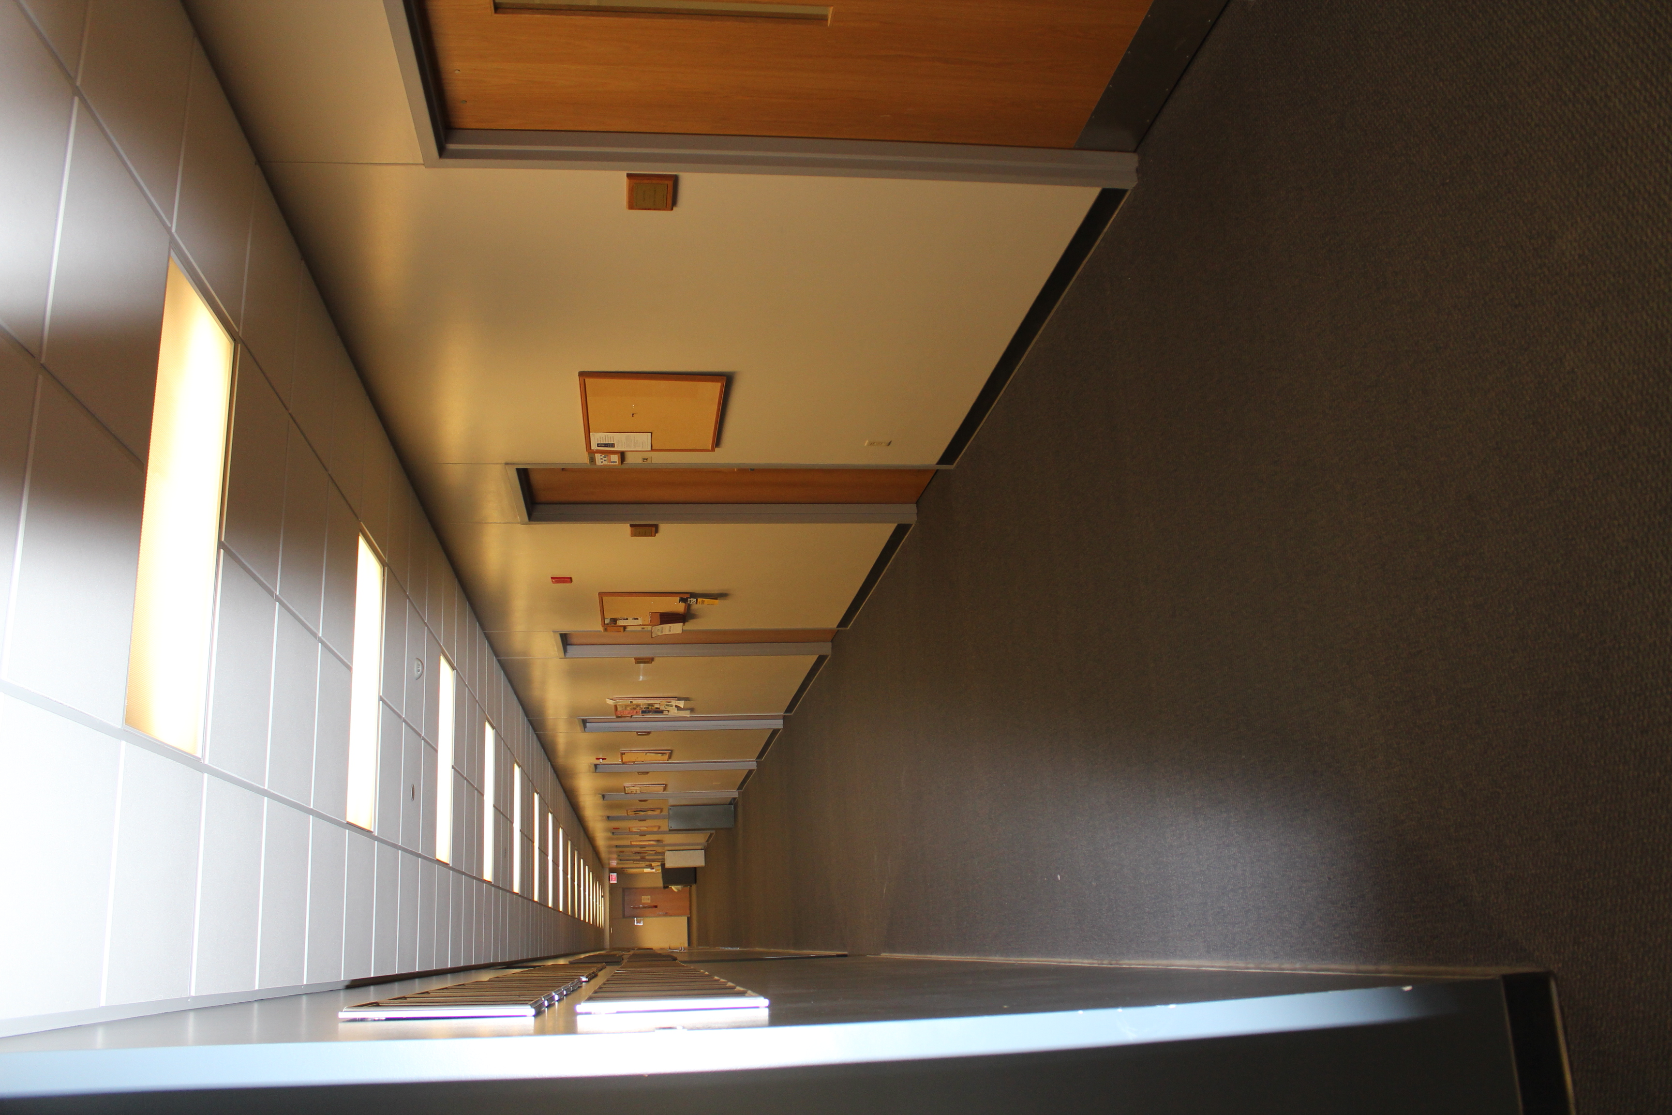
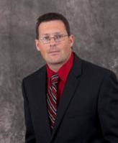
Establish an Exploratory Project
Notes:
Look, Listen, Find Champions
Strategic Plan – strategicplan.mst.edu
The Missouri University of Science and Technology is advancing the student learning experience by offering a new 3D printing service to all students, making 3D printing easily and affordably available to 7500 Engineering and Science students via their Library. Our strategic plan involves an effort to develop and inspire our creative thinkers and leaders for life-long success. Our 3D printing service opens opportunities for students to participate and create their own designs and practice with cheaper and more rapid prototyping. 3D printing is the process of creating an object using a 3D printer that puts down material layer by layer in three dimensions until your desired object is formed. A 3D printer extrudes melted plastic filament or other material, building objects based on specifications that come from 3D modeling software.

Slide 3
Dawes Group at Missouri S&T
Spectroscopy and dynamics on multiple potential energy surfaces
Potential energy surfaces for two electronic states of formyl radical (an important combustion intermediate).
Ro-vibrational states of (NH₃)₂ are explored computationally
Triplet Π-states of BeC
Spin-Forbidden Chemistry
(at left) The spin-forbidden chemistry of the O(³P) + CO → CO₂ reaction is studied using three automatically generated PESs. Two frustrated triplet states which correlate with ground state O(³P) have shallow wells hanging above the deep singlet CO₂ well. The spin-forbidden reaction occurs via spin-orbit coupling between the surfaces.
(at right) The possibility of spin-forbidden dynamics is explored for N-atom collisions
Funded by CHE-1300945

Slide 4
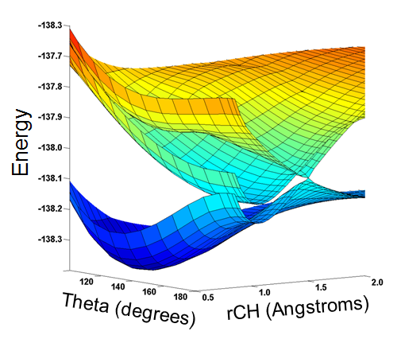
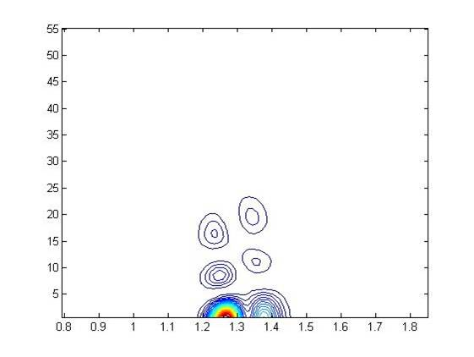
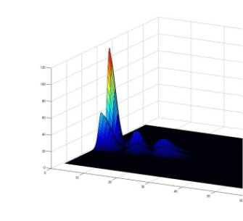
(above) Potential energy surfaces for the S₀, S₂, and S₃ electronic states of the CHF molecule.
(below) Contour and surface plots of the probability distribution associated with a particular vibrational state on the S₂ (middle) surface.
(0,4⁰,1)
Potential energy surfaces for the singlet S₀ and S₁ states (solid) and triplet T₁ (transparent) state of the CHCl molecule. The S₀ and S₁ states become (Renner-Teller) degenerate at linear geometries. The singlet and triplet states are spin-orbit coupled, perturbing and mixing the ro-vibrational states.

Slide 5
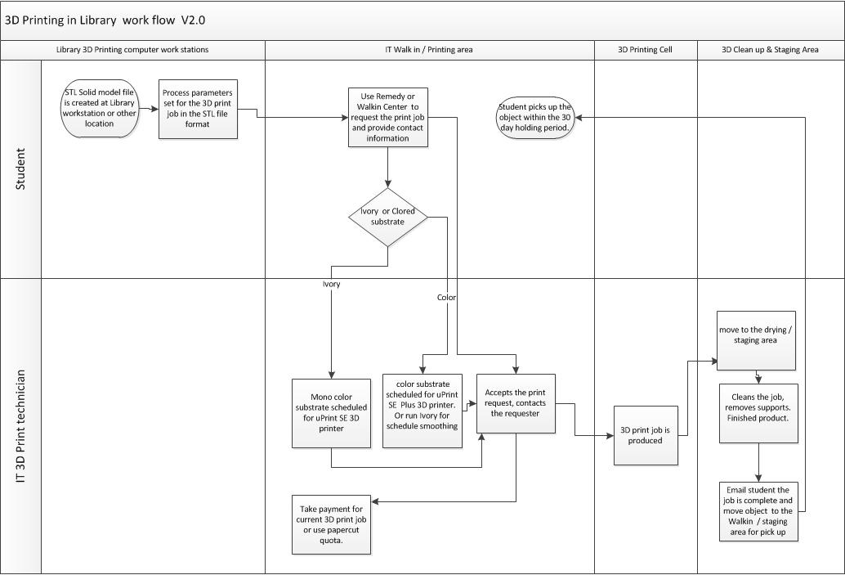
Changing Business Processes
Notes:
Charging
Customer Relations
Walk-In
Our 3D printing service advances the hands-on experimental learning experience that connects with a campus research hot topic called Additive Manufacturing, a similar, progressive and transformational manufacturing technique that can reduce manufacturing tooling costs and improve product develop cycle times while improving material quality. We are providing all the tools for the students to participate. Our Stratasys uPrint and uPrint Plus 3D Printers are hardened, industrial strength systems . Our new high-performance CAD 3D graphic work stations offer the latest CAD 3D graphic modeling software such as AutoCAD, SolidWorks, Pro-E, Adobe and many others. We utilize our existing PaperCut Print Management System so students have an option to use their printing allocation for printing of paper or 3D objects.
We have noticed an increase in student motivation by offering the 3D printing service to our 7500 Engineering and Science students. By locating the service next to the Starbuck coffee shop in the library it has made it convenient, fun and relaxing for the students to participate and our new student service is in high demand. 3D printing has excited students to learn the software in such a way that they can create the prototypes that they need. This has changed how students present in some of the classes. Motivation has increased as students want to know the software and calculation processes in order to create the perfect “print” the first time. The recreational use of 3D printing is a valuable aspect and is a recent topic brought up by potential students at recruitment time. We are showcasing the 3D Printing technology in the updated, high-traffic library space to foster awareness of the technology and our service. We have recently invested in updated, high-tech furniture for that area that will be a part of a larger Library Learning Commons initiative that includes providing state-of-the-art collaborative technology such as practice presentation rooms, experimental technology labs and 3D printing capability for teaching, learning and research

Slide 6
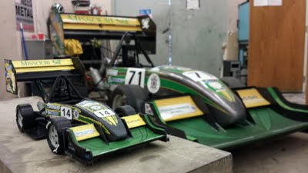
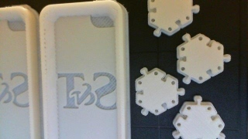

Slide 7
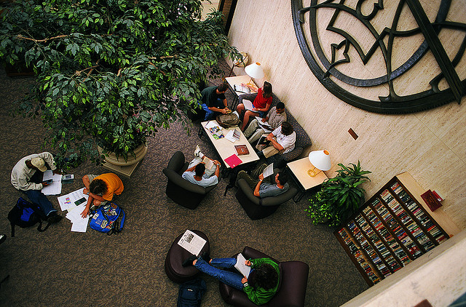

Slide 8
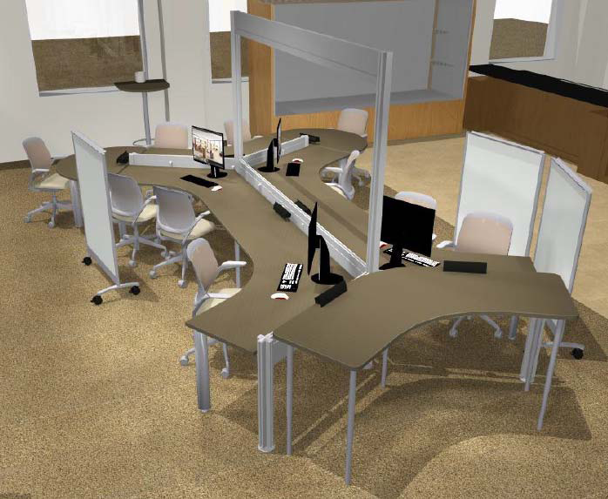
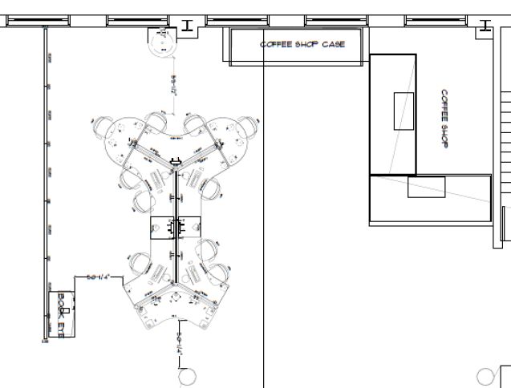

Slide 9
Continuing the Discussion
http://tinyurl.com/kygmnec
http://it.mst.edu/services/3d-print/
Notes:
http://tinyurl.com/kygmnec – This is to a Google Doc that has a place for questions and answers
http://it.mst.edu/services/3d-print/ - This is the website for 3D Printing at Missouri S&T

