Slide 1
Adaptive and Integrative Learning
Mike Connor, Raechelle Clemmons & Cara Biasucci, M.F.A.

Slide 2
Adaptive Learning in a Residential Liberal Arts Context
Mike Conner Digital Liberal Arts Specialist, Grinnell College

Slide 3
Adaptive Learning
Condition
Action

Slide 4
Flexible and Customizable

Slide 5
f2f Emphasis
f2f

Slide 6
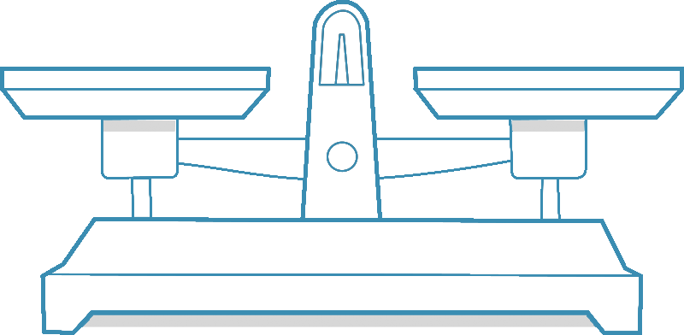
Balance of effort and payoff

Slide 7
Roadblocks

Slide 8
Are there sweet spots?

Slide 9
A Work in Progress: Online Competencies Curriculum (OCC) Project
Raechelle Clemmons Vice President & CIO, St. Norbert College

Slide 10
OCC Project Overview
4 institutions, 3 years (2014-17)
Teagle Foundation-funded project
Exploring multi-institution collaboration & blended/hybrid learning in the liberal arts

Slide 11
What Is OCC, Exactly?
11 online “modules” in 3 “emerging & evolving” competencies, for use across the curriculum (w/ co-curricular potential too)
Communication & Presentation
Overcoming Nerves
Writing and Preparing a Presentation
Delivering a Presentation
Communicating Professionally
Technological Adaptability
Collecting and Analyzing Quantitative and Qualitative Data Using Technology
Visual and Auditory Literacy
Information Fluency
Hacks, FAQs, and Information on the Web
Intellectual Property and Intellectual Honesty
Evaluating Scholarly Humanities Articles
Evaluating and Reading Monographs
Maps and Spacial Data

Slide 12
Faculty-Led Design Process
4 faculty on each competency team (1 from each institution)
Teams determined specific module quantity & topics; authored all content
Instructional design partner, Words & Numbers, helped teams shape content, integrated it into Smart Sparrow platform

Slide 13
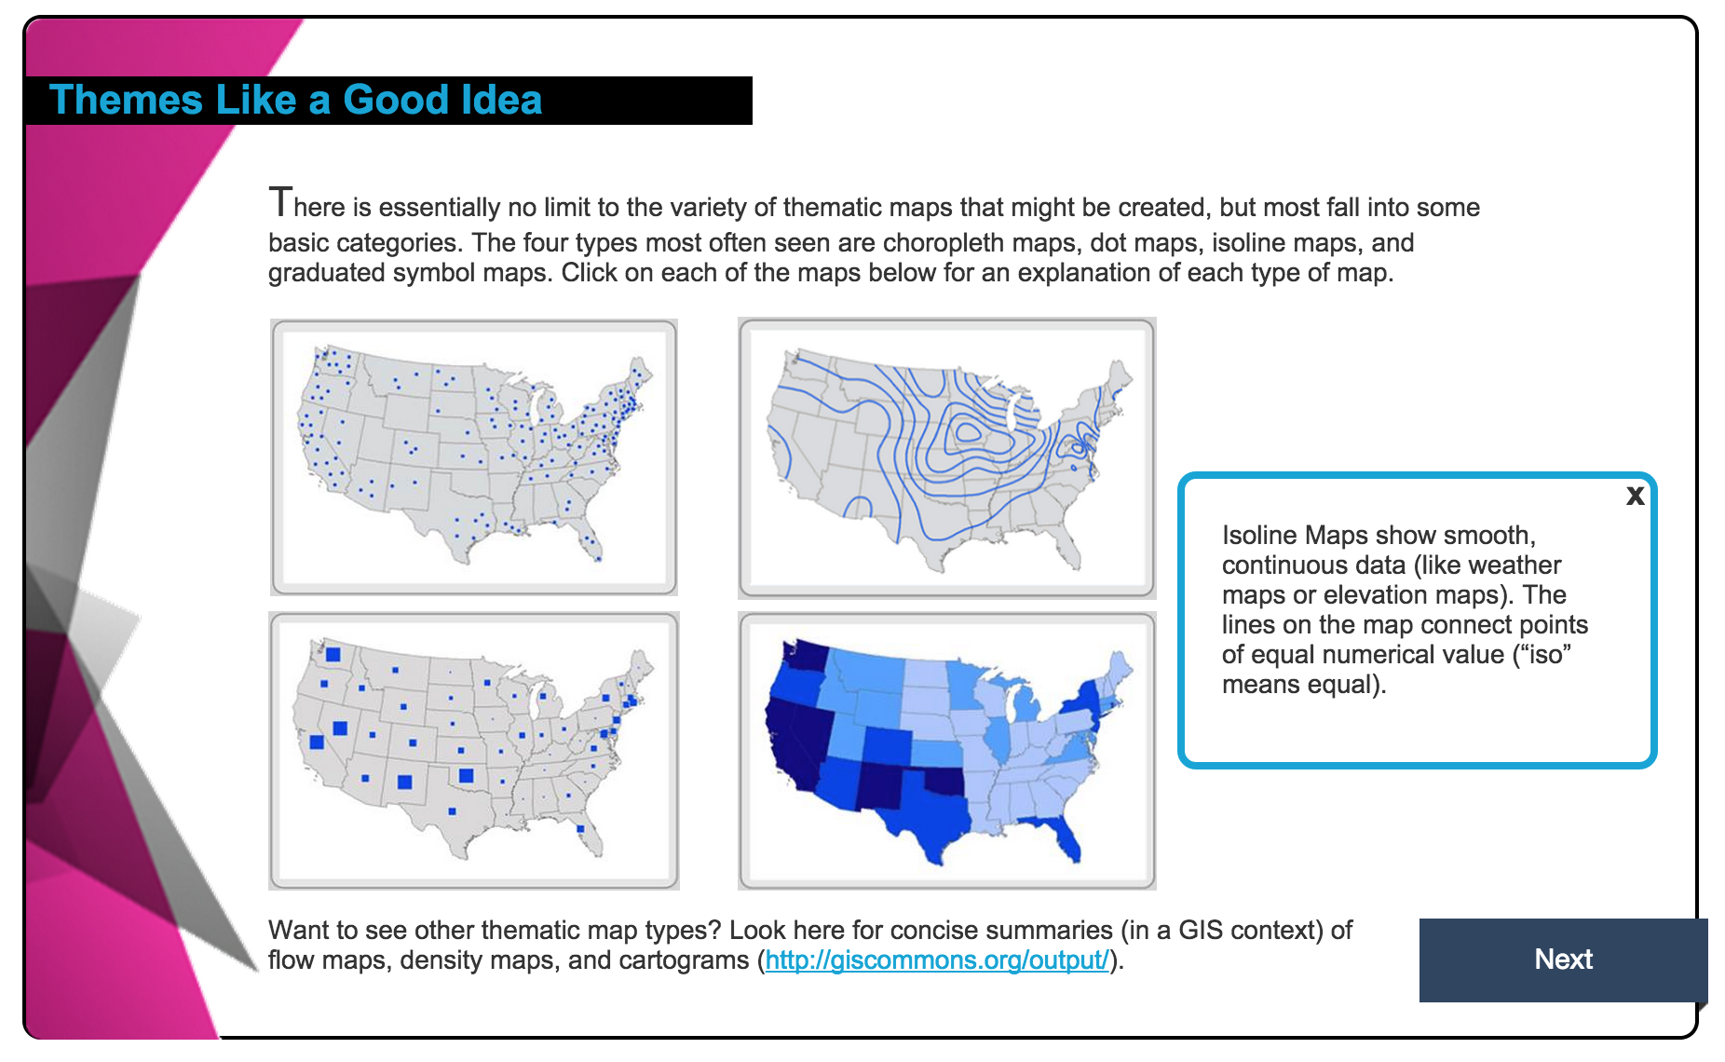
The “Final” Product (v.1)

Slide 14
Ready, Set…Pilot!
Piloting NOW (Spring 2016)
Target 10 courses per institution, campus project directors soliciting participants
Initial feedback is mixed:
Variability in quality & usefulness
Platform lacks pizzazz
Some fear over course replacement?

Slide 15
Where We’re Headed (We Hope)
Near term:
Revise & refine modules based on pilot
Create resources to help faculty integrate
Full rollout Fall 2016
Long term:
Create full competency curriculum plan based on AAC&U or other industry-accepted rubric
Open up modules for other schools’ use

Slide 16
Lessons Learned
Program needs a champion
Must have dedicated (& skilled) resources
Platforms/tools aren’t there yet
Ambiguity leads to…more ambiguity
(Anticipated) Will need direct faculty support resources for successful adoption

Slide 17
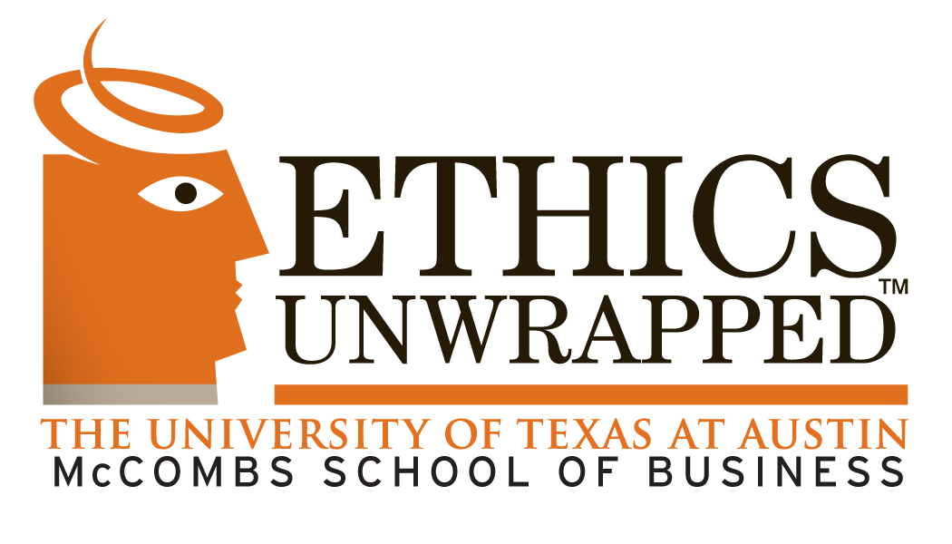
Ethics Curriculum Integration Initiative at The University of Texas at Austin
Cara Biasucci, M.F.A. McCombs School of Business

Slide 18
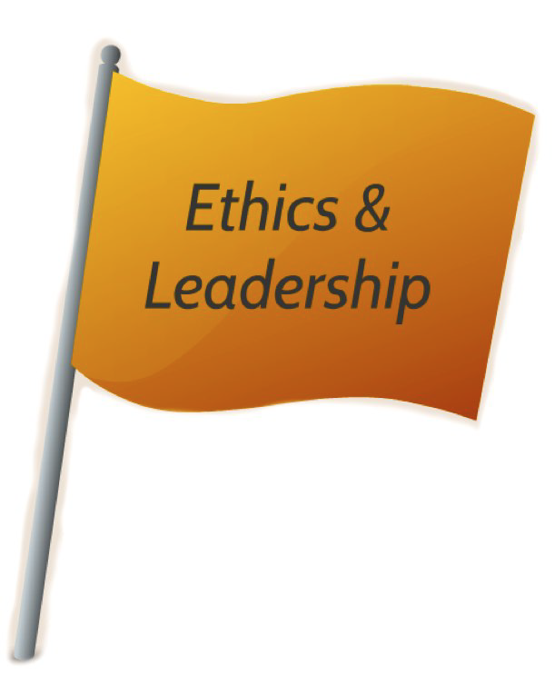
Ethics & Leadership Flag Program
1 of 6 academic skills requirements for all undergraduate students
33% of grade must be based on practical ethics component
First flagged courses offered in 2009
Initiative more than doubled enrollment in EL-flagged courses in College of Fine Arts and College of Liberal Arts in its first year
Ethical Awareness
Ethical Reasoning
Ethical Action

Slide 19
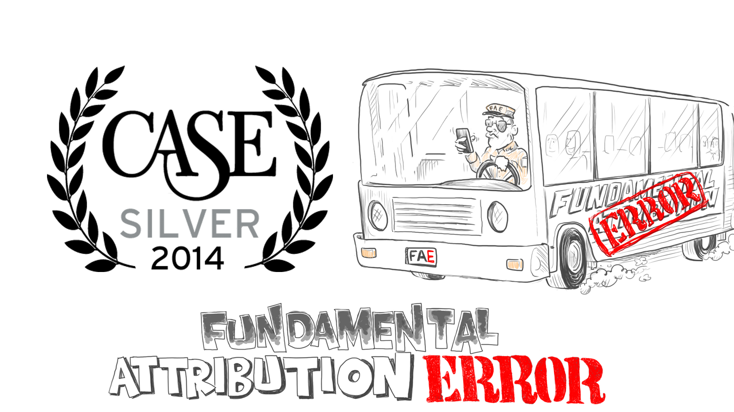
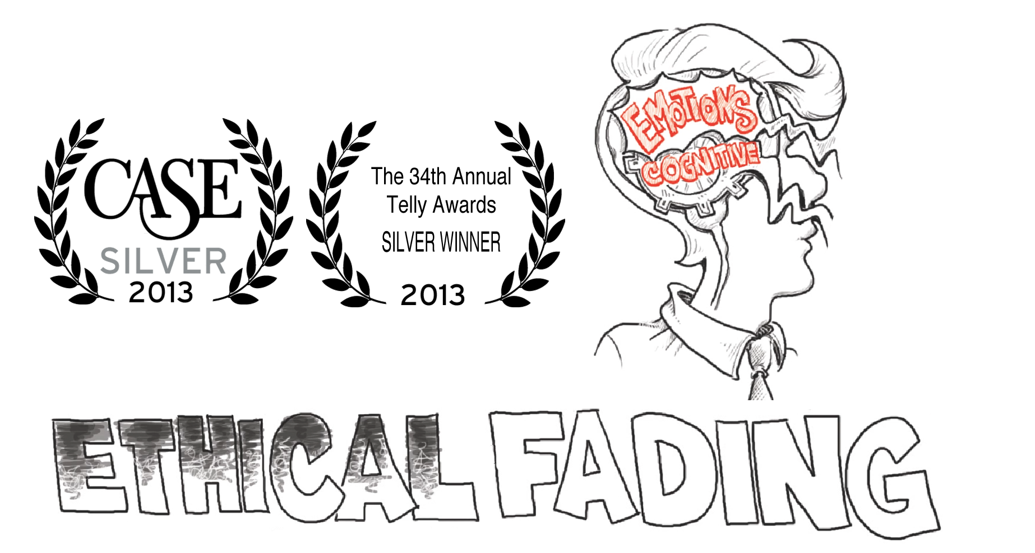
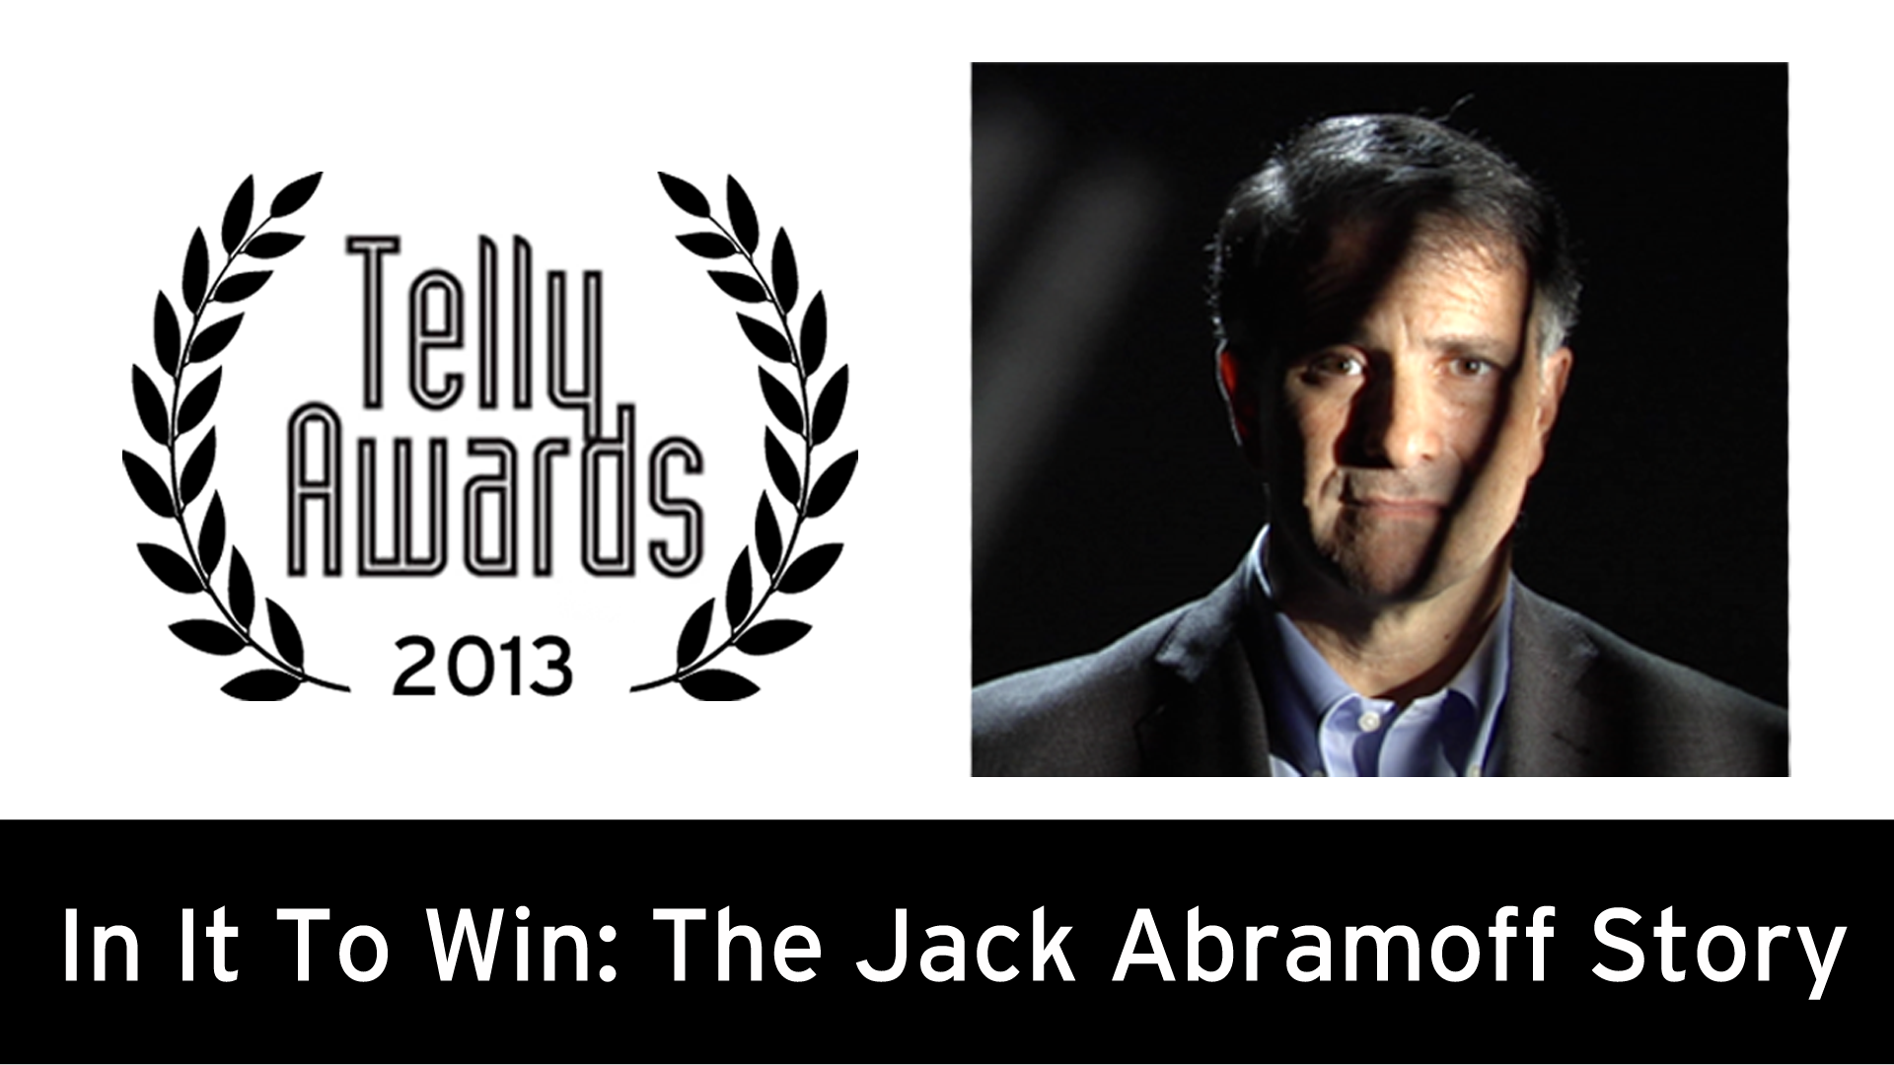
Ethics Unwrapped Video Series & Educational Program
48 high-quality, research-based videos
Supported by 20+ case studies and additional teaching resources
Easily accessible online and FREE
~ 400,000 YouTube views
Used at over 500 colleges and universities around the world
Winner of 7 academic & filmmaking awards

Slide 20
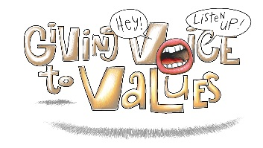
Ethics Unwrapped Overview
3 video series with accompanying teaching resources
33 short animated videos
Ethics concepts
Experts + Student interviews
8 short animated videos
Values-driven leadership
Features graduate students
Documentary + 6 shorts
Profile Jack Abramoff
Ethics Case Study
www.ethicsunwrapped.utexas.edu

Slide 21
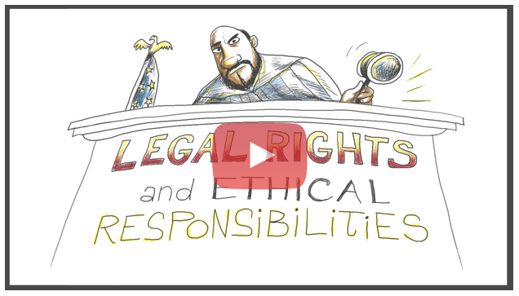
Ethics Unwrapped Teaching Resources
Classroom Discussion Questions:
Legal Rights & Ethical Responsibilities
The video poses that ethics demands more than the law. Do you agree? Can you think of an example? How about a counter example?
Although the video is attempting to highlight the conflict that sometimes occurs between law and ethics, more often they overlap. Can you give specific examples? Do you think the law follows ethics or ethics follows the law?
Have you ever been in a situation to do something legally permissible but ethically questionable, or vice versa?
In the case of Snyder v. Phelps, the Supreme Court protected Westboro Baptist Church’s right to freedom of speech, while Snyder sought to protect his family’s right to privacy and to not be caused unnecessary pain and suffering. Regardless of your opinion of Westboro or Snyder, which of these values do you believe is more important to defend? Why?
Is free speech so important that it should be protected even when it’s used to intentionally cause others emotional harm?
Do you think there is a way to uphold the right to free speech without protecting the sort of hateful speech the Westboro Baptist Church has used while protesting?
The Grantland editors chose to uphold the journalistic values of truthful and comprehensive reporting, even in light of the suicide of Dr. V. Do you agree that truth in journalism should be pursued at all costs, regardless of outcome? Why or why not?
If you had been in Hannan’s shoes, how would you have framed the article on the putter invented by Dr. V.?

Slide 22
Case Study:
Snyder v. Phelps
Case Study:
Approaching the Presidency: Roosevelt and Taft
Matthew Snyder was a Marine Lance Corporal from Maryland who died in Iraq on March 2, 2006 at the age of 20. The Westboro Baptist Church, led by Fred Phelps, announced in advance that they would picket his funeral. Westboro contends that American military deaths are a direct result of God’s vengeance for the tolerance of homosexuality in the United States. Church members protest military funerals because they believe enlisted soldiers “voluntarily [join] a fag-infested army to fight for a fag-run country.” They denounced Snyder’s parents, Albert Snyder and Julia Francis for raising their son Catholic, claiming they taught him to “be an idolater” and support the world’s “largest pedophile machine.” At Snyder’s funeral, Westboro members held up signs saying “Fag Troops,” “God hates the U.S.A.,” and many others of a similar nature.
Albert Snyder sued for defamation stemming from false statements made about his son’s upbringing. He also sued for “publicity given to private life” because his son’s funeral was a private, not public event. These counts were dismissed because the defamation fell under religious opinion and because an obituary was printed with details of their religion. Other counts, including intrusion upon seclusion, intentional infliction of emotional distress, and civil conspiracy, were all allowed to continue.
Westboro Baptist Church maintained that they followed all local ordinances and were compliant with all police instructions. They were allowed to picket in an area designated by police about 1000 feet from the church. Albert Snyder claimed he saw the tops of signs, but only read their contents when he saw a news program on television afterwards. Evidence was presented that showed Albert Snyder suffered physical and emotional harm, including complications from diabetes and depression.
At the district court level, Albert Snyder was awarded a total of $5 million in damages, but the Fourth Circuit later reversed this ruling. It was then appealed to the Supreme Court, which upheld the ruling of the Fourth Circuit: Westboro Baptist Church was within their free speech rights set forth in the First Amendment. The primary message of their signs dealt with their
Theodore Roosevelt embodied what many scholars typically refer to as the ‘stewardship presidency.’ In the words of Roosevelt, it is the president’s “duty to do anything that the needs of the nation demanded unless such action was forbidden by the Constitution or by the laws.” Under Roosevelt’s expansionist view, anything the president does is considered acceptable unless it is expressly forbidden by the Constitution or laws passed by Congress. Roosevelt believed he served the people, not just the government, and took many actions as president that stretched the limits of the executive branch, including the creation of national parks without regard for states’ jurisdiction and fostering revolt in Colombia to establish the Panama Canal.
William Howard Taft, on the other hand, embodied what many scholars refer to as a ‘strict constructionist’ model of the presidency. Under this approach, unless the Constitution or Congress explicitly grants a certain power, the president does not have the right to act. In Taft’s words, “the President can exercise no power which cannot be fairly and reasonably traced to some specific grant of power or justly implied and included within such express grant as proper and necessary to its exercise.”
While Roosevelt expanded federal power in many areas, Taft felt many of these actions were legal overreaches. For example, as a “trust-buster” Roosevelt differentiated between ‘good’ trusts and ‘bad’ trusts, using his expanded powers as president to make this distinction unilaterally. He made a ‘gentlemen’s agreement’ with U.S. Steel and told them that the American government would not attack their corporation as a monopoly since he believed the company was working in the interests of the American people. Roosevelt did not, however, pass any legislation or make any binding orders to this effect. Taft took a more legalistic view and later, as president, directed his attorney general to file an anti-trust lawsuit against U.S. Steel. Roosevelt took Taft’s actions as a personal attack upon Roosevelt’s presidency and positions.
Although Taft continued many of Roosevelt’s policies, he was inclined to look at the facts of the situation and make a choice based on evidence.

Slide 23
Case Study Discussion Questions:
Snyder v. Phelps
Case Study Discussion Questions:
Approaching the Presidency: Roosevelt and Taft
How would you rule in this case if you were the deciding vote on the Supreme Court? Why? What issues would you find most important in making that decision?
Does the fact that the Westboro Baptist Church did everything legally correct make their position acceptable? Should they adhere to any ethical boundaries beyond legal compliance?
How would you explain to both the Westboro Baptist Church and Albert Snyder the Supreme Court’s ruling while respecting both of their positions?
Can you think of any alternative methods by which the Westboro Baptist Church could make the same point without causing harm to individuals such as Albert Snyder?
Do you believe it is ethically permissible for someone to say whatever he or she wants, even if it causes harm or trauma to another person? If so, on what grounds? If not, where would you draw the line to limit speech?
What differences do you see between Roosevelt’s and Taft’s views of their ethical responsibilities as president?
How did Roosevelt and Taft each negotiate the line between law and ethics?
In the case of U.S. Steel, whose actions caused more harm: Roosevelt by making an informal agreement, or Taft by violating that agreement?
Whose approach to the U.S. presidency, Taft’s or Roosevelt’s, do you think is preferable in light of both legal and ethical considerations? Why?
Can you think of an example of another president or world leader whose approach to leadership is similar to either Roosevelt or Taft? How does this leader’s approach affect his/her political actions?
Additional Teaching Note & Additional Resources:
To learn more about ethical responsibility, watch our four-part video Being Your Best Self. These videos explore various components important to making moral decisions and acting ethically. Part 1, Moral Awareness, explores the ability to detect and appreciate the ethical aspects of decisions on must make. Part 2, Moral Decision Making, explains how to produce a reasonable and defensible answer to an ethical question. Part 3, Moral Intent, examines the desire to act ethically and overcome rationalizations when facing a decision. Lastly, Part 4, Moral Action, describes the necessary steps to transform the intent to do the right thing into reality.
Consider the roles that values and value systems play in shaping the relationship between laws and ethics; watch our video series Giving Voice to Values to learn more about values and how we can voice them.
Copyright laws and intellectual property policies have raised many debates over the relationship between law and ethics. To learn about how these issues apply to artistic and creative works, watch our video Appropriation & Attribution.
Elliott, Deni. 1985. “Distinguishing Ethics from Law.” SPLC Report 6 (2): 3-5.
Elliott, Deni. 2007. Ethics in the First Person: A Guide to Teaching and Learning Practical Ethics. Lanham, MD: Rowman & Littlefield Publishing.
Halbert, Terry, and Elaine Ingulli. 2015. Law & Ethics in the Business Environment. Stamford, CT: Cengage Learning.

Slide 24
Curriculum Integration:
First year (2014-15)
Focus on integrating Ethics Unwrapped into EL-flagged courses across campus, developing new videos and resources, and assessing the efficacy of the videos as a teaching and learning tool for students.
Integrated into these colleges:
College of Liberal Arts
College of Fine Arts
College of Education
McCombs School of Business
Sample courses include:
School Organizations and Classroom Management in Secondary Schools
Languages of the Stage
Ethics in Music
Introduction to the Holocaust
US Foreign Policy
Business Law and Ethics

Slide 25
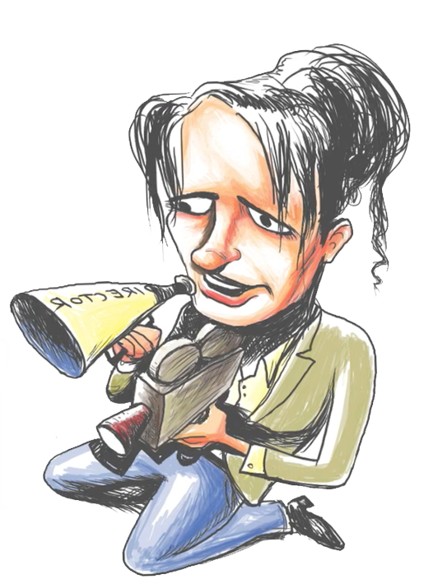
Curriculum Integration: Second year (2015-16)
Focus on creating additional teaching resources – more case studies, an instructor’s handbook for the Ethics Unwrapped website – continuing student assessments, and assessing faculty experiences with Ethics Unwrapped.
Expanded initiative to include more colleges and courses across campus, and repeated 2014-15 classes.
Added two colleges:
College of Natural Sciences
Moody College of Communication
Additional courses include:
Chemistry Peer Mentors in Research and Teaching
Communicating Sustainability

Slide 26
Assessment: Helpfulness of Videos for Learning
Not Helpful
2%
Minimally
Helpful
8%
Very Helpful
42%
Helpful
48%
~ 4,500 undergraduates over three semesters (2014-2015) were asked how helpful they found Ethics Unwrapped videos for explaining individual ethics concepts. Results show 90% of students found the videos helpful.

Slide 27
Assessment: Rise in Student Confidence Levels
Not Confident
2%
Very Confident
14%
Minimally
Confident
10%
Not Confident
24%
Very Confident
41%
Confident
31%
Minimally Confident
31%
Confident
47%
BEFORE viewing video
AFTER viewing video
~ 4,500 students were asked to rate their confidence in identifying, explaining, engaging in a conversation, and making an informed decision about the ethics concept both before and after watching an Ethics Unwrapped video.

Slide 28
Quantitative Impact of Curriculum Initiative
In 2014 – 2015:
Developed & produced 8 videos
Wrote 19 case studies
Modified 16 courses in 4 colleges
More than doubled EL-flagged courses offered in COLA & COFA
Integrated 28 Ethics Unwrapped videos
Worked with17 instructors and 32 teaching assistants
Surveyed ~2,200 students
Reached more than 3,200 undergraduate students
In 2015 – 2016:
Developed & produced 4 videos
Wrote 30 case studies
Modified 9 more courses
Added 2 more colleges
Integrated 31 Ethics Unwrapped videos
Working with 29 instructors and more than 30 teaching assistants
Surveying ~4,000 students
Reaching ~ 4,600 additional undergraduate students on UT Austin campus

Slide 29
Qualitative Impact of Curriculum Initiative
Student Comments:
“It is creative and easy to follow when the concept isn't necessarily simple”
“Wow I definitely do this. Glad I watched this.”
“The animations kept me really engaged and the student comments made me feel that the issues being discussed were pertinent to today's society and everyday issues.”
“Simple, clear, and to the point. Great video.”
“I may have read about this in a sociology textbook my freshman year, but this video definitely solidified the concept in my mind.”
“I thought the video was very helpful and informative. It wasn't an overabundance of information. It was concise and easy to understand, and the way in which the information was presented kept me engaged throughout the entirety of the video.”
“Getting student testimony as opposed to just someone with a title, to explain things made them more memorable, and easy to relate to.”
Faculty Comments:
“The videos at this point work well to illustrate the broad concepts of ethics and how they have opportunity to impact our daily lives.”
“Ethics unwrapped challenges students to be willing to address issues that otherwise often are a part of the hidden curriculum in teaching and learning. It helps them understand that multiple vantage points exist among themselves and their peers.”
“The videos and their discussion of the ethical concepts are easy for students to understand and relateable. Once they recognize the dynamic, then can use it analytically.”
“Inspired entirely new course and the revision of a proposed course; students very engaged and enjoyed the discussions a great deal. All students reported that they now think differently about issues in music.”
“I personally do not use the videos in class, but I do make students aware of them through our course management software so they can watch them outside of class if they like. The main benefit from the Ethics Unwrapped materials I get is the teaching notes/explanations of the concepts, which I use heavily in my course.”

Slide 30
Suggested Subject Areas:
Communication
Fine Arts
Humanities
Library and Museum Studies
Professions
Social Sciences
Videos:
All is Not Relative
Appropriation & Attribution
Framing
Fundamental Attribution Error
Fundamental Moral Unit
Moral Agent & Subject of Moral Worth
Moral Myopia
Legal Rights & Ethical Responsibilities
Representation
Case Studies:
Conversation Starter
- The Miss Saigon Controversy
Fine Arts, Humanities & Social Sciences
- Artistic Appropriation and Shepard Fairey’s “Hope”
- Christina Fallin: “Appropriate Culturation?”
- The “Blurred Lines” of Copyright
- Bullfighting
- Digital Downloads
Professions
- Teaching Blackface: A Lesson on Stereotypes
- Grantland and Dr. V
- Covering Robin Williams
Instructor’s Handbook
A guide to all the teaching resources
available on our website. Videos and case studies are organized by topic
for a range of academic disciplines.
Behavioral Ethics
Leadership
Media, Arts & Culture
Principles & Policies
Professional Ethics
Research Ethics
Organizational Ethics
Sustainability
Introductory Resources
Media, Arts & Culture:
A number of ethical dilemmas may arise across various media, arts, and cultures: from copyright infringement or biased framing of a news report, to cultural insensitivity or the perpetuation of negative stereotypes, the examples are countless. These resources take a look at the ways in which ethics and ethical frameworks affect our understanding of media, the arts, and different cultures.

Slide 31
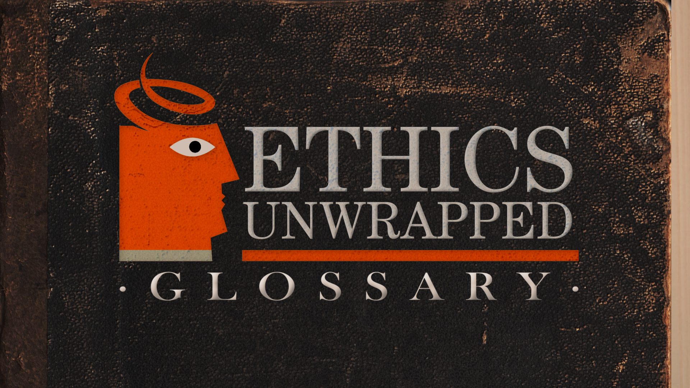
Ethics Glossary
Glossary Terms:
Altruism
Behavioral Ethics
Bounded Ethicality
Conflict of Interest
Conformity Bias
Consequentialism
Corruption
Corporate Social Responsibility
Deontology
Diffusion of Responsibility
Ethics
Ethical Fading
Fundamental Attribution Error
Fiduciary Duty
Framing
Groupthink
Hedonism
Incrementalism
In-group/Out-group
Integrity
Justice
Loss Aversion
Moral Absolutism
Moral Agent
Moral Cognition
Moral Emotions
Moral Equilibrium
Moral Imagination
Moral Muteness
Moral Myopia
Moral Philosophy
Moral Pluralism
Moral Psychology
Moral Reasoning
Moral Relativism
Morals
Neuroethics
Obedience to Authority
Overconfidence Bias
Prosocial Behavior
Role Morality
Self-serving Bias
Social Contract Theory
Subject of Moral Worth
Sustainability
Tangible & Abstract
Utilitarianism
Values
Veil of Ignorance
Virtue Ethics
A new video series of 50 ethics terms
concisely defined in 1–2 minute
animated videos. The broad-based
knowledge tool will be fully integrated
with all our teaching resources and the
video series on our website.

Slide 32
Q&A | Connect with us for further conversation:
Mike Conner connerms@grinnell.edu
Raechelle Clemmons @rclemmons | raclemmons@davidson.edu
Cara Biasucci, M.F.A. cara.biasucci@mccombs.utexas.edu www.ethicsunwrapped.utexas.edu

