Slide 1
How Do I Get There From Here?
Security-to-Privacy Career Transition
Jane Rosenthal, JD
Chief Privacy Officer
University of Kansas
Michael Carr, JD, CISSP, CIPP
Chief Information Security Officer
University of Kentucky
April 2013

Slide 2
Disclaimer
The content, discussion, or materials available at this web presentation are for informational purposes only and not for the purpose of providing legal advice. You should contact your attorney to obtain advice with respect to any particular issue or problem or advice. Use of and access to this information or material does not create an attorney-client relationship between Jane Rosenthal and the user or browser or between Michael Carr and the user or browser. The opinions expressed at or through this presentation are the opinions of the individual authors and do not reflect the opinions or advice of EDUCAUSE, the University of Kansas (KU), the University of Kentucky or any of their affiliates.
Any rebroadcast, retransmission, or account of this presentation, without the express written consent of Major League Baseball, er…, I mean, EDUCAUSE, is strictly prohibited. This presentation is meant for educational purposes only. Any resemblance to real persons, living or dead is purely coincidental. Void where prohibited. Do not use while operating a motor vehicle or heavy equipment. You must be present to win. Subject to change without notice. Disclaimer includes misuse, accident, lightning, flood, tornado, tsunami, volcanic eruption, earthquake, hurricanes and other Acts of God, neglect, damage from improper reading, incorrect line voltage, improper or unauthorized reading, broken antenna or marred cabinet, missing or altered serial numbers, electromagnetic radiation from nuclear blasts, sonic boom vibrations, customer adjustments that are not covered in this list, and incidents owing to an airplane crash, ship sinking or taking on water, motor vehicle crashing, dropping the item, falling rocks, leaky roof, broken glass, mud slides, forest fire, or projectile (which can include, but not be limited to, arrows, bullets, shot, BB's, shrapnel, lasers, napalm, torpedoes, or emissions of X-rays, Alpha, Beta and Gamma rays, knives, stones, etc.)

Slide 3
How Do I Get There From Here?
The Graduate (1967)
Mike Nichols: Best Director
What advice would Mr. McGuire give Ben (Dustin Hoffman) today?
“I just want to say one word to you. One word. Are you listening? Privacy. There’s a great future in privacy. ‘nuf said”

Slide 4
How Do I Get There From Here?
A Lot Has Changed in 45 years (since 1967)
Movie ticket: $1.25
Average cost of new car: $2,750
Gallon of gas: 33 cents
And in just the last 3 years…
The number of privacy
professionals has
doubled!
10,000
5,000
2009
2011
2012

Slide 5
How Do I Get There From Here?

Slide 6
Information Security
Encompasses the administrative, physical and technical safeguards designed to ensure information’s CIA (confidentiality, integrity and availability).

Slide 7
Privacy
is a claim to the right to determine as to when, how, and to what extent information about oneself is communicated to others*
* Alan F. Westin, Privacy and Freedom (New York: Atheneum, 1967), p. 7

Slide 8
You can have security without privacy but you cannot have privacy without security.

Slide 9
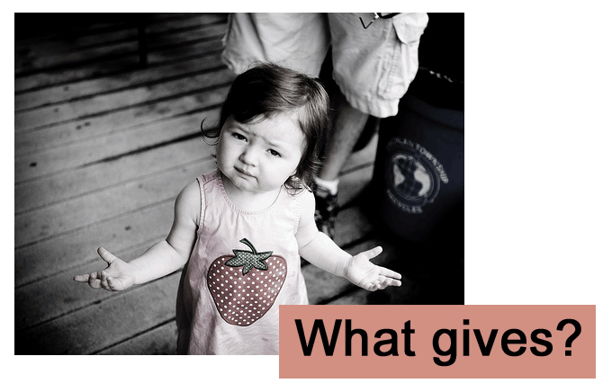
How Do I Get There From Here?

Slide 10
How Do I Get There From Here?
We’ve always had a love/hate
relationship with privacy
Appreciate Amazon.com’s personalization
Concerned over collection of “Big Data”
USA: Data “owned” by the collector
Europe: Data “owned” by the citizen

Slide 11
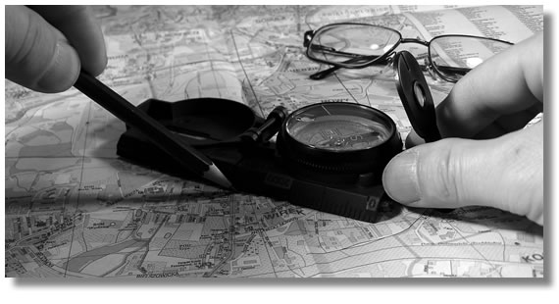
How Did We Get Here?

Slide 12
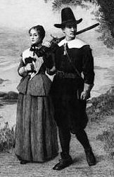
Privacy in America
In Massachusetts,
“tything-men” inspect
households for proper
moral conduct
1600
1700
Puritan Rule:
Civic duty to keep an eye
on your neighbor

Slide 13
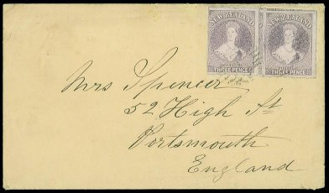
Privacy in America
1782: Congress
enforces postal
confidentiality
1600
1700
1790: First national
census is conducted

Slide 14
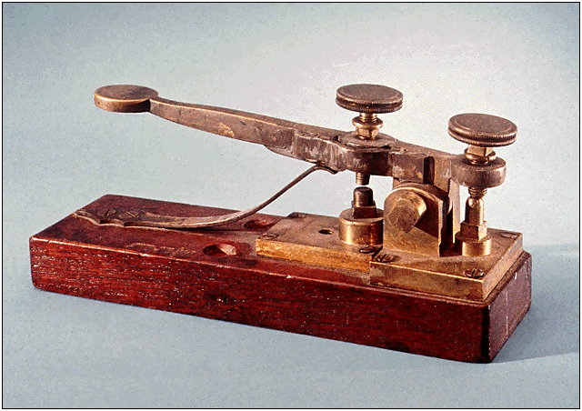
Privacy in America
1838: Telegraph
is introduced
1700
1800
1791: The Bill of Rights
protects freedom of speech
& freedom from
unreasonable search
and seizure

Slide 15
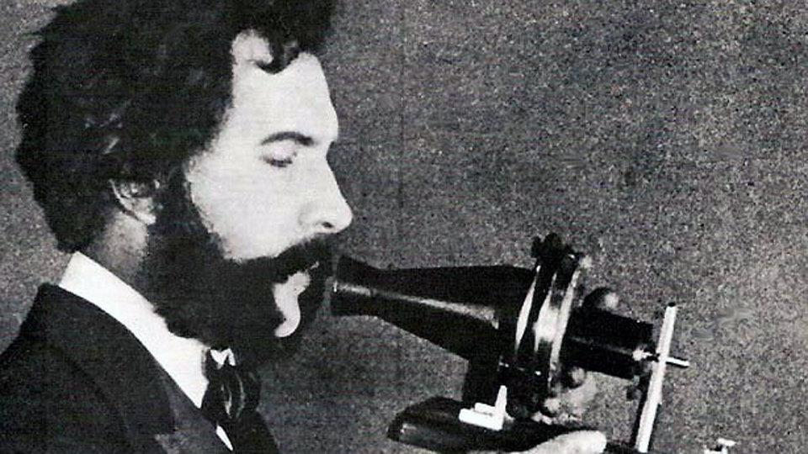
Privacy in America
1876: Alexander
Graham Bell invents
the telephone
1800
1900
1890: 1st Kodak snapshot
camera is invented. Census
Bureau develops automatic
counting machine

Slide 16
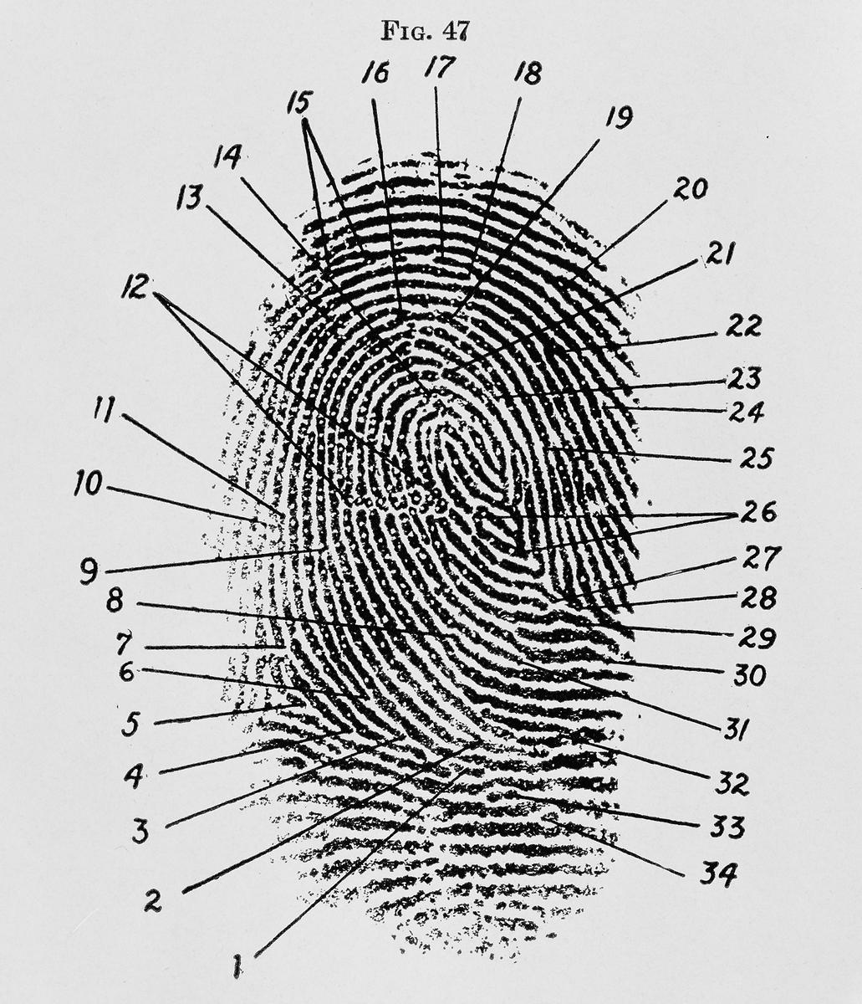
Privacy in America
1900: Fingerprints are
established as unique
& unchangeable identifiers
1966: Freedom of
Information Act
is passed.
1900
1936
1966
1968
1936: Social Security
Numbers are assigned
to most adult Americans
1968: Warrant is
required for
wiretapping

Slide 17
Privacy in America
1975: Personal
computers become
commercially available
1990: Increased reports
of a new crime called
Identity Theft
1999: Financial Services Modernization
Act (aka GLBA)
1974
1975
1980
1990
1998
1999
1974: FERPA
1980: DNA
fingerprinting
& cellular telephones
become commonplace
1998: The Children’s
Online Privacy
Protection Act
(COPPA)

Slide 18
Privacy in America
2002: Federal
Information Security
Management Act
2008: Higher
Education (re)Authorization Act
2001
2002
2003
2008
2009
2001: USA
PATRIOT Act
2008: PCI-DSS
2009: HITECH
Act
2003: Safeguards
Rule of GLBA
2008: Red Flags Rule

Slide 19
Privacy in America

Slide 20
Privacy in America
Is it all science fiction?

Slide 21
How Do I Get There From Here?
So… why leave the calm, serene confines of Information Security and get into Privacy?
The threat and the thrill ?

Slide 22
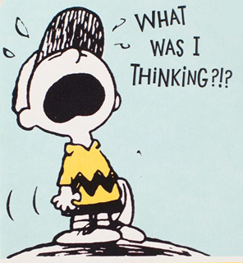
How Do I Get There From Here?

Slide 23
How Do I Get There From Here?
Me?
Currently: CISO @ Univ of Kentucky
Higher Ed: Past 10 years
Prior: 15 years with GE: IT & IT Security
Got law degree later in life (techie 1st, lawyer 2nd)
Jane?
Currently: Director, Privacy Office @ Univ of Kansas
Higher Ed: Past 15 years
Prior: Employment law then IP & research contracts @ KUMC
Got into IT & privacy later in life (lawyer 1st, privacy 2nd)

Slide 24
How Do I Get There From Here?
Requisite CPO Skill Set?

Slide 25
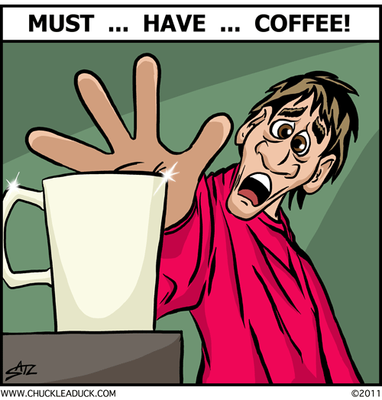
How Do I Get There From Here?
Requisite CPO Skill Set?

Slide 26
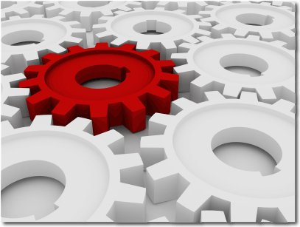
How Do I Get There From Here?
Requisite CPO Skill Set?

Slide 27
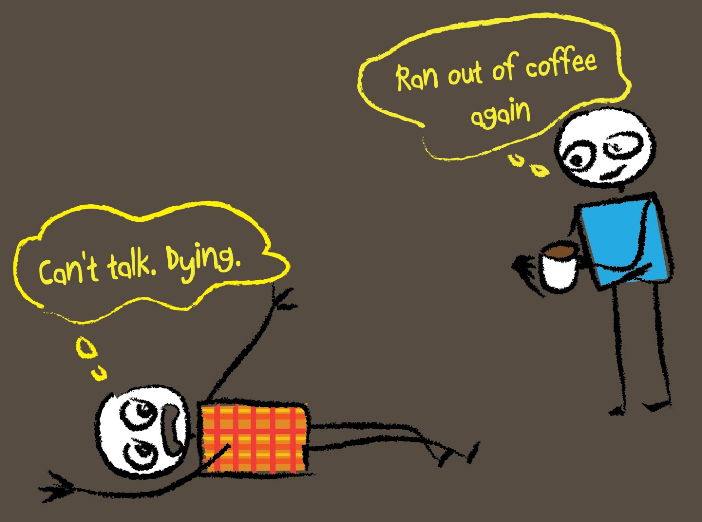
How Do I Get There From Here?
Requisite CPO Skill Set?

Slide 28
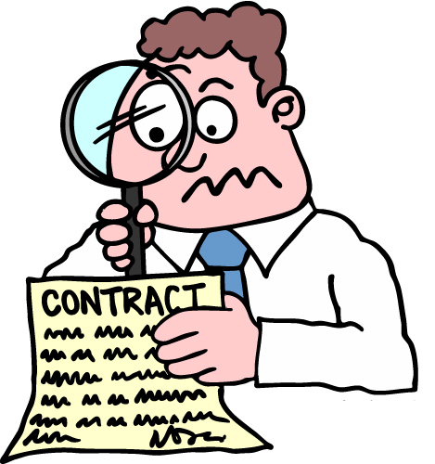
How Do I Get There From Here?
Requisite CPO Skill Set?

Slide 29
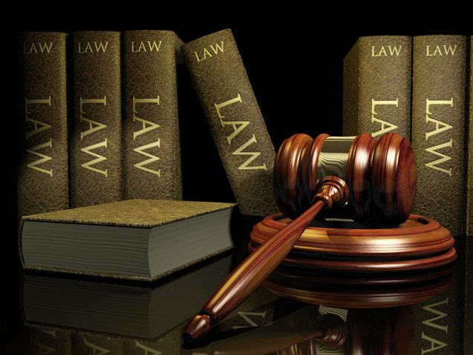
How Do I Get There From Here?
Requisite CPO Skill Set?

Slide 30
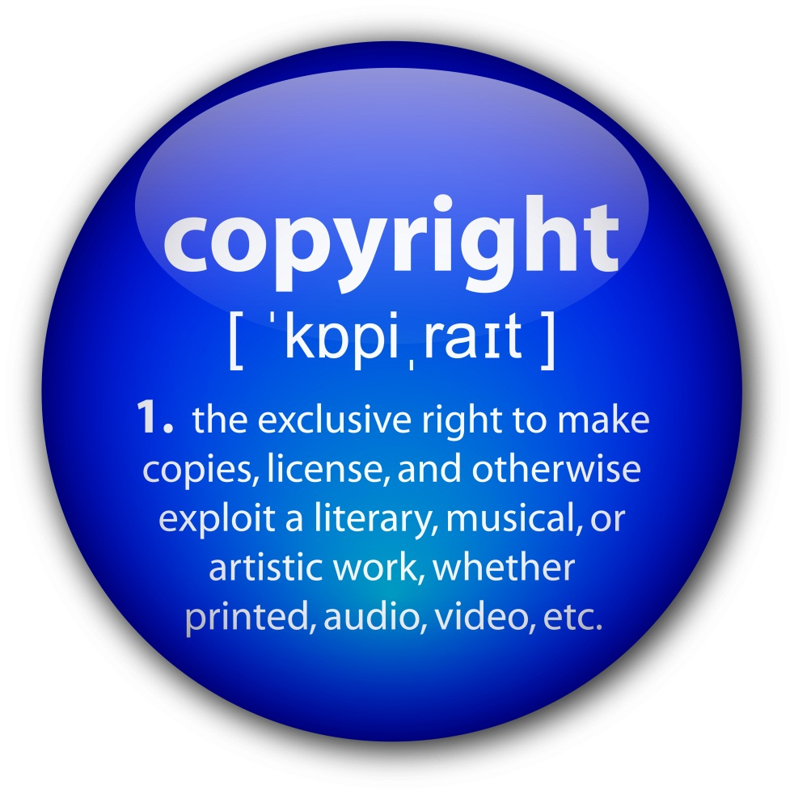
How Do I Get There From Here?
Requisite CPO Skill Set?

Slide 31
How Do I Get There From Here?
Requisite CPO Skill Set?

Slide 32
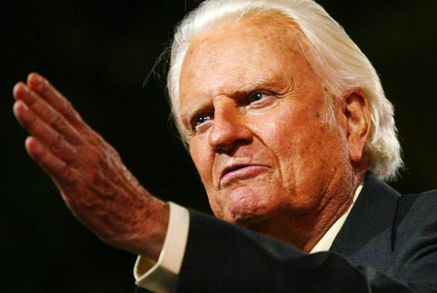
How Do I Get There From Here?
Requisite CPO Skill Set?

Slide 33
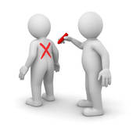
How Do I Get There From Here?
Requisite CPO Skill Set?

Slide 34
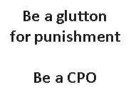
How Do I Get There From Here?
Requisite CPO Skill Set?

Slide 35
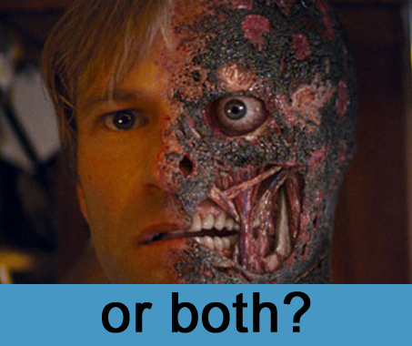
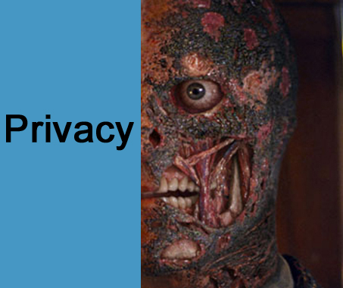
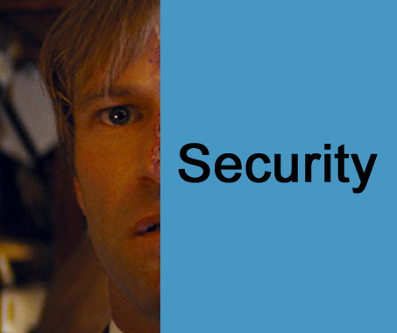
How Do I Get There From Here?
How do I choose?

Slide 36
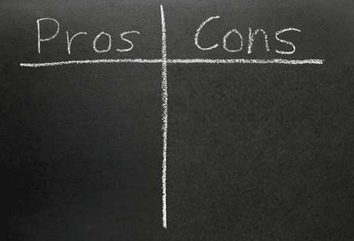
How Do I Get There From Here?
Chief Information Security & Privacy Officer?
Chief Security Officer?
Very interrelated
Complementary
Improved Management of Controls
Security & Privacy: Not Mature enough
Talent Shortage
People Change Management

Slide 37
Road to CPO
Educause Security Conference 2013
37
Notes:
Agenda/Outline
1. Introduction
2. A brief review of the privacy field and framework
a. www.worldprivacyforum.org/pdf/WPFselfregulationhistory.pdf
b. http://www.educause.edu/ero/article/information-privacy-revealed
3. Presenters’ experience as security and privacy officers at major research institutions
a. Michael Carr
i. Currently, CISO @ The University of Kentucky
ii. In Higher Ed for 10 years now
iii. But grew up @ GE in IT; Graduate education then law school
iv. Aside from a short stint as CIO at a small, liberal arts Univ in Ohio, has always been responsible for cyber security.
v. Often responsible for privacy because no one else was
b. Jane Rosenthal
i. Currently Director, Privacy Office @ The University of Kansas
ii. In Higher Ed for 15 years now
iii. Grew up as an Employment Attorney, public world, then research contracts & IP at KUMC and here for 7 years
iv. Responsible for Privacy and ironically Custodian of Public Records
4. CPO’s requisite skill set
a. Willing to read tall Regulations in a Single Bound (or with a lot of coffee)
b. Willing to be glutton for punishment
c. Likes to work in/with interdisciplinary area—Privacy, Security, Communications, Compliance, Legal, Audit, Student Affairs, health centers
d. Can change gears from one area to another
e. Understand purchasing /front end of agreements
f. Understand contracts & liabilities
g. Copyright & IP understanding
h. Taken at least 1 legal course in your life, such as business law, data security law, e-discovery law, health or admin law
5. The pros and cons of having a dedicated privacy officer and/or with combining with security
6. A typical day-in-the-life of a CPO
a. There is not a typical day
7. Moved before 6 - The pros/cons of a dedicated privacy officer and/or with combining with security
8. Career roadmaps to move into privacy
a. IAPP is an excellent choice for training (options CIPP/US/IT/EU/C/G)
b. AHIMA—CHPS (privacy & security)
c. Policy Office (Kent Wada at UCLA)
d. IT Policy Office (Tracy Mitrano, Cornell)
e. SANS 414 Management???
f. Faculty with an Administrative Bent
g. Legal training but don’t (under any circumstances) want to be a lawyer
h. Audit experience
i. Research knowledge/understanding a plus
j. University experience to understand the animal, I mean City is a plus
k. Geek who can speak to laypeople—that’s important; or legal type who can speak geek
9. What’s around the Corner for Privacy Tomorrow (and the Day After)
a. Big Data—everybody wants some
i. Your Communications & Alumni will want your Data and Track your Exes
b. BYOD is a sink hole w/o controls
i. Can you agree on policy
ii. How much is too much info to know about your users
c. Weird Devices will be vulnerable and leak info
i. Medical devices
ii. VoIP
iii. Multi-Factor Authentication
iv. More fines to come, come, come
d. Europe is getting closer w/o the Concorde Airplane
10. Q&A
• Okay with Splitting 1-5 Mike, 6-9 Jane ?
• Preferred PwrPt template ?
• Goal for 1st draft of PwrPt?

Slide 38
ROADMAP...
Privacy Officer Appointment
Background/Training
IAPP CIPP/US/IT/EU/C/G/CIPM, AHIMA—CHPS, SANS CISSP/GIAC, JD, MBA-IS, Project Management, Leadership, Training, Sales, Life
Privacy Principles for University
Policy/IT Policy
Assess Environment
Experience: Faculty, Legal/Audit Experience, Research knowledge, University experience
38

Slide 39
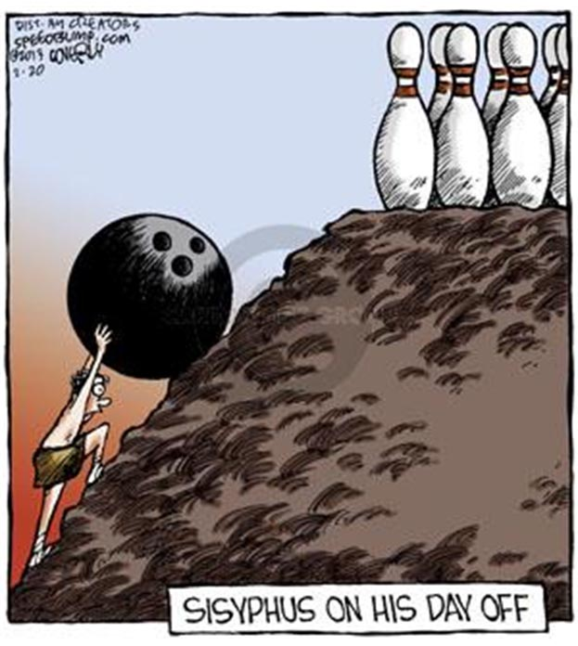
39

Slide 40
awareness
ethics
Multi-Dimensional
Multi-dimensional Technology
Risk Management to avoid consequences
Privacy Solutions & Mission aligned
norm
data
mission
change
budget
system
privacy
use
culture
share
training
end
40
Notes:
a. Big Data—everybody wants some
i. Your Communications & Alumni will want your Data and Track your Exes
b. BYOD is a sink hole w/o controls
i. Can you agree on policy
ii. How much is too much info to know about your users
c. Weird Devices will be vulnerable and leak info
i. Medical devices
ii. VoIP
iii. Multi-Factor Authentication
iv. More fines to come, come, come
d. Europe is getting closer w/o the Concorde Airplane

Slide 41
Multi-Dimensional
Review Legislation
Check out loss/theft
Training
Answer questions
Propose, Draft, Sell
Review Components
Lifecycle of Info and PIA
41

Slide 42
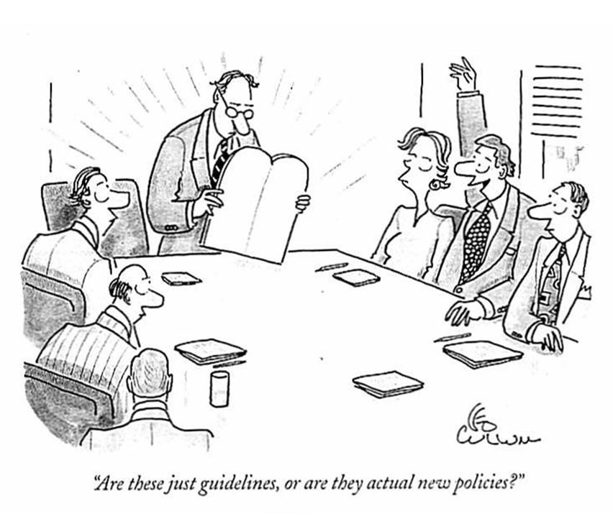
42

Slide 43
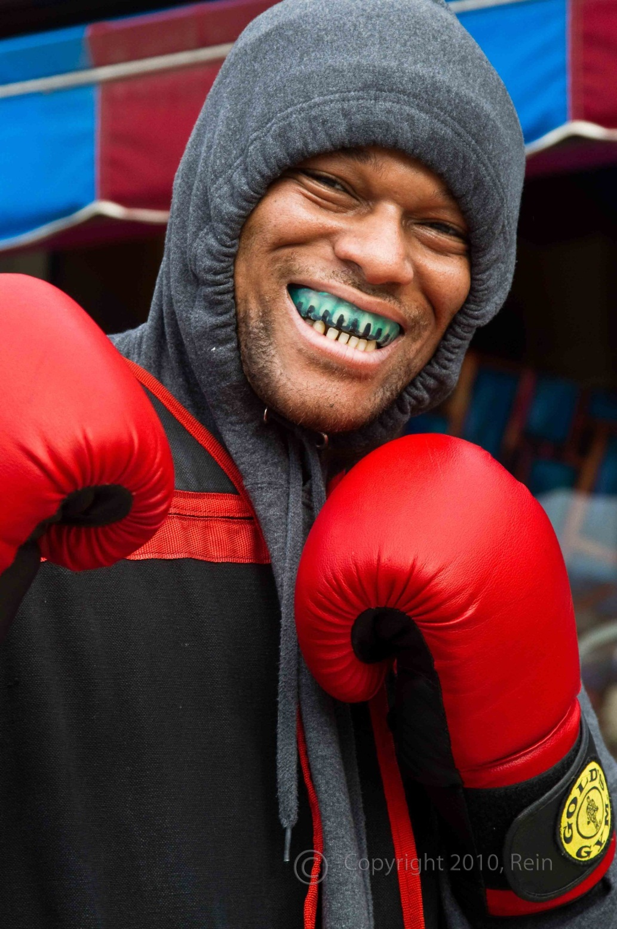
Privacy vs. Security
Is it a fight?
43

Slide 44
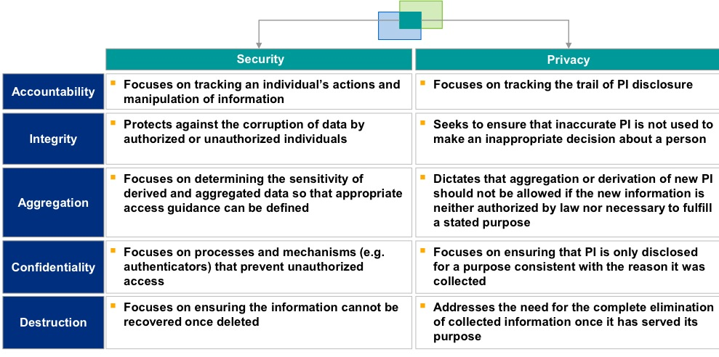
Privacy & Security Overlap
Mitre Corp 2005 Graphic, What an Info Security Officer Needs to Know
http://www.mitre.org/work/info_tech/privacy/pdf/PrivacyFundamentalsInformationSecurityOfficers.pdf
44

Slide 45
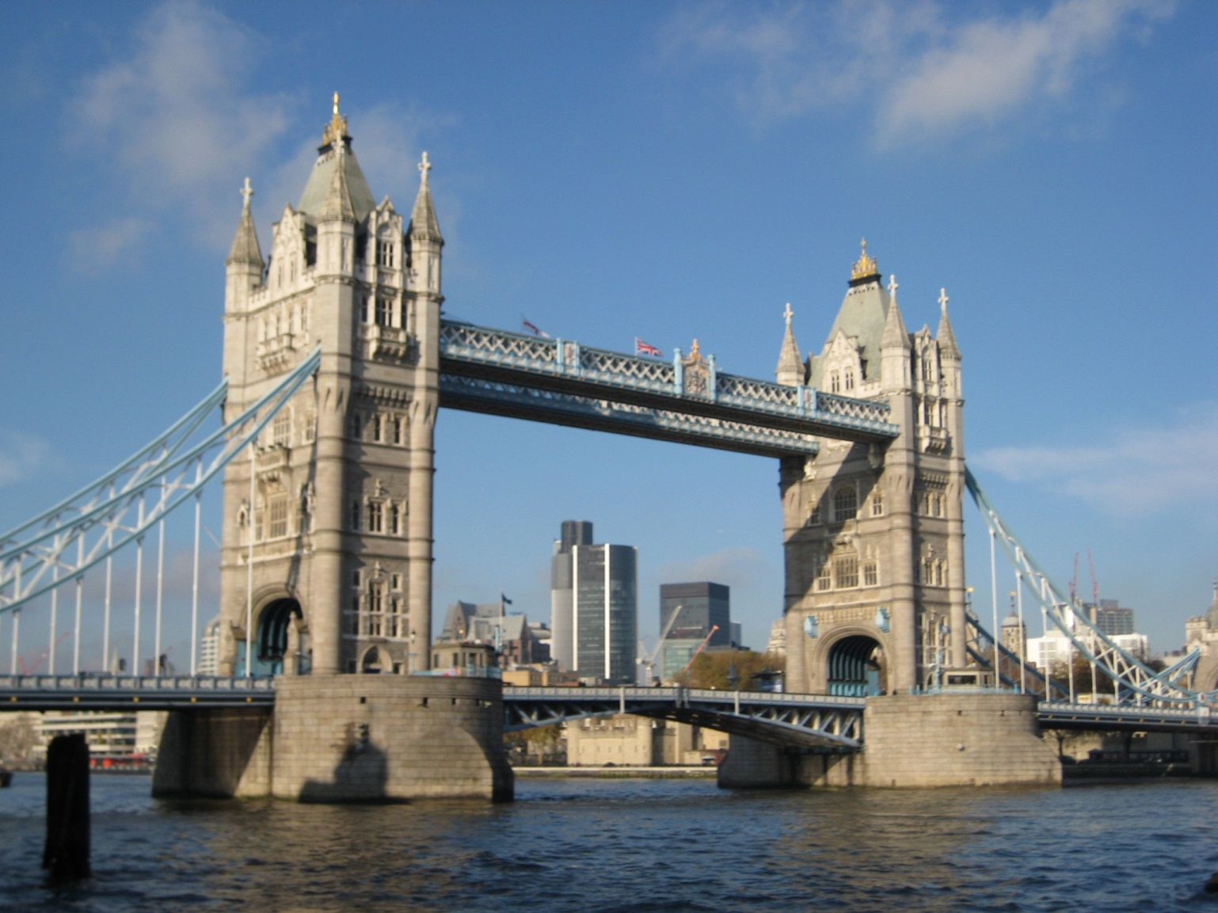
Bridging the Divide
Integration of the privacy, security, and compliance functions can result in conflicting missions
Decoupling them can make it difficult to ensure a cohesive institutional strategy.
Mike Corn & Jane Rosenthal
"Privacy, Security & Compliance: Strange Bedfellows or a Marriage Made in Heaven?“
Educause Review, January/February 2013.
45

Slide 46
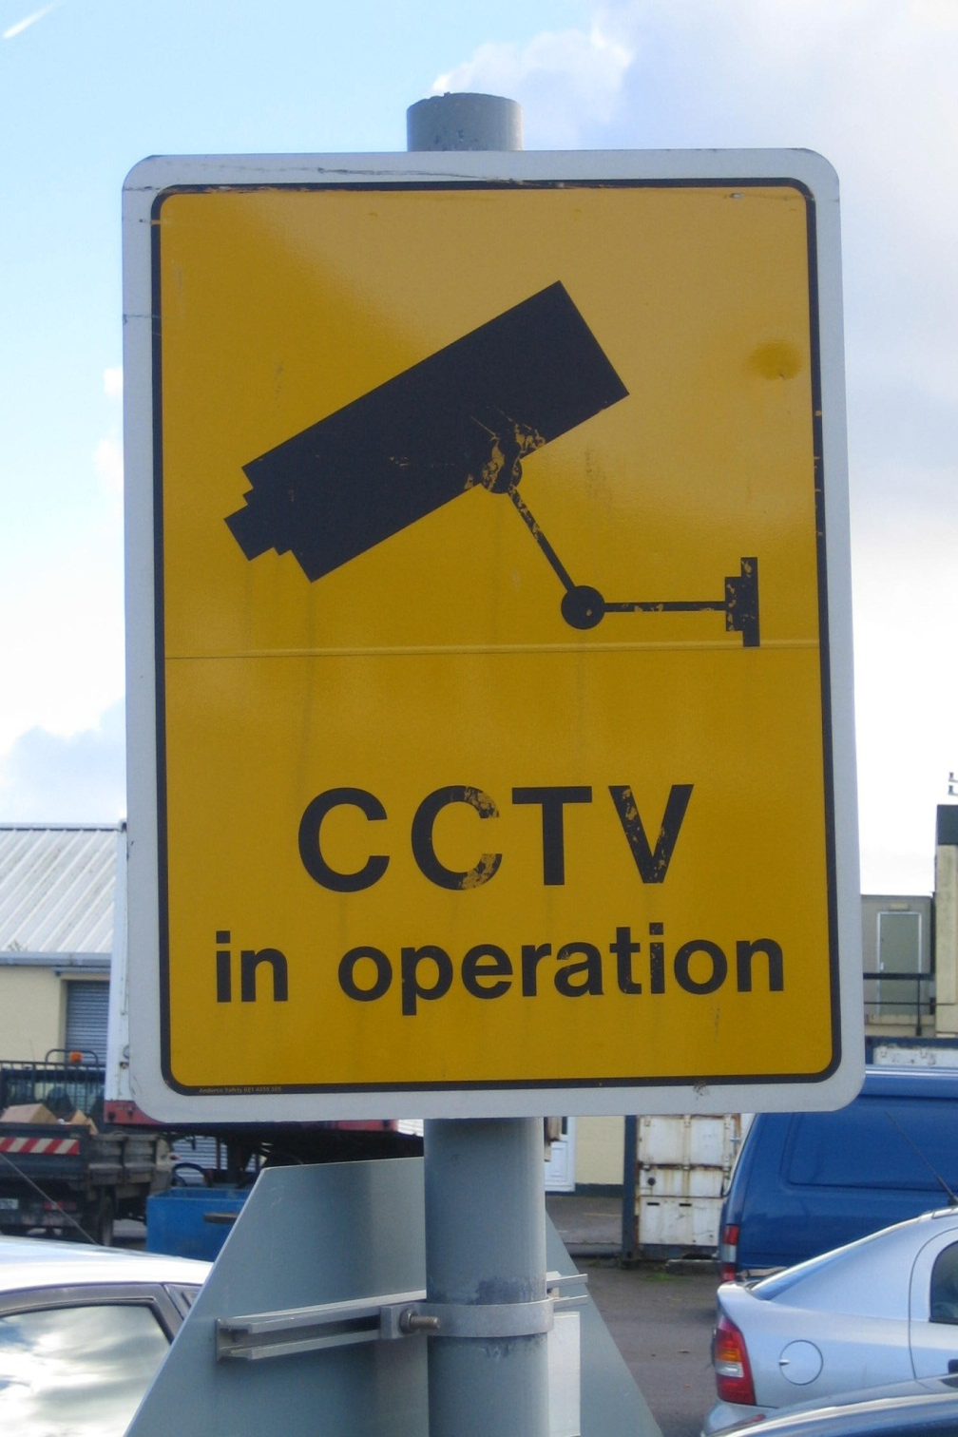
For Example…
Do you really get more security with surveillance?
What about the loss of autonomy from the loss of privacy?
Is there a policy on collection, use, disclosure,
Are we more secure?
46

Slide 47
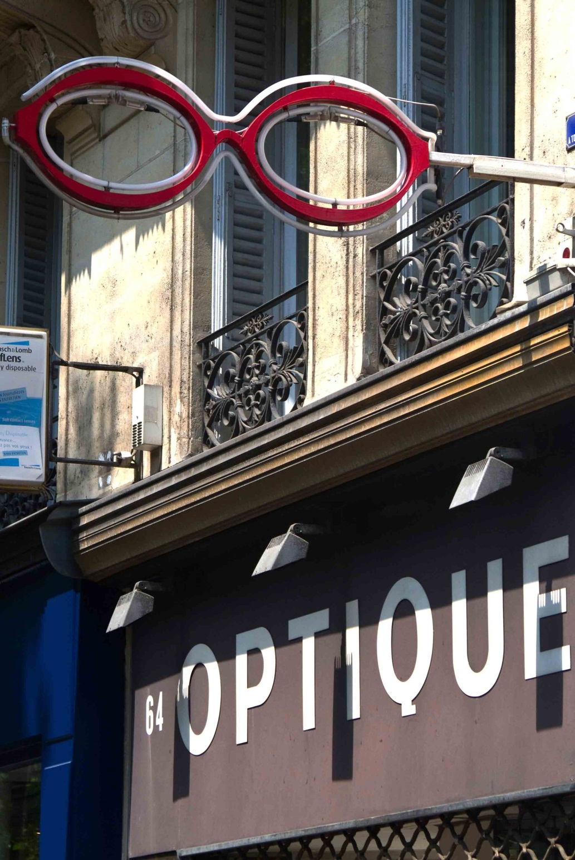
Map the Flow
Examine all the data
Classify it
Follow it
Protect it
47

Slide 48
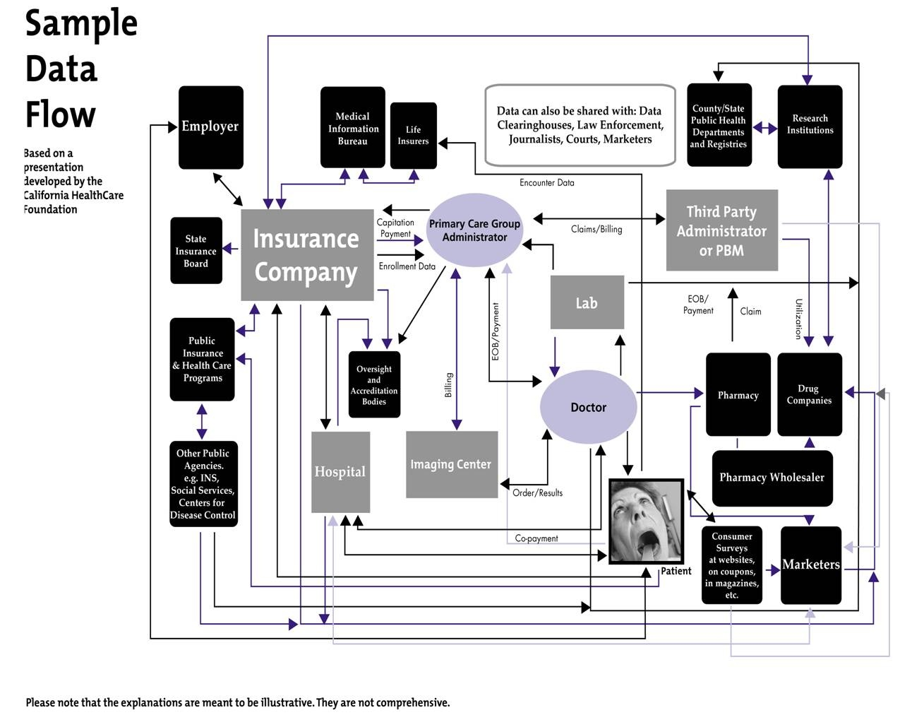
Data Flow Nightmares?
48

Slide 49
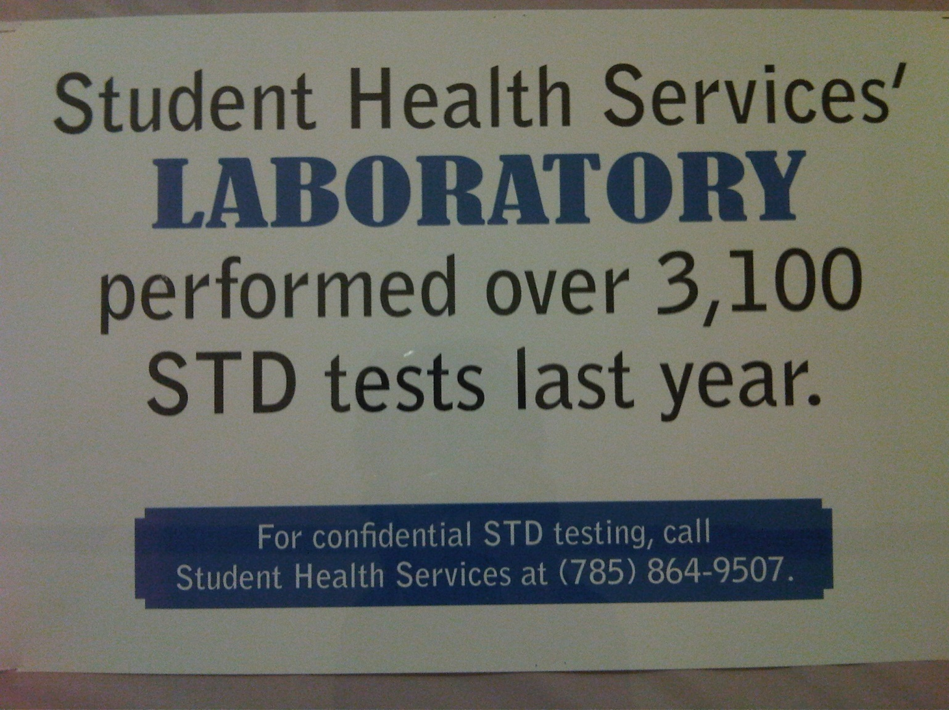
What are the Records?
49

Slide 50
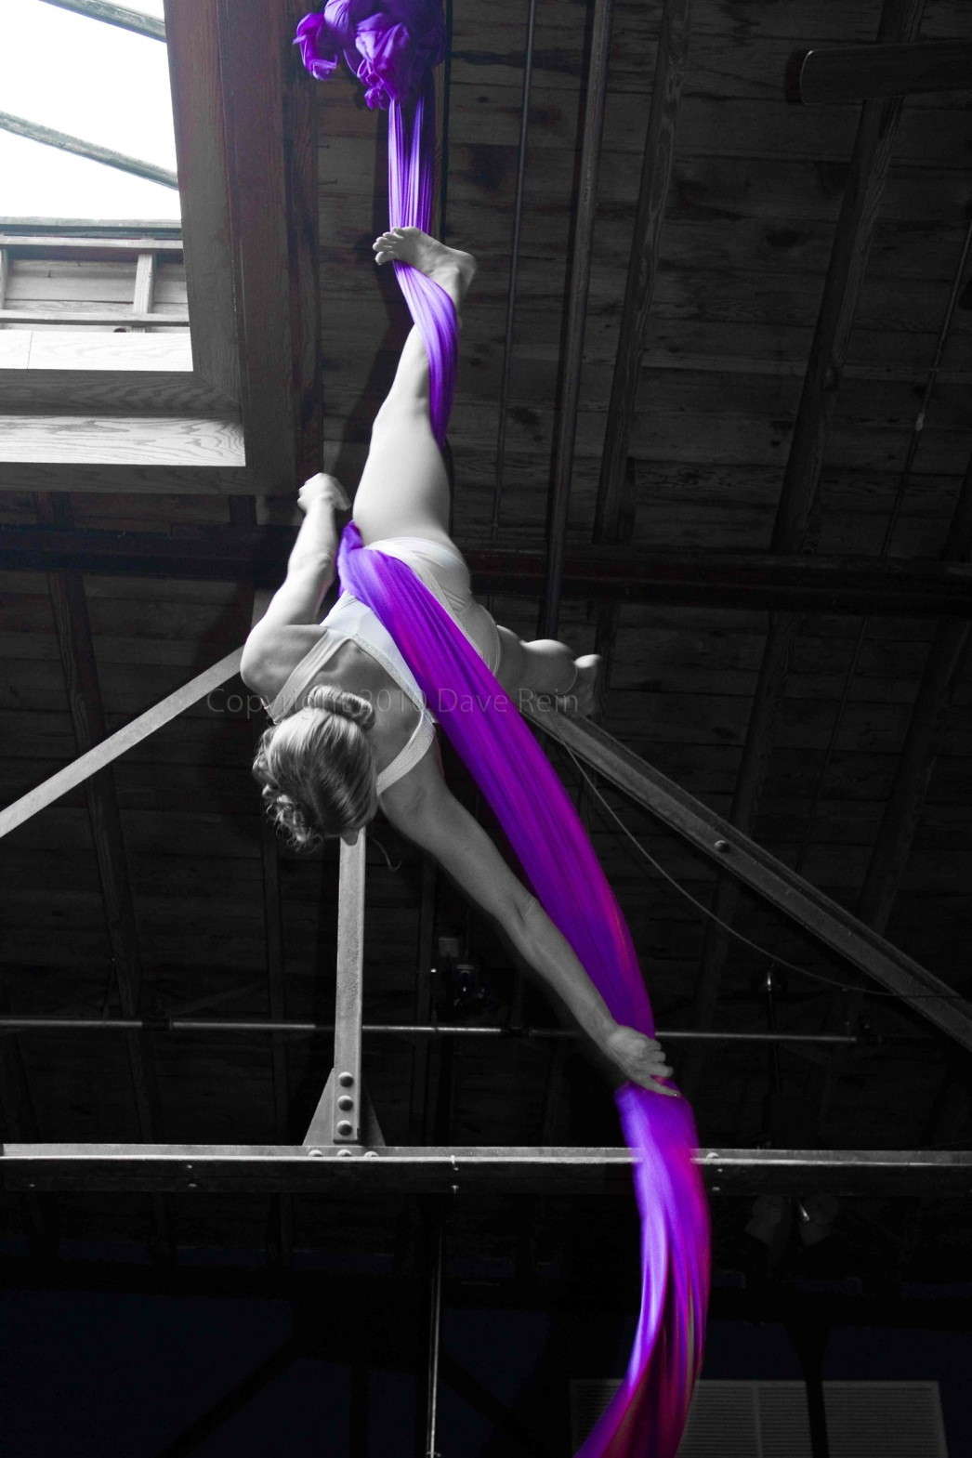
Contortion?
HIPAA expressly excludes from the coverage of its privacy provisions any records that are subject to FERPA
FERPA provides that “treatment records” are not subject to FERPA
HIPAA excludes “treatment records”
Treatment records disclosed then subject to FERPA
50
Notes:
— records created by medical professionals in the course of treating a student —

Slide 51
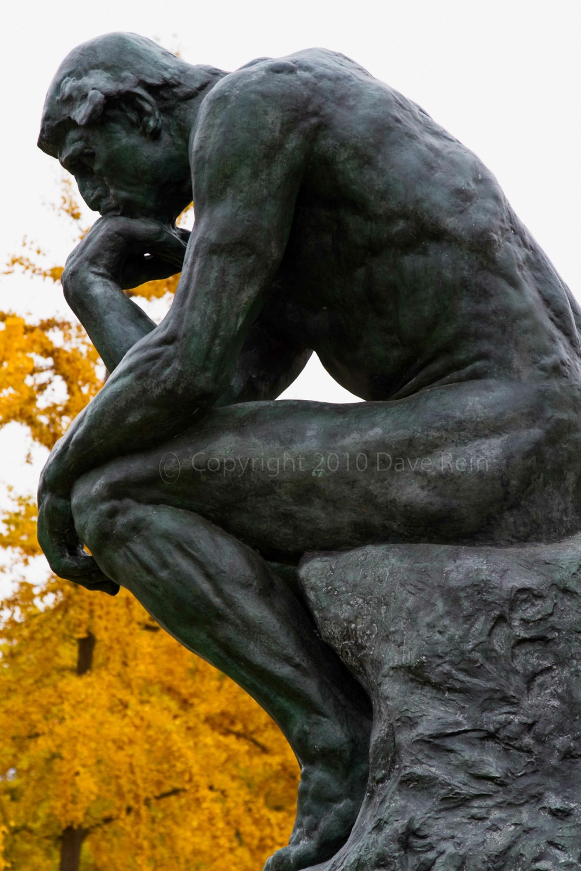
Results?
Medically-related student records – whether “treatment” records or not – are
Never subject to HIPAA’s privacy provisions
Always (really) subject to FERPA, and
“for all practical purposes, treated no differently under FERPA than any other student records.”
Steve McDonald, "The 7 Myths about FERPA", Chronicle of Higher Education, 2008
51

Slide 52
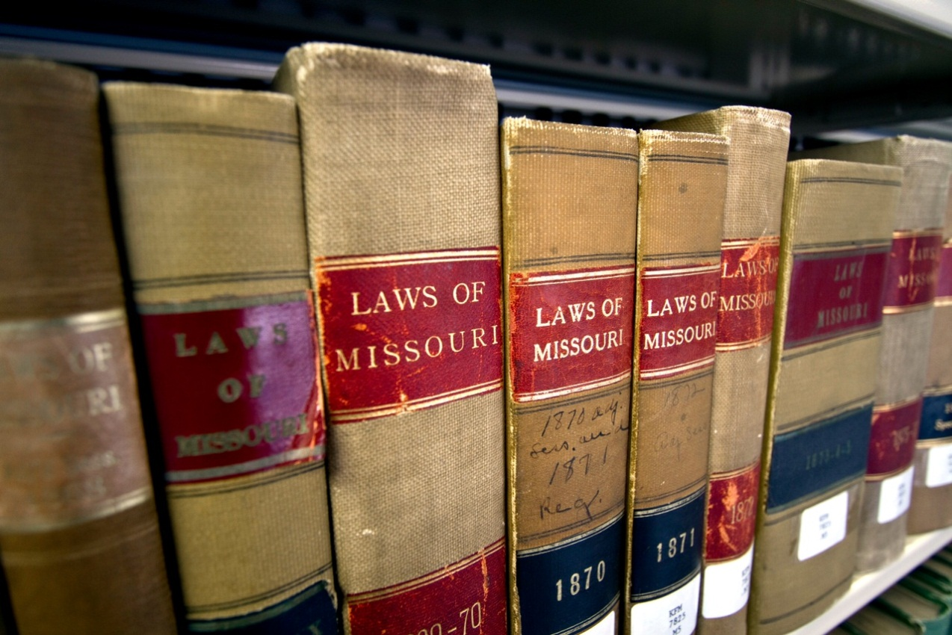
Reading Reading Reading
52

Slide 53
Compare & Contrast
FIPP | HIPAA | FERPA
Notice | Yes | yes
Choice/Consent | Yes | Yes
Collection Limit | Purpose | In attend
Use Retention | Min Nec | LEI
Disclosure Limit | Authorization | Consent/K
Access | Yes | Yes
Integrity/Secure | Yes | Yes
Enforcement | OCR | Education
53

Slide 54
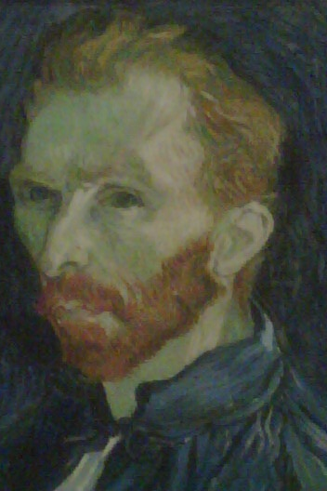
madness?
"Once the privacy risks are understood, the institution must take steps to address them. Information privacy is enhanced through the application of the Fair Information Practice Principles (FIPPs), through principles outlined in the OECD Guidelines on the Protection of Privacy and Transborder Flows of Personal Data, and through the Generally Accepted Privacy Principles."
Merribeth Lavagnino,
"Information Privacy Revealed,"
Educause Review, January/February 2013
54
Notes:
OECD FIPPs as Cited by MB Lavagnino, Educause Article
1 Notice
2 Choice/Consent
3 Collection Limits
4 Use & Retention
5 Disclosure Limit
6 Access
7 Integrity & Security
8 Enforcement & Redress

Slide 55
Build Better Mousetrap?
Is there a better way to train the masses?
What about handling the issues?
“In nearly every situation, an institution should be able to identify one or more actions it can take to address any privacy issues, while still achieving its business goal.”
Merribeth Lavagnino,
"Information Privacy Revealed,"
Educause Review, January/February 2013
55

Slide 56
Security Model
Confidentiality
Integrity
Availability
C
I
A
56

Slide 57
Privacy Model
Privacy Principles
Privacy Impact Analysis: P-I-A
Example: Note Penn does the SPIA – Security & Privacy Impact Analysis
Lifecycle
Accountability
Notice
Choice/Consent
Collection Limit
Use/Retention
Disclosure Limit
Access
IntegritySecurity
Enforcement
57

Slide 58
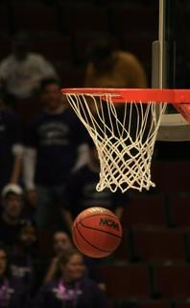
Lifecycle/Info Privacy
Creation/Receipt
Storage/Management
Use/Re-Disclosure
Retention
Disposition
Begin Again
58

Slide 59
P.I.A. Not C-I-A
What information is to be collected (e.g., nature & source)
Why the information is being collected (e.g., determine eligibility)
Intended use of the information (e.g., verify existing data)
With whom the information will be shared (e.g., another agency for a specified programmatic purpose)
59

Slide 60
P.I.A. continues
What opportunities individuals have to decline to provide information (e.g., where providing is voluntary) or to consent to particular use of the information (other than required or authorized use), and how individuals can grant consent
How information will be secure (e.g., administrative & technological controls)
Whether a system of records is being created subject to laws
60

Slide 61
Full-Time CPO or Part-Time CPO
Full-Time | Part-Time
Focus on Privacy | Limited or Split Focus
Info Management | Security
P.I.A. ahead | C-I-A
Policy | Not action
Not in I.T. | Not in I.T.
Decisionmaking | Harvard Email – Conflicted
61

Slide 62
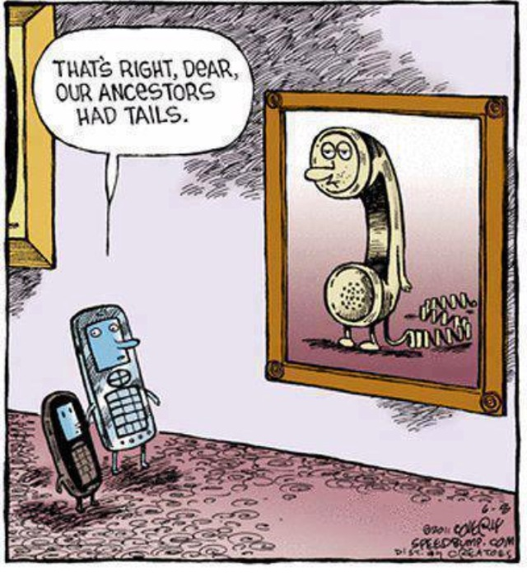
Next in Privacy
Coverley speedbump.com
6-8-2011
62

Slide 63
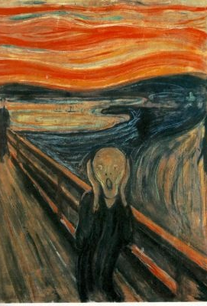
Next in Privacy
Big Data
BYOD/CYOC
Unusual Devices – Medical
Multi-Factor Authentication
Audits/Fines
Cloud Apps & Storage…
63
Notes:
a. Big Data—everybody wants some
i. Your Communications & Alumni will want your Data and Track your Exes
b. BYOD is a sink hole w/o controls
i. Can you agree on policy
ii. How much is too much info to know about your users
c. Weird Devices will be vulnerable and leak info
i. Medical devices
ii. VoIP
iii. Multi-Factor Authentication
iv. More fines to come, come, come
d. Europe is getting closer w/o the Concorde Airplane

Slide 64
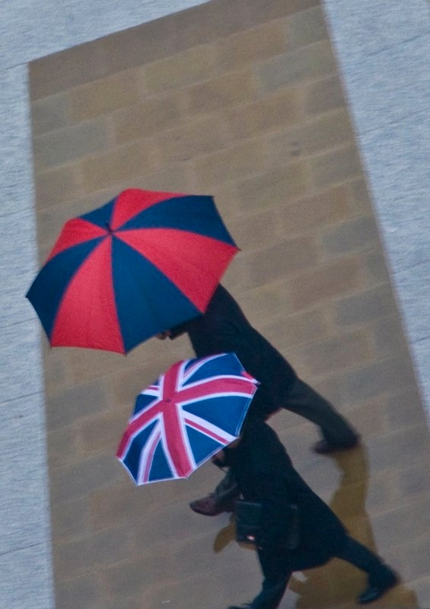
Global Issues
Transborder Dataflow
International Students
International Employees
Deemed Exports
Expectations of ownership?
PII vs. Personal Data
De-identification???
64

Slide 65
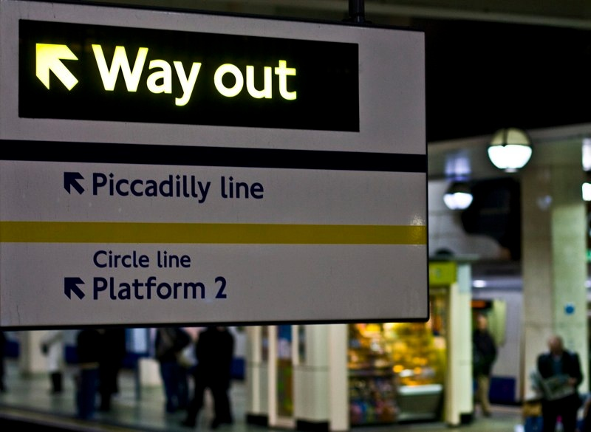
Information Privacy
Is Privacy the Way-out of the Quagmire?
Privacy = Respect for your community
Educause – Policy, Security, CPO
IAPP
65

Slide 66
questions?
CONTACT:
michael.carr@uky.edu Michael Carr
jer@ku.edu Jane Rosenthal
66

