Slide 1
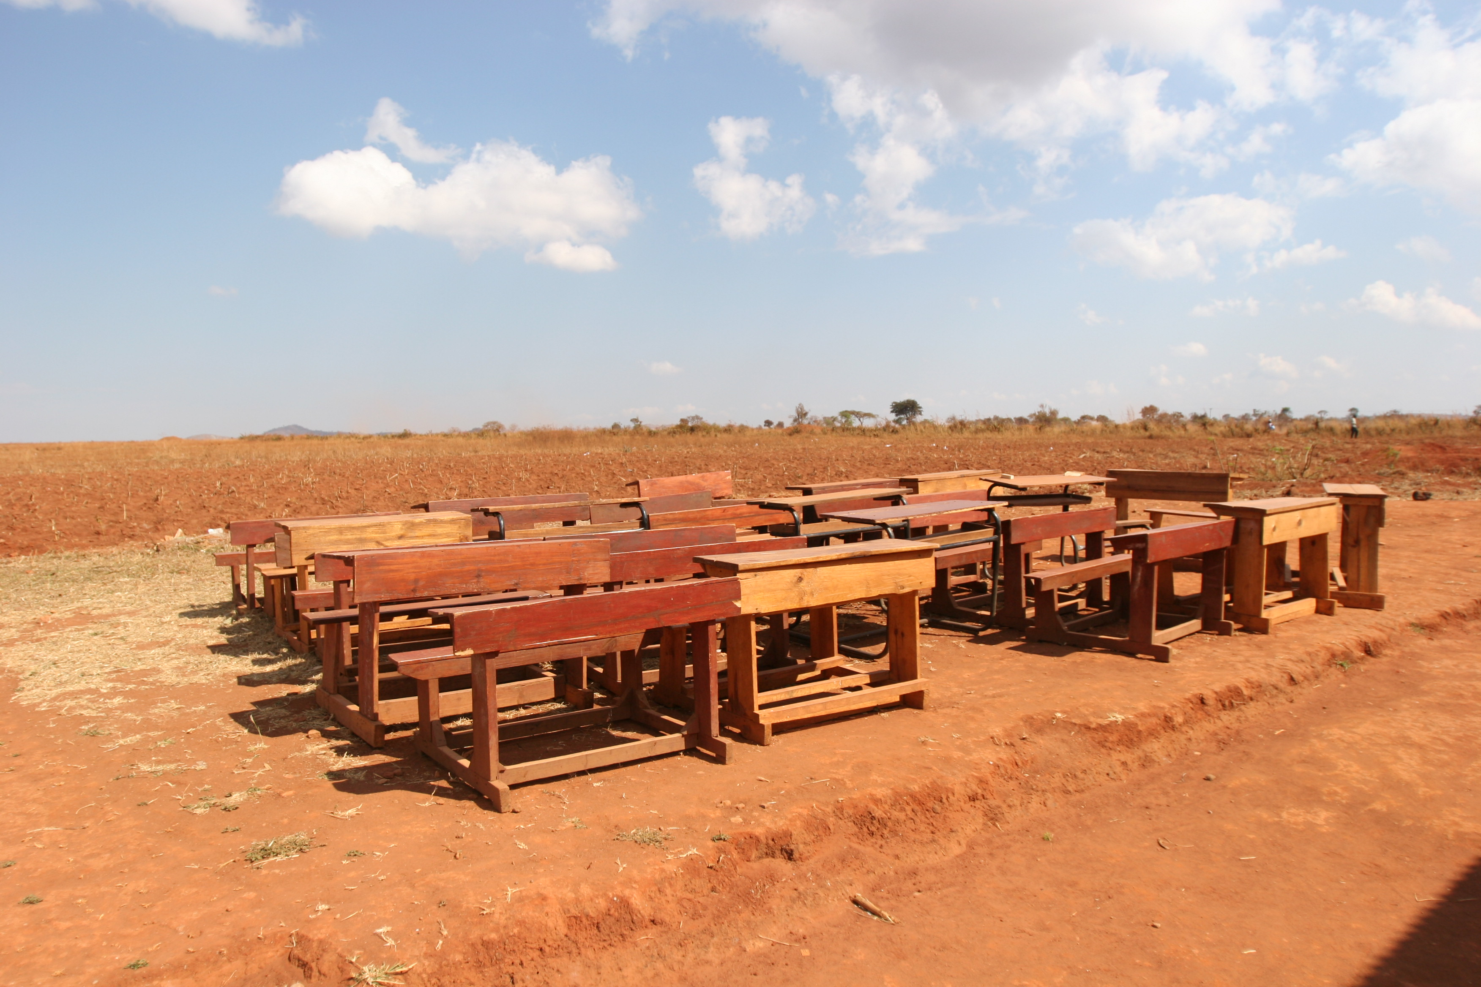

Slide 2
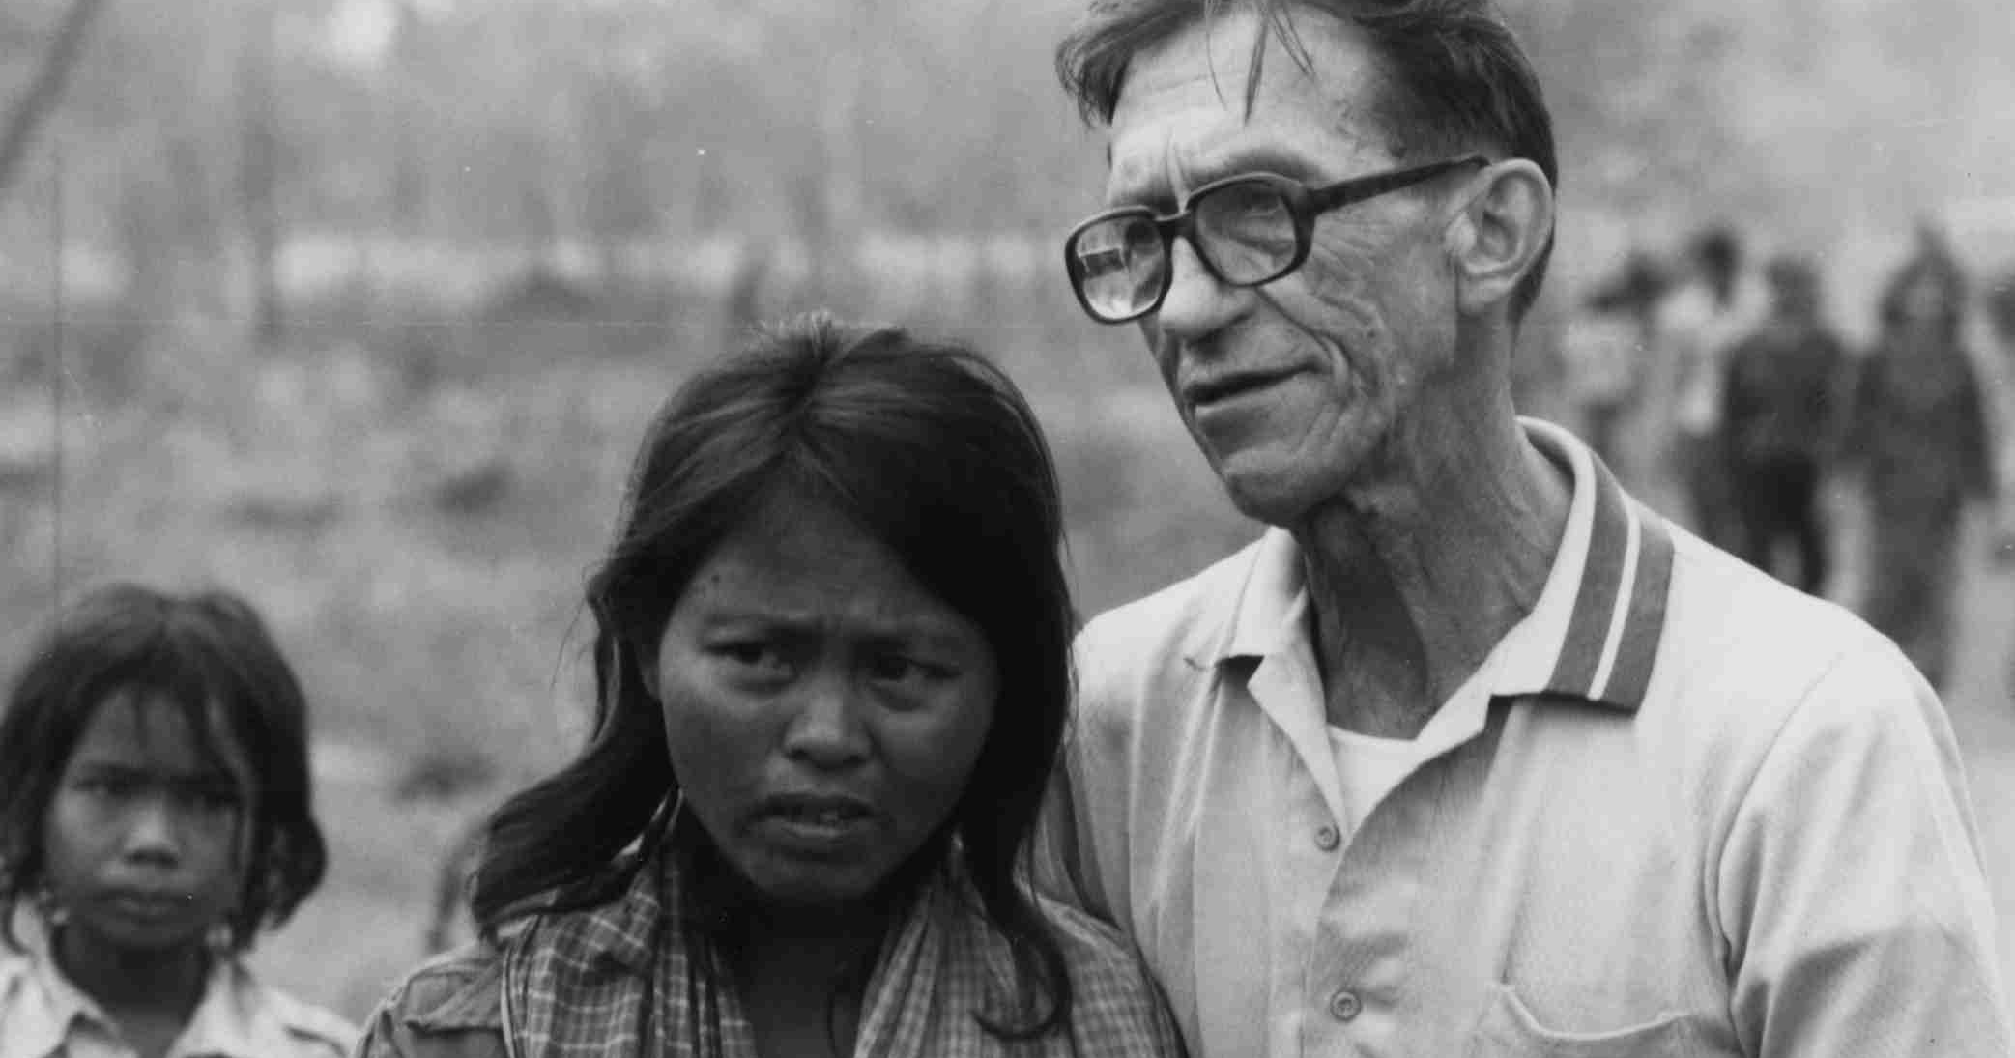
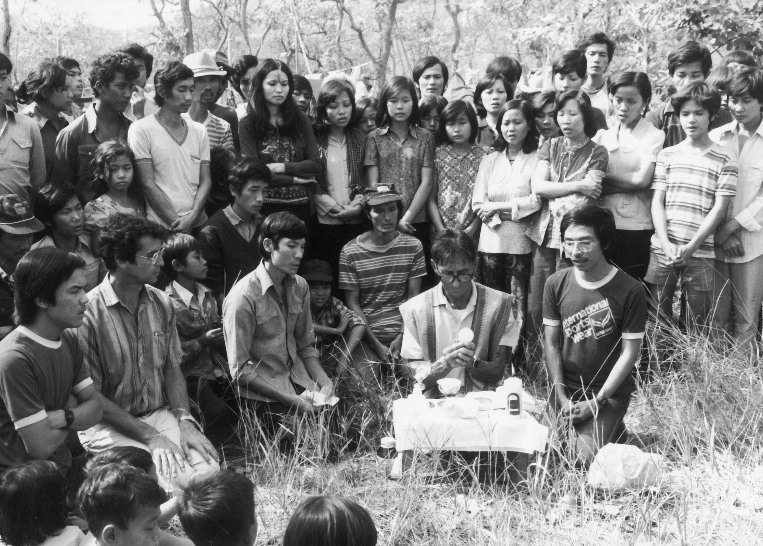
“Around Christmas time, last year, struck and shocked by the plight of thousands of boat people and refugees, I asked what the universal Society could do to bring at least some relief to such a tragic situation.” Pedro Arrupe

Slide 3
Causes of conflict: Poverty and low education
HDI:
Low income
Low education
Low life expectancy
HDI 2008, Human Development Index

Slide 4
Governance: Struggle for political power
Economy: Struggle for resources, ‘Resource wars”
Identity: Struggle for Ethnical and cultural Identity
Religion: Struggle for religious Identity

Slide 5
“The deeper spiritual, human and psychological proximity” -Education
Education as basic condition for political participation and democracy
JRS supports for the education of 280,000 children, youth and adults

Slide 6
The Challenge
The camp itself is relatively isolated. The nearest commercial airports are 90km away.
The camp is located around a dried river bed that floods on the rare occasions it rains.
Security is an issue however. The camp authorities request all NGO workers to leave the camp by 6 pm.
The camp is large, 13 km², divided into 4 areas

Slide 7
Project Objectives
The provision of stable and effective internet access at all three locations;
The enrollment of two cohorts of 60 students at two locations;
The successful completion of at least three-quarters of the numbers involved.

Slide 8
Project Objectives
The direct participation of at least 1,000 individuals in the academic credential and/or Community Service Learning Tracks.

Slide 9
One Year from Dream to Reality
Daniel/Cindy test - troubleshoot Multipoint Server Solution
(9/5)
Microsoft employees donate ALL Licenses
Computers arrive at Gonzaga. (9/15)
Repalletize computers (9/18)
ED205 Begins (1/14)
Roof leaks in Malawi. Switch to contingency plan.
Regis Meeting (7/29)
Kinoti and Mary Skype Thomas (7/30)
Presented concept to potential donor (3/18)
Equipment Clears Customs
Power and Internet
March | April | May | June | July | August | September | October | Nov | Dec | Jan | Feb | March | April
Awarded grant (4/14). Mexico City Summit (4/20)
Chris agrees to help (6/30)
Peter meets Bill Hilf (Microsoft) (7/8)
Peter meets Cindy in Rome (7/13)
Conference call with Microsoft and UNHCR (7/21)
Microsoft Meeting (8/11) Meet Multipoint Server Team. (James Duffus)
Jim orders computers.
Battery Crisis (9/21)
Labs Ship (9/22)
Bridge Course begins (9/27)
Thomas’ team sets up labs.
First posts from camps!
(11/27)
Roof repaired. Power restored.
Students complete first course. (4/5)

Slide 10
The original companions
Mary McFarland, Bill Husson, Charles Currie, Paul Locatelli, Chris Lowney, Peter Balleis and Neil Sparnon
Anne Ziegler and Johannes Ephrat
Gonzaga - Chris Gill -> Jim Jones & team
Regis University
Kinoti Meme -> Thomas Gitumbi
Thomas Gitumbi -> Stephen Mwangi
Christian Braunigger and Clotilde Garner
The Refugees

Slide 11
Strategic Planning or Divine Providence
Shipped 2 labs <5K
Issues
Wood Pallets
Lithium Batteries
Customs Declaration

Slide 13
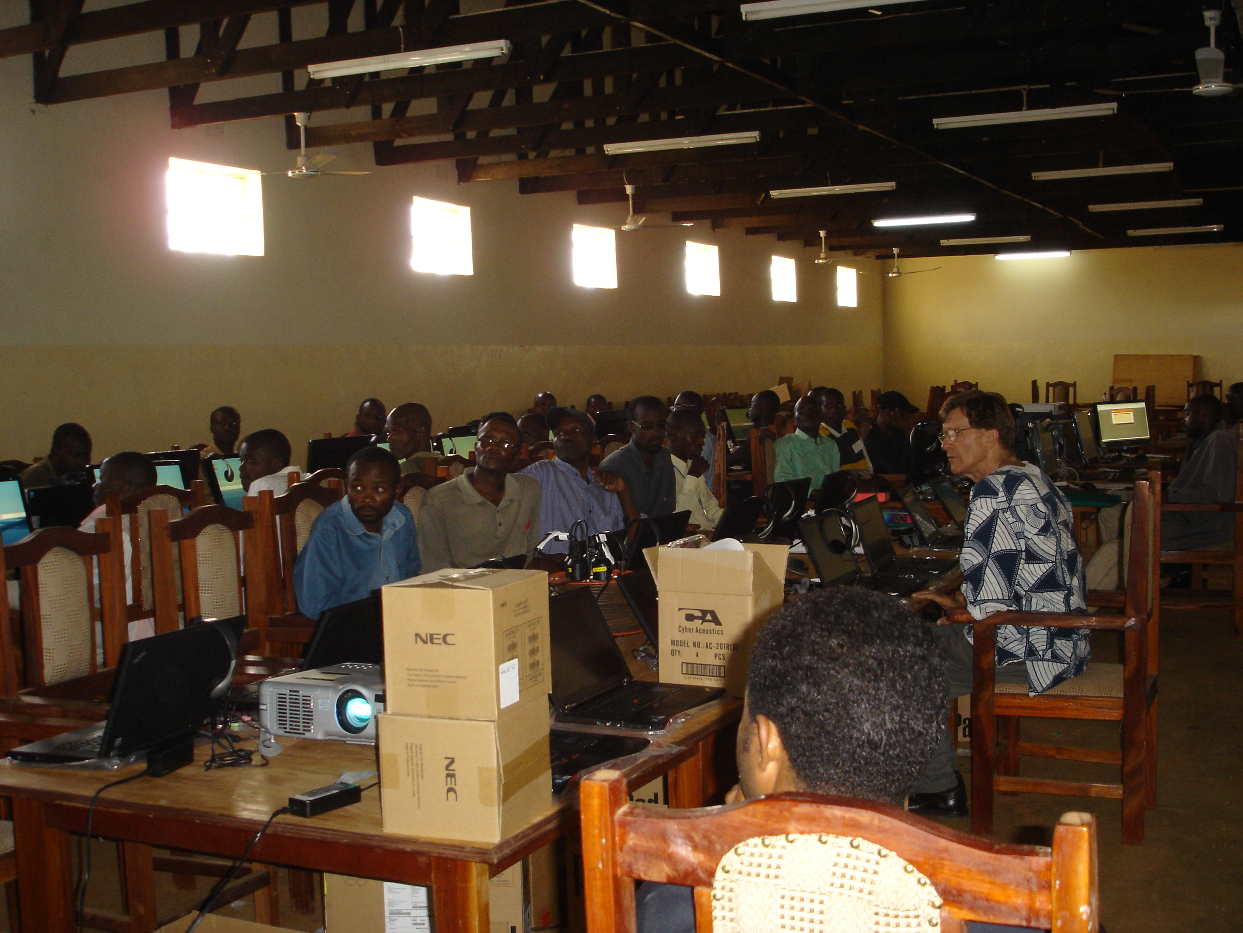

Slide 14
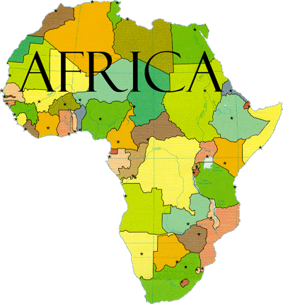
Meet the Students…
Kakuma
35 students admitted
7 countries represented:
Ethiopia;
Somalia;
Sudan;
Uganda;
Rwanda;
DR Congo;
Burundi;
Kenya (Turkana, host community; pastoralist people)
8 women

Slide 15
Meet the Students…
Dzaleka
32 students admitted
3 countries:
Burundi
Rwanda
DR Congo
2 women

Slide 16
Meet the Students…

Slide 17
More Companions
Faculty from 28 institutions
The Ricci Group (Pablo Molina responds first!)
Microsoft (Bill Hilf and James Duffus)
UNHCR
I2 (Dave Lambert and Anna Preston)
… and the list continues to grow.

Slide 18
“Thanks for the constant support and discrete work that turns the wheel.”

