Slide 1
Adaptive Vendor Management Strategies
Interactive Discussion based on two higher education perspectives and audience participation
Dana Gangemi
Sr. Manager, Supply Chain Management
New York University IT
Bill Koffenberger
Director Service and Contract Management
Division of IT
The George Washington University

Slide 2
Introductions – Who Are We?
Central IT comprised of ~470 employees
Segmented into 5 organizations (Office of VPs, Teaching and Learning with Technology, Services/Security/Compliance, .Edu, Technology Operations Services)
8 vendor management staff
Centralized IT 240 employees
DCIO Operations, AVP Research Technology, AVP Business Intelligence, AVP Information Security and Compliance
3 vendor management staff
~100 IT staff across schools and divisions
Advancement, Law, Engineering, Medical School, Academic Technologies etc. (about 12 schools and divisions total)

Slide 3
Audience Sharing
Feel free to approach a microphone when you have a question or comment.

Slide 4
Poll Question
Institutions represented in our session today:
Public Institutions >20,000 enrollments
Private Institutions >20,000 enrollments
Public Institutions 10 to 20,000 enrollments
Private Institutions 10 to 20,000 enrollments
Public Institutions <10,000 enrollments
Private Institutions <10,000 enrollments

Slide 5
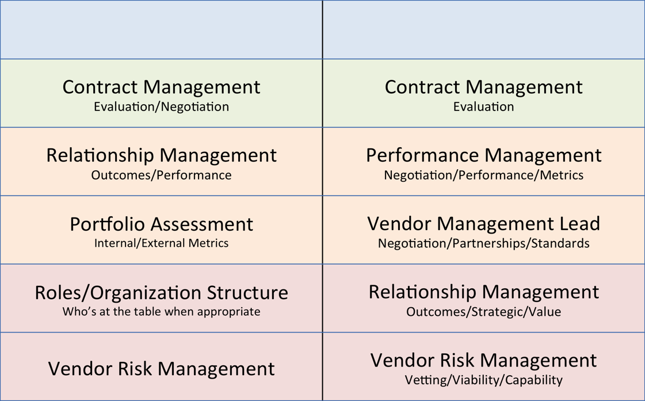
Comparison of Current State: Vendor Management
Leading strength
Current Focus
Improvement Opportunity

Slide 6
Vision
A formal vendor management program that realizes best value through partnerships/collaboration and support from leadership.
Objectives
View contracts portfolio holistically and find ways to consolidate/co-term.
Move away from “processing house” mentality.
Raise questions and hold both clients and vendors accountable.
Serve as experts in contract management/negotiation.
Take the emotion out of procurement.
vendors know our colleagues want the service, how do we get the best service for the best price?
Understanding what is on the horizon and plan/prepare accordingly.

Slide 7
Vision
Increase IT efficiencies and service value through formal vendor management program
Objectives
Mature contract review success toward tangible outcomes (measurable deliverables)
Consistent, efficient, repeatable process
Model for university
Trusted Partners to Counsel and Risk Management
Empower IT leaders / technical leads
Increase and measure accountability
Preparation for flexible staff and solutions sourcing
Holistic vendor engagement

Slide 8
Poll Question
Do you have a vision for IT vendor management?

Slide 9
Audience Sharing
Would one or two of you like to share your Vendor Management vision?

Slide 10
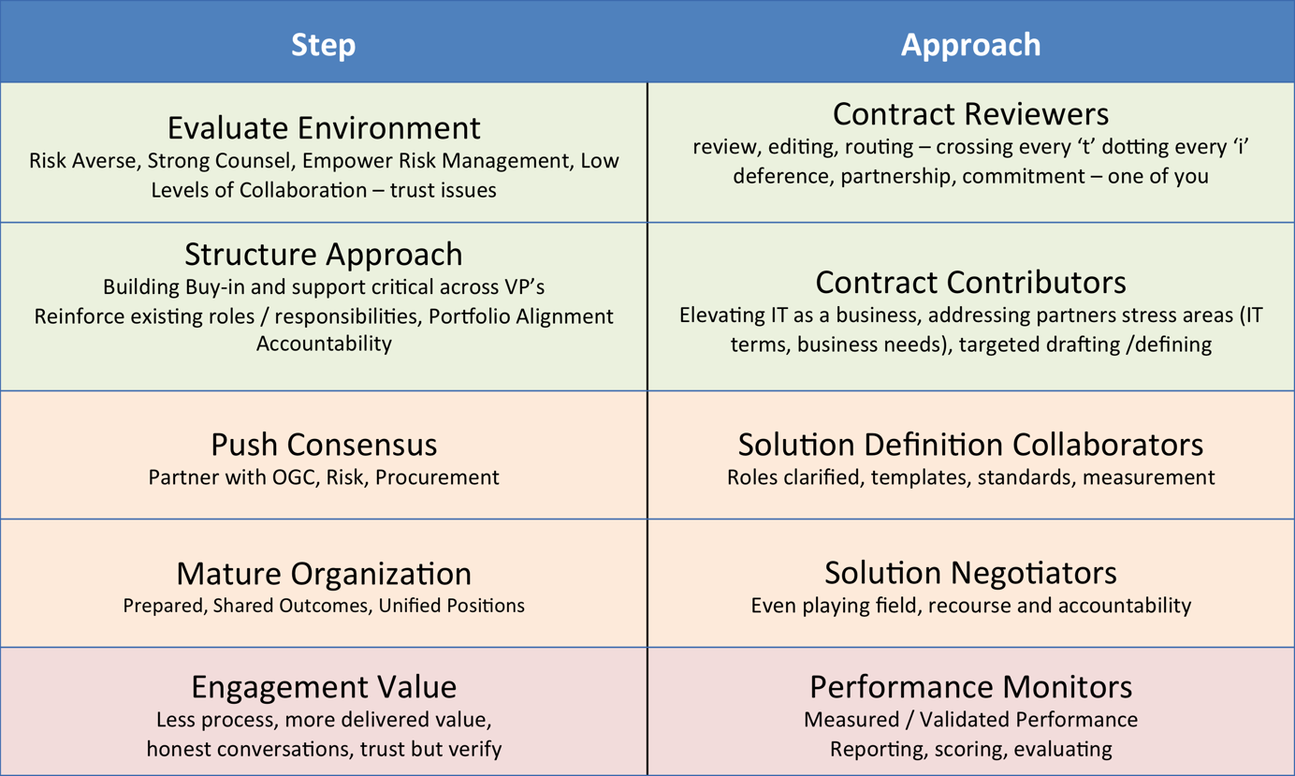
Strategy to Execution

Slide 11
Strategy to Execution
Developed contracts portfolio database to aide in decision making.
What do we have? What do we really need?
How does it fit in with our existing portfolio?
Is there overlap or synergies?
Attend key meetings where projects/initiatives are discussed.
Meet with directors to review portfolio.
Continued marketing and “selling” of our group to our organization.
Prove our worth!
Document and showcase savings/big wins
Liaise with central procurement on larger enterprise deals to gain buy-in from various schools/units.

Slide 12
Poll Question
Which of the following has been your biggest challenge?
Uncooperative partners (i.e. OGC, Procurement)
Lack of IT senior management engagement
No challenges it is all working terrifically
Not working on Vendor Management Program

Slide 13
Audience Discussion/Sharing
How have you overcome IT buy-in challenges in executing your vendor management program?

Slide 14
Vendor Management Program Three Strategies for Success
Partnership and Negotiation
Who are your negotiators?
Contract Reviews
Structured Review Approach
Security and Compliance
Considerations and vendor management leverage
Performance Management
Teeth behind the words
Sourcing – how are you evaluating / leveraging data?

Slide 15
Partnership & Negotiation Strategies
“Muscle”
Collaborate with business units and lead the negotiations
IT leads are engaged in details and specifics – what they want and how they want it done
“Good Cop/Bad Cop” strategy
Analyze bid to find gaps, use data to push for better offer
“Backbone”
Partnering and guiding technical leads – empower staff to obtain more successful outcomes
SOW’s template – milestones, deliverables, checkpoints, structure payments
Management pressure / support – ask for a better offer
Focus areas: Period of performance / milestones – how to structure a project to obtain expected outcomes

Slide 16
Thought to Consider
Are your vendor leads ready to be negotiators?
Please feel free to approach a microphone to share.

Slide 17
Contract Reviews
Vendor Management review centralized and reviews prior to OGC review
Developed Templates
Initial - GW InfoSec – early on data addendum, vendor assessments (infosec questionnaire)
Current – addendums, SOW template, key elements checklist
Standardized submission content
Building strong relationship with OGC, Procurement and Risk
Paralegals to Counsel’s office moving to collaborative reviews and IT as a business
IT contract management across all university groups
About 90% of administrative / ~75% provost IT contracts reviewed by IT contracts team
Dedicated team member to review all new contracts and redline prior to OCG review.
Developed template of standard NYU redlines to assist in efficient review.
Provide questionnaire to client to gain information on product/service to aide in reviewing business terms of contract.
Strong link between NYU IT, Central Procurement, OGC and Risk Management
Actively participate in conversations between NYU legal and Vendor legal teams
Provide “one-pager” with large enterprise contracts that identify key offerings

Slide 18
Thought to Consider
Are your contract reviews focused on legal issues or holistic vendor engagement and overall value?
Please feel free to approach a microphone to share.

Slide 19
Contract Reviews Security and Compliance
HIPAA and FERPA Language
Data Sharing (Privacy and Destruction)
Security Questionnaire
Language specific to integrations with enterprise systems
Confidential Data Addendum
Disaster Recovery and Business Continuity DR/BC provisions
Force Majeure - strategies to influence OGC engagement
Business alignment to service needs
Internal or SaaS vendors
Security Assessments / Questionnaire
HR – background checks standardized language

Slide 20
Quick Poll
Do you have the ‘right’ balance between information security risk elimination and acceptable risks?

Slide 21
Audience Sharing
What are one or two risk management strategies that work well for your institution?

Slide 22
Performance Management
Aspirational Effort
Master Agreements (review for opportunities)
Building internal IT Service Management / Portfolio
Service Levels and Service Level Agreements
Outage / service interruption text
Basic service levels / reporting
Lots of Room to Grow
Emerging Strength
Quarterly Business Reviews with Key Vendors
Well-defined SLAs
Building in credits for not meeting service level
Understanding performance from user community
Is the vendor/service meeting the need?

Slide 23
Audience Discussion
Do you measure performance? How do you track data?
Sourcing – how are you evaluating / leveraging data?

Slide 24
Wrap-Up
Evaluate Current State
Establish a Vision
Develop Plan to move from Strategy to Execution
Consider Focus Areas and Team Composition
Partnership and Negotiation
Who are your negotiators?
Contract Reviews
Structured Review Approach
Security and Compliance
Performance Management
Sourcing – how are you evaluating / leveraging data?
Final thoughts

Slide 25
Help Us Improve and Grow
Thank you for participating
in today’s session.
We’re very interested in your feedback. Please take
a minute to fill out the session evaluation found within
the conference mobile app, or the online agenda.
Dana Gangemi
Sr. Manager, Supply Chain Management
New York University IT
dana.gangemi@nyu.edu
Bill Koffenberger
Director IT Service and Contract Management
The George Washington University
billkoff@gwu.edu

