Slide 1
Centrally Led, Widely Dispersed:
Creating an Identity and Approach for a Unified Organization That Propels the Mission
Cindy Mitchell - CIO – Colby College (formerly Associate CIO - University of Maine System)
Fred Brittain - Associate CIO – University of Maine System

Slide 2
The University of Maine System in 2012
The News Ain’t Good
Enrollments
Budgets
Notes:
Declining Enrollments
Declining numbers of graduating high school seniors in the state
State appropriation has increased by 0.5% in the past nine years
Tuition frozen for the last six years
Fiscal modeling suggests a 90 million dollar shortfall with no change
Action: Align administrative units to achieve efficiencies and saving to invest in mission-focused activity. IT is up first.

Slide 3
The IT Function
Align operations, functions, budgets and creating savings
Notes:
Seven distinct campus IT units with an 8th central unit become one
Personnel are redistributed into statewide functional units
Budgets are consolidated with campuses paying a shared services fee
15% of IT labor capacity is reduced
Budget cut by 10%
Focus: Align operations, functions, budgets and creating savings

Slide 4
The IT Function - Outcome
Confusion, gridlock, frustration
Notes:
Staff cannot fully migrate to new positions while covering legacy duties
Campuses had varying levels of service quality and all experiences degradation in at least one area of IT
Staff morale at an all time low with numerous resignations
Identity of staff members was tightly aligned with campuses and difficulty to easily change: System is Evil.
People were expected to work across campuses which had various portfolios, varied skill levels. Gem-like pockets of shared effectiveness and expertise.
No consulting support, no professional development. We were on our own.

Slide 5
The IT Focus
Mid level Leaders
Collaboration
Notes:
Enter the third shift in the IT movement toward a single organization.
(First: become one organization in name and budget oversight; second move people to shared services)
The new goal is to create collaboration and coordination across units
Develop leadership in mid-level staff and up-and comers
Action: IT 2.0

Slide 6
The IT Focus - Outcome
Are we not part of something bigger?
Notes:
Strategy is generated
Subsets of the organization experience collaboration, professional development, common language
The majority of staff are not engaged in the new activity
The work continues with mounting pressure
IT is primarily inwardly looking; losing focus on our customers as we wrangle ourselves.
From 2.0 arises the question of who are we?
The question is answered in the form of an identity strategy claiming that IT will transition from an “Asset to Service Focus”

Slide 7
The IT and University Focus
Put strong leadership at the campuses that speak the language
Organize with a focus on University service
Value skills beyond the technical and come out of the cave
Customer Experience initiative launched with campus-level operational managers as a shared professional development experience
Action: IT 2.1
Notes:
The fourth shift: while centralizing the IT function recognize the heart of the work is at the campus.
Refocus leadership toward campuses and their work.
Put the customer at the heart of the purpose of the work.
Create a shared professional development experience.

Slide 8
Identity
Transform US:IT’s identity from an asset-focused organization to a service-focused organization.
Notes:
US:IT will become proactive in aligning its services with the business needs of the University, striving to understand the needs of those served. We strive to be a partner in a way IT can bring intelligence to address challenges and opportunities as they emerge, be a leader for positive use of technology, and assist in University transformations. Historically, IT has acquired and managed assets determined necessary through IT decision processes, mandates, or requests. The purpose and outcomes have been secondary to acquisition and management. With this shift to a service based organization, the outcome required and the quality of the delivery of service becomes the focus. The results will be a more proactive organization considered to be responsive to the needs of the University and will move IT from the appearance of being a utility provider to a strategic asset of the University.

Slide 9
Workforce
The right people, the right tools, the right level of responsibility, and the right attitude.
Notes:
US:IT will strive to create and inspire competencies and strengths combined with process and empowerment within its workforce to support differentiated needs, quick response, and a staff with ownership and pride in the success of all they serve.
1.1: Recruitment, training, and evaluation of employees will have a greater emphasis on soft skills and business understanding.
1.2: Empowerment of employees will become an expectation. Staff will be given the tools and trust to accomplish tasks e frequently within their space without the need for escalation. Employees are encouraged to act on behalf of quality service when process is absent but also are expected to share their actions and results to help develop new processes as needed.
1.3: Expectations will be set for management to encourage and support these new competencies and the role of empowered employees. Leadership will be expected to align their teams and actions with the mission(s) of the University and the overall vision for US:IT.

Slide 10
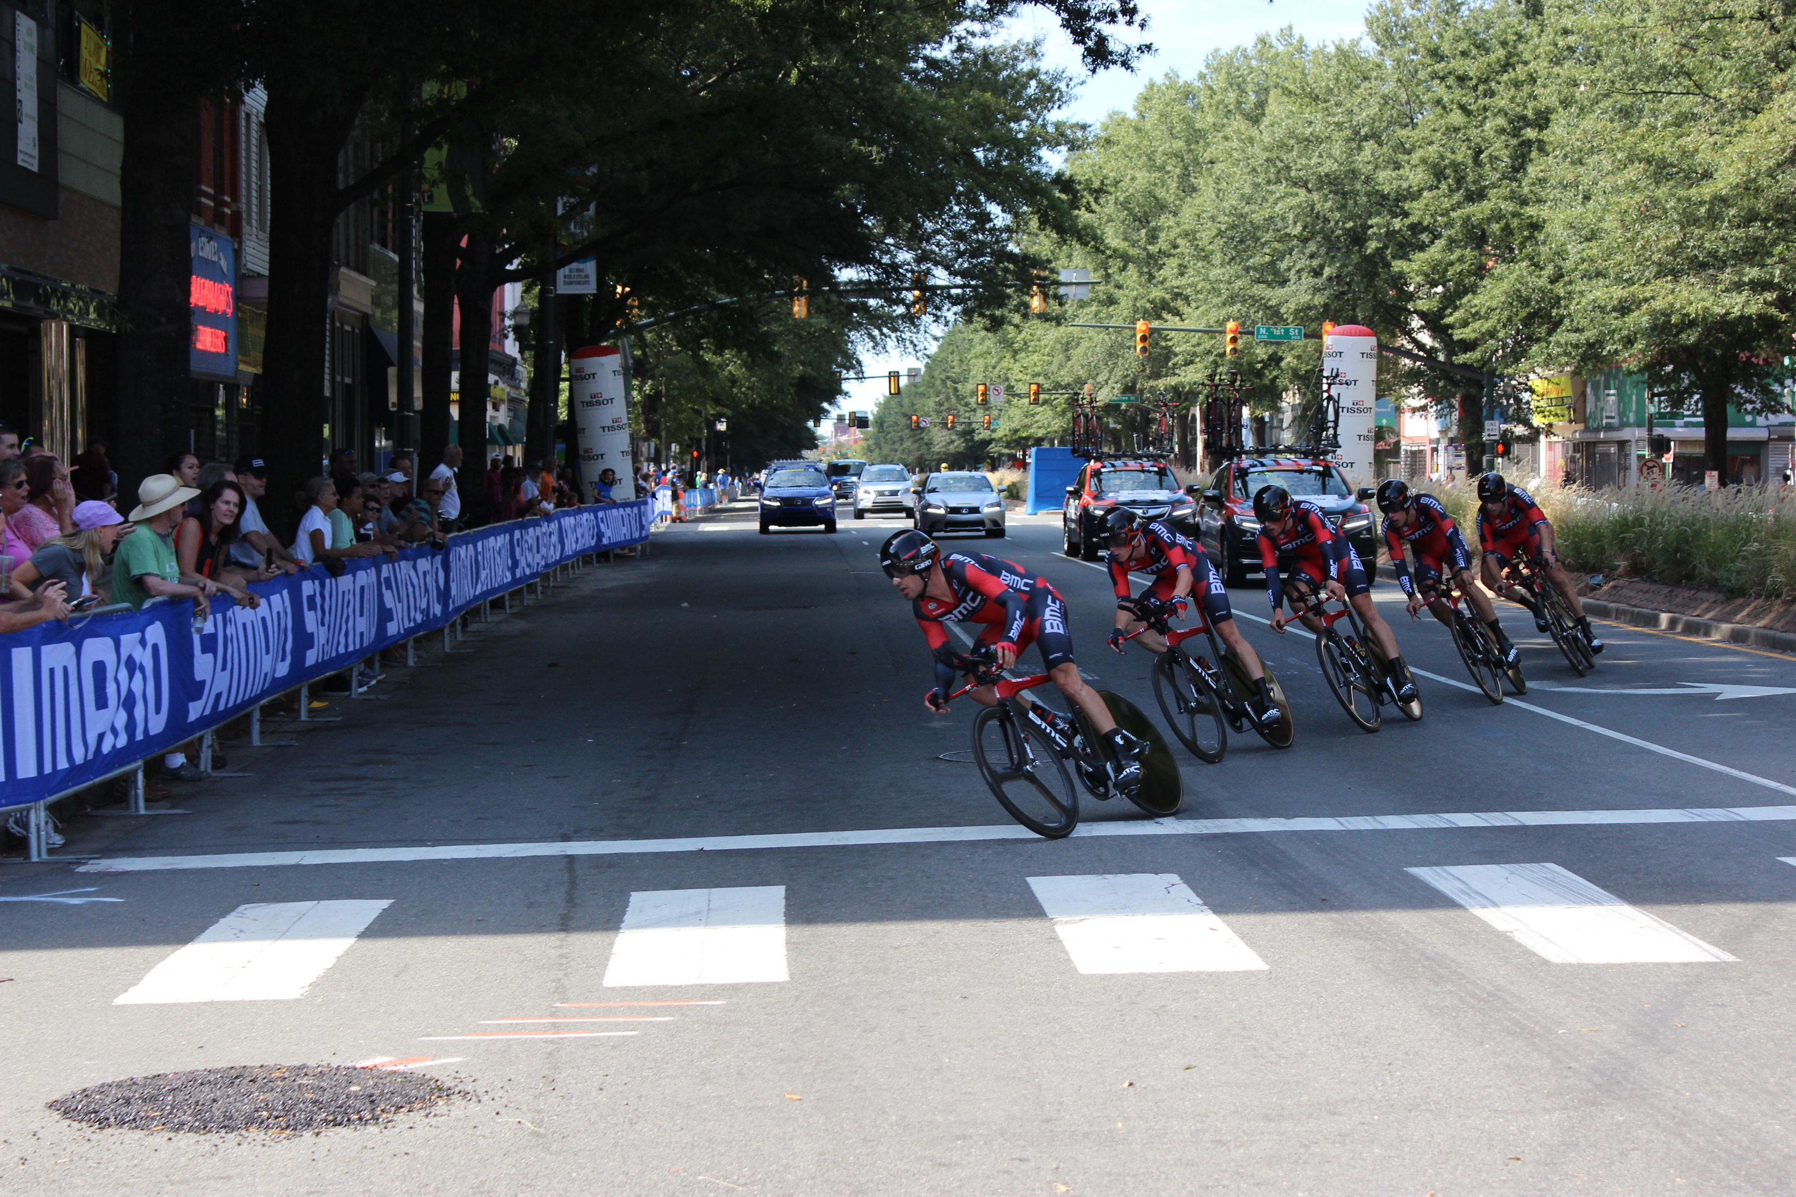
Relationships
We know who does the work, they know us, we share trust and common purpose.
Notes:
US:IT will put an emphasis on developing and maintaining relationships with academic, administrative and student units assuring an understanding of needs and creating a trust and belief within the University community that US:IT is committed to their success.
2.1: Structure will be created within the IT organization emphasizing relationship management across the University in a manner demonstrating IT’s belief the work happens on the campuses. Relationship managers will be expected to strive to understand all the areas on the campuses with which they work and will be empowered to bring and assign other members of US:IT to these areas as appropriate.
2.2: Communication will become a higher priority and will range from increased expectations of those who are assigned as having a committed relationship role to IT developing standard and robust communication strategies and mechanisms tailored to audiences and varying campus cultures.

Slide 11
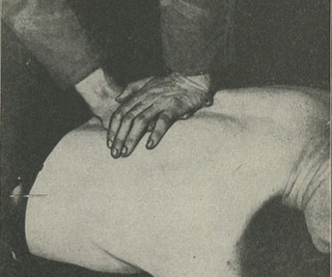
Alignment
In tune with the University. We’re not waiting for the next order but actively seeking ways to better the institution through technology.
Notes:
US:IT will strive to become more in tune with the business and academic needs across the institution. The results will be an organization sought out to address challenges and opportunities as they emerge, not solely for implementation and support.
3.1: Structure will be created to develop teams working directly with units across the University to be partners in the development of needs and ensure IT services used by those units are serving in a best possible manner, above and beyond support of tools.
3.2: Training will be prioritized to help IT staff in appropriate areas to fully understand the business of the units they work with and the transformation of those areas across the higher education landscape. These staff should be able to help units realize possibilities and leverage tools within the portfolio or advocate where there are gaps.
3.3: Direct contact with the IT staff who understand the work of units across the University will be employed whenever possible. Having those people who understand the work also providing support and direction in tandem with relationship management will be expected whenever possible.

Slide 12
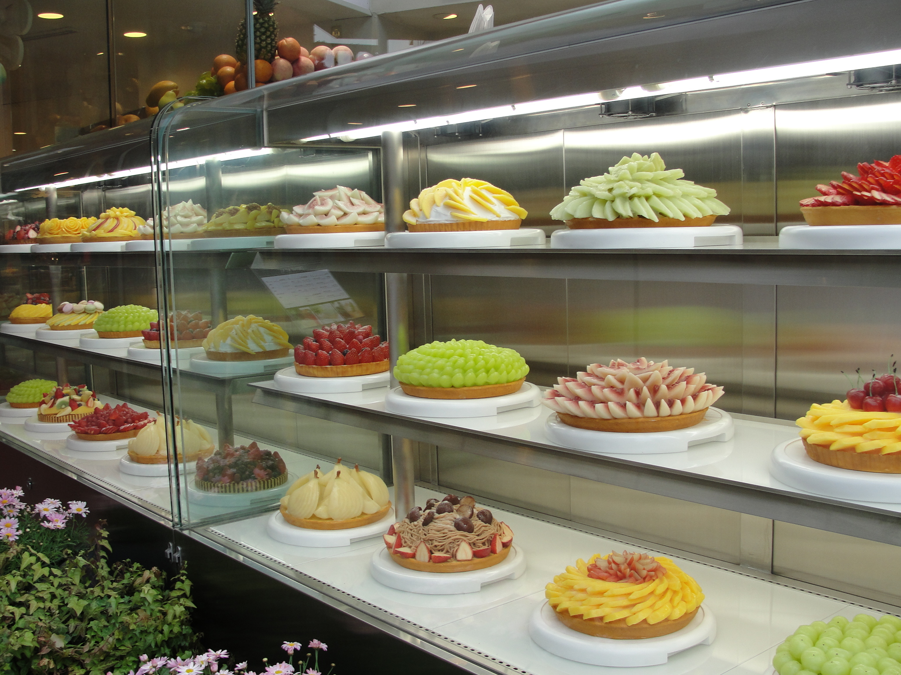
Portfolio
The right services to meet the need. We are providers and brokers.
Notes:
US:IT will effectively manage its portfolio in such a way to inform budgetary decisions, reduce expense, create a positive experience for students, faculty and staff while still ensuring needs are met.
4.1: Evaluation of all IT assets, including hardware, software and outsourced services will be performed. Key elements are total cost, alignment with need, performance, duplication with other services, and alternatives. Within this evaluation, recognition that similar but not identical services may be necessary given program uniqueness and through established relationships and collaboration with University leadership, decisions will be made.
4.2: Approach for all new services will be held to the same lens as the evaluation of existing services (4.1) and IT will strive to balance optimal service delivery with cost. Outsourced or cloud services will be an unbiased part of the evaluation whenever possible to keep IT staffing resources as focused.
4.3: Analysis of the current portfolio of services will be conducted with input from the University community. This to determine if IT is providing services in the most desirable way whenever possible, e.g. mobility, rather than simply confirming functional needs are met.
4.4: Prioritization of budgets and projects will be based on the determined needs of the portfolio and done with input from campus leadership.

Slide 13
Culture
A “can do” organization that makes the University even better.
Notes:
US:IT will work towards effective culture, structure and processes enabling the organization to become an effective and strategic element of the University.
5.1: Trust amongst IT units will be expected. IT managers will be encouraged and evaluated on their success in establishing process and relationships between their units and other IT areas empowering service-delivery and ownership of outcomes at all levels.
5.2: Flexibility within the organizational structure will be expected. Multi-disciplinary teams will be frequently used for both projects and problem solving. Staff will need to grow accustomed to a sense of responsibility to both people and projects not totally within their current area.
5.3: Learning and process creation will occur on an ongoing basis. IT staff will be expected to share problems and solutions in such a way that others may learn and IT can establish ways to efficiently and successfully handle the work.
5.4: Assessment will become a part of projects and new approaches. IT must strive to ensure its services are high performing and meeting needs. This will be accomplished through the channels of relationships, formal assessments of projects outcomes, after action reviews, and University-wide IT assessment processes.

Slide 14
Notes:
IT Customer Experience initiative. See: Jones, M, Kober, J (2010) Lead With Your Customer: Transform Culture and Brand into World-Class Excellence
Development and placement of Campus Information Technology Officers across the state
Moving the needle on Run, Grow, Transform
Creating transparency of services
Embedding assessment and decision-making into the culture

Slide 15
Questions? brittain@maine.edu cindy.mitchell@colby.edu
Notes:
US:IT will effectively manage its portfolio in such a way to inform budgetary decisions, reduce expense, create a positive experience for students, faculty and staff while still ensuring needs are met.
4.1: Evaluation of all IT assets, including hardware, software and outsourced services will be performed. Key elements are total cost, alignment with need, performance, duplication with other services, and alternatives. Within this evaluation, recognition that similar but not identical services may be necessary given program uniqueness and through established relationships and collaboration with University leadership, decisions will be made.
4.2: Approach for all new services will be held to the same lens as the evaluation of existing services (4.1) and IT will strive to balance optimal service delivery with cost. Outsourced or cloud services will be an unbiased part of the evaluation whenever possible to keep IT staffing resources as focused.
4.3: Analysis of the current portfolio of services will be conducted with input from the University community. This to determine if IT is providing services in the most desirable way whenever possible, e.g. mobility, rather than simply confirming functional needs are met.
4.4: Prioritization of budgets and projects will be based on the determined needs of the portfolio and done with input from campus leadership.

