Slide 1
Cloud Computing Constituent Group
Steve Terry, Denison University • Bob Flynn, Indiana University • Bill Wrobleski , University of Hawai‘i at Manoa

Slide 2
Meeting Agenda
Thursday, October 27 | 8:00am - 8:50am | Meeting Room 213B, Level Two
Introductions and Welcome – Steve Terry
CCCG Survey / Survey Results and Discussions – Bob Flynn, Steve Terry and CCCG membership
Open Forum – CCCG Membership
Available Resources Overview – Steve Terry, Bob Flynn

Slide 3
Introductions
Steve Terry, Director of Enterprise Applications – Denison University, Member of the ECAR Cloud Working Group, CCCG – Co-Chair
Bill Wrobleski, Director, Technology Infrastructure - University of Hawai'i System at Manoa, Member of the ECAR Cloud Working Group, CCCG – Co-Chair (*Not with us this morning)
Bob Flynn, Manager, Cloud Technology Support - Indiana University Bloomington, Member of the ECAR Cloud Working Group, (Pinch-hitting for Bill this morning)

Slide 4
CCCG Survey and Discussions

Slide 5
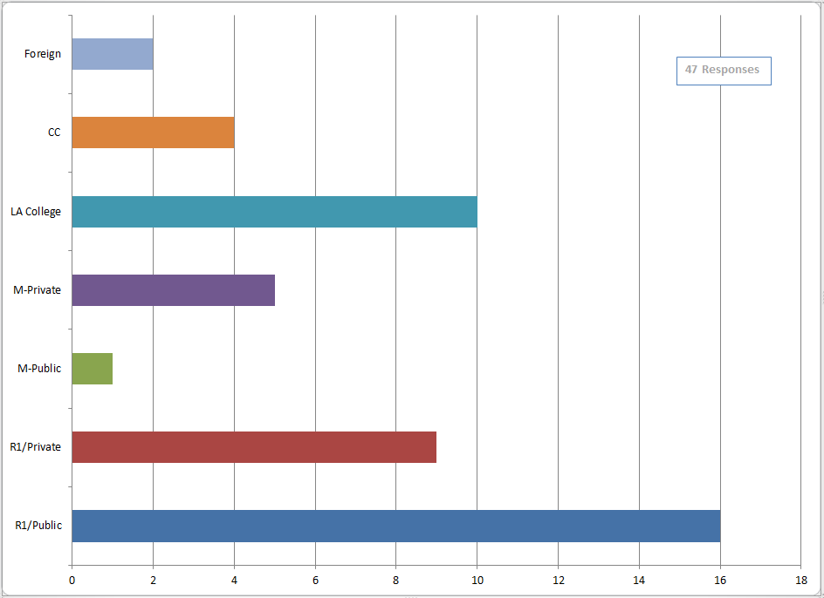
Briefly describe your institution’s profile: (size, public/private, research, etc.)
(47 responses)

Slide 6
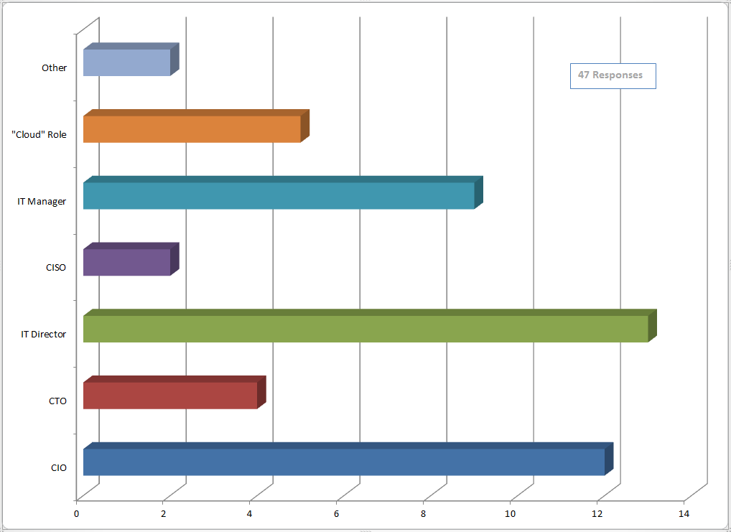
Please identify your role at your institution:
(47 responses)

Slide 7
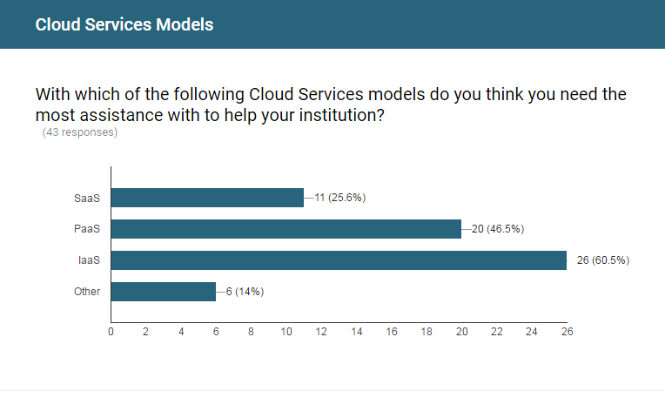
Needing assistance with Cloud Services

Slide 8
What are some of the biggest barriers your institution faces, with regards to cloud adoption? (47 responses)
Security and Privacy (18)
Cloud Costs / Funding (16)
Business Processes Impacts (13)
Data Integration / Control (11)
IT Staffing / Personnel (10)
Network Redundancy / Speed (8)
Lack of Migration Planning (7)
CAPEX – OPEX Cost Shifts (6)
Exit Strategy / Contracts (6)
Impacts to local chargeback model (5)
Cloud Vendor readiness (5)
“misguided attempts to justify cloud using ROI”
“gaps between some categories of cloud vendors feature sets and the enterprise/distributed environment needs of higher-ed (base features are good but hard to adopt at scale)”
“The people who need to work to bridge on premise and cloud do not understand it”

Slide 9
What are some of the successes surrounding the adoption of cloud services at your institution? (45 responses)
SaaS Implementations (43)
Ease / Speed of Deployment (10)
IaaS/PaaS- (AWS, Azure, SF) (8)
Shift in IT Resources (8)
Disaster Recovery (5)
Stability of Service (5)
End-User Happiness (2)
Reduction in Costs (2)
Increased Services to Students (2)
“Central IT's customers becoming self-sufficient by leasing virtual machines just in time from AWS”
“Great implementation of IaaS at department and research lab/group levels to provide flexibility, cost savings, agility and scale that would have been difficult in on-prem models”
“Deployment of enterprise research administration system in IaaS cloud”

Slide 10
CCCG Open Forum
How can the CCCG help with adoption of IaaS-based solutions?
How can the CCCG help you overcome some of the barriers you are facing at your institution?

Slide 11
Resources
CCCG - Join the CCCG Group
ECAR Working Groups: Cloud
Internet2 Cloud Services: http://www.internet2.edu/cloud-services/
Higher Education Cloud Vendor Assessment Tool. The tool "attempts to generalize higher education information security and data protection questions and issues regarding cloud services for consistency and ease of use” via a matrix
TCO for Cloud Services: A Framework
Cloud Strategy for Higher Education: Building a Common Solution (CSG Paper): https://library.educause.edu/resources/2014/11/cloud-strategy-for-higher-education-building-a-common-solution
Internet2 – Cloud Architecture: https://spaces.internet2.edu/display/CA/Cloud+Architecture+Home

Slide 12
Help Us Improve and Grow
Thank you for participating
in today’s session.
We’re very interested in your feedback. Please take
a minute to fill out the session evaluation found within
the conference mobile app, or the online agenda.

