Slide 1
Curation, Discovery, Adoption, and Research on Digital, Open Educational Resources:
An Innovative California Higher Ed Intersegmental Collaboration
http://tiny.cc/c63dgy
Notes:
Leslie

Slide 2
Ruth Guthrie, PhD, Cal Poly Pomona
Peter Krapp, PhD. Univ of CA, Irvine
Leslie Kennedy, EdD, CA State Univ System Office
Theresa Dykes, CA State Univ System Office
California Open Educational Resources Council Presentation by http://icas-ca.org/coerc is licensed under a Creative Commons Attribution-NonCommercial-ShareAlike 4.0 International License. Image credits on the last slide.
Notes:
Leslie

Slide 3
THE PROJECT GOAL
save students money on course materials
make it easier for faculty to adopt high quality, free and open educational resources
increase equity and access for all!
Notes:
Theresa

Slide 4
Project Funding
State of California Legislation ($1M out of $5M)
William and Flora Hewlett Foundation ($500,000)
Gates Foundation ($500,000)
Notes:
Theresa

Slide 5
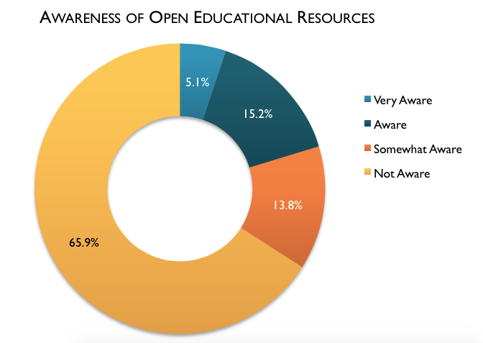
Phil Hill, “OER Adoption: The Worst of Times and The Best of Times” (Oct 13, 2014) based on Babson Report 2014
Notes:
Theresa or Leslie- the problem to be addressed

Slide 6
“The biggest takeaway from the Babson survey is this question – who will introduce the remaining 66%-75% of this country’s faculty to OER? Haters or advocates?”
--David Wiley
“The Babson OER Survey and the Future of
OER Adoption” (Nov 3, 2014)
Notes:
Theresa and Leslie

Slide 7
State of California Legislature
Senate Bill 1052: CA OER council
Bill to address textbooks’ price inflation
Establishes the CA OER Council
Select free or affordable textbooks for 50 high impact courses
High impact = High enrollment, quality, availability
Establish a peer-review process
Increase awareness and adoption among faculty
Identify high impact courses for which open textbooks are not available, or if the current open textbook options require improvement
Establish a process to support and facilitate the creation of open textbooks
Notes:
Theresa [move to slide 8]

Slide 8
State of California Legislature
Senate Bill 1052: CA OER council
Bill to address textbooks’ price inflation
Establishes the CA OER Council
Select free or affordable textbooks for 50 high impact courses
High impact = High enrollment, quality, availability
Establish a peer-review process
Increase awareness and adoption among faculty
Identify high impact courses for which open textbooks are not available, or if the current open textbook options require improvement
Establish a process to support and facilitate the creation of open textbooks
State of California Legislature
Senate Bill 1053: COOL4ED
Notes:
Theresa

Slide 9
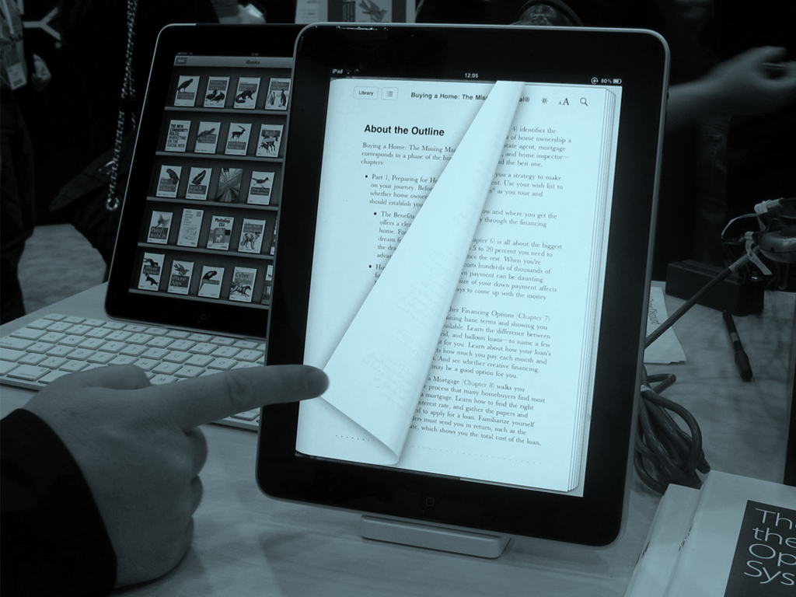
California OER Council (CA-OER) curated free and open educational resources which made it easier for faculty to find affordable options of a quality higher education experience for students in the state of California.
Notes:
Theresa and Leslie

Slide 10
http://www.cool4ed.org
Criteria for Selecting 50 Courses
CA-OER was able to identify more than 50 courses to evaluate OER textbooks using the following criteria:
Highly enrolled according to Course Identification Number System:
http://www.c-id.net/degreereview.html
Works for as many campuses as possible following the designation for general education courses:
Critical Thinking
Oral Communication
Quantitative Reasoning
Written Communication
Generates significant textbook savings
Relatively consistent across textbook products
Provides opportunities for faculty to augment open textbooks
Conducive to discipline-based pedagogies
Access to multiple OER textbooks for any given course
Notes:
Theresa or Leslie

Slide 11
Peer Review Process
Drawn from faculty across CCC, CSU, & UC
Self-identified based on response to the faculty survey
Competitively assembled panels
Selecting the panelists
1 panelist from each of the 3 segments (CCC, CSU, UC)
Balance of experience with OER materials
Balance of place in career
Resulting reviews are public along with names & institutions of each faculty member
http://www.cool4ed.org
Notes:
Theresa or Leslie

Slide 12
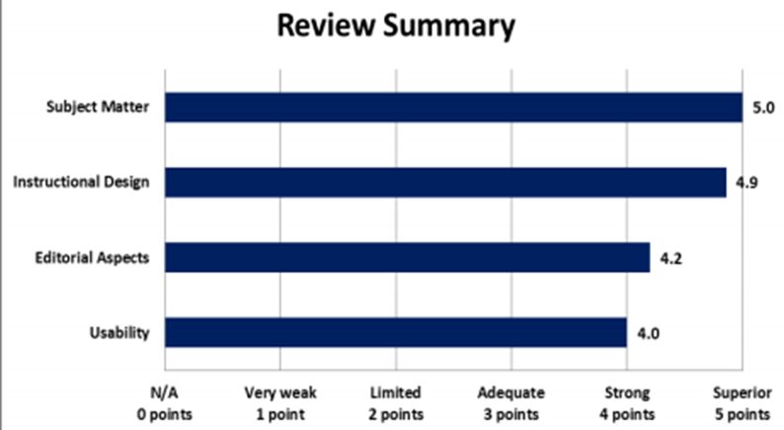
http://www.cool4ed.org
Notes:
Theresa or Leslie

Slide 13
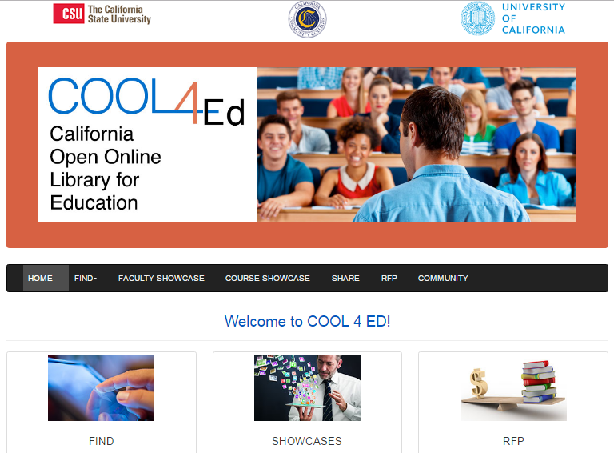
http://www.cool4ed.org
Notes:
Theresa

Slide 14
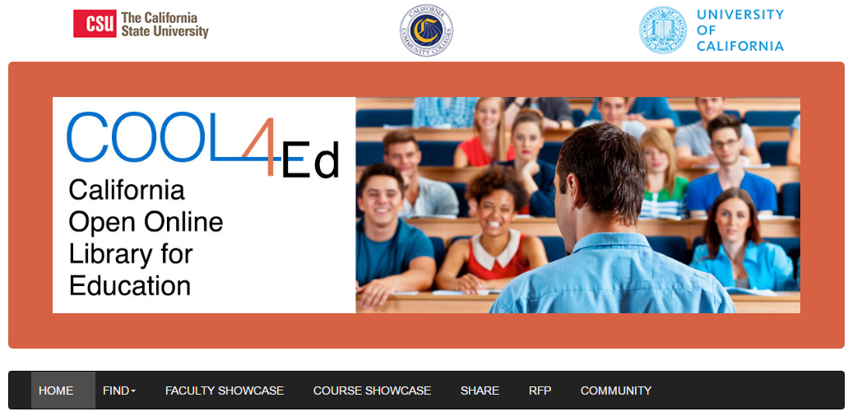
51 courses selected with peer-reviewed free or open textbooks.
http://www.cool4ed.org
Notes:
Theresa

Slide 15
Read details about faculty who have adopted open textbooks and student feedback.
http://www.cool4ed.org
Notes:
Theresa

Slide 16
A resource to find open or affordable textbooks, and other open educational resources.
http://www.cool4ed.org
Notes:
Theresa

Slide 17
Surveying the Faculty
1,200 Responses (out of 48,000 faculty from CCC, UC & CSU) as of 10/9/14
Distribution of disciplines for faculty survey participants
Notes:
Peter

Slide 18
Surveying the Faculty
1,200 Responses (out of 48,000 faculty from CCC, UC & CSU) as of 10/9/14
Notes:
Peter

Slide 19
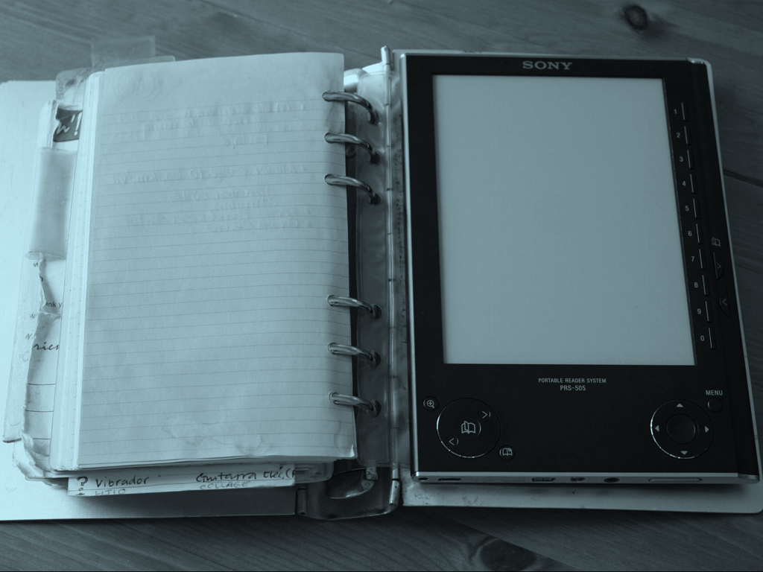
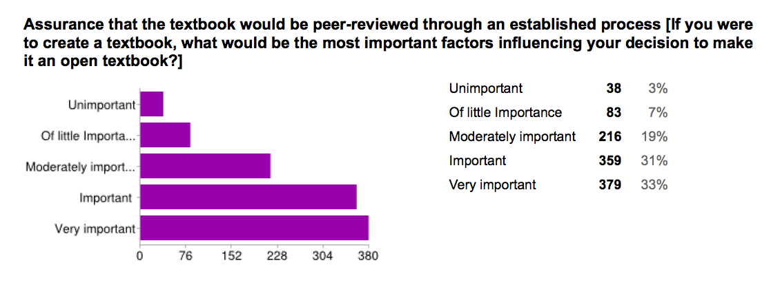
Surveying the Faculty
1,200 Responses (out of 48,000 faculty from CCC, UC & CSU) as of 10/9/14
Notes:
Peter

Slide 20
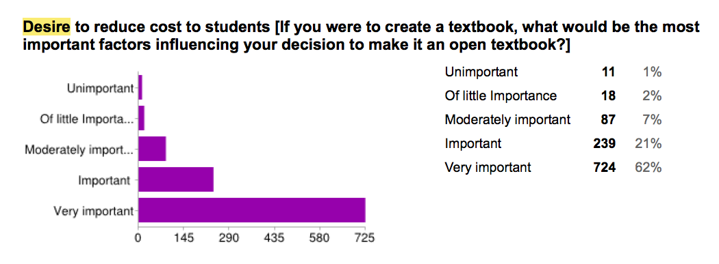
Surveying the Faculty
1,200 Responses (out of 48,000 faculty from CCC, UC & CSU) as of 10/9/14
Notes:
Peter

Slide 21
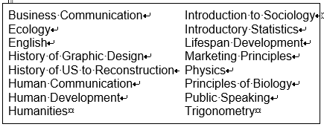
Textbook Adoption Study
16 faculty from CCC & CSU, Fall 2015
Quality of the Text
Ease of Implementation
Support Materials
Compared to Traditional Text
Influence on Teaching
Notes:
Ruth

Slide 22
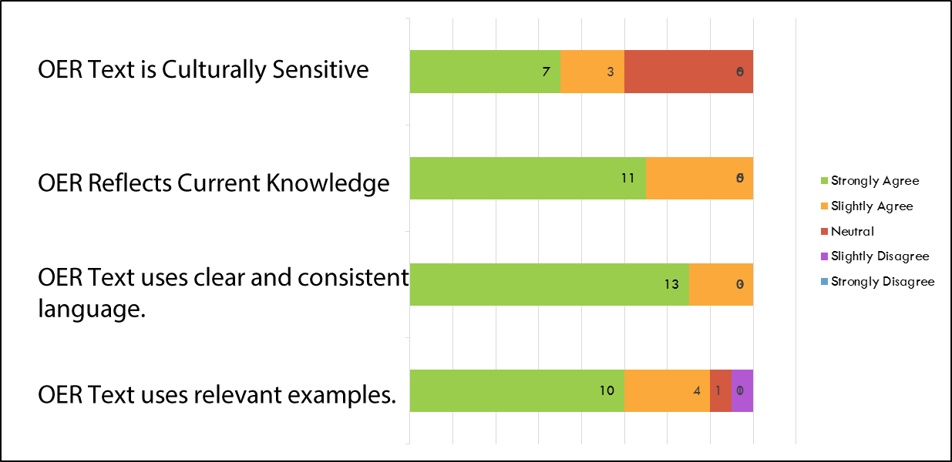
Quality of the OER Textbook
Notes:
Ruth

Slide 23
OER Textbook Ease of Use
Notes:
Ruth

Slide 24
OER Textbook Support Materials
Notes:
Ruth

Slide 25
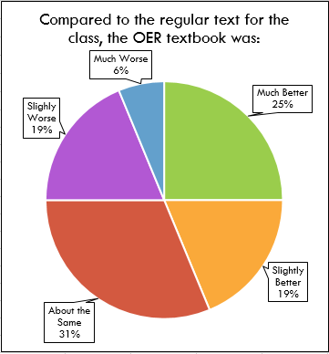
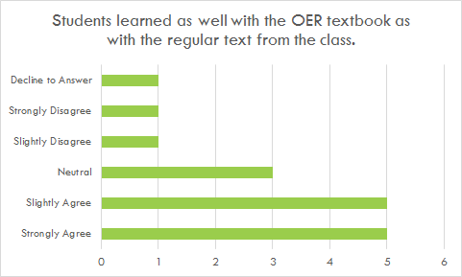
...compared to the traditional textbook
Notes:
Ruth

Slide 26
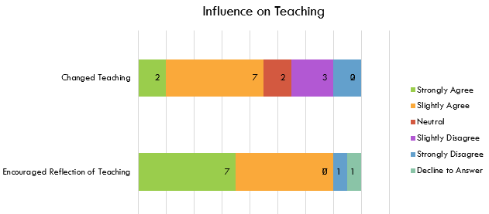
OERs Influence on Teaching
14/16 were positive about modifying an OER text.
12/18 were positive about sharing their work with others, for free.
Notes:
Ruth

Slide 27
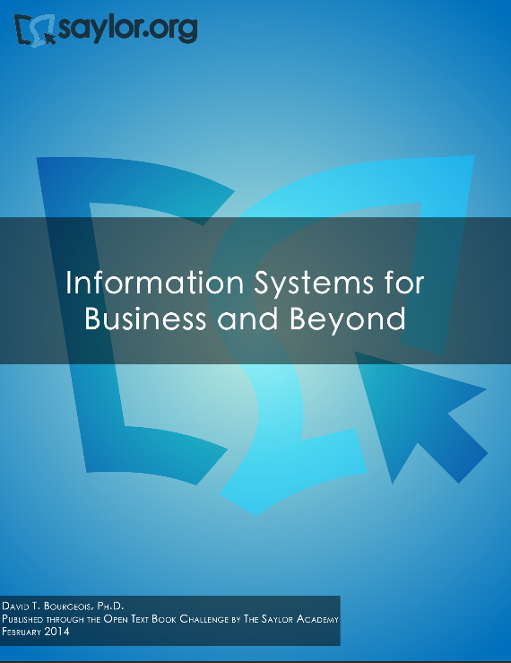
Department Adoption@
Cal Poly Pomona
CIS 310 Management Information Systems
SPICE Grant ($12000 to buy out faculty time to implement the book)
Add chapters & work on test banks, quizzes and assignments
Saylor.org (Information Systems for Business and Beyond, by David T. Bourgeois, Ph.D.)
Ancillary Materials
Staff Support
Thank Goodness for Adjunct Faculty
$167,000 in student savings
Share the materials we developed
Also added a Glossary, Self Quizzes and Quizlet Learning System
Surveyed Students & Faculty
Notes:
Ruth

Slide 28
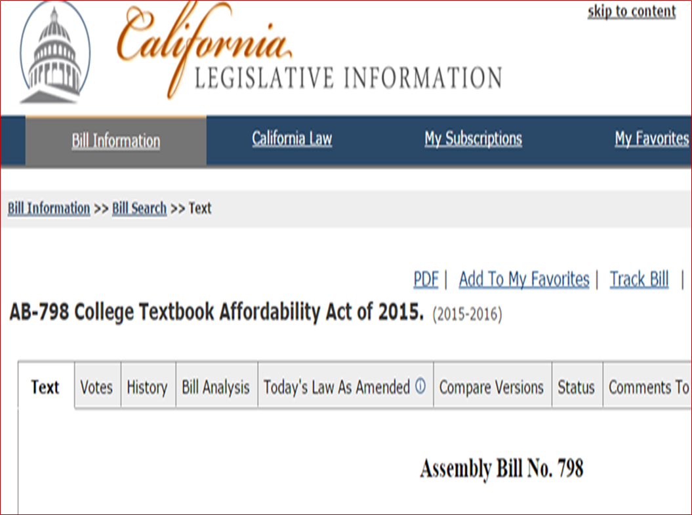
What’s Next?
http://www.cool4ed.org
Notes:
Gerry

Slide 29
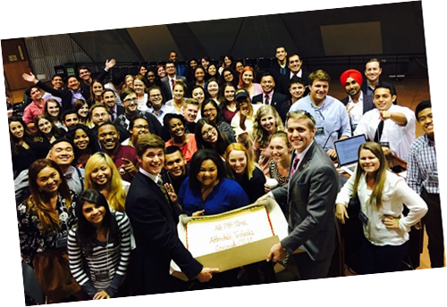
$3M focuses on faculty adoption of OER
http://www.cool4ed.org
Notes:
Gerry

Slide 30
OER Activity
Find an OER for your course.
http://tiny.cc/c63dgy
Notes:
Leslie

Slide 31
https://www.cpp.edu/~raguthrie/OER/
Notes:
Leslie

Slide 32
OER Search Strategies Activity: Find an OER for your course.
COOL4Ed.org - “Find”
MERLOT.org Advanced Search
Google
OER Catalogs/Repositories
http://tiny.cc/c63dgy
Notes:
Leslie

Slide 33
Search Strategy 1: Searching COOL4Ed.org
Use the “Find” tool in COOL4ED to look for:
1) Open textbooks or,
2) other open educational resources.
http://www.cool4ed.org
Educause 2016
Notes:
Ruth

Slide 34
Search Strategy #1
Use the “Find” tool in COOL4ED to look for:
1) Open textbooks or,
2) other open educational resources.
http://www.cool4ed.org
Educause 2016
Notes:
Leslie

Slide 35
Search Strategy #1
Use the “Find” tool in COOL4ED to look for:
1) Open textbooks or,
2) other open educational resources.
Information provided by the authors
Feedback/Reviews from the public
http://www.cool4ed.org
Educause 2016
Notes:
Leslie

Slide 36
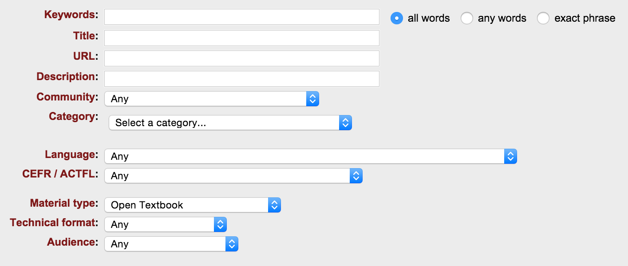
Search Strategy #2
Use the “Advanced Search” tool in MERLOT.org to look for:
1) Open textbooks or,
2) other open educational resources.
Select Open Textbook
https://www.merlot.org/merlot/advSearchMaterials.htm
Educause 2016
Notes:
Leslie

Slide 37
Search Strategy #3
Use a refined search in Google to look for:
1) Open textbooks or,
2) other open educational resources.
Mandatory term. It will find all the material that can be used for free | Common terms in the Open Educational Resources movement | Subject matter in the title or anywhere else | Words to refine the search
"creative commons" | "open textbook" | intitle:microeconomics | introduction
 | textbook | microeconomics | advanced
 | oer
 | eBook
 | resources
 | education
Search recommendations: intitle, site, and the use of quotation marks
Examples:
“creative commons” “open textbook” intitle:microeconomics “
“creative commons” “open textbook” microeconomics
“creative commons” “open textbook” intitle:microeconomics introduction
“creative commons” oer intitle:microeconomics
“creative commons” resources intitle:microeconomics
“creative commons” education intitle:microeconomics
Educause 2016
Notes:
Leslie

Slide 38
Search Strategy #4
Look for an open educational resource by browsing specialized directories/repositories
Additional portals/repositories/directories of Open Educational Resources
Affordable Learning Solutions | MyOpenMath
ALS: Open Educational Resources by College | OER Commons
BC Campus Open Ed | OER Research Hub
Open Textbook Library | Open Course Library
PHET Open Interactive Simulations | Open Courseware Consortium
CMU Open Learning Initiative | Open Professionals Education Network
College Open Textbooks | OpenStax
OpenStax Connexions | OpenTextBookStore
Creative Commons Search | Saylor Foundation
Lumen Learning | The Orange Grove
Merlot | UMN Open Academics
MerlotX | Community College Consortium for OERs
Educause 2016
Notes:
Leslie

Slide 39
Thank you.
Ruth Guthrie, PhD, Cal Poly Pomona
Peter Krapp, PhD. Univ of CA, Irvine
Leslie Kennedy, EdD, CA State Univ System Office
Theresa Dykes, CA State Univ System Office
COOL4ED@cdl.org
http://tiny.cc/c63dgy
Notes:
Leslie

Slide 40
Image Credits
Textbooks piled up
https://flic.kr/p/9SzFV7
Students in line at bookstore
https://flic.kr/p/9c7x75
Open textbook and marker
https://flic.kr/p/9c7x75
Student looking forward
https://flic.kr/p/xUQYn
Columns of books
https://flic.kr/p/cqvbsu
Vanishing point 1
https://flic.kr/p/8xcdk9
Vanishing point 2
https://flic.kr/p/kpBox
Vanishing point 3
https://flic.kr/p/crdKed
eBook on hand
https://flic.kr/p/7DNicZ
Vanishing point 4
https://flic.kr/p/4pdCfQ
Book with post its
https://flic.kr/p/9eS2Cc
Bookstore 1
https://flic.kr/p/9SwNsK
Book list
https://flic.kr/p/9c7x8E
Bookshelf
https://flic.kr/p/54q6w2
Fragmented book
https://flic.kr/p/i4kPNQ
Bookstore top view
https://flic.kr/p/p3PLwg
View up
https://flic.kr/p/dJFA8w
Colorful books
https://flic.kr/p/7WBuA2
Buying line 1
https://flic.kr/p/8xdkgU
Students in line at bookstore 2
https://flic.kr/p/2kcMUW
Sharing eBook
https://flic.kr/p/dc159e
eBook on lap
https://flic.kr/p/9DV2zS
eBook on bookshelf
https://flic.kr/p/bBD6C2
Pointing at eBook
https://flic.kr/p/7ZjXmZ
Different tablets
https://flic.kr/p/djZG8c
eBook close up
https://flic.kr/p/fFH6RS
Reading an eBook on a boat
https://flic.kr/p/4T3m4s
Black eBook
https://flic.kr/p/bBc2Lg
eBook in binder
https://flic.kr/p/5n82MF
Five tablets
https://flic.kr/p/fh3e9u
eBook close up 2
https://flic.kr/p/8dKu2N
Keyboard and eBook
https://flic.kr/p/8FkbB7
Books graffiti
https://flic.kr/p/gWDC87
eBook on bookshelf 2
https://flic.kr/p/nLo69W
Side of tablet
https://flic.kr/p/6b5aY1
Hand holding eBook
https://flic.kr/p/7DNicZ
Notes:
Leslie

