Slide 1
ECAR Working Group meeting
Susan Grajek, EDUCAUSE

Slide 2
2017 Top 10 Emerging Technologies
Active learning classrooms (e.g., student-cented, technology rich learning environments)
Technologies for improving analysis of student data
Uses of APIs
Incorporation of mobile devices in teaching and learning
Mobile apps for enterprise applications
Blended data center (on-prem and cloud-based)
Technologies for planning and mapping students' educational plans
Database encryption
Technologies for triggering interventions based on student behavior or faculty input
Mobile device management (tie)
Technologies for offering self-service resources that reduce advisor workloads (tie)

Slide 3
2017 Major Trends
Most influential
(major influence on IT strategy in 61-80% of institutions)
Continued complexity of security threats
Student success focus/imperatives
Data-driven decision making
Taking hold (in 41-60% of institutions)
IT as an agent of institutional transformation and innovation
Increasing complexity of technology, architecture, data
Changing enterprise system architectures, integrations, and workflows
Institution-wide data management and integrations
Business process redesign
Diversity and inclusivity
Compliance environment
Campus safety
Incorporating risk-management approaches into IT strategy and service delivery

Slide 4
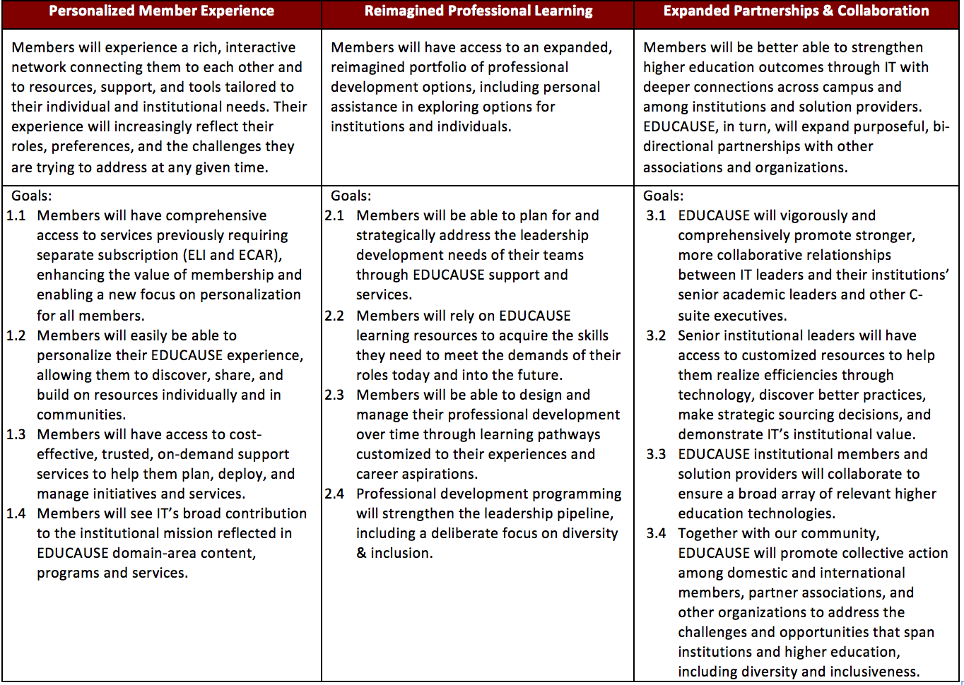
Notes:
Version with board’s most recent feedback incorporated. Version with changes highlighted in board book.

