Slide 1
Improving Learning and Teaching with Learning Analytics: What do teachers want?
Professor Deborah West
Director Learning and Teaching, Charles Darwin University
Notes:
.

Slide 2
Learning Analytics
‘measurement, collection, analysis and reporting of data about learners and their contexts, for the purposes of understanding and optimising learning and the environments in which it occurs’ (LAK’11 cited in Long & Siemens, 2011 p.34)

Slide 3
Levels of data integration
1. Stand-alone LMS data
2. LMS data integrated
with student
information system data
3. Data Warehouse

Slide 4
What is SoTL?
‘The scholarship of teaching and learning is, at its core, an approach to teaching that is informed by inquiry and evidence (both one’s own, and that of others) about student learning’ (Hutchings, Huber & Ciccone, 2011, p. 3)
“systematic reflection on teaching and learning made public.” (Illinois State University, 1998)

Slide 5
SoTL Process
Using a theory, model or framework to ground the initiative and provide justification of action.
Identify an intervention
Formulating an investigative question, which is essentially the hypothesis in research terms.
Conducting an investigation
Produce a result in the form of a public artefact
Inviting peer review/dissemination

Slide 6
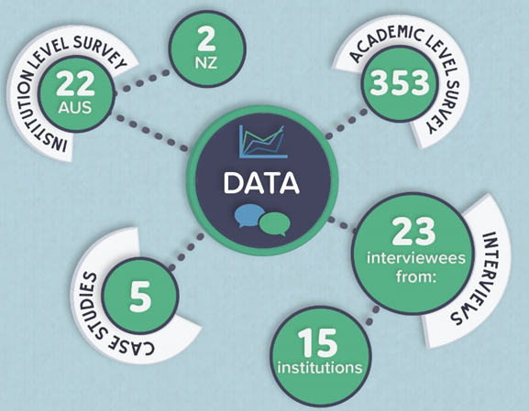
Academic Survey Demographics
Variable | Category | Absolute Frequency | Relative Frequency
Location (n = 351) | Australia | 341 | 97%
 | New Zealand | 10 | 3%
Primary Work Role (n = 353) | Teaching Students | 188 | 53%
 | Learning Support | 47 | 13%
 | Management/Administration | 37 | 11%
 | Other | 32 | 9%
 | Research | 24 | 7%
 | Academic Development | 18 | 5%
 | Student Support | 7 | 2%
LMS at Institution (n = 353) | Blackboard | 203 | 58%
 | Moodle | 124 | 35%
 | Brightspace (D2L) | 13 | 4%
 | Sakai | 2 | 1%
 | Other | 11 | 3%
Employment Basis (n = 351) | Full Time | 284 | 81%
 | Part Time | 44 | 13%
 | Casual | 18 | 5%
 | Other | 5 | 1%
Academic Level (n = 351) | Lecturer | 124 | 35%
 | Senior Lecturer | 88 | 25%
 | Other | 59 | 17%
 | Associate Professor | 30 | 9%
 | Associate Lecturer/Tutor | 30 | 9%
 | Professor | 20 | 6%
Length of employment in current institution (n = 324) | Less than 1.5 years | 40 | 12%
 | 1.5 – 5 years | 68 | 21%
 | 5 – 10 years | 96 | 30%
 | 10- 20 years | 86 | 27%
 | More than 20 years | 34 | 11%
Length of employment in Higher Education Sector (n = 345) | Less than 1.5 years | 11 | 3%
 | 1.5 – 5 years | 42 | 12%
 | 5 – 10 years | 85 | 25%
 | 10- 20 years | 130 | 38%
 | More than 20 years | 77 | 22%
Involvement in teaching students (n = 353) | Teaches students | 276 | 78%
 | Does not teach students | 77 | 22%

Slide 7
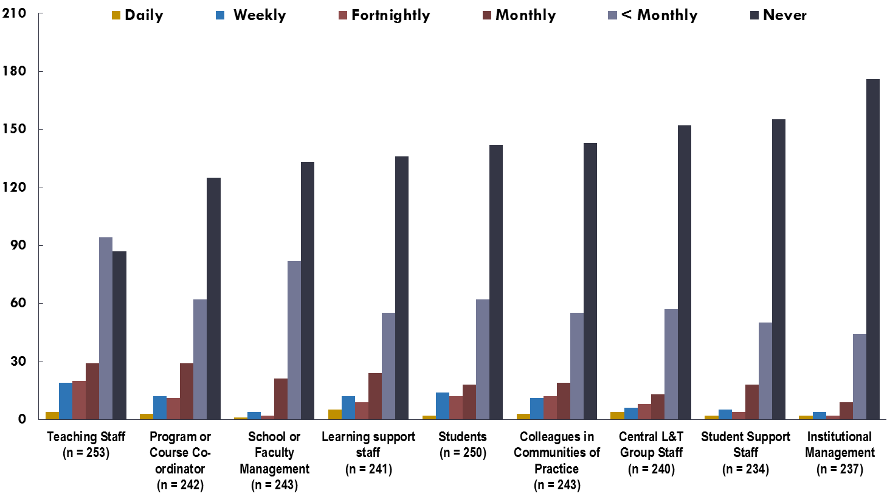
Learning analytics discussion frequency

Slide 8
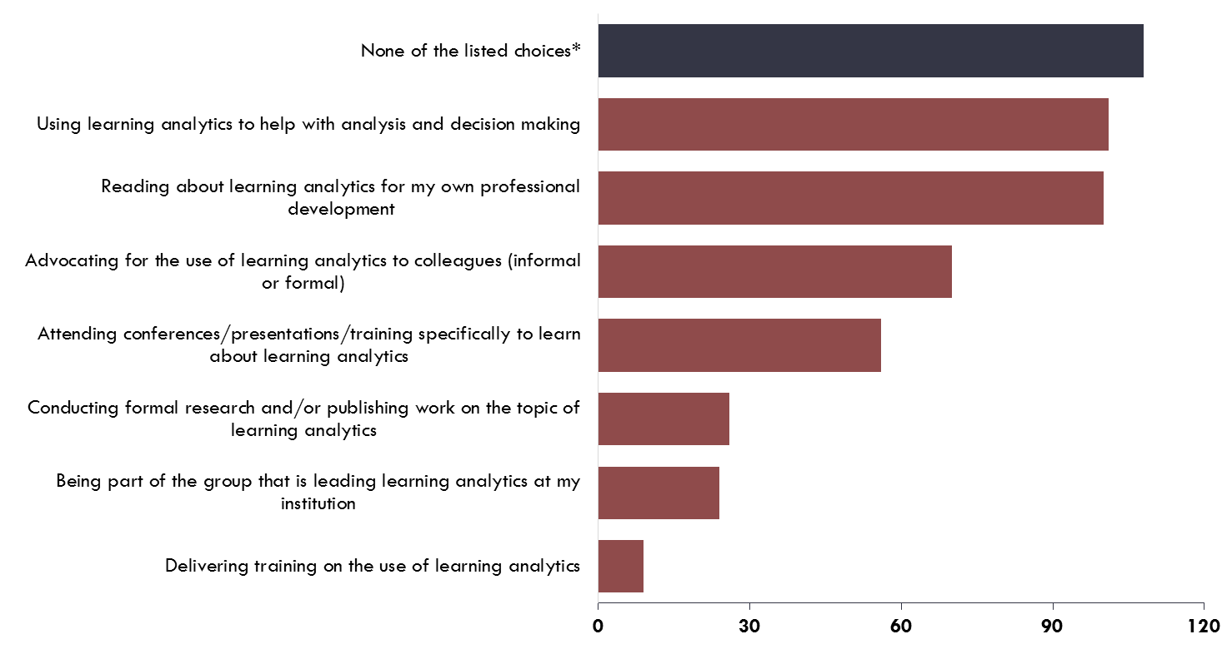
Learning analytics activity participation

Slide 9
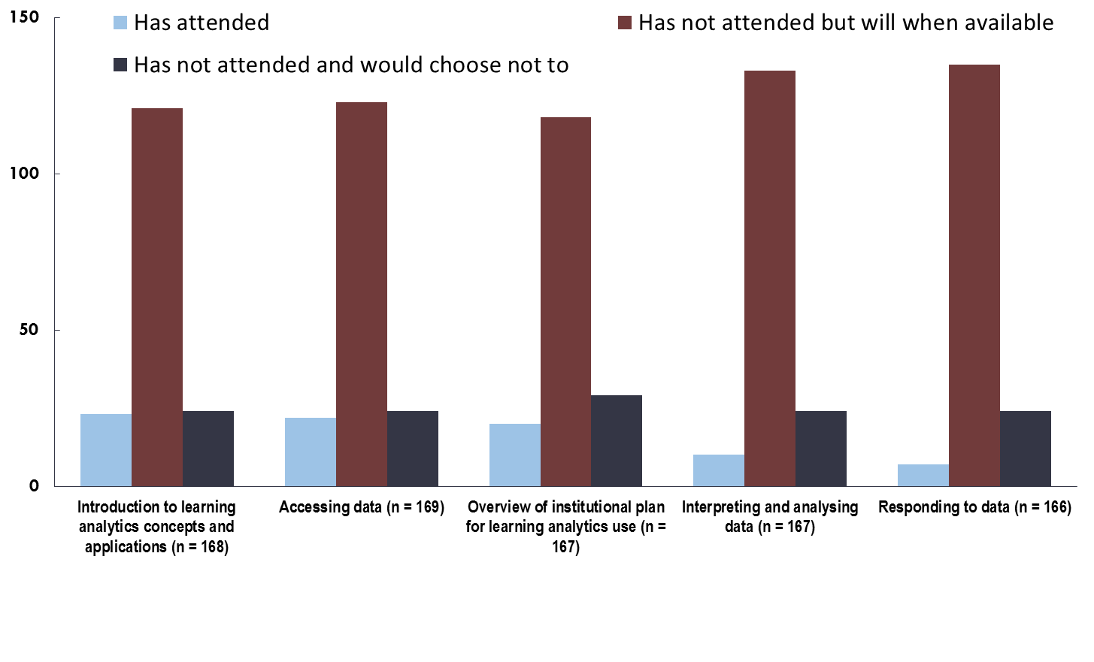
Training activity and interests

Slide 10
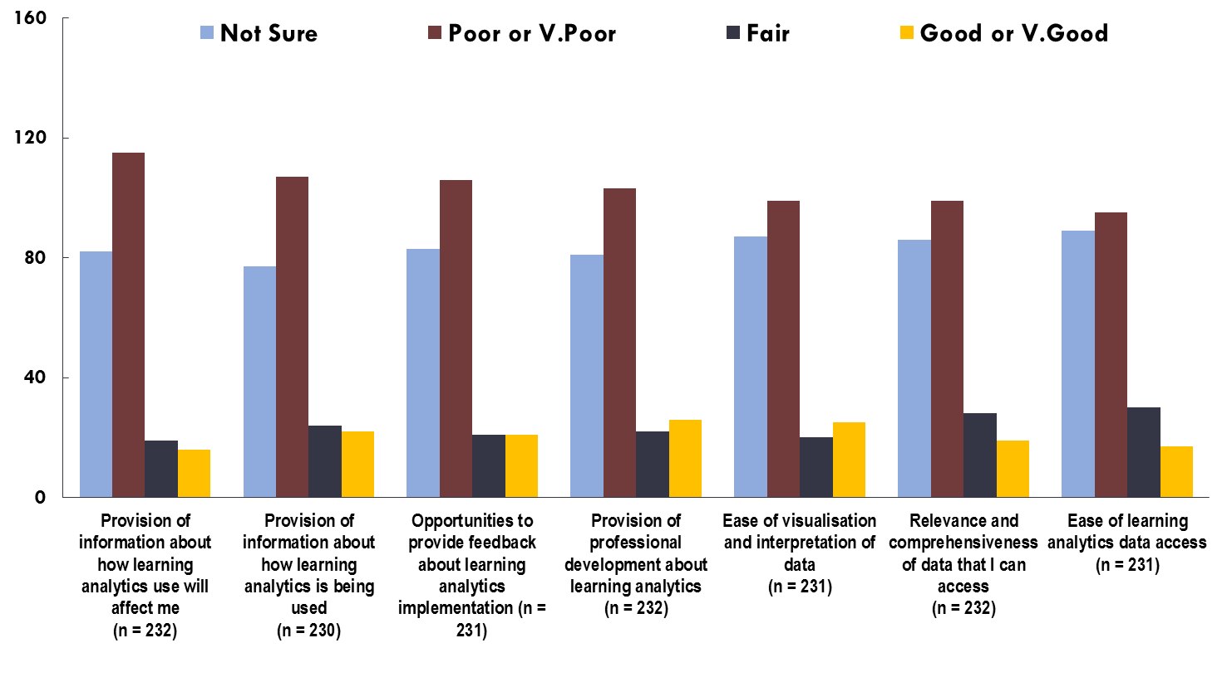
Institutional ratings around learning analytics

Slide 11
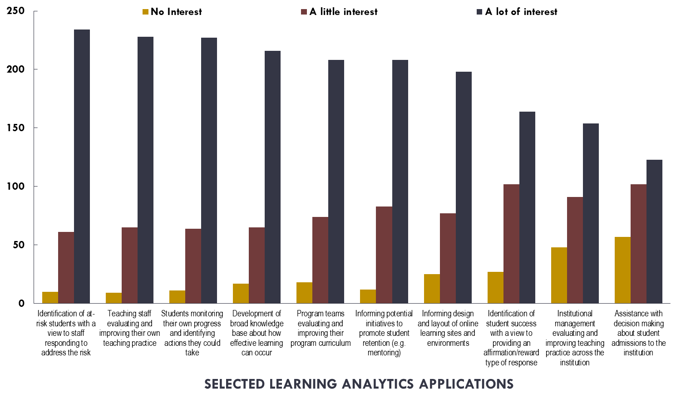
Interest in learning analytics applications

Slide 12
What academic staff want
“Tell me what data is available, give me access to it, give me the time to use it and give me guidance in using it”.

Slide 13
Course/curriculum design & teaching improvement
Is course design effective?
How can I improve my courses design and teaching to improve engagement and performance?
Which courses are performing well (within a school, faculty, university)?
What types of content are included in courses?
Is there a correlation between different course ‘styles’ (e.g. instructivist vs constructivist) and student achievement?
What tools/methods are more engaging?
What do students value or neglect?
What concepts are students struggling with the most?
What are the learning activities that lead to better outcomes?

Slide 14
Improve retention and student performance
Which students are most at risk?
What are the indicators of risk?
What interventions are more likely to be effective?
What effect does intervention with students have?
What trends can we see in terms of at risk students?
Are there relationships between progression, enrolment status and performance?

Slide 15
What does student behaviour mean?
How active are students in course content overall and at an individual item level?
How does the information related to engagement fit with student feedback?
What is the best way to structure content to improve learning performance?
What do students most value? Most like?
Have they accessed recordings or specific tools (e.g. wikis, blogs, journals etc.)
How does this correlate with what content the academic delivers?
If my students are clicking on something a lot, does it mean:
They love it?
They don’t understand it?
They hate it and have to keep coming back because it is too difficult or unpalatable to manage?

Slide 16
Key interests of academics
Being able to better understand who is in their class (demographics, prior academic history etc.)
Being able to have consolidated information about their individual students at the touch of a button (e.g. seeing how their students are doing in other units, what their demographic data is, whether they are using resources etc. all in one place)
Learning analytics being used by people centrally to better justify or evidence directives relating to their teaching (e.g. when academics are told to respond in 24 hours to students is there evidence for this being useful?)
Improving BOTH student (e.g. resource access patterns, socialisation) and teacher (e.g. teaching style, unit design) behaviour with respect to learning

Slide 17
Key points
SoTL can help us to develop our learning analytics frameworks around pedagogy and good teaching practice
SoTL can provide the framework for using the data generated by the systems at a local level.
To develop and use learning analytics to improve teaching and learning will require engagement from academics
A SoTL focus may help to engage academics in the learning analytics journey – both in development and application

Slide 18
Discussion points
In groups of two or three, reflect on and share how these findings fit with the direction/initiatives within your institutions.
Take a few minutes to identify/construct questions relevant to your context. Share in your group

Slide 19
References
Prosser & Trigwell (1999). Understanding learning and teaching: The experience in higher education. Open University Press, Maidenhead, UK.
Siemens, G. & Long, P. (2011). Penetrating the Fog: Analytics in learning and education. EDUCAUSE Review, 46(4) July/August. Retrieved from http://www.educause.edu/ero/article/penetrating-fog-analytics-learning-and-education
Trigwell, K. (2012). ‘Scholarship of teaching and learning’ chpt. 15 in L. Hunt & D. Chalmers (Eds) University Teaching in Focus: A learning-centred approach. ACER Press and Routledge, Taylor & Francis Group. London, UK.

Slide 20
Acknowledgement of Research Partners:
Dr Henk Huijser, Dr Jurg Bronnimann, Professor Alf Lizzio, Professor Carol Miles, Mr Bill Searle, Mr Danny Toohey, Mr David Heath
Acknowledgement of Graphics
Ms Mel Macklin
Acknowledgement of Funding:
Australian Government: Office for Learning and Teaching
Further information on the project can be found at:
http://www.letstalklearninganalytics.edu.au/

Slide 21
Thank you

