Slide 1
4G pilots VU University
Sylvia Moes,
Innovationmanager Education

Slide 2
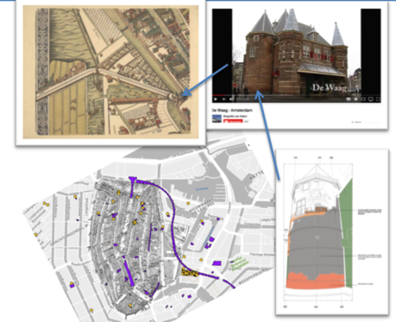
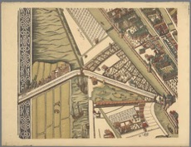
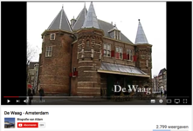
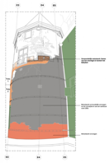
Walk through historic layers of Amsterdam based on heritage content of 1540 and later to discover, compare and discuss scientific topics…
Assignment during fieldtrip
Have a look on the map of 1544, from St. Antoniuszn.
Where was the canal situated below ‘De Waag’ and what is the situation right now?
What was the position of the Bulwark?
Watch the clip on Youtube and answer following questions
How high (in meter) was the Tower, seen from the water?
What was the function of the Tower in that period?

Slide 3
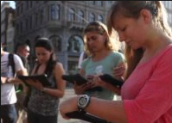
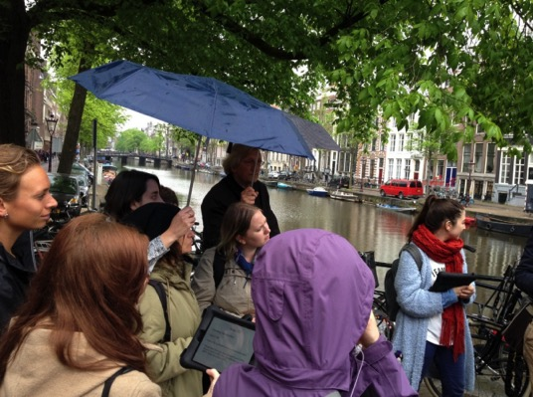
Intensify learning in the field

Slide 4
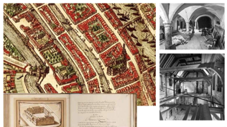
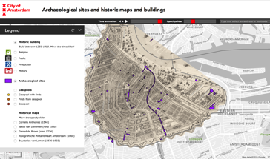
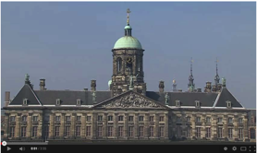
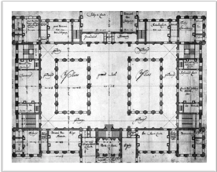
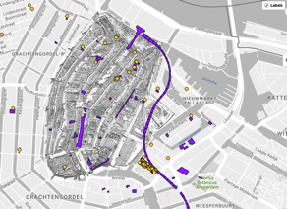
Cross medial heritage content

Slide 5
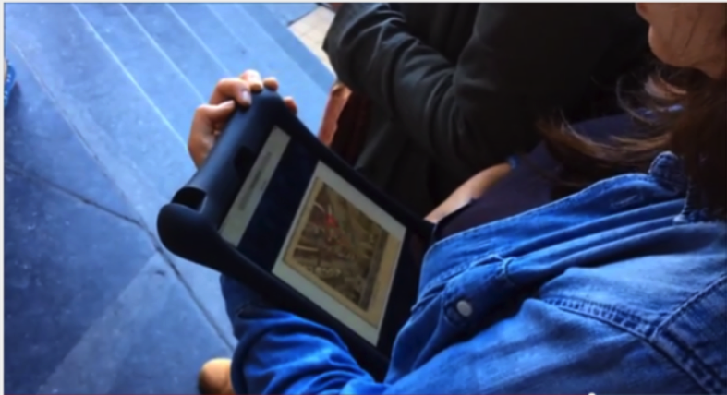
Tools iPads, 4G network and (AR) Apps

Slide 6
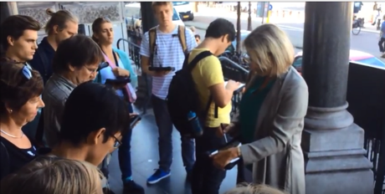
Stream presentation of lecturer to 25 iPads with 1 click in the old city of Amsterdam

Slide 7
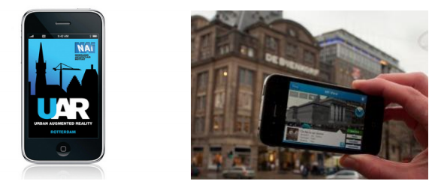
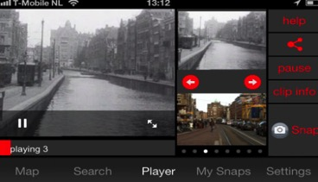
AR Apps to compare and explore
UAR app
Vistory app
Assignments
BlackBoard app

Slide 8
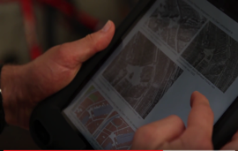
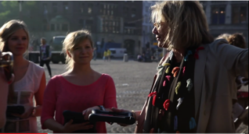
Results and students satisfaction

Slide 9
Lessons learned
4G network in combination with iPads helps intensifying fieldwork and has positive influence on students satisfaction
Student centric learning via assignments and group discussions
4G network is stabel
Integration of content in learning design is essential

Slide 10
Lessons learned
Stability of Apps
Blackboard is stabel
Vistory is an app in progress
Pedagogy design
Re-think assignments and the use of interactive content and maps
Prepare students, instructions on apps and iPads prior to field trips

