Slide 1

IT Disaster Recovery and Business Continuity
from the Inside Out
Karoline Westerlund
IT – Strategist
Umea Universitet
Donna Hill
Assistant Director Service Configuration, Continuity Management
The George Washington University
Bill Koffenberger
Director Service and Contract Management
The George Washington University

Slide 2
Session Overview

Slide 3

Academic and operational activities at universities are subject to major service disruptions caused by the environment, equipment failures, and people. Planning and preparation are paramount to successful recovery in a crisis. In this session, a disaster involving simultaneous main power feed, UPS, and generator failures will be reviewed and lessons learned during the two-month crisis. The valuable lessons learned and outcomes will provide the context for a discussion of a practical "inside out" recovery prioritization planning framework for IT and university business units.

Slide 4
Session Outcomes
Understand the importance of DR/BC planning and preparation
Learn from an actual disaster
Review approaches to DR/BC planning

Slide 5
Presenter Introductions

Slide 6

One Main Campus – some numbers
Total enrolled students 32000, Employees 4200
Central IT-Office, 6 employees
Strategic responsibility for all common IT at the university
ITS datacenter, Information and Communications Technology, 200 employees
30% in house supplier, 70% external services to all Swedish universities
Centralized IT 65 employees, library 7 employees
Decentralized IT ~50 IT employees
~ 70 major important IT- applications / 1 main operation hall, 1 reserv hall
5.2% Total IT spending as a precentage of institutional expences
2.9% Total central IT spending as a precentage of institutional expences
55% Total central IT spending as a precentage of total IT spending
23% Central IT outsourcing spending as a percentage of total central IT spending
Notes:
Need background slide

Slide 7

Our Campus Context
Chartered February 9, 1821 by Act of Congress
3 campus locations
  Main Campus – nestled between the White House, the Kennedy Center and federal and international agencies
  Virginia Science and Technology Campus in Ashburn, VA, GW’s (17 research labs, centers and institutes)
  Mount Vernon Campus, downtown traditional college campus atmosphere
10 schools and colleges, 26,000 undergraduate and graduate students, 12,000 internship opportunities, primarily residential students, 100 online programs, 230 graduate
Information Technology
  Centralized IT 240 employees
    DCIO Operations, AVP Research Technology, AVP Business Intelligence, AVP Information Security and Compliance
    150 ‘services’ / 2 data centers – mostly on premise services
    Infrastructure support includes – voice, video, data,
  Decentralized IT ~100 IT staff across schools and divisions
Notes:
Need background slide

Slide 8

Understanding our Audience
At my institution IT DR/BC planning maturity is:
    Very Mature – well defined, tested with business input on prioritization
    Mature – some technical services / some business services recoverable
    Evolving – some technical resiliency but nothing comprehensive
    Not Sure - I thought this session was about learning management systems
As you consider where the leadership formally resides, think about how effective it is.

Slide 9
Example - Disaster Recovery in Action

Slide 10
Disaster - Experience
Have you been in a disaster situation

Slide 11
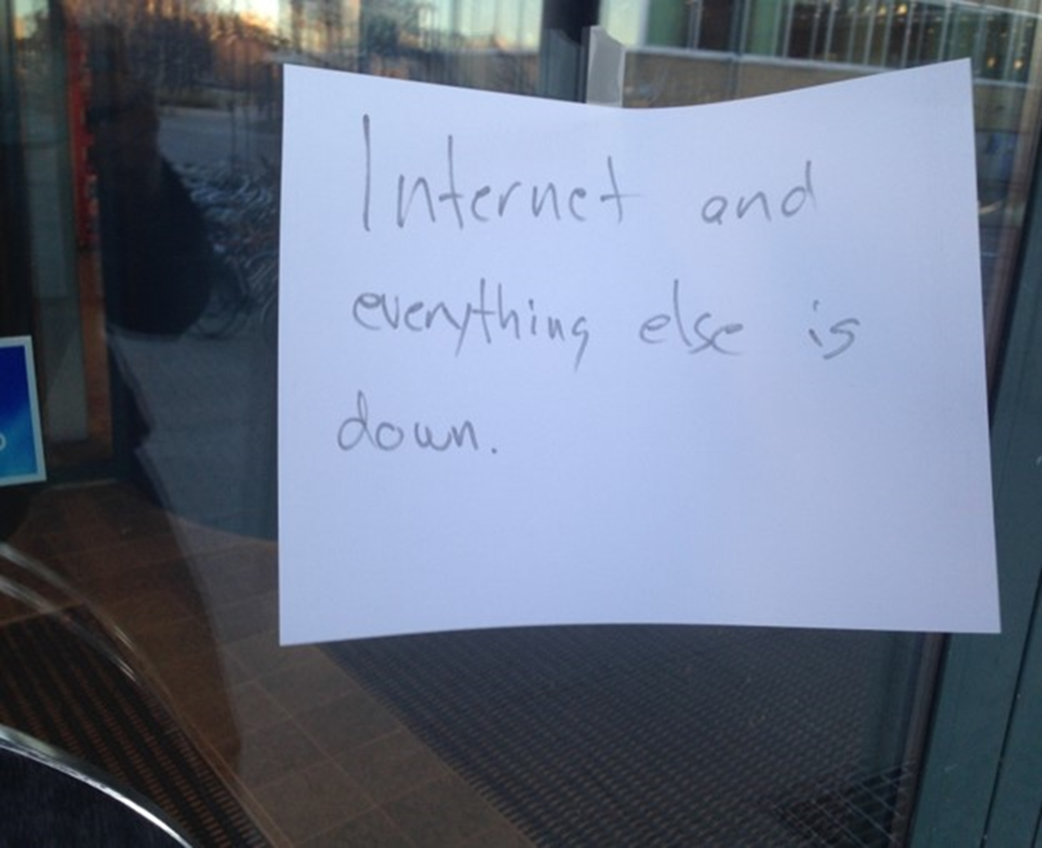
Disaster

Slide 12
Emergency mode !!!!!!!
Our main UPS and our diesel generator broke down in our main IT operation hall

Slide 13
Are you prepared?

Slide 14
Our Framework

Slide 15
Business Continuity or Disaster

Slide 16
The journey

Slide 17
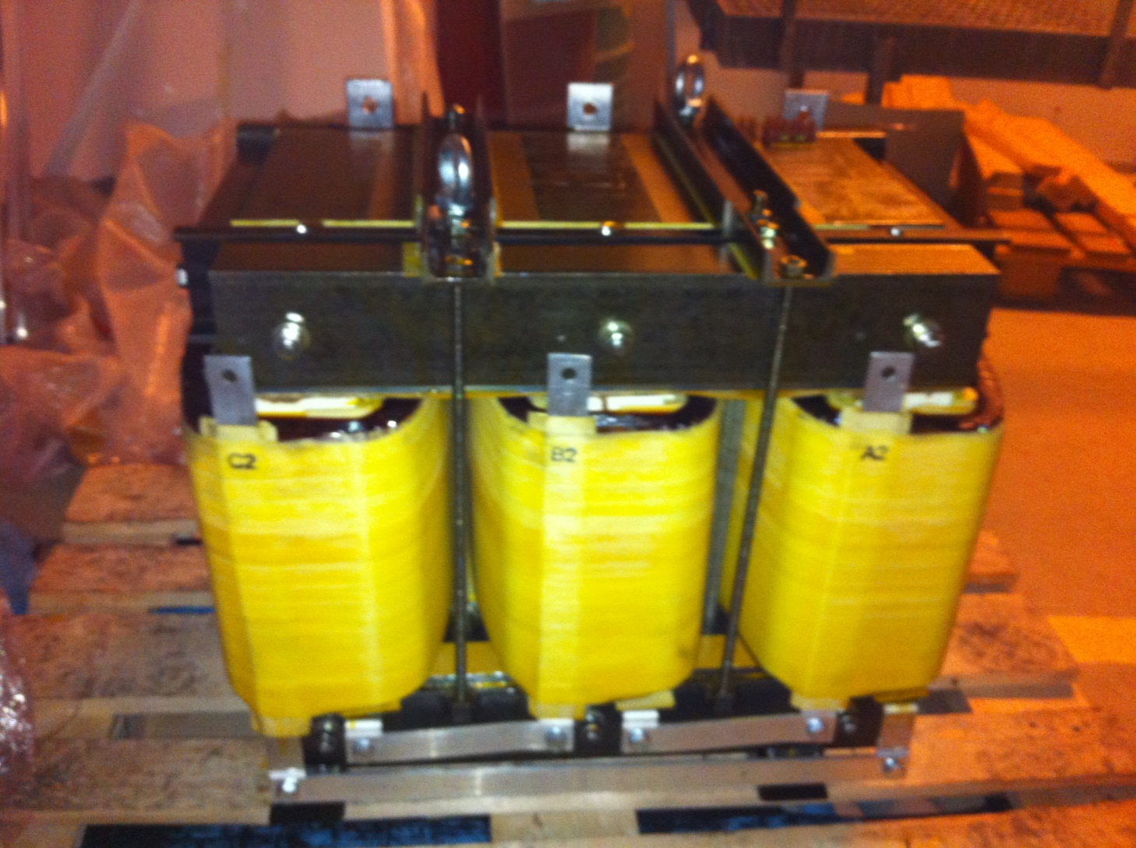
500 kilo

Slide 18
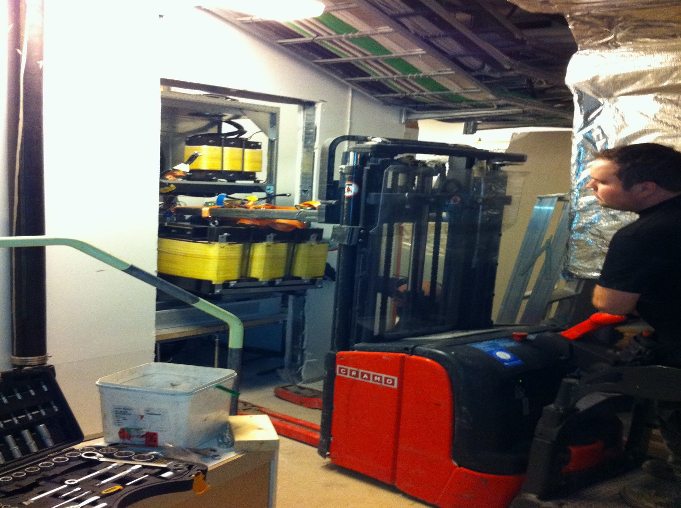
A hole in the wall

Slide 19
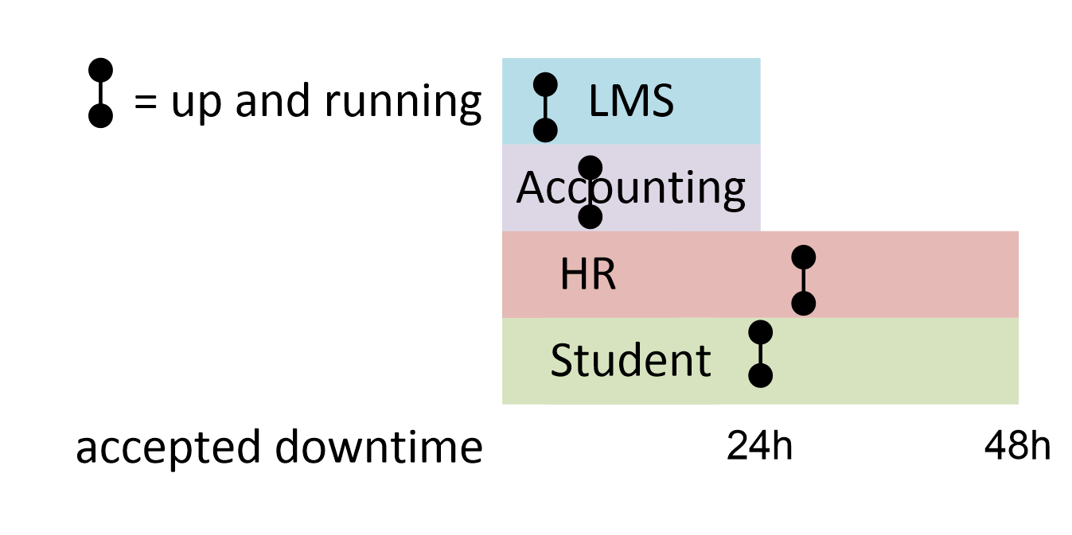
Accepted downtime – critical period

Slide 20
221 physical servers 357 virtual
“the order of priority is done in normal mode, not in connection with a disaster”

Slide 21
Planning process - highlights

Slide 22
GW Planning and Preparation Approach

Slide 23
Organizational Leadership
Who in your organization leads DR/BC planning?
  Specific Office (OEM, PD, COO etc.)
  President / Provost
  Everyone
  No one
  Not Sure
Do any of these answers worry you?

Slide 24

University Response Management
The Response Management Group (RMG) is the tactical-level Incident Management Team responsible for tactical decision making, coordinating and implementing the university’s response within its members’ respective divisions, departments or offices. The group collects and disseminates information regarding the incident, provides advice to the LG and ensures the continuity of each member’s areas of responsibility. Members of the RMG optimize the overall university response by understanding each other’s intentions and coordinating actions. Members of the RMG include representation from: [major academic / administrative units]

Slide 25
Broad IT Recovery Scope
Emergency Support Functions
  Emergency response and recovery operations are organized under Emergency Support Functions (ESF). The Office of Emergency Management will activate appropriate ESFs to support response and recovery efforts. There are 12 ESFs with identified primary GW divisions, departments and offices listed below. For additional information, see Emergency Support Functions A to L.
  ESF I: Information Technology and Telecommunications
  Division of Information Technology
ESFs organize university capabilities to coordinate internal emergency response and recovery operations.

Slide 26

Context - IT DR/BC Planning Background
Organizational Structure and Office of Emergency Management
  Focus crisis management / decision making – coordination
  Decentralized unit responsibilities (response and recovery)
IT Efforts through 2015
  Too focused on frameworks / complex documentation
  Conflict - DR/BC Practice and Higher Education Reality
  Crisis management versus recovery coordination
  Role of ‘Business’ Units in DR/BC (prioritization
  Technical capabilities ≠ defined services / tested plans
  Inconsistent IT service architecture / design applied
New Approach Required

Slide 27
IT DR/BC Approach Highlights
Organizational Readiness
  Staffing changes and budget considerations
  Successes in service / project / portfolio management approaches
  Consistent with Operations Model
  Recognition campus ‘organizational’ problem
Strategic Direction / Tactical Objectives
  Shift from top down ‘Best Practice’ to ‘Inside Out’
  Divisional Goals Elevated to Board
  Calculated Risk Taking
Campus awareness of IT DR/BC program through BIA’s

Slide 28
IT DR/BC Approach
Do you have a formal IT approach to DR/BC planning?
  Focused on Technical services
  Focused on Business Services
  Focused on both
  Neither (we hoping nothing happens)

Slide 29
Phases of DR/BC Program
Program Phase | Goal | Status
Phase I – Duty Officer Major Incident Assessment and Response Command Center, Roles and Responsibilities | Senior Management accountability and ownership through experience | ✔
Phase II – Disaster Recovery Basics Revised High Level Disaster Recovery Plan Business Impact Analysis (IT perspective) DR Plan Tests (IT perspectives) | Documenting reality Slaying the misperceptions Crafting the ‘message’ | ✔
Phase III – Meaningful DR/BC Business Unit Engagement Detailed Plans / Playbooks Decentralized IT Engagement Complete DR Plan Testing | Wise engagement Accountable staff Buy-in / Awareness | ✔ In progress
Phase IV – ‘Normal DR/BC Planning’ Business engaged through service lifecycle Experienced IT staff applying validated processes Practice, Assess, Improve | Repeatable and consistent Process Owned by IT Staff Supported by Business

Slide 30

DR/BC Frameworks - Sharing
Have formal DR/BC frameworks worked on your campus?

Slide 31
DR/BC Experience - Sharing
Are there any specific challenges you have overcome as you implemented a DR/BC program?

Slide 32
DR/BC Documentation - Sharing
Do you have suggestions or comments on the documentation related to DR/BC?
What do you require / request from the business units?
What do you expect from your IT units?
Notes:
Share standard examples and experiences in people leveraging them.
What is Actionable, Usable / Approachable

Slide 33
On Leadership
We have discussed leadership and ownership in our presentation, what leadership have you found to be critical?
Has the leadership approach changed at your campus? Due to a disaster?

Slide 34
Joint Review and Wrap-Up

Slide 35
Review
Develop a practical framework based on institutional maturity
Leverage focused / directed effort (sometimes at the individual level)
As always, obtain get buy-in (a CIO goal was very motivating)
Let organizational culture (IT and campus) drive approach
Consider IT driving toward Business DR/BC from the inside out

Slide 36
Final Thoughts
Importance of Role Clarity Across Institution
  ‘connecting the right people’
Initiate / Sustain / Own
  ‘Who is your institutions pain in the ass?’
Thank you!
Karoline Westerlund karoline.westerlund@umu.se Umea Universitet
Donna Hill dhill3@gwu.edu The George Washington University
Bill Koffenberger billkoff@gwu.edu The George Washington University

Slide 37

Help Us Improve and Grow
Thank you for participating
in today’s session.
We’re very interested in your feedback. Please take
a minute to fill out the session evaluation found within
the conference mobile app, or the online agenda.
Karoline Westerlund karoline.westerlund@umu.se Umea Universitet
Bill Koffenberger billkoff@gwu.edu The George Washington University

