Slide 1
Leading Transformation within Higher Education during a Period of Major Disruption
Thomas Andriola • Link Alander• Richard Bazile • Rashmi Radhakrishnan

Slide 2
Disruption – This too shall pass or an opportunity to transform learning?
What kind of CIO do institutions need?
How do we lead and enable a culture of innovation?
How do we keep our services relevant and our teams agile?
Thomas Andriola • Link Alander• Richard Bazile • Rashmi Radhakrishnan

Slide 3
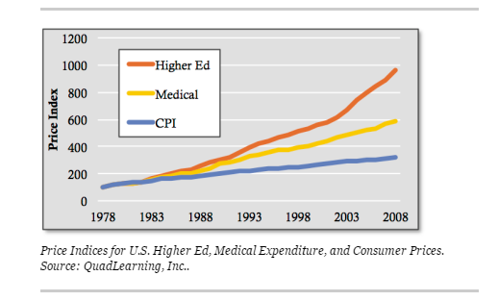
Disruption – Opportunity or inconvenience for IT
Price vs. Value
Technology
Changing demographics
http://www.forbes.com/sites/toddhixon/2014/01/06/higher-education-is-now-ground-zero-for-disruption/#7efb2b225bd9

Slide 5
Changing role of CIO

Slide 6
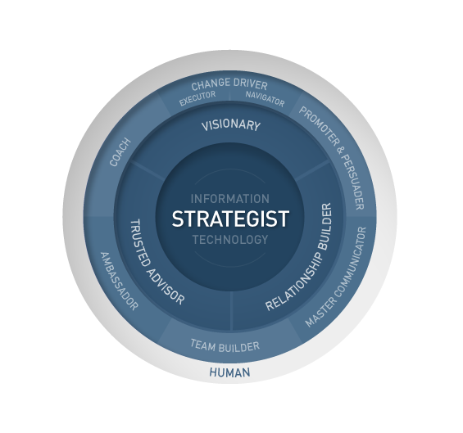
E.g., EDUCAUSE / JISC Working Group
Convened a working group of ten IT leaders to define a set of desired CIO characteristics and capabilities for the future of Higher Education
http://net.educause.edu/ir/library/pdf/pub9019.pdf

Slide 7
Educational futurist John Moravec observed’…Industrial society is giving way to knowledge and innovation work…’
Ideation
Social Intelligence
Global Awareness
Virtual Collaboration
Abstract Thinking
Design Mindset

Slide 8
Discussion Questions
What type of institution are you?
Small Public, Large Public, Small Private, Large Private,Other.
Open to bold new ideas, slow to adopt changes, let’s have progress without change.

Slide 9
What are the major disruptions at your institution?
How has your role as CIO changed in the last 5 years?
What are your biggest challenges now and in the immediate future?

Slide 10
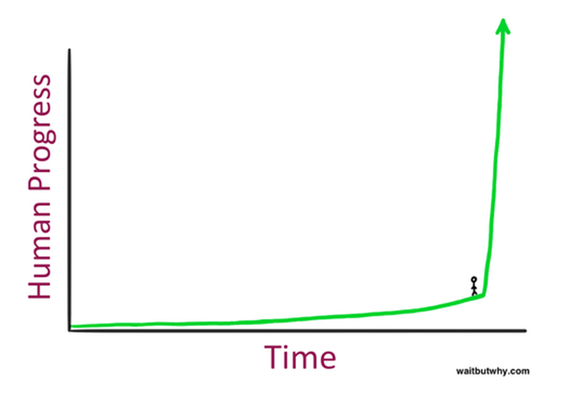
Questions?
Thomas Andriola • Link Alander• Richard Bazile • Rashmi Radhakrishnan
“The greatest thing in the world
Is not so much where we stand
as in what direction we are moving”
(Johann Wolfgang von Goethe – Poet
As quoted in the Building a Culture Innovation in Higher Education (2015) article)
“The acceleration of technological progress has been the central feature of this century. … we are on the edge of change comparable to the rise of human life on Earth” – Vernon Vinge
http://waitbutwhy.com/2015/01/artificial-intelligence-revolution-1.html

