Slide 1
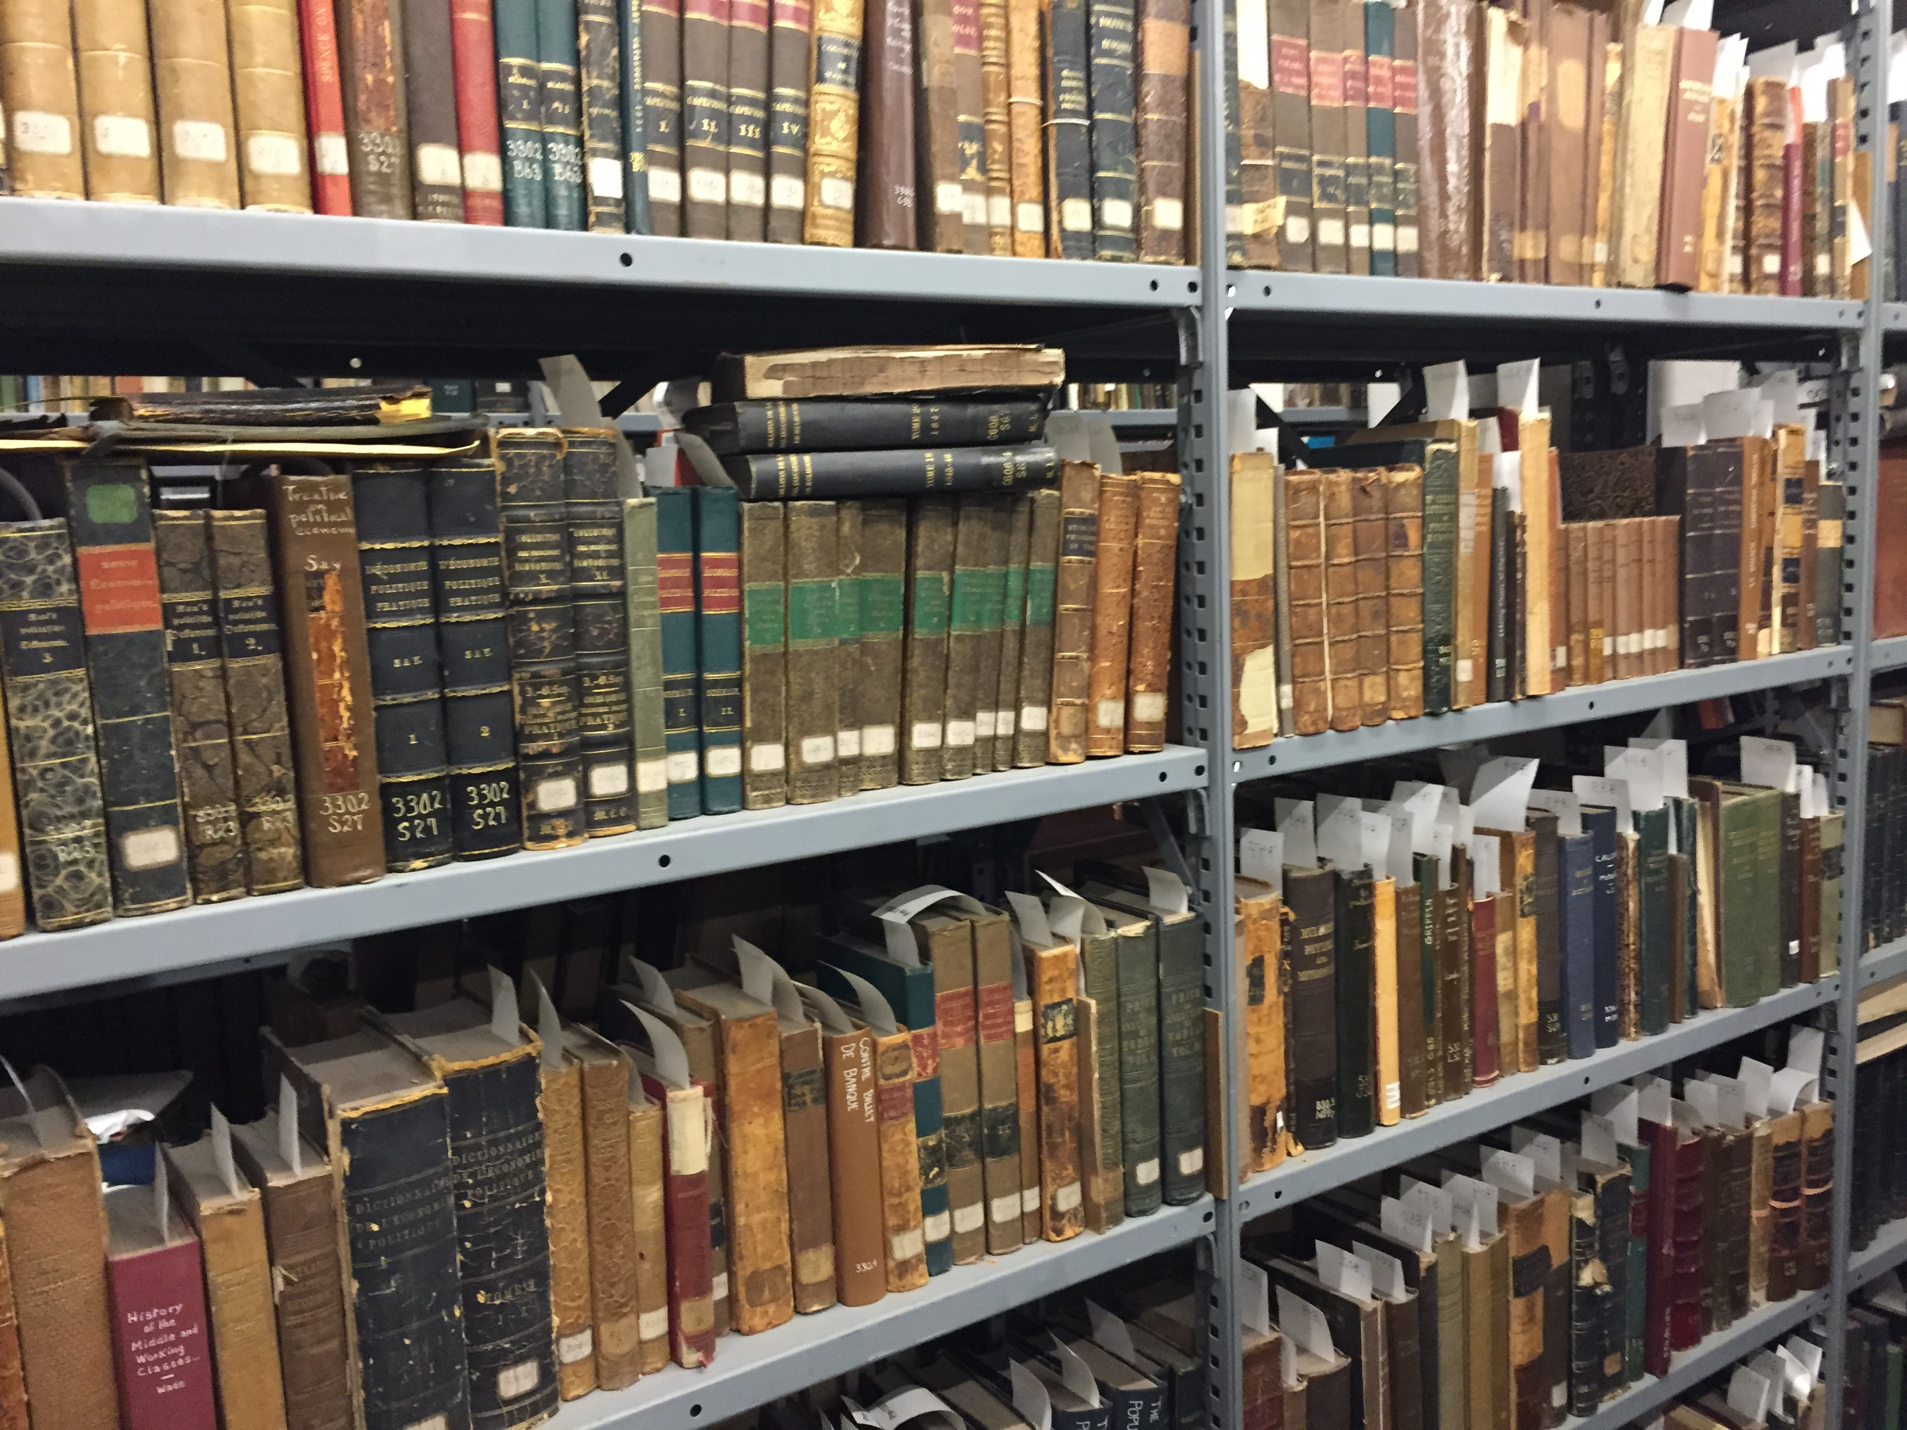
Libraries and the future of higher education
Chris Bourg
MIT Libraries
@mchris4duke

Slide 2
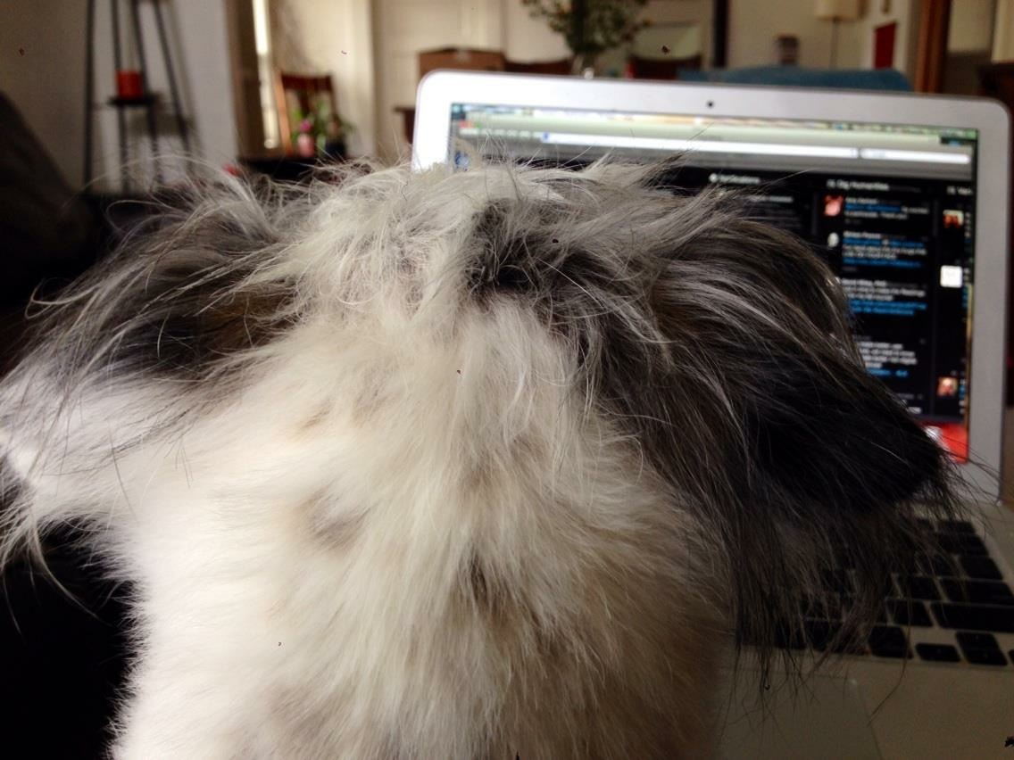
#EDU16
@mchris4duke

Slide 3
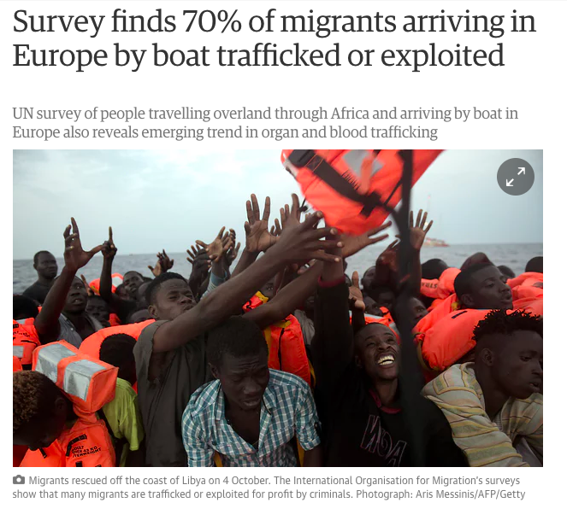
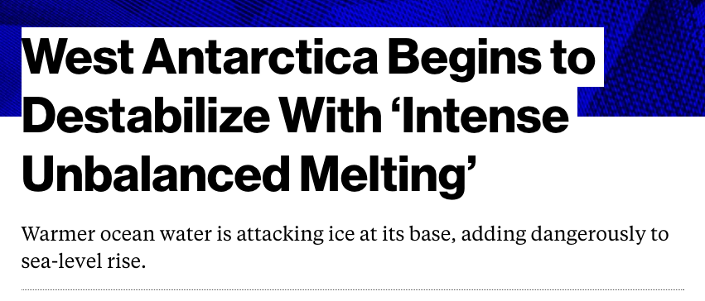

Slide 4
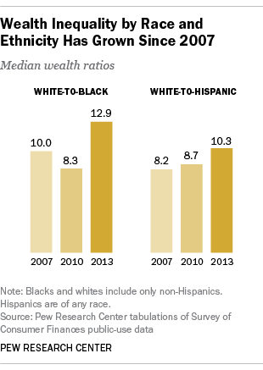

Slide 5
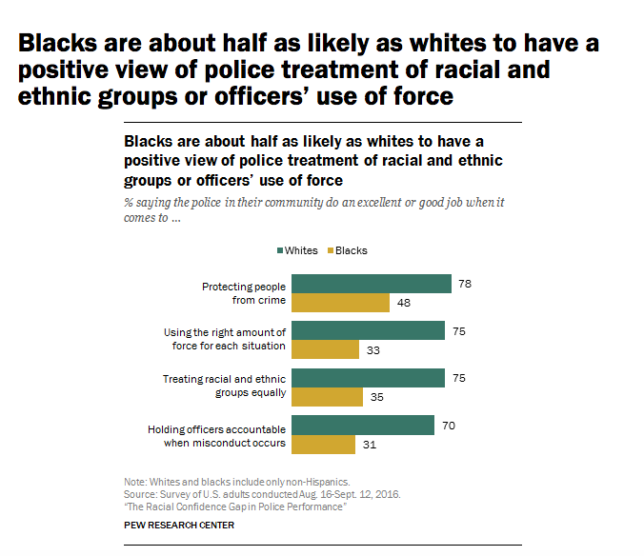

Slide 6
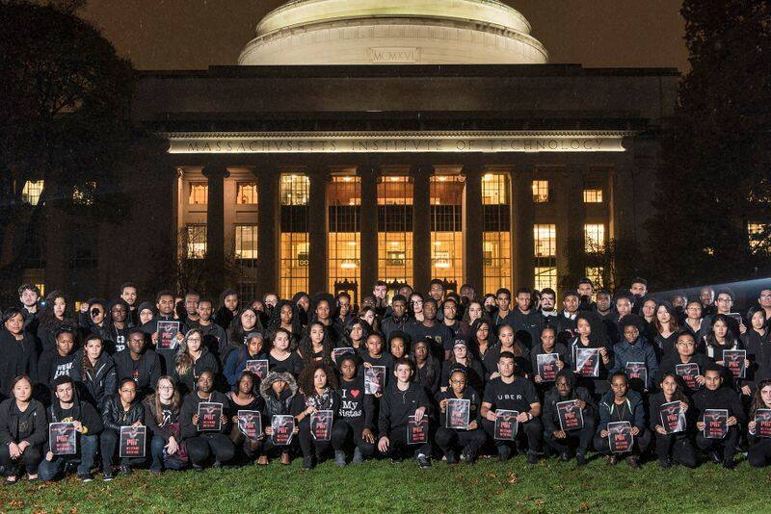

Slide 7
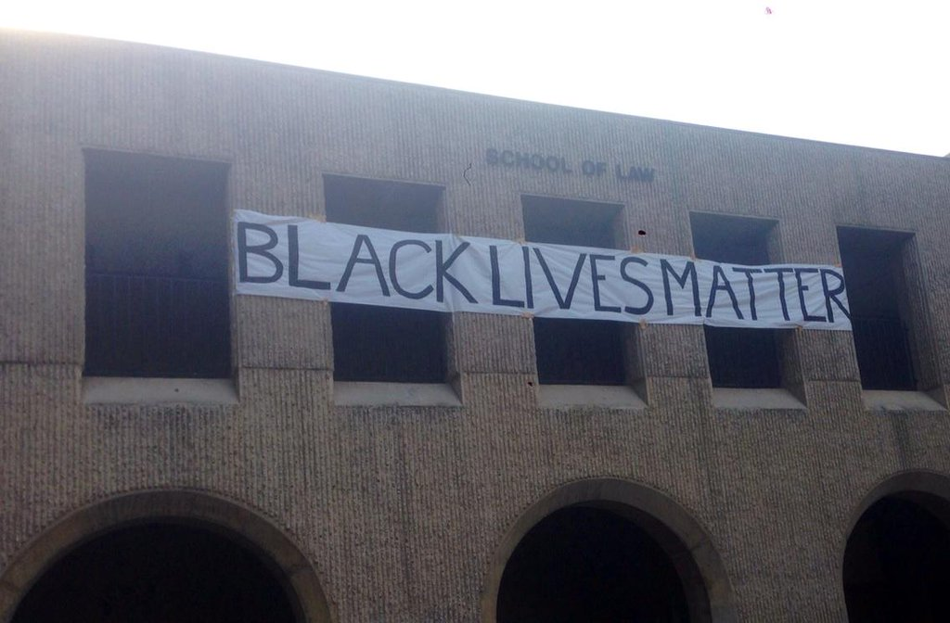
Stanford Law School
January 2015

Slide 8
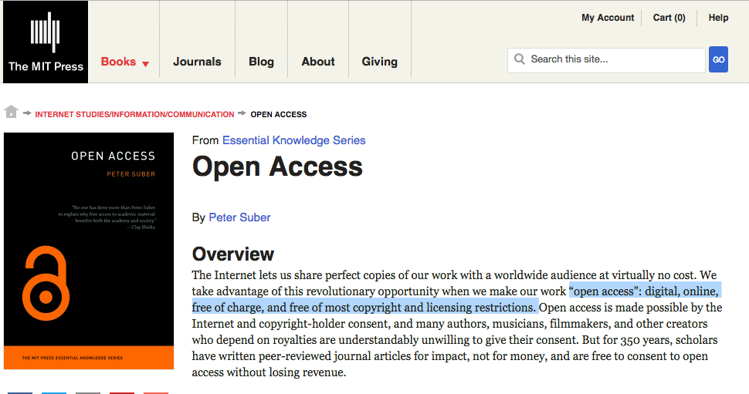

Slide 9
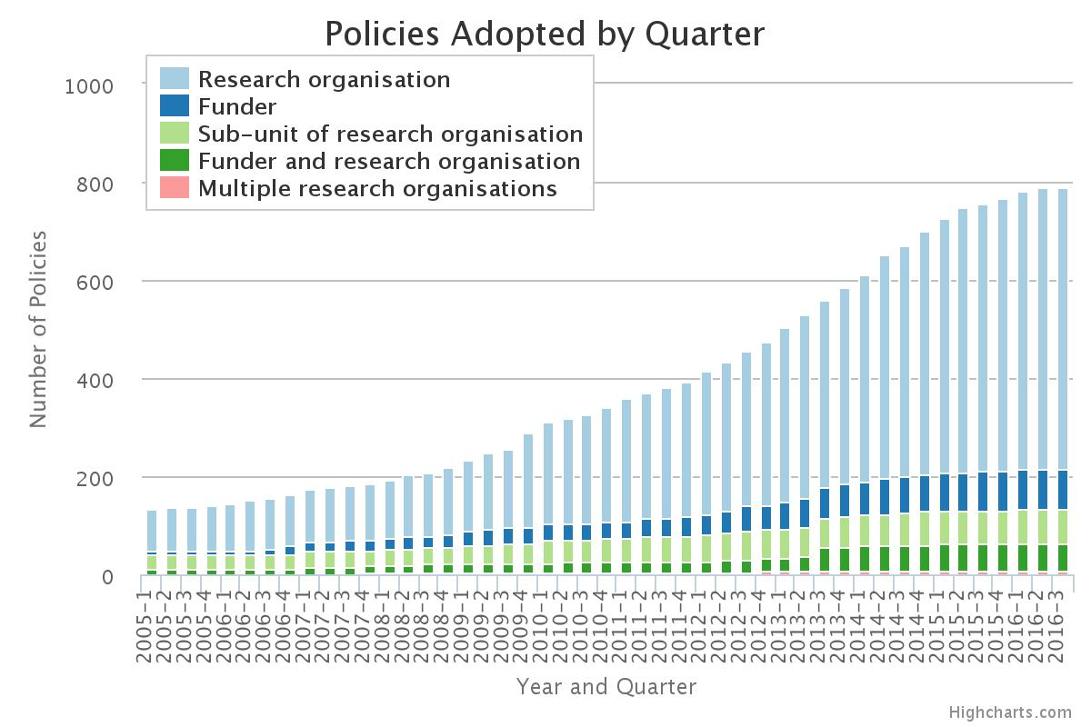

Slide 10
“For the MIT Libraries, the better world we seek is one in which there is abundant, equitable, meaningful access to knowledge and to the products of the full life cycle of research.”
Preliminary report: MIT Task Force on Future of Libraries
pubpub.org/pub/future-of-libraries

Slide 11
“… the Task Force’s vision is that the MIT Libraries must become a global library for a global university. We conceive of the library as an open platform serving the needs of our communities.”

Slide 12
"We envision the library as a networked set of global platforms … a repository of knowledge and data that can be exploited and analyzed by humans, machines, and algorithms. This … will enable the creation of new knowledge and of solutions to the world’s great challenges."

Slide 13
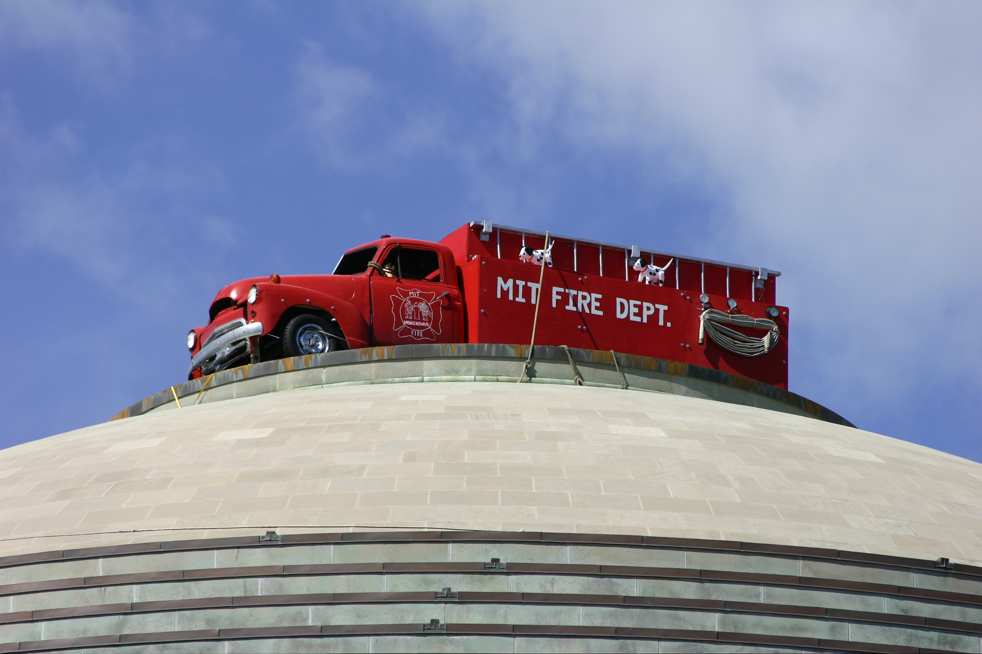
Hack the library
Photo credit: Erik Nygren

Slide 14
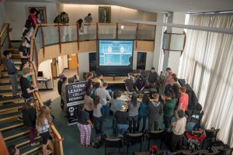

Slide 15
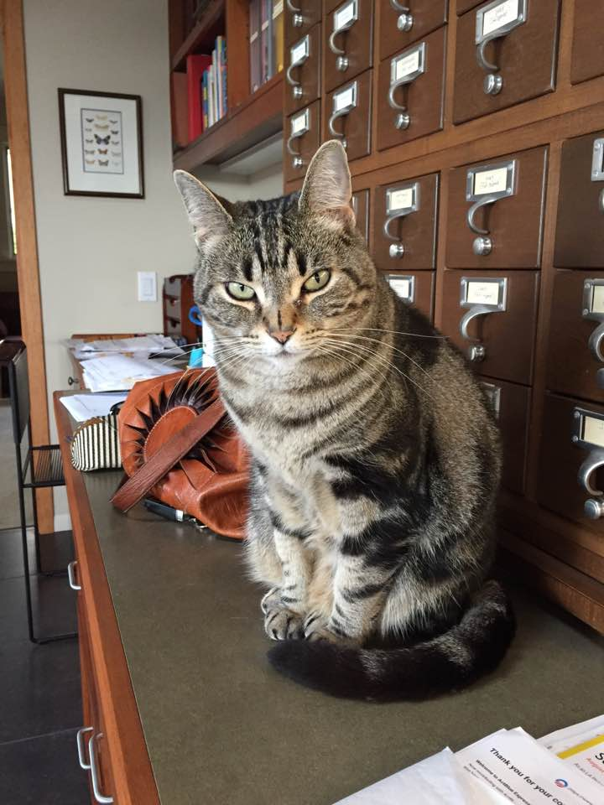
Questions?
Photo credits & references:
screen shots Bloomberg News & The Guardian, Pew Research Center, ROARMAP, Petrix5, MIT News Service, Eric Nygren.
Bailey, by Jackie Dooley

