Slide 1
Conducting IT Process Improvements
Seminar 06P
John Borwick

Slide 2
Who’s this guy?
ITIL® Expert, PMP®, CGEIT®
UNIX systems administrator
Wake Forest University PMO Director
Virginia Tech University Libraries IT Director
TeamDynamix managing consultant, process improvement
This is a vendor agnostic session.

Slide 3
Introductions
Name
Institution
Role

Slide 4
Goals (lightly edited and summarized)
Strategies for implementing IT process improvements in higher ed
Become more efficient at process improvement
Framework overview. Best practice implementation suggestions.
Understand what other higher ed institutions are doing re: IT process improvements.
Get ideas for how to implement a clear, effective system to collect and prioritize IT project requests from the institution.
Get ideas on how we can make process improvement a routine part of our operations. I also want us to be able to show what we are doing systematically to our steering committee, university executives and auditors.
Formalize the department's methodology used for process improvement
How to adapt agile / scrum framework; include new security framework
Grab ideas from session: Formal process? Documentation strategies? PM tools?
Gain insights into methodology with lean staff. Change management.

Slide 5
Agenda
Your improvement idea
Mental models
A whirlwind tour of IT process frameworks
Quick aside: Improvement and attitude
Stakeholder management
Organizational change management
Process improvement techniques
Reflection
Slides and other content will be made available to you.

Slide 6
Your improvement idea?

Slide 7
Mental models

Slide 8
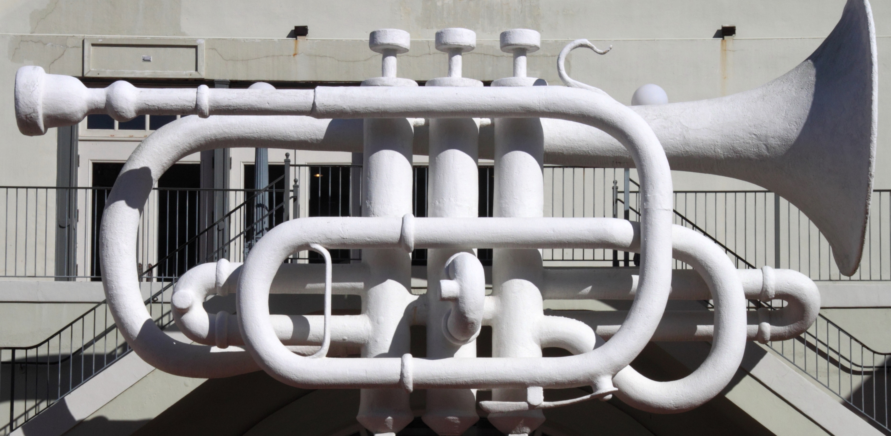
What is this?
https://www.flickr.com/photos/57412095@N05/8393265628/

Slide 9
Mental models in other disciplines
Degree programs
MLS
JD
Apprenticeships
Certifications

Slide 10
Equilibrate mental models
Help people learn your mental models
Understand where they are
Speak to them where they are

Slide 11
A whirlwind tour of IT process frameworks

Slide 12
Stops on our tour:
IT security
Software development methodologies
Project management
IT service management
IT governance
IT audit
Enterprise architecture
Organizational change management
Process improvement

Slide 13
For each framework:
Short description
Example organizations
Example frameworks
Example certifications
How to learn more

Slide 14
IT Security
Short description | Securing information—everything from physical security and network security to user security.
Example organizations | NIST (National Institute of Standards and Technology) (ISC)² (International Information System Security Certification Consortium)
Example frameworks | NIST Cybersecurity Framework ISO 27001
Example certifications | CISSP®
How to learn more | https://www.nist.gov/cyberframework https://www.isc2.org/cissp/default.aspx

Slide 15
Software development methodologies
Short description | Ways to make programmers more efficient through improved coding practices and team processes.
Example organizations | Scrum Alliance®
Example frameworks | Scrum Kanban
Example certifications | ScrumMaster®
How to learn more | http://www.educause.edu/annual-conference/2014/scrum-or-kanban-question-0

Slide 16
Project management
Short description | Organizing large and/or risky endeavors that involve many people to ensure success.
Example organizations | PMI® (Project Management Institute)
Example frameworks | PMBOK (Project Management Body of Knowledge) PRINCE2 (PRojects IN Controlled Environments)
Example certifications | PMP® (Project Management Professional) PRINCE2 Practitioner
How to learn more | EDUCAUSE Project CG

Slide 17
IT service management
Short description | Thinking in terms of services, and selecting, planning, transitioning, and operating effective services.
Example organizations | itSMF (IT Service Management Forum)
Example frameworks | ITIL® (IT Infrastructure Library) MoF® (Microsoft Operations Framework)
Example certifications | ITIL Foundations
How to learn more | EDUCAUSE ITSM CG

Slide 18
IT governance
Short description | Oversight and direction for IT resources, balancing cost, value, and risk.
Example organizations | IT Governance Institute (part of ISACA) ISACA
Example frameworks | COBIT ISO 38500
Example certifications | CGEIT®
How to learn more | https://library.educause.edu/topics/information-technology-management-and-leadership/it-governance

Slide 19
IT audit
Short description | Validating that IT has adequate controls, e.g. to ensure trustworthy information.
Example organizations | ISACA COSO (Committee of Sponsoring Organizations)
Example frameworks | COBIT COSO Internal Control Integrated Framework
Example certifications | CISA®
How to learn more | Your organization’s internal audit department

Slide 20
Enterprise architecture
Short description | Identifying the “tectonic shifts” ahead and building process, information, and service patterns to prepare.
Example organizations | The Open Group Gartner
Example frameworks | TOGAF®
Example certifications | TOGAF® 9 Certification
How to learn more | ITANA: https://spaces.internet2.edu/display/itana/Home

Slide 21
Organizational change management
Short description | Techniques to help organizations change.
Example organizations | ACMP (Association of Change Management Professionals)
Example frameworks | Kotter’s 8-step change model
Example certifications | CCMP (Certified Change Manager Professional)
How to learn more | Kotter’s Leading Change

Slide 22
Process improvement
Short description | Ways to reduce waste and improve value, including cultural changes and specific process techniques.
Example organizations | The Lean Enterprise Institute
Example frameworks | Lean Six Sigma
Example certifications | Lean IT Six Sigma Black Belt
How to learn more | Toyota Kata by Mike Rother lean.org (Lean Enterprise Institute)

Slide 23
Common challenges
“Do” the framework
One True Framework
How do these work together?

Slide 24
Reflection on process frameworks
IT security
Software development methodologies
Project management
IT service management
IT governance
IT audit
Enterprise architecture
Organizational change management
Process improvement

Slide 25
Quick aside: Improvement and attitude

Slide 26
Stakeholder management

Slide 27
John’s stakeholder thought process
Who are your stakeholders?

Slide 28
John’s stakeholder thought process
Who are your stakeholders?
How might they be impacted?

Slide 29
John’s stakeholder thought process
Who are your stakeholders?
How might they be impacted?
What are the power dynamics?

Slide 30
John’s stakeholder thought process
Who are your stakeholders?
How might they be impacted?
What are the power dynamics?
What incentives need to be considered?

Slide 31
Exercise: Identify your stakeholders
Stakeholders
Impact/Perceived impact
Power dynamics
Incentives at play

Slide 32
Organizational change management

Slide 33
Kotter’s Eight-Step Model
Sense of Urgency
Guiding Coalition
Strategic Vision & Initiatives
Volunteer Army
Remove Barriers
Short Term Wins
Sustain Acceleration
Anchor Change in the Culture

Slide 34
Quick wins and delivering value
Value
Time

Slide 35
Quick wins and delivering value
Value
Time

Slide 36
Organizational change and you
What is the sense of urgency?
Which stakeholders should be in your guiding coalition?
What must you do?
What are possible quick wins?

Slide 37
Process improvement techniques

Slide 38
A few improvement techniques:
Writing down processes
Feedback loops
+/- Feedback
Balanced roles
Facilitation
Negotiation
A3’s

Slide 39
Writing down processes
Description | Documenting approved processes in a central location, including process triggers, inputs, and outputs.
Key artifacts | Process template “Process process”
Key benefits | Everyone using the same process Easier to improve the process
Tricks/notes | Define the process owner You can choose the level of detail Business Process Modeling Notation (BPMN) for diagrams

Slide 40
Example process template sections
Introduction and background
Purpose and goals
Scope
Process owner
Definitions
Roles and responsibilities
Processes
Metrics
Related documentation
Revision history

Slide 41
Feedback loops
Description | Ensuring a “Plan/Do/Check/Act” cycle by identifying ways for the process to learn from itself.
Key artifacts | After-action reports Process metrics
Key benefits | Everyone using the same process Easier to improve the process
Tricks/notes | Watch when processes are expedited* Feedback loops work best in a culture of safety and trust, and worst in a culture of blame
*Expedited means that special steps were taken to make particular requests go faster.

Slide 42
+/- Feedback
Description | Asking a group to provide sticky note feedback for what’s good (+) and bad (-).
Key artifacts | “Affinitized” or grouped feedback Report out or summary to the group
Key benefits | Rapid feedback Learn your “unknown unknowns”
Tricks/notes | Don’t wait until the end of a project! Can help build a culture of safety and trust Engages “the organic system” i.e. all brains

Slide 43
Balanced roles
Description | Roles ideally are a balance of responsibilities, accountabilities, and authorities. Identify gaps/issues in roles and address them.
Key artifacts | Job descriptions RACI charts*
Key benefits | Engaged workers (sense of self-direction)
Tricks/notes | Define outcomes, but not approaches Use RACI charts sparingly Role playing/use cases can help
*RACI charts are a way of listing roles vs. process activities/steps. They show for each activity who’s responsible, who’s accountable, who’s consulted, and who’s informed.

Slide 44
Facilitation
Description | Helping a group of people listen to one another while moving towards a goal.
Key artifacts | Written meeting notes shared with the group
Key benefits | Sense of buy-in Validation that improvements will help
Tricks/notes | Ask people to state why they think they’re in the meeting Ask the group to validate your basic assumptions Use +/- feedback

Slide 45
Negotiation
Description | Helping identify possible value and “win”/”win” opportunities.
Key artifacts | Negotiation points identified Agreement
Key benefits | Sense of buy-in Validation that improvements will help
Tricks/notes | Getting to Yes by Fisher Ury Understand people’s motivations to move beyond impasses Be specific; use facts and observations.

Slide 46
A3’s
Description | Fold one A3-sized (~11”x17”) sheet in half: left side is the problem/issue; right side is possible solutions.
Key artifacts | Draft or completed A3 A3 feedback from your manager
Key benefits | Problem-centered approach Distills the issue without abstraction Easy for others to read
Tricks/notes | Managing to Learn by John Shook A3’s are high effort, high reward

Slide 47
Build IT project portfolio intake process (Example draft A3)
Initials 2016/10/25
Background: Central IT, an organization of 100 people, receives requests from departments all over campus. Many of these requests require the same people to implement. This results in IT having a backlog of “un-prioritized” work.
Possible countermeasures:
A. Intake process form
B. Triage process for projects
C. Review of existing projects for patterns that could be applied to new projects
D. Show time spent by area for existing services
E. Meeting of IT governance portfolio review board
Current state:
147 tickets submitted Jan 1-June 30 that were reclassified to “projects.”
Backlog of 90 project requests waiting to start.
CIO identifies which projects to pursue.
No sense of resource conflicts to date.
Implementation plan:
Oct 2016: finalize A3
Nov 2016: iteration #1: try out countermeasures A, B
Dec 2016: iteration #2: try out countermeasures C, D
Jan 2017: iteration #3: try out countermeasure E
Goals:
Visibility into the impact of existing work on new projects
Visibility into the ongoing resource needs for new projects
Root cause analysis:
Why are we getting these requests?
Executives want their units to be more efficient
Technology increasingly a part of implementing the strategic plans
Why are these projects?
Many projects require interfaces, which take a lot of time to build
Follow-up:
Nov 2016: A3 review meeting
Dec 2016: A3 review meeting, PMO project report
Jan 2017: A3 review meeting
Apr 2017: IT governance portfolio review meeting

Slide 48
What improvement techniques would help for your improvement?
Writing down processes
Feedback loops
+/- Feedback
Balanced roles
Facilitation
Negotiation
A3’s
Others ?

Slide 49
Reflection

Slide 50
Goals (lightly edited and summarized)
Strategies for implementing IT process improvements in higher ed
Become more efficient at process improvement
Framework overview. Best practice implementation suggestions.
Understand what other higher ED institutions are doing re: IT process improvements.
Get ideas for how to implement a clear, effective system to collect and prioritize IT project requests from the institution.
Get ideas on how we can make process improvement a routine part of our operations. I also want us to be able to show what we are doing systematically to our steering committee, university executives and auditors.
Formalize the department's methodology used for process improvement
How to adapt agile / scrum framework; include new security framework
Grab ideas from session: Formal process? Documentation strategies? PM tools?
Gain insights into methodology with lean staff. Change management.

Slide 51
Reflection
Your improvement idea
Mental models
A whirlwind tour of IT process frameworks
Quick aside: Improvement and attitude
Stakeholder management
Organizational change management
Process improvement techniques
Reflection
Slides and other content will be made available to you.

Slide 52
Help Us Improve and Grow
Thank you for participating
in today’s session.
We’re very interested in your feedback. Please take
a minute to fill out the session evaluation found within
the conference mobile app, or the online agenda.

