Slide 1
User Experience and Service Design Practice
Constituency Group Meeting
Mary Albert
Associate Director, User Experience Office
Office of Information Technology
Princeton University

Slide 2
User Experience and Service Design Practice
Constituency Group Meeting
Mary Albert
Associate Director, User Experience Office
Office of Information Technology
Princeton University
marya@princeton.edu

Slide 3
About the group
This EDUCAUSE constituent group addresses topics faced by professionals responsible for user experience within IT departments in higher education.
Discussions include best practices and tools, promoting user experience in project and team management, interface design including interactions, information architecture and visual design, and institutionalizing user experience.
This group meets at the annual EDUCAUSE conferences and uses the electronic discussion list to discuss issues throughout the year.

Slide 4
Agenda
Who we are
Our work in UX and service design
How we can support each other in the CG
Notes:
----- Meeting Notes (10/26/16 14:44) -----
UX for service design
UX being adaptive,what to do when UX is brought in late.
The student experience
End to end experience

Slide 5
How we can support each other in the CG
Community session ongoing
Slack, WebEx
The UX process
How to get traction
Agile, SCRUM based projects. Should UX be part of the scrum team?
UX board and development board in JIRA – kept separate
Slack used asynchronously
Share audience analysis tool to list

Slide 6
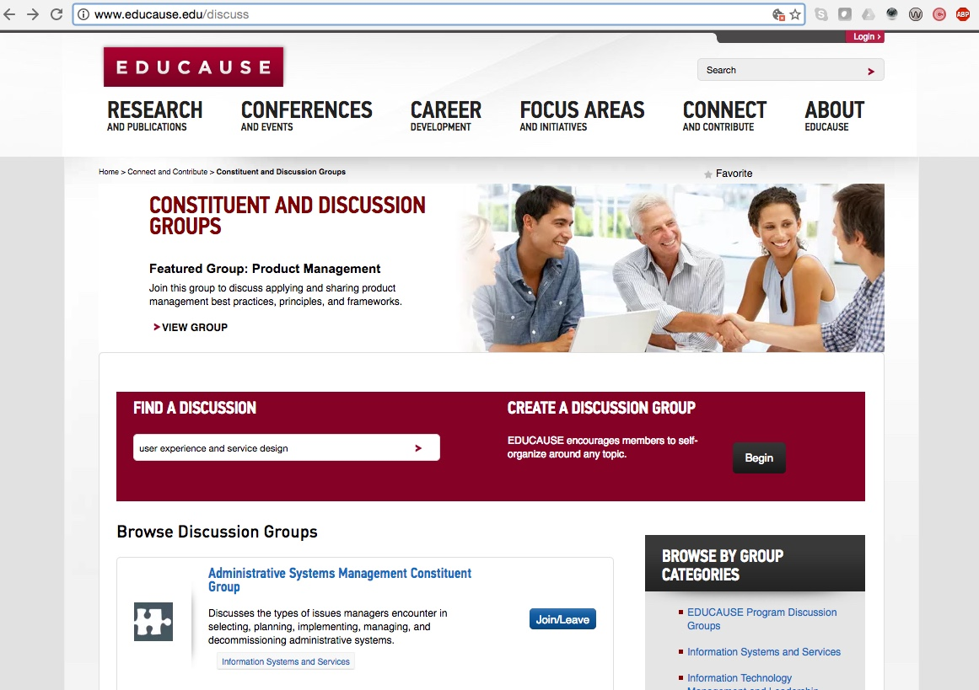
Join at: www.educause.edu/discuss
Type here:

Slide 7
Help Us Improve and Grow
Thank you for participating
in today’s session.
We’re very interested in your feedback. Please take
a minute to fill out the session evaluation found within
the conference mobile app, or the online agenda.

