Slide 1
Drive University Innovation Through Enhanced PMO Services
Warick L. Pond, PMP, CSM | Assistant Vice President
Entrepreneurial Project Management Skills
Objectives
Outcomes: Innovation Delivery
Arizona State University’s Planning & Program Management Office (PPMO) embraces flexible methodologies. Entrepreneurial project managers have strong stakeholder partnership, judgment, risk management, and team leadership skills. While understanding organizational and business priorities, they are also agile learners who are comfortable with ambiguity and capable of managing across matrix organizational structures. It is imperative to train university staff to understand project management concepts and skills. The PPMO has trained 1,165 and issued 960 PDUs as a R.E.P. with PMI. We have also created the ASU PM Network of practitioners across the campus. Our Business Support Services supports the team with appropriate tools and method agnostic processes.
ASUs performance on the Project Manager Effectiveness Index is based on the 17 project managers that received both PMO Executive and sponsor feedback with a 12% Overall improvement.
A 15% increase in Project Effort and 20% SLA Effort increase with a 35% decrease in Maintenance Effort in 3 years.
Business Support Services
3
Tactical Holistic Organizational Readiness
4
Procurement Security & Risk
THOR stands for Tactical Holistic Organizational Readiness. It is a weekly meeting with cross IT representation. Stakeholders are welcome to attend. In THOR, projects will be reviewed to gain approval of project readiness to move toward planning, execution, or closed status. Agenda items are built around the project stages.
Risk is identified early in the process prior to any purchase of new technologies. Using a proprietary Security Review to score possible IT risk severity coupled with a contract review that includes the Information Security and Risk Management Offices.
1
Sparky’s Director Evaluation
IT functional area Directors review project information provided and determine if the request is viable to become a project or is an existing IT Service. The project will either be approved, canceled or postponed. If the request fits within an existing program it will follow that program’s intake governance and be guided by the appropriate Program Manager.
5
Product Design Consulting
Bring high-level project requirements or rough-draft project charters to get ideas and feedback on architecture, application and web design for the project (before the project is underway) from a cross representation of ASU technology experts.
2
Executive Customer Priority
Priorities are defined by the business capabilities aligned to ASU’s unique Charter & Mission. The PPMO brings Program Roadmaps that link capabilities with projects to a roadmap. These discussions are not about IT but about new business functions and capabilities.
6
Quality Assurance
The PPMO Quality Assurance group is an evolving group of experts who remain flexible and versatile in their approach to helping customers achieve successful IT projects that are highly usable, with a high level of confidence before go-live. QA services are tailored to each project and include support before, during, and after project testing phases, up to go-live, and during the maintenance and upgrade phases that follow.
ASU Project Management Innovation Framework
ASU Project Acceleration Differentiator

Slide 2

Only at ASU...
Notes:
Welcome to one of the most radical redesigns in higher learning...

Slide 3
Only at ASU...
does the reinvention of higher education extend across all boundaries, where groundbreaking research makes community impact, where partnerships unite global thinkers and leaders, where academic excellence meets athletic prowess.
A reinvention based on a new way of thinking
and doing has taken root in all that is ASU.
Notes:
Only at ASU does the reinvention of higher education extend across all boundaries — this is where academic excellence meets athletic prowess, where groundbreaking research makes community impact, where partnership goes global. A reinvention — based on a new way of thinking and doing — has taken root in all that is ASU.

Slide 4

“Each person
is gifted,
there is no
reason to hold
anyone back”
–Michael M. Crow,
President, ASU

Slide 5
Assuming fundamental
responsibility for our
community
ASU Charter: ASU is a comprehensive public research university, measured not by whom we exclude, but rather by whom we include and how they succeed: advancing research and discovery of public value: and assuming fundamental responsibility for the economic, social, cultural and overall health of the communities we serve.

Slide 6

3
years in a row

Slide 7

Launching
innovators
into the world
Notes:
With more than 80,000 master learners across six campuses and multiple learning centers, ASU reflects the socioeconomic demographic of those the university serves, providing meaningful solutions to real-world challenges.

Slide 8
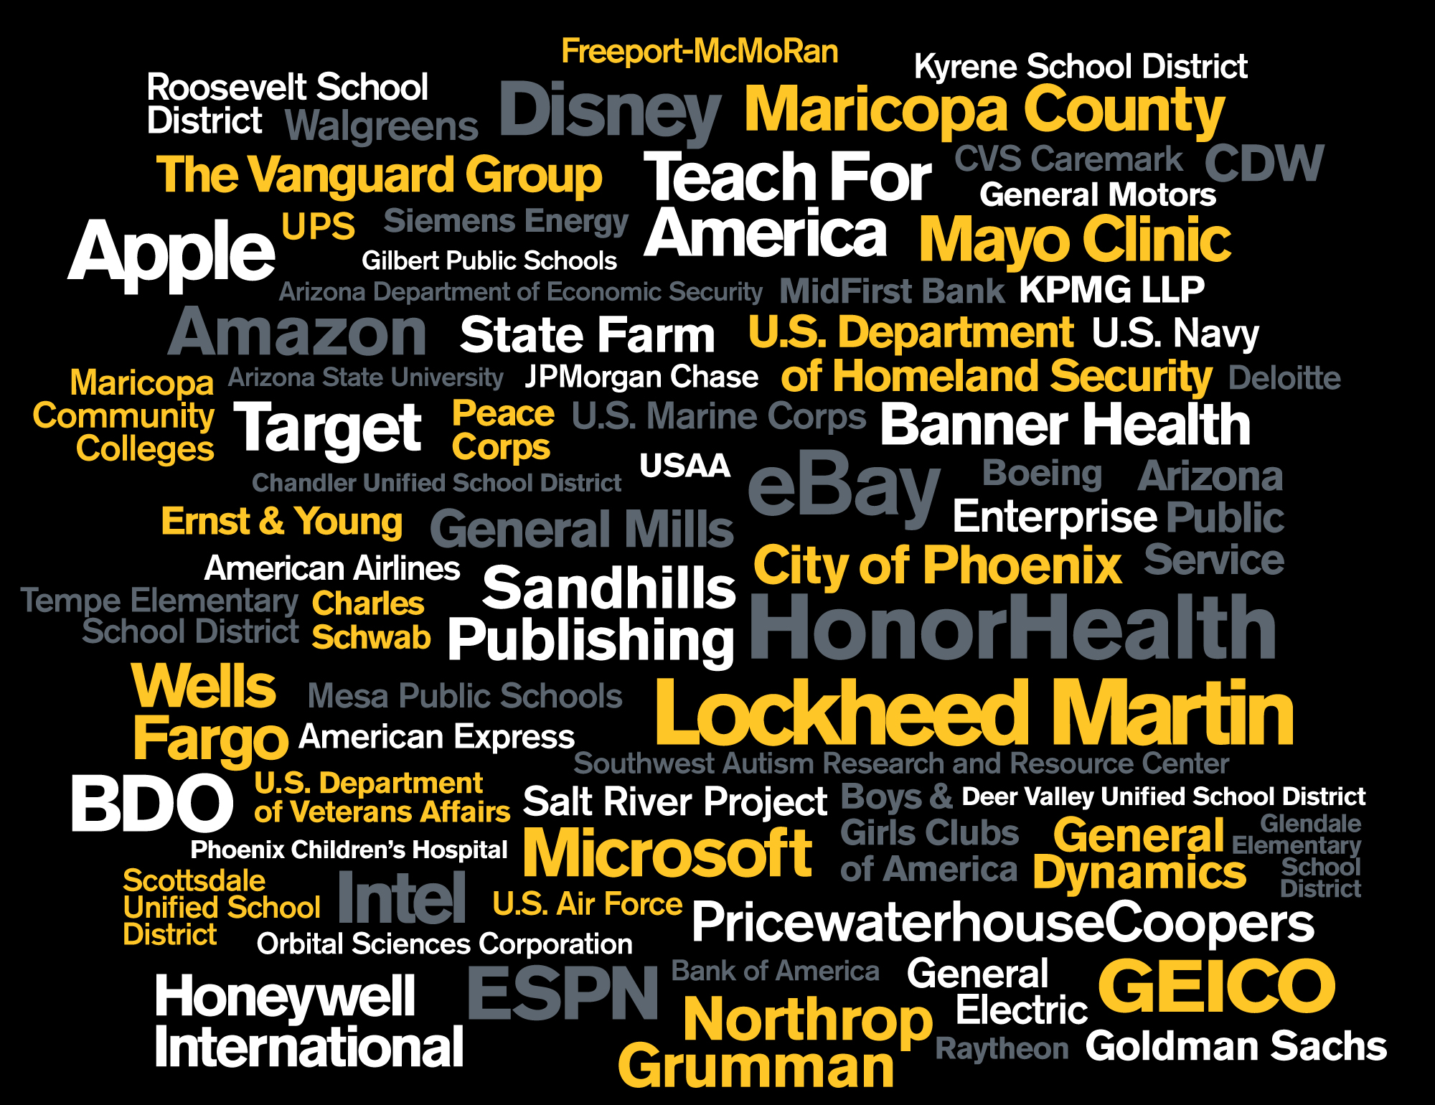
Launching
innovators
into the world
Who are hired
by leading
employers
bvv
Notes:
Group 15 --

Slide 9
LMK: Layout with just three stats
Launching
innovators
into the world
96,000+ students
from more than 180 countries — ASU enrollment
No. 5 in the U.S.
for Fulbright Student Scholars — Fulbright
No. 5 in the U.S.
for best-qualified graduates — The Wall Street Journal
Top 20 for landing a job
in Silicon Valley — Business Insider
who are
earning
global
recognition

Slide 10
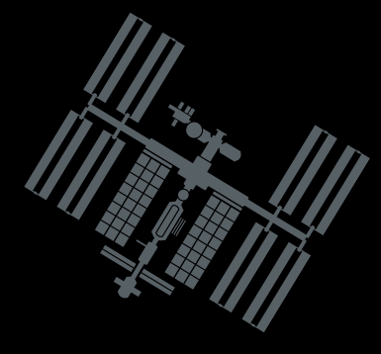
Redefining
academic
powerhouse
by creating
an
innovation
epicenter
Top 10
One of the fastest-growing research universities in the country
– Forbes
One of the top research universities
in the world
– Academic Ranking
of World Universities
“Outstanding public research university”
– American City Business Journals
“Most innovative and practical thinkers: ASU President Michael Crow”
– Time
More than 80 companies
and $500 million in funding have launched based on
ASU innovations.

Slide 11
Creating a bold network
that
accelerates
mutual success
Mayo Clinic
Starbucks
NASA
Blackboard
Dell
GE
Company name here
Coca Cola
Disney
adidas
+
Honeywell
+1000 more
+
Notes:
Group 15 --

Slide 12
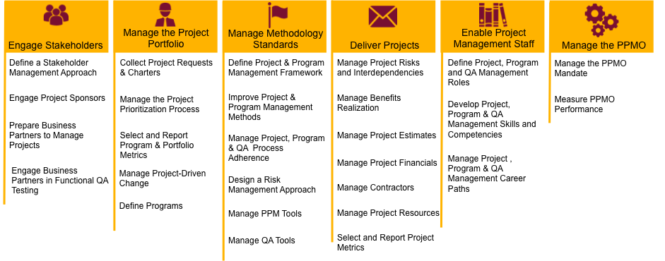
PPMO Activities

Slide 13
Objectives
PREDICTABILITY
accurately predict when we can deliver a solution
accurately predict how much we can deliver in an on-time delivery
AGILITY
stay nimble
be able to react to the priorities
break up large unwieldy projects
SPEED VALUE DELIVERY
deliver business outcomes earlier
deliver projects faster

Slide 14
Challenges to Our Goals

Slide 15
Discovery
Execution
Request Charter
Sparky’s Director Evaluation
Project Charter
Status Reporting
Change Management
Escalation Paths & Governance
Risk & Issue Mitigation
THOR
Ideation
Validation
Executive Customer Priority
Identify Project Planning Team
Procurement Security & Risk
Onboard Vender / Partner
User Acceptant Testing
Quality Assurance bug fixes
Plan – Do – Check – Adjust Cycle
Planning
Closure
Product Design Consulting & Requirements
ARB & Security Reviews
Organization Change Mngmt
Schedule, Scope, Resources, Risks, Budget
Communication and QA Plans
Closeout Review & Report
Lessons Learned
Retrospective / Stakeholder Review

Slide 16
Methodology Agnostic
Six Sigma
Waterfall / WBS
Agile / Scrum

Slide 17
Entrepreneurial Project Management
Business
I.
VII.
Stakeholder
Knowledge
Partnership
Relationship
Management
Communication
Influencing
Organizational Awareness
II.
Learning
Learning and Researching
Adapting and Responding to Change
Agility
Decision Making
Analytic Ability
Judgment
VI.
Achieving Personal
Goals and Objectives
Business
Results
Orientation
Decision Making
Organizational Awareness
V.
Risk
Teamwork
Leading and Supervising
Management
Ownership
III.
and Commitment
IV. Team
Leadership

Slide 19
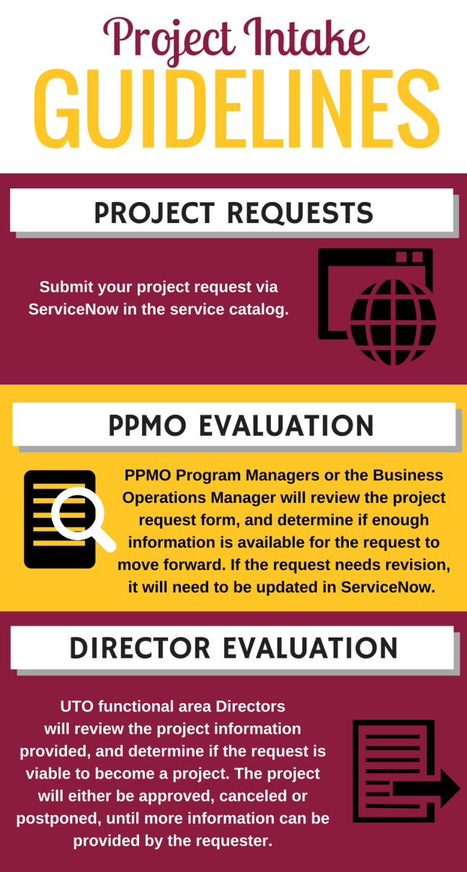
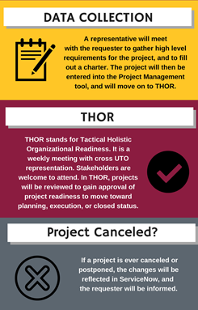
Sparky’s Director Evaluation

Slide 20
Executive Customer Priority

Slide 21
Executive Customer Priority
Strategic Business Capabilities | Specific objectives that support the completion of the business objective
Improve student retention and graduation rates (Student Success) | Place Civitas Persistence Outlook scores in student profile and advisor portal UIA – First in World Grant Additional student integrators in Salesforce (Civitas and others) Automate outreach case creation (Civitas and other indicators) Develop coach and advisor portal reporting Expand portal to First Year success coaches Me3 HS data available in Salesforce Develop me3 reporting Develop portal for me3 HS educators
Brand integrity and personalized messaging at scale | Implement a subscription center Develop method to import contacts Migrate from unconnected orgs to connected org Implement SMS
Constituent 360 degree Stakeholder View | High-Level Requirements for creating constituent 360 page Evaluate Org to Org Data Sharing Methodologies Implement Constituent 360 page
Increasing quantity and quality applicant pool | Graduate Application Supplement Graduate App GFA Org integration Event Management integration Multi-Org Recruitment strategy Recruitment Outreach Efficiencies Expand portal to recruitment outreach
Track ASUs Corporate Partners and Engagements | Implement pipeline management (opportunities on an account) Implement organization 360 (account) Handshake integration Establish best practices for data handling
Improving student services through next generation technology (e.g. IoT, Einstein) | Opportunities with Internet of Things (IoT) Cloud Opportunities for Artificial Intelligence and Machine Learning leveraging Einstein

Slide 22
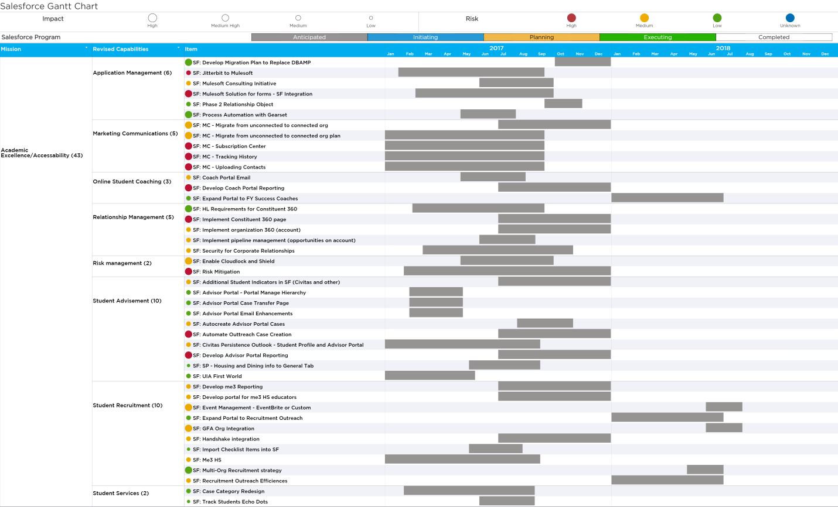
Executive Customer Priority

Slide 23
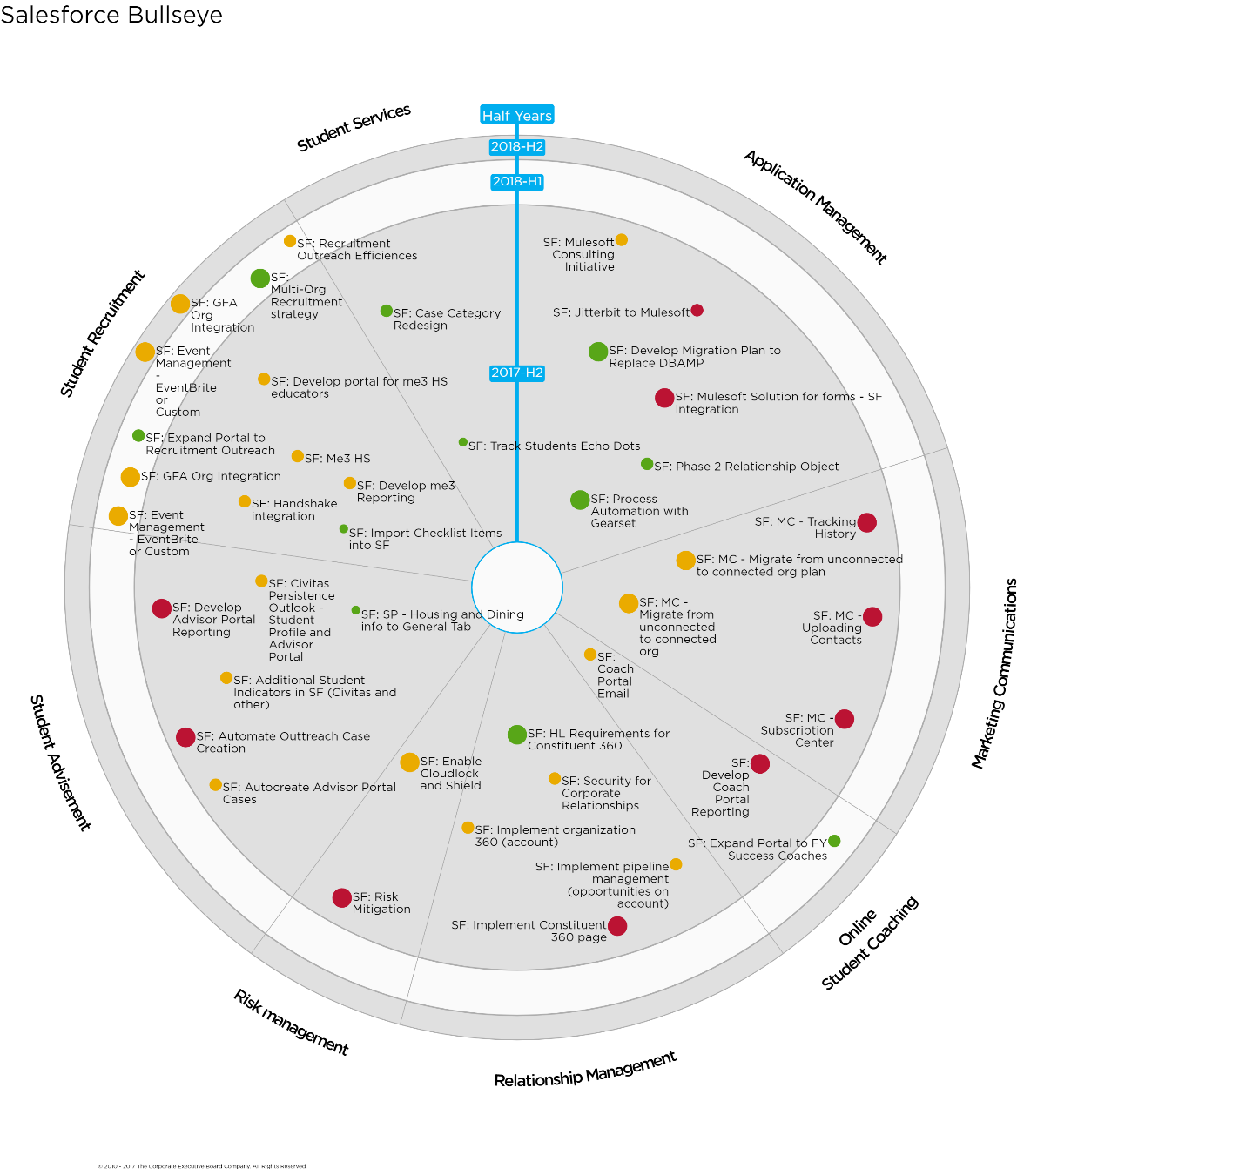
Executive Customer Priority

Slide 24
Tactical Holistic Organizational Readiness (THOR)

Slide 25
Procurement Security & Risk

Slide 26
Procurement Security & Risk

Slide 27
Product Design Consulting

Slide 28
Quality Assurance

Slide 29
Outcomes
PREDICTABILITY
accurately predict when we can deliver a solution
accurately predict how much we can deliver in an on-time delivery
8.4% Improvement

Slide 30
Meets or Exceeds Expectations
Somewhat Meets Expectations
Fails Expectations

Slide 31
Outcomes
AGILITY
stay nimble
be able to react to the priorities
break up large unwieldy projects

Slide 32
Outcomes
AGILITY
stay nimble
be able to react to the priorities
break up large unwieldy projects

Slide 33
Outcomes
AGILITY
stay nimble
be able to react to the priorities
break up large unwieldy projects

Slide 34
Outcomes
SPEED VALUE DELIVERY
deliver business outcomes earlier
deliver projects faster
16% Improvement

Slide 36
Business
I.
Requirement Based Testing
System Testing
Exploratory Testing
Integration Testing
User Interface Testing
Web Based Standards & Compliance Testing
Regression Testing
Performance & Load Testing
Stakeholder
VII.
Knowledge
Partnership
Relationship
Management
Communication
Influencing
Organizational Awareness
Learning
II.
Agility
Learning and Researching
Adapting and Responding to Change
Decision Making
Analytic Ability
VI.
Judgment
Achieving Personal
Goals and Objectives
Business
Results
Orientation
Decision Making
Organizational Awareness
V.
Risk
Teamwork
Leading and Supervising
Management
Ownership
III.
and Commitment
IV. Team
Leadership

Slide 37
Business
I.
Requirement Based Testing
System Testing
Exploratory Testing
Integration Testing
User Interface Testing
Web Based Standards & Compliance Testing
Regression Testing
Performance & Load Testing
Stakeholder
VII.
Knowledge
Partnership
Relationship
Management
Communication
Influencing
Organizational Awareness
Learning
II.
Agility
Learning and Researching
Adapting and Responding to Change
Decision Making
Analytic Ability
VI.
Judgment
Achieving Personal
Goals and Objectives
Business
Results
Orientation
Decision Making
Organizational Awareness
V.
Risk
Teamwork
Leading and Supervising
Management
Ownership
III.
and Commitment
IV. Team
Leadership

Slide 38







Sparky’s Director Evaluation
Strategic Planning
Operational
Planning
Work & Resource Management
AVP Review & Approval
Demand Management
Charter Development
PPMO &ITSM
Resource Requirements
PM
Community of Practice
Project Management
Resource Assignments
Customer AVP Expectations
WBS Development
Reports / Status
Executive Planning
Resource Assignments
Capacity Estimates
Resource Management
Approve / Deny
Monitor Utilization
Financial Management
Labor & Non Labor Spend
UTO Director Portfolios
Academic Technologies
Development
Operations
CARE
Infrastructure Network
Information Security
Training/PPMO
Financial Metrics
Planned Labor Costs
Actual Labor Costs
Planned Expenses
Funded Expenses
Actual Expenses
Align Capacity
Level Resources
Governance for Project & Operational work
Capacity Estimates

Slide 39
Strategic Planning
Operational
Planning
Work & Resource Management
AVP Review & Approval
Demand Management
Charter Development
Resource Requirements
Project Management
Resource Assignments
Customer AVP Expectations
WBS Development
Reports / Status
Executive Planning
Resource Assignments
Capacity Estimates
Resource Management
Approve / Deny
Monitor Utilization
Financial Management
Labor & Non Labor Spend
Capacity Estimates

Slide 40
Maintenance
Project
SLA

