Slide 1

Evaluating Digital Learning Implementation with the CWiC Framework
November 1,2017

Slide 2
Our Presenters
Senior Instructional Designer at the Center for Distributed Learning at the University of Central Florida (UCF).
Leads the Personalized Adaptive Learning team, designs and delivers faculty professional development programs, and teaches graduate courses on Instructional Systems Design.
Works closely with teaching faculty members to design and develop adaptive learning courses by utilizing digital courseware to personalize instruction that maximizes student learning.
Baiyun Chen, Ph.D.
Technology Manager at EdPlus (ASU) where he helps identify needs and build systems that enhance the online learning experience and improve student outcomes.
Works with faculty to design pedagogically sound courses, and identify the best technologies to use across different disciplines.
Philippos is curious about the interaction between technology and learning.
Philippos Savvides
Sharon Goodall is Director of Innovations, Design & Analysis in Learning Design & Solutions at University of Maryland University College (UMUC).
Leads efforts in investigating and applying next generation instructional design approaches to online learning with the goal of improving student outcomes.
Works in close collaboration throughout the innovation pilot lifecycle with the Center for Innovation in Learning and Student Success.
Sharon Goodall

Slide 3
Agenda
01
02
03
04
05
06
Courseware-in-Context (CWiC) Framework
Evaluating Courseware at UCF
Systematizing Product Selection at ASU
Comparing Feature Sets of Products at UMUC
Breakout
Q&A

Slide 4
The Courseware-in-Context (CWiC) Framework
The CWiC Guide to Courseware

Slide 5
CWiC Framework: Product Taxonomy

Slide 6
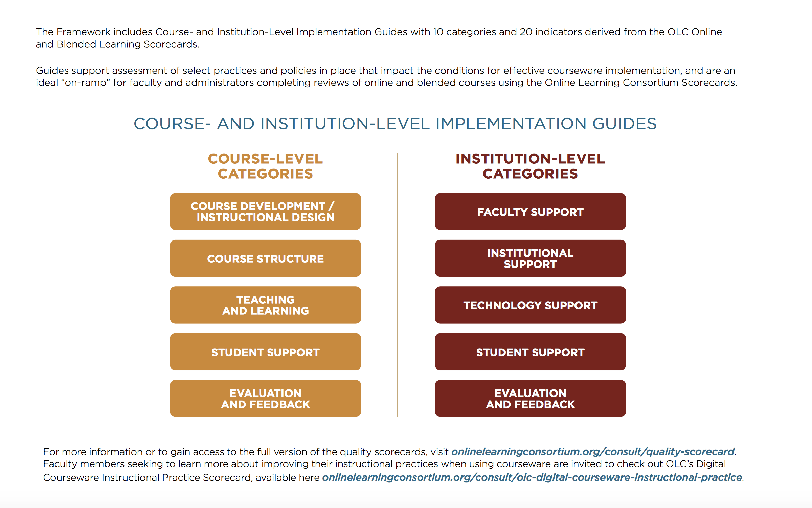
CWiC Framework: Implementation Guides

Slide 7
Evaluating Courseware at UCF
Background
Informing changes to CWiC
Instructional designers compared implementations of ALEKS and RealizeIT
Evaluations varied moderately from the Vendors’ self evaluation
Product evaluations took 2-hours or less for power-users (ID team and faculty)
Several minor UX changes were forwarded directly to the Lea(R)n team
Customization attributes should be made more granular
Provide examples and additional clarity on social-emotional factors to assist faculty who may be unfamiliar with that language
General Feedback
Overall
Evaluations could be done by an academic or tech-focused dept.; any department that is making a decision between two products
Faculty found the implementation guides to be useful
Some interoperability, privacy & security, and scalability questions were not able to be answered by anyone at institution
Use of the CWiC Framework to evaluate implementations of ALEKS and RealizeIT supported differentiation between products
The analysis will be useful for product selection decisions going forward, in particular for adaptive products
Notes:
Align boxes

Slide 8
Systematizing Product Selection at ASU
Background
Impact
Instructional Designers and faculty used staff input, impact analysis and the interactive CWiC Framework’s Feature Analysis
Evaluated the impact of the use of Yellowdig on students’ performance.
Demonstrated that the interactive CWiC Framework can be combined with other tools to measure impact of courseware on student outcomes.
Pilot participants found that the Interactive CWiC Framework allowed for systematizing courseware evaluation
Pilot Overview
Conclusion
IDs partnered with 31 instructors to complete the CWiC Framework feature analysis
Used Yellowdig participation data and student performance metrics (i.e grades and retention) to identify relationship between Yellowdig participation and student success.
Holistic product evaluation through faculty feedback collection, review of the product against the CWiC Framework, and impact analysis form a strong body of data that will inform discussions around expanded use of Yellowdig.
Notes:
Align boxes

Slide 9
Comparing Feature Sets of Products at UMUC
Background
Proposed Implementation
Exploring alternative placement opportunities for Math
  Vetting multiple vendors takes a tremendous amount of time and effort
  Systematic comparison of features is difficult
  Stakeholder involvement is inconsistent
  Prior investigations are not well-documented
Use CWiC Primer to focus investigations into digital courseware vendors:
  Evaluation is structured by a prioritized capability set
  These functional capabilities provide clear parameters for systematic comparisons
Key Stakeholders
Next Steps
Faculty
Program Chairs
Learning/Instructional Designers
Academic Technology
Socialize CWiC Product Primer with stakeholders
Investigate Product Taxonomy via Lea(R)n
Identify courseware options
Draw from questions in CWiC Primer Set 7 for vendor conversations
Dig into the capabilities of each option through full CWiC Product Taxonomy

Slide 10
Breakout Session
Using the CWiC Framework to differentiate and select between two different courseware products used in the same course.
Evaluate
Using the CWiC Framework as a component of a broader analysis of the impact of a digital learning program on students
Compare
Using using the CWIC Framework to help in the comparing between prospective courseware products.
Differentiate

Slide 11
Q & A
Notes:
- Guiding questions;

