Slide 1
Post-Secondary Institution Data-Security Overview and Requirements
Tiina K.O. Rodrigue, EdDc, CISSP, CISM, PMP, CSM, CEA, ITIL, ISC2 Compliance Mapper, A+, FAC P/PM III
Senior Advisor – Cybersecurity - 2017

Slide 2
Agenda
Who needs to worry about data security?
Why do I need to worry about data security?
What are the data security requirements?
What is a breach?
When do I report a breach?
How do I report a breach?
How can you help me with data security?
What are my next steps?

Slide 3
Who needs to worry about data security?
President & Board of Directors/Regents
CIO, CISO Staff
Staff & Faculty
Registrars, Comptrollers, and Treasurers
Financial Aid Professionals
Financial Aid VP/Director
Users
Students
Applicants
Parents

Slide 4
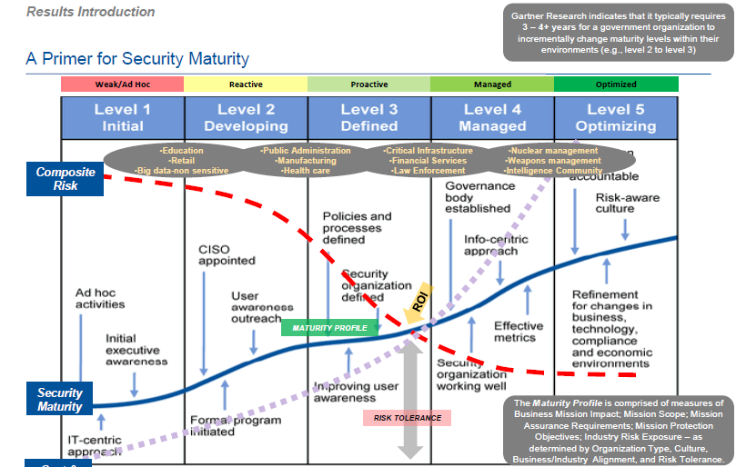
Why do I need to worry about data security?
Cost and Effort

Slide 5
Why do I need to worry about data security?
Educational institutions are specifically being targeted because of the current state of ad-hoc security coupled with the educational environment being a rich trove of emails, information and research.

Slide 6
Why do I need to worry about data security?
Starting in FY18, GLBA information security safeguards will be audited to ensure administrative capability. Draft audit language:
Audit Objectives – Determine whether the IHE designated an individual to coordinate the information security program; performed a risk assessment that addresses the three areas noted in 16 CFR 314.4 (b) and documented safeguards for identified risks.
Suggested Audit Procedures
a. Verify that the IHE has designated an individual to coordinate the information security program.
b. Obtain the IHE risk assessment and verify that it addresses the three required areas noted in 16 CFR 314.4 (b).
c. Obtain the documentation created by the IHE that aligns each safeguard with each risk identified from step b above, verifying that the IHE has identified a safeguard for each risk.

Slide 7
What are the data security requirements?
Title IV schools are financial institutions per Gramm-Leach-Bliley Act (GLBA, 2002)
Per FSA PPA & SAIG agreements, these schools must have GLBA safeguards in place. Schools without GLBA safeguards may be found administratively incapable (unable to properly administer Title IV funds).
GLBA Safeguards are:
Develop, implement, & maintain documented data security (info-sec) program
Designate an employee(s) to coordinate the program

Slide 8
What are the data security requirements? cont’d
Identify reasonably foreseeable internal and external risks to data security via formal, documented risk assessments of:
Employee training and management
Information systems, including network and software design, as well as information processing, storage, transmission, and disposal
Detecting, preventing and responding to attacks, intrusions, or other systems failures
Control the risks identified, by designing and implement information safeguards and regularly test /monitor their effectiveness.

Slide 9
What are the data security requirements? cont’d
• Oversee service providers, by:
Taking reasonable steps to select and retain service providers that are capable of maintaining appropriate safeguards for the FSA, student, & school (customer) information at issue
Requiring your service providers by contract to implement and maintain such safeguards.
• Evaluate & adjust school’s info-sec program in light of:
the results of the required testing /monitoring
any material changes to your operations or business arrangements;
any other circumstances that you know may have a material impact on your information security program.

Slide 10
What are the data security requirements? cont’d
Title IV schools are subject to the requirements of the FTC Identity Theft Red Flags Rule (72 Fed. Reg. 63718) issued on November 9, 2007
The “Red Flags Rule” requires an institution to develop and implement a written Identify Theft Prevention Program to:
Detect
Prevent
Respond to patterns, practices, or specific activities that may indicate identity theft

Slide 11
What is a breach?
Per GLBA, a breach is any unauthorized disclosure, misuse, alteration, destruction or other compromise of information. (§314.4 (b))
Administrative, technical, and physical safeguards:
ensure the security & confidentiality of customer information
protect against any anticipated threats or hazards to the security or integrity of such records
protect against unauthorized access to or use of such records or information which could result in substantial harm or inconvenience to any customer.
Important items to note:
No minimum size or # of records
Employee access is not exempt if wrong
Not strictly digital or technology-based – paper counts!
Covers data in storage, in transit or being processed

Slide 12
When do I report a breach?
The Student Aid Internet Gateway (SAIG) Agreement requires that as a condition of continued participation in the federal student aid programs Title IV schools report suspected/actual data breaches
Title IV schools must report on the day of detection when a data breach is even suspected
The Department has the authority to fine institutions that do not comply with the requirement to self-report data breaches; up to $54,789 per violation per 34 C.F.R. § 36.2
The Department has reminded all institutions of this requirement through Dear Colleague Letters (GEN 15-18, GEN 16-12), electronic announcements, and the annual FSA Handbook.

Slide 13
How do I report a data breach? (Yes, you!)
Email cpssaig@ed.gov & copy your
data breach team, executives, per your policy
Data to include in the e-mail:
Date of breach (suspected or known)
Impact of breach (# of records, etc.)
Method of breach (hack, accidental disclosure, etc.)
Information Security Program Point of Contact
Email and phone details will be necessary
Remediation Status (complete, in process – with detail)
Next steps (as needed)
2. Call Education Security Operations Center (ED SOC) at 202-245-6550 with above data. ED-SOC operates 7x24.
3. Call or Email Tiina Rodrigue – tiina.rodrigue@ed.gov or 202-377-3887 – if both previous methods fail.

Slide 14
How can you help me with data security?
Cybersecurity Assessment Tool (CAT) - optional self-assessment electronic tool that helps establish school’s current risk profile and cybersecurity maturity for executive review & prioritization:
Built by Federal Financial Institution Examiners’ Council (FFIEC) to help financial institutions review current state
Education has automated it to better enable schools of all levels to review current state of risk and maturity
Targets specific areas to address to close the gaps from a best practice perspective while preventing waste or over-engineering
Covers 5 Domains in depth, with diverse areas including culture, acquisitions, 3rd-party management which aligns with GLBA requirements
Pertains to policy, people and process issues, too

Slide 15
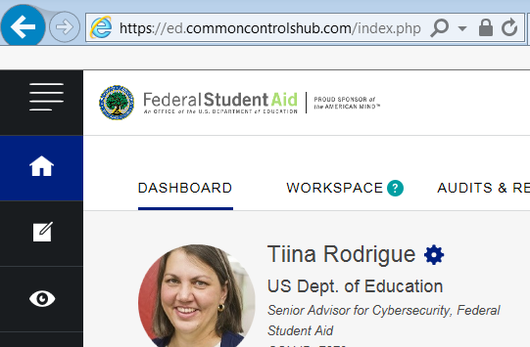
How can you help me with data security?
Institutions of Higher Education (IHE) Compliance Framework
Public-Private Partnership to reduce the burden of compliance for security and privacy controls for Title IV schools
Register for a free account to access the optional tool & data
Driven by the regulation on a federal and state level
Includes the international regulations for foreign schools
Consolidates all relevant laws into one compliance framework
Prevents duplicate effort, saving the schools money and effort

Slide 16
How can you help me with data security?
NIST has provided non-FISMA guidelines (800-171) that are recommended by FSA & Education in GEN 16-12 which gives specific technical standards to prove GLBA compliance:
Access Control
Awareness and Training
Audit and Accountability
Configuration Management
Identification Authentication
Incident Response
Maintenance
Media Protection
Personnel Security
Physical Protection
Risk Assessment Requirements
Security Assessment Requirements
System and Communications Protection
System and Information Integrity

Slide 17
How can you help me with data security?
As an option, you can contact Senior Advisor – Cybersecurity to:
Ask hypothetical questions – is this an area of concern?
Get a consultative review – policy or process (it’s free!)
Use the tools or get additional information (also free)
Collaborate on best practices or bring ideas forward
Review new Cybersecurity Compliance page – send input
Contact information:
Tiina Rodrigue – tiina.rodrigue@ed.gov
202-377-3887

Slide 18
What are my next steps?
Find your information security policy and program for your school - If you don’t have one, develop one
Verify your school’s information security policy and program has an individual with his/her contact information - Make sure to keep that person up to date in the policy and is actively managing the program
Verify that your school has information risk assessment/testing schedule in place - if you don’t have one, develop one
Verify that your school has documented the tests and results based on that schedule - if haven’t tested, have team start to follow the schedule and DOCUMENT it
Add your information security policy/program/schedule/contact information to your consumer information and compliance website so that you can easily find/maintain it
Communicate to your entire executive team so that if a breach happens, everyone is prepared to respond immediately & appropriately

Slide 19
Post-Secondary Institution Data-Security Overview and Requirements
Tiina K.O. Rodrigue, EdDc, CISSP, CISM, PMP, CSM, CEA, ITIL, ISC2 Compliance Mapper, A+, FAC P/PM III
Senior Advisor – Cybersecurity - 2017

Slide 20
The GLBA Safeguards Rule defines the following:
• An information security program is defined as the administrative, technical, or physical safeguards used to access, collect, distribute, process, protect, store, use, transmit, dispose of, or otherwise handle customer information.
• Customer information is defined as any record containing nonpublic personal information as defined in 16 CFR 313.3(n), about a customer of a financial institution, whether in paper, electronic, or other form, that is handled or maintained by or on behalf of the financial institution or its affiliates.
• A service provider is defined as any person or entity that receives, maintains, processes, or otherwise is permitted access to customer information through its provision of services directly to a financial institution that is subject to the Safeguards Rule.

Slide 21
