Slide 1
What Drives Institutions to Make a Technology Change Now?
Thursday, November 02 | 1:30pm - 2:20pm ET | Meeting Room 105A/B, 100 Level

Slide 2
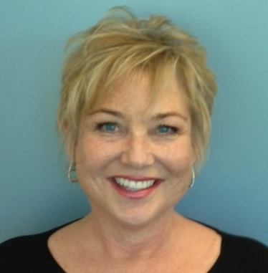
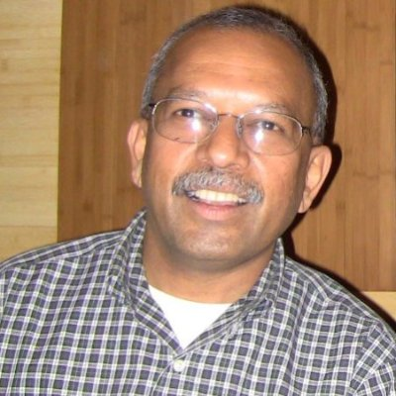
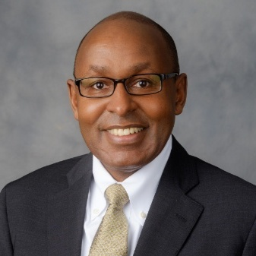
Panelist Introductions
Liz Dietz
Vice President Product
Management and Strategy, Workday Student
Workday
Ravi Ravishanker
Chief Information Officer & Associate Provost
Wellesley College
Mur Muchane
Associate Vice President for
IT & CIO
Wake Forest University
Paul O’Brien
Vice President of
Institutional Technology, CIO
Indian River State College

Slide 3
Q&A

Slide 4
Join Us: Meet and Mingle Session
Topic: Rethink and streamline business processes with one smart system
Location: Meet & mingle area in Grand Hall
Date/time: Thursday November 2nd 2:20-3:05pm
Speakers:
Liz Dietz, VP Product Strategy, Workday Student
Betsy Reinitz, Director of Enterprise IT, EDUCAUSE
Notes:
Format: 15 minute thought leadership speaking session and 30 min mingling Q&A time

