Slide 1
Session Title
PRESENTED BY:
Presenter # 1 • Presenter # 2 • Presenter # 3

Slide 2
Session Title
PRESENTED BY:
Presenter # 1 • Presenter # 2 • Presenter # 3

Slide 9
Level 1
Level 2
Level 3
Level 4

Slide 10
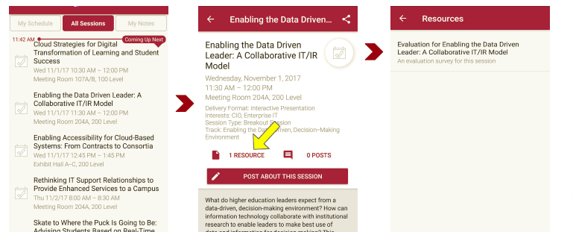
Please take a moment to evaluate this session There are two ways to access the session and presenter evaluations
1
2
In the online agenda, click on the “Evaluate Session” link
From the mobile app, click on the session you want from the schedule > then click the associated resources > and the evaluation will pop up in the list

