Slide 1
Making Connections:
Using Technology to Increase Student Engagement and Success
Karla Fisher, Ph.D.
Paul Arcario, Ed.D.
C. Jason Smith, Ph.D.
May 3, 2010

Slide 2
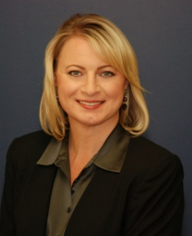


Karla Fisher, Ph.D.
College Relations Coordinator
Center for Community College Student Engagement (TX)
fisher@ccsse.org • 512-232-8247
Paul Arcario, Ed.D.
Dean for Academic Affairs
Professor of English as a Second Language
LaGuardia Community College (NY)
arcariop@lagcc.cuny.edu • 718-482-5405
C. Jason Smith, Ph.D.
Associate Professor of English
Veterans’ Faculty Advisor
LaGuardia Community College (NY)
jsmith@lagcc.cuny.edu • 718.482.5649

Slide 3
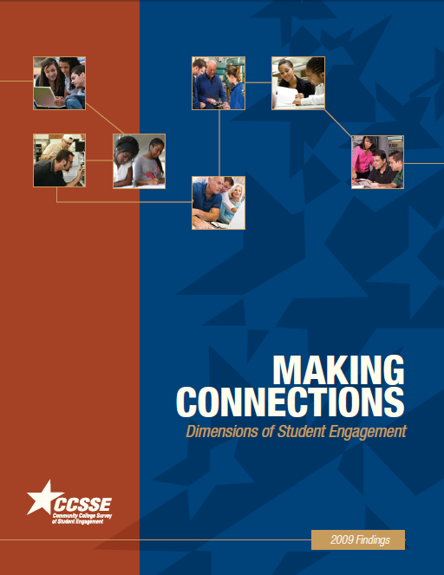
2009 CCSSE Cohort
(2007, 2008, 2009)
Quantitative data:
  400,000+ students
  663 institutions
  48 states, plus British Columbia, Marshall Islands, Nova Scotia, and Ontario
Qualitative data from the Center’s Starting Right Initiative
College vignettes
www.ccsse.org/publications

Slide 4
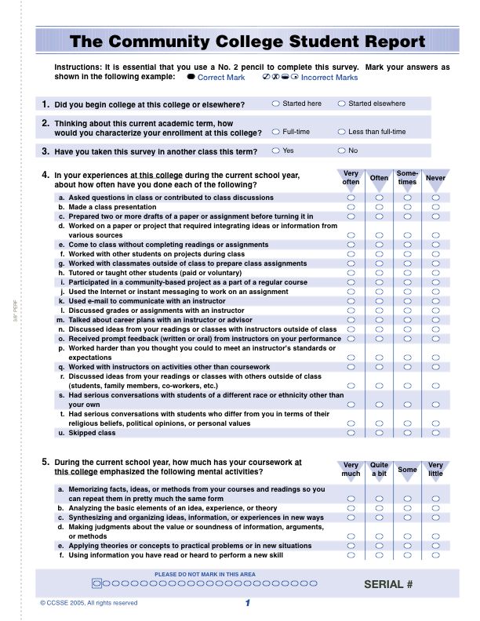
About the Survey
Benchmarking instrument — established national norms on educational practice and performance by community and technical colleges
Diagnostic tool — identifying areas in which a college can enhance students’ educational experiences
Monitoring device — documenting and improving institutional effectiveness over time
CCSSE 2011 registration: www.ccsse.org/join

Slide 5
Community College Students Contend with Competing Priorities
Most Students Are Enrolled Part-Time
Most Students
Work for Pay
Full-time students who work more than 30 hours per week
21%
Part-time students
Source: AACC, 2009.
Source: 2009 CCSSE Cohort data.

Slide 6
Key Demographics, Enrollment, and Attendance
Many Students Take Evening Classes
Many Students Take Classes Online
Students who take evening classes
Students who have taken an online class
Source: 2009 CCSSE Cohort data.
Source: Data from American Association of Community College and Allen, I.E. & Seaman, J. Analysis by CCSSE .
Notes:
6
Close to a third (29%) of community college students take evening classes, and 28% have taken an online class.
1.9 million community college students are taking online classes.

Slide 7
Community College Students’ Plans
When asked when they plan to take classes at this college again, 22% of students had no plan to return or were uncertain about their future plans.
Source: 2009 CCSSE Cohort data.
Notes:
Given their competing priorities, it’s not surprising that a little over one-fifth (22%) of community college students are uncertain of their future plans.

Slide 8
HOW CAN WE HELP?
In focus groups with students, what do they typically report as the most important factor in keeping them in school and persisting toward their goals?
RELATIONSHIPS

Slide 9
Making Connections:
Dimensions of Student Engagement
  Connections in the classroom
  Connections on campus
  Connections beyond the campus
  Connections in virtual space

Slide 10

Students Use Technology
Steady increases over 5 yrs
in student use of technology: computers, Internet, email
Age gaps are closing for
these technologies
Age gaps remain for Web 2.0

Slide 11
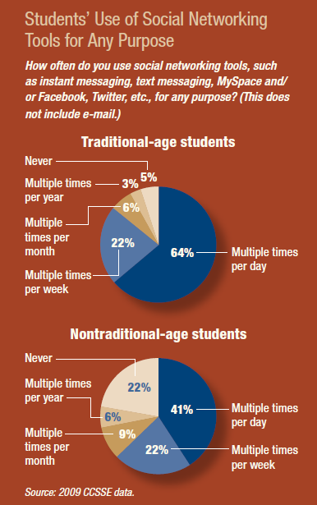

Slide 12
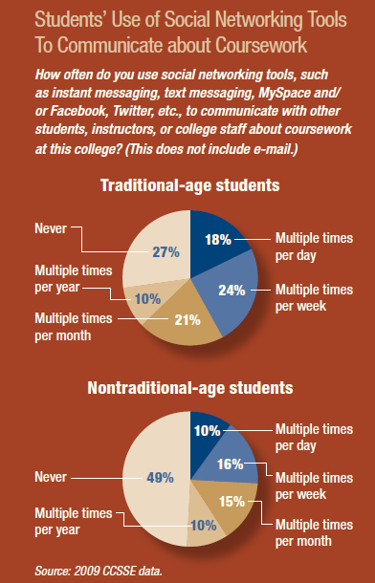

Slide 13
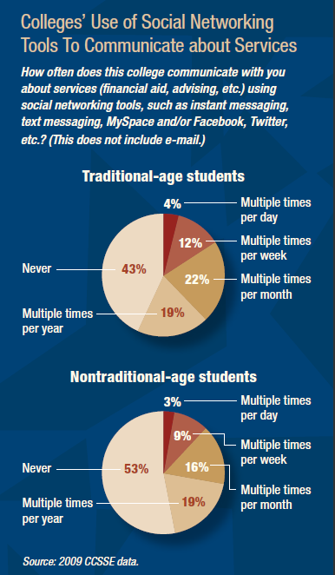

Slide 14
Technology Conundrum
In focus groups, students consistently say that colleges should eliminate online orientation, which they criticize as “impersonal”….
yet they reliably applaud online tutoring.
The magic happens when colleges find the
right match between students’ needs and
the mode of response to meet those needs.

Slide 15
Colleges Making Connections
Phillip’s Community College of the University of Arkansas (AR)
Lone Star College System (TX)
Wisconsin Indianhead Technical College (WI)
LaGuardia Community College (NY)

Slide 16
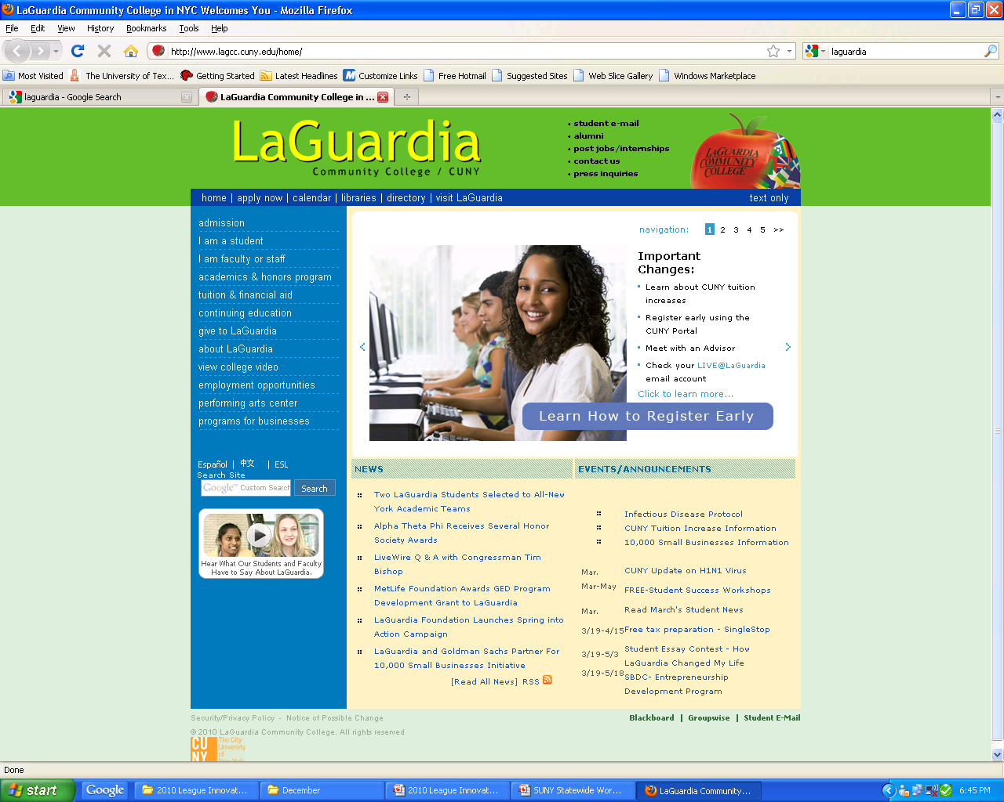
16,000 matriculated students
39,000 continuing education students
79% minority - 2/3 foreign born
61% female
45% part-time
80% work for pay
67% traditional age
Notes:
Two-thirds of LaGuardia students are foreign born;
of these, half have been in the U.S. under five years
160 different countries; 109 different primary languages
Seventy-nine percent of our students are minorities

Slide 17
60% first-generation college students
2/3 have family income of $25,000 or less
100% commuter campus
80% of entering students need one or more basic skills course

Slide 18
ePortfolio Challenge
2003-04 370 students building ePortfolios
2005-06 5,024 students building ePortfolios
2008-09 8,000 students building ePortfolios

Slide 19
Studio Hour for First-Year Courses
Free hour designed to:
Employ advanced students as mentors for first-year students
Support development of students’ ePortfolios
Develop technological literacy
Incorporate co-curricular activities

Slide 20
Studio Hour is programmed into:
  First-Year Academy Learning Communities (first semester)
  A required career development course, Fundamentals of Professional Advancement (second semester)
  Capstone courses

Slide 21

Studio Hour facilitated by:
“ePortfolio Consultants” – advanced students who have “graduated” from our Student Technology Mentor (STM) program
15 ePortfolio Consultants currently facilitate 72 sections of Studio Hour
Funded by grants and student technology fee

Slide 22
Consultant Training Resources:
www.eportfolio.lagcc.cuny.edu/consultants/m403.html
ePortfolio Consultant website:
Consultants’ Schedules
Task Lists
Faculty Information
Modules/Lesson Plans
Materials and handbook
Notes:
Show Consultant website and items 4a (Academy Studio Hour) and 5a reflection prompts

Slide 23
Studio Hour Courses:
CCSSE Outcomes
"How much of your coursework emphasized synthesizing and organizing ideas, information or experiences in new ways?"
Percent responding “quite a bit” or “very much”…
National 57.7%
LaGuardia 67.8%
Freestanding ePortfolio courses 75.5%
Studio Hour ePortfolio courses 82.3%
This pattern repeated itself on questions about use of engagement with writing, educational technology and collaboration with other students.

Slide 24
Studio Hour Courses:
Retention Outcomes
Collegewide semester-to-semester retention in…
Courses that did not use ePortfolio: 71.7%
Freestanding ePortfolio courses: 73.7%
Studio Hour ePortfolio courses
(intensive interaction with Consultants): 79.6%

Slide 25
Virtual Interest Groups (VIGs)
Online communities designed to provide career development and transfer guidance.
Offered in discipline areas (e.g., Education, Business, Media and Communication, Liberal Arts).
Faculty and advisors use Blackboard site to post 4-5 online assignments per semester.

Slide 26
How the VIGs work…
Students complete assignments by posting to the Bb discussion board.
Faculty and advisors moderate discussion and respond to postings, along with student peer advisors/mentors.
Attached to a course and part of course requirements.

Slide 27
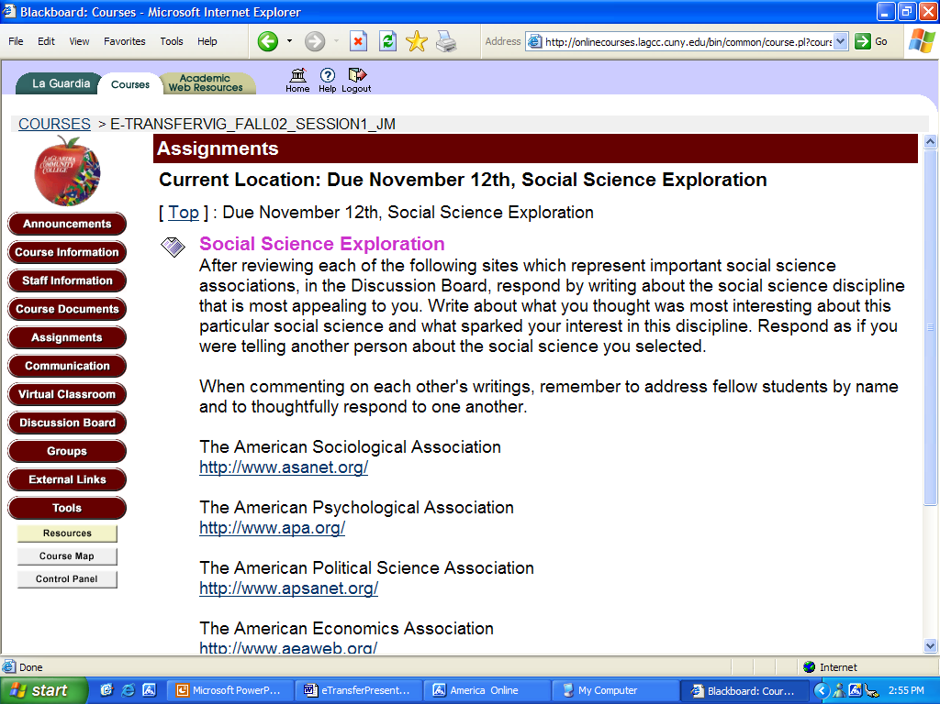

Slide 28
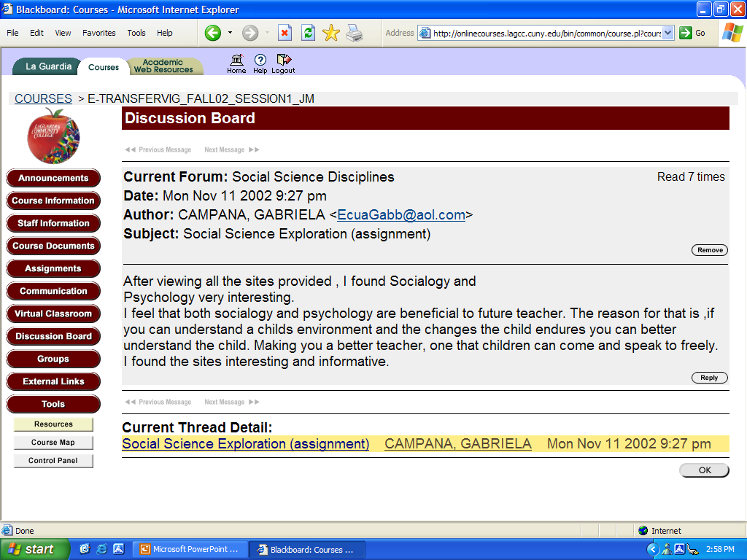

Slide 29
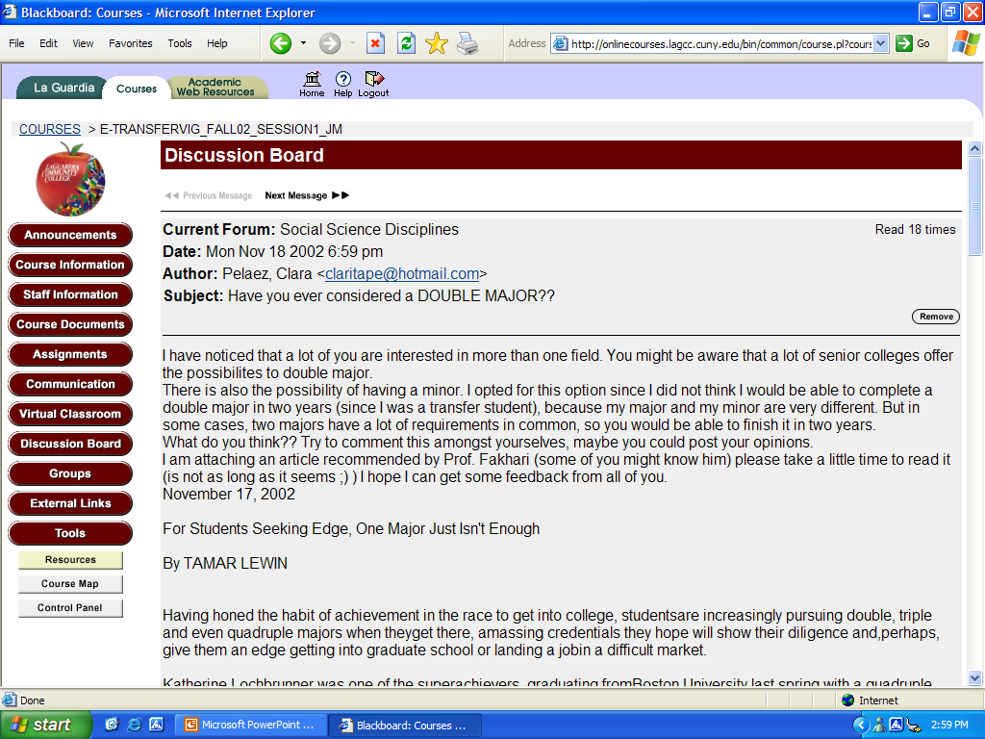

Slide 30
VIG Outcomes:
Pre- and Post-Surveys
Had a good idea about steps to prepare for their career:
23% >> 63%
Knew the daily tasks in their career:
21% >> 68%
Understood requirements for their career:
38% >> 82%
Knew how credits would transfer:
43% >> 68%

Slide 31
Studio Hour and VIGs:
Qualitative Data Analysis
Focus group of ePortfolio Consultants
Two focus groups of students who had taken Studio Hour
Online postings from Virtual Interest Groups (VIGs)
“The Power of Peers: New Ways for Students to Support Students”
Paul Arcario, Bret Eynon, Louis Lucca (forthcoming)

Slide 32
Building community
Connecting with peers:
“It was easier to relate and talk about your experience.”
“It allowed me to get to know my fellow peers outside of the class, especially since I do not get the chance to know them within the class.”
Sharing the same goals:
“It is good that there are others that share your passion for teaching in different ways.”
Facing similar challenges:
“I was devastated when I withdrew from Human Biology until time passed by when there was more posts, and I learned I'm not the only one.”

Slide 33
LEARNING NETWORKS
Sample WEB 2.0 Network Interactions and Traditional Connections
Interactive, Public, Student-Driven Content
Proprietary, Secure
Web 2.0
Web 1.0
Blogger Home
Student Blogs
LAGCC Home
Youtube Home
YouTube Student Pages
LAGCC Email
Wikipedia Home
Wikipedia Users Group
Blackboard
Facebook Home
Facebook Student Pages
ePortfolio
Netvibes Home
Netvibes Student Pages
The Ning Home
Ning Student Pages
Shared Google Calendar

Slide 34
Traditional Learning Community
Theme Driven Content
Instructor A
Instructor B
Instructor C
College
Composition
Research Paper
Integrated Hour
Course in Major
Course in Major
Student Cohort

Slide 35
Sample Learning Network 1
LIB 200
ENG 103
ENG 102
ENG 101
ENG 099
Instructor A
Student Group E
Student Group A
Student Group B
Student Group C
Student Group D

Slide 36
Sample Learning Network 2
Capstone
Urban Studies
Composition and Research
Basic Writing
Student Group A
Student Group B
Student Group D
Instructor C
Instructor A
Instructor B
Mass Media
Student Group C

Slide 37
Constructing the Networks
Twenty-five faculty in pilot
(Developmental Writing, Freshman Comp,
World Literature, Intro to Business, Criminal Justice,
Mass Media, Speech, Library Research)
Faculty…
  Describe courses
  Identify content themes
  Group themes
  Work in theme group
Develop assignments to link students across courses

Slide 38
Theme Tags: Using Blogspot.com
agriculture (2) animals (2) business (3) colonialism (1) Communication (3) computers (1) Crime (1) dystopia (2) economies (3) ethics (3) feminism (2) food (2) gender (7) globalization (4) health (2) hybridity (1) identity (6) justice (3) labor (5) literature (6) media (9) mythology (6) networks (1) paranormal (1) performance (1) philosophy (3) policy (1) politics (10) privacy (2) psychology (4) race (8) religion (2) research (9) science (3) simulation (1) sports (1) teaching (2) technology (4) theory (2) urban (3) utopia (1) writing (10)

Slide 39
Sample Assignment Planning 1
My students in Woman Trouble (ENG 099) and Sex and the City (ENG101/103) will write about the social construction of gender in print ads as they appear in GenderAds.com.
High stakes for the ENG099 students (400+ word paper analyzing one ad) and low stakes for my ENG 101 students (a Ning blog discussing how the ads make use of stereotypes as part of a larger).
Since the 099 assignment comes before the 101, have ENG099 students comment on the ENG101 blogs.
Jason’s Media for the Masses ENG101 students will peer critique the ENG 099 papers.
http://womantrouble.ning.com

Slide 40
Sample Assignment Planning 2
Scott and I will connect students in his Intro to Criminal Justice with my students in World Lit Written in English.
Lit students read Alexie’s The Absolutely True Diary of a Part-Time Indian.
Each group will blog and read each others’ blogs and comment on questions Scott will raise, e.g., What do you think best explains crime? What role does race play in criminal justice?
http://ssj101spring2010.ning.com/profiles/blogs/race-and-crime-3

Slide 41
Faculty Comments
“What Scott and I are finding interesting is that students are ‘totally psyched’ as they say about using the NING to have conversations with each other and they love the idea of talking with another class about something that they are studying.”
“We were astonished that students had done so much writing—and it was all done outside of class—I don’t have a lab!”
“So I am noticing in ‘blog land’ that if you post something students start responding (even when not asked to do so) and making connections between our readings (The Absolutely True Diary of a Part-Time Indian) and the Criminal Justice class.”
“I have not prescribed much beyond having them post their assignment, a blog about the effect of race on crime. Before their papers were due, they began friending each other and posting and commenting. Remember, this is an evening class of older students. There has been an organic development of community without my direction.”

Slide 42

Learning Networks
Initial Assessments Planned
Course retention
Course grades
Student focus groups
Relevant CCSSE items
Notes:
Most relevant CCSSE questions:
4 worked with other students on projects during class; worked with classmates outside of class to prepare class assignments; used the internet…to work on an assignment.
5 synthesizing or organizing ideas, info, or experiences in new ways
9 extent to which the college encourages contact among students from different groups; using computers in academic work
10 hours preparing for classess
11 quality of relationship with other students
12 working effectively with others

Slide 43
Community 2.0
Teaching and Learning Networks at LaGuardia Community College
http://lagccnetworks.blogspot.com/

Slide 44
Additional questions or comments?
Karla Fisher • fisher@ccsse.org 512-232-8247
Paul Arcario • arcariop@lagcc.cuny.edu 718-482-5405
Jason Smith • jsmith@lagcc.cuny.edu 718.482.5649
THANK YOU!

