Slide 1
Blockchain in Education and Lifelong Learning
Preparing for Disruption, Leading the Transformation
Feng Hou,
CIO and Chief Digital Learning Officer,
Central New Mexico Community College
fhou@cnm.edu
Alex Kaplan,
Global Strategist, IBM Global Education;
Member, IBM Industry Academy
  Alex.kaplan@us.ibm.com
  linkedin.com/in/alexkaplanibm
May 2019

Slide 2
We’re entering a new age of education
Education must address the disruption upon us and the changing landscape of technology .
Self Sovereignty & Privacy
The days of handing our data to big companies is coming to an end - we insist on controlling our digital lives and identities.
Trust disruption
Our faith and trust in data and information has been shaken – we demand trusted provenance.
Data disruption
Data about us can help change the course of our lives – we want to put it to use .
Learning disruption
The one size fits all education experience is invalid - meta-universities and lifelong learning pathways allow us to take control.

Slide 3

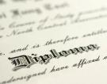


Credentials unlock our lifelong learning experiences
Credentials are evidence of mastery of skill.
Credentials are issued by 1000s
of organizations around the globe.
Mastery can be demonstrated multiple ways.
Micro-credentials can unlock their value.

Slide 4

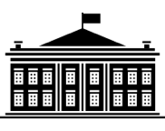

Transforming credentials into digital assets makes them “transactable”
Today credentials are managed in central databases designed to solve the data problem
Solves the data problem
One party governs the data
Can be centralised or distributed
Tomorrow credential owners directly control and “transact” with their credentials
Solves the trusted sharing problem
Multiple parties govern the data
Distributed around the globe
Student
Student
Education
Institutions
Credentialing
Organization
Education
Institutions
Credentialing
Organization
Employer
Employer
Industry
Leader
Industry
Leader

Slide 5




Industry challenges stand in the way of unlocking credentials’ value
Costs
Verifying credentials is inefficient and qualifying prior work for educational credit is costly
Trust and Fraud
Employers report that 33% of employee reported degrees are fraudulent
Regulatory Requirements
Credentials expire and are revoked requiring that they be continuously updated
Pathways to Employment
Pathways have inadequate fidelity to provide clear guidance
Learners
Credentials get lost and destroyed making them unmanageable
Transparency and Insight
Provenance and content of credentials is often unclear

Slide 6
A learning credential blockchain is the transformative technology to unlock the future
“ A shared, replicated, permissioned ledger
with consensus, provenance, immutability and finality for credentials*”
Student
  Built on existing education industry
  and technical standards
Founded by key education institutions
and leaders of the education industry
Supporting all credential use cases
Available to all stakeholders working
with credentials
Education
Institutions
Credentialing
Organization
* “Blockchain: What It Is, What It Does, and Why You Probably Don’t Need One” David Andolfatto, Economic Research Federal Reserve Bank of St Louis, Vol. 100, No. 2 Posted 2018-04-16
Employer
Industry
Leader

Slide 7
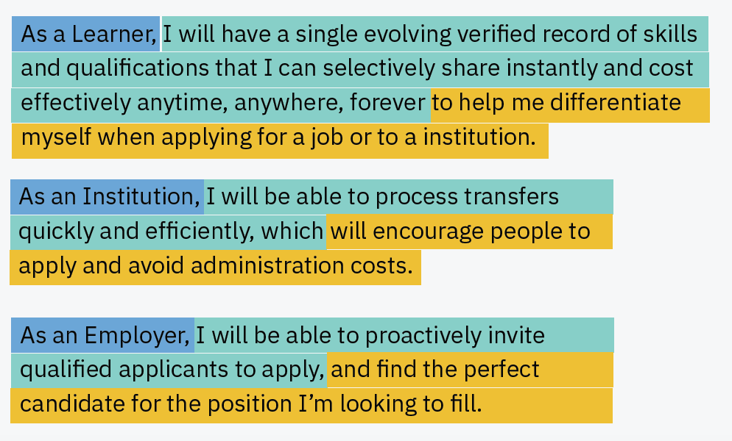
The compelling value proposition exists for the learner, institution and employer
Central New Mexico Community College District, Design Thinking Workshop, Oct 2018.

Slide 8
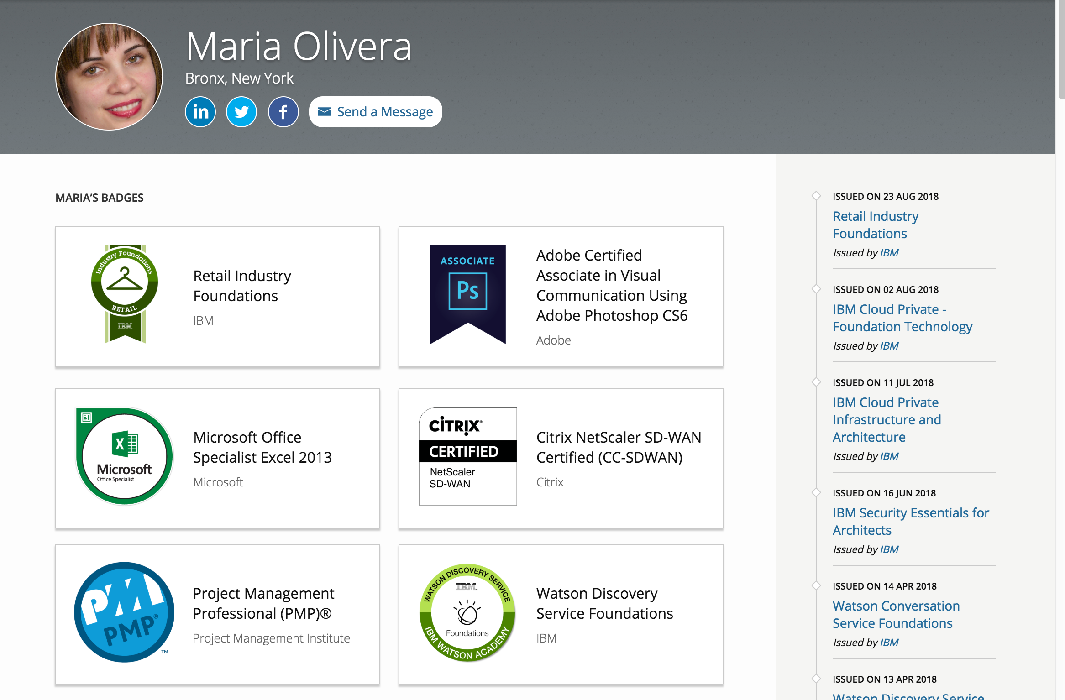

We envision learners having a wallet allowing them to transact with their credentials

Slide 9
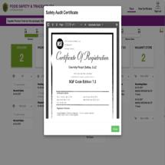





The blockchain would be anchored on 5 core capabilities
Issue Credential: Streamline the issuance of credentials that demonstrate skill mastery.
Verify Credential: Instant verification by issuer that a learner credential is authentic.
Search Credentials: Look inside an individual’s skill-wallet and find credential matches for job candidates, school admission, projects, etc. (“the job will find me”).
Exchange Credential: Share MY credentials with others for jobs, admissions, certifications, etc.
Manage Credentials: Update, revoke, and aggregate view of credentials from multiple organizations.

Slide 10











IBM’s digital badging program is core to our talent transformation strategies
“The results exceeded our wildest expectations”
IBM has issued 1m credentials on the Credly Acclaim platform with applications in training, certification and human capital management.
Enrollments
Completions
Social Media
Skills Registry
125% increase
694% increase
$50-200K per 10,000 badges
195 countries
Engagement
Certifications
Product Trials
Employability
87% increase
57% increase
64% increase
92% say verifies job skills

Slide 11

About Central New Mexico Community College
No. 1 in graduating Native American students
No. 1 in graduating Hispanics students
No. 4 in awarding associate degrees to minority students overall
No. 6 in awarding associate degrees in all disciplines overall, and
No. 3 in awarding two-year certificates earned in all disciplines
Source: Albuquerque Journal
(https://www.abqjournal.com/852769/cnm-reaches-pinnacle-in-national-degree-rankings.html)

Slide 12
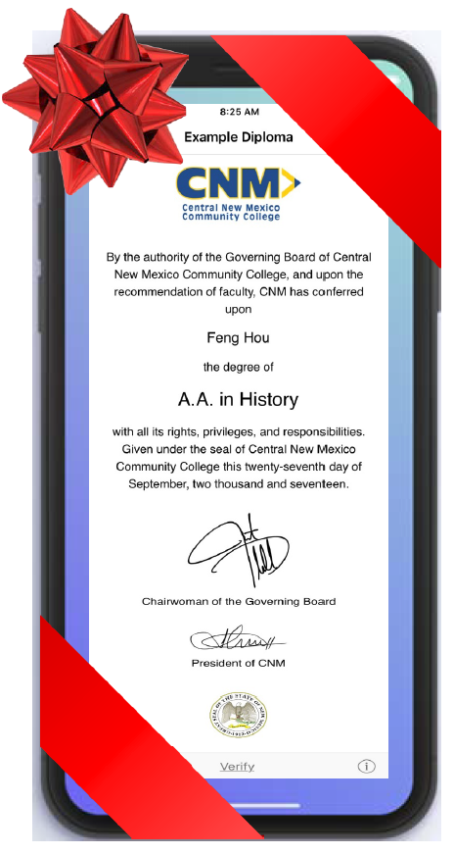
CNM is two years into its innovative blockchain journey
In August 2017, CNM joined the Blockcert pilot with MIT as the first community college in the nation to implement a blockchain solution.
In November 2017, CNM successfully issued the certificates to CNM Ingenuity deep dive coding boot camp graduates.
In May 2018, CNM issued the first batch of degree diplomas as a pilot to CNM Gen-Ed graduates.
In August 2018, CNM has announced ALL CNM graduates will receive optional blockchain degree diplomas.
In December 2018, CNM has received the distinguished Innovator of the Year Award from Education Dive.

Slide 13
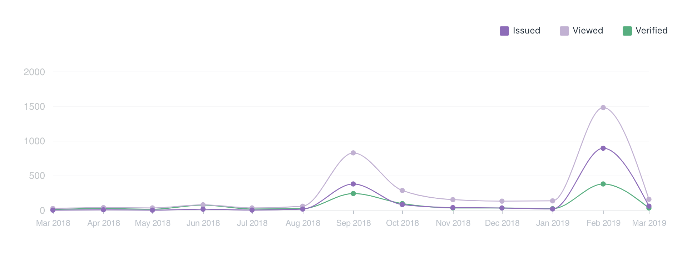
CNM has already seen strong success with its blockchain initiative
The data indicates that both the students and community have embraced the technology and truly transformed our students learning credentialin experience.
586
Students Invited
349
Downloaded Diploma
61%
Student Participation
40%
Uniquely Verified
Our First Issuance of Degree Diplomas in 2018

Slide 14

IBM and Central New Mexico Community College District are collaborating on the future of credentials and blockchain
CNM and IBM will expand both organizations’ opportunities and skills in supporting the transformation of the education industry through blockchain.
Envision the use of blockchain by and between institutions, stakeholders, providers, employers and other interested members.
Envision the creation of a global learning credential blockchain and collaborate with others with similar objectives.
Utilize IBM as an experienced advisor in the domain of blockchain governance, methodology, tools and technologies.
Collaborate, as appropriate, with standards setting bodies such as IMS Global Learning Consortium and other standards bodies.

Slide 15
A credentialing blockchain empowers learners to realize their aspirations
Rebecca is studying at the university
The university issues
a BS credential on the blockchain network
Rebecca works at IBM®. She passes the certification
and is issued an IBM Blockchain Foundation for Developers credential on the blockchain network
Rebecca’s credentials are
on the blockchain network along with everyone else’s, creating a single, tamper-resistant ledger
She completes her Bachelor of Science in Software Engineering
Once an organization issues a credential,
it cannot be altered
Her manager wants to verify her credentials. Rebecca’s BS and Blockchain credentials are easily traced back to the organizations that issued them

Slide 16
The IBM Blockchain platform
A fully integrated enterprise-ready blockchain platform designed to accelerate the development, governance,
and operation of a multi-institution business network
    Developer tools use Hyperledger Composer
    to quickly build blockchain application
    Hyperledger Fabric provides the ledger, managed
    through a set of operational tools
    Governance tools for democratic management
    of the business network
    The highly secure and performant IBM Cloud™ environment
Blockchain application
Operational Tools
Developer Tools
Hyperledger Fabric
Governance Tools
IBM Cloud
Network convening power
IBM provides global leadership
in education and blockchain.
IBM Blockchain platform
IBM’s depth and breadth of blockchain technical and industry experience is an essential aspect of success.
Technical expertise
IBM depth and breadth of expertise leads the education industry in blockchain transformation.
Roadmap for the future
IBM’s guidance on education blockchain will assist the industry in growing its network.

Slide 17
Thank you
For more information on IBM and Blockchain:
https://www.ibm.com/blockchain
For more information on Central New Mexico Community College
https://www.cnm.edu/
© Copyright IBM Corporation 2018. All rights reserved. The information contained in these materials is provided for informational purposes only, and is provided AS IS without warranty of any kind, express or implied. Any statement of direction represents IBM's current intent, is subject to change or withdrawal, and represents only goals and objectives. IBM, the IBM logo, and other IBM products and services are trademarks of the International Business Machines Corporation, in the United States, other countries or both. Other company, product, or service names may be trademarks or service marks of others.

