Slide 1


Breaking the Iron Triangle “The Obviousness of Open Policy”
Dr. Cable Green
Director of Global Learning
cable@creativecommons.org
@cgreen

Slide 2
open education week
March 5-10, 2012
www.openeducationweek.org
open
webinars
videos
documents
discussions
resources
FAQ
links to events around the world

Slide 3

Community College
Consortium for
Open Educational Resources (CCCOER)
Una Daly
Community College Outreach Manager
OpenCourseWare Consortium
unatdaly@ocwconsortium.org
James Glapa-Grossklag
College of the Canyons
President, CCCOER Advisory Board
James.glapa-grossklag@canyons.edu

Slide 4
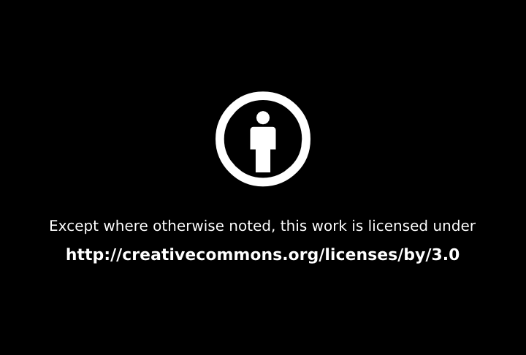

Slide 5
Some things in life are obvious…

Slide 6
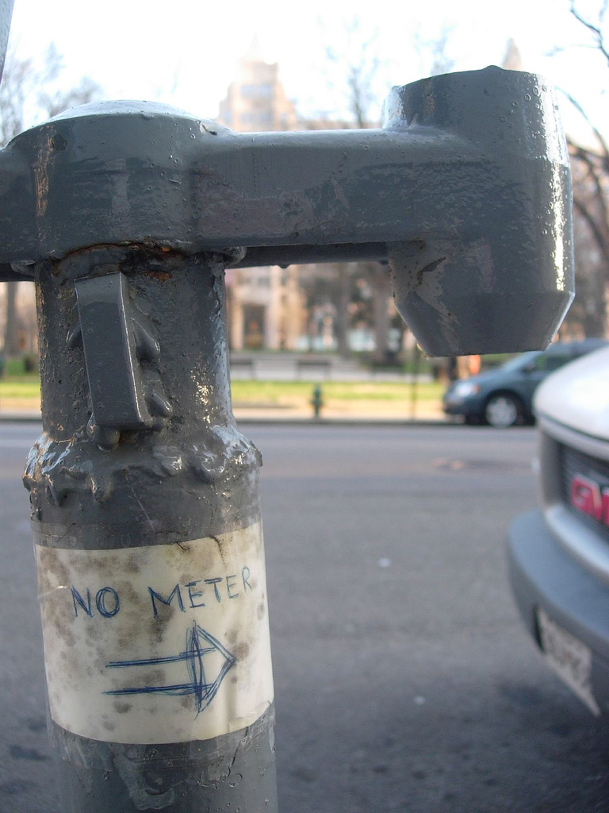
No meter, fo' sho’ By: Monceau
http://www.flickr.com/photos/monceau/115573273/
CC BY-NC-SA

Slide 7
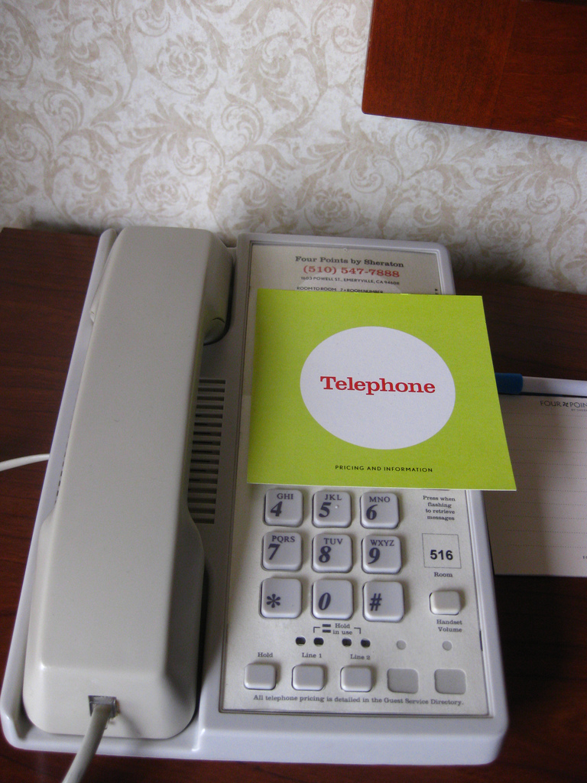
Obvious Telephone is Obvious By: Bexx Brown-Spinelli
hhttp://www.flickr.com/photos/angeldye/4108548446/
CC BY-ND

Slide 8
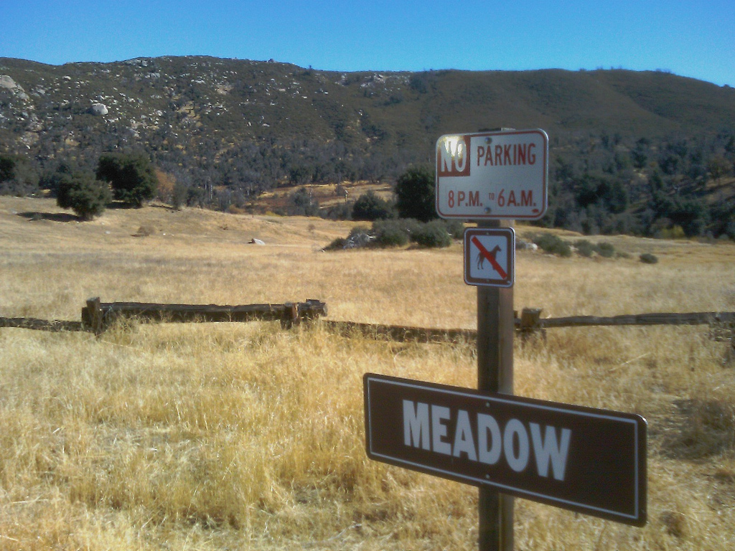
CC BY-NC-SA
Duh. By: slworking2 http://www.flickr.com/photos/slworking/4112481205/

Slide 9
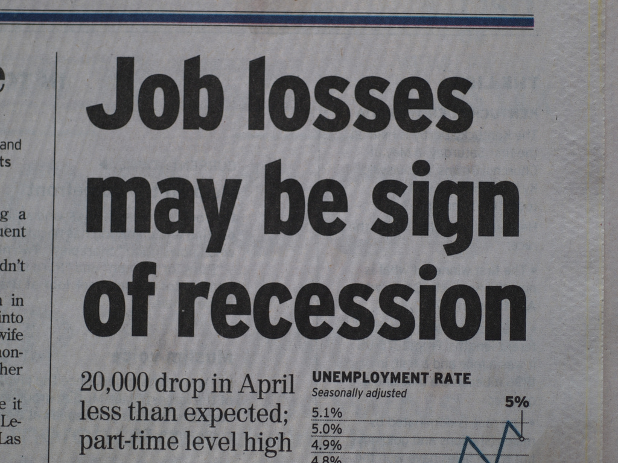
Painfully Obvious 4483 By: mliu92
http://www.flickr.com/photos/mliu92/2469130437/
CC BY-NC-SA

Slide 10

Just in case By Nick Sherman
http://www.flickr.com/photos/nicksherman/3351990271
CC BY-NC-SA

Slide 11
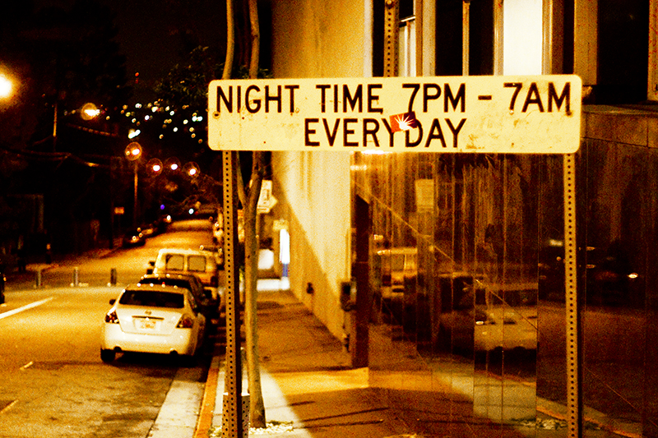
Duh... By: Brian Auer http://www.flickr.com/photos/brianauer/3731836271
CC BY-NC-ND

Slide 12
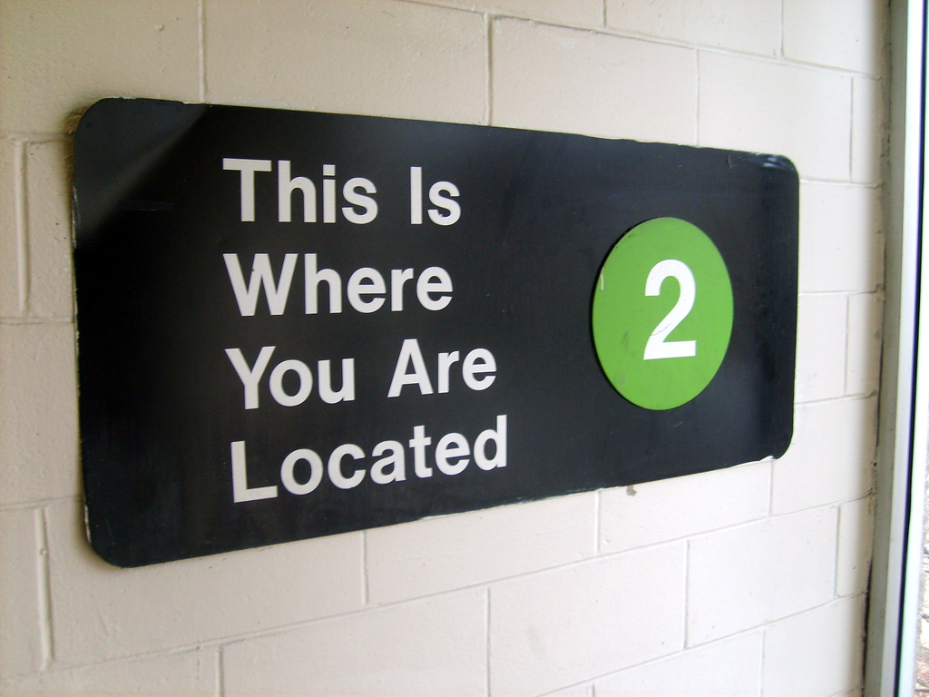
CC BY-NC-SA
Giant Reassuring Sign By: Billy V http://www.flickr.com/photos/billyv/352560572

Slide 13
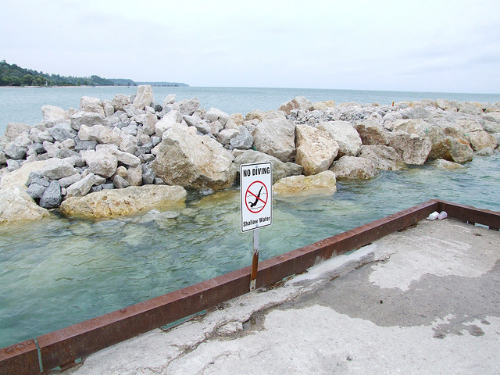
CC BY-NC-SA
Duh! By: n0ah84 http://www.flickr.com/photos/n0ah84/195114057/

Slide 14
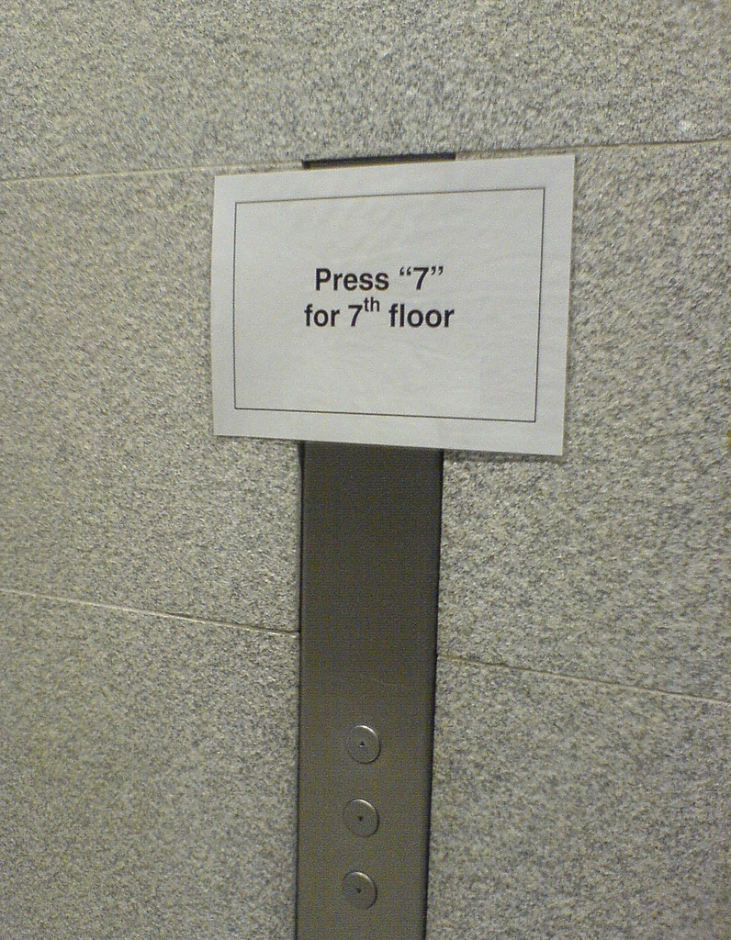
Press 7 (p462) By: oobrien
http://www.flickr.com/photos/oobrien/87573653/
CC BY-NC-SA

Slide 15
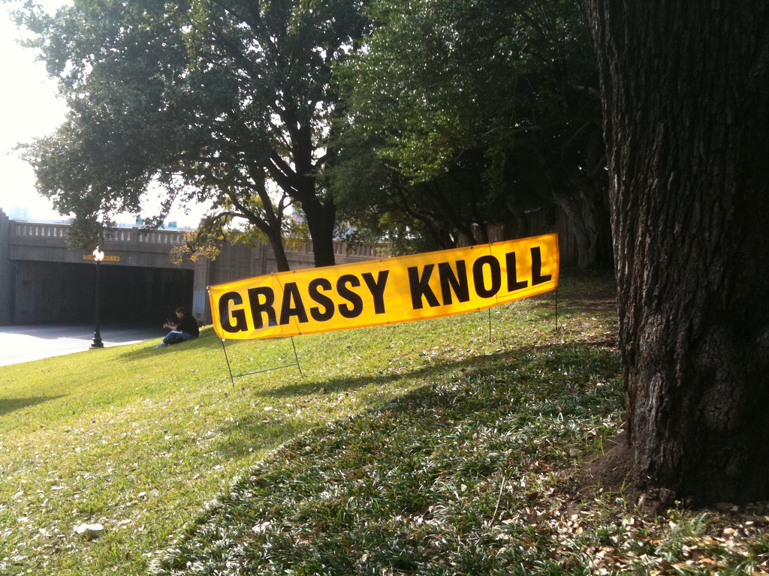
CC BY-NC-ND
Duh By: Susan Batterman http://www.flickr.com/photos/sbatterman/4125761794
Notes:
And some things are both obvious AND important.

Slide 16
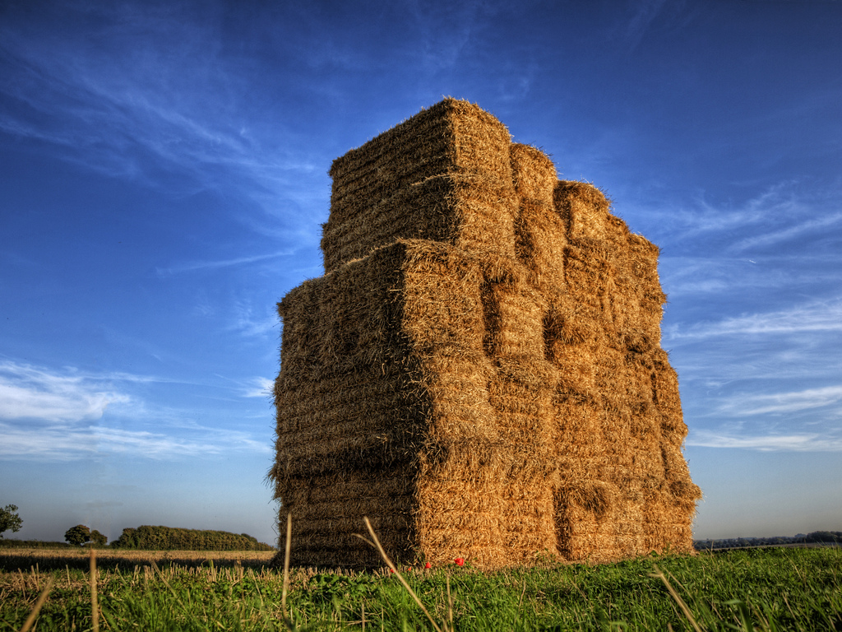
CC BY-NC
A tower of Hay – Winchester By: neilalderney123 http://www.flickr.com/photos/neilsingapore/6202632783
Notes:
According to the World Food Program there are 925 million undernourished people in the world today. That means one in seven people do not get enough food.
What if we had a food machine that could feed everyone?
Marginal cost of feeding everyone was close to $0
Doing so doesn’t hurt farmers
net result =everyone in the world has enough to eat
Question is: should we turn on the food machine? Let’s take a vote (raise your hand)
Obvious, yes?
I believe we have a “learning machine”, it is within our power to turn it on… but it needs public open policies to provide ongoing, sustainable funding and to effect necessary cultural change.

Slide 17

CC BY
Children Reading Pratham Books and Akshara By Ryan Lobo http://www.flickr.com/photos/prathambooks/3291617463
Notes:
My Education Dream is simple: Everyone in the world can attain all the education they desire.
It will require we share the educational resources we produce and that we spend our limited public resources wisely.

Slide 18
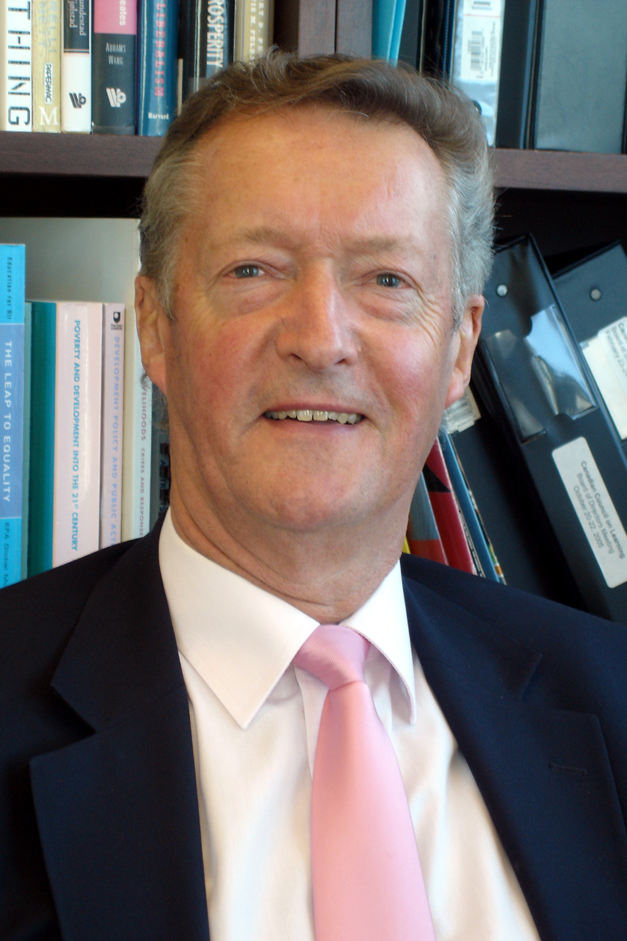
“Nearly one-third of the world’s population (29.3%) is under 15. Today there are 158 million people enrolled in tertiary education¹. Projections suggest that that participation will peak at 263 million² in 2025. Accommodating the additional 105 million students would require more than four major universities (30,000 students) to open every week for the next fifteen years.
By: COL http://www.col.org/SiteCollectionDocuments/JohnDaniel_2008_3x5.jpg
¹ ISCED levels 5 & 6 UNESCO Institute of Statistics figures
² British Council and IDP Australia projections
Notes:
And the world needs this dream to come true … and quickly… if we are to meet the global demand for higher / tertiary education.
Sir John Daniel, President & DEO of the Commonwealth of Learning notes:
What do you think the odds are the world will build four major universities (30,000 students) to open every week for the next fifteen years?

Slide 19

CC BY-NC-ND
Dreaming Girls Head By: Elfleda http://www.flickr.com/photos/carolinespics/153137487
Notes:
This isn’t just my dream. Many have this Dream
In 2006, Cathy Casserly and Mike Smith (@ Hewlett Foundation) wrote: “At the heart of the movement towards Open Educational Resources is the simple and powerful idea that the world’s knowledge is a public good and that technology in general and the Worldwide Web in particular provide an opportunity for everyone to share, use, and reuse it.”
------------------
(Smith, M.S. and Casserly, C.M. 2006. The promise of Open Educational Resources. Change, Vol. 38, No. 5, pp. 8-17)

Slide 20
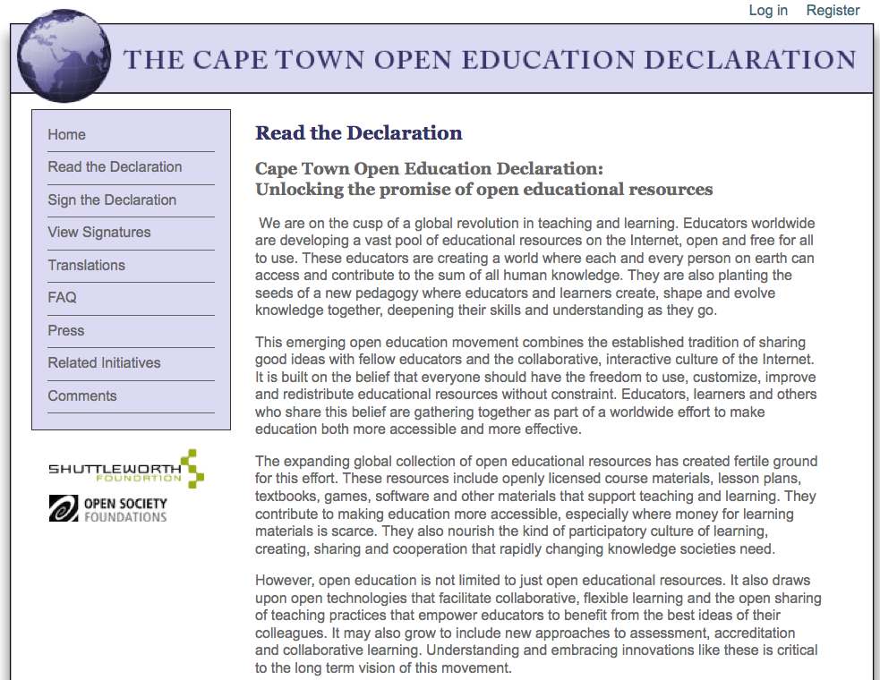
http://www.capetowndeclaration.org
Notes:
The next year, there was a meeting in Cape Town, South Africa.
The Cape Town Declaration begins:
We are on the cusp of a global revolution in teaching and learning. Educators worldwide are developing a vast pool of educational resources on the Internet, open and free for all to use. These educators are creating a world where each and every person on earth can access and contribute to the sum of all human knowledge.

Slide 21
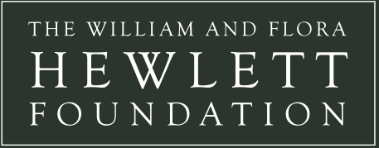
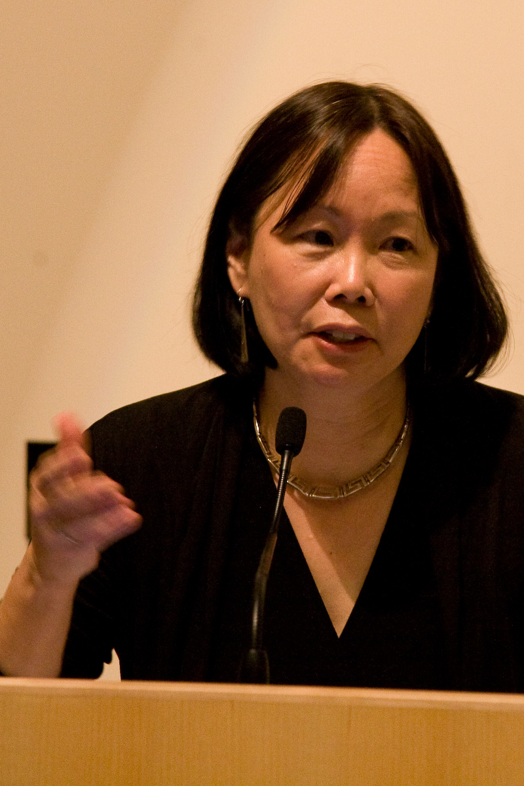
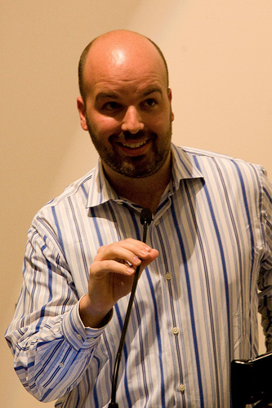
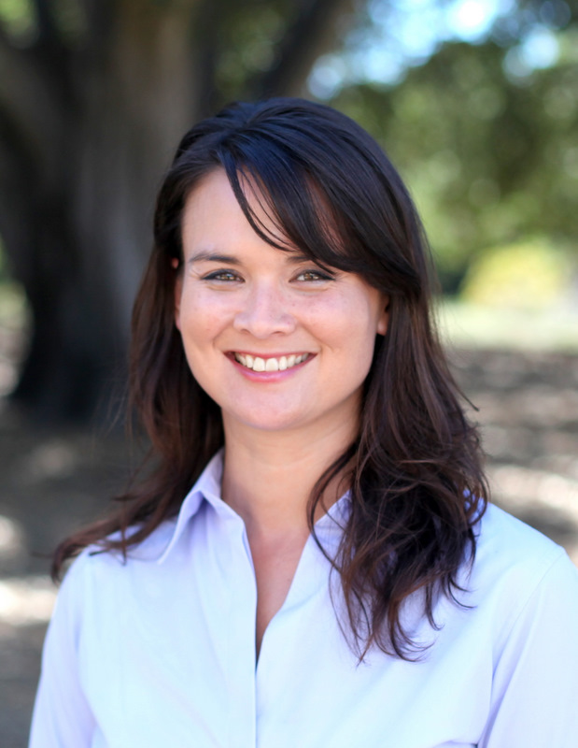
Vic: http://farm5.static.flickr.com/4052/4505411171_edb5e277b5.jpg
Kathy: http://www.hewlett.org/uploads/images/staff/kathy_2.JPG
Barbara: http://www.flickr.com/photos/jrandomf/4506044752/in/set-72157623816205676
Notes:
And we are collectively grateful there continue to be outstanding leaders at the helm of Hewlett’s OER initiatives.

Slide 22

Notes:
The Open Society Foundation has been an ardent supporter of both Open Access and OER.

Slide 23

Education grant making
Notes:
Shuttleworth Foundation believes if we are rigorously open about ideas and practices, more people will copy them and make the world a better place in a shorter period of time.

Slide 24
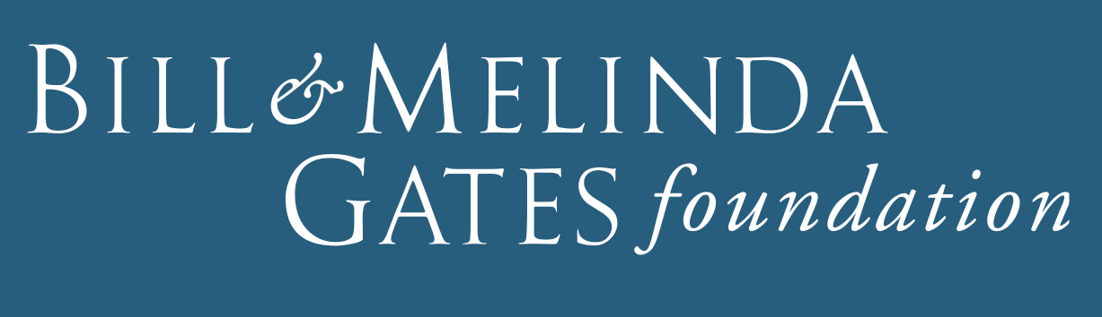

Notes:
The Gates Foundation has made significant investments in Open Education and is requiring open licensing on many of its grants.
They believe every life has equal value… and an education is a core part of helping everyone achieve their potential.

Slide 25
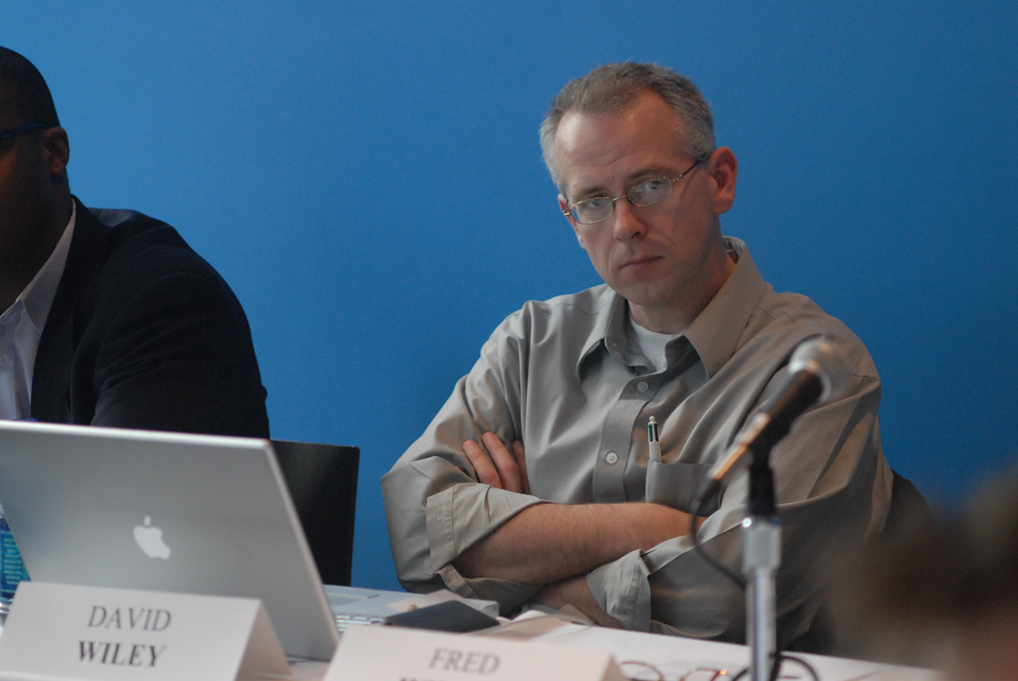
CC BY
MSC_1205 By: USV http://www.flickr.com/photos/unionsquareventures/3339520899
Notes:
My friend, David Wiley… who reminds us – if we’re not sharing, we’re not teaching.

Slide 26

By: UNESCO: http://www.moveoneinc.com/blog/wp-content/uploads/2011/07/UNESCO.jpg
Notes:
UNESCO: whose participants in 2002 expressed “their wish to develop together a universal educational resource available for the whole of humanity”
2012 Global OER Conference next June

Slide 27

By: OECD: http://www.eifl.net/system/files/201106/oecd_text_20cm_hd_0.jpg
Notes:
OECD’s OER project that asks why OER is happening, who is involved and what the most important implications are of this global movement.

Slide 28
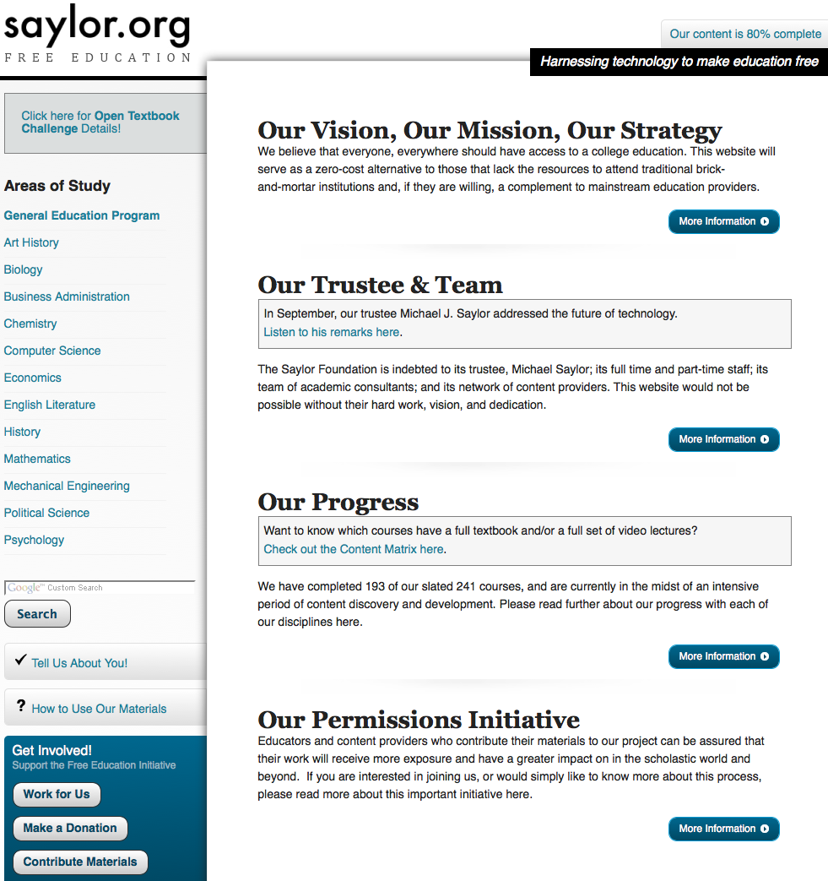
http://www.saylor.org/
Notes:
The Saylor Foundation believes that everyone, everywhere should have access to a college education.
Their site serves as a zero-cost alternative to those who lack the resources to attend traditional institutions.

Slide 29
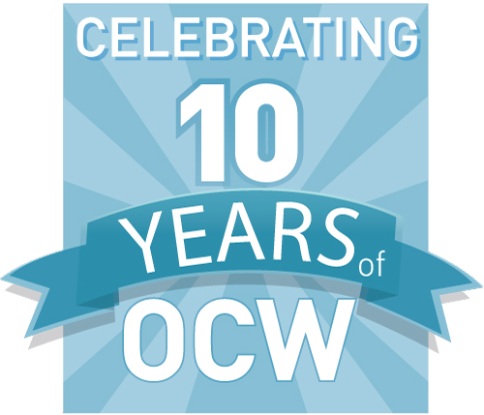
By: MIT OCW: http://conferences.ocwconsortium.org/2011/cambridge/images/logo-ocwc-decade.jpg
Notes:
The Open Courseware Consortium envisions a world in which the desire to learn is fully met by the opportunity to do so anywhere in the world.

Slide 30
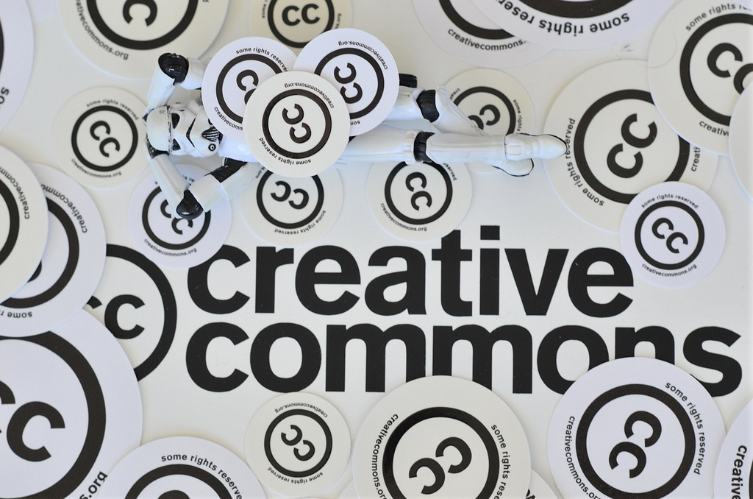
Creative Beauty at Creative Commons By: Kristina Alexanderson
http://www.flickr.com/photos/kalexanderson/6051120264/
CC BY-SA
Notes:
Creative Commons works to make it easy for creators to share … to realize the full potential of the internet – universal access to research, education, full participation in culture – to drive a new era of development, growth, and productivity.
CC Licenses make it easy and legal to share… and, as we all know, the core part of any OER definition is the educational resource is either
Open license
In the public domain
So anyone can: reuse, revise, remix and redistribute.

Slide 31
OER are teaching, learning, and research materials in any medium that reside in the public domain or have been released under an open license that permits their free use and re-purposing by others.
Notes:
Open license is key.
Free as in free beer and free as in freedom

Slide 32



Notes:
Our Open Access colleagues:
SPARC
Right to Research
And all of the Universities, Libraries and Faculty who share their creative works…
seek to return scholarly publishing to its original purpose: to spread knowledge and allow that knowledge to be built upon.

Slide 33
Connexions
MERLOT
CK-12
OER Africa
OER Brazil
OER Foundation
OLnet
Wikipedia
Mozilla
PIRGS
OLI
Universities & Community Colleges
… and MANY others
Notes:
And the list goes on and on … the OPEN community is large, it is passionate, and it is strong.
And we share that common dream: where everyone, everywhere is able to access affordable, educationally and culturally appropriate opportunities to gain whatever knowledge or training they desire.

Slide 34
BUT … Four Challenges for the Next Decade
Completion challenge
Middle skill job demand
Stagnant ~40% AA+ attainment levels
Low completion rates
Quality challenge
Increasing demands from global economy
Questioning what students are really learning
Funding challenge
State budget cuts
Limits to student and family ability to pay and to borrow
Demographic challenge
Increasing diversity
Low academic readiness
“Non-traditional” new normal
Attribution: Josh Jarrett, Bill and Melinda Gates Foundation

Slide 35

What’s the problem? The world changed
75% of students are ‘nontraditional’ -- they meet one of these criteria...
…they're
OLDER
…they’re
CARE-
GIVERS
... they’re older
…they live
OFF-CAMPUS
…they
WORK
…they’re financially on
THEIR OWN
Attribution: Josh Jarrett, Bill and Melinda Gates Foundation
Notes:
Half of all undergraduates are older than age 22
38 percent delayed enrollment after high school
One in three students work full-time; almost half work at least part-time
27 percent have dependents; 13 percent are single parents
Half are on their own financially
Only 14 percent live on campus

Slide 36
But institutions haven’t – and “can’t”
The “Iron Triangle” suggests institutions are constrained in their ability to adapt
“In the view of many college and university presidents, the three main factors in higher education—cost, quality, and access—exist in what we call an iron triangle. These factors are linked in an unbreakable reciprocal relationship, such that any change in one will inevitably impact the others.”
- Public Agenda research on opinions of higher education presidents
Source: The Iron Triangle: College Presidents Talk About Costs, Access, and Quality, Public Agenda, October 2008.
Source: The Iron Triangle: College Presidents Talk About Costs, Access, and Quality, Public Agenda, October 2008.
Notes:
Most policy makers still exist in this world… and think in these terms when thinking about education.

Slide 37
The Iron Triangle
Three concepts dominate the concerns presidents:
  increasing cost of higher education
  challenge of providing access
  need to maintain and improve educational quality
Three missions in tension:
  Access up = quality down and/or costs up
  Quality up = access down and/or costs up
  Costs down = quality down and/or access down
Notes:
Traditional education policy makers need our assistance to understand that these trends allow them to think and act in completely new ways.
Remind them – they are not behind – the confluence of these trends is new – first time in human history – but they have the power and responsibility to act – to adopt open policies.

Slide 38

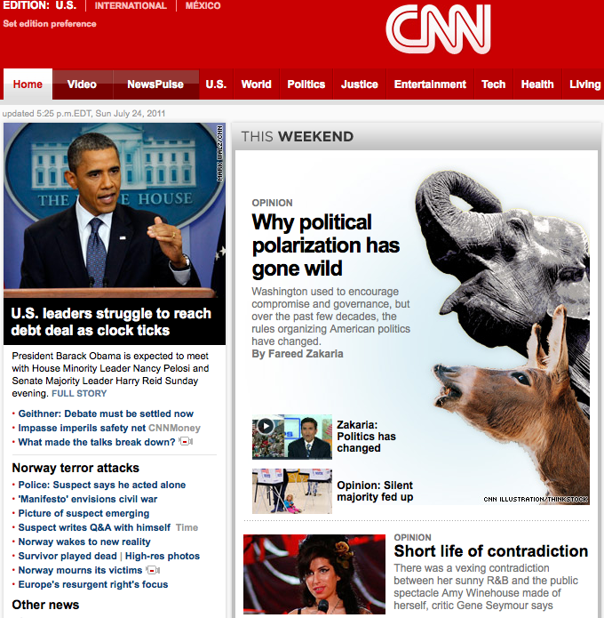
Rivalrous vs. Non-Rivalrous Resources
vs.
Notes:
We have to help policy leaders understand the affordances of digital things… and how digital courses, textbooks, data, research, science
… can be non-rivalrous resources IF educational resources are openly licensed.

Slide 39

OLPC and FOSS@RIT--Education innovation the open source way By: opensourceway
http://www.flickr.com/photos/opensourceway/4863541086/sizes/o/in/photostream/
CC BY-SA
Notes:
But we have a Policy Problem
Most policy makers don’t understand 21st century technical and legal tools and how they collectively enable “the learning machine”.
Understanding the opportunity afforded by wielding these tools is key to event understanding that the dream is possible.
Without this understanding, policy makers can only make decisions within existing frameworks, within existing business models.
Tools:
Internet
affordances of digital things: storage, distribution, copies
hardware costs down
bandwidth speed up
mobility up
Open content licensing is 10+ years old
Mass willingness to share
Taken together these tools collectively enable affordable, high quality, continuously improving, openly licensed educational resources.
Case in point: http://utahopentextbooks.org/2011/08/26/the-5-textbook/ : $5.35 textbook (including shipping) – ask David Wiley and CK-12
David Wiley’s recent open K-12 textbook study in Utah found – NSD: Simply substituting open textbooks for proprietary textbooks does not impact learning outcomes.
http://utahopentextbooks.org/2011/10/12/efficacy-data-are-in

Slide 40
Cost of “Copy”
For one 250 page book:
Copy by hand - $1,000
Copy by print on demand - $4.90
Copy by computer - $0.00084
CC BY: David Wiley, BYU

Slide 41
Cost of “Distribute”
For one 250 page book:
Distribute by mail - $5.20
  $0 with print-on-demand (2000+ copies)
Distribute by internet - $0.00072
CC BY: David Wiley, BYU

Slide 42
Copy and Distribute are “Free”
This changes everything
CC BY: David Wiley, BYU
Notes:
Clearly, the Internet has empowered us to copy and share with an efficiency never before known or imagined.
However, long before the Internet was invented, copyright law began regulating the very activities the Internet makes essentially free (copying and distributing).
Consequently, the Internet was born at a severe disadvantage, as preexisting laws discouraged people from realizing the full potential of the network.

Slide 43
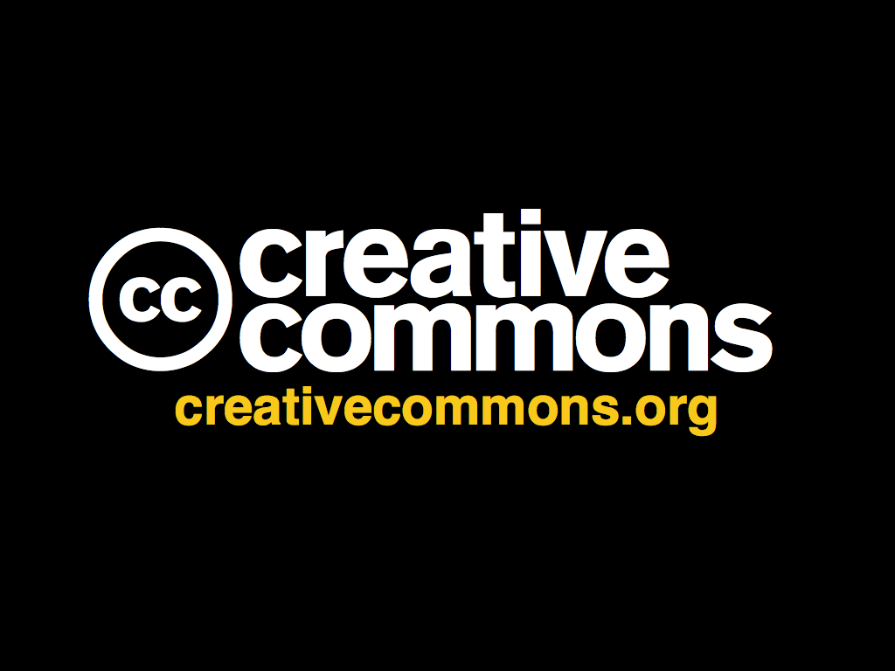

Video

Slide 44
A simple, standardized way to grant copyright permissions to your creative work.
Notes:
CC offers free tools that allow artists, musicians, journalists, educators and others share content on more flexible terms than default all rights reserved copyright
it’s important to note that CC Licenses are not a substitute for copyright; they’re built on top of copyright law

Slide 45
Easy-to-use, standardized licenses and public domain tools that allow creators to publish their works on more flexible terms than standard copyright
Notes:
CC offers a suite of free copyright licenses and public domain tools that give everyone from individual creators to large companies and institutions a simple, standardized way to keep their copyright while allowing certain uses of their work.

Slide 46
“Some rights reserved”
Notes:
CC is a “some rights reserved” approach to the default “all rights reserved” copyright regime.

Slide 47
Step 1: Choose Conditions
Attribution
ShareAlike
NonCommercial
NoDerivatives
Notes:
can do this right at creativecommons.org via our license chooser
step 1 is to choose the conditions that you want to attach to the work
all cc licenses require attribution to the original author of the work
after that users can decide which conditions they want to apply

Slide 48
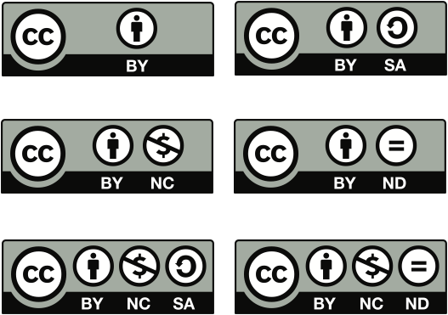
Step 2: Receive a License
Notes:
step 2 is to simply receive the license
there are 6 CC licenses that reflect a spectrum of rights
for the photos I share on Flickr, I use the Attribution only license, which means that anyone can download, copy, distribute, remix, tweak, and build upon them, even commercially, as long as they give me credit

Slide 49


CC0 public
domain dedication
Public Domain Mark
Notes:
In addition to the licenses, CC also provide tools that work in the “all rights granted” space of the public domain.
Our CC0 tool allows licensors to waive all rights and place a work in the public domain
Public Domain Mark allows any web user to “mark” a work as being in the public domain.

Slide 50






most free
least free
Notes:
50

Slide 51
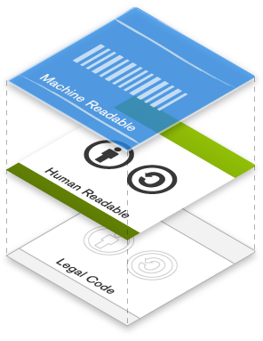
3 layers
Notes:
Our public copyright licenses incorporate a unique and innovative “three-layer” design.
Taken together, these three layers of licenses ensure that the spectrum of rights isn’t just a legal concept.
It’s something that the creators of works can understand, their users can understand, and even the Web itself can understand.

Slide 52
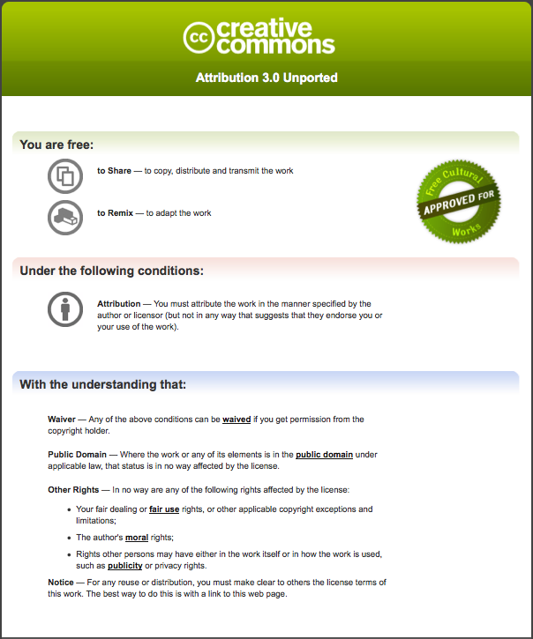
“human readable” deed
Notes:
first, there’s a human readable deed that simplifies the terms of each license into a few universal icons and non-technical language

Slide 53
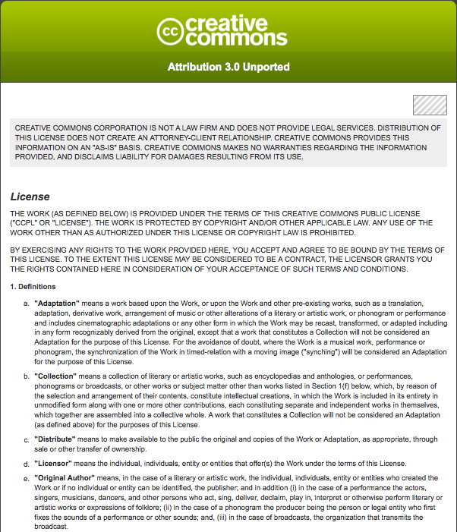
“lawyer readable” license
Notes:
second, there’s the lawyer-readable legal text, which has been vetted by a global team of legal experts
CC licenses are enforceable in a court

Slide 54
<span xmlns:cc=“http://creativecommons.org/ns#” xmlns:dc=http://purl.org/dc/elements/1.1/”>
<span rel="dc:type" href="http://purl.org/dc/dcmitype/Text" property="dc:title">My Photo</span> by
<a rel="cc:attributionURL" property="cc:attributionName" href="http://joi.ito.com/my_photo">Joi Ito</a>
is licensed under a
<a rel="license" href="http://creativecommons.org/licenses/by/3.0/">Creative Commons Attribution 3.0 License</a>.
<span rel="dc:source" href="http://fredbenenson.com/photo/”>
Permissions beyond the scope of this license may be available at <a rel="cc:morePermissions" href="http://ozmo.com/revenue_sharing_agreement">OZMO</a>.
</span></span>
“machine readable” metadata
Notes:
Third, there’s a machine-readable code that enables search and discovery via search engines like Google
The final layer of the license design recognizes that software, from search engines to office productivity to music editing, plays an enormous role in the creation, copying, discovery, and distribution of works.

Slide 55
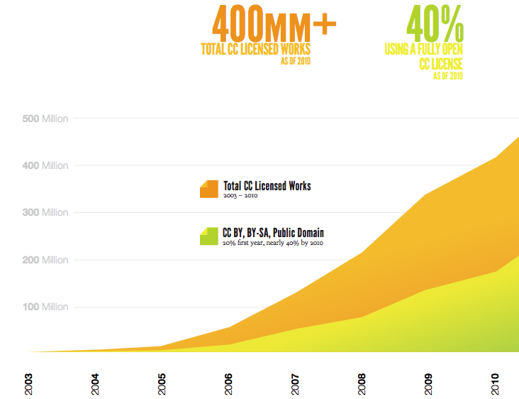
Notes:
There are over 500 million CC-licensed works published on the Web.
This is a conservative estimate.
As use of Creative Commons licenses has grown, the mix of licenses used has changed.
After its ”first year, only about 20% of works were licensed to permit in advance both remix and commercial use – that is, considered fully “free” or “open.”
After 8 years, that proportion had approximately doubled.

Slide 56
Updated #s (and growing fast)
Over 500 million items
Notes:
500M+ CC licensed works online today

Slide 57
Culture
Science
Government
Education
More
Notes:
Creative Commons licenses and public domain tools are used in a variety of areas
artists and the cultural sector
science and scholarly research
governments and public sector bodies
education via teachers, students, and self learners
and many, many more.

Slide 58
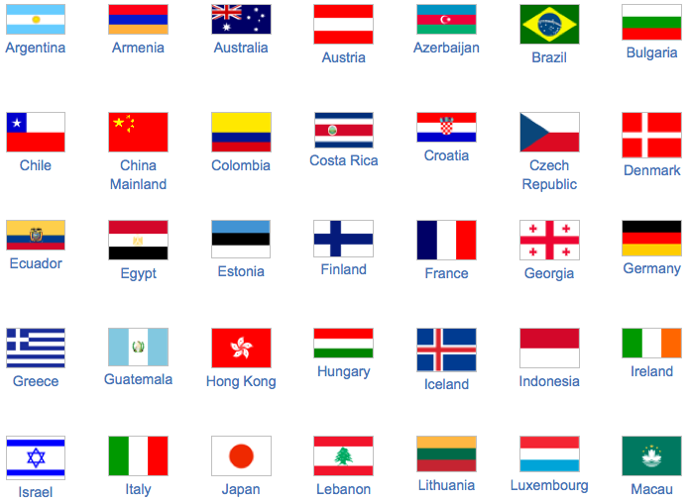
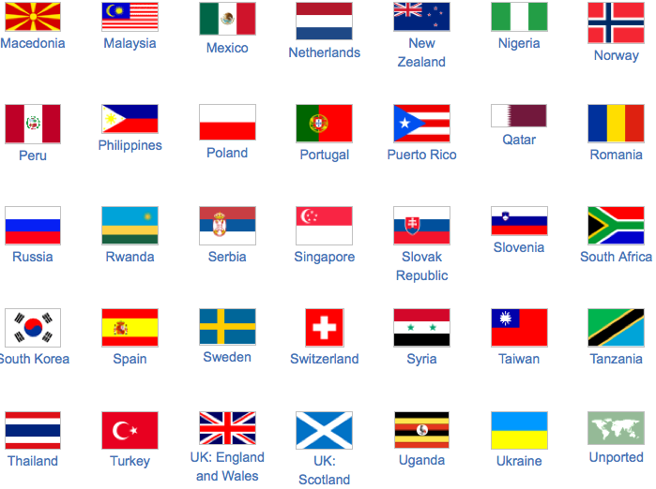

72 Creative Commons “Affiliate” Teams
Notes:
within the jurisdiction, public and legal lead volunteers help to make the licenses work in their individual countries’ legal system
we have 72 active affiliate teams with several more in process

Slide 59

Notes:
Wikipedia, which about 2 years ago merged all their content into using CC attribution share-alike license
17 million Wikipedia articles across all languages
8.5 million media files in Wikimedia Commons database.
All are available under a free license.

Slide 60
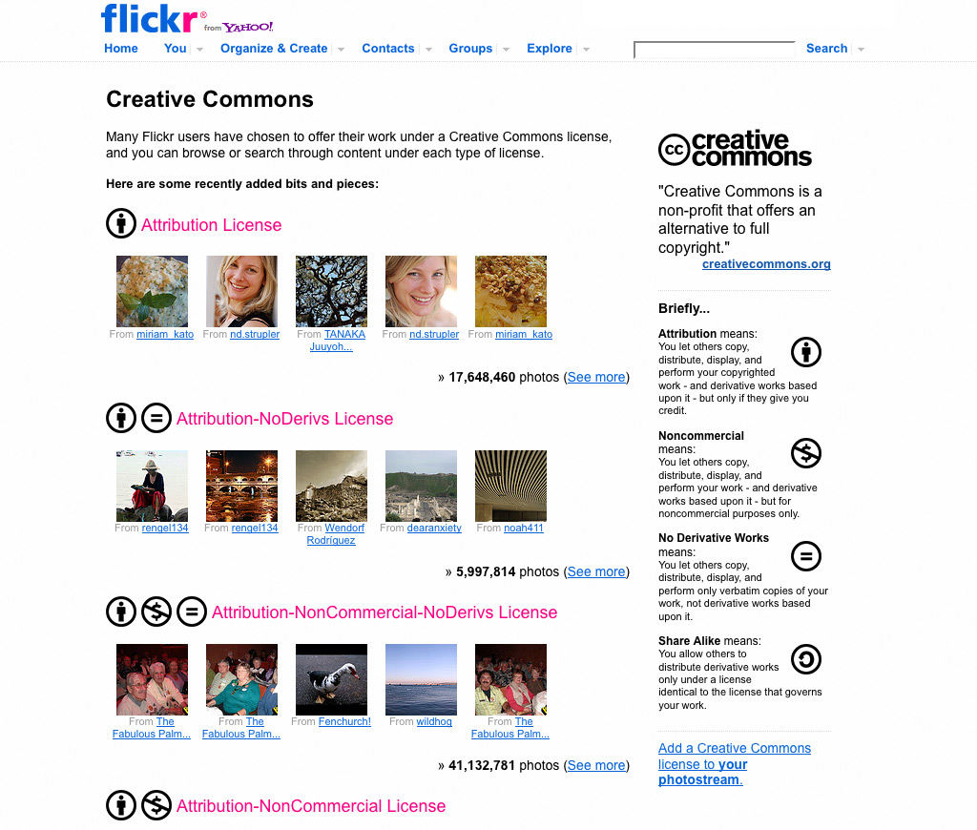
175+ Million CC Licensed Photos on Flickr
60
Notes:
Photo websites like Flickr, with over 175 million CC-licensed photos

Slide 61
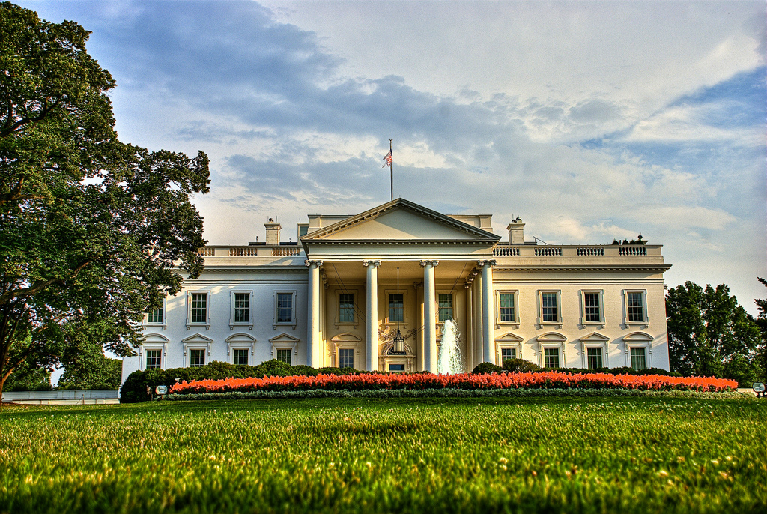
http://www.flickr.com/photos/22240293@N05/3735172478/in/set-72157621681117648 By: Francisco Diez
Notes:
the White House, where user contributions to whitehouse.gov are licensed under a CC Attribution license

Slide 62
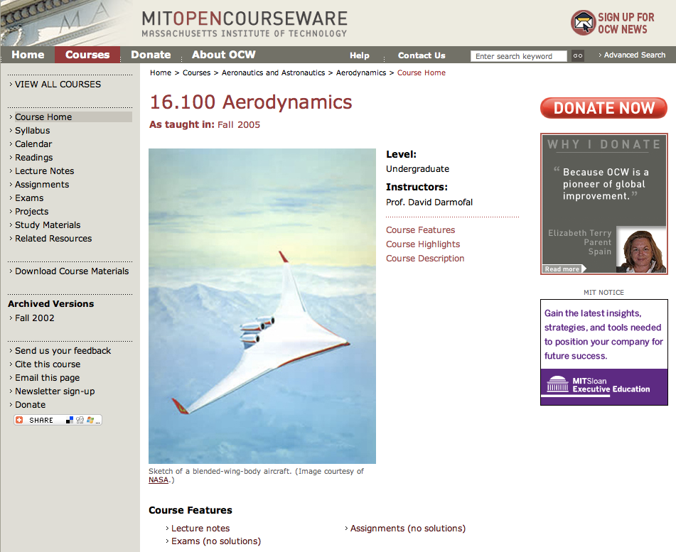
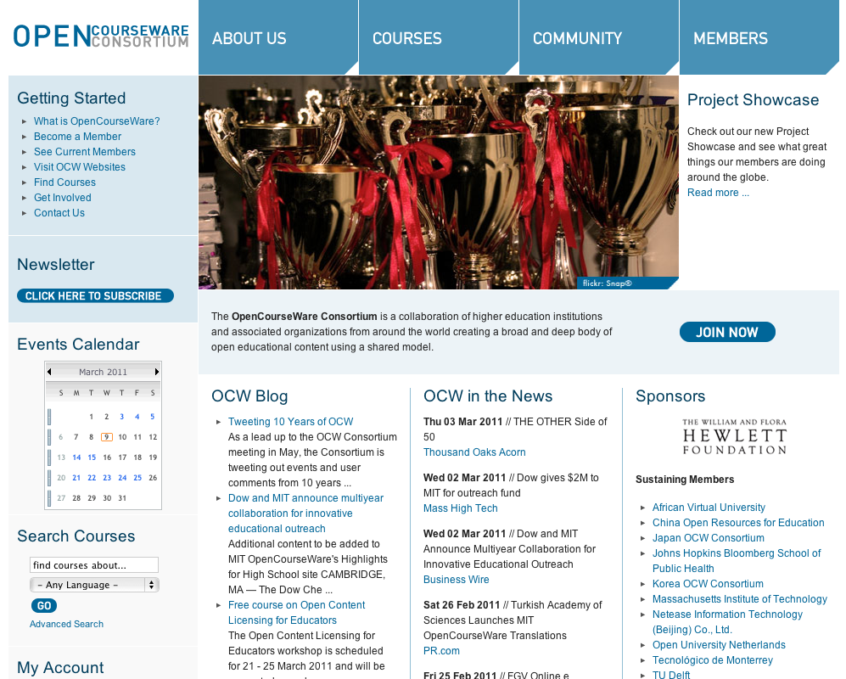
Higher Ed
Notes:
Higher Ed
MIT OCW- the largest OCW project, sharing course content from all 1,900 MIT courses

Slide 63
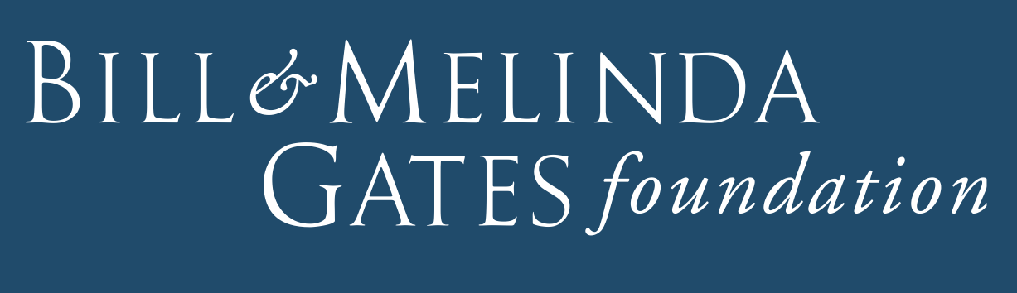
Education grant making
Notes:
CC used by philanthropic foundations for the projects they fund
the Shuttleworth Foundation
Hewlett
NGLC grants funded by Gates, Hewlett, others, all content created using grant funds must be licensed CC BY

Slide 64
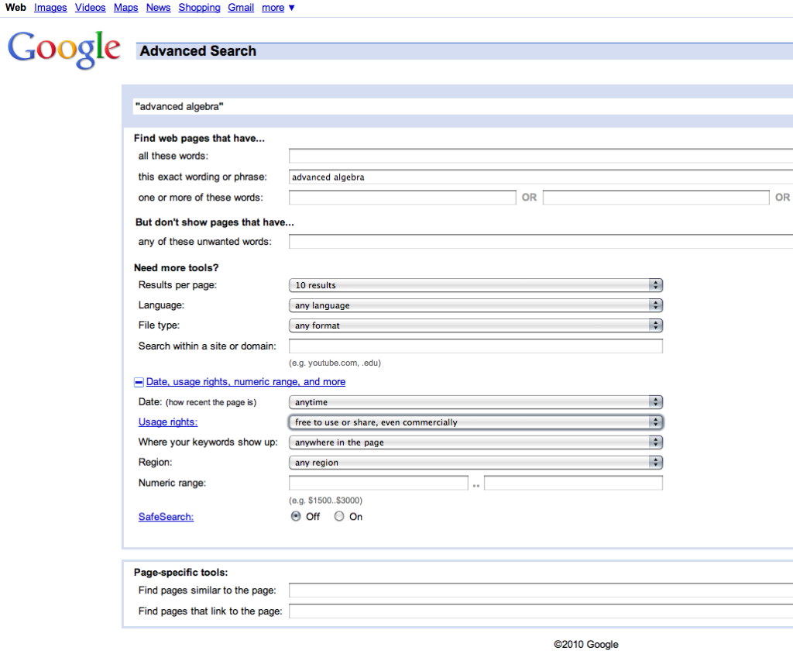
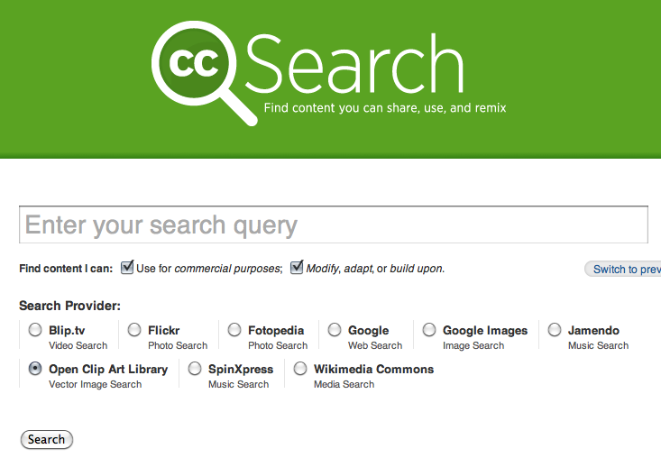
Search & Discovery
Notes:
CC licensed resources aid in search and discovery; the licenses clarify to educators, students the rights available to them for reuse, revise, remix and redistribute.
LRMI

Slide 65
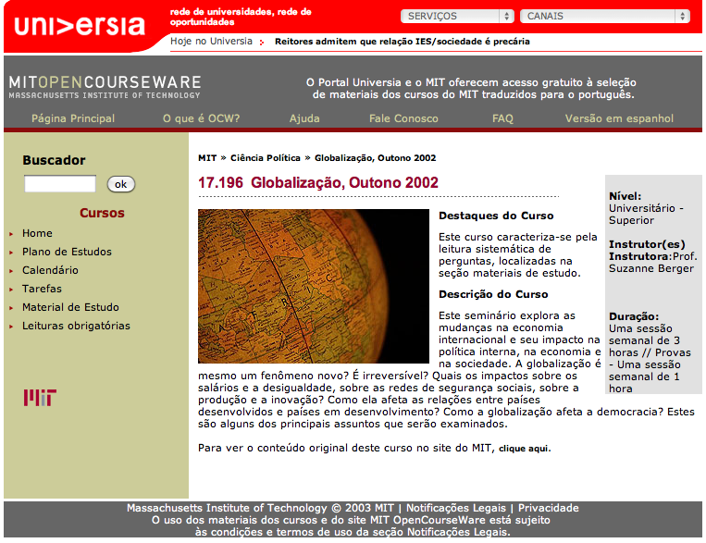
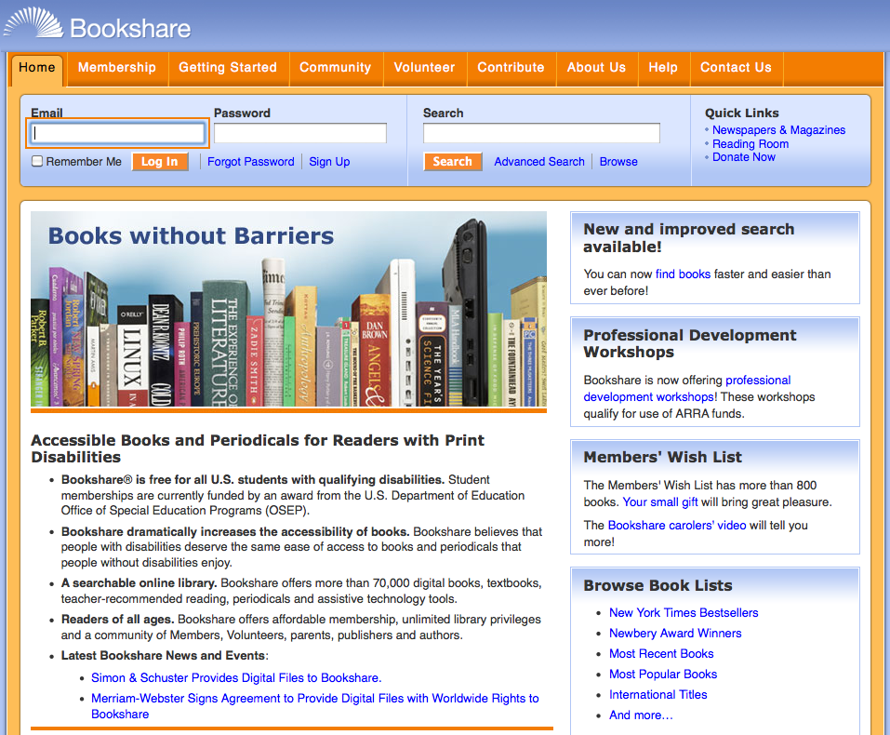
Translations & Accessibility
Notes:
CC licensed OER address language and accessibility concerns
OER 800 MIT OCW courses have been translated into languages other than English, all without needing to ask permission from the copyright holder
Open textbooks can be converted into accessible formats, such as audiobooks and Braille refresh; no additional royalty costs since the rights are pre-cleared via the CC license

Slide 66
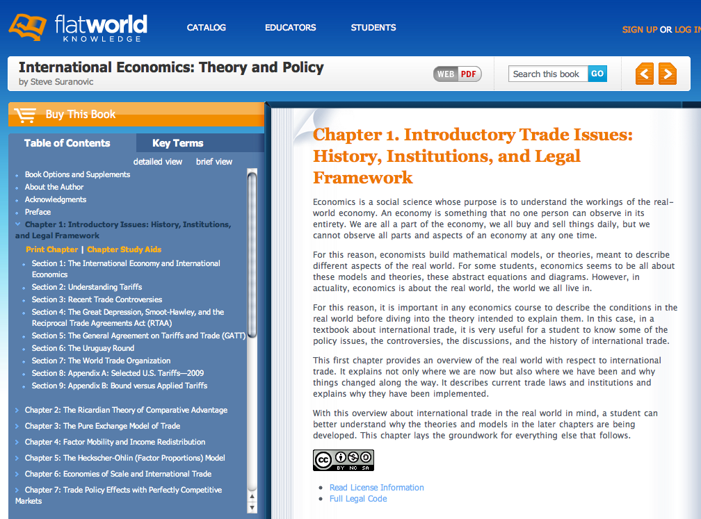

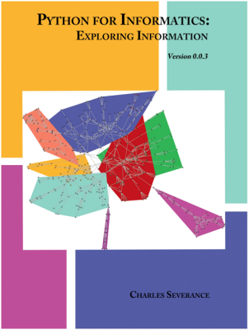
Customization & Affordability
Notes:
CC licensed open textbooks is one solution to enable creativity, customizability, keep materials up to date, and make learning materials more affordable
Flat World is a commercial textbook publisher that incorporates CC licenses into the core of their business model, offering free online access, and affordable print on demand physical copies of textbooks and supplemental materials
FWK 800 colleges will utilize their open textbooks this year, saving 150,000 students $12 million or more in textbook expenses
CK-12 has produced several open textbooks called “flexbooks”, and their Physics Flexbook is in use in Virginia high schools; developed and delivered within 6 months
a professor at the UMICH School of Information, took an existing Computer Science Python textbook that was licensed under an open license and remixed the book in only 11 days, Michigan’s espresso book machine printed copies for $10

Slide 67
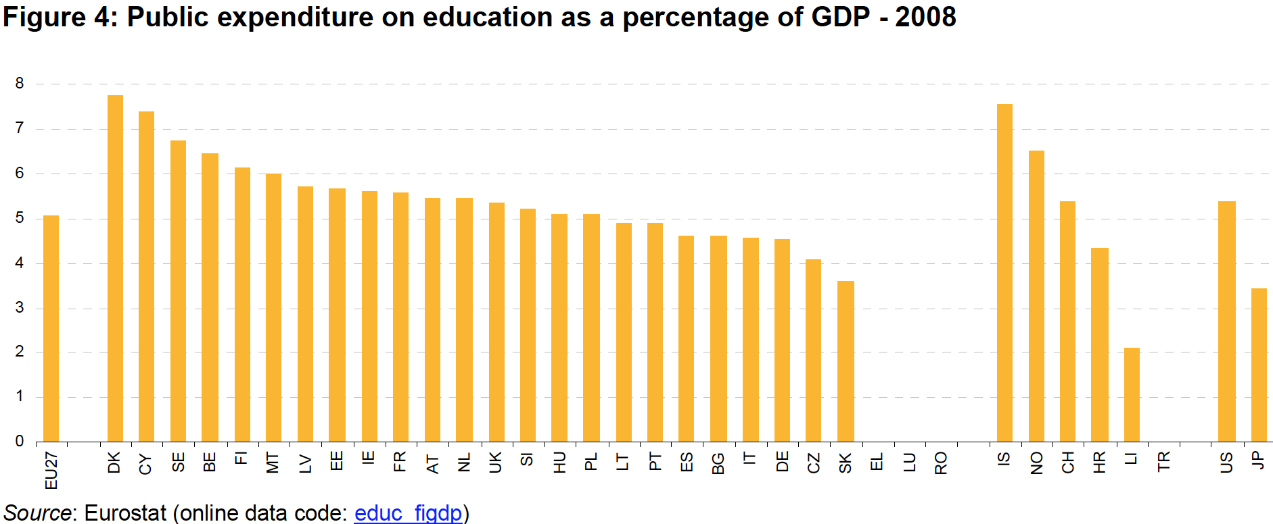
By: Eurostat: http://appsso.eurostat.ec.europa.eu/nui/show.do?dataset=educ_figdp&lang=en
Notes:
So what? Why focus on Open Policy? Why am I talking about it?
1st the Policy = Publicly funded resources are openly licensed resources.
While there are many open licenses, publicly funded educational resources should use an open license that allows the public to revise, reuse, remix and redistribute those materials.
For the purposes of the open policies that contribute to the Commons, I define policy broadly as legislation, regulation, and/or funder mandates. If we are going to unleash the power of billions of dollars of publicly funded education, research and science projects, we need broad adoption of open policies.
Why focus on Publicly funded educational resources = LOTS of $$$
Brazil: approximately 5% of GDP ($2.1T dollars) on education
European Union – 5% of GDP ($16.2T) on Education
Argentina spends 6% of GDP ($307B) on Education
United States spends just over 5% of GDP ($14.1T)
Malaysia has been spending between 20 and 25% of its annual budget on education [ a third of it in HE], for the last two decades.
================
These might be useful - though they're both very dated:
http://www.oclc.org/reports/escan/economic/educationlibraryspending.htm
http://www.nationmaster.com/graph/edu_edu_spe-education-spending-of-gdp
This gives you a thorough break down of Australia's GDP expenditure on education between 2003 and 2008: http://www.abs.gov.au/AUSSTATS/abs@.nsf/Lookup/0E0701553637F843CA25773700169C99?opendocument

Slide 68
Global GPD = US $58.3 T
x 5% = US $2.915 T / year
How much of that is spent:
creating courseware?
subsidizing or directly purchasing textbooks?
Notes:
Global GDP comes in at just about $58.3T – World Bank Data (2009)
If countries spend roughly 5% of GPD on education = $58.3T x 5% = US $2.9T / year
If we can move to a simple open public policy, hundreds of billions of dollars of educational resources will be available under an open license and will be freely available to the public that paid for them.
National / state / provincial governments and education systems all play a critical role in setting policies that drive education investments, and have an interest in ensuring that public funding in education make a meaningful, cost-effective contribution to socio-economic development.
Given this role, these policy-making entities are ideally positioned to encourage or mandate recipients of public funding to produce educational resources under an open license.

Slide 69
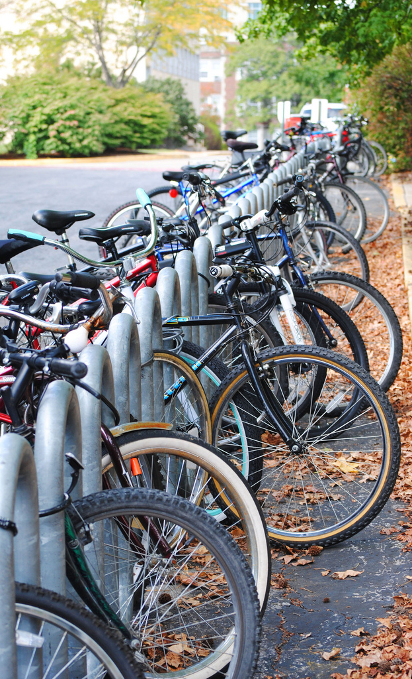
Lines of Bikes By: KOMU News
http://www.flickr.com/photos/komunews/6176280963
CC BY
Notes:
This is why Open Policies are important. If we get this simple idea right, OER sustainability will cease to be an issue because:
(a) there will be plenty of public funding to build and maintain all of the teaching, learning and research resources the world needs, and,
(b) “open” becomes the default and “closed” becomes the exception. … and the bar for receiving an exception should be high.
Wrong frame (today) – how do we sustain that [pilot] project?
Right frame – how do we maximize the investments we’re already making (& have already made – sunk costs) on learning resources we need for our students… for our university … our state … our nation?
OER becomes the default output of normal work -- so no new money required. It’s part of normal business. Sustaining OER = sustaining the academy.
This was our sustainability plan in WA State – we are only going to be selfish and build / maintain what we would have done anyway for WA students. We’re also going to put a CC BY license on everything we build because (a) we believe education is about sharing and (b) good things happen to us when we share: updates, new partners, grant opportunities, translations…
There will still need to be ongoing investments … but if we collectively need quality, affordable learning resources that are iteratively improved based on data from assessments … shouldn’t we:
(a) demand that we get access to what we, the taxpayers, paid for so we’re not starting from scratch and;
(b) share what we build as we have a collective goal of educating more people to higher levels? Are we educators or not?

Slide 70
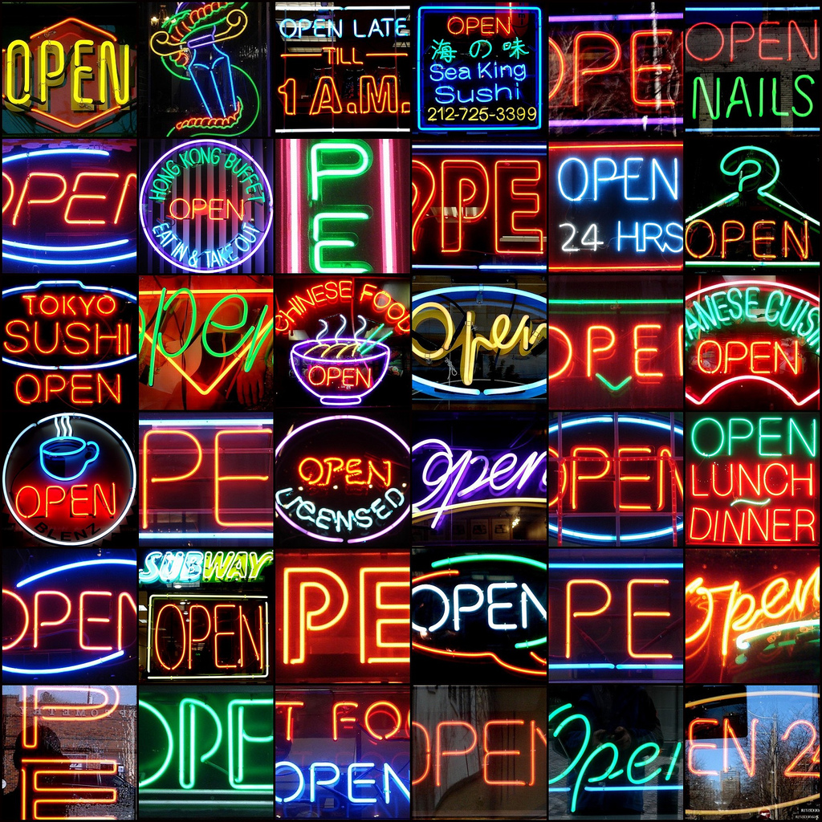
OPEN By: Tom Magliery
http://www.flickr.com/photos/mag3737/1914076277
CC BY-NC-SA
Notes:
The Policy is simple to say, explain and convince impartial policy actors of its obviousness.
Policy = Publicly funded resources are openly licensed resources.
Implementation? All publicly funded creative works are either placed into the public domain or are openly licensed with a license that allows: revise, reuse, remix, redistribute.
Important: such a policy is about sharing what is built with public funds. It says nothing about requiring use.
Slogans:
Buy one get one (Wiley)
You should get what you pay for.
Public Access to Publicly Funded Resources
======================
Good news. Many have already called for Open Policies
Open Access community
Cape Town Declaration
the recent… Washington Declaration on Intellectual Property and the Public Interest

Slide 71
Partner with Legislators
who care about:
(a) efficient use of national / state
tax dollars;
(b) saving students money;
(c) increasing access to education
Notes:
More good news – the arguments for getting policy makers to adopt open policies are simple and compelling.

Slide 72
Why is “Open” Important?
Cooperate & share = We all Win
  Faculty have new choices when building learning spaces.
  …the more eyes on a problem, the greater chance for a solution.
Affordability: students can’t afford textbooks
Self-interest: good things happen when I share
It’s a social justice issue: everyone should have the right to access digital knowledge.
Notes:
And there is an open argument that will work with most people – regardless of political bias or views on the size and/or role of Government.
All want public tax dollars to be used wisely and efficiently.
Hal Plotkin – 5% of the worlds population have access to high quality education… odds are the cure for cancer, renewable energy solutions, etc. are in that 95% … we have a collective self-interest in turning on the “learning machine”

Slide 73

Dream in Colour By: Vineet Radhakrishnan
http://www.flickr.com/photos/vineetradhakrishnan/6038259665
CC BY-NC-ND
Notes:
What’s Possible with Open Policies?
It’s real simple – HUGE amounts of publicly funded educational and scientific resources could be made available under an open license or placed directly into the public domain.
European Commission report says that OECD countries spent $638 billion on basic and applied R&D in 2001.
US spends $60 Billion / year on grants
We need Open Access policies on all publicly funded research and data
Action: US Congress adopts Federal Research Public Access Act
This would require that 11 U.S. government agencies with annual extramural research expenditures over $100 million make manuscripts of journal articles stemming from research funded by that agency publicly available via the Internet six months after it has been published in a peer-reviewed journal.
=============
EU Commission: Bottom of page 5: http://ec.europa.eu/research/science-society/pdf/scientific-publication-study_en.pdf

Slide 74
Legislative Strategy
Textbook RFP?
Higher Education
  Textbooks for top 100 highest enrolled courses (see California)
Primary / K-12
  Textbooks for US “Common Core”
Notes:
What if the public that paid for elementary textbooks (through taxes)
& higher education textbooks (also through taxes supporting state and national financial aid)
had free and open access to the textbooks they paid for?

Slide 75
    English Composition I
    55,000+ enrollments / year
    x $175 textbook
    = $9.6⁺ Million every year
Notes:
What about something small – local? Do open policies make sense on a smaller scale?
Even one open textbook for a top 100 course makes sense.
But WA should (a) ask if anyone else has already done this and openly licensed it (e.g., CK12), (b) alert other states / countries that it is going to make this investment and share.

Slide 76
    English Composition I
    55,000+ enrollments / year
    x $175 textbook
    = $9.6⁺ Million every year
Insane

Slide 77

http://openstaxcollege.org
OpenStax College texts are CC BY and can be adopted and adapted by faculty
OpenStax College texts meet scope/sequence requirements of course and are professionally developed
Any format, on any device, at any time and epub/pdf is always free and never expire
New ecosystem of partners to support the content

Slide 78


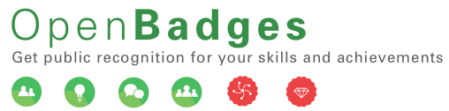

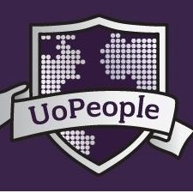

NEW HE Models are En Route
Credit: Timothy Valentine & Leo Reynolds CC-BY-NC-SA
Notes:
New Models are showing us what the dream looks like.

Slide 79

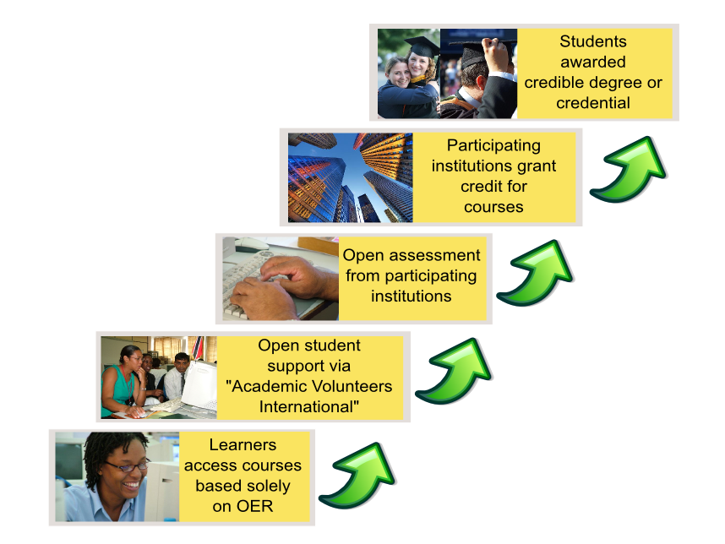

The OER university
Free learning opportunities for all students worldwide
Adapted from Taylor 2007
Notes:
OERu will provide free learning alternatives to all students worldwide with pathways to achieve formal credentials.

Slide 80

National Wikiwijs Program
Dec. 2008 / LAUNCH by Minister of Education
Goal: Mainstreaming OER in all educational sectors
Six Activity Areas:
Technology, Content, Professionalization,
Communities, Research, Communication
2009–2011 / INITIAL IMPLEMENTATION
Intense user evaluation
Many committed stakeholders
Good progress, and … lessons …
2011–2013 / SUSTAINABLE PERSPECTIVE
Fully utilize user participation
Clearly differentiate between the educational sectors
Establish ownership with relevant partners in those sectors
BUDGET 2009–2013: € 8,0 million
www.wikiwijs.nl
Notes:
Good News – Some have already Adopted Open Policies … laying the policy groundwork to support the dream
Wikiwijs is an open educational resources (OER) platform for teachers launched by the Dutch Ministry of Education to
"stimulate development and use of OER",
"improve access to both open and 'closed' digital learning materials",
"support teachers in arranging their own learning materials and professionalization", and to
"increase teacher involvement in development and use of OER."

Slide 81
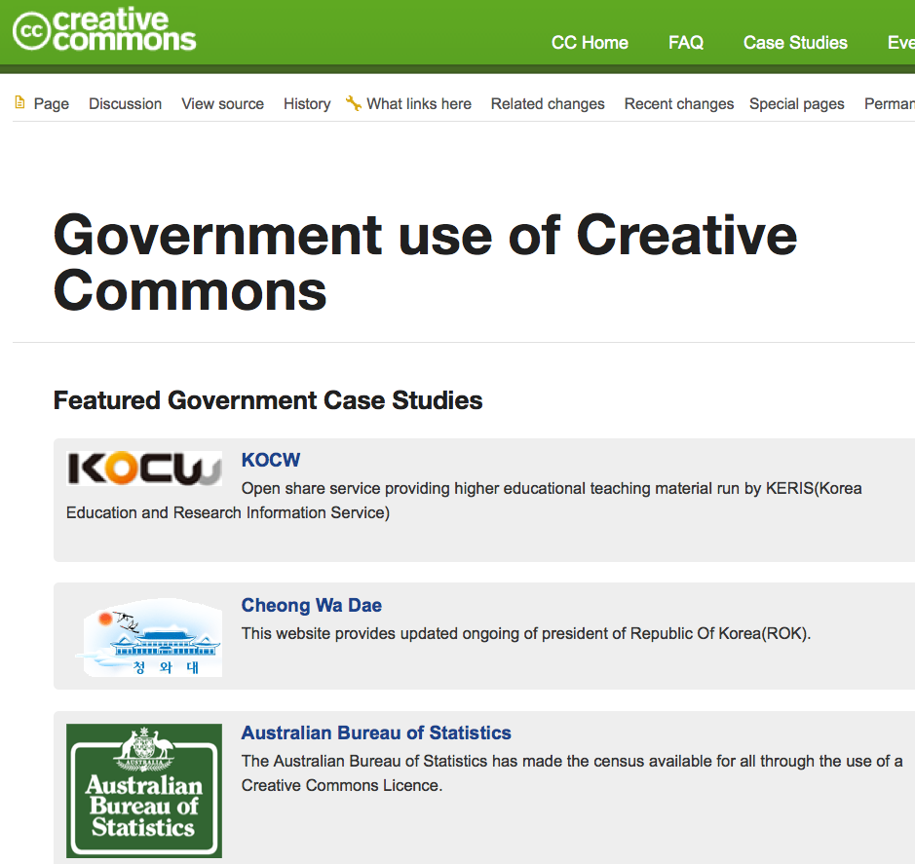
Notes:
Brazil – working on open legislation
It 1) requires government funded educational resources to be made widely available to the public under an open license, 2) clarifies that resources produced by public servants under his/her official capacities should be open educational resources, and 3) urges the government to support open federated systems for the distribution and archiving of OER.
Poland – is working on legislation
Athabasca - process requirement for new course development whereby instructional designers are required to first search for published OERs before purchasing proprietary content or committing to in-house development.
US:
NIH open access policy
DOL grant policy
New York Board of Regents – working to require CC licenses on “Race to the Top” funding
SBCTC Open Policy
Multiple Open Access Policies

Slide 82
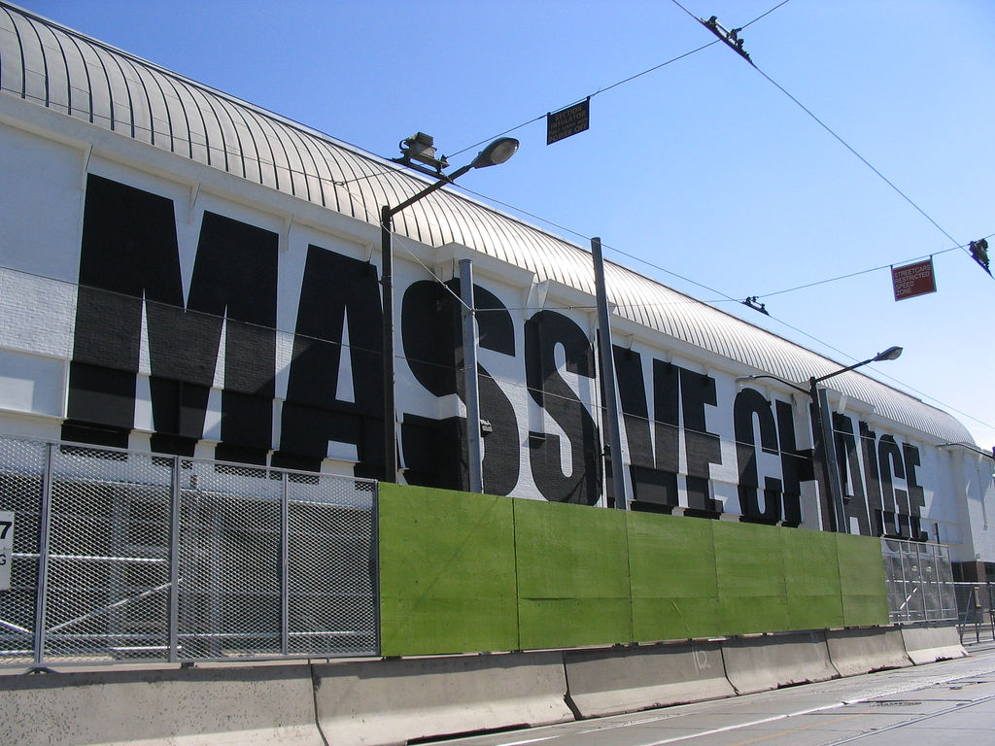
CC BY
massive change By: sookie http://www.flickr.com/photos/sookie/31219031
Notes:
Challenge: Existing Structures are Difficult to Change
Most educational content business models built on gatekeeping and locking up resources (to make them rivalrous) are challenged by these trends that allow digital resources to be non-rivalrous.
Existing business models are starting to fight, and they have money and lobbyists.

Slide 83

Notes:
Textbook publishers sought to change an existing California law that requires students be allowed to keep the educational resources they purchase when an instructional materials fee is charged.
Change policy to enable their new business model – make the 1st sale to every student and “time bomb” the materials.
The meetings were behind closed doors, was heavily weighted with publishers, and failed to disclose conflicts of interest.

Slide 84

Defeated

Slide 85
U.S. House Appropriations Committee draft FY2012 Labor, Health and Human Services funding bill
SEC. 124. None of the funds made available by this Act for the Department of Labor may be used to develop new courses, modules, learning materials, or projects in carrying out education or career job training grant programs unless the Secretary of Labor certifies, after a comprehensive market-based analysis, that such courses, modules, learning materials, or projects are not otherwise available for purchase or licensing in the marketplace or under development for students who require them to participate in such education or career job training grant programs.
http://appropriations.house.gov/UploadedFiles/FY_2012_Final_LHHSE.pdf
Notes:
The US House Appropriations Committee released a draft fiscal year 2012 funding bill.
Included in this bill is the following provision, which would appear to strip the ability of the DOL to support any further OER investments:
Really?
No one is allowed to build anything with public funds, with our tax dollars, “…unless the Secretary of Labor certifies, after a comprehensive market-based analysis, that such courses, modules, learning materials, or projects are not otherwise available for purchase or licensing in the marketplace or under development…"?
Really?
If the American people want to get maximum benefit from their precious public investments, the US Congress would rewrite the budget language to:
"SEC. 124. None of the funds made available by this Act for the Department of Labor may be used to purchase proprietary, non-openly licensed new courses, modules, learning materials, or projects in carrying out education or career job training grant programs unless the Secretary of Labor certifies, after a comprehensive Open Educational Resources analysis, that such courses, modules, learning materials, or projects are not otherwise available under an open license that allows free reuse for students who require them to participate in such education or career job training grant programs."
Let’s get to the crux of the issue. This is not about duplicating publisher works - this is about we, the tax payers, getting free and legal access to what we paid for... and our students, tax paying citizens, having access to high quality, affordable, openly licensed learning materials.
The Department of Labor (DOL) has put forth a simple, rational public policy: Taxpayer-funded educational resources should be open educational resources. Information that is designed, developed and distributed through the generosity of public tax dollars should be accessible to the public that paid for it.
If the publishers wish to debate, it will be on this point.
What publishers and industry trade associations would do well to recognize is the CC BY license does not restrict commercialization of the open content produced by the DOL grantees. To be clear, the commercial publishers can take ALL of the content created in this DOL grant, modify it, make it better, add value, and sell it. The consumer (states, colleges, students) will then have a choice: (a) use the free openly licensed version(s) or (b) purchase the commercial for-a-fee version. If the commercial content / services are worth paying for, people will pay. If not, they won’t.
Releasing information created with public funds should be a public right – not viewed as a disadvantage to commercial interests.
How can you tell me I can’t have access to what I paid for – that’s crazy.

Slide 86
U.S. House Appropriations Committee draft FY2012 Labor, Health and Human Services funding bill
SEC. 124. None of the funds made available by this Act for the Department of Labor may be used to develop new courses, modules, learning materials, or projects in carrying out education or career job training grant programs unless the Secretary of Labor certifies, after a comprehensive market-based analysis, that such courses, modules, learning materials, or projects are not otherwise available for purchase or licensing in the marketplace or under development for students who require them to participate in such education or career job training grant programs.
http://appropriations.house.gov/UploadedFiles/FY_2012_Final_LHHSE.pdf
Defeated

Slide 87

Stop Online Piracy Act
PROTECT IP Act
Occupy the Internet - Stop SOPA and PIPA By: DobkeyHotey
http://www.flickr.com/photos/donkeyhotey/6720673741
CC BY
Notes:
The legislation would allow copyright holders and the Justice Department to seek court orders against websites associated with copyright infringement.
If that court order is granted, the entire website would be taken down.

Slide 88

Wikipedia Blackout Screen By: Wikimedia Commons CC BY SA
http://en.wikipedia.org/wiki/File:Wikipedia_Blackout_Screen.jpg
Notes:
Good news – due to the overwhelming communication to the US Congress and
The Blackout Screens on major internet web sites
The votes on SOPA and PIPA have been indefinitely delayed.

Slide 89
H.R. 3699
"No Federal agency may adopt, implement, maintain, continue, or otherwise engage in any policy, program, or other activity that -- (1) causes, permits, or authorizes network dissemination of any private-sector research work without the prior consent of the publisher of such work; or (2) requires that any actual or prospective author, or the employer of such an actual or prospective author, assent to network dissemination of a private-sector research work."
Notes:
Essentially, the bill seeks to prohibit federal agencies from conditioning their grants to require that articles reporting on publicly funded research be made accessible to the public online.
Translation and Comments:
"If public tax money is used to fund research, that research becomes "private research" once a publisher "adds value" to it by managing the peer review.”
Comment: Researchers do the peer review for the publisher for free, just as researchers give their papers to the publisher for free, together with the exclusive right to sell subscriptions to it, on-paper and online, seeking and receiving no fee or royalty in return.

Slide 90

046: Rule #2: See Rule #1 By: William Couch
http://www.flickr.com/photos/wcouch/2268610556
CC BY-NC-ND
Notes:
If we are to fight this nonsense, Open Policy strategy must follow NEW RULES.
Disruptive Innovation Lessons (Clayton Christensen):
Never attack existing business models head-on – incumbents typically win because you are playing by their rules
rather play by new rules that “the trends” afford – KEY point to remind policy makers – I’ve found this is NOT obvious to people.
e.g., Open Course Library – we changed the rules - $30 cap – want to play? We will do this with or without you… would rather partner, but don’t oppose us – we have all the best arguments and the public is on our side.
And as Professor Eben Moglen reminds us: when we openly license our work, and leverage the Internet as a free distribution channel, we put the creator / the author, and not the distributor, in control of human knowledge.
We make things and we give them away.
Here we made this, would you like it?
Take some it's free
http://www.youtube.com/watch?v=tN00_v7gpbo&feature=youtu.be&t=6m45s
----------------
(1) Choose the most open license (e.g., public domain, CC BY) possible to (a) increase the degrees of freedom for downstream use, (b) increase interperability among licenses = more re-mix opportunities, and (c) reduce concern from existing for-profit businesses.

Slide 91

CC BY-NC-ND
Lincoln By: carfull… http://www.flickr.com/photos/carfull/5720220773
Notes:
We have to think bigger and make smarter decisions collectively.
December 1, 1862. One month before signing the Emancipation Proclamation, President Lincoln sent a long message to the US Congress: in it he said:
The dogmas of the quiet past, are inadequate to the stormy present. The occasion is piled high with difficulty, and we must rise -- with the occasion. As our case is new, so we must think anew, and act anew. We must disenthrall ourselves, and then we shall save our country.
Can we disenthrall ourselves from our current behaviors and think and act anew? I think we can.
We ought be straight, honest, expose the amount and flow of the $$$, make the open policy argument, and force the opposition to make their best arguments – and be ready to counter quickly.
The open community is passionate and powerful if called to action for an important cause.
Don’t work alone – share new policies with each other
We all need to try to implement open policies where we can – some policies will take quicker than others due to local opportunities and challenges.
We need to help one another pass open policies (testify, meetings, webinars)
we can revise and remix others’ policies and legislation
What can WE (the global Open community) do to help Governments, Foundations, States / Provinces, Systems, Institutions to adopt open policies?
Presentations
Insert open policy into strategic plans – system efficiency plans – education reform plans – government efficiency plans, etc.
Every opportunity!
Share what their peers have done – no one wants to be left behind
Provide draft open policy language, translated, customized for local needs.

Slide 92
Only ONE thing Matters:
Efficient use of public funds to increase student success and access to quality educational materials.
Everything else (including all existing business models) is secondary.
Notes:
Most important, take Policy makers back to first principles…

Slide 93

Chess Pawn By: Doug Wheller
http://www.flickr.com/photos/doug88888/3400002114
CC BY-NC
Notes:
End Game?
Winning argument: Policy makers will want the highest ROI and impact of public investments.
Open Policy Goal? Open policies adopted by all nations, national agencies, states / provinces, systems of education, institutions, departments and individual creators.

Slide 94


CC BY No titles. By: Cable Green
Notes:
Remember the food machine?
We don’t have such a device.
While we might have the global capacity to feed everyone, food is not digital and is a rivalrous good, and so a universal access solution is a greater challenge.
Which is a shame because many people don’t have nearly enough food to eat.
If we did have a food machine – we would turn it on tomorrow – no question about it. The moral imperative to do so would overwhelm any opposition.

Slide 95

CC BY-SA
Open nature By: opensourceway
http://www.flickr.com/photos/opensourceway/5537457709
Notes:
We do have a Learning Machine
We simply need to turn it on.
Moreover, because we understand the tools and the strategy; I contend we have a moral and ethical responsibility to act.
We’re off to a good start.
Adopting Open Policies is the next step.
Repeat after me: (call) “Public Access” (response) “to Publicly Funded Resources.”
Buy One Get One
I should get what I paid for
“if we share” “everyone in the world can learn”

Slide 96
Notes:
Creative Commons stands ready to partner with anyone who wants to pursue and implement Open Policies.

Slide 97
the opposite of open isn’t “closed”
Notes:
A closing thought, in the 21st century…

Slide 98
the opposite of open is “broken”

Slide 99
Dr. Cable Green
Director of Global Learning cable@creativecommons.org twitter: cgreen
Notes:
Thank you.

