Slide 1
Notes:
Malcolm

Slide 2
OPEN QA … http://tinyurl.com/elinew
Notes:
Malcolm

Slide 3
General/Featured Sessions
Preconference Seminars
Interactive Presentations
Short Presentation Pairs
Discussion Circles
Hands-On Workshops
Poster Sessions
Corporate and Campus Solutions
Notes:
Malcolm

Slide 4
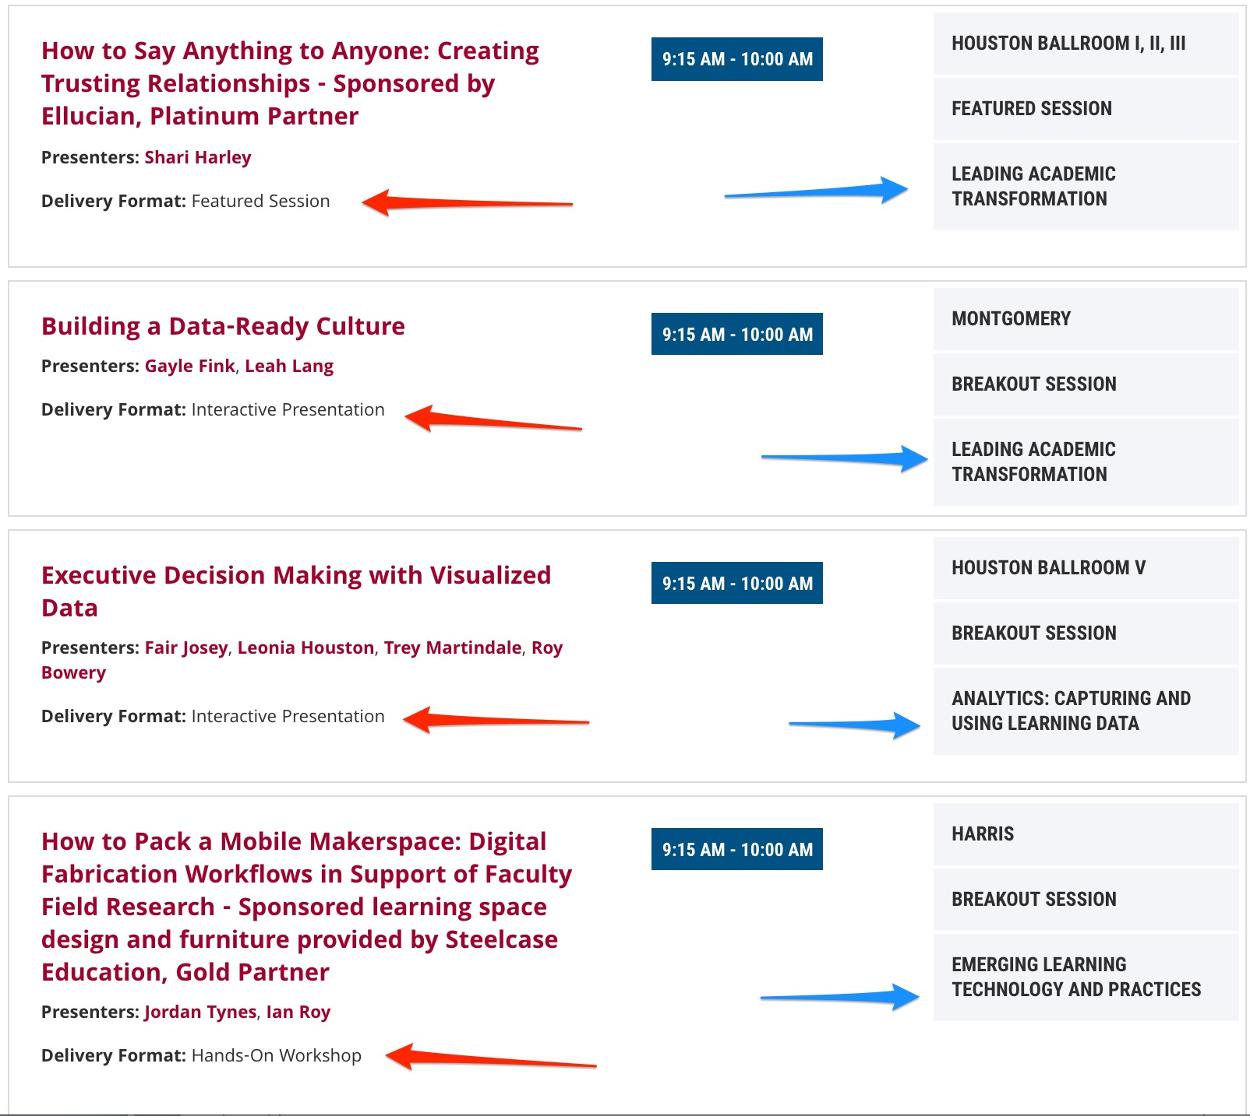
Notes:
Malcolm

Slide 5
Notes:
Malcolm
By delivery format

Slide 6
Notes:
Malcolm
By program track

Slide 7
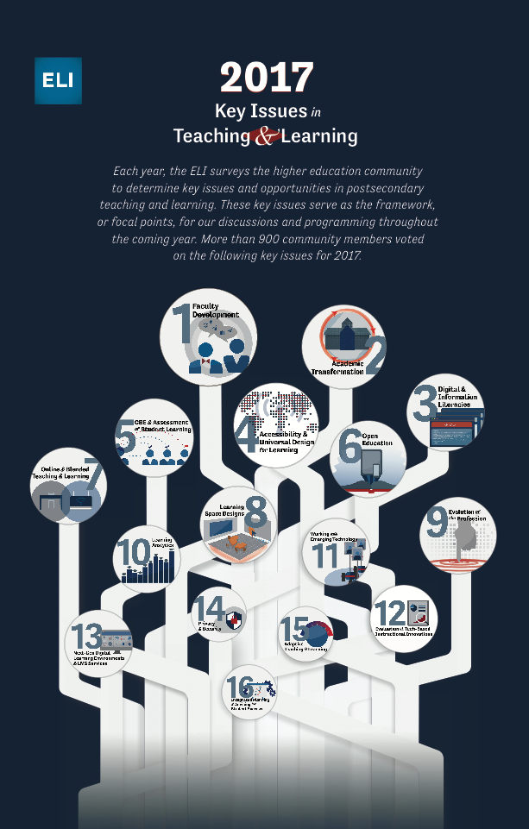
tinyurl.com/2017keyissues
Notes:
Malcolm

Slide 8
Breakfast Discussions
The Coming Active Learning Apocalypse: When Demand for Classrooms Exceeds Capacity
Blended Learning on a Residential Campus
Building Community among Online Learners
Exploring the possibilities for a Global Edtech Assessment Repository (GEAR)
Notes:
Malcolm

Slide 9
Lunch Discussions
Adaptive Learning and Courseware
Learning Spaces: Maker/Innovation Spaces
Improving Technology Adoption Outcomes
Exploring the possibilities for a Global Edtech Assessment Repository (GEAR)
Notes:
Malcolm

Slide 10
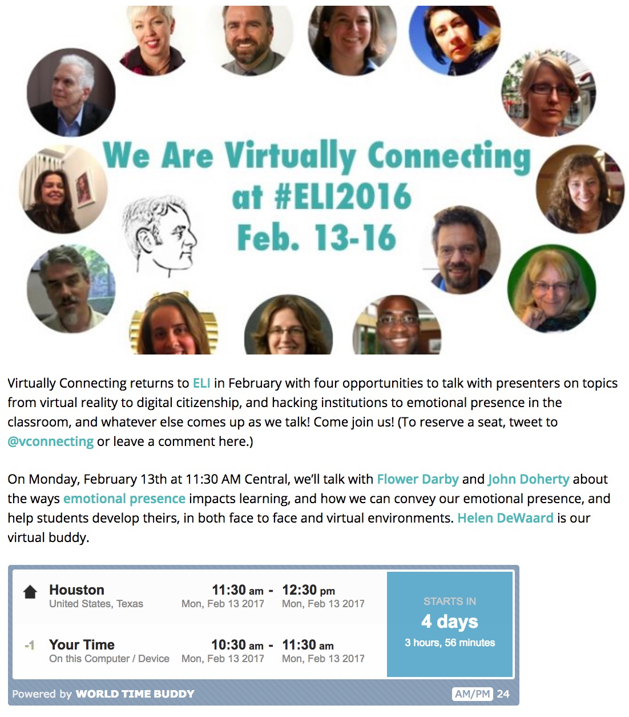
http://tinyurl.com/ELIVC
Notes:
Malcolm

Slide 11
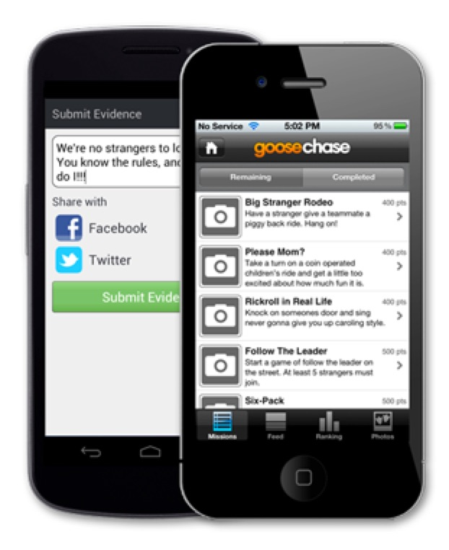
Download the goosechase app
Join the ELI game called "ELI Annual Meeting 2017” select "Join" and enter the password "ELI2017”
Complete missions, submit evidence
Track your opponents ☺
Game closes and winners are announced at the closing session, Wednesday 2-15 at 10am CT
http://tinyurl.com/goose17
Notes:
Veronica

Slide 12
Events Within the Event
Notes:
Veronica

Slide 13
Young Professionals Networking Event Monday, February 13 11:15am - 12:00pm ET Montgomery
Notes:
Veronica
EDUCAUSE Young Professional Advisory Council (YPAC) to discuss how EDUCAUSE currently meets the needs of young professionals, as well as ways it could enhance its services. This will be a great event to connect with other young professionals and help the YPAC advise EDUCAUSE on ways to encourage sharing, help build future leaders, and empower volunteerism among young professionals!

Slide 14
Networking on Tuesday Evening
Notes:
Veronica

Slide 15
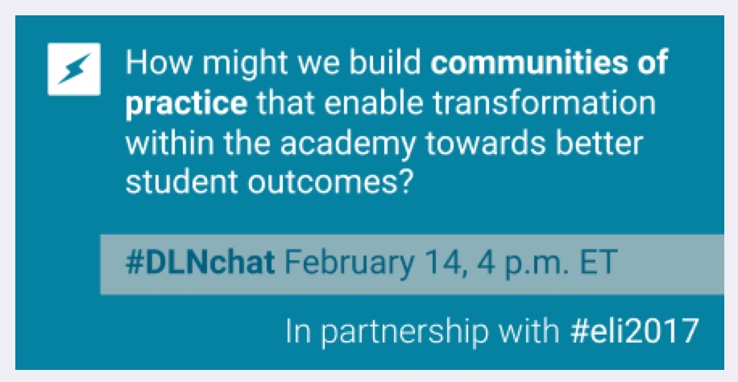
Notes:
Veronica

Slide 16
Using the CWiC Framework to Improve Your Courseware Selection and Implementation Wednesday, February 15 9:30am - 10:15am ET | Fort Bend Highlights three use cases of the CWiC Framework—initial courseware exploration, courseware procurement, and course evaluation—and will include real-time discussion with institutional leaders about how they have used the CWiC Framework to address various goals and challenges related to online/blended learning.
Notes:
Veronica

Slide 17
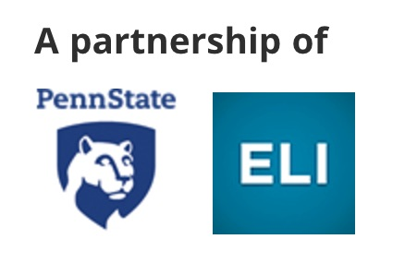
Cross-Institutional
Professional Development for
Instructional Designers
…………….
http://tinyurl.com/id2id
Notes:
Veronica

Slide 18
http://tinyurl.com/design17
Notes:
Veronica
Includes badge

Slide 19
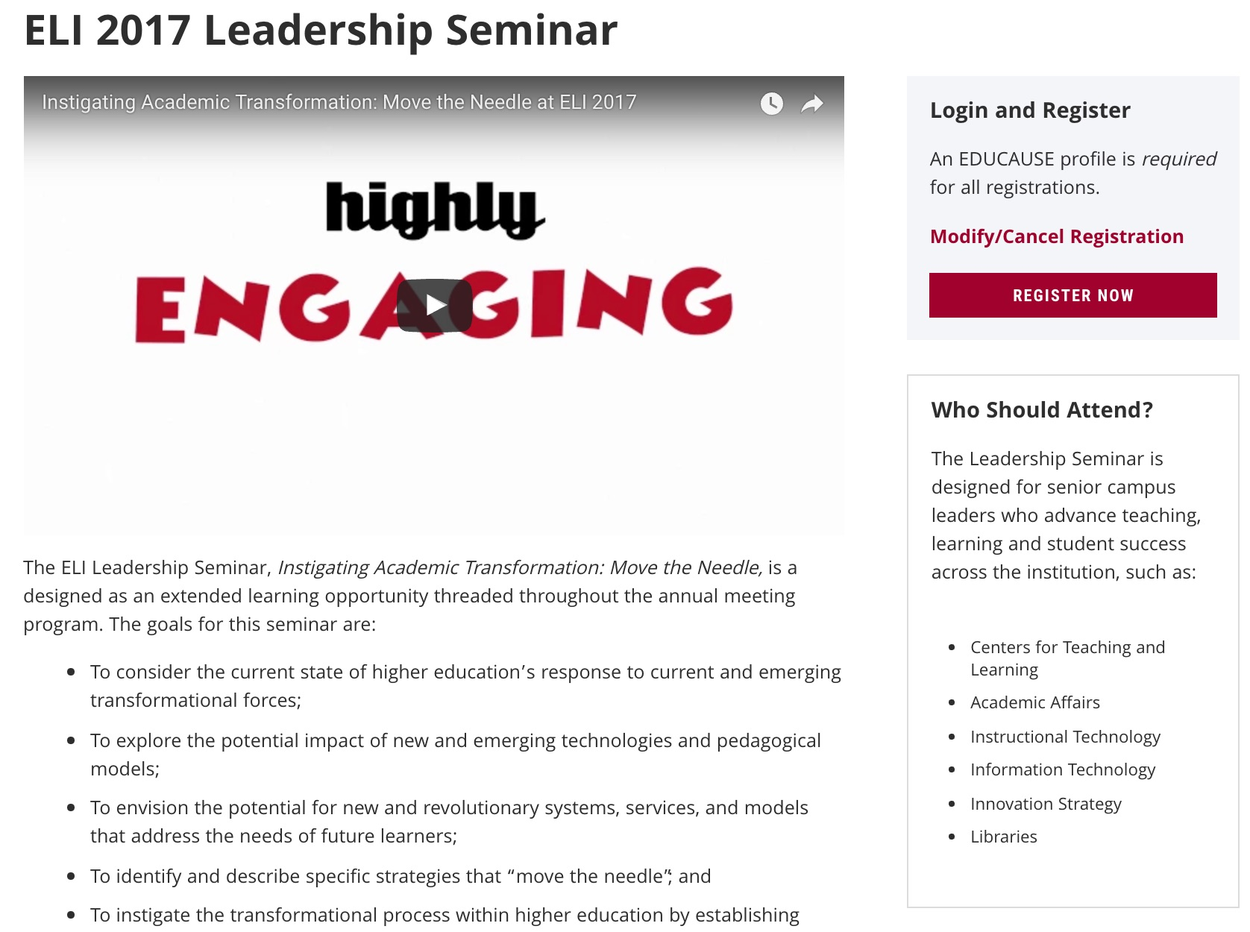
https://events.educause.edu/eli/annual-meeting/2017/agenda/leadership-seminar
Notes:
Veronica

Slide 20
Special Interest Meetings
Check out the whole list
EDUCAUSE Instructional Design Constituent Group
Liberal Arts Colleges Roundtable Discussion
Leading Academic Transformation (LAT) Roundtable
Notes:
Veronica

Slide 21
CFP: Late June 2017
General/Featured Sessions
Preconference Seminar
Interactive Presentation
Short Presentation Pairs
Discussion Circles
Hands-On Workshops
Poster Sessions
Corporate and Campus Solutions
Notes:
Veronica

Slide 22
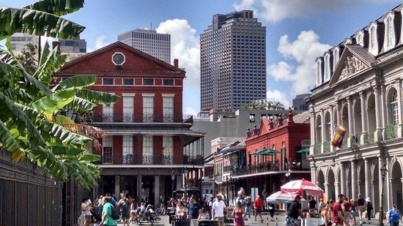
ELI Annual Meeting 2018 January 29–31, New Orleans, LA
Notes:
Veronica

Slide 23
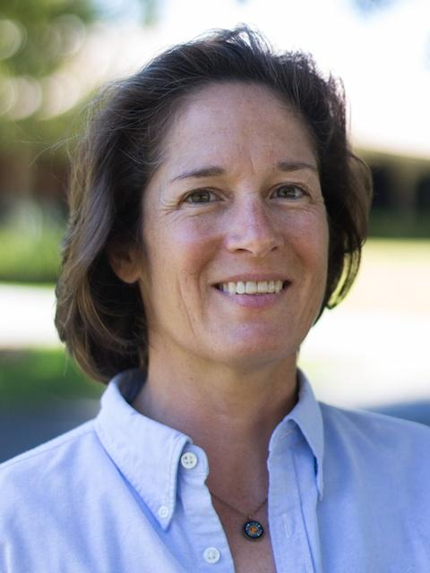
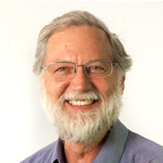
Beth McCullough
Director
Learning Environments Integration
Stanford University
Don Carter
Director
eLearning Center
Northern Arizona University

Slide 24
EDUCAUSE 2017 Membership Overview Tuesday, February 14 4:15pm - 5:00pm CT | Montgomery
http://tinyurl.com/elimember
Notes:
Veronica

Slide 25
Stay in Touch
ELI Forum
http://tinyurl.com/eliforumjoin
Malcolm Brown
mbrown@educause.edu
Veronica Diaz
vdiaz@educause.edu
Notes:
Veronica

Slide 26
OPEN QA … http://tinyurl.com/elinew
Notes:
Veronica

