Slide 5
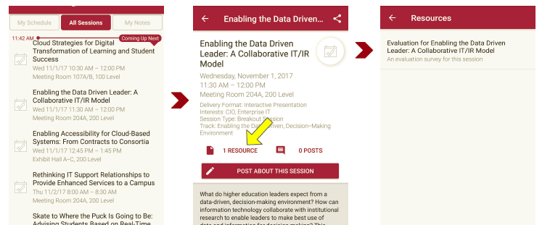
Session Evaluations There are two ways to access the session and presenter evaluations:
1
2
In the online agenda, click on the “Evaluate Session” link
From the mobile app, click on the session you want from the schedule > then click the associated resources > and the evaluation will pop up in the list

