Slide 5
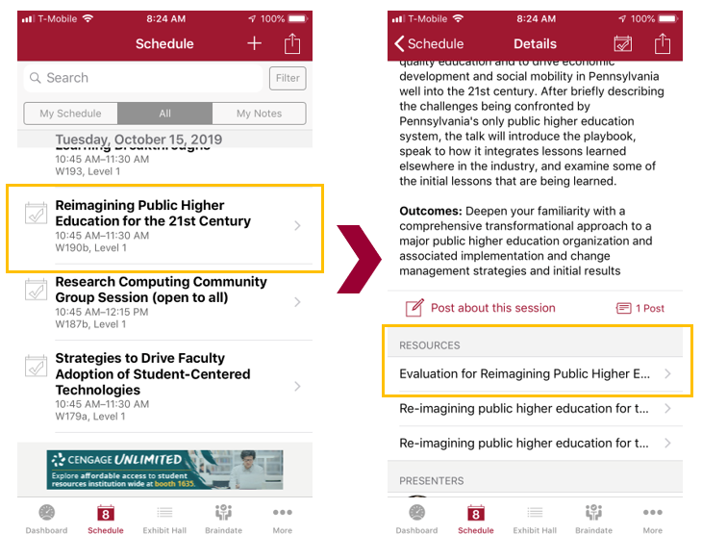
Session Evaluations There are two ways to access the session and presenter evaluations:
1
2
In the online agenda, click on the “Evaluate Session” link
From the mobile app, click on the session you want from the schedule > then scroll down to Resources > the evaluation will be listed > click on it to fill out the evaluation

Slide 6
Contact Information
NOTE: This presentation leaves copyright of the content to the presenter. Unless otherwise noted in the materials, uploaded content carries the Creative Commons Attribution 4.0 International (CC BY 4.0), which grants usage to the general public, with appropriate credit to the author.

