Slide 1
EDUCAUSE Analytics Services
Leah Lang, Director of Analytics Services
October 2, 2018

Slide 4
Core Data Service (CDS)
What is it?

Slide 5
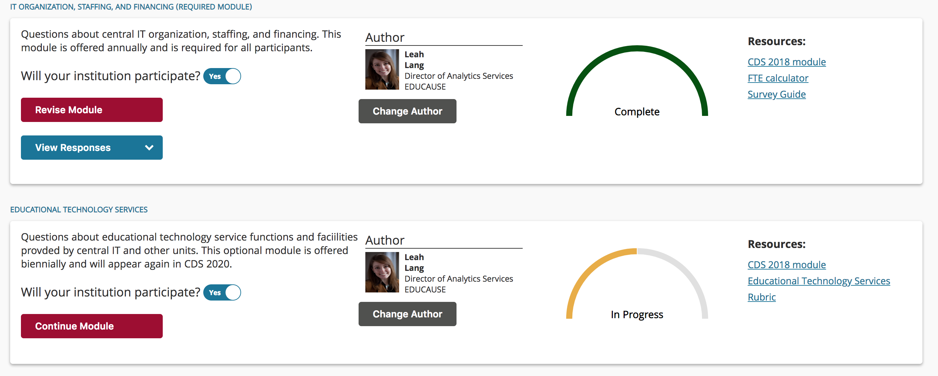
Take the survey
Notes:
Between 780 and 850 participants annually
Survey open from July – November each year
Data available Jan – November each year
You only get access to the data if you participate

Slide 6
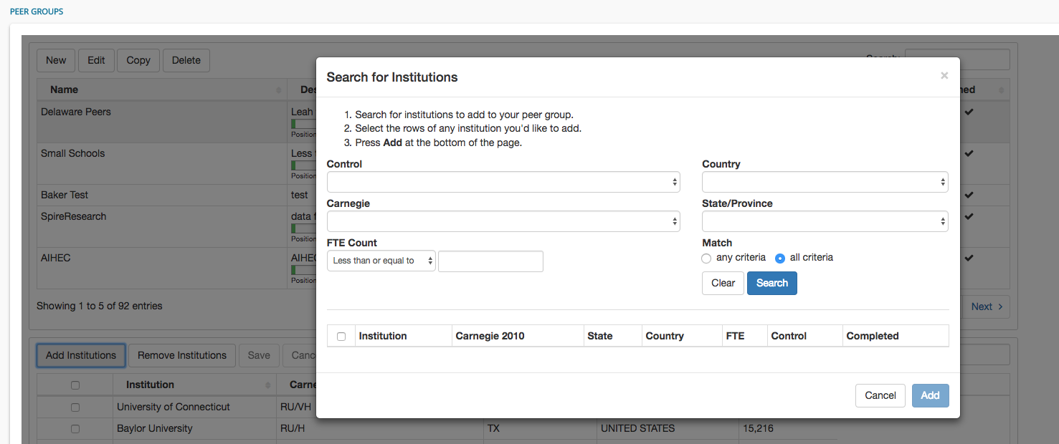
Create a Custom Peer Group

Slide 7
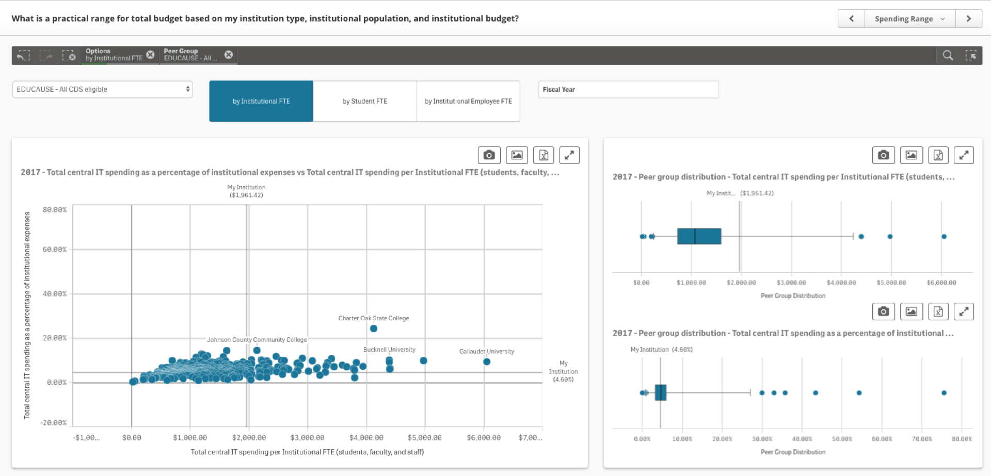
Get the data

Slide 8
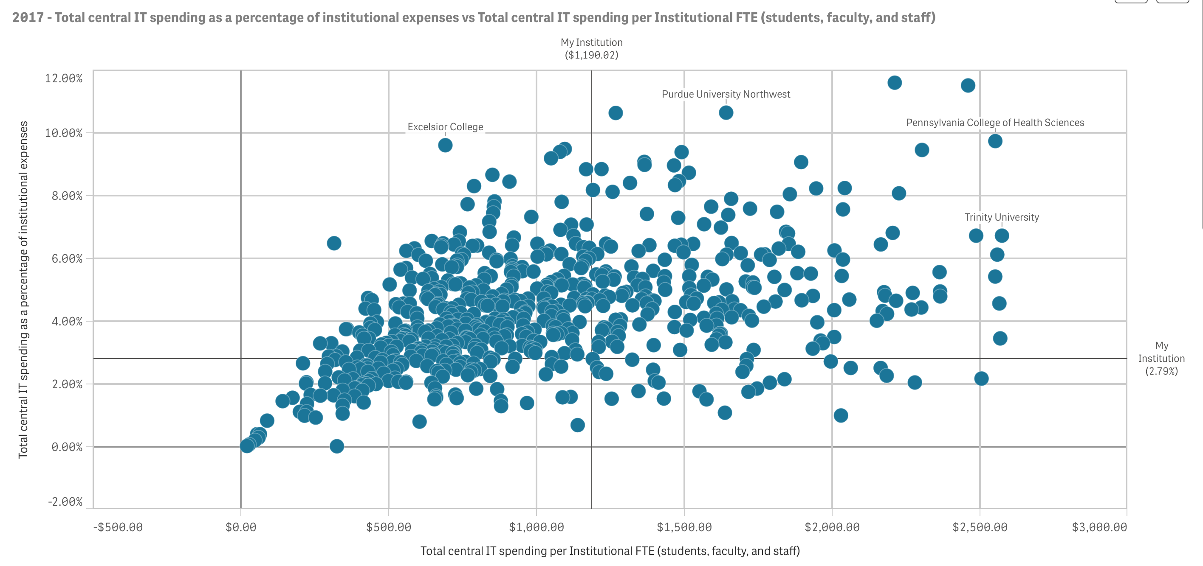
Popular Metrics

Slide 9
2017 Data Available Now
IT Financials and Staffing
IT Support Services
Research Computing
Information Systems and Applications
IT Systems, HR, Financial, Facilities, Enterprise, Research Administration
Maturity Indices
IT Service Management, Student Success Technologies, Research Computing, ITGRC
Deployment Indices
Student Success Technologies, Research Computing

Slide 10
2018 Data Collection
IT Financials and Staffing
Educational Technology Services
Information Security
Information Systems and Applications
IT Systems, Advancement, Academic, Student Services
Maturity Indices
Educational Technology Services, Student Success Technologies, Disaster Recovery, Information Security, Analytics
Deployment Indices
Educational Technology Services, Student Success Technologies, Information Security, Analytics

Slide 11
Core Data Service (CDS)
What is it?
Who participates?

Slide 12
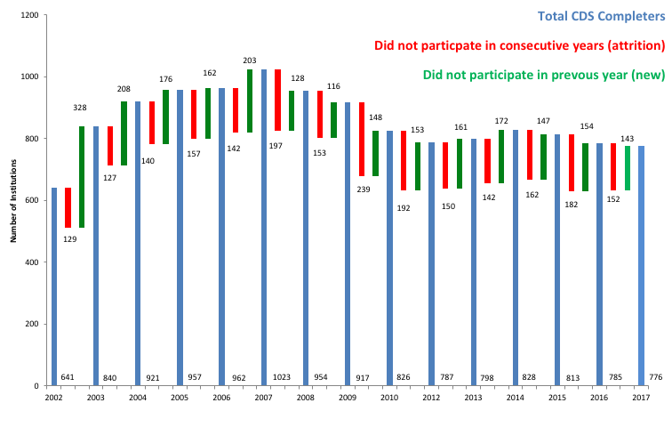

Slide 13
776 Participating Institutions in 2017

Slide 14
776 Participating Institutions in 2017

Slide 15
4,142 Unique Users (Dec 2016-present)
Notes:
40% authors
56% reviewers
32% some other role
25% PR
11% CDS Managers

Slide 16
Core Data Service (CDS)
What is it?
Who participates?
What do we need you to do?

Slide 17
Core Data Service (CDS)
What is it?
Who participates?
What do we need you to do?
Submit data – due 10/19

Slide 18
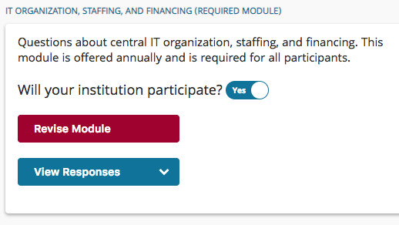
1. Decide which modules to complete.
IT Organization, Staffing, and Financing
Educational Technology Services
Information Security
Information Systems and Applications
Capability and Technology Deployment

Slide 19
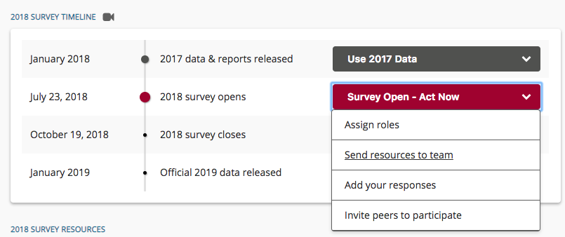
2. Delegate!
Review modules and find the best respondents.
Assign module author roles.
Send resources to your team.

Slide 20
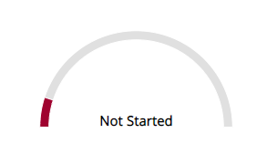
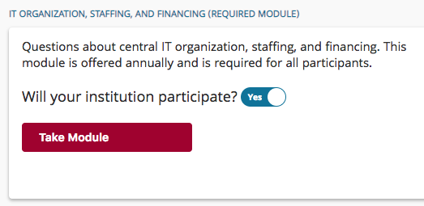
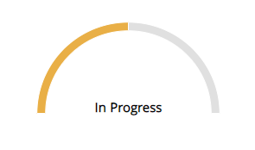
3. Add your responses.

Slide 21
Core Data Service (CDS)
What is it?
Who participates?
What do we need you to do?
Submit data – due 10/19
Promote use on your campus
Notes:
Promote use
Let people know about the topics in the survey from year to year
Get them access to the data and remind them that it is there
Assign roles

Slide 22
1. Identify data users
Data on… | Is great for…
IT Financials and Staffing | CIOs, CBOs, Finance Directors
IT Support Services | Help Desk/Service Desk Managers
Educational Technology Services | Teaching and Learning Directors, Learning Space Managers, Center for Teaching and Learning
Research Computing | CIOs, Research Computing Directors
Information Security | CIOs, CISOs
Information Systems | CIOs, IT Directors who are planning system implementations or upgrades
Analytics | CIOs, IR Directors
Student Success Technologies | CIOs, Directors of Student Success
Disaster Recovery | CIOs, Risk Officers, Infrastructure Directors,

Slide 23
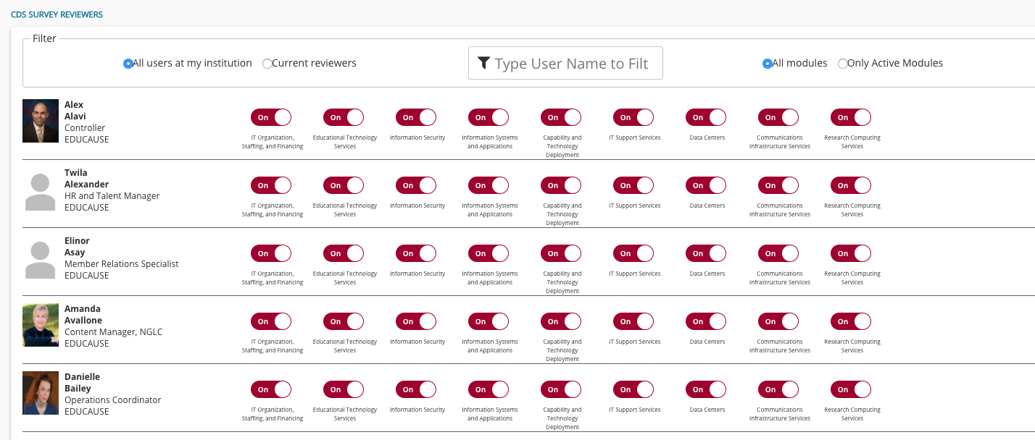
2. Assign Reviewer Roles

Slide 25
EDUCAUSE Technology Research in the Academic Community (ETRAC)
What is it?

Slide 26
2019 EDUCAUSE Student Study Timeline
October 2018- January 2019
January 2019 - April 2019
July 2019
Finalize local survey implementation logistics
Choose dates
Draft invitations
Create a marketing plan
Data file will be accessible on the ETRAC portal
Raw data
Benchmarking data
Review your institution's primary rep and survey administrator status
Complete planning forms
Implement your survey
Send out links to students/faculty
Monitor response rates

Slide 27
Notes:
Available online for your perusal and edification

Slide 28
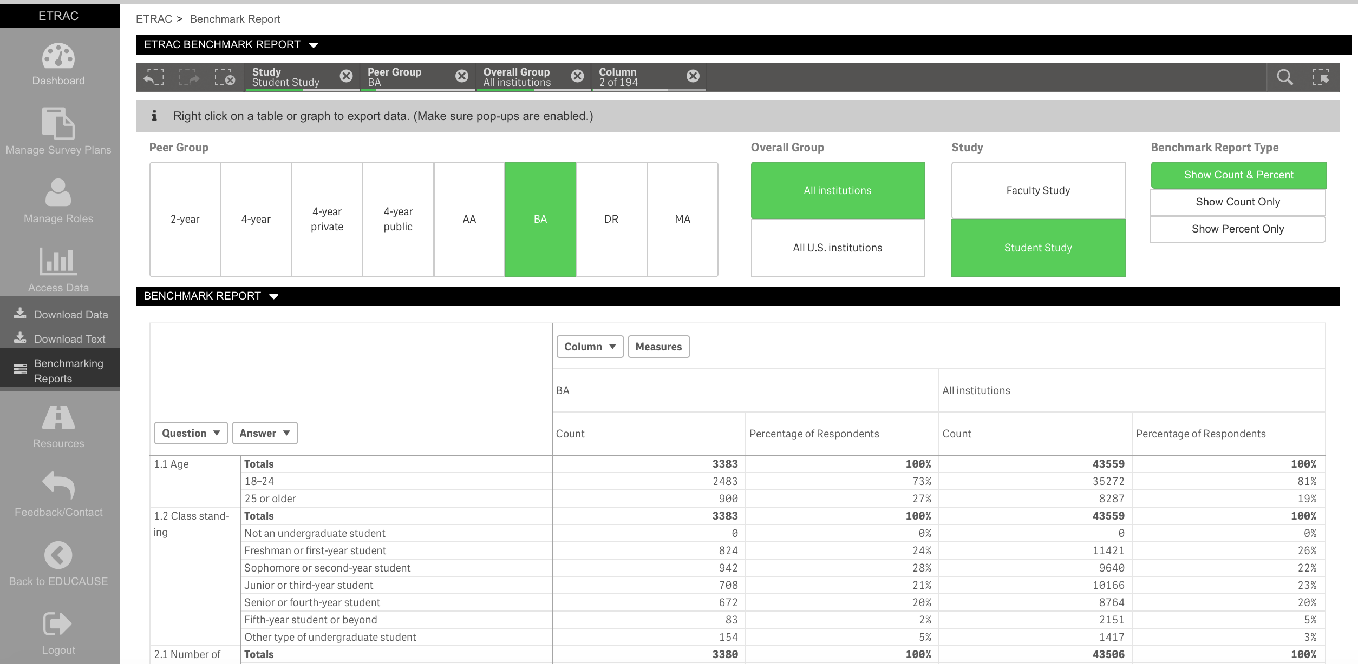

Slide 29
2017 report topics
Device ownership
Campus technology experiences
Security training and practices
Sources of technology support
Classroom technology experiences
Desired technologies for teaching and learning
Student success technology evaluations
Perspectives and preferences for teaching and learning environments
Classroom mobile experiences and policies
Notes:
Overarching themes
Experience of IT on campus
Includes classroom device policies
Opinions about IT use
The LMS
We asked a bunch of Qs about the LMS
But from those Qs
We have some findings that speak to work on NGDLE
Learning with technology

Slide 30
EDUCAUSE Technology Research in the Academic Community (ETRAC)
What is it?
Who participates?

Slide 31
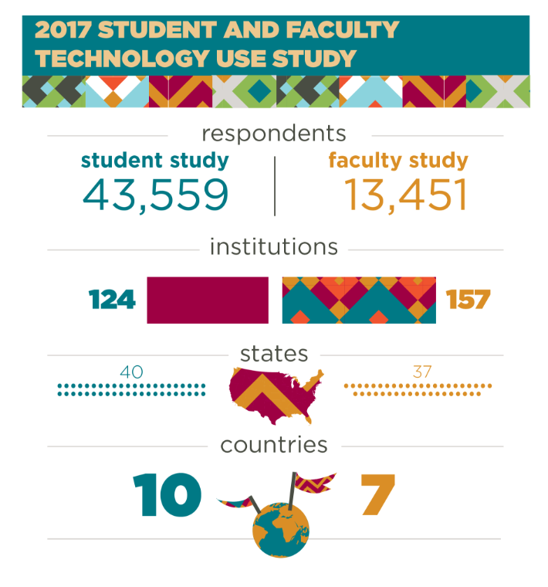
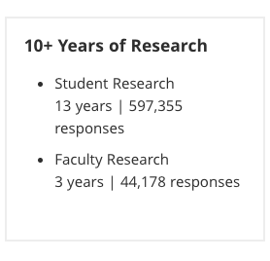

Slide 32
With what other departments, units, or individuals do you anticipate sharing the student response data you will receive from ECAR?

Slide 33
How do you anticipate the student response data from the survey will be used at your institution?

Slide 34
EDUCAUSE Technology Research in the Academic Community (ETRAC)
What is it?
Who participates?
What do we need you to do?
Sign-up!

Slide 35
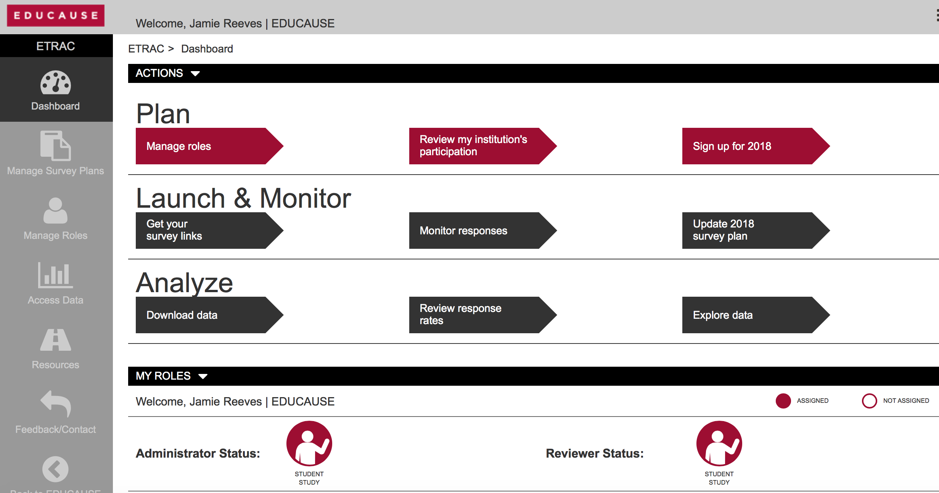

Slide 36
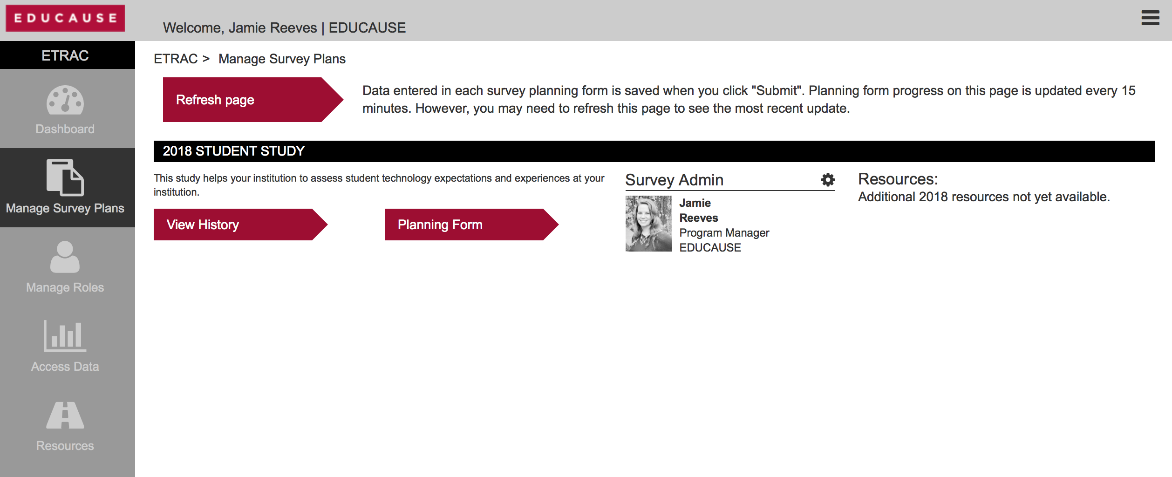

Slide 38
Custom Analytics Examples
Custom CDS Module
Aggregate analysis for non-participants

Slide 39
Resources
www.educause.edu/coredata
www.educause.edu/etrac
benchmarking@educause.edu

