Slide 1
Inside Scoop:
Cybersecurity Program
April 3, 2019
Notes:
We’re here to tell you a little bit more about the EDUCAUSE Cybersecurity Program.

Slide 2
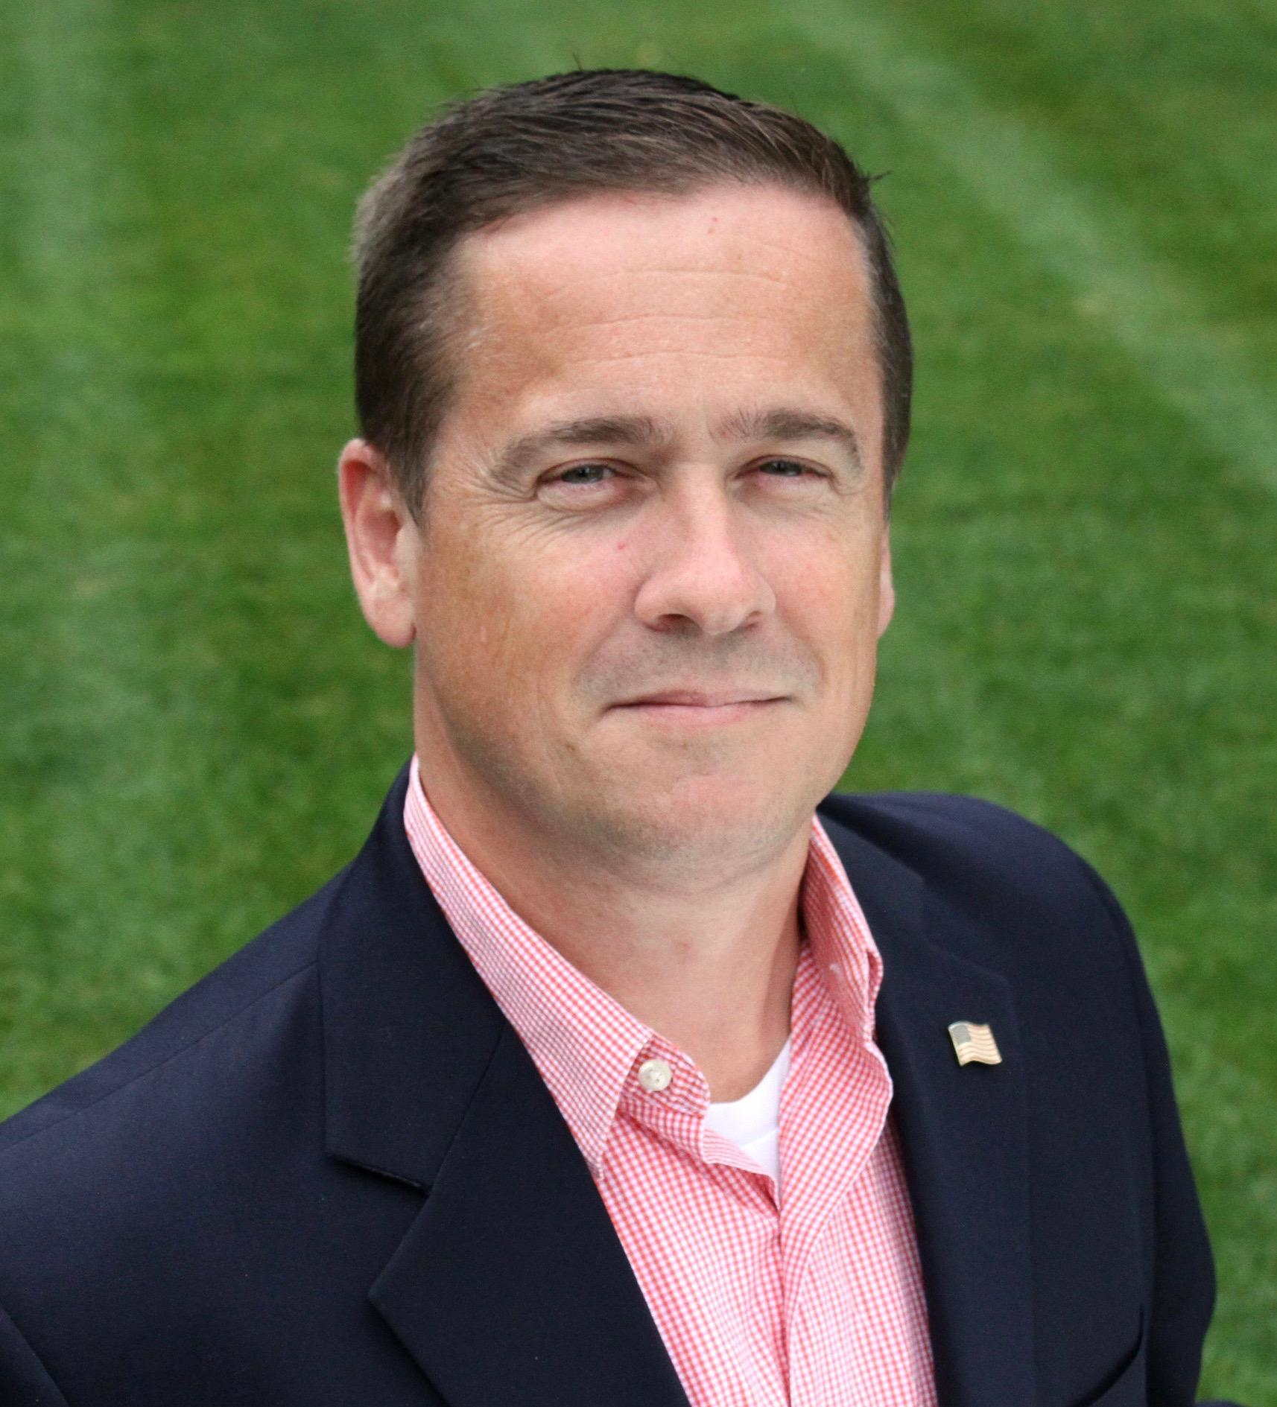
EDUCAUSE Cybersecurity Program Staff
Brian Kelly joined EDUCAUSE on March 4 as the Cybersecurity Program Director. He previously served as the CISO at Quinnipiac University.
Valerie Vogel is Senior Manager of the EDUCAUSE Cybersecurity Program.
Notes:
Brian’s intro.
Val’s intro.

Slide 3
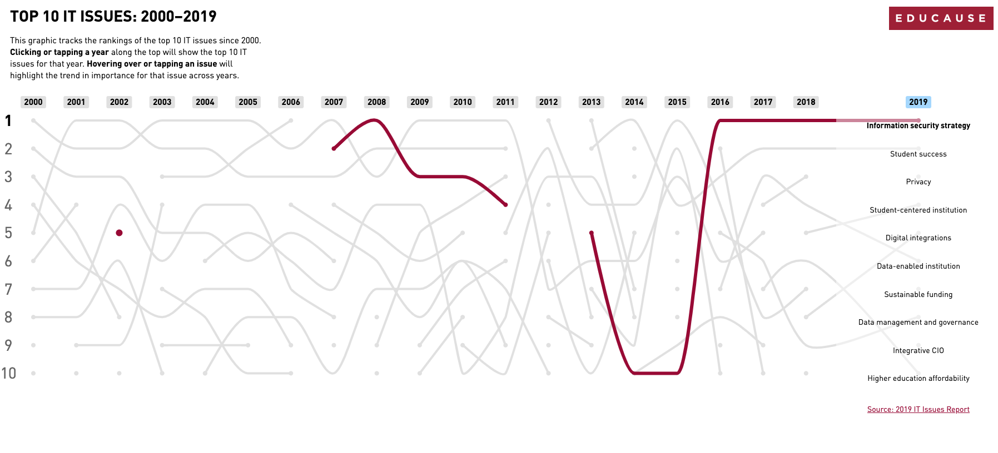
https://www.educause.edu/itissues
Notes:
For the fourth year in a row, information security tops the Top 10 IT Issues list.
For the first year, privacy makes an appearance on the list at #3.
Information Security Strategy and Privacy are part of the theme, Trusted Data. In addition to collecting, securing, integrating, and standardizing data, campuses are preparing to use data meaningfully and ethically.
Article published in EDUCAUSE Review in January discusses the yin-and-yang concepts of security and privacy: https://er.educause.edu/articles/2019/1/the-yin-and-yang-of-security-and-privacy

Slide 4
CDS 2018 Data
51% of US institutions are part of 3 or more multi-institutional collaborations related to information security (up from 46% in 2016).
The percentage of institutions that have a dedicated person whose primary responsibility is information security rose from 34% in 2016 to 41% in 2018.
There was an increase in performing risk assessments due to regulatory requirements from 39% in 2016 to 48% in 2018.
Central IT spending on information security (including identity and access management) as a percentage of total central IT spending increased from 3% in 2016 to 4% in 2018.
Notes:
Here are a few interesting data points from the EDUCAUSE Core Data Service (CDS). This information will be available in mid-April when we publish a new Information Security Almanac using CDS data from the 2018 survey.
Note: The Information Security module is included in the CDS survey every other year (e.g., 2016, 2018).
https://www.educause.edu/research-and-publications/research/core-data-service
Point 1: REN-ISAC, Internet2, US FBI InfraGard program, and HEISC were the most common responses. For comparison, the number was 46% in 2016.
Point 2: This means that more than half of responding institutions do not have someone who is a full-time information security leader, like a chief information security officer (CISO). The 2018 data is a sign that institutions are dedicating more resources to information security FTE. In a review of responses to a recent EDUCAUSE Maturity Index on information security, institutions that indicated they had an individual with institution-wide information security responsibility and authority written into their job description (this may be the CIO, CISO, CSO, or other) scored higher on the overall maturity index and on each dimension than institutions reporting otherwise.
Point 3: Our community finds value in information sharing as regulatory requirements are increasing.
Point 4: This increase is significant, but many institutions still face budget and staffing shortfalls when compared to demand. The community responded with a three-part publication series Budget Conscious Information Security Resources to help under-resourced institutions set up and maintain information security programs. We also have many examples of ways that institutions are collaborating and sharing services (regional groups, SOCs, virtual CISOs, etc.).

Slide 5
EDUCAUSE Cybersecurity Program
Higher Education Information Security Council (HEISC)
Annual Security Professionals Conference
Information Security Guide
Working Groups & Community Groups
Security Matters blog column in EDUCAUSE Review
Partnerships
https://www.educause.edu/security
Notes:
HEISC refers to our community’s volunteer efforts and it is the volunteer-driven part of the EDUCAUSE Cybersecurity Program. In addition to the work of HEISC, the Cybersecurity Program includes our internally prepared activities, which might include research publications, articles, presentations to the community, and outreach to other organizations.
The EDUCAUSE Cybersecurity Program—established in July 2000 through an NSF grant, and formalized as a program in 2003—is designed to support higher education institutions as they improve their campus information security governance, compliance, data protection, and privacy programs. This work is accomplished through strong volunteer groups supported by EDUCAUSE staff, as well as collaborations with other organizations that address information security and privacy in higher education.
Working groups include:
Awareness and Training
Governance, Risk, and Compliance
Technologies, Operations, and Practices
Higher Ed Chief Privacy Officers
Information Security Guide Editorial Board
Security Conference Program Committee
Shared Cloud Security Assessments (Phase IV is just starting with a new team of volunteers)
Community Groups include:
Security
Privacy
Identity & Access Management
Others we’ve collaborated with in the past (e.g., CIO, IT Communications)
Partnerships
REN-ISAC
Internet2 and InCommon
NCSA (NCSAM & DPD)
SANS (Security Awareness Summit, August 7-8 in San Diego; annual Security Awareness survey and report)
AACRAO (session with the National Student Clearinghouse at their spring 2019 conference)
AACC (workshop at their spring 2019 conference)
Other higher ed associations like NACUBO, NACUA, ACE, etc.

Slide 6
#Security19
#Security19
https://www.educause.edu/sec19
Notes:
The Security Professionals Conference is the premier forum for connecting with higher education information security and privacy professionals. This is the one higher ed event that gives our attendees a chance to network and discuss information security and privacy trends and current issues with peers and solution providers over three days.
This year’s conference is May 13–15, in Chicago. We offer a full day of in-depth, hands-on workshops followed by two days of track sessions, lightning talks, networking activities, and a keynote by Wendy Nather (Duo Security/Cisco).
2019 Chair: Jacqueline Pitter, Reed College; 2019 Vice Chair (and 2020 Chair): Jesse Bowling, Duke University
This conference has grown from a 100-person workshop first held in Temecula, CA in 2003 to a 3-day event with over 500 attendees for the past 4 years. In 2018, we had a record number of attendees: over 830. We expect ~900 attendees this year. In 2020, the conference will be April 21-23 in Bellevue, WA with room for 1,100 attendees.
We typically receive between 100-150 proposals and we can usually accept 60-80 proposals.
Note: Participants can claim credits for their privacy and security certifications (up to 11 hours of CPE credits for the main conference and up to 6 additional hours of CPE credits by attending the workshops).

Slide 7
Created by and for higher ed security and privacy professionals .
Based on ISO, NIST, and other common industry-recognized security and privacy frameworks
https://www.educause.edu/security/guide
Notes:
Effective practices and solutions created by and for higher infosec and privacy professionals. This is a resource for campus practitioners.
17 chapters
Over 2 dozen toolkits
Constantly under revision and review, with new materials added regularly

Slide 8
Annual Campus Security Awareness Campaign
National Cybersecurity Awareness Month (October)
Data Privacy Day (January 28)
Notes:
Campuses can use our cybersecurity (and privacy) awareness resources to plan campaigns during National Cybersecurity Awareness Month in October, Data Privacy Day on January 28, and year round.
EDUCAUSE supports security awareness in higher education with the year-round Campus Security Awareness Campaign, a framework that assists information security professionals and IT communicators as they develop or enhance their security awareness plans. Monthly topic features in the EDUCAUSE Review Security Matters column include ready-made web and social media content that makes it easier to keep a steady stream of security and privacy best practices prominent in campus communications. The 2019 content was published in December 2018.
Data Privacy Day 2019:
EDUCAUSE hosted a free webinar, “Artificial Intelligence in Education: Legal Considerations and Ethical Questions,” with Elana Zeide (PULSE Fellow in Artificial Intelligence, Law & Policy at UCLA). The January 29, 2019 event had 165 participants. Published resources include a webinar recording and transcript.
More than 90 colleges and universities signed up as Data Privacy Day Champions in 2019 (an increase from 80 in 2018).
EDUCAUSE maintained a Data Privacy Day website to provide the higher education community with free privacy resources, including a guest blog published in the EDUCAUSE Review Security Matters column that shared ideas for campus privacy awareness activities or events. Since one day is not nearly enough time to focus on the privacy topics most important to higher education, so colleges and universities are encouraged to plan privacy awareness activities and events throughout the months of January and February.
EDUCAUSE registered as a Data Privacy Day 2019 Champion. This is our 8th year supporting NCSA and Data Privacy Day in higher ed.
NCSAM 2018
Over 260 higher education institutions showed their support as official champions (an increase from 206 higher ed champions in 2017).
248 attendees joined the October 11 EDUCAUSE Live! webinar with guest speaker, Robert Jorgensen, who discussed Utah Valley University’s Campus-Wide Two-Factor Authentication (2FA) Saturation Campaign. Daniel Stern, DHS Branch Chief for Cybersecurity Education and Awareness, Office of Cybersecurity and Communications, helped kick off this NCSAM online event. This was the fourth highest attended online event for EDUCAUSE in 2018. Since the webinar, there have been 307 on-demand views of the recording. (That is the second highest number of on-demand views of an EDUCAUSE webinar in 2018. Our security and privacy online events are consistently popular with the higher ed community.)

Slide 9
Preparing for NCSAM 2019 (October 1-31)
NCSAM Champions
#CyberAware on social media
NCSAM Planning Guide (8-question worksheet)
Find resources (NCSA, STOP.THINK.CONNECT., EDUCAUSE)
Save the date! Free EDUCAUSE webinar: October 8, 2019
https://www.educause.edu/securityawareness
Notes:
The EDUCAUSE Live! webinar in October will focus on a security-related topic. The guest speaker will be announced by late summer.
Updated NCSAM planning resources from NCSA will be available by late spring/early summer. If there are resources you’d like to see created, please let us know and we’ll share those requests with NCSA.
We’ll continue encouraging campuses to join EDUCAUSE as a NCSAM champion (online sign-up should be available this summer; this is a free and easy way to show your support).

Slide 10
Key HEISC Tools & Resources
Information Security Program Assessment Tool
Budget Conscious InfoSec Resources
Information Security Almanac 2017
HECVAT (Higher Ed Cloud Vendor Assessment Tool)
CISO Resources:
Toolkit for New CISOs
Advance Your InfoSec Career
Information Security Leadership white paper
Notes:
The Cybersecurity Program offers a variety of resources developed by and for higher education information security and privacy professionals. These are some of our key resources.

Slide 11
New/Updated Resources in 2019
7 Things You Should Know About Federated Identity
Two-Factor Authentication (2FA) Lessons Learned
Revisions to the guide’s Risk Management and Incident Management chapters
InfoSec Almanac with 2018 CDS data (April 2019)
SOC Case Study (Spring 2019)
Updates to Phishing Simulation Programs and Password Managers (Spring/Summer 2019)
Security Professionals Conference 2020 CFP (Fall 2019)
Security and Privacy Awareness Resources (Fall/Winter 2019)
Notes:
Two new publications in January on federated identity and 2FA.
Revamped content in the guide’s Risk Management and Incident Management & Response chapters.
Updated Information Security Almanac using 2018 CDS data will be published in mid-April.
New/updated resources on hot topics like Security Operations Centers, phishing simulation programs, and password managers.
Security 2020 call for proposals will open in August/September. Consider submitting a proposal or inviting your team to submit.
Note: An updated infographic on the 5 key cybersecurity program resources will be available by late April/early May: https://www.educause.edu/about/discover-membership/cybersecurity-member-orientation

Slide 12
Follow Us!
@HEISCouncil
https://www.linkedin.com/showcase/heisc/
Notes:
Please feel free to contact us with additional questions: vvogel@educause.edu or bkelly@educause.edu

