Slide 1

Transforming Data Into Persona-Based Insights
PRESENTED BY:
James Willey• Patty Patria

Slide 2

Wednesday, November 01 | 3:10pm - 4:00pm ET | Meeting Room 107A/B, 100 Level
James Willey
SVP of Product Management
Ellucian
Patty Patria
VP of Information Technology
Becker College

Slide 3

2,500
18
125
1 Focus
+
Institutions
million
Partners
Higher
Education
students

Slide 4
The mission of Becker College is to deliver to each student a transformational learning experience – anchored by academic excellence, social responsibility, and creative expression – that prepares graduates to thrive, contribute to, and lead in a global society. Today, our student body comprises more than 1,900 students annually, from across the country and around the world.

Slide 5
Embracing the
entire campus
through a unified
solution
Built for users
One data source powers the entire institution
Higher focus
All functionality integrated, mobile
Role driven content

Slide 6

400
GPA | Designations | Person | Recruitment Teams | Goals
Hiatus | Marketing Lists | Bio | Employee Summary | Designations
Student Populations | Capital Campaigns | Relationships | Employee Positions | Donations
Faculty | Communications Campaigns | Emergency Info | Time and attendance | Session
Qualifications | Responses | Institutional Roles | Departments | Giving History
Advisors | Contributions | Comments | Organizational Hierarchy | Giving groups
Advisees | Telefunding | Immigration | Employment History | Communications
Schedule | Programs | SEVIS (US) | Benefits | Tender
Office Hours | Memberships | Credentials | Leave | Structure
Class Assignments | Communications | Identifiers | Status | Staff
Teaching Assistants | Events | Contact Information | Salary | Time and Effort Reporting
Workload | FA Awards | Social Media | Dependents and Beneficiaries | Work order
Contracts | Actions | Health | Employee classes | Scheduled Maintenance
Positions | Disbursements | Interests | Seniority | GEO Regions
Non-academic Positions | Packages | Military Info (US) | Personnel Action Forms (PAFs) | Prospects
Academic Committees | Loans | Organization Profile | Communications Management | Assignments
Account Summary | Grants | Contacts | Employee Tax | Stages
Payments | Title IV Grants | Membership | Contracts | Wealth Score
Financial Aid Payments | Title IV Loans | Institutions | Faculty assignments | Philanthropic Interests
Payment Plans | FA Summary | Buildings | Pay Summary | Research
Deposits | History | Rooms | Wages | Assets
Refunds | Communications | Utilization | Stipends | Ratings
Invoices | Tracking | Availability | Deductions | Activities
Cash Receipts | Applicant Profile | Locations | Leave accruals | Proposals
Cashiers | FAFSA | Campus calendar | Direct Deposit | Assets
Billing Methods | ISIR | Scheduling | Paychecks | Wealth
Billing Periods | Other applications/profiles | Events and activities | Encumbrances | Awards
Billing Tables | Need analysis data | Housing | Affordable Care Act (1095-C) | Philanthropic Interests
Charges | Cost of attendance | Judicials | W2, T4, T4A, etc | Publications
Finance charges | Unmet needs | Clubs and Organizations | Tax year end summary | Comments
Sponsors | Rules | Meal plans | Quarterly Totals | Ratings
Third party billing | Budget | Athletics | Regional | Research
Statements | Loans | Restrictions/Holds | Applicants | Matching Gift Policies
Applications | Loan applications | Communications | Applications | Corporate Hierarchy
Prospects | Loan disbursements | Courses | Candidate | Recognition

Slide 7
Student Success
Board of Trustees
Bursar
Academic Dean
Advancement Donor Relations
Budget Office
Business Unit Directors
Advancement Campaign Director
Director Admissions
Director of Athletics
Career Development
Comptroller
Director Financial Aid
Director of Annual Giving
Director of Human Resources
Department Chairs
Financial Aid Counselor
Financial Aid Loan Manager
Faculty
Director of Health Services / Counseling
Director of Residence Life
Director of Student Employment
Fundraising Manager
Facilities Manager
Institutional Research
Provost
Financial Aid Operations Manager
Financial Aid Quality
Financial Aid Director of Scholarships
President
Registrar
Grants Manager
VP Student Affairs / Dean of Students
VP Academic Affairs
VP Advancement
VP Enrollment Manager
VP Finance (CFO)
VP Human Resources
Connected Roles

Slide 8
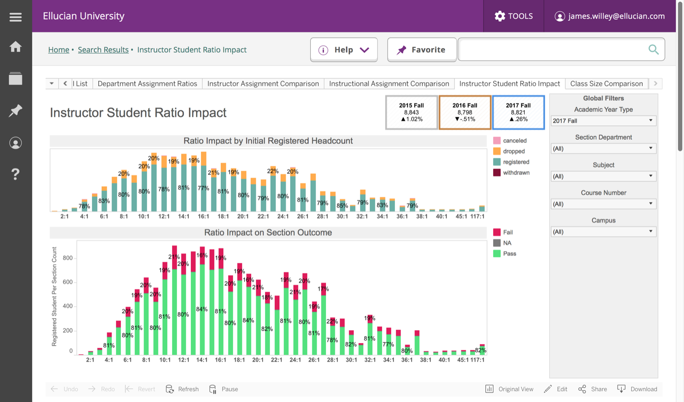
Student
As the student-to-instructor ratio increases, are there more drops and withdrawals?

Slide 9
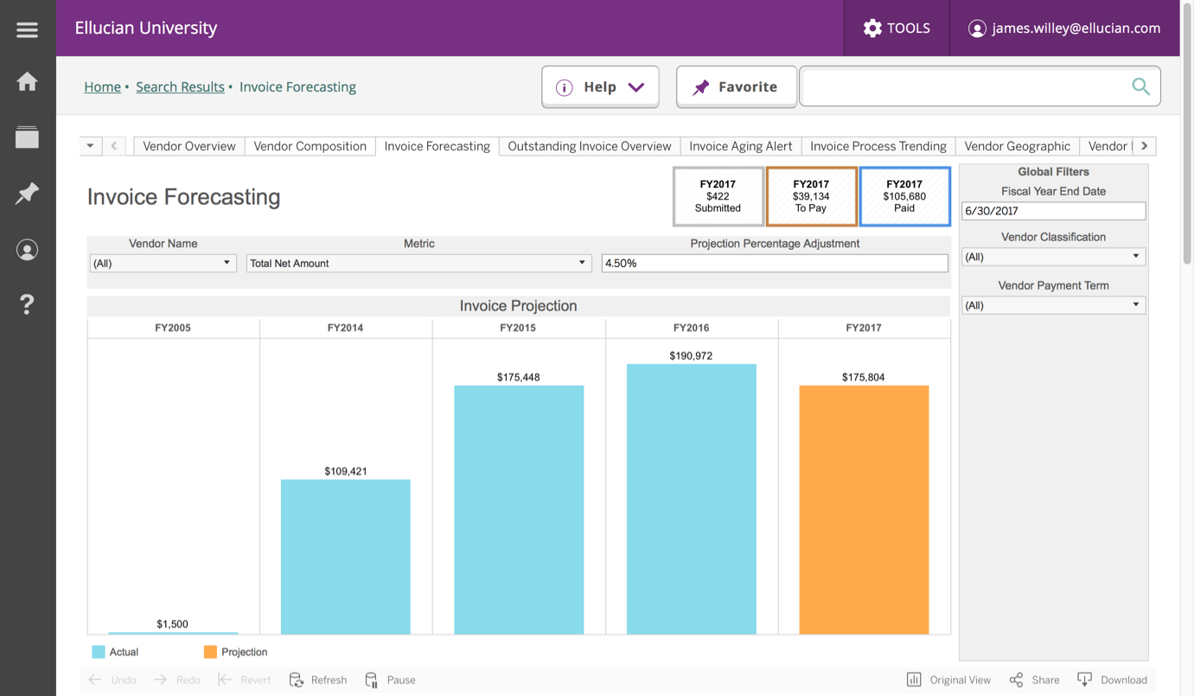
Finance
Based on a three-year average of activity with a specified vendor, how much would a discount save us?

Slide 10
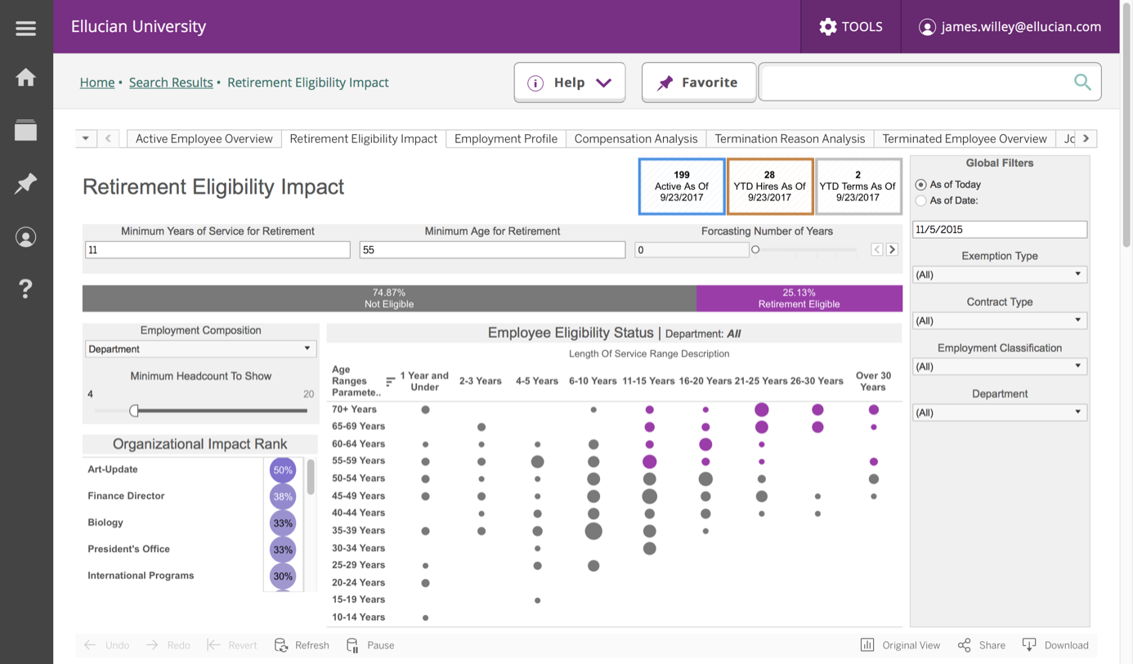
Human
Resources
What would be the impact if we change the minimum years of service?

Slide 11
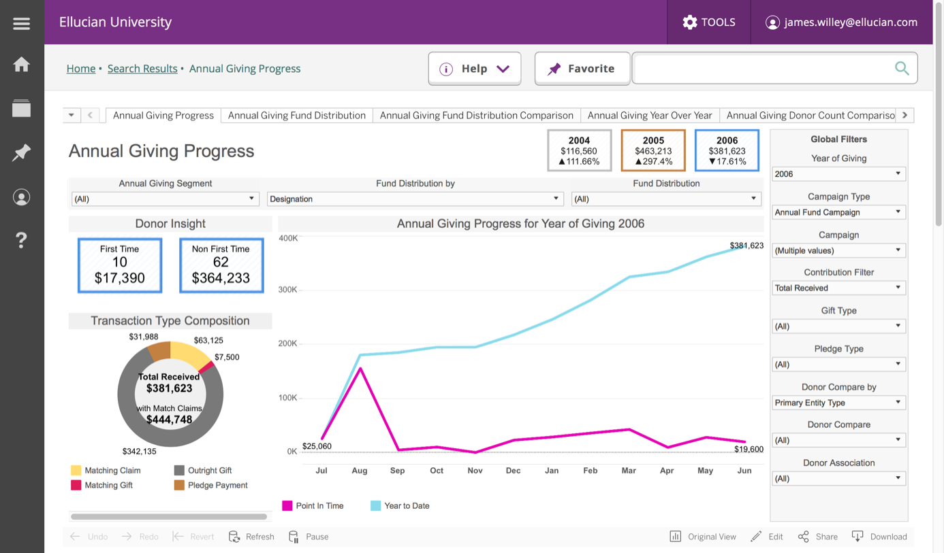
Advancement
What is the breakdown of giving by contribution transaction type?

Slide 12
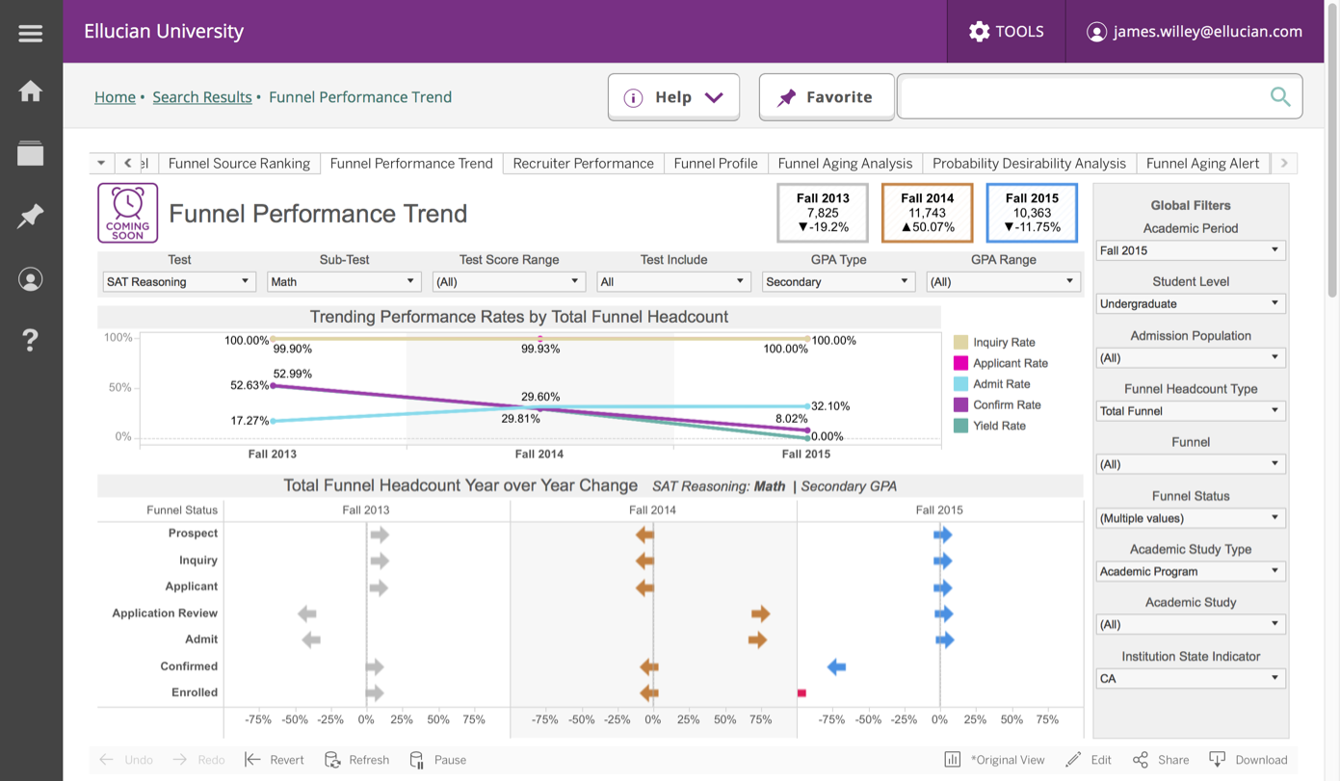
Recruitment
Are prospective student academic qualifications a predictor of yield rates?

Slide 13

?
what have we learned
What is the role of data governance? Am I starting for a uniform view?
Notes:
What if you have 90 applications all wanting student based information and they all talk in their own way or worse yet you have to define unique definitions for each of them. A primary driver of a data model is you are defined once for many, you are shifting the model from each solution having it own understanding to solution view.
Imagine helping find a student, helping them succeed, and hopefully becoming a valued alumni. The data model allows us to not only define who you are, but allows you to exist at different points in time with a common definition.
Have you ever relied on unique skills to “understand” schemas so you could join application A to B or worried about are those the right fields to use in a report or graph. The data model is design for uniformity, understandable with security in mind.

Slide 14
?
what have we learned
Does predefined role-based content improve results?

Slide 15
?
what have we learned
What does a single-data view mean and what are key functional needs moving forward?

Slide 16
?
what have we learned
What is the impact of cloud in a complex system model?

