Slide 1
Is Cloud Identity Management Ready
for Higher Education?
PRESENTED BY:
Jon Allen

Slide 2
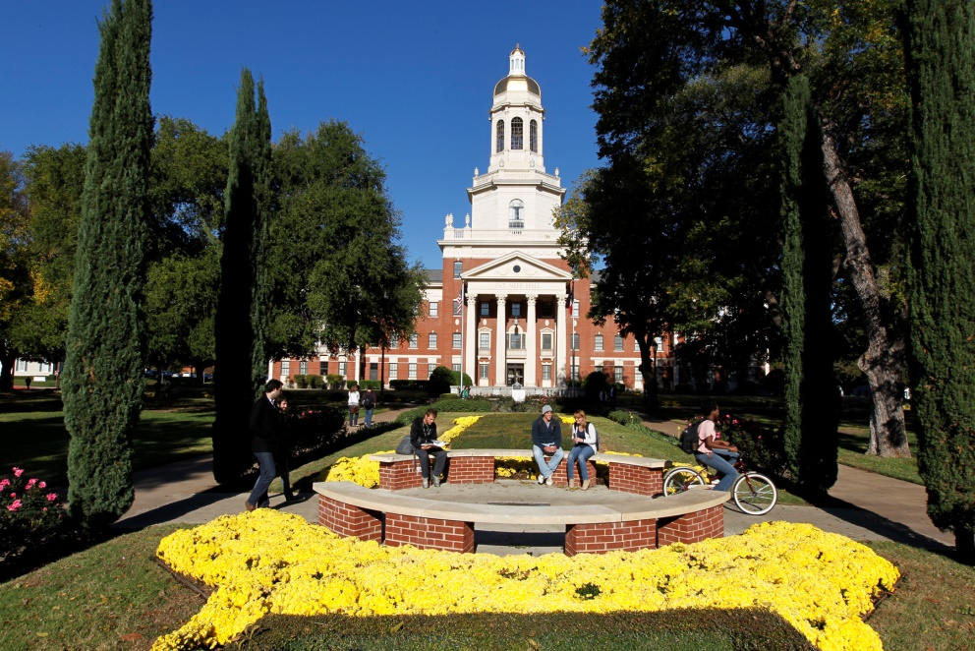
About Baylor
Chartered in 1845
Largest Baptist University in the world
17,000 students
3,000 full time employees
Waco Texas

Slide 3
Why IDM
Security lifecycle
Compliance
One of the main controls left

Slide 4
Seriously Cloud
Keys to the kingdom
It nothing sacred
IDM is security

Slide 5
History
Homebuilt scripts
Customized local database
Lack of clear ownership
Documentation was from memory and code

Slide 6
IDM is Difficult
Nothing flashy about being a plumber
Ultimate of integrations
Project failures rarely technical

Slide 7
Evaluating a Solution
Understand your needs
Technical requirements
Gather information from across the organization

Slide 8
Technical Needs
Integrations
User interface
Flexibility

Slide 9
Often Overlooked
Vendor integrations are critical
Consultants must know your business
Do you want to build the car or drive it

Slide 10
Implementation
Six months from start to Go Live
Staff must be bought in
Testing is critical

Slide 11
Integrations

Slide 12
Full Provisioning
Accounts created
Licensing managed
Authorizations

Slide 13
Soft Provisioning
Accounts created
Access approvals
Manual authorization

Slide 14
Termination List
Replaces non interactive emails
Allows for audit trail
Deprovisioning the most critical part of IDM

Slide 15
Going Live
Flipped the switch
Edge cases
Bad SOA data

Slide 16
IDM is lifecycle
Identity is constantly changing
Time spent on edge cases
Perfection is not possible

Slide 17
Lessons learned
Communication
Wrong assumptions
We want real time
Testing is good but….

Slide 18
Journey Continues
Added integrations
Further refinement
Expanding reach (applicants)

Slide 19
Vendor Assessments
Include IDM considerations
Lack of integrations open risk
HECVAT

Slide 20
Results
Account provisioning smoother
Account removal happening
Identities have owners
Self service

Slide 21
Questions?

