Slide 1
SharePoint/O365 CG
EDUCAUSE ANNUAL CONFERENCE 2017
Philadelphia, PA
Presented by:
Mike Meyer and Precious McKoy (co-leads)

Slide 2
Welcome to our newly formed
2017-2018 Steering Committee!

Slide 3
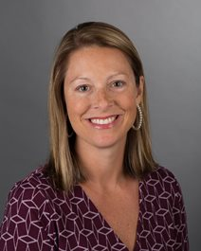
Wendi Cannon
Florida State University College of Medicine
Director of Information Technology
Wendi Cannon received her bachelor's degree in information studies from Florida State University. She began her career at the newly created FSU College of Medicine as the web technology coordinator. As the college grew, she transitioned to various positions within the IT office, and currently she is the director of information technology. She provides leadership and direction for the 30 person IT office which includes mission-critical services such as application development, database administration, server management, and statewide videoconferencing. She is a member of several committees, such as the Medical Library and Learning Resources Committee and Alumni Strategic Plan Committee, to help facilitate the role of information technology College-wide.
Wendi is chair of the TalTech Alliance, a local non-profit technology group, member of the City of Tallahassee Family First Employers Task Force, and Leadership Tallahassee Class 35 participant. She is also a member of the Alzheimer’s Association Fight to Tackle Alzheimer’s committee, Kate Sullivan Parent Teacher Association and a volunteer for FSU Opening Nights.

Slide 4
James M maher II
Saginaw Valley State University
Executive Director of Information Technology Services
With a strong focus on customer service and sharpening operational performance, Jim Maher offers a unique blend of technical expertise and strategic vision. Jim is the Executive Director of Information Technology Services at Saginaw Valley State University. He has built a responsive IT organization raising IT's visibility by bringing technology decisions to Executive and Administrative committees. He has 37+ years in the technology field, starting in the programming and development areas, then moving to networking and system administration before taking leadership positions in the early '90s. Previously, Jim worked at Covenant HealthCare as the Manager of Information Systems and led the technical team in implementing the first Electronic Medical Record system in the Saginaw Region. He received his Bachelor of Science from Saginaw Valley and his MBA from Central Michigan University.

Slide 5
Philip Nyman
University of Illinois at UC
Philip Nyman works at the University of Illinois at UC campus (40K+) and has been actively involved with SharePoint since 2001 as an administrator, developer, consultant, trainer and campus evangelist. He has taught SharePoint administration and development using SP Designer and has written several courses for end-users that he has presented on campus and at the neighboring Parkland Community College. He is part of the campus central IT department (Technology Services), a member of the Software Services group that provides software to all three campuses (Urbana, Chicago and Springfield) performing project and new infrastructure development work and is Lead Training Specialist for the campus ‘FAST3’ training group. He is also currently chair of the university SharePoint Advisory board (spanning all three campuses) and has presented SharePoint topics at university IT forums as well as educational events.
He is involved with SharePoint in addition to the work that’s part of his formal position and is interested in keeping current and working with a wider range of people so that he can share his experiences and bring new knowledge back to the campus. We have SP 2016 on-prem and an Ofc 365 tenancy.

Slide 6
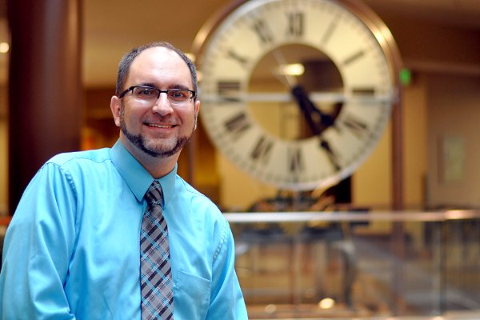
Corey Seliger
Director of Software Services
Purdue
As Director of Software Services, Corey’s teams manage the infrastructure layer of software for various services including Blackboard Learn, Banner, SAP, Microsoft Office 365, SharePoint, Exchange, and other university-wide applications. His experiences include developing middleware, designing system architecture, and implementing infrastructure, and leading people. He has worked at Purdue for over 15 years and received his Bachelor’s Degree from Purdue in Computer and Information Technologies. He is currently working a Master’s Degree in Data Analytics.

Slide 7
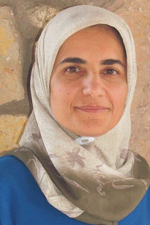
Rajaa Shindi
Project Lead
New Mexico State University
Rajaa Shindi is Systems Administrator at New Mexico State University (NMSU) located in Las Cruces, New Mexico. She is leading the NMSU’s initiative to develop an INTRANET across NMSU System. She is an expert in SharePoint migration and management technologies, and a faculty member at teaching computer information technology courses. She holds a PhD in Human Computer Interaction from NMSU where she worked on the research and development of a novel system for enhancing attention among children with Attention Disorder. Rajaa is a strong supporter of STEM, and is project leader on EDUCAUSE iPASS STEM grant to promote STEM among Middle, High School and DACC students. The grant is also to encourage the students to "think computationally" across disciplines to empower students' capability and encourage them to major in STEM.

Slide 8
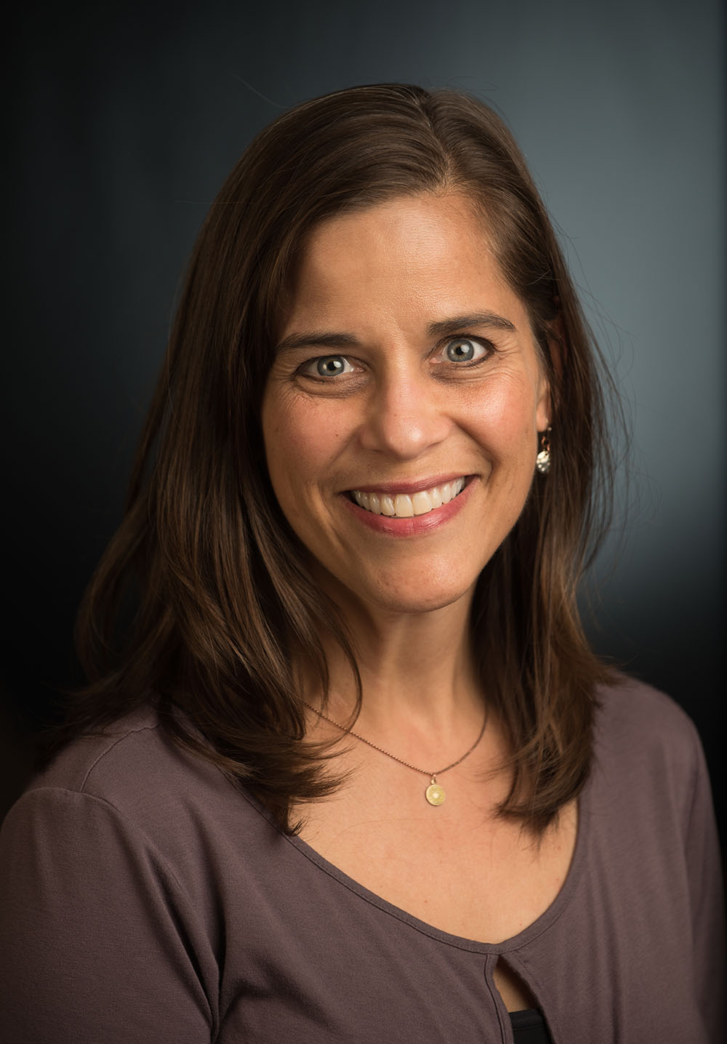
Kara Hughes
Gonzaga University
SharePoint Analyst
Kara Hughes has spent the past 5 years as the SharePoint Analyst at Gonzaga University located in Spokane, Washington. She spends the majority of her time evangelizing SharePoint solutions and working to automate business processes and training teams on the use of the platform. SharePoint sites at Gonzaga are used for internal team collaboration and for ad hoc committee work across campus. She is part of the central ITS Department and has led the effort of broadening use of SharePoint and various other Office 365 applications. She was involved in efforts to implement hybrid search to connect both the on-premises SharePoint which houses the university’s BI reports with cloud SharePoint content. Kara has worked with SharePoint for the past 10 years. Previously, Kara spent more than 15 years in the field of marketing/communications and is a graduate of the University of Washington in English Literature. She jumped into the field of IT when she noticed how the use of technology, specifically SharePoint, can inspire new ways for teams to collaborate and get their work accomplished while minimizing the use of paper-based solutions.

Slide 9
Sarah alkire
University of Washington
Systems Analyst
Sarah Alkire has been integral in the launch of SharePoint Online for an Intranet for the University of Washington. She is interested in the next iteration of the Intranet, which includes more portability across devices. She is interested in incorporating other tools, such as Bridge, a cloud LMS, into SharePoint for the next generation.

Slide 10
Gregory Frick
University of Washington
SharePoint Architect
Greg is currently the SharePoint Service Option Lead at the UW. In this role Greg works closely with departments and groups across the UW campuses to help them derive benefits from the both the UW on premises SharePoint farm and SharePoint Online. Prior to joining the UW-IT Academic and Collaborative Applications Team, Greg was the SharePoint Architect for the School of Medicine Department of Radiology. In this role Greg deployed and developed the Radiology SharePoint based Intranet. Greg holds a number of Microsoft Certifications and was a full time instructor for Quickstart Intelligence in Bellevue Washington prior to joining the University of Washington. While at Quickstart, Greg delivered over 4,000 hours of SharePoint classes and co-developed their top selling SharePoint Power User curriculum.

Slide 11
Round-table discussion

Slide 12
Jake Ducharme office 365 technical specialist Microsoft

Slide 13
Proposed Bi-monthly Conference
Calls/Webinars

Slide 14
Please mark your calendars for the following upcoming discussions:
December 2017
February 2018
Topic: CG Updates Post EDUCAUSE 2017
Desired Date: December 7, 4-5 EST
Description: We will update and debrief our CG on the discussions that have taken place during the EDUCAUSE conference.
Facilitator/s: Mike Meyer and Precious McKoy
Topic: Governance
Desired Date: TBD
Description: Campus usage of SharePoint and Office 365 applications varies greatly across higher education institution. Some dictate very specific uses of the tools and others allow for wide-open access. This conversation intends to understand what other various constituent institutions are doing in this space. What governance methods are being used, and how are they effective? What happens if lack of governance has run amok? Are there best practices being adopted as institutions continue migrating services into Office 365?
Facilitator/s: Corey Seliger

Slide 15
Please mark your calendars for the following upcoming discussions:
April 2018
June 2018
Topic: Visualizing SharePoint data using Power BI
Desired Date: TBD
Description: The ability to extract, load and transform SharePoint list and library data using Power Query and DAX is an important skillset. Creating effective dashboards that provide insight into heaps of data creates true value for an organization and helps guide decision-making and leadership.
Facilitator/s: Philip Nyman
Topic: Using SharePoint as an Intranet
Desired Date: TBD
Description: Using SharePoint as an Intranet and integrating collaborative features of other applications. In the School of Nursing, the University of Washington is using SharePoint, promoting the use of Delve, Flow, Teams, and Bridge LMS for a holistic Intranet experience.
Facilitator/s: Sarah Alkire

Slide 16
Please mark your calendars for the following upcoming discussions:
August 2018
October 2018
Topic: Using SharePoint as a Document Routing Solution
Desired Date: TBD
Description: At New Mexico State University (NMSU), we are implementing a central hub (Intranet) for our organization document sharing and routing, based on the SharePoint and O365 platform. The Intranet will be an essential gateway to the entire university for organizing internal communication. Current Model: Email, shared drives, silo systems, personal computers, One Drive, Google doc (Distributed)
Facilitator/s: Rajaa Shindi
Topic: EDUCAUSE 2018 Conference Updates
Desired Date: TBD
Description: We will discuss where to meet and what to expect.
Facilitator/s: Co-Leads and Steering Committee Members

Slide 17
SharePoint/Office 365 Meet-and-Greet
Thursday, November 02 | 3:30pm – 4:20pm ET | Community Central Collaborate Lounge (Table 2&3)

