Slide 1
Who Is Doing Our Data Laundry? EDUCAUSE 2017
Brad Wheeler, Ph.D.
IU Vice President for Information Technology, & CIO Professor of Information Systems, Kelley School of Business
This work by Brad Wheeler is licensed under a Creative Commons Attribution 4.0 International License.
October 2017

Slide 2
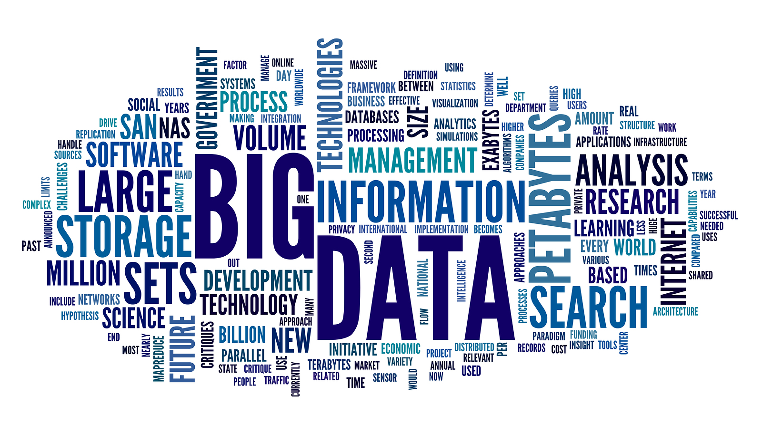

Slide 3
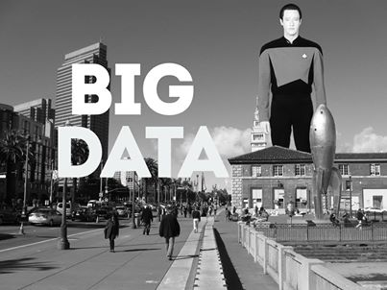

Slide 4
http://www.popsci.com/sites/popsci.com/files/styles/large_1x_/public/import/2013/images/2013/02/thinkingfyi.jpg?itok=5DXKOYXW
What should I do?

Slide 5
What’s the Campus Imperative?
Accelerate Student Success goals in terms of graduation rates, retention, course sequencing, etc
Benchmark an institution’s performance on key performance indicator ratios for efficiency and effectiveness.
Rapidly remediate information reporting and dashboards to get everyone on a common basis of facts
Enable better financial decisions by deans and department chairs as they make choices in degrees to offer, frequency of courses, and teaching assignments
Empower advisors and students with predictive information to support wise decisions in major and course selection;

Slide 6
Capital $
https://pixabay.com/en/washing-machine-laundry-tumble-drier-2668472/

Slide 7
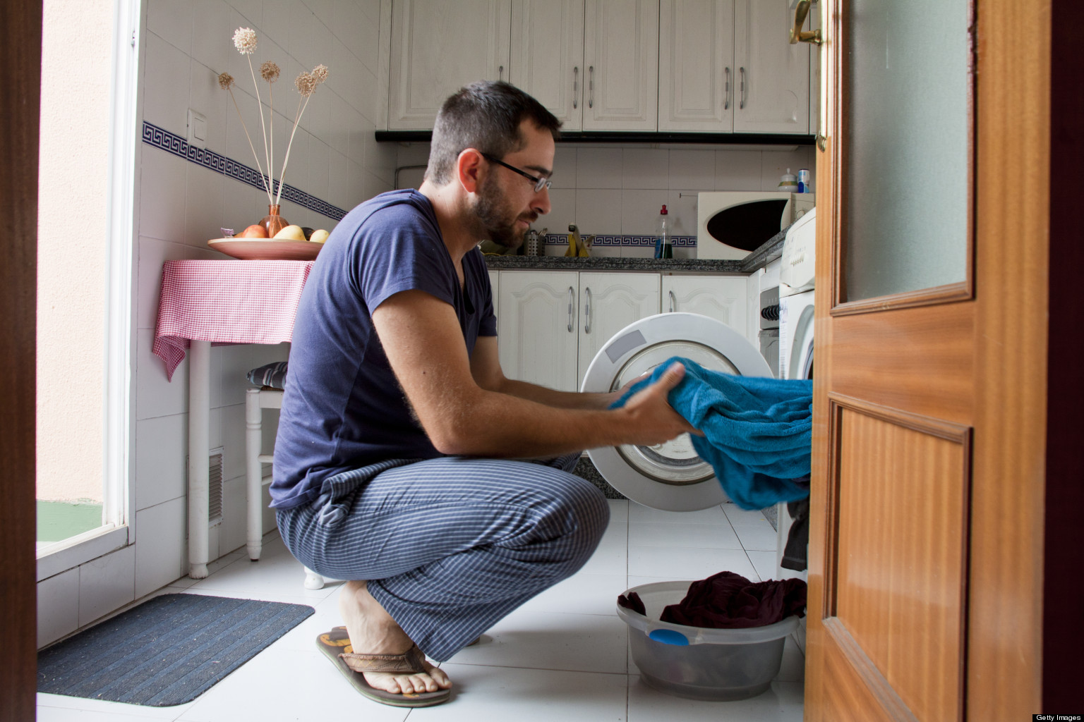
Labor & Expertise

Slide 8
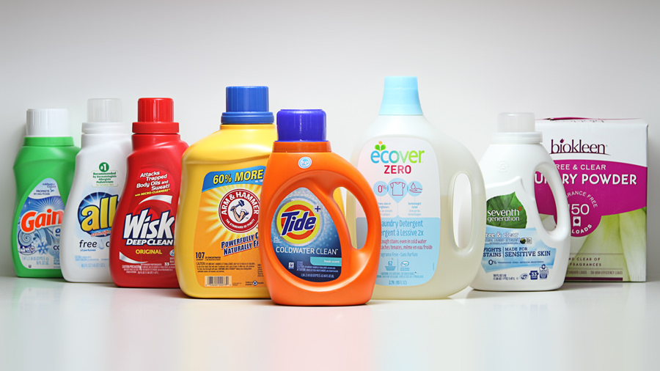
Consumables $
https://c1.staticflickr.com/3/2571/33036441516_c854330a10_b.jpg

Slide 11
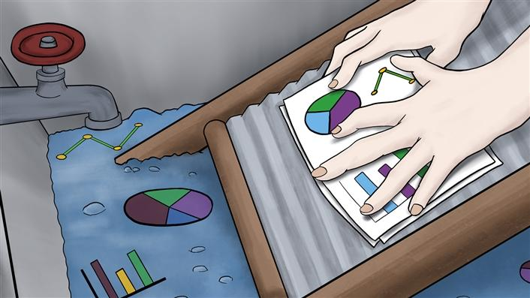
Who is Doing Our Data Laundry?
The EDUCAUSE Review Online, 13 March 2017
https://er.educause.edu/articles/2017/3/who-is-doing-our-data-laundry

Slide 12
What is Data Laundry?
“
By data laundry, I am referring to the legitimate process of transforming and repurposing abundant data into timely, insightful, and relevant information for another context. It is a mostly unseen, antecedent process that unlocks data’s value and insights for the needs of decision makers.
.”

Slide 13
Why is Our Data Laundry Piling Up?
“
Our institutions are often quite data-rich and insight-poor.
.”
Increasing pressures from external and internal forces for better decisions

Slide 14
Doing the Data Laundry
“
The data laundry work includes two distinct and sequenced phases. First, data cleaning prepares the data for reuse in a different context.... Clean data likewise needs additional work, and that is done in the second phase: data (information) presentation contextualizes the information into reports, graphs, dashboards, and decision support systems.
.”

Slide 15
Data Cleaning
Discovering
Extracting
Re-coding
Uploading
Normalizing

Slide 16
Information Presentation
Enriching
Comparing
Presenting

Slide 17
Data Laundry and the Magic Bundle
In-House
Discovering
Extracting
Recoding
Uploading
Normalizing
Enriching
Comparing
Presenting
Workflow
Outsourced
Discovering
Extracting
Recoding
Uploading
Normalizing
Enriching
Comparing
Presenting
Workflow
Learn and Revise Loop
The Magic Bundle
Red = Presumed work and expertise advantage
Thick white borders denote challenging tasks
Dashed borders indicate optional steps that may not be in every project

Slide 18
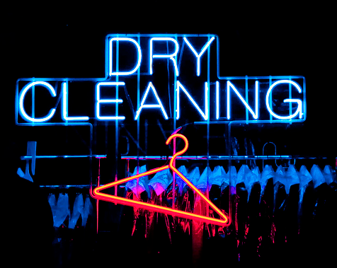
Insource or Outsource?

Slide 19
TASKS | IN-HOUSE (OR VIA CONSULTANTS) | OUTSOURCED
Discovering data sources that support the goal | Knowing where data resides in campus systems | Possibly knowing of external data sources
Extracting data from systems of record | Conducting considerable functional and technical work to extract data from core systems | Technical consulting
Re-coding data to preserve context and conform to new formats | Using local expertise or work to convey business logic and to format data | Knowledge of intended uses and models required to adapt context to new purpose
Uploading | Extensive internal reviews of uses for legal/policy compliance before data is uploaded to campus or vended systems | Technical consulting
Normalizing | Normalizing data to new context and as inputs for models | Normalized to vendor’s models
Enriching | Enriching with local predictive models | Enriched with vendor’s predictive models or peer benchmarks
Comparing | N/A or internal within/across an institution | Enriched with normalized peer group comparisons
Presenting | Providing dashboards, screens, reports | Dashboards, screens, reports
Workflow (often never achieved) | Integrating the new presentations into workflow and other campus systems | Technical consulting

Slide 20
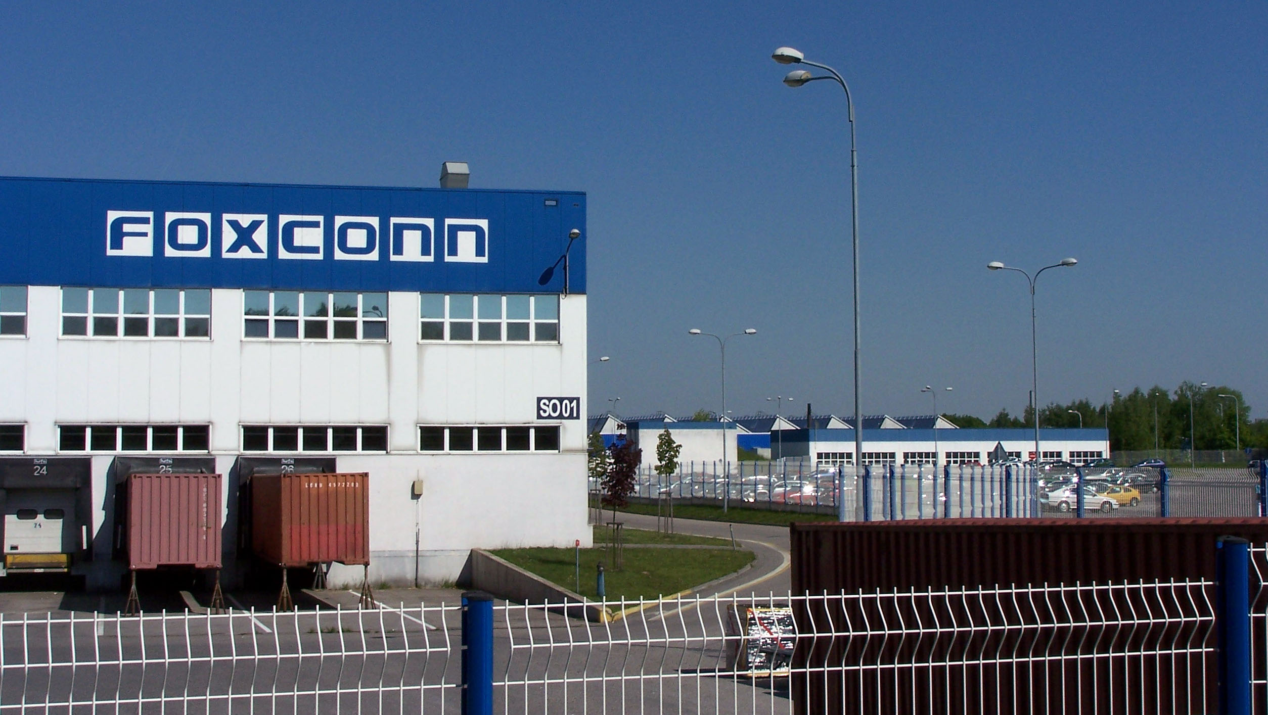

Slide 21
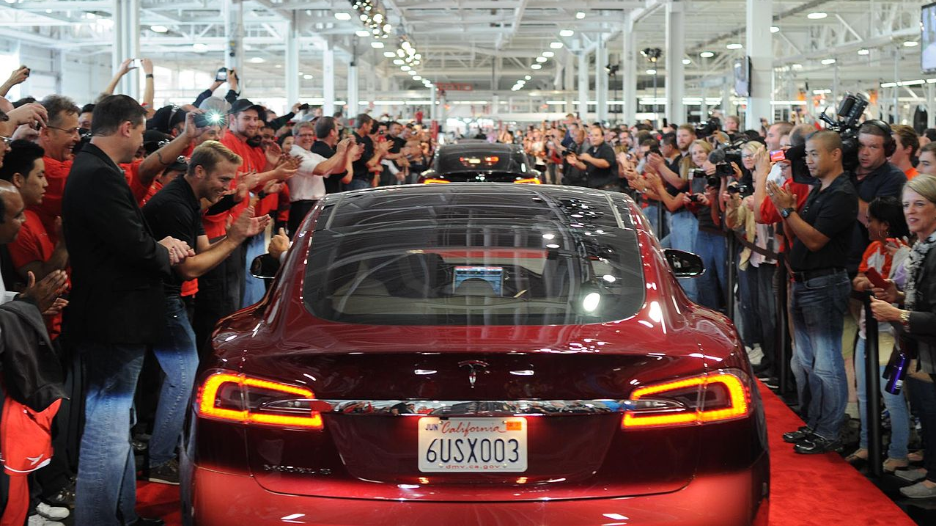

Slide 22
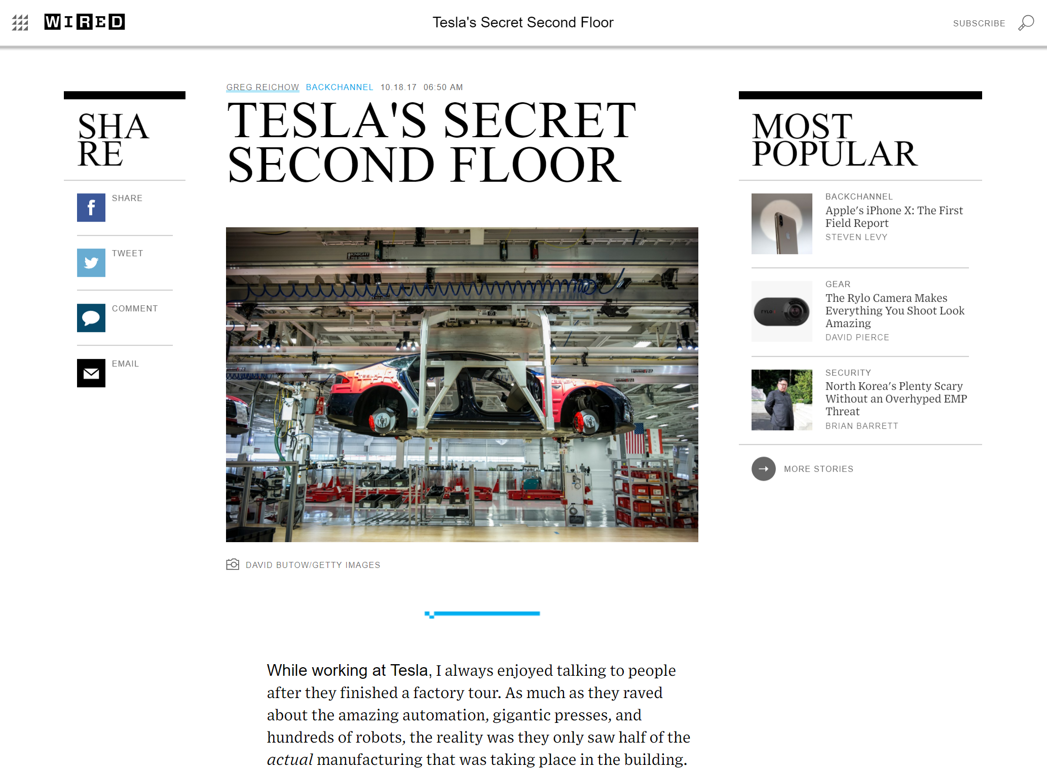

Slide 23
IU’s Data Laundromat
2015…

Slide 24
“
Indiana University is a data-rich organization, as it collects elements on all aspects of students, faculty and staff, facilities, finances, budgets and research. However, this assessment has uncovered that although all of this information is collected, it is not in the most usable format as possible for the key decision makers at all levels within the university…. the university is lacking in its ability to perform analysis across the functional areas both in a structured format as well as in an ad-hoc nature.
.”
Indiana University Business Intelligence Assessment and Recommendations Report
Prepared by IBM Global Business Services - 2009
Notes:
Other quote: Mired in decade old reporting practices, the university does not approach decision making at a university wide level, by defining key performance indicators to keep a pulse on the state of affairs. Instead, the decision making is pushed down to the lowest levels of each functional area, allowing decisions to be made that might best suit the functional area rather than the university as a whole.

Slide 25
IU Decision Support Initiative (2015)
Enable report and dashboard “discovery” via search
ds.iu.edu Decision Support
Created a factory for Decision Support Initiatives
Agile methodology -- then run, run, run!

Slide 26
Decision Support Initiative Goal
“To improve decision making at all levels of Indiana University by dramatically enhancing the availability of timely, relevant, and accurate information to support decision makers”
+
=
ü
X
X
X
ü
X
http://decisionsupport.iu.edu

Slide 27
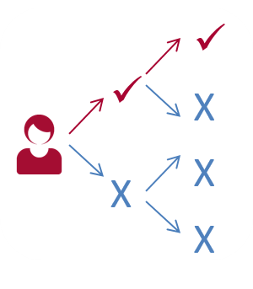
DSI will affect People and Organizations. It addresses changes in culture, roles, authority over data, access, skills, work habits…
DSI will affect Data and Technology. Over time, it will address standardizing Data Definitions and change some of the core Data, Information, and Reporting IT.
DSI will affect departments, schools, and campuses across IU. It will provide greater transparency into and across many areas. The focus is to improve decision outcomes for IU in a rapidly changing world.

Slide 28
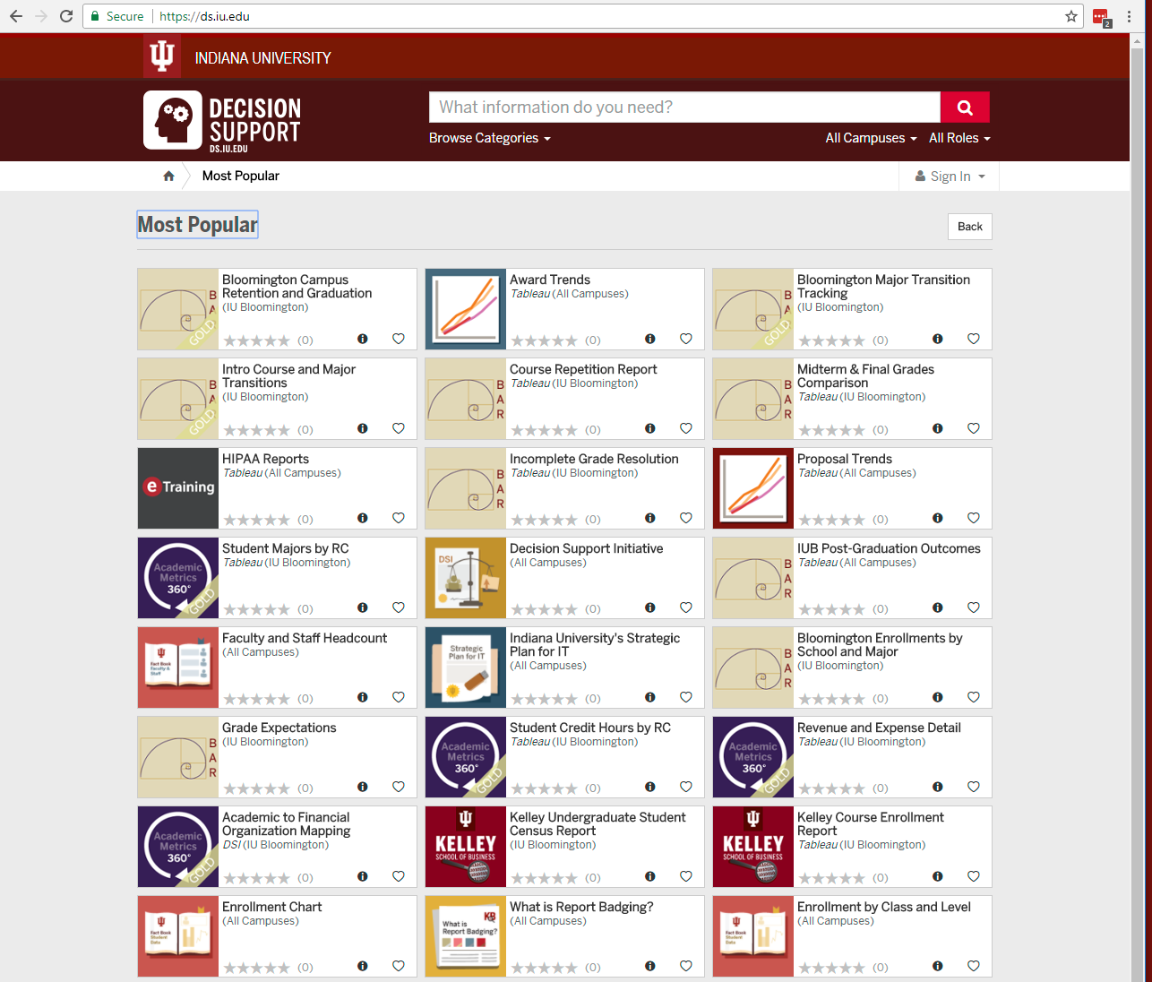
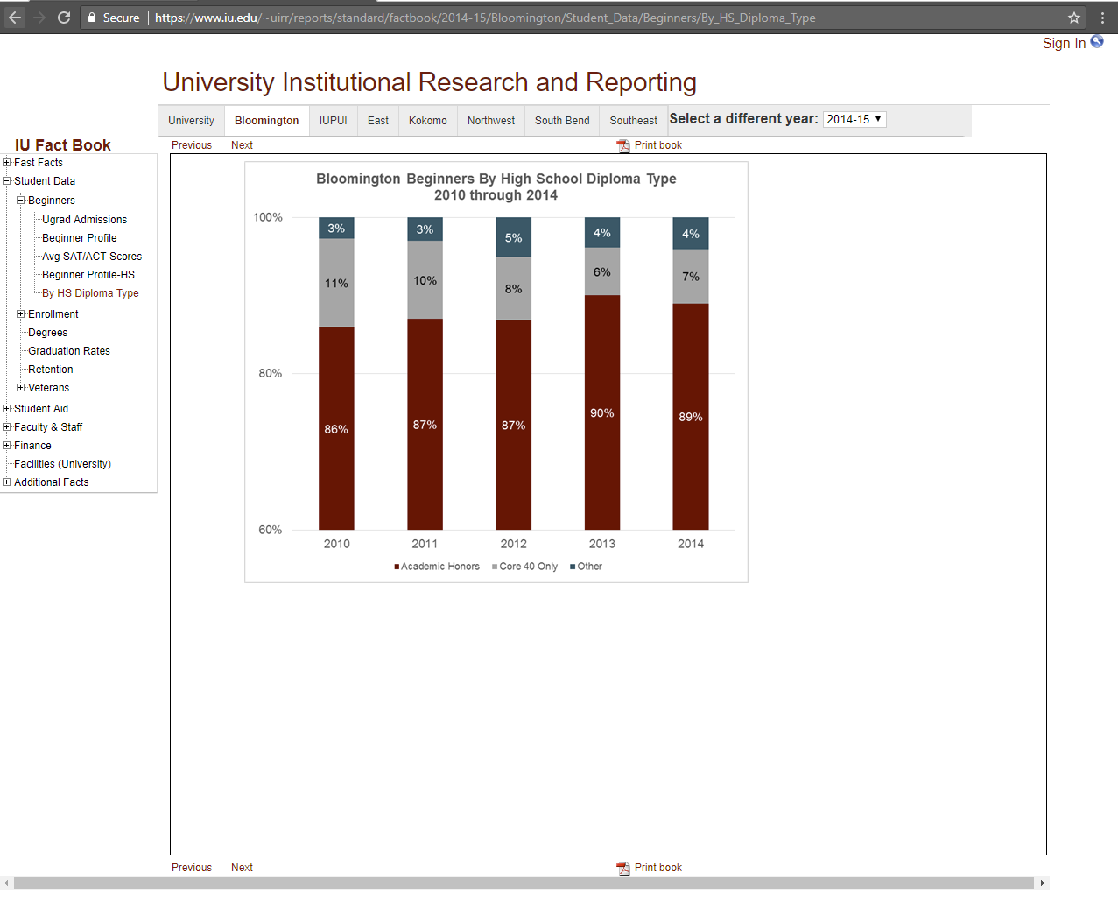
Insourced Discovery and Dashboards
ds.iu.edu

Slide 29
Insourced Tools + Outsourced Services
Via the Unizin Consortium

Slide 30
DSI Project Pipeline
Many ideas…
Only formal Project Charters advance for consideration and prioritization.
Charters detail merits of the project, scope, commitments of functional staffing, etc.
Charters Queue:
Project Charter
Project Charter
Project Charter
…
Education
Training
Rollout
Diffusion
Evaluation
Support
Enhancement
+
DSS Factory
Disciplined, Formal Agile Process
(explained in slide #x)
DSI Steering Council
Assesses resource capacity
Approves Charters
Prioritizes Charters
http://ds.iu.edu
Reports
Dashboards
Decision Support
…
Agile Team #1
Agile Team #2
Agile Team #3
Work Queue:
Approved Charter
Approved Charter
Approved Charter
…
Functional and Technical Staff, Highly Prescriptive Process, Time-boxed 2 Week Delivery Sprints

Slide 31
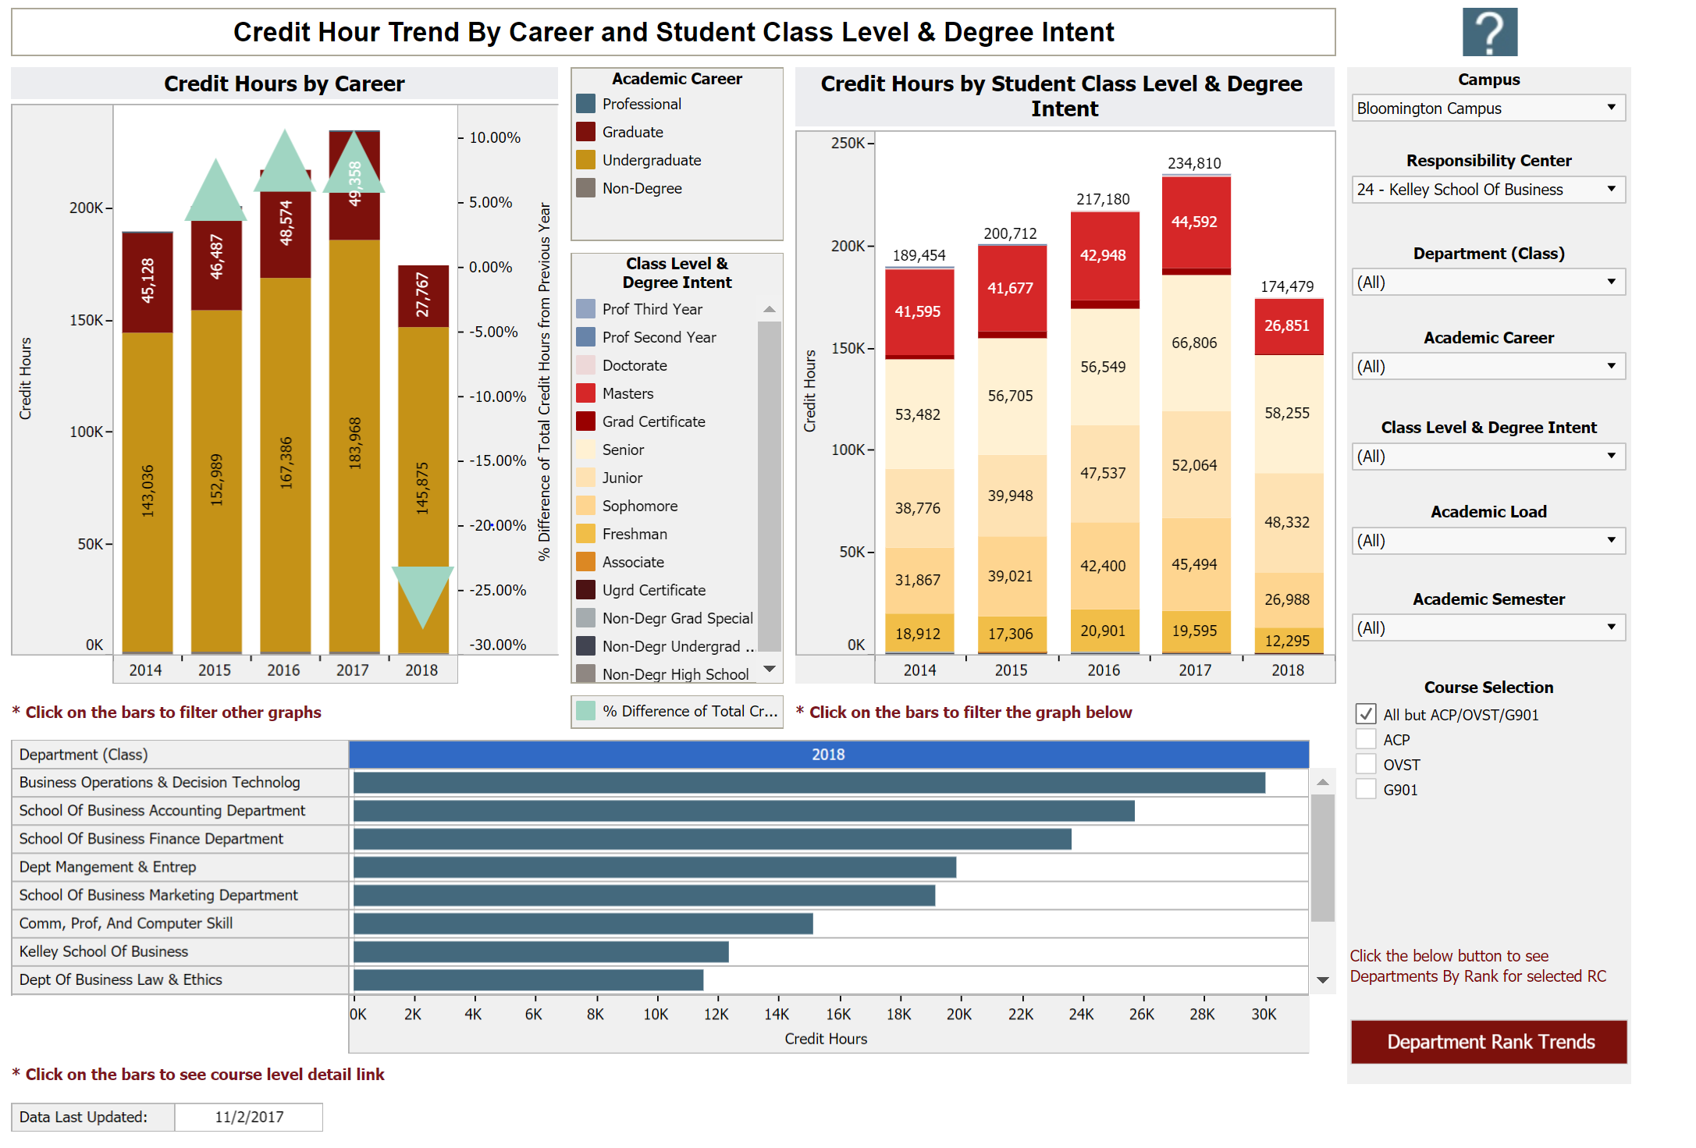
IU Academic Metrics 360
Credit Hours
HR data
Financials
Trends and forecasts
Tailored to How we make decisions
Data Laundry Work!!

Slide 32
Will clean data lead to good decisions?

Slide 33
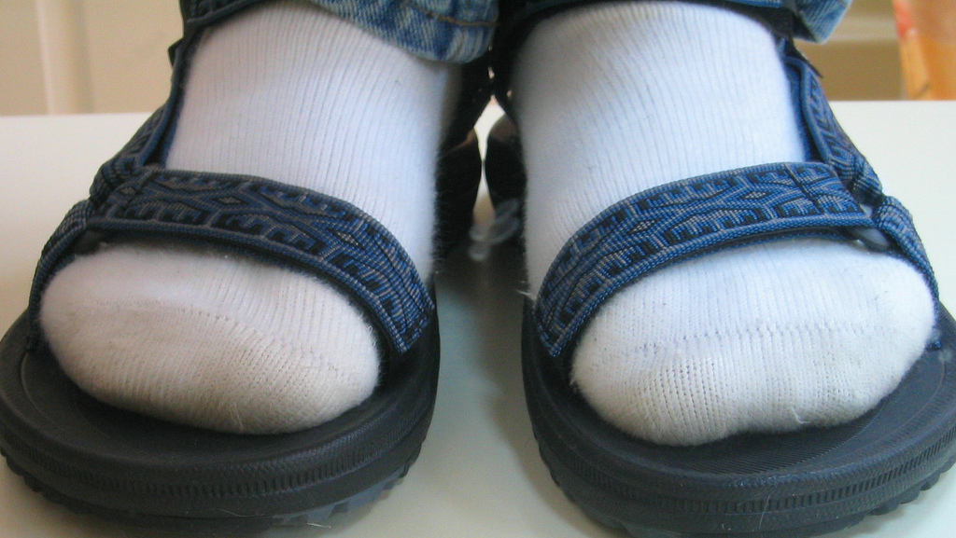
Notes:
Just because it’s clean, doesn’t mean it leads to good decisions!

Slide 34
Give them more information and decision making will improve.
In many cases, decision makers suffer from an overload of irrelevant information more than a lack of relevant information for a decision.
Decision makers know what information they need.
In many cases, decision makers often request vastly more information than needed to optimally make a decision (exacerbating #1).
Give decision makers the information that they need and decisions will improve.
In many cases, decision makers do not have refined models of the relevant information that best predict desired outcomes.
Caution!
Ackoff, 1967. Management MISinformation Systems, Management Science.

Slide 35
What’s up with YOUR data laundry?

Slide 36
Who Is Doing Our Data Laundry? EDUCAUSE 2017
Brad Wheeler, Ph.D.
IU Vice President for Information Technology, & CIO Professor of Information Systems, Kelley School of Business
This work by Brad Wheeler is licensed under a Creative Commons Attribution 4.0 International License.
October 2017

Slide 37
Data Laundry and the Magic Bundle
In-House
Discovering
Extracting
Recoding
Uploading
Normalizing
Enriching
Comparing
Presenting
Workflow
Outsourced
Discovering
Extracting
Recoding
Uploading
Normalizing
Enriching
Comparing
Presenting
Workflow
Learn and Revise Loop
The Magic Bundle
Red = Presumed work and expertise advantage
Thick white borders denote challenging tasks
Dashed borders indicate optional steps that may not be in every project

