Slide 1
The importance of cybersecurity governance
Perspectives from presidents, trustees, and IT leaders

Slide 2
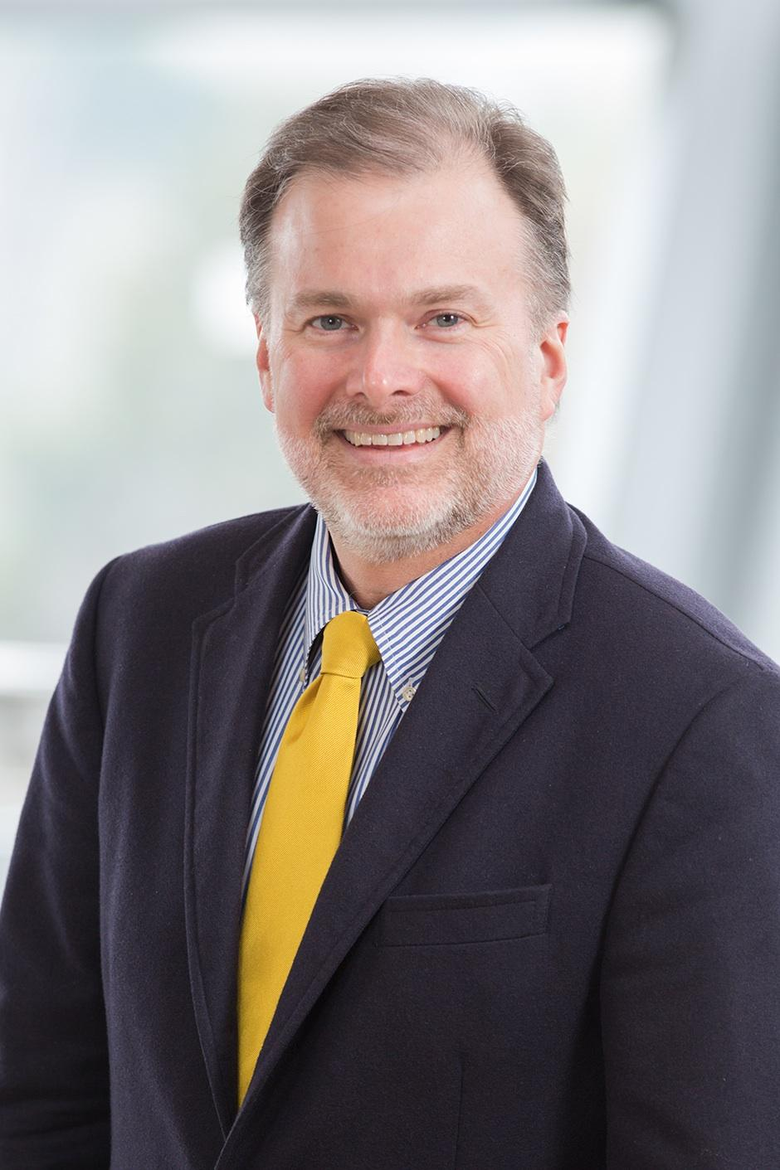
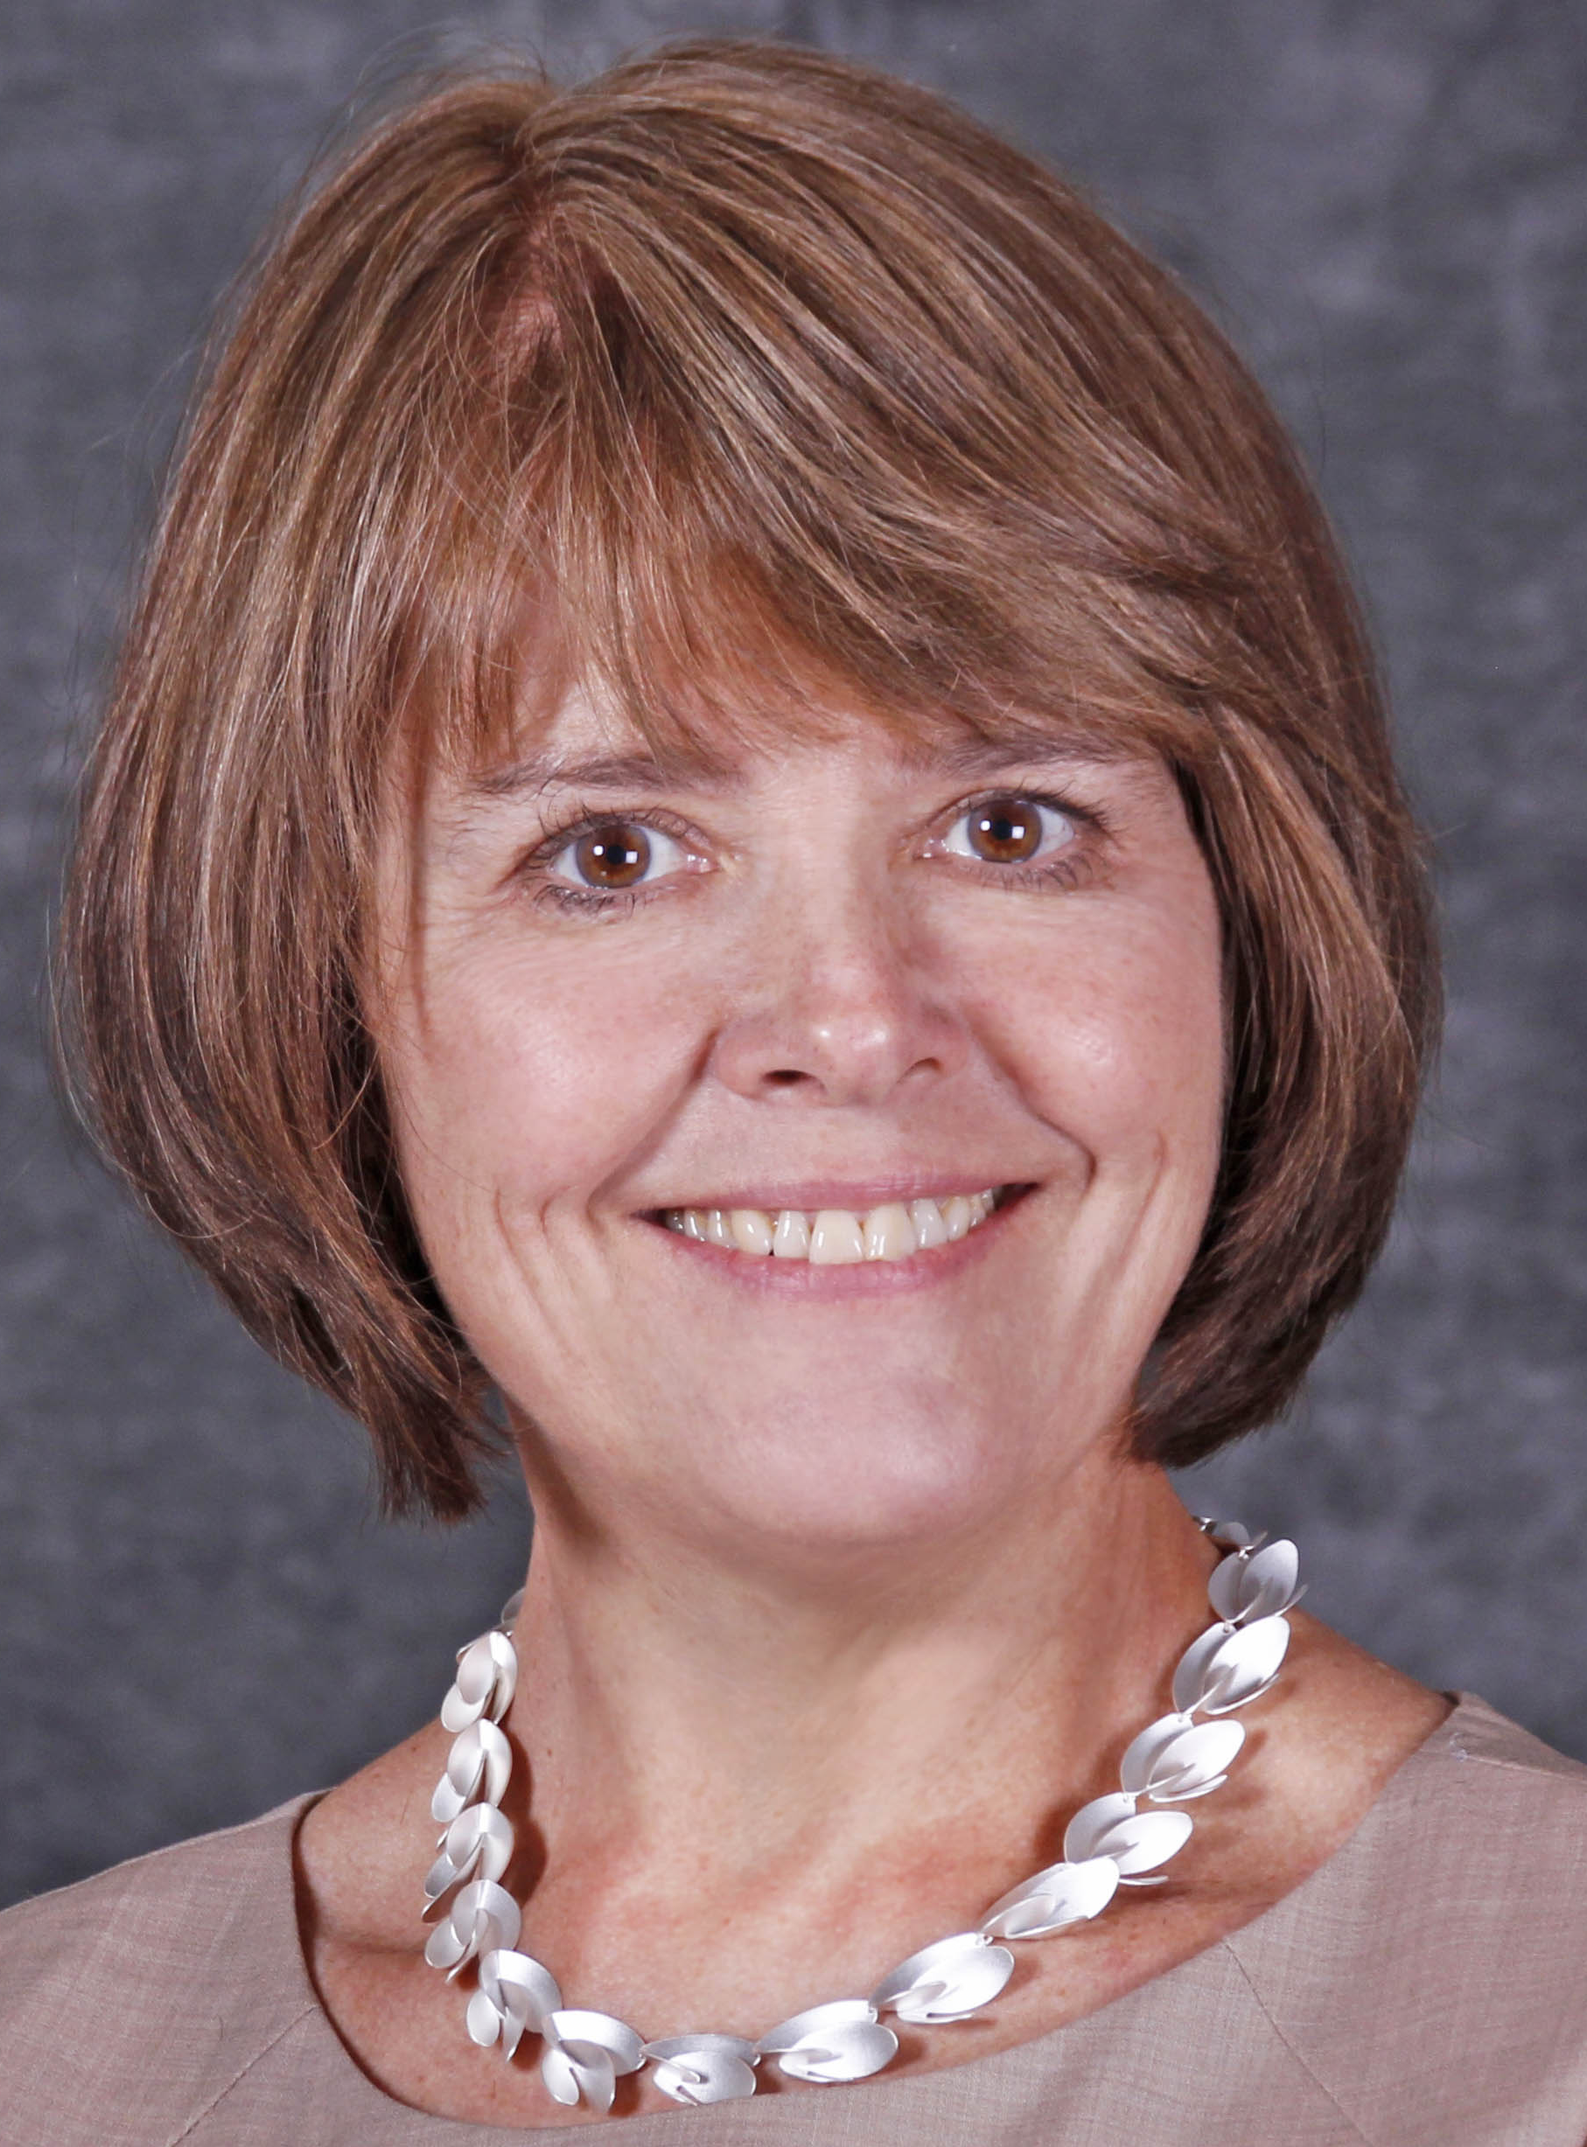
Deloitte and EDUCAUSE collaboration
Cole Clark
Executive Director, Higher Education Deloitte
Susan Grajek
Vice President, Communities and Research EDUCAUSE

Slide 3
Deloitte and EDUCAUSE collaboration
EDUCAUSE brings together a loyal network of 1,800 colleges and universities, 300 corporations, and numerous higher education associations.
Extensive IT benchmarking information.
Publishes leading thoughtware through the EDUCAUSE Center for Analysis and Research.
Produces groundbreaking research to help colleges and universities navigate their toughest challenges and reimagine how they achieve excellence in every aspect of the academy.
Brings access to thought leaders and prior research related to IoT; blockchain; Agile; digitization of the enterprise; leadership and talent development; cybersecurity; to name a few.
Our relationship
Notes:
Two extraordinary individuals have joined the Center since our last meeting

Slide 4
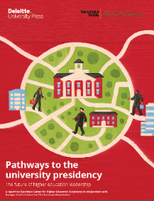
Deloitte Center for Higher Education Excellence
Current focus areas:
Student success
Leadership issues
Cybersecurity
Future of public higher education
Digitization of the academic enterprise
Exploring higher education innovation and trends
Higher education institutions may confront a number of challenges, from dramatic shifts in sources of funding resulting from broader structural changes in the economy to demands for greater accountability at all levels to the imperative to increase effectiveness and efficiency through the adoption of modern technology.
Deloitte’s Center for Higher Education Excellence focuses on groundbreaking research to help colleges and universities navigate these challenges and reimagine how they achieve innovation in every aspect of the future college campus: Teaching, learning, and research.
Through forums and immersive lab sessions, we engage the higher education community collaboratively on a transformative journey, exploring critical topics, overcoming constraints, and expanding the limits of the art of the possible.

Slide 5
Our first joint publication: NIST Special Publication 800-171 for higher education
Provides a guide to help colleges and universities comply with new NIST standard
Developed in coordination with working group members from Coppin State University, Montgomery College, American University, Virginia Tech, and George Washington University
http://bit.ly/2A0KDhk
Notes:
Two extraordinary individuals have joined the Center since our last meeting

Slide 6
What we are currently working on
Executive cyber fluency: As universities become increasingly wired, cyber risk is becoming a prominent issue in executive leadership and board-level circles. This report will make the case for why cyber risk demands greater executive attention and engagement, describe what effective engagement looks like in practice and how to build a more resilient enterprise.
Digitization of the academic enterprise: The tools (cloud, mobile, analytics) and talent exist to transform how technology is used within higher education. A digital mindset and new way of thinking about students, faculty, staff, and alumni will help higher education to jump ahead and become faster, more iterative, and adaptable. This study will help to create the vision for what the future might hold.
Notes:
Two extraordinary individuals have joined the Center since our last meeting

Slide 7
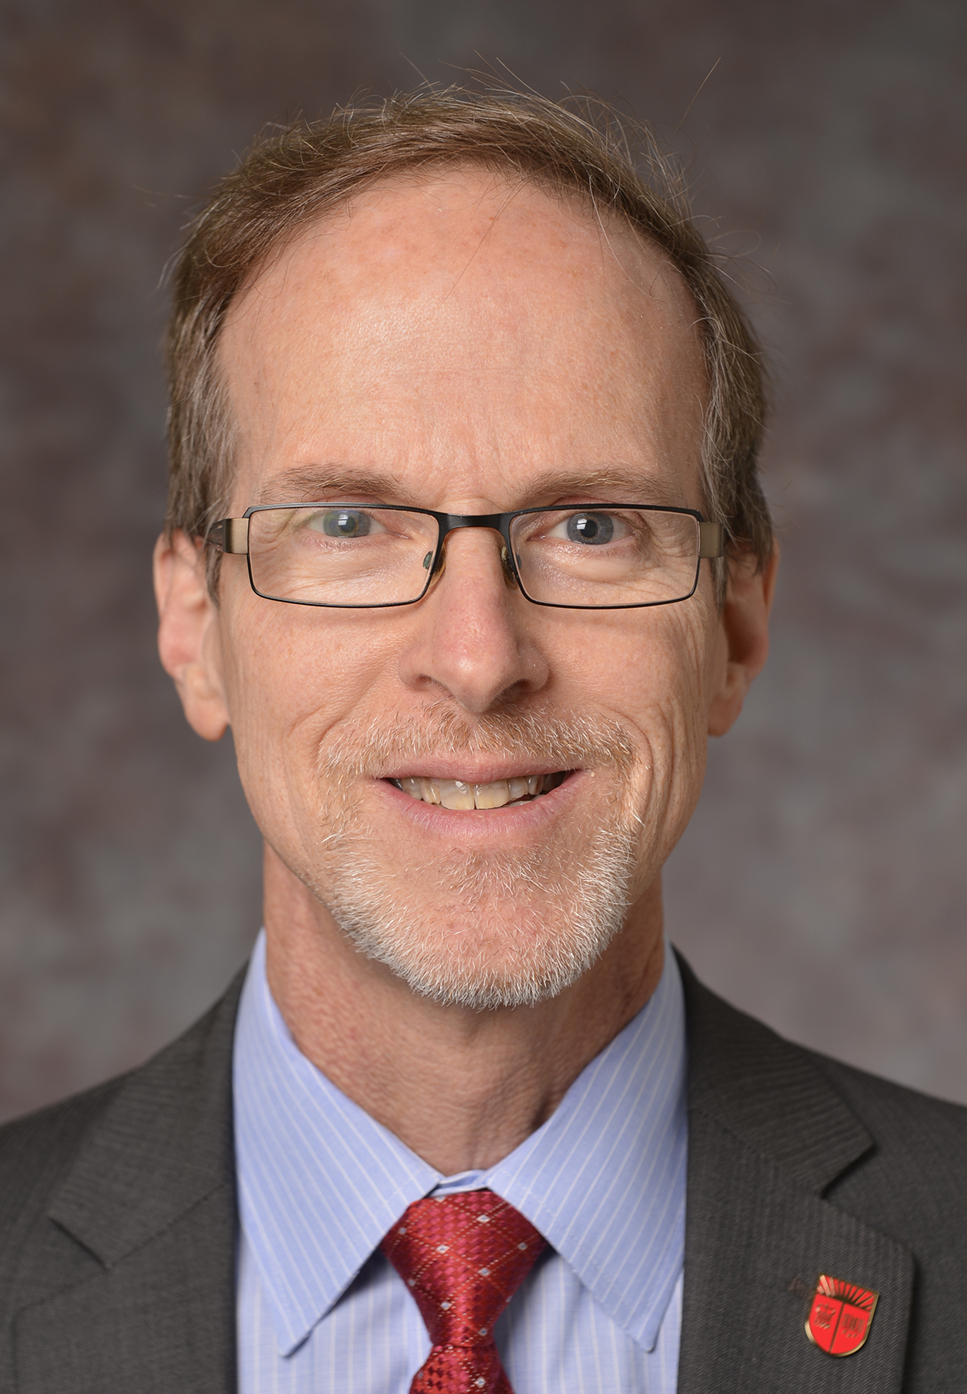
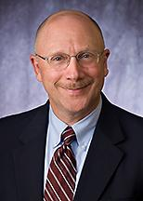
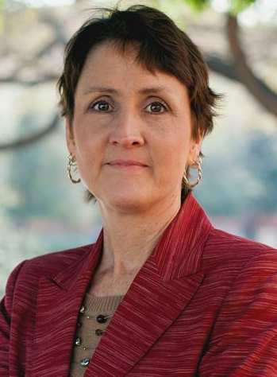
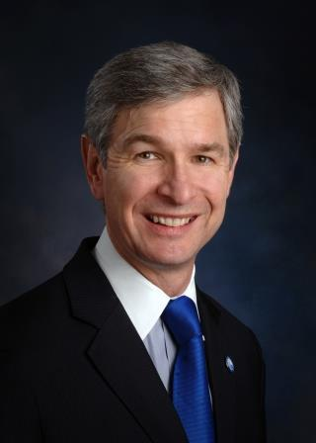
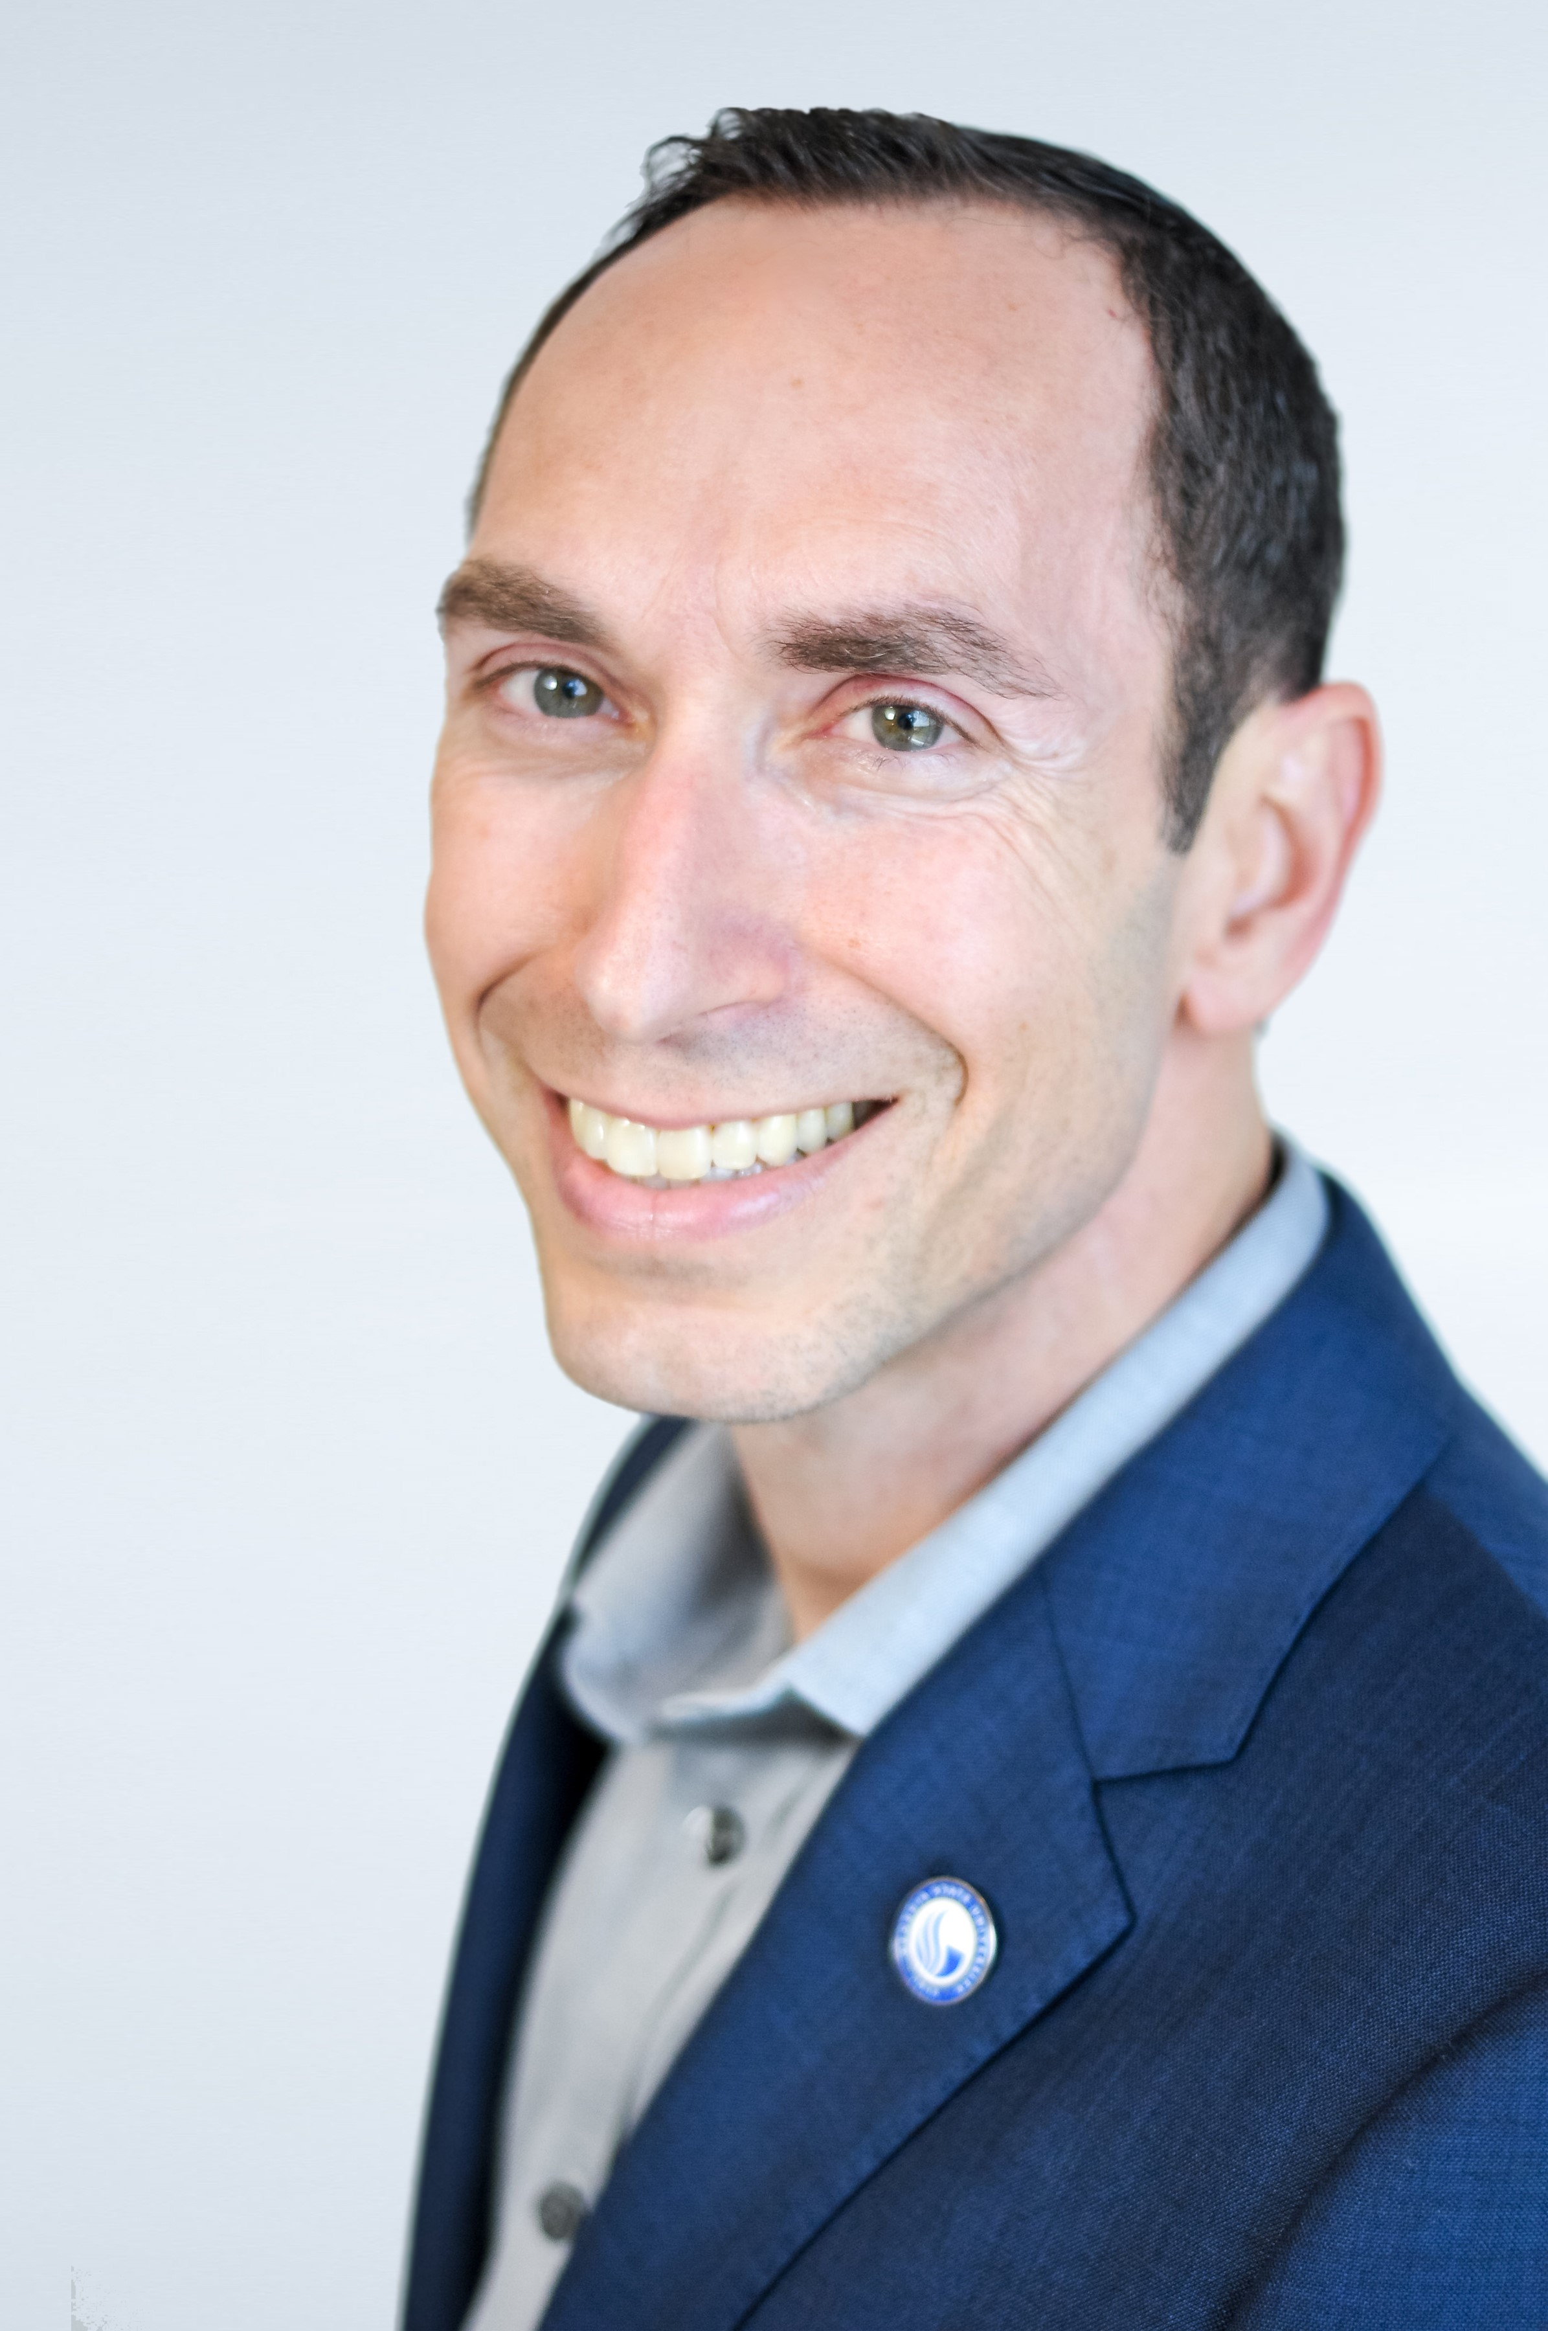
The Importance of Cybersecurity Governance: Perspectives from Presidents, Trustees, and IT Leaders
Cornelius Kerwin
President Emeritus, American University
Cole Clark
Executive Director, Higher Education, Deloitte
Michael Gower
Executive Vice President for Finance & Administration, Rutgers The State University of New Jersey
David Swartz
Vice President & Chief Information Officer, American University
Michele Norin
Senior Vice President and Chief Information Officer, Rutgers The State University of New Jersey
Mark Becker
President, Georgia State University
Phillip Ventimiglia
Chief Innovation Officer, Georgia State University
Notes:
Two extraordinary individuals have joined the Center since our last meeting

