Slide 1
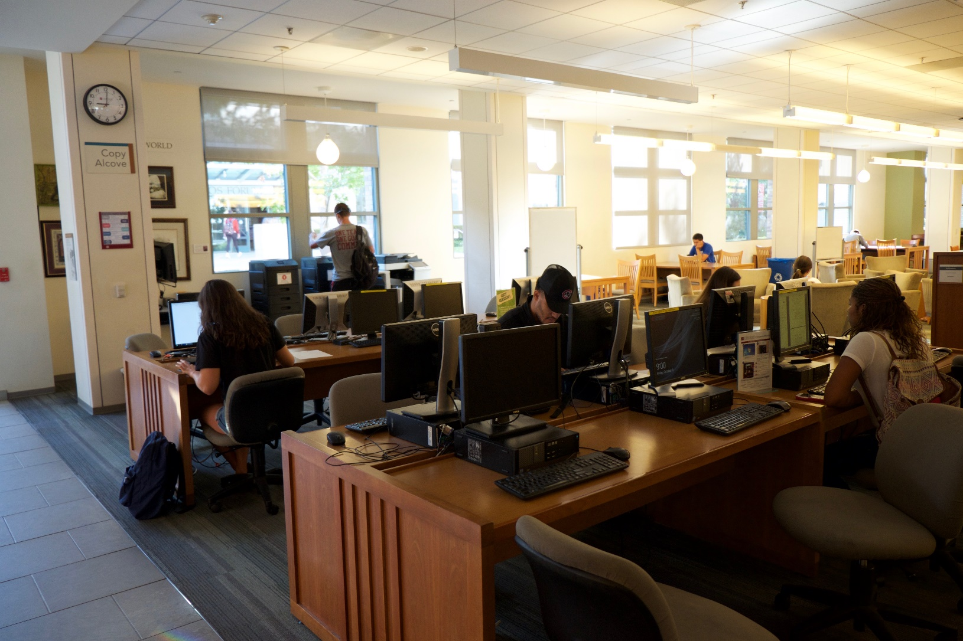
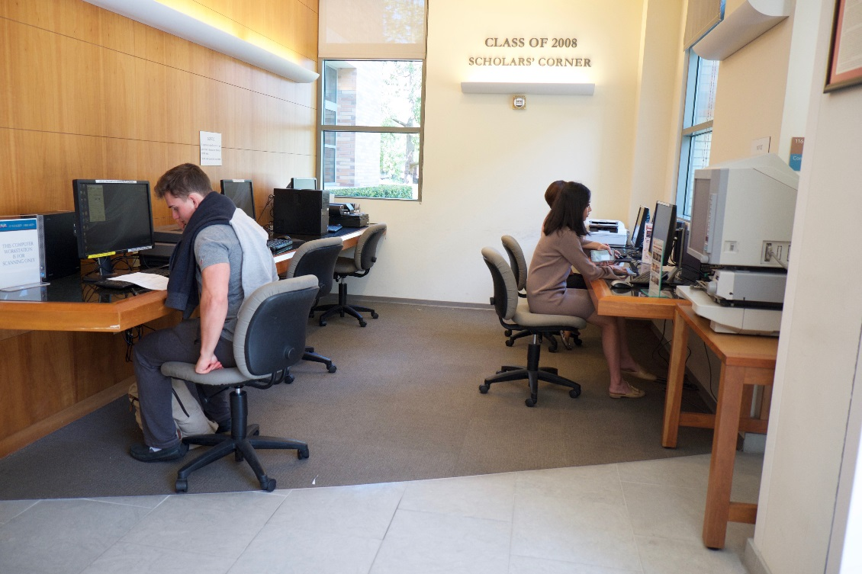
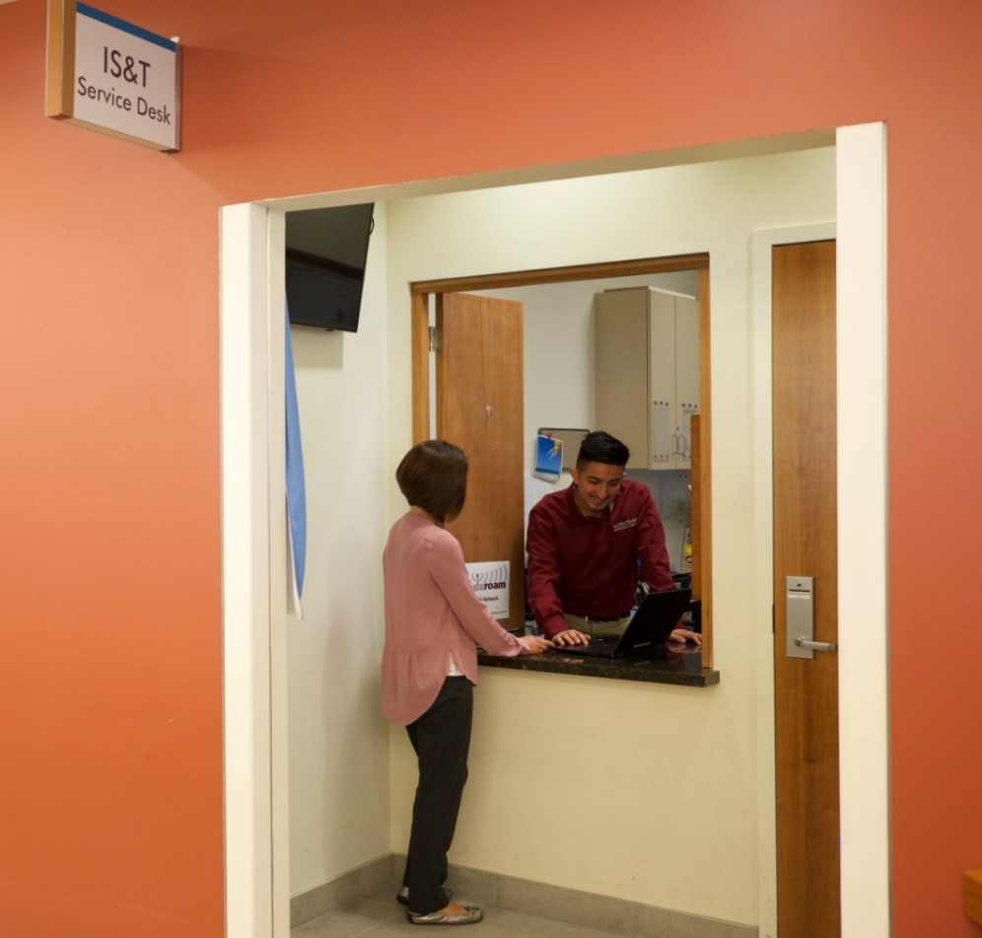
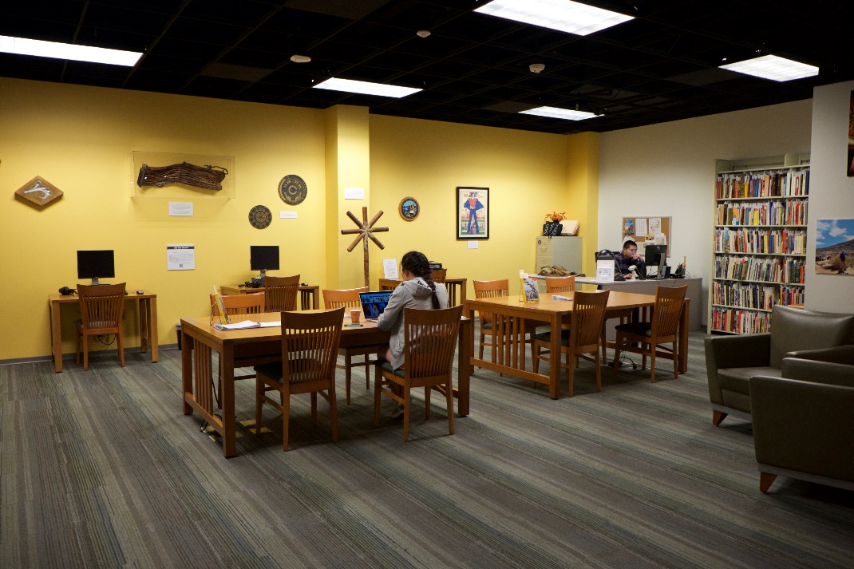
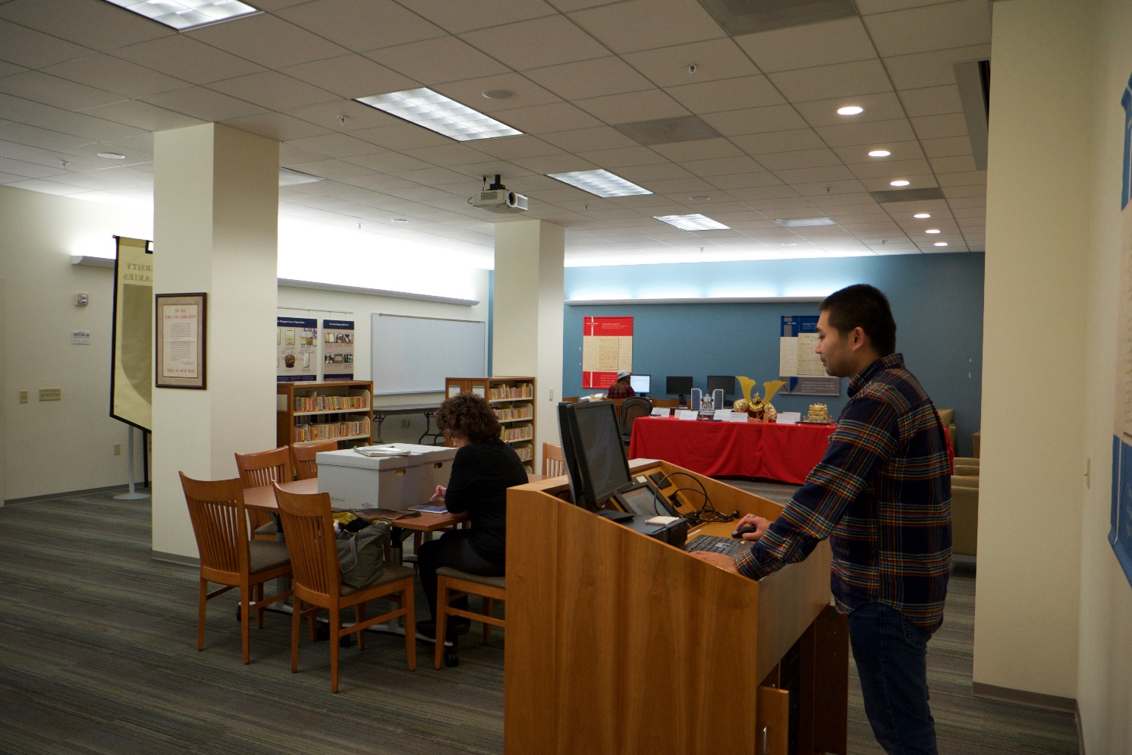
Introduction
Defining and Promoting Student Success
Mutual Benefits
Conclusions
The Leatherby Libraries at Chapman University was completed in August of 2004, and housed the IS&T student service desk, call center, desktop service center, computer lab, and office spaces. Physical proximity encouraged a symbiotic and sustainable relationship between IS&T and the library. Selected collaborative partnership examples are provided to demonstrate how space reconfiguration promoted student success.
In 2011, our collaborative partnership led to the acquisition of storage space totaling 1,100 sq. ft. This space formerly housed the computer service center, but in 2012 this space was repurposed to accommodate prominent gift collections and archives which directly benefited our student researchers’ success through the increase in access to primary collections and rare materials.
In 2013, our student population reduced its static computer lab usage in favor of mobile devices (i.e., laptops, tablets, PDA’s). With this recognition, and through transparent communication between IS&T and the Leatherby Libraries, an agreement was struck that allowed the library to convert an underutilized computer lab into a prominent exhibit on California history and study space beneficial to students.
In 2015, the CIO and Dean of the library collaborated to reconfigure the physical space in the library to increase visibility and access to the IS&T Service Desk. Additionally, librarians, library staff, senior leaders from the Campus Planning Department, the Provost’s office, and University Advancement were consulted. A collaborative and diverse partnership was established which would form the catalyst to implement the space reconfigurations in a cost effective and timely manner.
The Service Desk and the desktop service center moved to the 1st floor of the library. Student success was promoted by providing IS&T and library employees direct access to students to efficiently address technology related issues, increase service to students, and update software applications on library computers in a timely manner.
Within the context of a collaborative partnership between IS&T and the Library, we define student success as the provision of resources and services that assist students with reaching their academic goals for educational attainment.
The benefits for both the IS&T Department and the Leatherby Libraries include the provision of a “one-stop-shop” approach to services and resources provided by these two departments to emphasize and promote student success.
Additional mutual benefits derived from the collaborative partnership include:
Opportunities to maximize the utilization of space in an efficient manner
Alignment of the IS&T and library staff toward the same timely customer service oriented processes
Promotion of IS&T and the library through their physical proximity within the library building
Validation of the library as a place to conduct research, study, and collaborate with others with direct IS&T support
This partnership between the IS&T Department and the Leatherby Libraries is providing a path for innovative utilization of space, increased awareness and visibility of services, and collaborative opportunities between the two departments to promote student success. Evidence of this collaborative partnership includes:
Acquiring and repurposing space in new ways including:
The library acquiring 1,075 sq. ft. in 2009, 1,809 sq. ft. in 2011, and 1,972 sq. ft. in 2015 from IS&T
Repurposing space for archival storage, exhibits and archives, staff offices, digitization lab, and general storage
IS&T increasing their Service Desk from 120 sq. ft. to 198 sq. ft. (65% increase) which raised awareness and visibility of the Service Desk by moving from the basement to the 1st floor
Walkups to the Service Desk increased from 150 to 450, which resulted in a 200% increase in the provision of services to students
References
Andrews, C., Wright, S. E., and Raskin, H. (2016). Library learning spaces:
Investigating libraries and investing in student feedback. Journal of
Library Administration, 56(6), 647-672.
Cha, S. H. and Kim, T. W. (2015). What matters for students’ use of physical
library space? Journal of Academic Librarianship, 41(3), 274-279.
Khoo, M. J., Rozaklis, L., Hall, C., and Kusunoki, D. (2016). “A really nice
spot”: Evaluating place, space, and technology in academic libraries.
College & Research Libraries, 77(1), 51-70.
Montgomery, S. E. (2014). Library space assessment: User learning behaviors
in the library. Journal of Academic Librarianship, 40(1), 70-75.
IS&T promotes student success by:
Increasing awareness and visibility of services
Immediate classroom support
Increased staffing available to improve workflow
Improved troubleshooting turnaround time
Leatherby Libraries promotes student success by:
Increasing awareness of services and resources
Access to primary documents for student research in the Center for American War Letters Archives and the California’s Gold Exhibit and Huell Howser Archives
Access to additional study, office, and storage spaces in key locations
On the left, a student utilizes one of our new spaces, California’s Gold Exhibit and Huell Howser Archives.
On the right, is the Center for American War Letters Archives, a collaborative space for student research, study, and use of technology.

