Slide 1
Conducting Usability and UX Assessment for Educational Technology
Doug Peterson

Slide 2
User Experience (UX) in Education
Introduction
Know your users
Activity
From avionics to student achievement.
Developing Heuristics
Activity
Evaluation Methods
Review
Survey
Setting Benchmarks
Wrap up

Slide 3
User Experience (UX) in Education
Introduction
Know your users
Activity
From avionics to student achievement
In education, users are rarely the customer
When UX is poor, learning suffers
Acknowledgements
Developing Heuristics
Activity
Evaluation Methods
Review
Survey
Setting Benchmarks
Wrap up

Slide 4
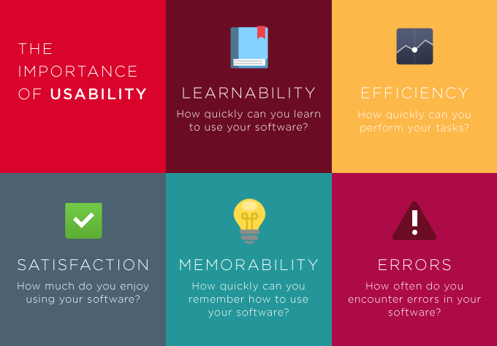
Usability
Introduction
Know your users
Activity
Developing Heuristics
Activity
Evaluation Methods
Review
Survey
Setting Benchmarks
Wrap up
Notes:
Two of the most well known researchers in the field of usability and product design are Jakob Nielsen and Donald Norman. Although other researchers, such as Ben Shneiderman (1987) defined usability guidelines, the research efforts of Nielsen and Normal led to the development of widely recognized usability design principles and heuristics.
Norman began to write about User Centered System Design and published his design principles in his book called The Design of Everyday Things. While his design guidelines are well known, they are high level and don’t translate well to evaluation.
Nielsen introduced five basic components or attributes of a usable product/system, three of which overlap with the ISO standard 9241, efficiency, effectiveness (errors), and satisfaction - Nielsen added the concepts of learnability and memorability.
-LMSs in particular need to be both learnable and memorable
-Both students and instructors need to learn to use a system quickly
-If it’s not memorable, it’s a problem because users have to use an LMS every semester, so they need to be able to return to the system after a period of time and use it like no time had past between their last use

Slide 5
THE UX HONEYCOMB
Introduction
Know your users
Activity
Developing Heuristics
Activity
Evaluation Methods
Review
Survey
Setting Benchmarks
Wrap up
Peter Morville (2004) https://www.usability.gov/what-and-why/user-experience.html

Slide 6
Overview
Introduction
Know your users
Activity
Know your users
Activity: develop user profiles
Heuristic Development
Activity: heuristic generation
User Research
Activity: Expert review
Activity: Survey development
Drawing Conclusions
Developing Heuristics
Activity
Evaluation Methods
You will…
Identify a product
Write user profiles
Develop UX heuristics
Write a user survey
Review
Survey
Setting Benchmarks
Wrap up

Slide 7
Know your Users
Introduction
Know your users
Activity
User profiles
Journey map (also useful in sharing findings)
Data gathering methods
Focus groups
SMEs
Developing Heuristics
Activity
Evaluation Methods
Review
Survey
Setting Benchmarks
Wrap up
Notes:
Users generally say they need what they know – need to get them dreaming about what they want.

Slide 8
User Profiles
Introduction
Know your users
Activity
Developing Heuristics
Erin, 21
Transfer student from local community college. 3rd year media and journalism major. 3.1 GPA. Member of student government, social organization, works for campus radio station. Moderate hearing impairment.
Activity
Evaluation Methods
Review
Survey
Setting Benchmarks
Wrap up

Slide 9
User Profiles
Introduction
Know your users
Activity
Developing Heuristics
Darren 19
Frist year, Engineering major. 3.9 GPA. Member of campus gaming group and two service clubs. Hobbies include competitive robotics and golf. Works part time for pet supply chain store. Avid video game player.
Activity
Evaluation Methods
Review
Survey
Setting Benchmarks
Wrap up

Slide 10
User Profiles
Introduction
Know your users
Activity
Developing Heuristics
Rick 37
Non-traditional student returning to school after some time off. Mortuary Science major. 2.2 GPA. Single father with two children. Works full-time while attending school.
Activity
Evaluation Methods
Review
Survey
Setting Benchmarks
Wrap up

Slide 11
User Profiles and User Population
Introduction
Know your users
Activity
Developing Heuristics
54%
User A
Activity
Evaluation Methods
One profile can represent any size user cluster
User B
Review
24%
Survey
User C
17%
Setting Benchmarks
Wrap up

Slide 12
Know your Users Needs
Introduction
Know your users
Activity
Task inventory or analysis
What do they do
What should they do
Users don’t think like designer, programmers, engineers or professors
Developing Heuristics
Activity
Evaluation Methods
Review
Survey
Setting Benchmarks
Wrap up

Slide 13
Dual User – Dual Use
Introduction
Know your users
Learning Management System
Learner
User
Instructor
Teacher
Dual User
Dual Use
User
Student
Activity
Developing Heuristics
Activity
Evaluation Methods
Review
Survey
Setting Benchmarks
Wrap up
Sorenson, A. (2016). Usability in eLearning: An Instructor Perspective. Dissertation

Slide 14
Activity
Introduction
Know your users
Activity
Identify major user groups for product
Write one user profile per person
Developing Heuristics
Activity
Evaluation Methods
Review
Survey
Setting Benchmarks
Wrap up

Slide 15
Develop Heuristics
Introduction
Know your users
Activity
Heuristics – design principles leading to a positive user experience
What makes a chocolate chip cookie?
Developing Heuristics
Activity
Evaluation Methods
Review
Survey
Setting Benchmarks
Wrap up

Slide 16
Develop Heuristics
Introduction
Know your users
Activity
Heuristics – design principles leading to a positive user experience
What makes a GOOD chocolate chip cookie?
Developing Heuristics
Activity
Evaluation Methods
Review
Survey
Setting Benchmarks
Wrap up

Slide 17
Develop Heuristics
Introduction
Know your users
Activity
Heuristics – design principles leading to a positive user experience
What makes a GOOD chocolate chip cookie?
Draw from existing sets of general heuristics
Consider application or device specific heuristics
Developing Heuristics
Activity
Evaluation Methods
Review
Survey
Setting Benchmarks
Wrap up

Slide 18
Nielsen’s Heuristics
Introduction
Know your users
Activity
Visibility of system status
Match between system and the real world
User control and freedom
Consistency and standards
Error prevention
Recognition rather than recall
Flexibility and efficiency of use
Aesthetic and minimalist design
Help users recognize, diagnose, and recover from errors
Help and documentation
Developing Heuristics
Activity
Evaluation Methods
Review
Survey
Setting Benchmarks
Wrap up
https://www.nngroup.com/articles/ten-usability-heuristics/
Notes:
Nielsen, J. (1994a). Enhancing the explanatory power of usability heuristics. Proc. ACM CHI'94 Conf.(Boston, MA, April 24-28), 152-158.

Slide 19
Norman’s Design Principles
Introduction
Know your users
Activity
Use both knowledge in the world and knowledge in the head
Simplify the structure of tasks
Make things visible
Get the mappings right
Exploit the power of constraints, both natural and artificial
Design for error
When all else fails, standardize
Affordances
Visibility
Feedback
Mapping
Constraints
Consistency
Developing Heuristics
Activity
Evaluation Methods
Review
Survey
Setting Benchmarks
Wrap up
Notes:
https://www.csun.edu/science/courses/671/bibliography/preece.html
https://medium.com/@sachinrekhi/don-normans-principles-of-interaction-design-51025a2c0f33

Slide 20
Nielsen (1994) | Koohang (2004) |  | CSU-17 | SUI-17
1. Match between system and the real world | 1. Simplicity 2. Comfort 3. User-friendliness 4. Readability |  | 1. Easy to Use 2. Learnability 3. User-friendliness 4. Readability
2. Recognition rather than recall | 5. Navigation 6. Link Visibility 7. Well Organized 8. Recognition |  | 5. Navigation
3. Visibility of system status | 9. Load/Access Time 10. Adequacy/Task Match 11. Feedback |  | 6. Feedback
4. Aesthetic and minimalist design | 12. Right to the point information 13. High Color Contrast 14. Font type and size 15. Visual Presentation |  | 7. Aesthetic User Interface
5. Help users recognize, diagnose, and recover from errors |  |  | 8. Error Prevention
6. User control and freedom |  |  | 9. Course Maintenance
7. Consistency and standards | 16. Consistency |  | 10. Consistency & Standards
8. Error prevention |  |  | 8. Errors
9. Flexibility and efficiency of use | 17. Control |  | 11. Flexibility
10. Help and documentation | 18. Direction
Non-Nielsen (LMS Domain Specific items) | 19. Information Relevancy |  | 12. Feature Relevancy 13. Communication 14. Learning Facilitation 15. Engaging 16. Confidence 17. Efficiency
Introduction
Know your users
Activity
Developing Heuristics
Activity
Evaluation Methods
Review
Survey
Setting Benchmarks
Wrap up

Slide 21
Education Specific Principles
Introduction
Know your users
Activity
Learning is the first priority
Except when it’s not
Make migration simple
First impressions matter… a lot.
Developing Heuristics
Activity
Evaluation Methods
Review
Survey
Setting Benchmarks
Wrap up
Notes:
https://www.csun.edu/science/courses/671/bibliography/preece.html
https://medium.com/@sachinrekhi/don-normans-principles-of-interaction-design-51025a2c0f33

Slide 22
Heuristic Development
Introduction
Know your users
Activity
Step 1: Task Analysis
Step 2: Card sorting
Step 3: Streamline (eliminate duplicates, combine if possible)
Step 4: Categorize and organize
Step 5: Retranslation check
Developing Heuristics
Activity
Evaluation Methods
Review
Survey
Setting Benchmarks
Wrap up

Slide 23
Introduction
Know your users
Activity
https://docs.google.com/document/d/1YBqeFI3J9cF3d7XueLR6hOS4jm-P3af1J1MWvbFE66c/edit
https://docs.google.com/spreadsheets/d/1I32kKjZGSzWr8Xk5XEsZIdKVwkGCw-6z0xFAbdioi18/edit?usp=sharing
https://docs.google.com/document/d/17bg6wXVvws1vML9_n3czCk9PE823YWKxDwU0n1sr6OE/edit
https://docs.google.com/spreadsheets/d/19-cy1RVmfw1JoQ6C4_O-n1LfwKp0DLFJicfeyXJ2O1E/edit?usp=sharing
Developing Heuristics
Activity
Evaluation Methods
Review
Survey
Setting Benchmarks
Wrap up
Notes:
https://docs.google.com/spreadsheets/d/1m2wgFcFO_4UumjlqrbLpfA7s88xANNZ6rws8wVp8TGY/edit#gid=0

Slide 24
Applying Heuristics
Introduction
Know your users
Activity
Conduct heuristic evaluations
Develop survey
Identify alternate metrics
Developing Heuristics
Activity
Evaluation Methods
Review
Survey
Setting Benchmarks
Wrap up
Notes:
We will conduct a partial heuristic evaluation.
5 groups – 4-5 people each.
In Groups develop 3 heuristics (minimum with behaviorally specific tasks)
Create rating sheet in excel/google spreadsheet
Grant alternate team access to product and heuristic sheet/descriptions
Alternate team will rate product -

Slide 25
Expert Review
Introduction
Know your users
Activity
Use 3-5 “experts”
Keep review simple using ratings of frequency and severity
5 point scale 0-4 for severity
0 = no problem
1 = cosmetic (may affect UX but not Use)
2 = minor (will affect UX and may affect Use)
3 = major (will affect UX and Use)
4 = catastrophic (will end Use)
Developing Heuristics
Activity
Evaluation Methods
Review
Survey
Setting Benchmarks
Wrap up

Slide 26
ACTIVITY
Introduction
Know your users
Activity
Share your heuristics and product with another group for evaluation
Developing Heuristics
Activity
Evaluation Methods
Review
Survey
Setting Benchmarks
Wrap up

Slide 27
Heuristic Based Surveys
Introduction
Know your users
Activity
Attitude vs behavioral items
Clear single focus for each item
Limit the number of items
Adopt a consistent response format
Standardized vs. custom
Developing Heuristics
Activity
Evaluation Methods
Review
Survey
Setting Benchmarks
Wrap up

Slide 28
System Usability Scale
I think that I would like to use this system frequently.
I found the system unnecessarily complex.
I thought the system was easy to use.
I think that I would need the support of a technical person to be able to use this system.
I found the various functions in this system were well integrated.
I thought there was too much inconsistency in this system.
I would imagine that most people would learn to use this system very quickly.
I found the system very cumbersome to use.
I felt very confident using the system.
I needed to learn a lot of things before I could get going with this system.
https://www.usability.gov/how-to-and-tools/resources/templates/system-usability-scale-sus.html

Slide 29
Activity
Introduction
Know your users
Activity
Develop a 10 question user survey
Developing Heuristics
Activity
Evaluation Methods
Review
Survey
Setting Benchmarks
Wrap up

Slide 30
Measuring UX
Introduction
Know your users
Activity
Measure ONLY what you need (not what you can)
Don’t let the data drive your questions
Not all metrics are created equal
Avoid data overload
Developing Heuristics
Activity
Evaluation Methods
Review
Survey
Setting Benchmarks
Wrap up

Slide 31
How good is good enough?
Introduction
Know your users
Activity
Make comparison evaluations with caution
Not all differences are meaningful
Developing Heuristics
Activity
Evaluation Methods
Review
Survey
Setting Benchmarks
Wrap up

Slide 32
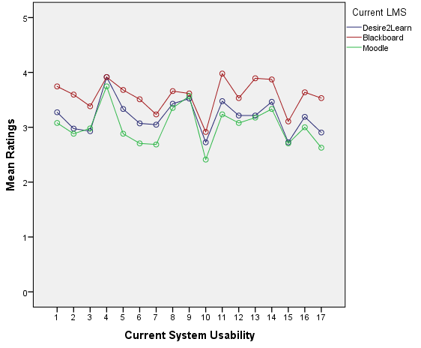
Comparing LMS using the CSU-17
Introduction
Know your users
Activity
Developing Heuristics
Activity
Evaluation Methods
Review
Survey
Setting Benchmarks
Wrap up
Notes:
This is the logical profile analysis, we have groups, this is how this can be used
This is a useful way to study the usability of Learning Management Systems.
We can look at the item level how these systems compare to one another. For example Blackboard trends better on items 1, 2, and 3, but all systems perform similarly on item 4.
If you’re a school, this data could help you decide on a system - if an element that isn’t important to your needs, maybe not worth spending the money to pay for increased usability in that area.
The data from this dissertation did not find that differences ixcn LMS are related to the usability items, Pillai’s Trace = 0.24, F(32, 330) = 1.39, p = .085, R² = 0.24.

Slide 33
How good is good enough?
Introduction
Know your users
Activity
Make comparison evaluations with caution
Not all differences are meaningful
Setting Benchmarks
Developing Heuristics
Activity
Evaluation Methods
Review
Survey
Setting Benchmarks
Wrap up

Slide 34
Sharing Findings
Introduction
Know your users
Activity
Your work is only as good as the summary you write
Get to the point
Show don’t tell
Developing Heuristics
Activity
Evaluation Methods
Review
Survey
Setting Benchmarks
Wrap up

Slide 35
Journey Map
Introduction
Know your users
Activity
Developing Heuristics
Activity
Evaluation Methods
Review
Survey
Setting Benchmarks
Wrap up

Slide 36
Thank you
Introduction
Know your users
Activity
Please complete the session evaluation
And provide any feedback you might find useful
Developing Heuristics
Activity
Evaluation Methods
Review
Survey
Setting Benchmarks
Wrap up

