Slide 1
It Takes Two
Pairing communication and support for successful rollout of two-factor authentication
Cathy O’Bryan
Associate Vice President, Client Services and Support
Office of the Vice President for IT and CIO
caobryan@iu.edu
Daphne Siefert-Herron
Communications Officer
Office of the Vice President for IT and CIO
dsiefert@iu.edu
Notes:
Welcome: Cathy Joke…..
Dance step themed presentation…. Who would lead?
Neither of us can take a lead……

Slide 2
What we’ll cover
Why is it important for communication and support to work together?
How did we manage the rollout of two-factor at IU?
What lessons did we learn?
What should you consider when rolling out two-factor at your own institution?
Notes:
Cathy

Slide 3
About Indiana University
Big 10 university with eight campuses across the state
Core campuses are Bloomington (46k students) and IUPUI (31k students), about 110k students total
More than 19k faculty and staff across all campuses
Notes:
Daphne

Slide 4
About Indiana University
Required two-factor authentication for all faculty/staff logins last February—on very compressed timeline.
Requiring two-factor for all students on November 2, 2017!
Notes:
Daphne

Slide 5
Survey
Who has rolled out two-factor authentication?
Who plans to in next six months?
Next year?
Uncertain?
Notes:
Cathy
Will take us out to internet to insure connection..

Slide 6
Surprise! Let’s require two-factor for ALL faculty and staff…
RIGHT NOW!
Notes:
Daphne

Slide 7
What worries you most?
Notes:
Daphne

Slide 8
Why is this happening to us?!?!
Notes:
Cathy

Slide 9
Support’s biggest worries
Timing is problematic—“Hello, it’s winter break…and then the new semester is starting!”
Rollout audience is large and message is urgent
Service isn’t user friendly—got help from our User Experience team to improve the interface, before doing anything else
Notes:
Cathy

Slide 10
Communications’ biggest worries
Timing is problematic—“Hello, it’s winter break…and then the new semester is starting!”
Rollout audience is large and message is urgent! Need to get the word out fast! (But also can’t overwhelm the support center with questions.)
Notes:
Daphne

Slide 11
Communications’ biggest worries
Who do we tell first?
How do we reach them?
How do we stop rumors and misconceptions?
Handling social media onslaught
Notes:
Daphne

Slide 12
Executive Leadership
Need clear charge and help getting buy-in
Support
They are going to be your front line in helping users
Communications
They need to get the word out in a way that minimizes overall support needs
Who needs to be in the room?
Technical Leads
They need to inform Support, and consider Support’s challenges before making some decisions
Other Outreach/ Communication Pros
This will vary by institution
User Experience
If you have a UX team, use them! It will make your job a million times easier
Notes:
Cathy

Slide 13
What’s in a name?
Two-factor authentication— makes perfect sense, right?
After a great deal of unnecessary drama and hand-wringing, decided on Two-step Login (Just let the communications people do their job, please.)
Name is clear, plain language
Notes:
Cathy

Slide 14
What’s in a name?
Developed graphics to compliment name
Convinced SafeIT Committee to push back the date to February 2 (2/2 to Two-Step)
Notes:
Daphne

Slide 15
Who did we need to reach?
Deans and department heads
Local Area Support in the departments
Faculty – For themselves and also their affected students
Notes:
Cathy

Slide 16
Who did we need to reach?
Staff – Widely varied job functions and comfort with technology
Student employees – This could affect them in the classroom
Notes:
Cathy

Slide 17
Who did we need to reach?
Remote and overseas employees – How do we support them?
Gateway offices
Affiliates
Statewide Clinical Staff
Purely Online Students
Notes:
Cathy

Slide 18
Support & Communication Plan
STEP 1
STEP 2
STEP 3
Tell IT Pros (our Local Service Providers) in the department and tell deans and department heads; sent direct email, had infoshares with IT Pros
Two weeks later, begin general messaging, don’t include 2/2 date. Allow early adopters to give feedback, made tweaks to the interface
Tabling events at biggest, and most resistant departments, staffed by support and outreach staff. (Business school, auxiliary units who aren’t as tech savvy.)
Notes:
Daphne

Slide 19
Niche cases & special challenges
Gateway offices
International travel and remote staff
People without phones
24X7 staff on campuses
Clinics across Indiana
Online students and staff
Affiliates
Notes:
Cathy

Slide 20
Results
NUMBER OF SUPPORT CONTACTS: 40,834 (and counting)
Notes:
Cathy

Slide 21
Current Two-Step Employee Enrollment
Notes:
Cathy

Slide 22
Results
Very few complaints, handful of social media complaints
One small student group on social media – stalled at 60 members
Went so well, we’re doing it again!
Notes:
Daphne

Slide 23
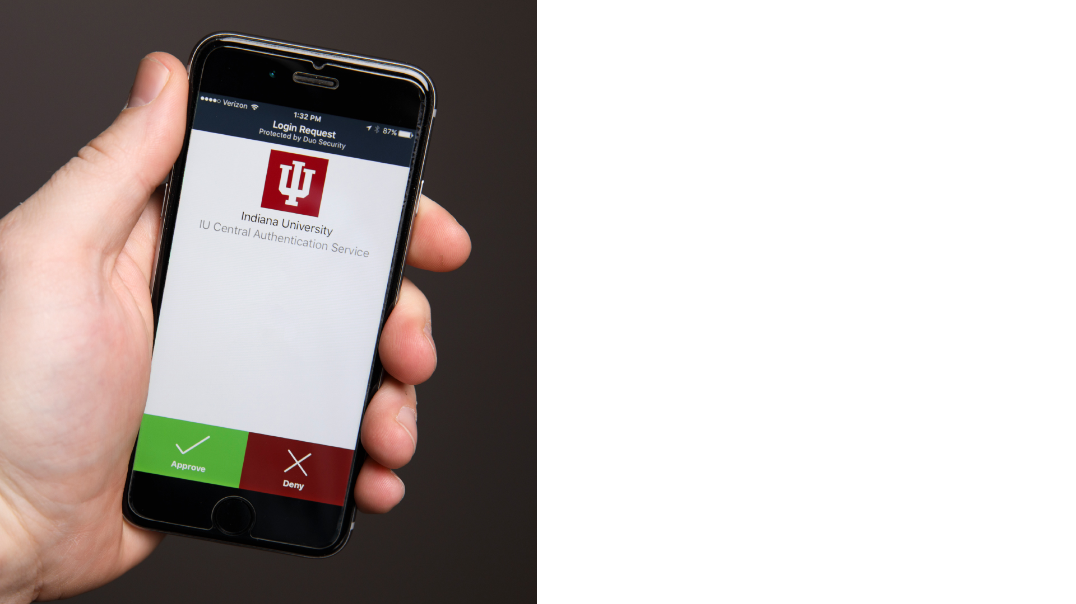
Lessons learned
Improve your interface first and test it! Is it easy to use? Repeat!
Encourage users to use phone as primary, but just give them the tokens for free… Just do it. Labor is $.
Have options for people without phones/devices and make sure they know about them and they are well-documented
Leverage your student groups and newspapers
No such thing as over-communicating internally
Notes:
Cathy

Slide 24
What to remember
Start with the right people at the table, no more, no less!
Communicate regularly and freely.
Set up good meetings and communication channels.
Know your audience, meet them where they are.
Notes:
Daphne

Slide 25
What to remember
Remember Ying/Yang… Convenience vs. Security! Balance!
Address misconceptions and concerns immediately.
Be flexible and nimble, adjust your approach based on data.
You will forget things! Be ready to scramble sometimes.
Notes:
Daphne

Slide 26
Questions?
Cathy O’Bryan
Associate Vice President, Client Services and Support
Office of the Vice President for IT and CIO
caobryan@iu.edu
Daphne Siefert-Herron
Communications Officer
Office of the Vice President for IT and CIO
dsiefert@iu.edu
Communications Plans:
http://go.iu.edu/1JUV
Support Documentation:
https://kb.iu.edu/search?q=duo&s=15

