Slide 1
Building a Mentorship Network
Panel Discussion - Educause 2017 Annual Conference
#EDU17

Slide 2
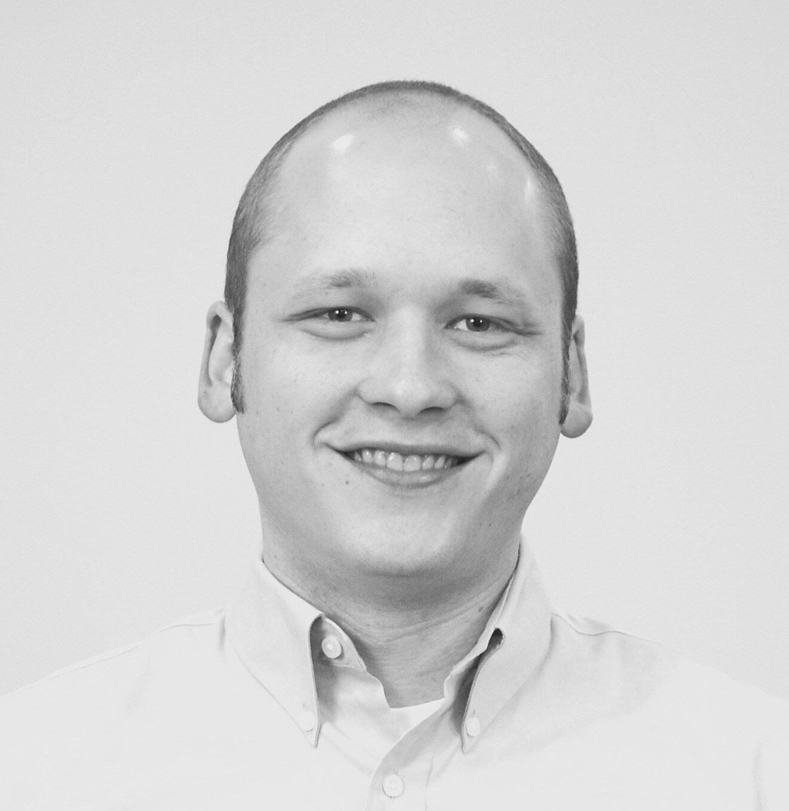
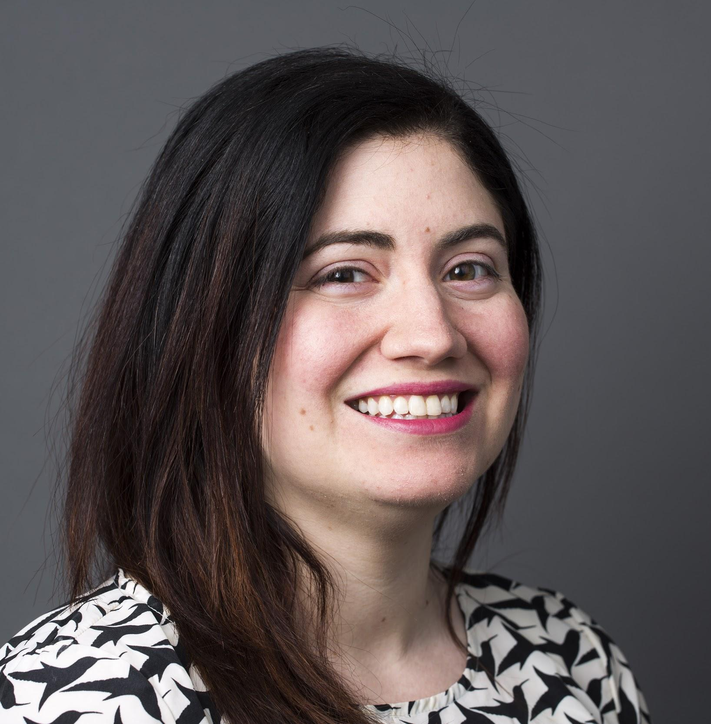
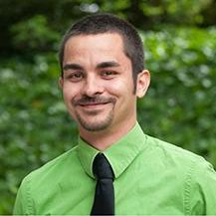
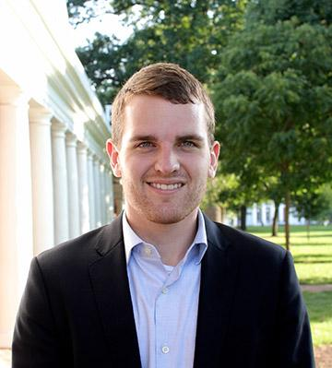
Introductions
Ryan Bass,
Portland State U
Shauna’h Fuegen,
Bates College
Jonathan Hardy,
U of Georgia
Kevin Duvall,
U of Virginia
#EDU17

Slide 3
Welcome
Format
Questions - Direct or via Google Slides link
Young Professionals Advisory Council
Young Professionals Constituent Group
Notes:
Format - We will start with background from the panel, then open the floor to questions from the audience. We also have some prepared questions to get us started if needed.
Google Slides questions
Plug for YPAC and CG
The four of us connect through YPAC, it was created to provide counsel to the Educause President and strengthen the focus in EDUCAUSE on emerging leaders and new voices, especially from those demographics that are typically underrepresented in EDUCAUSE volunteer leadership.
YP CG is intended to provide a forum for open dialogue, collaboration, and engagement on topics of interest to young professionals in higher ed work environments

Slide 4
Questions and Discussion
Notes:
First question: What are your experiences with both formal and informal mentorship?
Followups if needed:
What is the most impactful mentoring relationship you have had/have and why?
What are your greatest challenges with mentorship as a young professional?
How do you begin? What does that process look like?

Slide 6
Resources/
Other Sessions at EDUCAUSE 2017
(continued)
CSU’s Technology Enabled Advising Showcase
Wednesday, November 1 at 12:45pm
Orlando Leon
The Future of the IT Workforce in Higher Ed
Thursday, November 2 at 8:00am
Orlando Leon
Course and Campus Collaboration Made Cohesive
Thursday, November 2 at 4:30pm
Nicole Weber
Look for Us!
Young Professionals Advisory Council
Young Professionals CG
Mentorship Map
Sessions/Posters at EDUCAUSE 2017:
Wanna TACO 'bout it? An Employee Engagement Initiative
Wednesday , November 1 at 12:45pm
Kelsey Lunsmann
Young Professionals Constituent Group Meeting
Wednesday , November 1 at 3:10pm
Jonathan Hardy and Tina Pappas
#EDU17

Slide 7
Thank You

