Slide 1
IT 2.0: Reimagining the IT Organization
PRESENTED BY:
Raechelle Clemmons • Steve Fabiani • Keith McIntosh

Slide 2
Reimagining IT at Davidson College
Planned: June - August 2017 | Completed: September 2016
Motivation: Break down silos, bimodal capacity, new capabilities, more leadership opps
 | BEFORE | AFTER
Employees | 38.75 FTE | 41.375 FTE
Departments | Technology Help Services Academic Technology Administrative Systems Systems & Network IT Finance, Facilities & Ops | Engagement Digital Innovation Core Services CIO’s Office, incl Analytics & BI
Leadership Team | 5 members: CIO + 4 directors | 10 members: CIO + 4 direct reports + 1 manager + 3 team leads + fellow

Slide 3
Reimagining IT at Colgate University
Planned: Fall 2016 | Completed: Spring 2017
Motivation: Improve Service, Combine Logically, and Enable Innovation
 | BEFORE | AFTER
Employees | 47 FTE | 47 FTE / No Change in Bottom Line
Departments | Academic Technologies AV Services Misc Unaffiliated Staff Networking and Operations Enterprise Systems In Person Technology Support Phone Based Tech Support CIO | Learning / Applied Innovation Classrooms, Media and Events Services and Infrastructure Engagement and Support Data Analytics Office of the CIO (inc. info sec, budget mgmt)
Leadership Team | CIO + 4 Directors | Strategic Leadership: 7 + CIO Extended Leadership 12 + CIO

Slide 4
Reimagining IT at Ithaca College
Planned: November 2014 | Completed: October 2015
Motivation: Eliminate silos, eliminate operational inefficiencies, Bi-Modal, Service Broker, Proactive, Flatten organization
 | BEFORE | AFTER
Employees | 71 FTE | 66 FTE (Target: below 60)
Departments | Technology & Instructional Support Services (TISS) Infrastructure and Communication Services Enterprise Application Services Information Security Project Management | Teaching and Learning with Technology Engagement and Implementation Architecture and Infrastructure Information Security
Leadership Team | 6 members: CIO + 4 Directors + 1 Manager | 5 members: CIO + 4 Directors

Slide 5
What observations led to the organizational shifts?
What process was followed in redefining the organization?

Slide 6
How were the changes received by -- and what impact did they have on -- the department and the campus?

Slide 7
Where did you see the greatest successes with your plan? What would you do differently next time? Where might you go from here?

Slide 8
Questions?
(We don’t promise to have the answers, but we’ll try)
Raechelle Clemmons, raclemmons@davidson.edu, @rclemmons
Steve Fabiani, sfabiani@colgate.edu, @fabiani
Keith McIntosh, kmcintosh@richmond.edu, @keith_mcintosh

Slide 9
Appendix

Slide 10
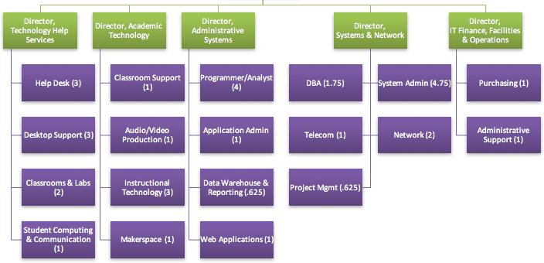
Davidson College - Before (38.75 FTE)

Slide 11
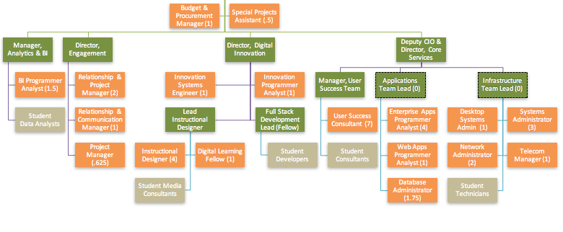
Davidson College - After (41.375 FTE)
Green = members of leadership team

Slide 12
Ithaca College - Before (5 offices; 5 levels)
Technology & Instructional Support Services
Infrastructure and Comm.
Services
Enterprise Application Services
Information
Security
Project
Management
Staff
Member
Assoc.
Director
Director
AVP
Manager

Slide 13
Ithaca College - After (4 Offices & 4 Levels)
Teaching and Learning with Technology
Technology services that support teaching, learning, and research
Engagement and Implementation
Our front door with the campus.
Application implementation. Business Process Improvements
Architecture and Infrastructure
Operation of our on premise and cloud technology infrastructure.
Information Security
College-wide information security program
Staff
Member
Assoc.
Director
Director
AVP

Slide 14
Colgate University
Services and Shared Infra.
App Dev
Applications
Systems
Servers
Net and Com
Facilities
Data Analytics
Warehouse
Data Analysis
Visualization
Decision Support
Classrooms, Digital Media and Events
~80 Classrooms Audio and Video Studios
>1000 Events
Learning/ Applied Innovation
Learning With and About Technology
Seeding Creativity
Engagement and Support
Office of the CIO (Budget, Policy, Security, Projects)

Slide 15
