Slide 1
Setting the Agenda: Research Data Management: International and Institutional Intersections
Miho Funamori
National Institute of INformatics
Nov.1, 2017

Slide 2
Lightning talk
Institutional aspect
Edinburgh University—RDM: Edinburgh University Library’s Approach
California Digital Library—Research Data Management at the University of California
International Aspect
Kyoto Univ–Envisioning RDM Services in 2030
Purdue University—Towards Global Data Citizenship as an Institution

Slide 3
Why, Research Data Management ?
Accountability
Public-fund
Mandate
Data Reuse
Innovation
society
Research
Transparency
Reproducibility
Data-intensive
Science
academic
reactive
proactive

Slide 4
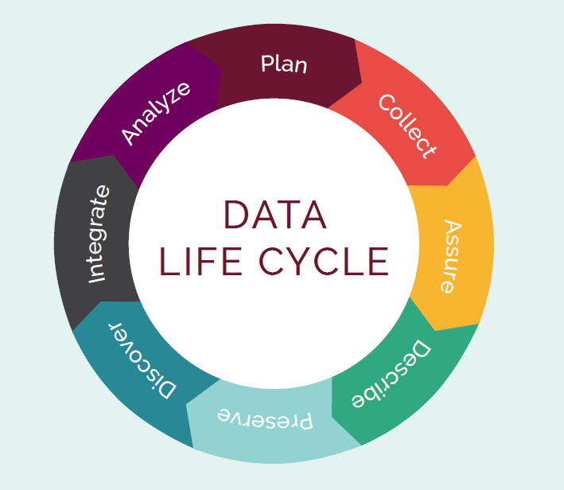
Issues in RDM
Systemize RDM within institution
How do we keep the data life cycle workflow going?
Make research data reusable
What is the most effective
way data get reused?

Slide 5
RDM: Institutional Aspect
Institution-wide Policy
Faculty buy-in
Advocacy
Staff training

Slide 6
RDM: International Aspect
Interoperability
Language-issue
Domain vs. Institutional Repository
Data location and accessibility

