Slide 1
Research Data Management at the University of California
Educause Annual Conference 2017
Philadelphia, 31 October – 2 November 2017
Perry Willett
Digital Preservation Service Manager
California Digital Library
Nov 1, 2017

Slide 2
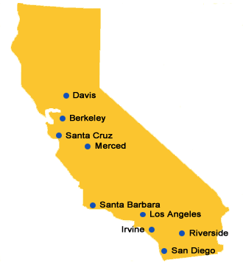
University of California
10 campuses
5 medical centers
3 national laboratories
State-wide agricultural and natural resources network
238,700 students
198,300 employees
61 Nobel laureates

Slide 3
California Digital Library
Founded in 1997 to provide system-wide library services and expertise
Organizationally part of the President’s Office
Four CDL programs:
Access and Publishing (IR, Digital Library)
Collection Development (journal subscriptions, mass digitization)
Discovery and Delivery (union catalog, ILL, OpenURL resolver)
UC Curation Center (digital preservation, research data management)
https://cdlib.org

Slide 4
UC Curation Center
RDM services we provide
DMPTool: https://dmptool.org
Dash (data publishing platform): https://dash.ucop.edu
Merritt (preservation repository): https://merritt.cdlib.org
Along with expertise, coordination, advice, support

Slide 5
UC Curation Center
Consortial approach to RDM:
CDL/UC3 Roles:
Develops services
Provides expertise
Conducts research
Campus library roles
Adopts and customizes services
Works with researchers

Slide 6
UC Curation Center
Research/grant-funded projects
“Actionable” DMPs
Dat in the Lab
Data Mirror
Data training
Make Data Count
RDM Maturity Guide

Slide 7
UC Curation Center
Range of success across UC
Some campuses moved very quickly, with a coordinated effort between Research Office, IT and Library
Others are building this coalition, taking longer
Still others are building expertise in-house
And at still others, the library is somewhat isolated in promoting RDM, lacking coordination and resources

Slide 8
UC Curation Center
Questions
Who pays for storage?
How long should we keep these data? Who decides?

