Slide 1
Maintaining a Diverse Workforce:
Approaches to Retention that Work!
PRESENTED BY:
David Ferguson • Keith McIntosh • Deborah Stanley-McAulay • Melissa Woo
This presentation leaves copyright of the content to the presenter. Unless otherwise noted in the materials, uploaded content carries the Creative Commons Attribution-NonCommercial-ShareAlike license, which grants usage to the general public with the stipulated criteria.
Notes:
This presentation leaves copyright of the content to the presenter. Unless otherwise noted in the materials, uploaded content carries the Creative Commons Attribution-NonCommercial-ShareAlike license, which grants usage to the general public with the stipulated criteria.

Slide 2
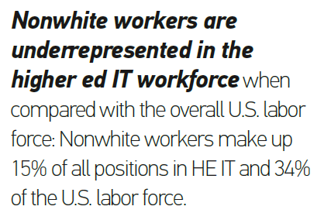
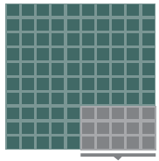
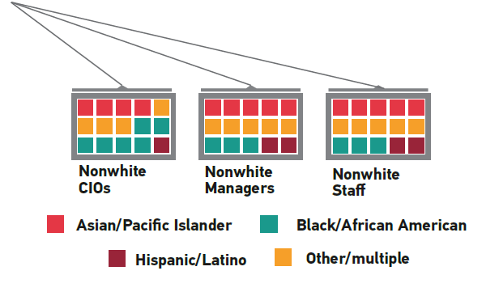
Overall HE IT workforce
Nonwhite = 15%
White = 85%
Data Source - U.S. Bureau of Labor Statistics: ethnicity (http://www.bls.gov/cps/cpsaat11.htm), 2015.
Data Source - ECAR Research: Pomerantz, Jeffrey, and D. Christopher Brooks. The Higher Education IT Workforce Landscape, 2016. (https://library.educause.edu/resources/2016/3/the-it-workforce-in-higher-education-2016).

Slide 3
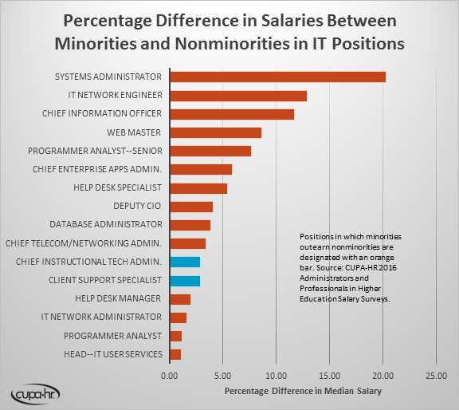
Data Source - The 2015-16 Administrations in Higher Education Salary Survey Report. Research report. Knoxville, TN: CUPA-HR, March 2016. Available from http://www.cupahr.org/surveys/ahe.aspx.
Data Source - The 2015-16 Professionals in Higher Education Salary Survey Report. Research report. Knoxville, TN: CUPA-HR, March 2016. Available from http://www.cupahr.org/surveys/phe.aspx.

Slide 4
Data Source - U.S. Department of Labor: gender (http://www.dol.gov/wb/stats/latest_annual_data.htm), 2014.
Data Source - ECAR Research: Pomerantz, Jeffrey, and D. Christopher Brooks. The Higher Education IT Workforce Landscape, 2016. (https://library.educause.edu/resources/2016/3/the-it-workforce-in-higher-education-2016).

Slide 5
Data Source - ECAR Research: Pomerantz, Jeffrey, and D. Christopher Brooks. The Higher Education IT Workforce Landscape, 2016. (https://library.educause.edu/resources/2016/3/the-it-workforce-in-higher-education-2016).

Slide 6
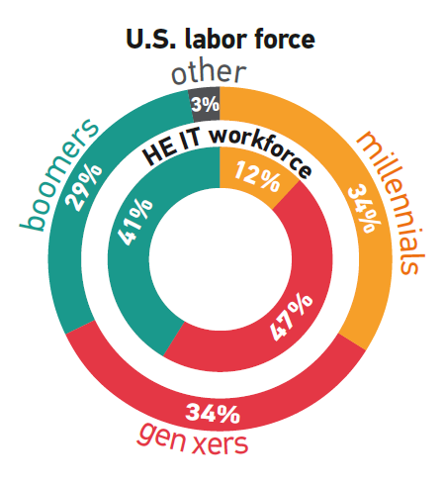
Data Source - Pew Research: “Millennials Surpass Gen Xers as the Largest Generation in the U.S. Labor Force”
(http://www.pewresearch.org/fact-tank/2015/05/11/millennials-surpass-gen-xers-as-the-largest-generation-in-u-s-labor-force/), 2015.
Data Source - ECAR Research: Pomerantz, Jeffrey, and D. Christopher Brooks. The Higher Education IT Workforce Landscape, 2016. (https://library.educause.edu/resources/2016/3/the-it-workforce-in-higher-education-2016).
Notes:
The HE IT workforce is older than the U.S. labor force, perhaps as a result of a stronger tradition of employee retention. HE IT workers remain at their institutions more than two times longer than the typical U.S. worker stays with a single employer (median of 10 years versus 4.6 years).
The median age of HE IT professionals is 48 years, while the median age for the U.S. workforce is 42 years. The Media age of the HE IT workforce is:
CIOs = 53
Managers = 48
Staff = 43

Slide 7
Recruiting without effective retention is like trying to fill a leaky bucket.
Notes:
Photo credit: igrow, Creative Commons CC0
( Need research/stories that indicate how diversity positively affects the bottom line in the business and higher ed sectors )

Slide 8
Overall HE IT workforce
Nonwhite = 15%
White = 85%
Data Source - U.S. Bureau of Labor Statistics: ethnicity (http://www.bls.gov/cps/cpsaat11.htm), 2015.
Data Source - ECAR Research: Pomerantz, Jeffrey, and D. Christopher Brooks. The Higher Education IT Workforce Landscape, 2016. (https://library.educause.edu/resources/2016/3/the-it-workforce-in-higher-education-2016).
Notes:
( Opportunities and challenges of the IT environment/culture )

Slide 9
Tools you can use
Notes:
Photo credit: Florian Richter, CC BY 2.0

Slide 10
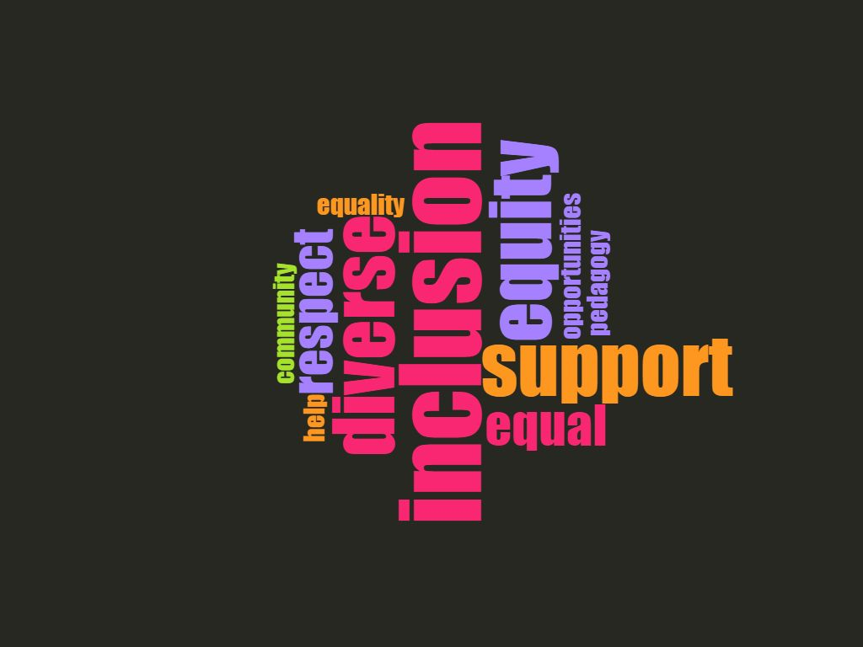
Creating an Inclusive Environment
Notes:
Communicate and practice a zero tolerance policy
Empowering others
Calling out behaviors when they occur
Suggesting to others different approaches
Recognize and communicate that there are different paths to IT and IT leadership
Create a DEI council and/or affinity groups to address workforce issues and provide social support for new hires
Professional development
Unconscious/inherent bias education
Opportunities need to be provided (strategically) to retain staff
Provide training for all staff about diversity, cultural proficiency, and business culture
Provide training on how to call out behaviors, etc.
Onboarding
Enlist mentors to help integrate new employees

Slide 12
Case Study: Prepared or Not
Your company has a newly formed Women’s IT Network, called Women Innovate Now (WIN). WIN’s annual goals are listed below:
Recruitment - assist with the creation of a female recruitment strategy aimed at increasing representation of women in the IT field
Retention - increase retention of female IT professionals
Visibility - increase awareness both within and outside of the company about the D&I efforts
Climate & Culture - assist with strengthening the culture for female employees, XYZ company as a great place for women.
Your company’s Chief Information Officer (CIO), a white male, has been invited by WIN to be a lunch time speaker. He has accepted the invitation.

Slide 13
Case Study: Prepared or Not
INSTRUCTIONS
Instructions: Each working group will focus on one of the following themes: Culture, Leadership, Community, Career, and/or Customers. Thinking about your groups assigned theme, discuss the questions listed below and document your responses.
Group Discussion Prompts:
What concerns if any do you have about this invitation?
What inclusionary action step(s) should the CIO take prior to the lunch time talk? During the talk? Following the talk?
What if any obstacles might exist because of these inclusionary actions?

Slide 14
Resources
Global Diversity and Inclusion Benchmarks: Standards for Organizations Around the World
http://diversitycollegium.org/usertools/GDIB-V-03072016-6-5MB.pdf
From http://diversitycollegium.org/downloadgdib.php
Diversity Retention Reading Room, “External Talent: Why do Minorities and Women Leave in the First Year?”
http://www.multiculturaladvantage.com/recruit/retention/minorities-women-leave.asp
Partners in Diversity Workforce Diversity Project: Recommended Diversity Strategies
https://www.partnersindiversity.org/assets/files/workforce_diversity_sections/FINAL%20Recomended%20Workforce%20Diversity%20Strategies%20June%202017.pdf
Case Study: Whirlpool’s Diverse Talent Retention Strategy
http://www.diversitybestpractices.com/news-articles/case-study-whirlpools-diverse-talent-retention-strategy
What 11 CEOs Have Learned About Championing Diversity
https://hbr.org/2017/08/what-11-ceos-have-learned-about-championing-diversity

Slide 15
Please consider attending this session!
Pursuing Diversity, Equity, and Inclusion for Strategic Advantage - Michael Cato, Chief Information Officer, Vassar College
Thurs., Nov. 2 | 1:30pm - 2:20pm ET | Meeting Room 204C, 200 Level
Notes:
Pursuing Diversity, Equity, and Inclusion for Strategic Advantage
Thursday, November 02 | 1:30pm - 2:20pm ET | Meeting Room 204C, 200 Level
Session Type: Breakout Session
Delivery Format: Interactive Presentation
Global companies and management firms have long touted the benefits of diverse and inclusive organizations, highlighting increased innovation, talent retention, and competitiveness. Leading tech companies have begun the messy process of acknowledging the work they must do to make these gains. With 95% of higher education CIOs identifying themselves as white, and only 20% of them being women, isn't it time for higher ed IT to do the same? Whether through gender, ethnicity, sexual orientation, age, or any of the other myriad ways teams can be diverse, is it possible that emphasizing the strategic advantages of pursuing diversity, equity, and inclusion (DEI) can help change the demographics of our community? This session will cover topics such as unconscious bias and research-based approaches to encourage DEI, with a focus on articulating strategic advantages to our organizations and institutions.
Outcomes: Consider the implications of higher ed IT demographic trends and statistics * Explore examples of the strategic benefits of inclusive workplaces * Consider approaches to translate these benefits to your organization and institution

