Slide 1
In House Data Science for Student Success
Jeff Grabill
Brendan Gunther
Yesim Askin

Slide 2
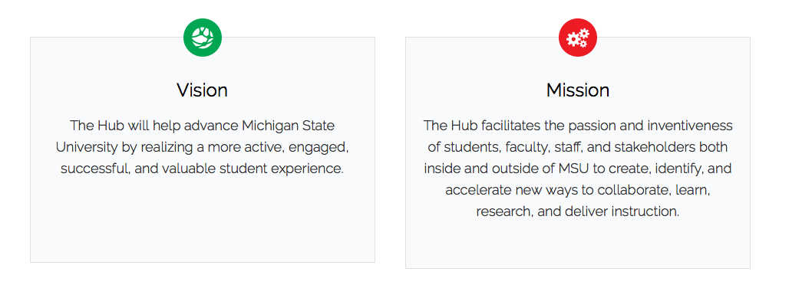
Hub for Innovation in Learning and Technology
Shorter: To help MSU reinvent itself as a learning institution

Slide 3
Our Goal is to Use MSU Data to Change the Institution for Students
Uncover artificial barriers to student success
Challenge the myths on which our curricula, our policies, and our practices are based
Identify successful interventions
Realize which students face particular challenges and for whom particular interventions work

Slide 4
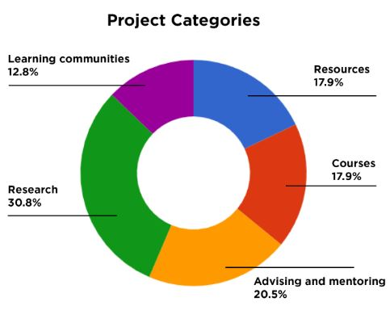
Learning Analytics Group
A cross organizational function focused on mission-driven analytical experiments

Slide 5
Generating Demand
Measuring Capacity

Slide 7
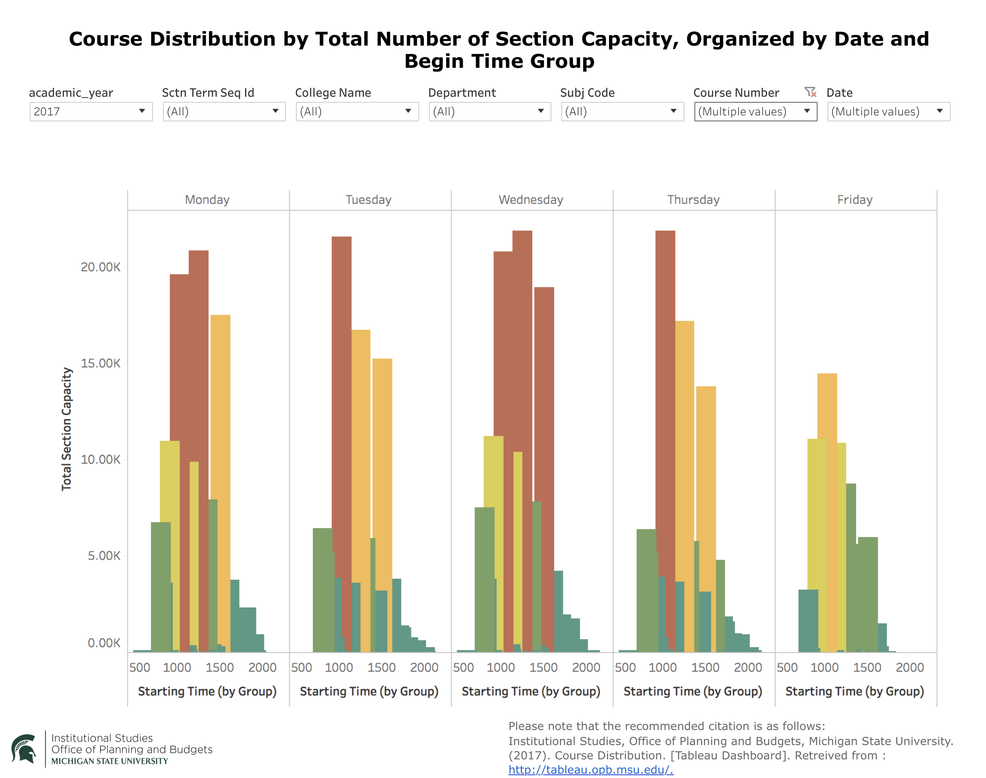

Slide 8
Technology Support
Data availability and accessibility
“Don’t be a statistic” – 70-80% Data Scientists spend their time on….
Enabling tools
Where is the magic bullet?
Data science platforms?
In house or packaged?
How to collaborate
Understand the cultures
Evaluating the composition of the team
Distinction of analytics vs data science

