Slide 1
Practical Evaluation of Digital Learning: Tools and Approaches for Measuring the Effectiveness of Ed Tech
Rebecca Griffiths, Principal Education Researcher, SRI Education, Center for Technology in Learning
Nancy O’Neill, Associate Director, William E. Kirwan Center for Academic Innovation
University System of Maryland
November 2, 2017
Notes:
Do quick poll of who’s in the room

Slide 2
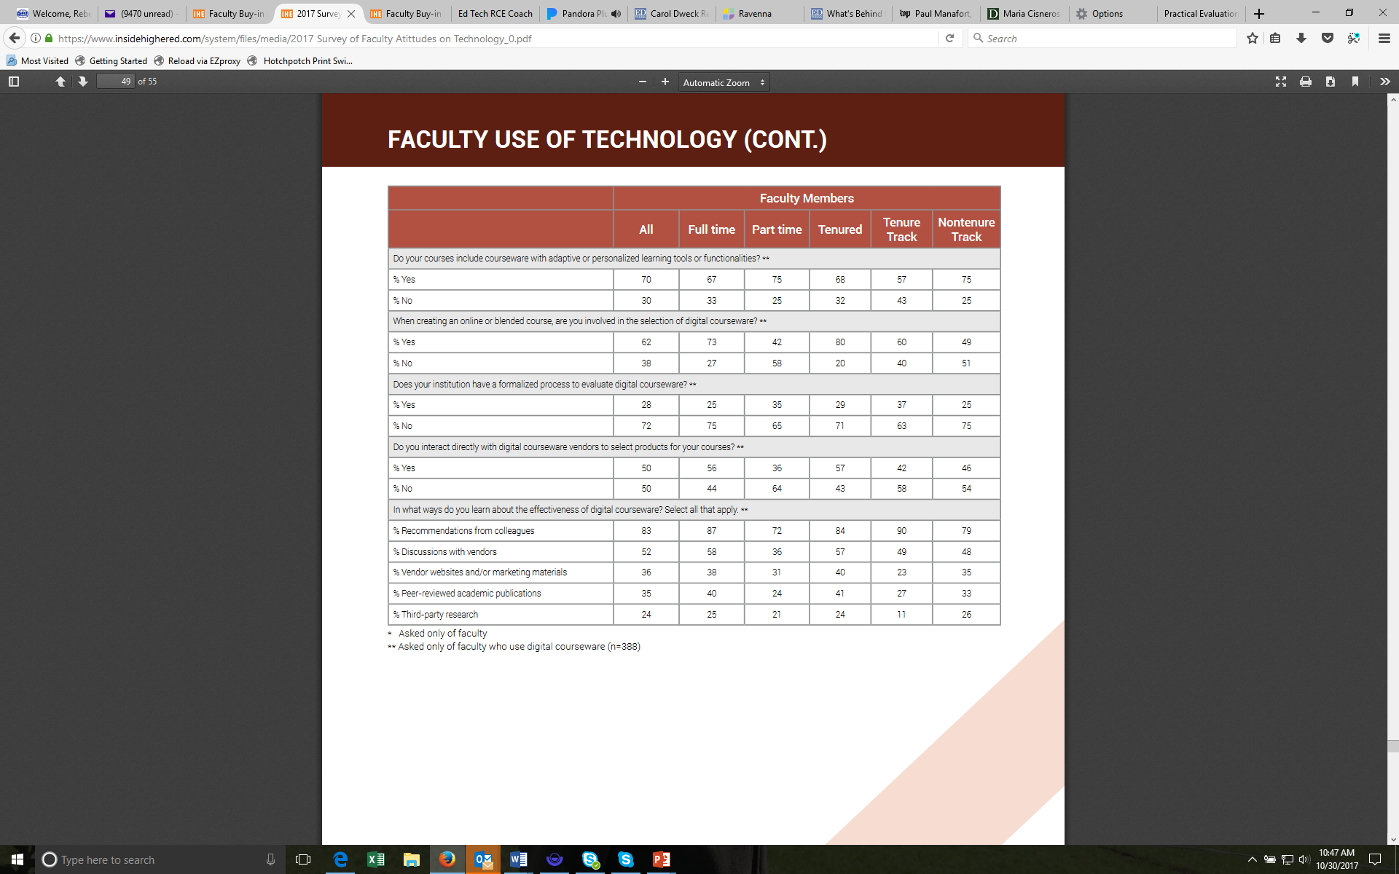
Notes:
Wanted to share some survey data that was just released earlier this week from IHE and Gallup. I’d like to highlight a couple findings – one, when asked how they learn about the effectiveness of digital courseware (defined as…) they overwhelmingly say through WOM. 35% say through peer reviewed academic pubs, but even this seems inflated to me.

Slide 3
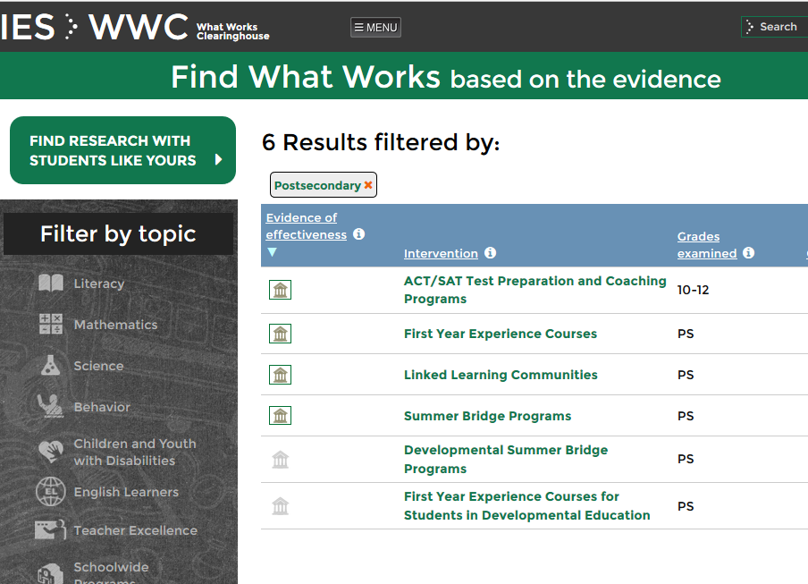

Notes:
Because it is not easy to find peer reviewed evaluations of education technologies. There are no studies of specific technologies in the Dept of Education’s What Works Clearinghouse, which is one source of evidence about proven interventions. And it is very difficult to locate an article in a peer reviewed journal about a specific technology. These journals tend to be oriented to researchers rather than practitioners, and due to the long lead time for publication it is likely that by the time studies do get published they are of obsolete technologies or versions that are no longer in use. This is not to mention all the other issues:
Too jargon-y
Not the right focus
Doesn’t measure outcomes you care about
Impact estimate not available or trustworthy
This is why understanding the effectiveness of technologies in your own environment is so important.
Search terms for Individual studies:
“online learning”
All topics = 27 studies
Postsecondary = 3 studies
3 of the 27 results Meet WWC standards without reservations
All have “at least one statistically significant positive finding”
1 of the 27 results Meet WWC standards with reservations
No statistically significant findings
“blended learning”
2 out of 4 results meet WWC standards with or without reservations

Slide 4
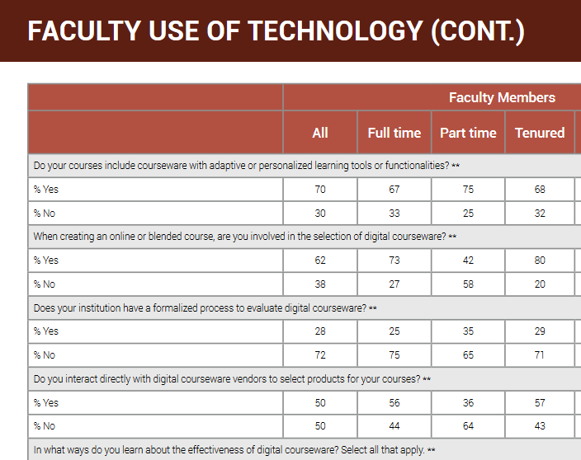
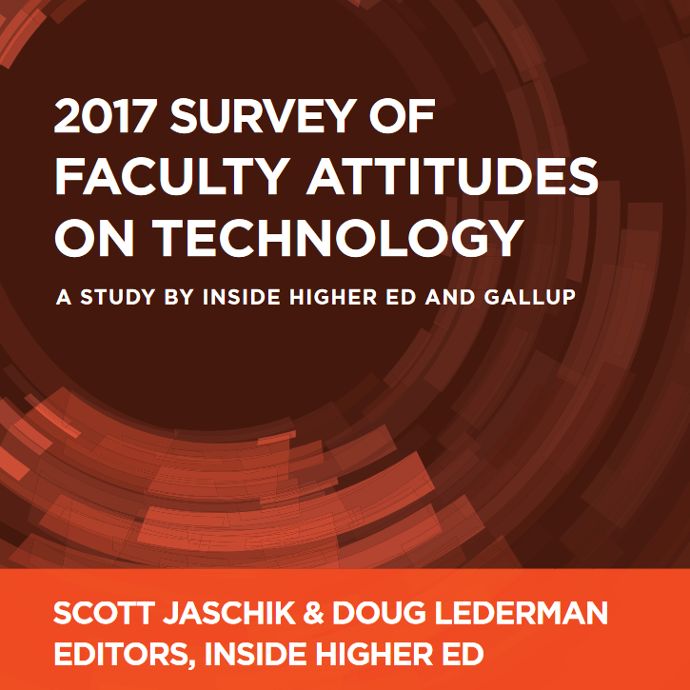

Slide 5
Large Variation in Effects, Even for the Same Product
Effect Sizes for Digital Courseware Product
-2.00 -1.00 0 +1.00 +2.00
Source: SRI Education (2017). Internal analyses
Notes:
Another important factor is that even well designed technologies may get positive or negative results depending on how it is used. Findings vary depending on context and implementation.
Question is not “does this technology work” so much as “does technology for these students when used in this particular way”

Slide 6
What type of evidence is appropriate for the decision you want to make?
Notes:
So, when thinking about the types of decisions instructors are making about education technologies, or that you are helping them to make, what type of evidence is appropriate?

Slide 7
Low stakes
High stakes
Involves big change in instructional practice
Impacts lots of students
Impacts student’ chances of getting course credits
Substantial costs involved
Type of tech adoption
decision
Involves small change in instructional practice
Impacts small # of students
Low cost
Formative
Pilots
Case studies
Informal surveys
Uncontrolled comparisons
Appropriate
evidence
Correlational
Less rigorous quasi-experiments
System log analyses
Causal
RCT
Strong quasi-experimental studies (QED)
Notes:
We think about this in terms of what’s “at stake.” For a decision that has relatively low stakes in terms of consequences for student learning, course outcomes, and costs, less rigorous studies may be fine. For example, if you are considering adding a free or low cost supplement, such as a simulation exercise for a concept in statistics.
At the other end of the spectrum, we would argue that high stakes decisions that impact lots of students, involve a major change in instructional practice, and/or have high costs involved, would merit a more rigorous evaluation such as a QED or even RCT, if you want to be extremely confident about your results.
A couple things to note:
1. we see a lot of institutions comparing section level averages. This is fine for relatively low stakes decisions, but we have observed that the types of students enrolled in a course can vary a lot. In one portfolio evaluation we had to throw out a significant share of impact studies because they failed baseline equivalence tests, meaning that students were so different in terms of prior achievement or other key attributes that we could make a fair comparison, even using statistical controls.
2. Just because students like a technology doesn’t mean it’s helping them (cite Brookings study)
Instructor preferences driven by many criteria in addition to impacts on student learning

Slide 8

Practical Evaluation of Digital Learning (PEDL) toolkit helps users:
Understand basic types of evidence of effectiveness
Choose the most appropriate research design
Capture qualitative information about context and implementation
Conduct basic quantitative analyses
Obtain and interpret data from learning system log files
Address IRB permissions and privacy/confidentiality issues
Report research findings for sharing with other higher education faculty and staff as well as for possible publication
Notes:
To support local evaluations of the effectiveness of instructional practices using education technologies, we have developed a prototype set of tools called PEDL.
Designed to walk users through the steps of conducting an evaluation, starting with understanding basic types of evidence, selecting an appropriate study design,

Slide 9
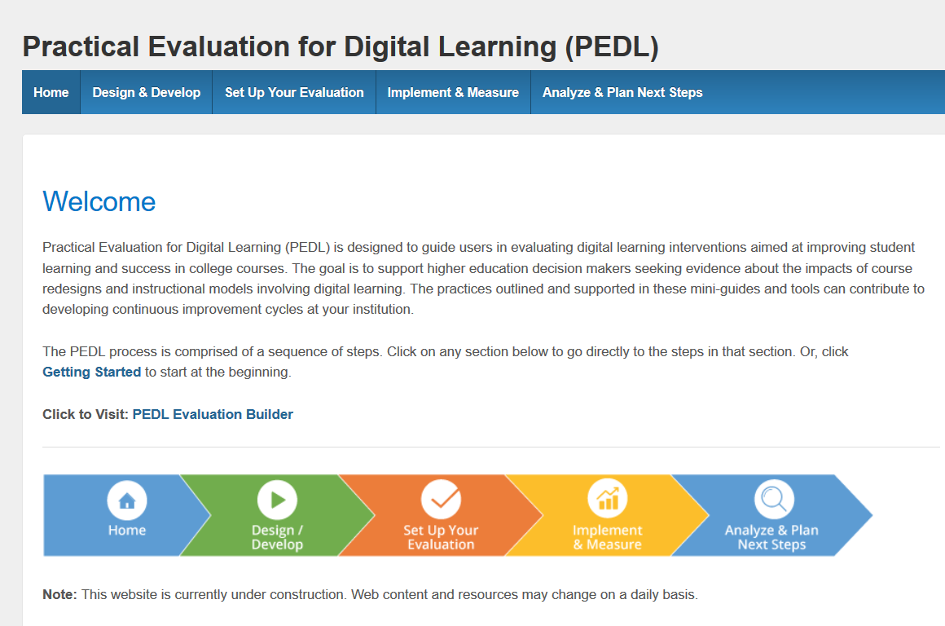

Slide 10
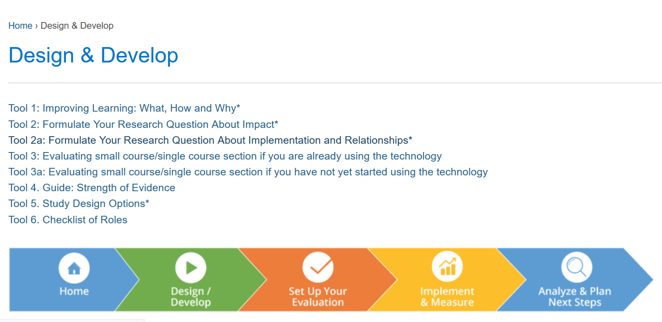

Slide 11
Partners for improvement
Instructor/SME
Colleagues/Dept. Leader
IT Support
Instructional Designer
Evaluator/Data Office
Notes:
Can’t rely on instructors to do this work alone. PEDL does not aim to turn humanities professors into social scientists.
To close that feedback loop concerning the learning attained with tech-supported ed interventions, I believe we’ll need partnerships of people with different types of expertise and different organizational homes.
I think tech has opened up new possibilities for using data to support the work of such partnerships, but as of yet such collaborations are the exception rather than the rule within education systems.

Slide 12
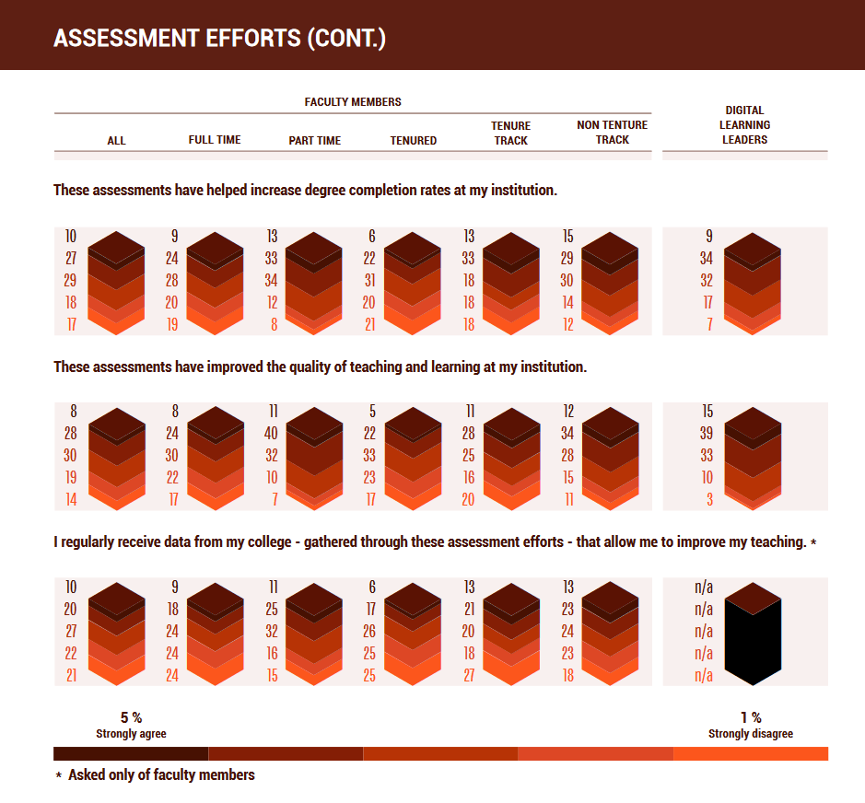
Notes:
IROs were typically set up to provide information to external agencies such as accreditors and to do program level assessment. So while, they have access to the types of student data needed to conduct evaluation, and some have capacity in statistical analysis, often they do not view supporting course level assessment as their responsibility or priority. We can imagine a culture shift in which instructors see IROs as units that can support instructional improvement efforts. We can also imagine other support units that work closely with faculty to improve instruction, such as instructional design, providing a bridge.

Slide 13


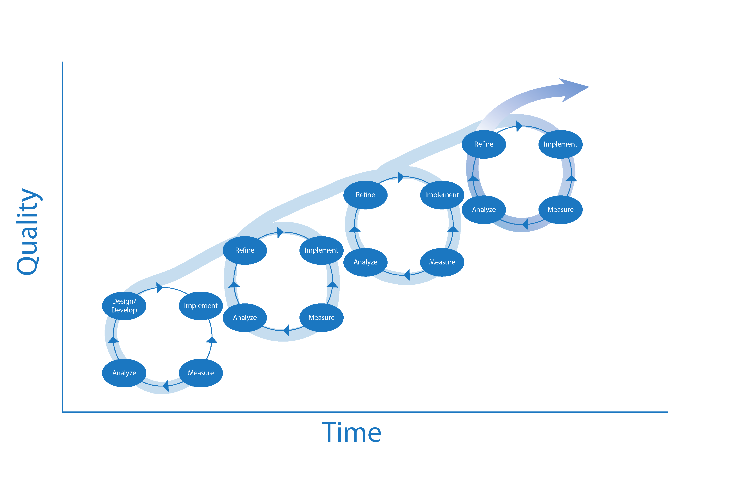
Series of Rapid Small Improvement Studies
Notes:
Idea to do in real time and iterate, not one off 3 year studies. Especially important given the pace of technology evolution.

Slide 14
Scenarios for use of PEDL
Faculty members seeking small grants to implement new tech tool, need to include evaluation in proposal
Department decides to redesign gateway course, e.g. Intro to Chemistry.
CAO announces policy to prioritize use of OER where possible, wants systematic measurement of course impacts.
Notes:
[hand over to Nancy to reflect on what I’ve said so far, talk about how this looks in USM, discuss scenarios for usage]

Slide 15
USM Reflections
The reality of single course evaluations
Helps to have something tangible to show people (kicking the tires)
Faculty fellows use case holds promise (changing the RFP, coordination of support)
Availability of tools is necessary but not sufficient
  Faculty/departmental incentives to be more evidence-based
  Knowledge of and ease of access to resources and supports
Audience Reflection
What are the “enabling conditions” that would motivate faculty and staff at your institution to make use of these tools?

Slide 16
Thank you!
PEDL Prototype: http://evaltoolkit.wpengine.com/implement-measure/
User name: demo
Password: evaluation

